Slide 1

ODESSA NATIONAL MEDICAL UNIVERSITY
Department of Dermatology and Venereology
Larysa Kovtun, M.D.,PhD
Practical lesson on the topic: Pyodermas.

Slide 2
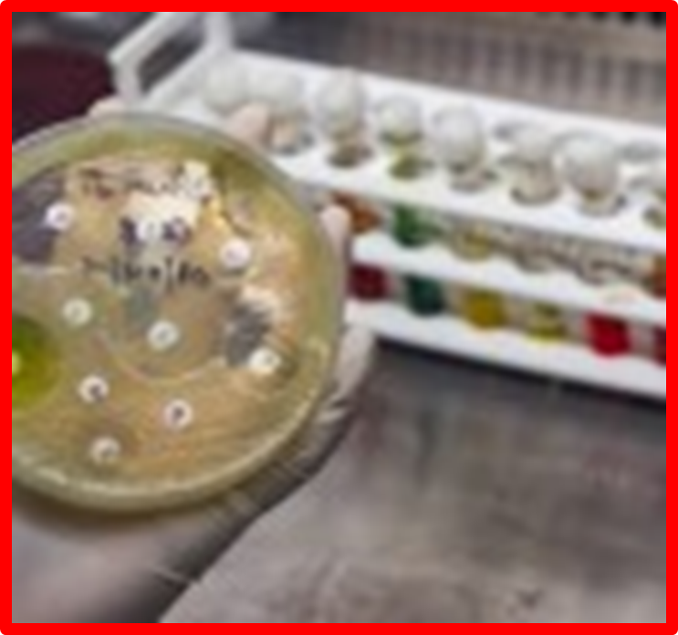
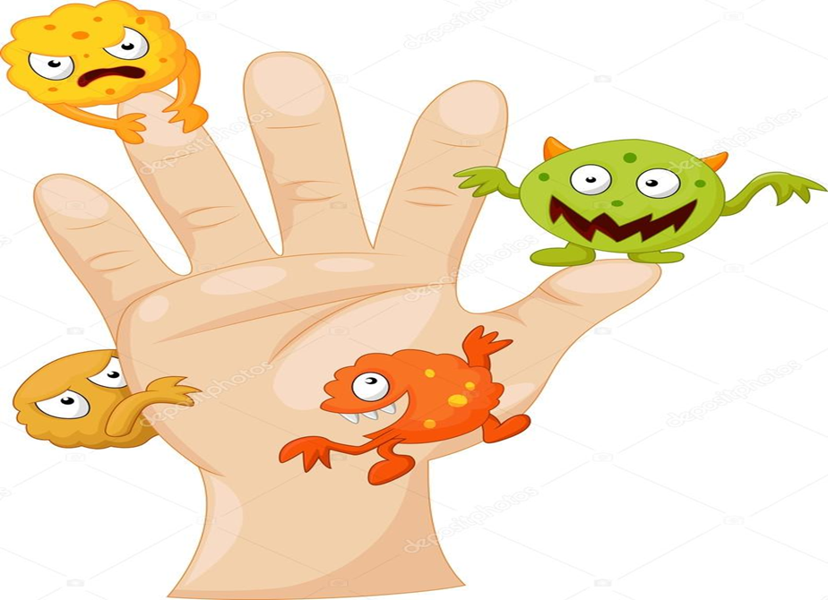
Pyoderma (from ancient Greek πύον - pus and δέρμα - skin) is a purulent lesion of the skin that occurs as a result of the introduction of pyogenic cocci into it.

Slide 3
acute
chronic
primary
secondary
superficial
deep
by the nature of the flow:
by the depth of the lesion:
Classification of pyoderma
by the chronology of occurrence:
by prevalence:
by etiology:
localized
common
Staphylococcal
Streptococcal
Mixed strepto-staphyloderma
Hair follicles, sebaceous and sweat glands are affected.
Smooth skin and folds with a tendency to peripheral growth of lesions are affected. The appendages of the skin are not affected.

Slide 4
Superficial staphylococcal pyodermas are:
Folliculitis
Sycosis
Vesiculopustulosis
Osteofolliculitis (Bockhart’s impetigo)
Pemphigus epidemicus neonatorum
Ritter’s Disease (Dermatitis Exfoliativa Neonatorum)
Staphylococcal scalded skin syndrome (SSSS)
Staphylococcal toxic shock syndrome (TSS)

Slide 5
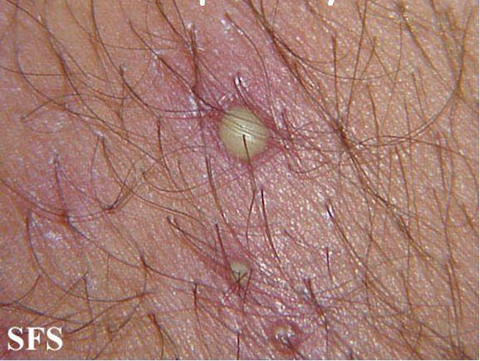
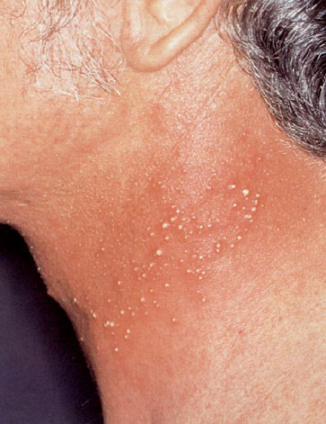
Osteofolliculitis (impetigo Bockhart) is inflammation of the orifice of the hair follicle.
Folliculitis is purulent inflammation of the hair follicle.

Slide 6
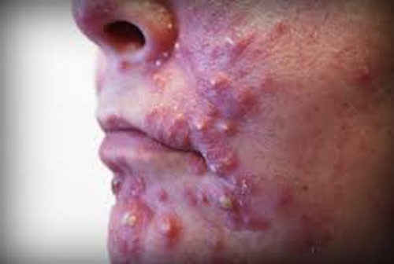
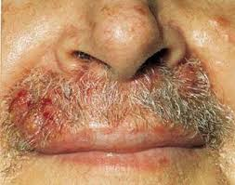
Sycosis vulgaris (staphylococcal sycosis, nonparasitic sycosis) is chronic diffuse folliculitis.

Slide 7
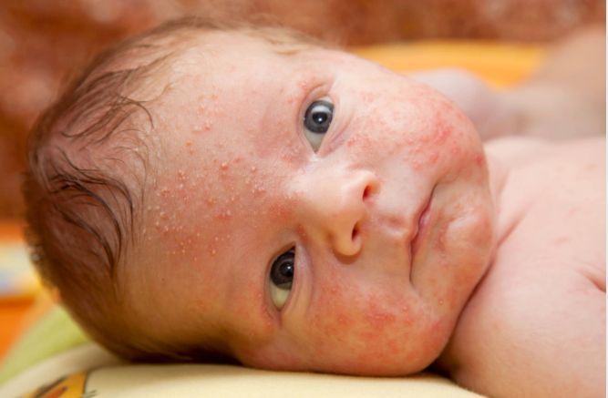
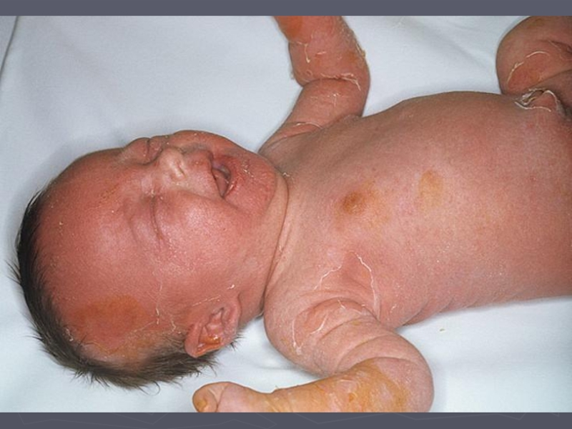
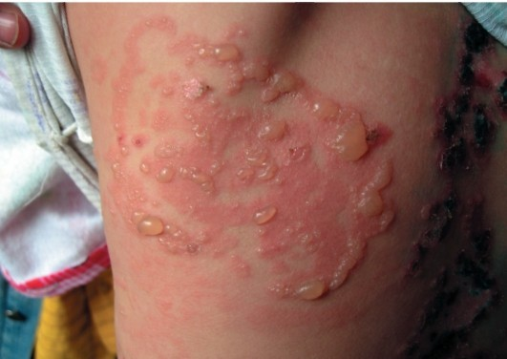
Vesiculopustulosis (periporitis, osteoporitis) is purulent inflammation of the orifices of the eccrine sweat glands. The disease is common in newborns
Epidemic pemphigus of newborns (pyococcal pemphigoid, pyococcal pemphigus) is highly contagious pustular skin disease of newborns, characterized by a fast clinical course, onset and disseminanion of the phlyctenas (flabby blisters) on the skin. The phlyctenas have the size from a pea to a hazelnut with a cloudy content on non-inflamed skin.

Slide 8
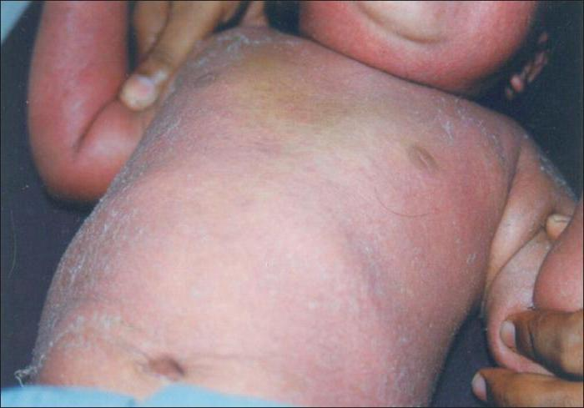
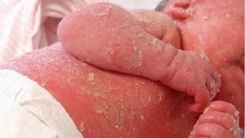
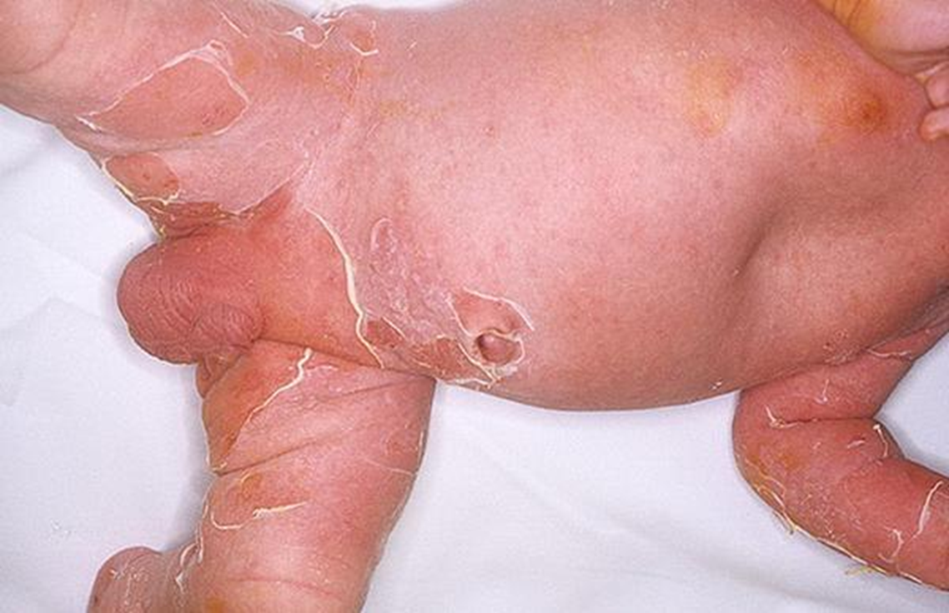
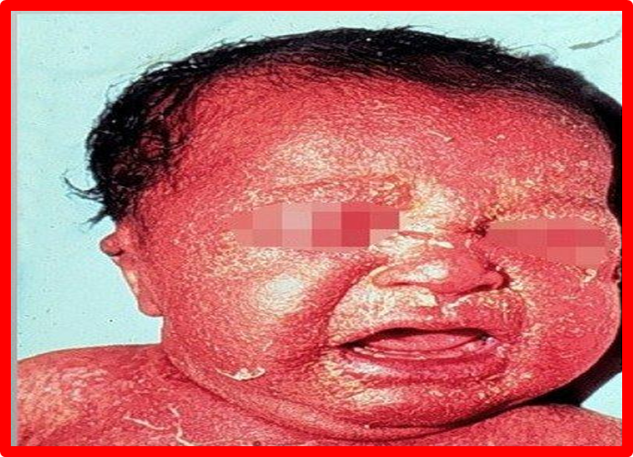
Ritter`s dermatitis exfoliativa (epidermolysis of newborns, acute) is severe version of epidemic pemphigus newborns.
Staphylococcal Scalded Skin Syndrome is similar to exfoliative dermatitis, there is in children older than a month of life and up to 5 years.

Slide 9
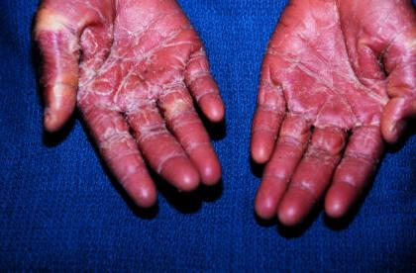
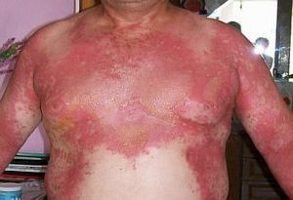
Staphylococcal toxic shock syndrome (TSS) is characterized by a sudden rise in temperature body, arterial hypotension, redness of the skin and mucous membranes and multiple organ failure.

Slide 10
Deep staphyloderma
Furuncle
Furunculosis
Carbuncle
Hydradenitis
Pseudofurunculosis
Abscess

Slide 11
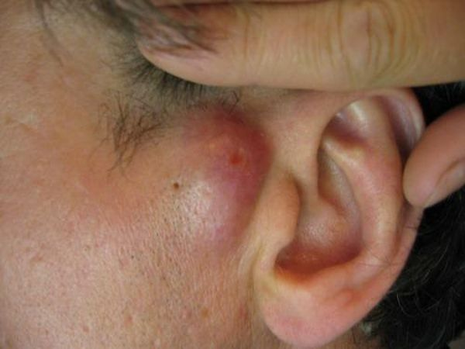
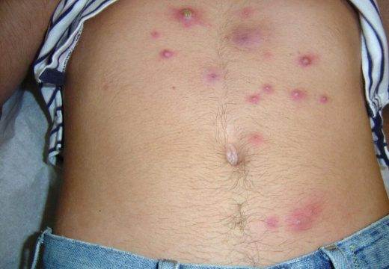
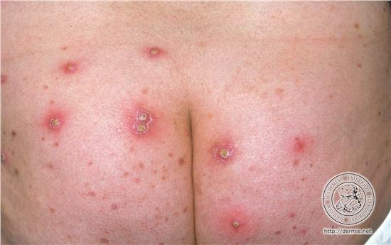
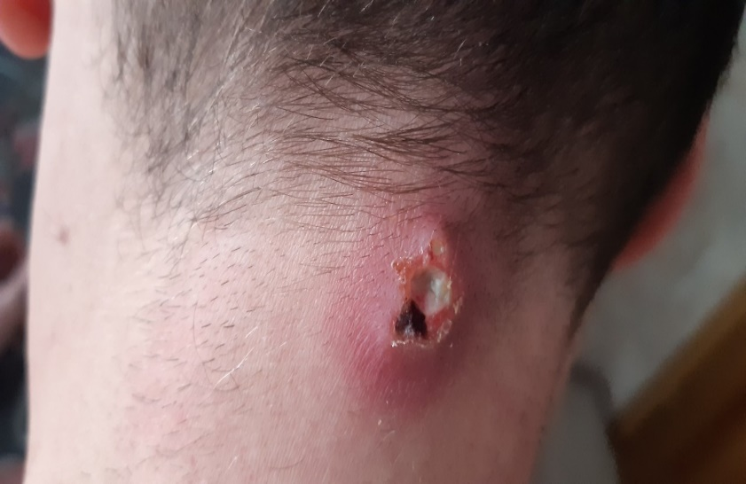
Furuncle is purulent-necrotic inflammation of the hair follicle, the sebaceous gland and the surrounding subcutaneous fat.
Furunculosis is a chronic recurrent process in which furuncules appear in the patient successively for a long time. New elements often appear, when the old ones did not regress.

Slide 12
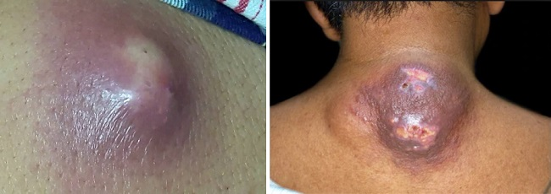
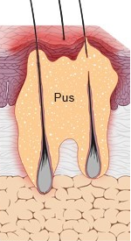
Carbuncle is the conglomerate of furuncles, united by a common infiltrate.
The ulcer fills with granulation and heals with a scar.

Slide 13
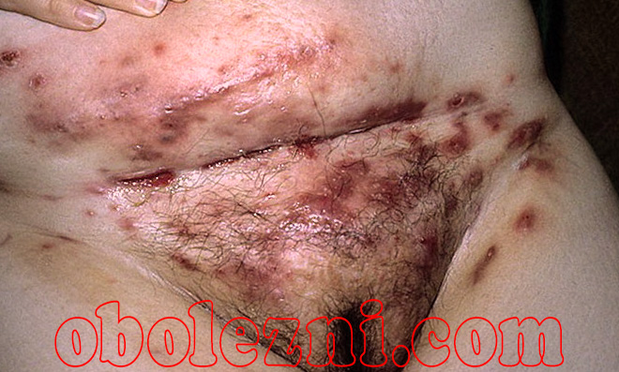
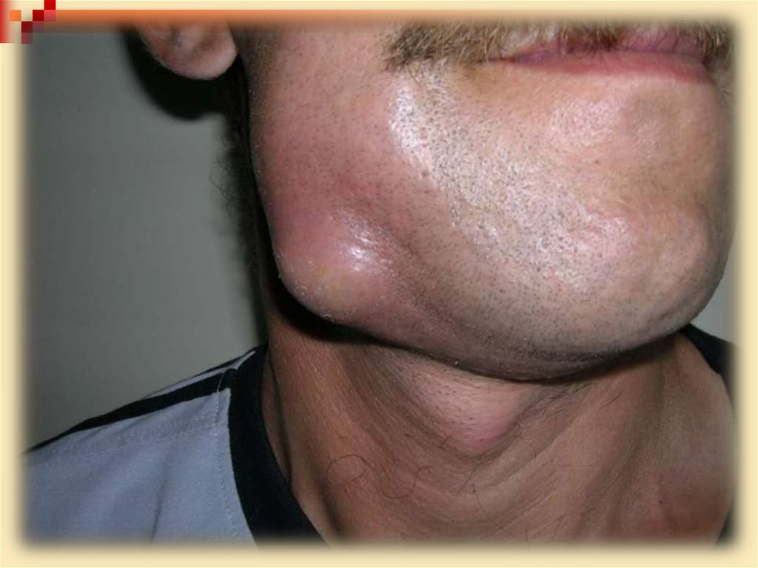
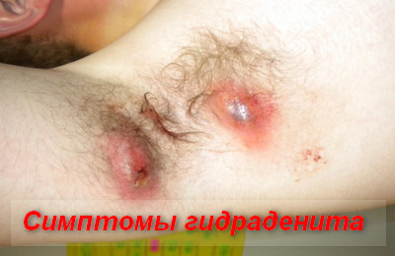
Hydradenitis is purulent inflammation of the apocrine glands.
Abscess is a limited cavity filled with pus, which is located in the dermis, subcutaneous tissue, muscles.

Slide 14
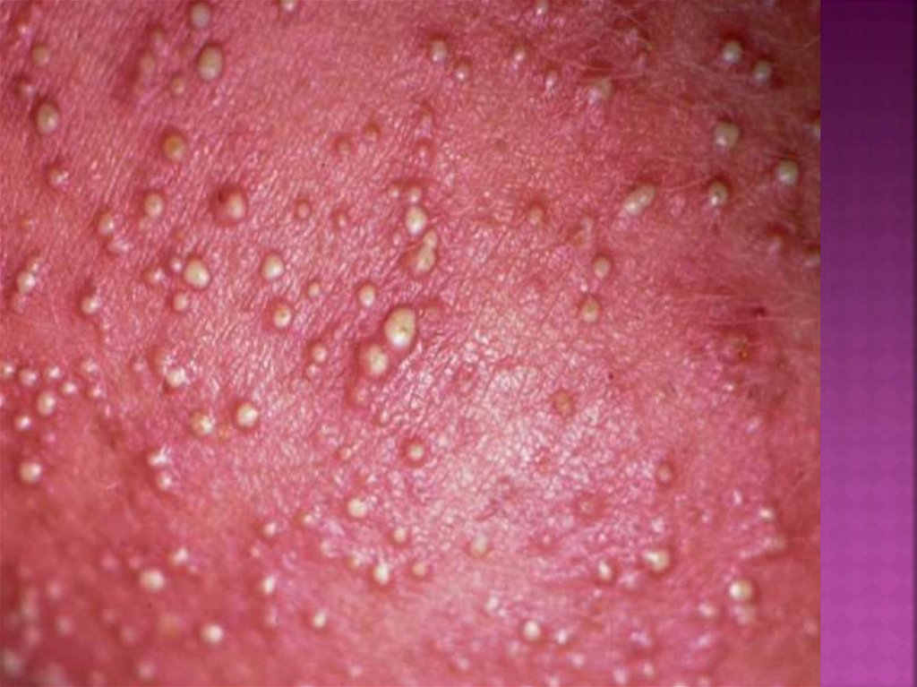
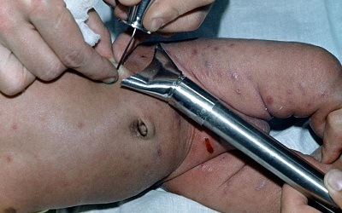
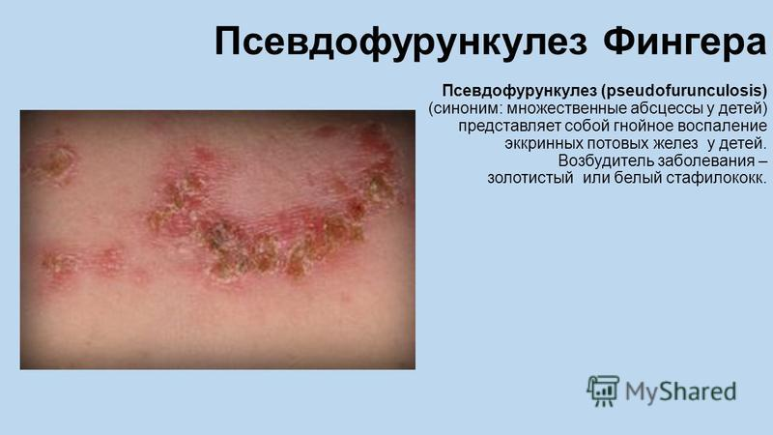
Pseudofurunculosis (multiple miliary abscesses of newborn) is inflammation of the eccrine sweat glands in children.

Slide 15
Superficial streptoderma
Streptococcal impetigo
Erysipelas
Streptococcal toxic shock syndrome (STSSS)
A types of impetigo
Impetigo bullous
Angulus infectious (impetigo fissurica (Perleche)
Pytyriasis simplex
Paronychia
Papulo-erosive streptoderma
Intertriginous streptoderma
Acute diffuse streptoderma

Slide 16
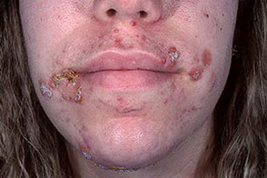
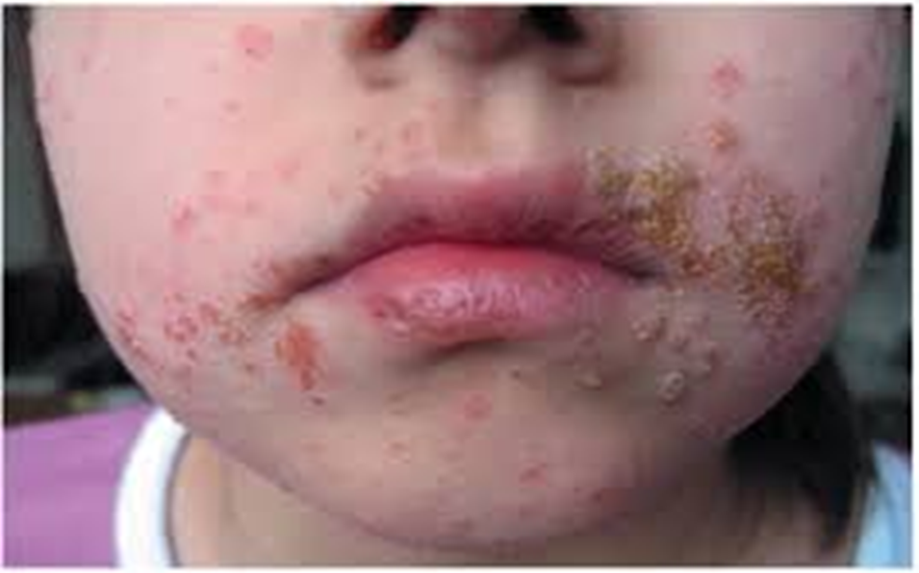
Streptococcal impetigo is highly contagious skin infection, more common in children and young women, characterized by the formation of phlyctena.

Slide 17
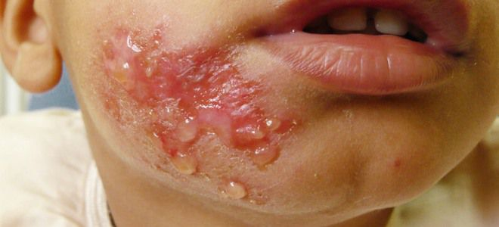
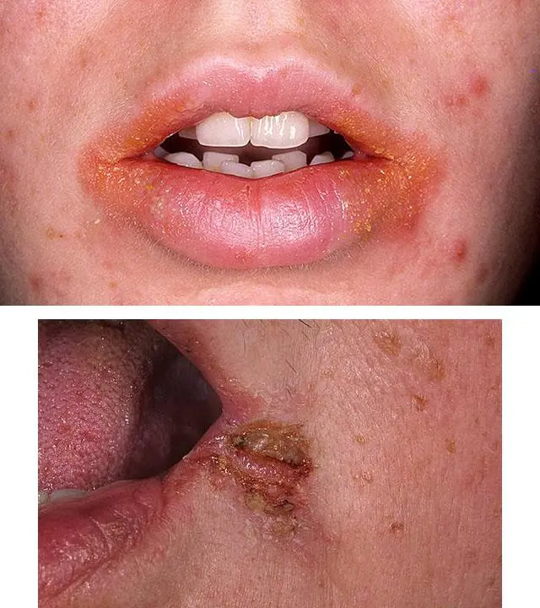
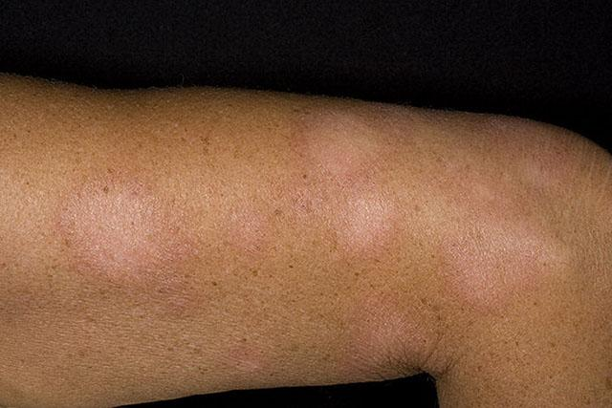
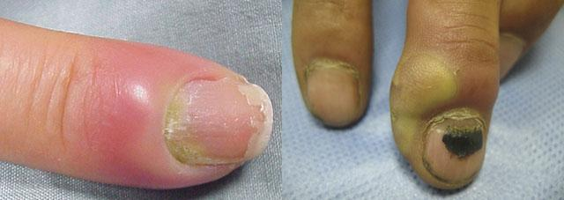
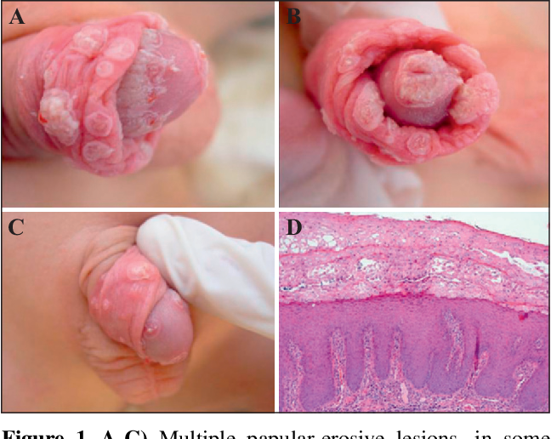
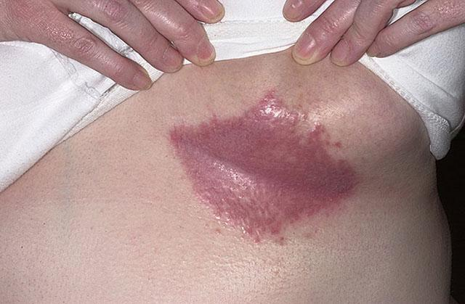
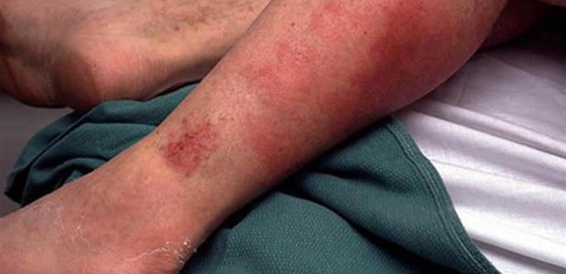
The clinical types of streptococcal impetigo are
Bullous impetigo
Angulus infectious (perleche, impetigo fissurica)
Pytyriasis simplex (dry streptoderma
Paronychia (superficial panaritium)
Intertriginous streptoderma
Acute streptoderma
Papular syphiloid impetigo (papulo-erosive streptoderma)

Slide 18
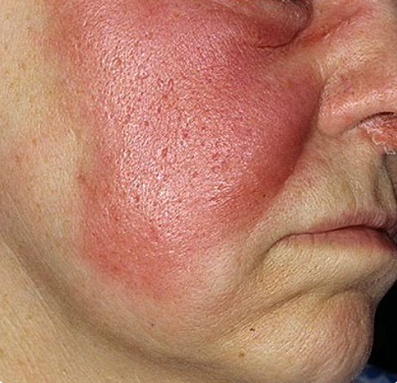
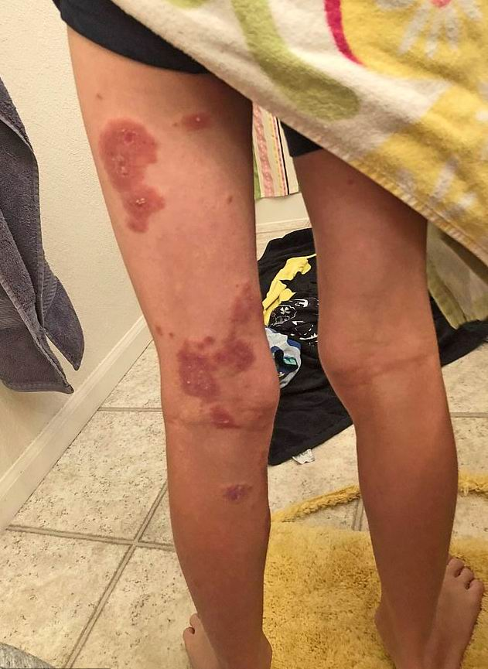
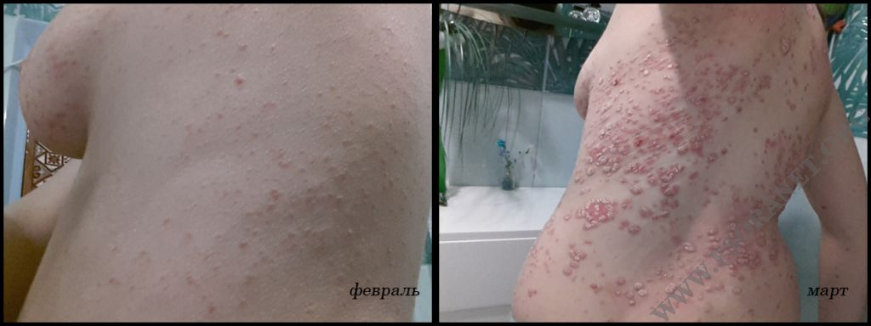
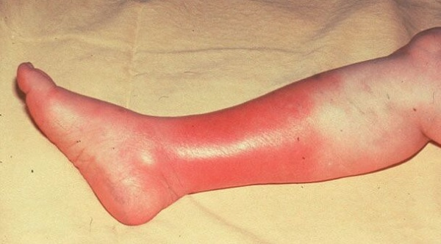
Erysipelas is an acute bacterial infection of the dermis and subcutaneous tissue, characterized by the formation of a sharply limited inflammatory focus, as well as fever and symptoms of general intoxication.
Streptococcal toxic shock syndrome (STSS) develops as a complication in patients with extensive traumatic skin lesions and disorder peripheral circulation.
It is characterized by acute development of shock and multisystem organ deficiency. Lethality reaches 30%

Slide 19
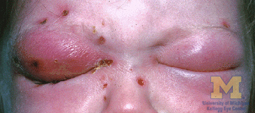
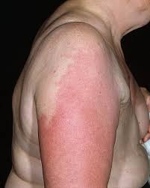
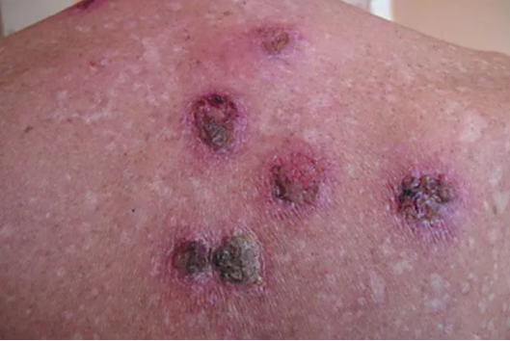
Deep streptoderma
Cellulite is acute infectious inflammation of the subcutaneous fat.
Ecthyma vulgaris (streptoderma ulcerative) is deep streptococcal skin lesions with ulceration in a limited area (non-follicular deep pustule).

Slide 20
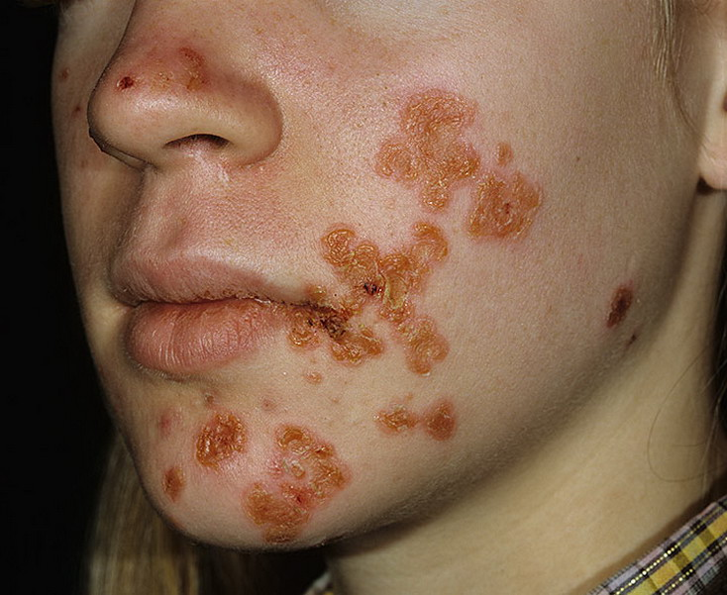
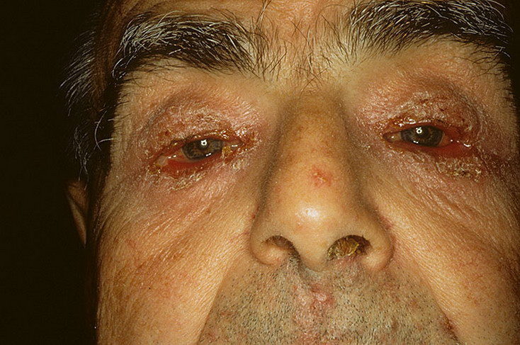
Superficial strepto-staphyloderma
Strepto-staphylococcal vulgar impetigo
is a contagious skin disease caused by streptococci and staphylococci.

Slide 21
Chronic deep ulcerative vegetative pyoderma
Chancriform pyoderma
Gangrene of the penis and scrotum
Acne keloidea (folliculitis sclerosans of the occiput )
Hallopo`s vegetative pyoderma
Deep strepto-staphyloderma
Gangrenous pyoderma
Hoffmann's folliculitis abscendens et suffodiens capitis
Scarring folliculitis (folliculitis decalvans)
Vegetative pyostomatitis

Slide 22
Treatment of pyoderma
To treat any kind of pyoderma it is necessary to follow three main principles:
Elimination of predisposing factors:
Local circulatory disturbances;
Endocrine disorders;
Hypo and avitaminosis;
Immunodeficiency states;
Focal infection;
Hyperhidrosis, poor skin hygiene;
Mechanical irritation.
III. Prevention of dissemination:
Treatment of skin with 2 per cent salicylic spirit;
Prohibition of washing and massage;
Prohibition of opining and stripping of any elements of eruption on the skin by a patient.
II. Focus control:
Antimicrobials (it is desirable to take into consideration microorganisms sensitivity);
Specific immunobiological medications (staphylococcal anatoxin, staphylococcal antifagin);
Local therapy -disinfectants, antibacterial and anti-inflammatory medications.

Slide 23
kdvrem@gmail.com

