Slide 1
Sexually Transmitted Diseases. Syphilis. Gonorrhoea.
Prokofyeva Nina, MD. PhD
Department of Dermatology and Venereology of Odessa National Medical University

Slide 2
Sexually transmitted diseases (STDs)
More than 1 million sexually transmitted infections (STIs) are acquired every day worldwide
The majority of STIs have no symptoms or only mild symptoms that may not be recognized as an STI.
In some cases, STIs can have serious reproductive health consequences beyond the immediate impact of the infection itself (e.g., infertility or mother-to-child transmission)

Slide 3
Classification
Classic venereal diseases
1. Syphilis.
2. Gonorrhea.
3. Shankroid.
4. Inguinal lymphogranulomatosis.
5. Granuloma venereal.
Other sexually transmitted infections
A With a predominant genital injury:
6. Genitourinary chlamydiosis
7. Genitourinary trichomoniasis.
8. Candidal vulvovaginitis and balanoposthitis.
9. Genitourinary mycoplasmosis.
10. Genital herpes.
11. Genital warts.
12. Genital molluscum contagiosum.
13. Gardnerella vaginitis.
14. Urogenital shigellosis of homosexuals.
15. Pubic lice.
16. Scabies.
B. With predominant damage to other organs
17. Infection caused by the human immunodeficiency virus (AIDS).
18. Hepatitis B.
19. Cytomegalovirus infection
20. Amoebiasis (mainly in homosexuals).
21. Giardiasis (lambliasis)
22. Sepsis of newborns.

Slide 4
SYPHILIS

Slide 5
Syphilis (synonym - Lues) – is a chronic systematic infectious disease with an undulating variable course, which is predominantly transmitted by sexual way and which affects all organs and systems of human body.
Syphilis is caused by Treponema pallidum ( It belongs to Spirochaetalis species; class Spirochaetacae, and family Treponema)

Slide 6
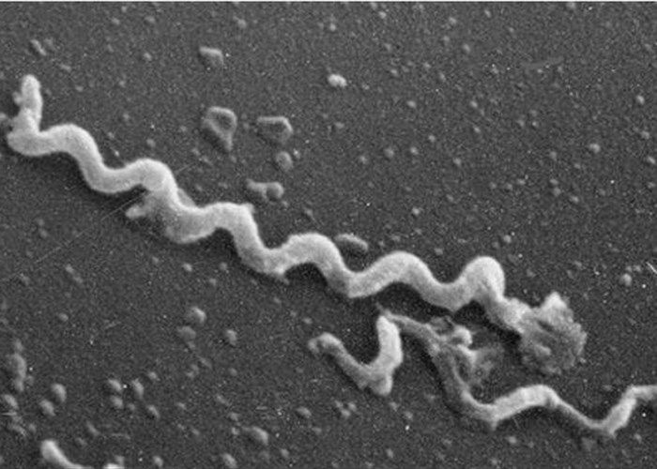
Treponema pallidum

Slide 7
Treponema pallidum
It is a procaryotic microorganism.
It was called "palli­dum" for its inability to stain well with different dyes.
It has a number of char­acteristic morphological features. It's thin thread-like form, has from 8 to 12 uniform spirals
The length is about 6 to 14 microns.
There are four types of its movements:
1. flexion-extension (pendulum-like)
2. rotary (around its own axis)
3. progressive motion
4. undulation (wave-like)

Slide 8
Morphologic elements of T.pallidum (spiral-form )
Protoplasmic cylinder (including nucleotide, cytoplasm, ribosomes, and cytoplasmic membrane);
Cellular wall with triple-layer membrane;
Capsule-like substance.

Slide 9
Survival forms of T. pallidum
1. Cysts (with protective membrane)
2. L-forms (partial or complete loss of the cell wall, reduction of metabolism, and disturbances of cell division process)
3. Grains, or granules (fragments of Treponema division)
4. Polymembranous phagosomes

Slide 10
The source of infection is an infected person. Patients are most contagious at early periods of disease (up to 2 years from the moment of contamination).
Ways of contamination:
1.Sexual (90-95%);
2. Domestic — through any household goods contaminated with alive Treponema pallidum;
3. Transfusional — in case of direct transfusion of blood from an infected donor
4. Transplacental (intrauterine) — contamination of the fetus from infected mother via placenta
5. Occupational — developing in medical personnel conducting various manipulations with syphilitic patients.

Slide 11
Immunity
There is no natural immunity
In the period of syphilitic infection develops
non-ster­ile, infectious immunity
Reinfection is a new infection with T. pallidum in a patient who had a previous syphilitic infection which had been completely eradicated by specific therapy.
Superinfection is a repeated contamination of a person who has not been completely cured.

Slide 12
The periods of acquired syphilis:
Incubation period (3-4 weeks)
I. Primary period of syphilis (6-8 weeks):
primary seronegative (3-4 weeks)
primary seropositive (3-4 weeks)
II. Secondary period of syphilis (2-4 years):
secondary early syphilis
secondary latent syphilis
secondary recurrent syphilis
III. Tertiary period of syphilis:
ac­tive tertiary syphilis
latent tertiary syphilis

Slide 13
Primary syphilis
begins from the moment of hard chancre formation and lasts until the appearance of numerous syphilitic eruptions on the skin and mucous membranes
Characteristic features:
Primary affection (hard chancre);
Regional lymphadenitis (+lymphangitis).

Slide 14
Characteristic features of hard chancre:
Location - genital or extragenital (mucous membranes of the mouth, lips, tongue, tonsils, rectum ect.)
It is represented as erosion or ulcer;
Its shape is round or oval (l-2cm in diameter);
The number of chancres is one or few;
Borders of erosion (ulcer) are regular, slightly elevated and descended (saucer-like form);
Distinct sharp borders, the bottom of erosion is smooth, dense infiltrate is palpated at the base of it;
Color is red, "color of fresh meat".
Discharge is scanty, contains Treponema pallidum;
No subjective symptoms (painless)
Erosive chancre heals without the trace, ulcerous chancre forms a scar.

Slide 15
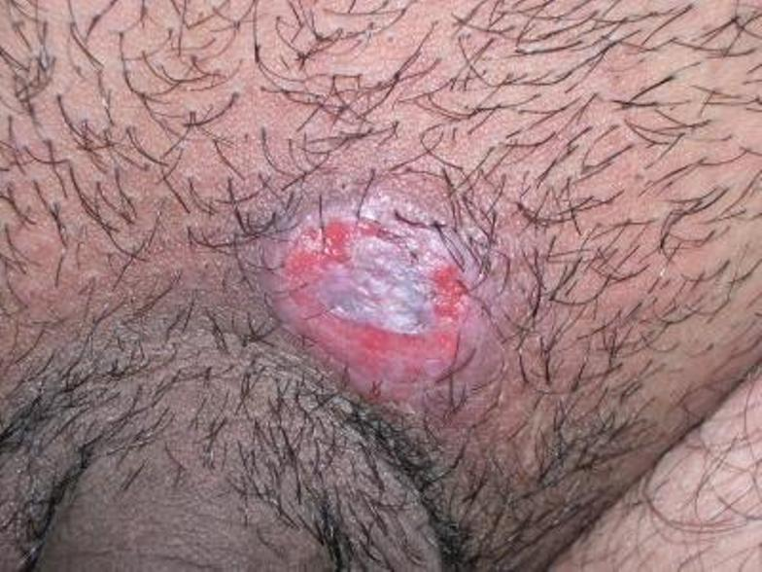
Typical hard chancre

Slide 16
Atypical forms of hard chancre:
Indurative swelling
Chancre-amygdalitis
Chancre-panaritium
Chancre of the cervix uteri and rectum

Slide 17
Complications of hard chancre
In men:
              balanitis
              balanoposthitis
              phimo­sis
              paraphimosis
              gangrene
In women:
                vulvitis
                vulvovaginitis

Slide 18
Regional lymphadenitis
It becomes apparent at the end of the 1st week after appearance of hard chancre;
Localization of lymph nodes is directly related to the place of the chancre appearance;
Lymph nodes enlarge up to the size of a bean or a hazel-nut and become dense-elastic;
They are painless, and the overlying skin is normal;
They are not connected with each other or with the skin, are mobile;
The process is usually bilateral;
Regional lymphadenitis persists for the whole primary course, and sometimes during the first months of the secondary one.

Slide 19
Differential diagnosis:
Genital herpes;
Squamous cell carcinoma of skin;
Mycotic erosion;
Chancriform pyoderma;
Chancroid;
Erosive balanitis and balanopostitis;
Chancriform itchy ectima in scabies;
Erythroplasia Queyrat;
Traumatic erosion.

Slide 20
Diagnosis
Primary seronegative syphilis – detection of T.pallidum in secret from surface of the chancre (dark field microscopy)
Primary seropositive syphilis – classic serological reactions for syphilis are positive

Slide 21
Serological tests:
Non-treponemal
- Microreaction of precipitation (MRP);
- Compliment fixation test (CFT)with cardiolipin antigen (Wasserman reaction);
- ElISA with cardiolipin antigen;
- RPR-test (Rapid Plasma Reagin) with the blood plasma;
- TRUST- test (Toluidin Red Unheated Serum Test) with unheated serum and azo dyes;
- VDRL –test (Venereal Disease Research Labaratory Test) with an inactivated serum;
-USR-test (Unheated Serum Reagins) with active stabilized serum;
- RST-test (Reagin Screen Test) – screening for reagin;
- ART-test (Automated Reagin Test) –automated reagin test
Treponemmal
- Complement fixation test (CFT) with treponemal antigen;
- Immunofluorescence test (IFT) an its modifications;
- Treponema pallidum immobilization test (TPIT);
- The reaction of passive hemagglutination (RPH);
- ELISA;
- Immunoblotting method;
- Cytotest on chromatographic strips;
PCR

Slide 22
Secondary syphilis
The secondary stage is characterized by dissemination and multiplication of the microorganism in different tissues.
This stage follows primary syphilis in almost every patient in the absence of appropriate treatment.
Various lesions may occur due to circulating immune complexes, human fibronectin, antibodies, and complements with accompanying systemic signs

Slide 23
General features of clinical course of the secondary syphilis
Absence of subjective feelings and violation of the general condition of the patient;
Rash is highly contagious;
The clinical manifestations are resolved without treatment;
Total duration of secondary syphilis is 2-4 years;
Rash is presented by macular, papular, pustular and pigmented syphilides (true polymorphism), as well as syphilitic alopecia;
Rash is not acute inflamatory, its color pale pink or brownish

Slide 24
Types of eruption of the secondary syphilis:
Macular syphilid (syphilitic roseola);
Papular syphilid;
Pustular syphilid;
Pigmentary syphilid (leicoderma syphiliticum);
Syphilitic alopecia (alopecia syphilitica).

Slide 25
Macular syphilid (syphilitic roseola):
Is the most common morpho­logical lesion of the secondary syphilis;
Localization- the lateral surfaces of the trunk, upper abdomen; back, front surface of the upper extremities and hips;
Color varies from pink to yellow-brown;
Roseolas are round with a diameter of 8-12 mm;
Roseolas disappear or becomes pale at diascopy;
No peripheral growth;
Subjective symptoms and scaling are absent;
They become more visible after i/m injection of penicillin (Jarish-Herxhimer reaction).

Slide 26
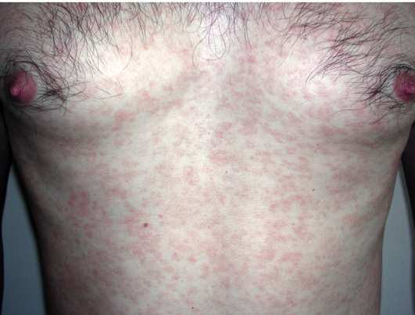
Syphilitic roseola

Slide 27
Papular syphilid
Papules are well-defined discrete lesions of firm consistency, but, located in the skin folds they show a tendency to peripheral growth and confluence.
The surface of the papules is flat;
Are mostly located isolated from each other;
Clearly localized from the surrounding skin without inflammatory crown around the edge;
Their color varies from pink to brownish and cyanotic red;
Papules after resolution are sometimes covered with scales;
Under unfavourable con­ditions they are subjected to erosion and ulceration, sometimes they vegetate and are hypertrophied (flat condyloma, condyloma latum).

Slide 28
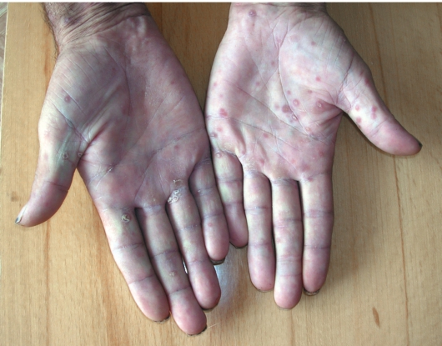
Papular syphilid

Slide 29
Pustular syphilid
is considered to be a severe manifestation of second­ary syphilis;
It occurs in 2-10 % of patients suffering from concomitant chronic diseases, alcohol and drugs abuse, HlV-infection, and hypovitaminoses;
Clinical forms of pustular syphilid:
syphilitic impetigo;
acneform syphilid;
variolar syphilid;
syphilitic ecthyma;
rupia syphilitica.

Slide 30
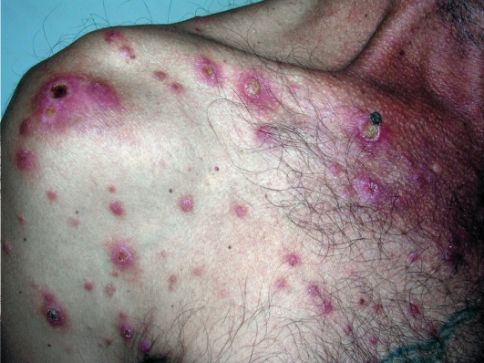
Syphilitic impetigo

Slide 31
Pigmentary syphilid (syphilitic leukoderma)
Is observed in the secondary recurent syphilis;
occurs on the 4-6th month of disease
It is vaguely demarcated, incompletely hypopigmented leukoderma;
Localization - back and lateral surface of neck (necklace [collar] of Venus), more rarely — anterior walls of armpits, upper part of chest, back and stomach;
Whitish rounded spots are re­vealed on the background of slightly hyperemic skin;
It is often combines with syphilitic alopecia;
Syphilitic leukoderma doesn't exfoliate and there are no subjective symptoms.

Slide 32
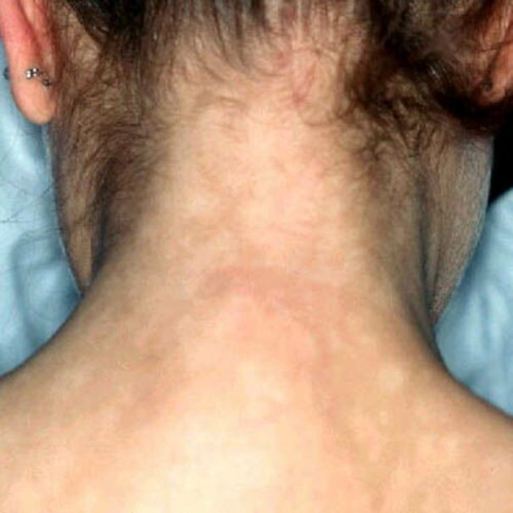
Syphilitic leukoderma

Slide 33
Syphilitic alopecia
It is observed in the secondary recurrent syphilis;
Multiple patches of hair loss of 5 mm to 20 mm in diameter appear and spread gradually on the entire scalp;
It appears suddenly and progresses rapidly;
It often affects the frontal-parietal and occipital areas.
There are 3 types of alopecia:
fine-focal syphilitic alopecia;
diffuse alopecia;
mixed syphilitic alopecia.

Slide 34
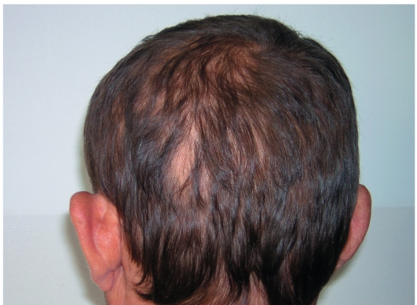
Syphilitic alopecia

Slide 35
Latent syphilis
After a period of 3–12 weeks, untreated secondary syphilis typically resolves spontaneously, followed by an asymptomatic state called latent syphilis;
The diagnosis at this stage can only be made based on a positive serology.
About 90% of relapses occur within the first year, referred as early latent stage. After 1 year, the patients enter the late latent stage, lasting for months to years.

Slide 36
Tertiary Period of Syphilis
It is a serious chronic systematic disease in which destructive pathological changes develop in the affected organ;
It develops in patients without or poor treatment in 4-5 years and even later after contamination;
Approximately 25–40% of patients with untreated syphilis can develop late disease, and symptoms may appear at any time from 1 to 30 years after primary infection
It has a variable range of manifestations that appear months to years after initial infection. Involvement of the skin, bones, CNS, heart, and major vessels is pathognomonic.

Slide 37
Characteristics features:
Not only skin but internal organs and central nervous system are affected;
A threat for the patient's life arises from affection of vital organs;
Eruptions on the skin are represented by tubercles and gummas;
Tertiary syphilids as a rule are not accompanied with subjective complaints;
Infectious granuloma is a morphologic element of tissue affection.
Treponemas pallidum are sporadic in the affection foci, so patients are almost not contagious.
A number of positive results CSR (Complex of Serological Reactions) is reduced.

Slide 38
Tubercular syphilid
Can localize on any site of the skin and mucous mem­branes, but more often it is revealed on the body, extensor surfaces of extremi­ties, and face.
Tubercle is copper — colored.
It is of cherry stone size, rather dense, and has distinct borders.
Tubercles can gradually resolve, disappear (so called "dry" resolution) leaving superficial atrophic scars surrounded by pig­mented border.

Slide 39
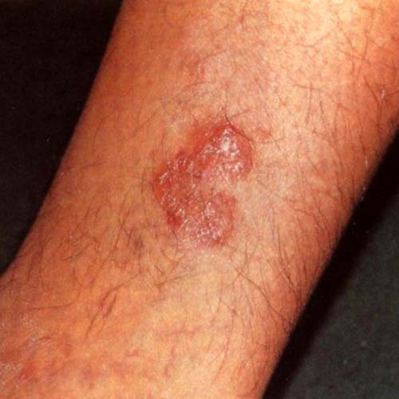
Tubercular syphilid

Slide 40
Syphilitic gumma (gummatous syphilid)
Gummas are locally destructive lesions in the skin, bones, liver, and other organs.
The gummas in the skin are nodular or noduloulcerative granulomatous lesions with a round, irregular, or serpiginous shape, remaining for weeks to months, and eventually heal with scar tissue.
A subcutaneous gumma may become necrotic, resulting in ulceration of the skin or mucous membranes as well as destruction of underlying bones.
Gummatous lesions of the bones are usually accompanied by periostitis and osteitis.
Clinical manifestations include pain, swelling, and limited range of motion.
Other sites that can be affected by gummas include the tongue and oral cavity, upper respiratory tract, myocardium, and gastrointestinal and nervous systems.

Slide 41
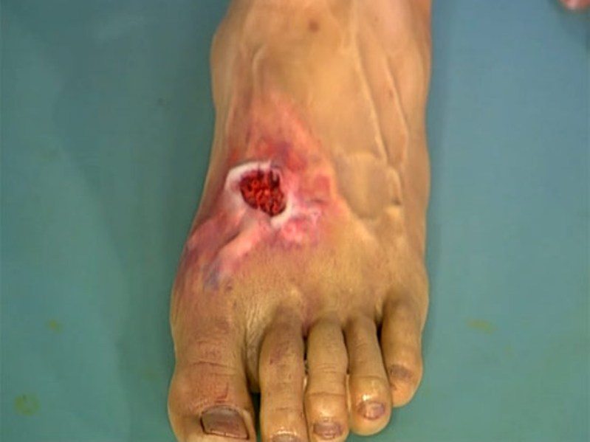
Syphilitic gumma

Slide 42
Neurosyphilis
Neurosyphilis is the infection of the central nervous system by T. pallidum, and although it is typically a manifestation of tertiary syphilis, it can occur at any stage of the disease.
It was common in the pre-antibiotic era, occurring in 25–35% of patients with syphilis; however, nowadays, it is most frequently seen in patients with HIV infection.
Early in the course, the disease involves cerebrospinal fluid, meninges, and vasculature, while later on brain and spinal cord parenchyma are also affected.

Slide 43
Congenital syphilis
Congenital syphilis occurs when the spirochete T. pallidum is transmitted from a pregnant woman to her fetus.
Infection can result in stillbirth, prematurity, or a wide spectrum of clinical manifestations, and only severe cases are clinically apparent at birth.
If a child has physical, laboratory, or radiographic signs of congenital syphilis and was born to a mother with untreated, inadequately, or suboptimally treated syphilis, this condition is defined as congenital syphilis.
Among women with untreated early syphilis, 40% of pregnancies result in spontaneous abortion

Slide 44
Congenital syphilis classification
I.Syphilis of the fetus and placenta;
II.Early congenital syphilis (a child under two):
Nurseling;
Infancy.
III.Late congenital syphilis (a child after two).

Slide 45
Early congenital syphilis
I. All types of typical secondary syphilids (mainly papular ones);
II. Special forms:
  Pemphigus syphiliticus;
  A diffuse papular infiltration of skin (Hochsinger);
  Syphilitic rhinitis.
Anemia, thrombocytopenia, syphilitic pneumonitis, hepatitis, nephropathy, lymphadenopathy, and hepatosplenomegaly may also be observed.
Osteochondritis of skeletal bones may result in pseudoparalysis of Parrot due to reduced movement of the extremities due to pain.

Slide 46
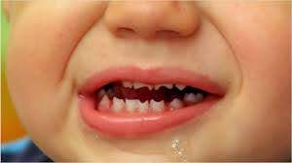
Late congenital syphilis
Manifestations of late congenital syphilis can be divided into: symptomatic and asymptomatic.
There are three symptomatic signs of late congenital syphilis known as Hutchinson's triad:
Hutchinson's teeth
Parenchymatous keratitis
Labyrinthine disease (deafness)

Slide 47
Asymptomatic signs of the late congenital syphilis:
Symptom of Robinson-Fourniet — radial cicatrices around the mouth;
Saber shins — a tibia that has a pronounced anterior convexity resembling the curve of a saber and caused by osteochondritis;
Saddle nose — develops because of syphilitic rhinitis;
Breech-like cranium — develops because of hydrocephaly with periostitis;
Syphilitic gonitis — these are symmetrical synovitises of knee joints
without affection of cartilages and bone epiphyses;
Axiphoidia — is a lack of xiphoid process;
Avsytidiisky's sign — thickening of sternal end of clavicle;
Goshe sign — the upper incisors are wide apart (there is a gap between
the upper incisors);
Dubois' sign — infantile little finger;
High "Gothic" palate,"Olympic" forehead.

Slide 48
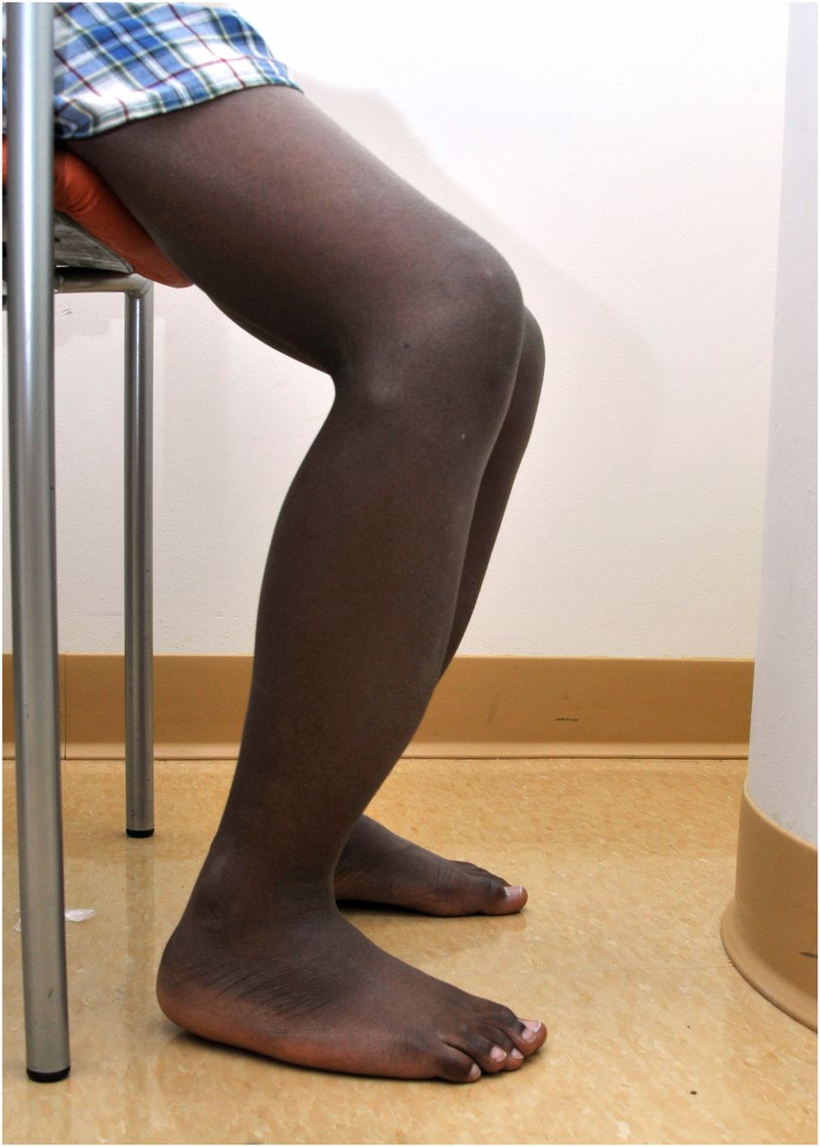

Slide 49
Treatment
A non-treponemal serologic test should be obtained before initiating therapy (preferably on the first day of treatment) to establish the pretreatment titer and adequacy of serological response.
Parenteral Benzylpenicillin (every 4 hours), penicillin G is the treatment of choice for all stages of the disease
The dosage and duration of treatment depend upon the stage of the disease.
In case of penicillin allergy, rechallenging or desensitization can be tried initially. Alternative antimicrobial agents include tetracyclines and cephalosporins.

Slide 50
Jarisch-Herxheimer reaction
is an acute febrile reaction frequently accompanied by headache and myalgias within the first 24 hours of penicillin treatment and is most common among patients with early syphilis.

Slide 51
Follow-up
Patients should be monitored clinically and with laboratory testing to ensure that they are responding appropriately to therapy.
A fourfold decline in the non-treponemal titer, equivalent to a change of two dilutions, is considered as good response to therapy.
In patients with early syphilis, serologic testing should be performed 6 and 12 months following treatment and at any time if clinical symptoms recur
Patients with late syphilis should undergo follow-up serologic testing at 6, 12, and 24 months

Slide 52
Gonorrhea

Slide 53
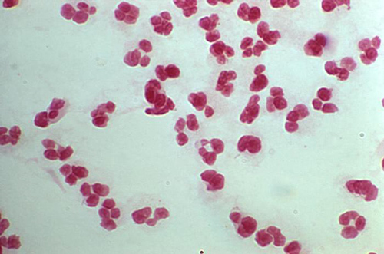
Gonorrhea
is a common sexually transmitted infection caused by the bacterium Neisseria gonorrhea

Slide 54
Microbiology and Pathogenesis
A causative agent of disease is gonococcus — gram-negative diplococci of kidney bean shape
Their sizes are 1.25-1.6 micron long and 0.7-0.9 micron breadth.
Gonococci primarily infect columnar or cuboidal epithelium. They attach to mucosal epithelial cells, penetrate into the cells and multiply, and then pass through the cells into the subepithelial space, where infection is established.
Outside the human body the gonococcus dies within a few seconds because it does not survive sunshine, drying or soap and water.

Slide 55
Epidemiology
Transmission may occur from infected urethral, cervical, rectal and pharyngeal surfaces.
The incubation period is 1 to 14 days, but usually 2 to 5 days.
Transmission from male to female after one exposure is 50-70%, whereas transmission from female to male is 20%.
Recurrent infection is common
Gonorrhea is usually spread by carriers who have no symptoms or who have ignored symptoms

Slide 56
Classification
I. Fresh gonorrhea ( course of disease up to two months):
acute;
subacute;
torpid.
II. Chronic gonorrhea ( course of disease more than two months):
acute;
subacute;
torpid.
III. Latent gonorrhea

Slide 57
Clinical Features
The most frequent clinical presentation is urethritis in men and cervicitis in women.
Urethritis in men – anterior urethritis is the most common manifestation in men and presents with a purulent urethral discharge and/or dysuria.
The discharge may be profuse, minimal or undetectable.
The initial infection is asymptomatic in 5% of men.
Complications include prostatitis, epididymitis (presents with unilateral testicular pain and swelling), urethral stricture, and disseminated gonococcal infection.

Slide 58
Clinical Features (cont.)
Urogenital infection in women –mucopurulent cervicitis.
The urethra may be involved as well (urethritis).
Symptoms include vaginal discharge, pelvic pain, dysuria, frequent urination, and abnormal uterine bleeding.
The majority of infected women are asymptomatic
Untreated infection can result in pelvic inflammatory disease and infertility.
Other complications include Bartholin’s glands abscess or infection (manifest as labial pain and swelling) and perihepatitis (Fitz-Hugh-Curtis syndrome which involves right upper quadrant abdominal pain and tenderness and elevated liver enzymes; due to direct extension of gonorrhea or chlamydia from the fallopian tube to the liver capsule and overlying peritoneum).

Slide 59
Rectal infection
Proctitis can occur in both men and women.
Symptoms include anal irritation, painful defecation, bleeding, cramping, constipation and mucopurulent rectal discharge.
Many patients with rectal infection are asymptomatic.

Slide 60
Pharyngeal infection
results from orogenital contact and is usually asymptomatic, but can cause exudative pharyngitis and cervical adenitis, and can be a source of further transmission.

Slide 61
Pelvic inflammatory disease (PID)
refers to infection of the endometrium (endometritis), fallopian tubes (salpingitis) and/or surrounding peritoneum (pelvic peritonitis) which occurs as a complication of cervicitis, due to ascending infection.
10-20% of women with gonorrhea develop PID
Signs and symptoms include lower abdominal pain, fever, dyspareunia (pain during intercourse) and vaginal bleeding.
Signs include mucopurulent endocervical discharge, cervical motion tenderness (pain during movement of the cervix during pelvic exam), uterine or adnexal tenderness, fever, an elevated white blood cell count, and an elevated erythrocyte sedimentation rate (ESR) or C-reactive protein.
Tubo-ovarian abscesses can also occur. Tubal scarring can lead to infertility (the most common serious consequence of PID) and ectopic pregnancy.
Infertility has been identified in approximately 1 in 5 women after one episode of PID, and the risk rises with subsequent PID episodes.

Slide 62
Disseminated gonococcal infection
results from gonococcal bacteremia and occurs in 1- 3% of infected patients.
Symptoms include fever, skin lesions (pustules, sometimes hemorrhagic or necrotic, on an erythematous base, located mostly on the extremities), tenosynovitis, oligoarthritis (inflammation of a few joints, most commonly knee, also elbows, ankles, wrists, small joints of hands and feet), and migratory polyarthralgias (joint pain). This presentation is called the arthritis-dermatitis syndrome.
Rarely, hepatitis, endocarditis, or meningitis can occur.

Slide 63
Ophthalmia neonatorum
Perinatal disease – the neonate may develop gonococcal conjunctivitis (ophthalmia neonatorum) due to passage through an infected birth canal.
It presents as a severe sightthreatening bilateral conjunctival inflammation
presents with oedema of the eyelid and purulent exudate
Administration at birth to all neonates of eye drops with antibiotics protects against the development of ophthalmia neonatorum.

Slide 64
Diagnosis
A Gram stain of urethral discharge
Culture
Nucleic acid amplification assays for N. gonorrhoeae (including polymerase chain reaction, transcription-mediated amplification, and strand displacement amplification) have been developed for use with clinical specimens (urine, urethral, cervical). These assays are highly sensitive and specific, and in many laboratories these assays have replaced culture.

Slide 65
Treatment
Third generation cephalosporins (a single intramuscular injection of ceftriaxone or a single oral dose of cefixime) are the treatment of choice for uncomplicated gonococcal urethritis or cervicitis.
Treatment of pelvic inflammatory disease is more complicated and prolonged

Slide 66
Prevention involves:
education regarding safer sex practices,
aggressive detection,
rigorous follow-up screening and treatment of sexual contacts,
screening of asymptomatic at-risk persons.
No vaccine is available to prevent gonorrhea.

Slide 67
Thank you!

