Slide 1

FORMS OF ENTERING OF PHARMACEUTICAL COMPANIES ON FOREIGN MARKETS
ODESSA NATIONAL MEDICAL UNIVERSITY
FACULTY OF PHARMACY
Department of organization and economics of pharmacy
with post-diploma specialization

Slide 2
The choice of entry strategies on foreign markets and growth depends on the strategic goals of the company, product, political, economic and legal risks in other countries. No one market entry strategy works for all international markets. There will be a number of factors that will influence your choice of strategy, including, but not limited to, tariff rates, the degree of adaptation of your product required, marketing and transportation costs.

Slide 3
Five main choice in International market
Exporting
Licensing
Franchising
Contract manufacturing
Join venture
Direct Foreign Investment .

Slide 4
Exporting
Exporting is also a common approach for mature international companies with strong marketing and relational capabilities.
Direct Exporting
Direct exporting is selling openly into the market you have selected using in the first occurrence you own resources.
Indirect exporting
company sells to a buyer (importer or distributor) in the home country, which in turn exports the product

Slide 5

Licensing.
Licensing is a relatively sophisticated arrangement where a firm transfers the rights to the use of a product or service to another firm. It is a particularly useful strategy if the purchaser of the license has a relatively large market share in the market you want to enter. Licenses can be for marketing or production licensing).
Patent rights, trademark rights, and the rights to use technological processes are granted in foreign licensing.

Slide 6

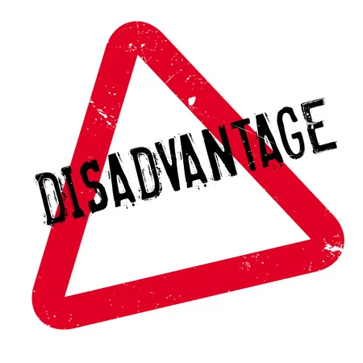
Licensing
wrong partner
quality and other production problems
payment problems
loss of marketing control.
capital is scarce
import restrictions forbid other means of entry,
The country is sensitive to foreign ownership,
patents and trademarks must be protected
against cancellation for nonuse.

Slide 7

Franchising
Franchising is a business system where under the franchisor grants a license to the franchise to use the franchisor’s diverse intellectual property rights, namely, know-how, designs, brands, trademarks, patents, and trade secrets along with the franchisor’s proven name, reputation and marketing techniques to market the franchisor’s products or services in return for a sum of money.
It is special form of licensing where the franshiser not only sell intangible property to the franchisee but also insist the franchisee to follow the strict guidelines on how to do business

Slide 8
Franchising
In England, for example, annual franchised sales of fast foods are estimated at nearly $2 billion, which accounts for 30 percent of all foods eaten outside the home.
The key factors that influence success of franchising approaches are monitoring costs (based on physical and cultural distances), the principal’s international experience, and the brand equity in the new market.

Slide 9

Advantages
The franchiser gets important feedback about the popularity of the product and specific need and preferences of the local customers from the franchisees.
Franchising enables the franchisor to increase his goodwill and reputation by expanding his network.
The franchisor gains wider acceptance of his brand name through the franchisees.
The rights of the franchisor are protected as only the franchise can use the franchiser’s patents, trademark, brand names, etc.
Disadvantages
There is a danger that the franchise may start an identical business with a slightly different brand name.
The franchisor’s brand name and reputation may get tarnished if the franchise is not able to maintain standards of quality and service.
The franchisor has to provide initial financial assistance and support in the form of staff training, advertising, etc.
There is a risk of trade secrets getting leaked out in the foreign market. The leakage may cause serious losses.
There are ongoing costs of supporting the franchise and national advertising.

Slide 10
The franchise does not enjoy complete freedom in his business. The franchise agreement generally contains restrictions on how the franchise would run the business.
Payment of royalty on a regular basis is to be made to the franchiser.
There is always a possibility of conflict between the parties regarding maintenance of accounts, payment of royalty, violation of quality norms, etc. It may sometimes lead to litigation between the franchiser and franchisee.
The franchisee cannot sell his business without taking approval from his franchiser.

Slide 11

Contract manufacturing
Contract manufacturing, at which an exporter signs the contract with a foreign manufacturer to establish production and sales of goods of the exporter.
Contract manufacturing is a process under which a company does not manufacture its products. The production activities are outsourced to contract manufacturers. Contract manufacturers are those who manufacture other company’s products on a contract basis.

Slide 12
What is driving so much outsourcing in the pharmaceutical industry?
Here are some of the relevant factors:
Pressure to reduce expenses due to diminished R&D returns and increased competition
Pharma industry consolidation
Pharma company restructuring capabilities around technologies experiencing rapid growth, including gene and cell therapy or biologics
Need to shift operations away from markets with high labor costs or less profitable drug products
Shortage of technical talent in pharmaceutical industry
Push from tech giants into the pharma/healthcare space

Slide 13
A pharma contract manufacturing company provides an array of services to drug companies which may include:
Drug development
Drug manufacturing and commercial production
Documentation of compliance with FDA regulatory requirements
Pre-formulation
Development of drug formulation
Conduction of stability studies, method development, pre-clinical and Phase I clinical trials
Providing late-stage clinical trial materials
Providing formal stability, scale-up, registration batches

Slide 14
What is a CRO and a CMO?
In the pharmaceutical industry, a CRO or contract research organization company provides support to pharmaceutical companies by providing a range of professional research services on a contract basis so that this work is no longer done internally. Contract research organizations help drug manufacturers in the extensive drug discovery process by lightening some of the costly burdens involved with data research, testing, project management and drug trials that are run on a post-approval, pre-clinical and clinical basis.
A CMO, or contract manufacturer organization is different from a CRO in that it specializes in manufacturing drug products for pharmaceutical companies rather than engaging in research. Some outsource entities perform multiple duties, such as a CDMO, or contract development and manufacturing organization which provides comprehensive services from drug development through to drug manufacturing.

Slide 15
What is a CTL?
In pharma, the term CTL refers to a contract testing laboratory which provides pharmaceutical testing services to drug manufacturers. Here are some of the types of services provided by a contract testing laboratory:
Bioanalytical services/bioanalytical testing services
Drug development services/drug discovery services
Pharmaceutical dissolution testing services
Preclinical testing services
Central laboratory services/clinical trials laboratory services

Slide 16
What is a CTL?
In pharma, the term CTL refers to a contract testing laboratory which provides pharmaceutical testing services to drug manufacturers. Here are some of the types of services provided by a contract testing laboratory:
Bioanalytical services/bioanalytical testing services
Drug development services/drug discovery services
Pharmaceutical dissolution testing services
Preclinical testing services
Central laboratory services/clinical trials laboratory services

Slide 17
The third party manufacturing?
What is the meaning of third party manufacturing?
In pharma parlance, the term “third party manufacturing” refers to a contact manufacturer that produces goods for drug companies but does not own the inventory. This strategic partnership provides significant benefits for the contract manufacturing company, drug companies and patients. The CMO is contracted by a pharma company to provide the materials and labor to manufacture drug products which are then owned and paid for by the client. The manufacturing work is performed externally, by a third party rather than by the pharmaceutical company itself usually to reduce costs and save time.

Slide 18
There are three basic approaches to resolve a wide range of contract manufacturing:
Contract structure: This category includes private mark manufacturing, contracts for making one segment or particular parts, work or administration subcontracting, and start to finish administration contracts.
Services, instruments, and materials:
Even if two contract producers both give private name
manufacturing, their manufacturing cycle and kinds of devices or
materials they use might be different.
Supported businesses: Some contract makers represent considerable authority in specific enterprises. Pick a maker that comprehends the requirements of your clients just as your industry’s market and guidelines.

Slide 19

Joint ownership
Joint ownership lies in the fact that the exporting firm combines its capital with a capital of a foreign partner for create a foreign company in which the partners jointly control the production and sale.

Slide 20

Joint marketing
Joint marketing an agreement between two companies for the joint promotion and distribution of certain products in specific markets.
In other countries joint ventures are quite common in the exploration, produc- tion and marketing of medicines. For example, “Merck & Co” (USA) and the firm “AsheGgour” (Brazil) organized a manufacturing enterprise “Prodome”; company “Roshe” and the Japanese firm “Nicon Medi-Physics” formed a company “Medicom”.

Slide 21

International Joint Ventures
International joint ventures (IJVs) as a means of foreign market entry have accelerated sharply during the last 30 years. Besides serving as a means of lessening political and economic risks by the amount of the partner’s contribution to the venture. IJVs provide a way to enter markets that pose legal and cultural barriers that is less risky than acquisition of an existing company.

Slide 22
Joint ventures involves partnerships between the company and exporter company of a foreign country with the aim of combining some aspects of the production and marketing in order to share expertise, the costs of communication.
A joint venture is different from other types of strategic alliances or collaborative relationships in that a joint venture is a partnership of two or more participating companies that have joined forces to create a separate legal entity.

Slide 23
International Joint Ventures
Advantages
Allows for risk sharing–financial and political
Provides opportunity to learn new environment
Provides opportunity to achieve synergy by combining strengths of partners
May be the only way to enter market given barriers to entry
Disadvantages
Requires more investment than a licensing agreement
Must share rewards as well as risks
Requires strong coordination
Potential for conflict among partners
Partner may become a competitor

Slide 24
Four characteristics define joint ventures:
JVs are established, separate, legal
entities;
They acknowledge intent by the partners to share in the management of the JV;
They are partnerships between legally incorporated entities, such as companies, chartered organizations, or governments, and not between individuals;
Equity positions are held by each of the partners.

Slide 25
The choice of partners and the qualities of the relationships between the executives are important factors leading to success. Several other factors contribute to their success or failure as well: positions of partners in industrial networks, how control is shared, relations with parents, institutional (legal) environments, marketing capabilities, experience, and the extent to which knowledge is shared across partners

Slide 26

Written Joint Venture Agreement should cover:
The parties involved
The objectives of the joint venture
Financial contributions you will each make whether you will transfer any assets or employees to the joint venture
Intellectual property developed by the participants in the joint venture
Day to day management of finances, responsibilities and processes to be followed.
Dispute resolution, how any disagreements between the parties will be resolved
How if necessary the joint venture can be terminated.
The use of confidentiality or non-disclosure agreements is also recommended to protect the parties when disclosing sensitive commercial secrets or confidential information.

Slide 27
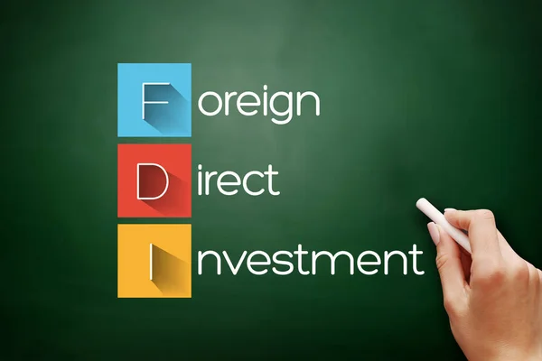
Direct Foreign Investment
Direct foreign investment- is investment within a foreign country.
Several factors have been found to influence the structure and performance of direct investments:
Timing - first movers have advantages but are more risky;
the growing complexity and contingencies of contracts;
transaction cost structures;
technology and knowledge transfer;
degree of product differentiation;
the previous experiences and cultural diversity of acquired firms;
advertising and reputation barriers.
This mix of considerations and risks makes for increasingly difficult decisions about such foreign investments.

Slide 28


Slide 29
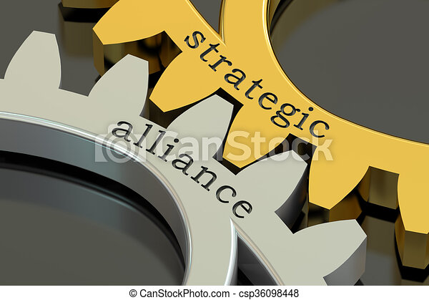
The strategic international alliance (SIA)
A strategic international alliance (SIA) is a business relationship established by two or more companies to cooperate out of mutual need and to share risk in achieving a common objective. Strategic alliances have grown in importance over the last few decades as a competitive strategy in global marketing management. Strategic international alliances are sought as a way to shore up weaknesses and increase competitive strengths—that is, complementarity is key.

Slide 30
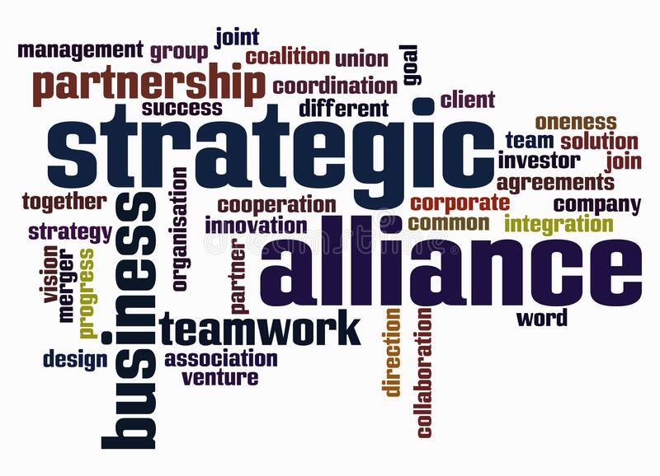
Motives for Strategic Alliances.
opportunities for rapid expansion into new markets
access to new technology
more efficient production and innovation
reduced marketing costs,
strategic competitive moves
access to additional sources of products and capital.

Slide 31

International company
International company is a special form of activity based on the cooperation labour of workers of many factories located in different coun tries but united by a common title of ownership of the means of production which is owned by the parent company, serving as the organizational and economic management centre.

Slide 32
Characteristic features of the international company are:
A network controlled by the production of branches and subsidiaries in other countries whose functions include production of certain products on previously known foreign markets, or supply of the parent company by raw materials and material resources.
The use of technological cooperation and specialization-controlled enterprises.
Control and coordinate the activities of branches and subsidiaries from a single centre, taking into account differences in their legal status

Slide 33
Characteristic features of the international company are:
A network controlled by the production of branches and subsidiaries in other countries whose functions include production of certain products on previously known foreign markets, or supply of the parent company by raw materials and material resources.
The use of technological cooperation and specialization-controlled enterprises.
Control and coordinate the activities of branches and subsidiaries from a single centre, taking into account differences in their legal status

Slide 34
Characteristic features of the international company are:
A network controlled by the production of branches and subsidiaries in other countries whose functions include production of certain products on previously known foreign markets, or supply of the parent company by raw materials and material resources.
The use of technological cooperation and specialization-controlled enterprises.
Control and coordinate the activities of branches and subsidiaries from a single centre, taking into account differences in their legal status

Slide 35
On national structure international firms are divided into:
Multinational companies (the corporation).
Transnational corporations (TNCs) is a complex that uses in its work an international approach and provides for the formation of transnational production, trade and financial complex with a single center of decision-making in the home country, with branches and subsidiaries located in at least six foreign countries.
Multinational corporations.
The second group of international firms belong multinational corporations (MNCs). It trusts and other industrial associations which are international companies not only by areal of activities but also for the control of them. MNCs join the national company of two or more countries on industrial, scientific and technical basis belonging to the owners of these countries. Branches are located at the same time in different countries.
International corporate alliances. International corporate alliances often take the form of consortia. They created the industrial, scientific, technical and commercial basis are special union of industrial, banking and other corporations formed to solve massive economic problems.

Slide 36


