Slide 1

ODESSA NATIONAL MEDICAL UNIVERSITY
FACULTY OF PHARMACY
Department of organization and economics of pharmacy
with post-diploma specialization
Principles of product distribution in international marketing
Prepared by senior teacher
Oksana STEPANOVA

Slide 2
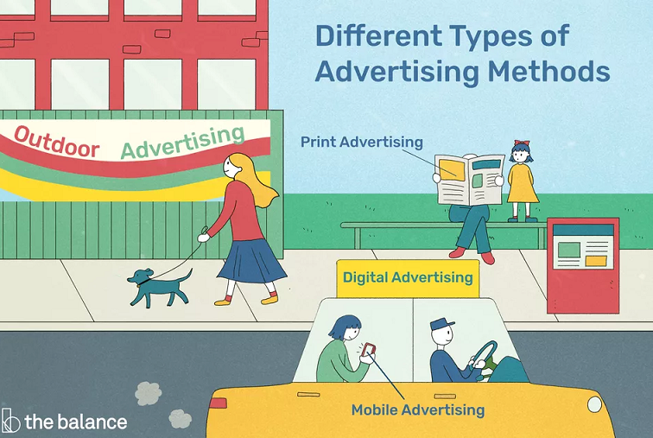

Slide 3
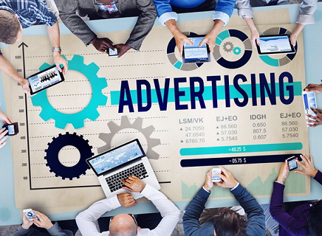
Advertising has evolved into a vastly complex form of communication, with literally thousands of different ways for a business to get a message to the consumer. Today's advertisers have a vast array of choices at their disposal.
The internet alone provides many of these, with the advent of branded viral videos, banners, advertorials, sponsored websites, branded chat rooms and so much more.

Slide 4
What is Online Advertising?
It’s a……“form of online advertising where an advertiser’s message is shown on a destination web page, generally set off in a box at the top or bottom, or to one side of the content of the page” Online advertising is also called:
Web Advertising
Display Advertising (not to be confused with the newspaper version of ‘display’ advertising)

Slide 5
Here are a few examples of what's available for your media arsenal:
Online Advertising (aka Digital)
If you see an advertisement via the internet, then it is classified as online advertising. In fact, there are ads on this very page, and most other websites you visit, as they are the primary revenue driver for the internet. Another avenue of online advertising is native advertising, which is the digital variation of the old print advertorials and sponsored content. There are many digital marketing strategies including placing ads on popular websites and social media sites.

Slide 6
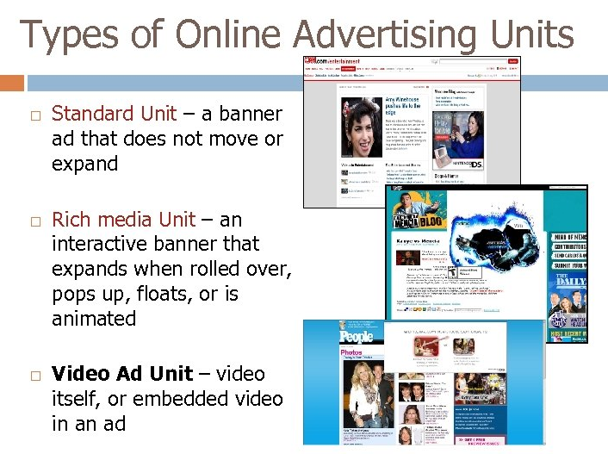

Slide 7
Role of Online Advertising
Creates interactive with your target consumer
Drives web traffic
Very measurable
Rich media and video ads have better click through rates Extremely targetable

Slide 8
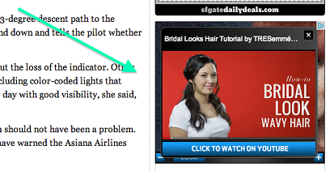
Search Marketing
Largest form of all interactive media ad spending There are 2 kinds of Search:
SEM = Search Engine Marketing. Paid
SEO = Search Engine Optimization. “Free. ”
Role of Search
Provides a consumer convenience:
Manage vast amounts of internet info
Helps consumers pre-shop
Generates greater clicks to your website
Drives “leads” – names of new people, and new business!
Target your message to those who want to search for you

Slide 9

Online Ads: Bought Using CPM
Cost per thousand (CPM) is the basis for buying online advertising
The CPM varies on the type of website and for the quality of the ad:
High traffic sites can charge higher CPM
More interactive, rich media ads have higher CPM

Slide 10
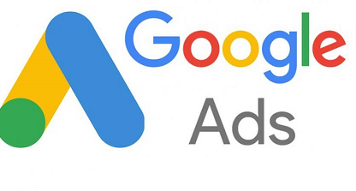
Google Ads
Google Ads
Google Ads allows companies to bid on the placement of an ad on Google's search engine results page.1
﻿By using keywords or common search terms, searches that are related to the business and their products and services appear in the search results. For example, a company that advertises insurance will show up in any search queries for insurance products. The business pays Google if the ad is clicked on, which is why it's called a cost per click basis.2

Slide 11

LinkedIn Advertising
Companies can create a business page and post content, videos, products offerings on their page as a way of reaching the millions of LinkedIn users.
Companies can also place ads on LinkedIn that can be targeted to particular traits or demographics of LinkedIn users.
Other social media sites, such as Facebook and Twitter, offer similar programs like the ones outlined from Google and LinkedIn. With digital advertising, it's important to research and target the specific audience that'll likely buy a company's product or service before placing an ad.

Slide 12

Cell Phone & Mobile Advertising
A dominating force in digital advertising is through mobile devices such as cell phones, iPads, Kindles, and other portable electronic devices with internet connectivity. Current trends in mobile advertising involve major use of social media such as Twitter, Instagram, Snapchat, LinkedIn, and Facebook. Mobile advertising is similar to online advertising and is increasingly gaining importance as a method of reaching new customers.

Slide 13

Print Advertising
Once a huge driver of sales, print is taking a back seat to the many digital forms of advertising now available to marketers. However, if there is one thing that's certain about advertising, it's that being different is good. And when consumers tire of digital ads, a return to printed pieces and the tactile feeling and permanence they provide is definitely in the cards.

Slide 14
Typically, print can be split into three subcategories:
1.Periodical Advertising
If it's in a magazine, a newspaper, or anything else that comes out at regular intervals, then it's periodical advertising (aka a print ad). To grab the center spread of a big magazine or the back cover of a newspaper meant millions of people saw the message.
2. Brochures, Leaflets, Flyers, Handouts, and Point-of-Sale Advertising
3. Direct Mail Advertising
Either of the techniques mentioned above can be incorporated into direct mail. It simply means that your printed pieces are mailed directly to the consumer. This is a technique that has been and continues to be, abused by inferior marketing agencies that have turned the craft into junk mail. If it is creative and intelligently conceived and executed, direct mail can be a fantastic way to engage the customer. Do not count it out.

Slide 15
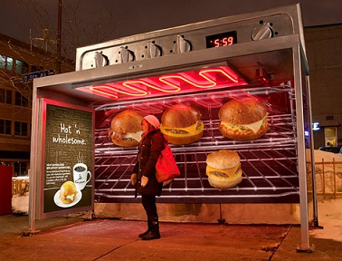
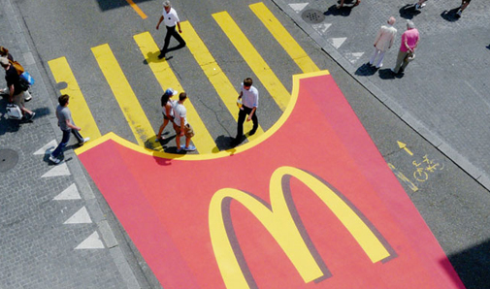
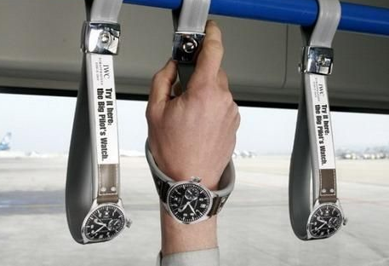
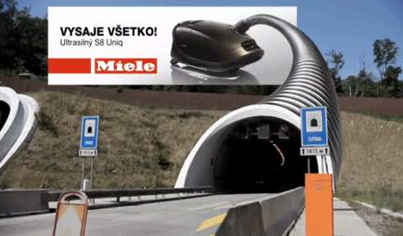
Guerrilla Advertising
Guerilla marketing is born a way of marketing which allows brand differentiation concerning the competition.
By implementing these elements and characteristic points for the clients, like zebra crossing, paper bins, stop lights, stairs or bus stops, it is straightforward that the potential client to notice on the fact that there is something innovative in all
Therefore, it is understood as guerilla marketing those actions that are done with more imagination than money, in which the creativity and the impact on traditional marketing prevails.

Slide 16
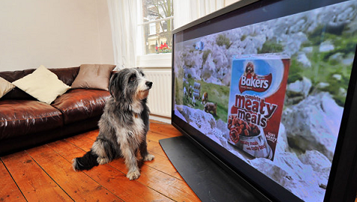
Broadcast Advertising
A mass-market form of communication including television and radio, broadcast advertising has, until recently, been the most dominant way to reach a large number of consumers.

Slide 17
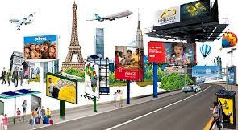
Outdoor Advertising
Also known as out-of-home (OOH) advertising, this is a broad term that describes any type of advertising that reaches consumers when they are away from home. Think of billboards, bus shelter posters, fly posters.

Slide 18
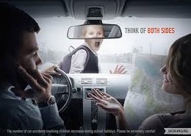
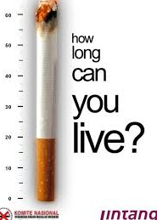
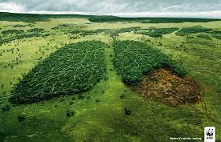
Public Service Advertising
Unlike traditional commercials, Public Service Advertisements (PSA) are primarily designed to inform and educate rather than sell a product or service. PSAs traditionally appear on TV and radio but are also heavily promoted online. The objectives of PSAs are to raise awareness and change public attitudes, opinions, or even behavior towards an issue. These messages can be instructional, inspirational, or even shocking to elicit emotion and action.

Slide 19
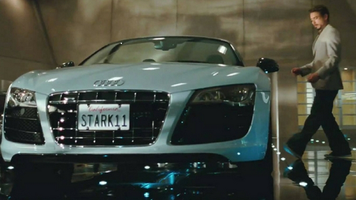
Product Placement Advertising
Product placement is the promotion of branded goods and services within the context of a show or movie, rather than as an explicit advertisement. If you have ever seen a movie and wondered, "Wow, they sure are driving a lot of Fords in this scene," or "Does everyone in this TV show drink Pepsi?" then you are noticing product placement. It's a way that these films and shows get funding, and is a great way for advertisers to reach a targeted demographic.
AUDI IN THE IRON MAN TRILOGY
Google (Search Engine) in The Internship
https://marketsplash.com/product-placement/

