Slide 1
CLASS №1
The technique of qualitative analysis using the semi-micro method
Odessa National Medical University
Faculty of Pharmacy
Department of Pharmaceutical Chemistry
Одеса 2022

Slide 2
Analytical chemistry subject, its place and role among other chemical disciplines
Analytical chemistry is a fundamental chemical science about methods of determining the qualitative and quantitative composition of compounds and their mixtures, as well as establishing the chemical structure of substances.
The subject of analytical chemistry is the study of the theoretical foundations of analysis methods, the development of analytical methods and the practical implementation of analyzes.

Slide 3
Analytical chemistry subject, its place and role among other chemical disciplines
The main tasks of analytical chemistry:
1. Development of the theory of chemical processes, calculation of complex chemical systems based on thermodynamic and quantum chemical concepts using algorithms and computer technology.
2. Study of the relationship between the structure of substances and their chemical-analytical properties; creation of chemical analysis methods based on analytical properties and analytical reactions of substances; increasing the accuracy and correctness of the results of analytical determinations and developing methods for assessing their accuracy and correctness
3. Study of the structure of the most important biologically active compounds, development of bioanalytical chemistry.
4. Development of instrumental methods of analysis; solving the problem of chemical metrology - development and improvement of measurement units, their reproducibility in the form of standards, the use of standard samples of the chemical composition of substances and materials.
5. Chemical and technological control of production at all its stages.

Slide 4
Methods of analytical chemistry
The main method of analytical chemistry is analysis.
Chemical analysis is a set of actions, as a result of which information about the chemical composition of the object is obtained. Means of chemical analysis — reagents, devices, standard samples, etc
The analysis method is a universal and theoretically grounded way of determining the composition, which is based on the relationship between the composition and the property being determined.
Methodology of analysis – application of the method of analysis to a specific object to be determined with a detailed description of all analytical operations.
The analysis methodology may include the following stages:
Sampling
Sample preparation
Obtaining an analytical signal
Results processing and interpretation

Slide 5
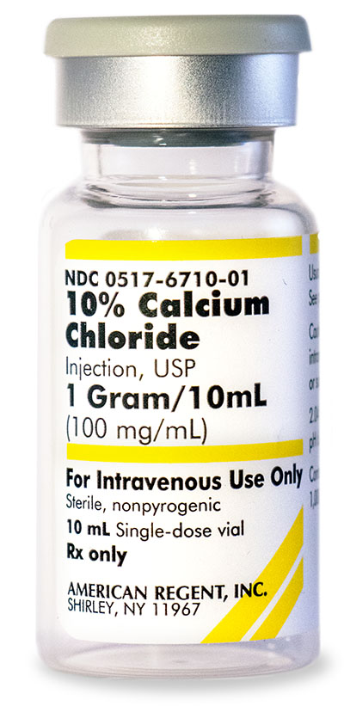
Methods of analytical chemistry
Chemical analysis: qualitatively and quantitatively prove that in ampoules CaCl₂ 10%
Analysis method
For the qualitative determination of:
calcium cations in the solution - test tube reaction with carbonate ion, oxalate ion, potassium hexacyanoferrate (II);
chloride anions - test tube reaction with silver cations.
For the quantitative determination of calcium chloride in a solution, you can use titrimetric methods of analysis: argentometry and complexonometry
Analysis method: add 2 ml of ammonium oxalate solution to 1 ml of calcium chloride solution. We observe the formation of a white crystalline precipitate.

Slide 6
Methods of analytical chemistry
Analysis methods are classified by:
measurable properties of the analyzed substance: chemical, physical and physico-chemical;
ways of solving this or that task – qualitative analysis (identification and detection) and quantitative analysis.
mass of the substance taken for analysis
object of analytical control and purpose of analysis: labeling, rapid or express analyses, arbitration analyses;

Slide 7
macro-, semi-micro-, micro- and ultra-micro methods of qualitative analysis
Analytical methods
Macro-
0.5-1 g of substance or 20-50 ml of solutions
Semi-micro-
Micro-
several milligrams of solid matter or several tenths of milliliters of solution
Ultra-micro
approximately 50 mg of solid or 1 ml of solution
the amount of the substance is less than 1 mg. Almost all analysis operations are carried out under a microscope

Slide 8
Methods of analytical chemistry
Chemical analysis
Qualitative analysis
Quantitative analysis
determination of chemical elements, ions, atomic groups and molecules in the investigated substance
determination of the number of chemical elements, ions, atomic groups and molecules in the substance under study.

Slide 9
Qualitative analysis
Depending on the composition of the studied mixture, the following are distinguished:
analysis of inorganic substances, including determination of cations and anions;
analysis of organic substances, which includes elemental analysis and functional analysis;
molecular analysis – analysis of individual chemical compounds.
In chemical methods of analysis, characteristic qualitative analytical reactions are used. A substance that is used to carry out a qualitative analytical reaction is called a reagent.

Slide 10
Qualitative analysis
Analytical reactions – reactions used in qualitative analysis and based on the transformation of the substance under investigation as a result of interaction with an analytical reagent with the formation of products with characteristic analytical features (effects) (formation of precipitates, colored compounds, dissolution of precipitates, release of gases, formation of crystals of a characteristic shape, appearance or quenching of luminescence, coloration of the flame of a gas burner, etc.).
The reaction used in the qualitative analysis must satisfy the following requirements
run quickly, almost instantly;
be accompanied by an external effect: the formation of a characteristic precipitate, gas or the appearance of color;
to be practically irreversible, i.e. to run mainly in one direction;
be as specific as possible and have high sensitivity.

Slide 11
Qualitative analysis
Detection limit (m_{min} or С_{min}) – the smallest mass or concentration of a substance that can be determined by the certaine analytical reaction.
Minimal (limit) concentration (С_{min})– the lowest concentration of ions or substances at which this reaction still allows to detect them in a small volume of solution (0,01-0,03 cm³).
деV – solvent volume, cm³, per 1 g of substance or ions to be determined.
The limiting dilution (W) is the inverse of the minimum concentration
The relationship between these indicators is defined as follows:
where: m is the opening minimum, µg;
С_{min} — limit concentration, g/cm³;
W— limit dilution;
V_{min} is the minimum volume of the solution required for the determination of the studied ions, cm³.

Slide 12
Conditions affecting the sensitivity of the analytical reaction:
sufficient concentration of the reagent and the analyzed substance in the solution being analyzed;
the presence of an appropriate pH value of the environment;
compliance with the temperature regime;
the volume of the aliquot (the volume of the sample of the analyzed substance) taken for one analysis;
the sequence of adding reagents.

Slide 13
Ways to increase the sensitivity of the analytical reaction:
increasing the concentration of the substance to be determined in the solution being analyzed and the reagent being added;
creation of conditions to accelerate sediment formation (cooling of the solution, introduction of crystallization centers, addition of an organic solvent, etc.);
reducing the solubility of the sediment by adding organic non-electrolytes, for example, ethanol, ether;
the use of masking interfering ions.
Masking is the elimination of the impact of interfering ions by binding them into complex compounds with the help of complexons, tartaric acid, fluoride ion, chloride ion.

Slide 14
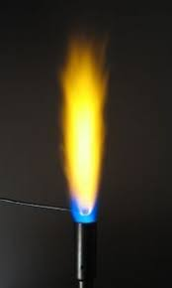
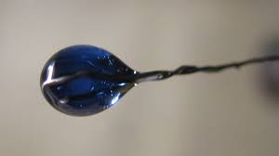
Methods of performing analytical reactions
Analytical reaction
Dry method
Wet
method
the color of the flame
receiving pearls
friction
Wet reactions are fundamental in qualitative analysis. Analytical qualitative reactions between electrolytes occur, as a rule, in aqueous solutions due to the interaction between ions, so they are written in the abbreviated ionic form:
• for strong electrolytes, only the ions that enter into a reaction that lead to the formation of a poorly soluble compound, a weak electrolyte or a gaseous product are recorded, for example:
Ва²⁺ + SO₄^{2 –} →ВаSO₄↓
• weak electrolytes, sparingly soluble and gaseous substances are written in molecular form, for example:
ВаСO₃ + 2СН₃СООН → Ва²⁺ + 2СН₃СОО–
+ Н₂O + СO₂↑

Slide 15
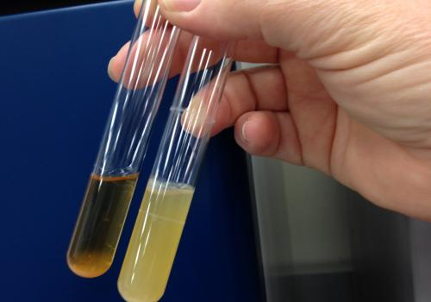
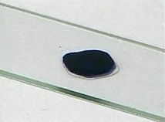
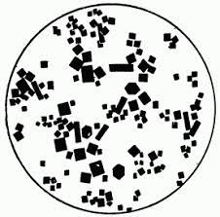
Methods of the technique of performing characteristic reactions by the wet method:
Test tube - the deposition reaction is carried out in centrifuge tubes, which place a few drops of the test solution and add a few drops of the reagent, stir with a glass rod.
Tubeless:
dropwise - by mixing a drop of the test solution and a reagent on a porcelain (ceramic or glass) plate with depressions, on glass or on filter paper or in a drop tube
b) microcrystalloscopic - apply 1-2 drops of the solution under study and 1-2 drops of the reagent, which gives the characteristic formation of crystals that are examined under a microscope
c) extractive.

Slide 16
specific (characteristic), selective and group reactions and reagents:
Specific reactions are reactions that allow one or another substance (ion) to be detected in the presence of other substances (ions).
Characteristic reactions are those reactions in which products with particularly pronounced external features are formed with this type of ions: a pronounced crystal structure of the precipitate or the color of the precipitate; distinct change in the color of the solution; gassing.
Selective reactions are analytical reactions of a reagent with a limited number of ions. The smaller the number of ions that react with a given reactant, the more selective the given reaction and reactant are.
Group reactions are analytical reactions of a reagent with a certain group of ions, allowing to separate this group from other ions.
Group reagents must meet certain requirements:
• quantitatively separate ions according to their analytical groups (residual concentration in the solution should not exceed 10-6 mol/l);
• an excess of group reagent should not interfere with the detection of ions remaining in the test sample;
• the precipitate obtained should be easily soluble in certain reagents for further analysis

Slide 17
Qualitative analysis of cations
In most cases, when analyzing cations, the presence of some ions interferes with the determination of others, because specific reactions exist only for individual ions. In this regard, detection of ions is most often carried out using a systematic course of analysis. There are two methods of analysis: fractional and systematic.
Methods of analysis
systematic
separation of a mixture of ions using group reagents into groups and further detection of ions using selective reactions
fractional
detection of each ion in the presence of others using specific reactions or carrying out reactions under conditions that exclude the influence of other ions.

Slide 18
Qualitative analysis of cations
Systematic method
hydrogen sulfide
is based on the solubility of cation sulfides
ammonia-phosphate
Depending on the group reagent
Number of analytical groups
acid-base
based on the different solubility of hydroxides and some salts formed by cations and strong acids
based on the different solubility of phosphate cations
5
5
6

Slide 19
Qualitative analysis of cations according to acid-base classification
Group | Cation | Group reagent | Аналітичний ефект
I | Na⁺, K⁺, NH₄⁺ | absent | absent
II | Ag⁺, Hg₂²⁺(I), Pb²⁺ | Solution HCl (2 М) | White precipitate
III | Ca²⁺, Sr²⁺, Ba²⁺ | Solution H₂SO₄ (1 М) (+C₂H₅OH) | White precipitates, insoluble in acids and bases
IV | Zn²⁺, Al³⁺, Sn²⁺, Sn⁴⁺, Cr³⁺, As³⁺,As⁵⁺ | Solution NaOH (6М) in the presence 3% Н₂О₂ | Precipitates soluble in an excess of group reagent
V | Mg²⁺, Mn²⁺, Fe²⁺, Fe³⁺, Sb³⁺, Sb⁵⁺, Bi³⁺ | Excess solution NH₄OH | Precipitates not soluble in an excess of group reagent
VI | Cu²⁺, Co²⁺, Hg²⁺(II), Ni²⁺ | Excess solution NH₄OH | Precipitates soluble in an excess of group reagent

