Slide 1
CLASS №2
Basic operations of qualitative chemical analysis
Odessa National Medical University
Faculty of Pharmacy
Department of Pharmaceutical Chemistry

Slide 2
Method and Methodology
Chemical analysis is a set of actions, as a result of which information about the chemical composition of the object is obtained. Means of chemical analysis — reagents, devices, standard samples, etc
The analysis method is a universal and theoretically grounded way of determining the composition, which is based on the relationship between the composition and the property being determined.
Methodology of analysis – application of the method of analysis to a specific object to be determined with a detailed description of all analytical operations.
The analysis methodology may include the following stages:
Sampling
Sample preparation
Obtaining an analytical signal
Results processing and interpretation

Slide 3
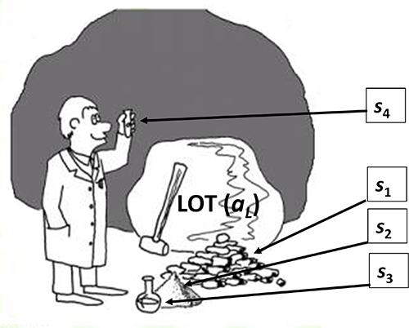
Method and Methodology
Only part of the substance is analyzed in the analytical laboratory. The analyzed substance is called the object of analysis, the element or group of elements that are determined are often called components, and the portion of the substance being analyzed is called the analytical sample or sample.
Requirements for the analyzed sample - it must correspond to the composition of the analyzed object, that is, be representative of the object of analysis.

Slide 4
Sampling
Sampling depends on the aggregate state of the object, homogeneity and particle size.
all
object of analysis
1-50 kg
general sample
25 g – 1 kg
laboratory sample
1 – 10 g
sample for analysis
https://www.youtube.com/watch?v=K7VM-8tiEsM

Slide 5
laboratory sample
preliminary studies
analyzed sample
arbitration (verification).

Slide 6
Sampling
gaseous
liquid
solids

Slide 7
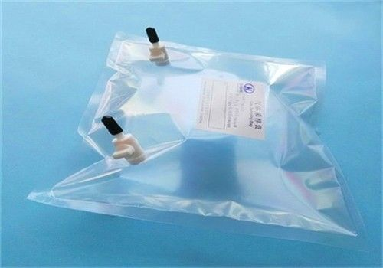
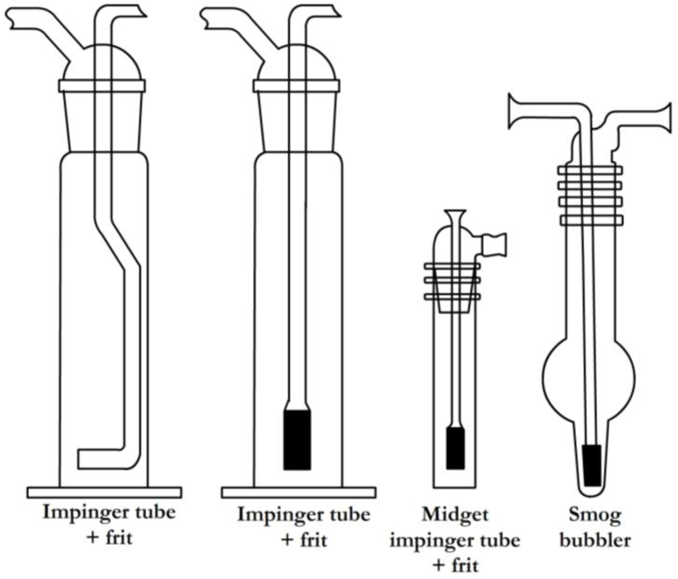
Sampling of substances in a gaseous state
Small samples can be taken in special burette containers, evacuated flasks, pipettes, gas chambers.
For the selection of large volumes of gas samples, the aspiration method is used, that is, air or gas is pumped through solid or liquid absorbers.

Slide 8
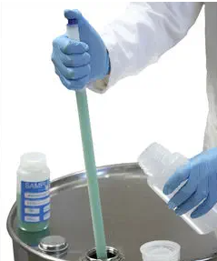
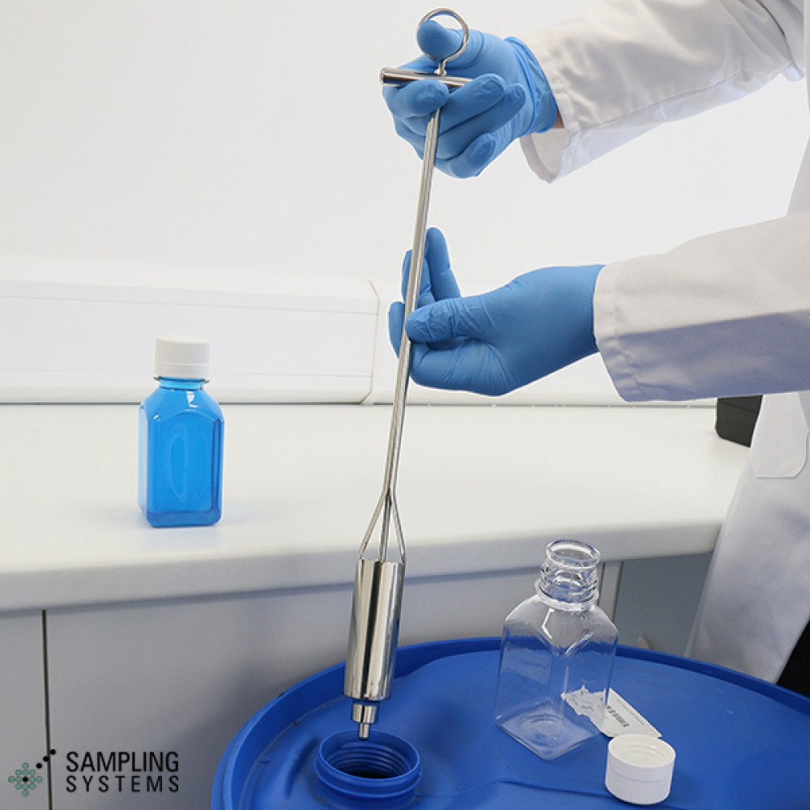

Sampling of liquid substances
Liquids can be homogeneous or heterogeneous. Homogeneous liquids are mixed and samples are taken, volumes are measured with burettes, pipettes, liquid sampler.
It is more difficult to take samples of heterogeneous liquids, they are often stratified, and preliminary homogenization is necessary. It can be mixing, heating, ultrasound action

Slide 9
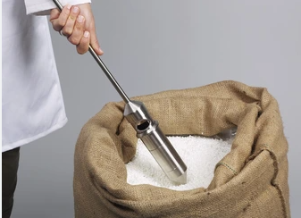
Sampling of solids
The most difficult problem is the sampling of solids, especially with high heterogeneity and different particle sizes.
The main stages of sampling:
1. Selection of a general sample (sometimes up to 50-100 kg).
2. Grinding in special mills.
3. Averaging and selection of a laboratory sample.

Slide 10
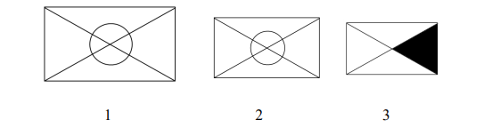
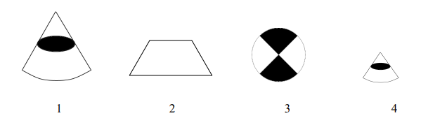
Methods of averaging samples
Samples of solid bulk substances can be averaged by the envelope method, by quartering.
envelope method
by quartering

Slide 11
Sample preparation for analysis
Sample preparation for analysis includes several stages:
1. Drying of the sample.
2. Decomposition of the sample.
3. Elimination of the influence of interfering components: masking, separation.

Slide 12
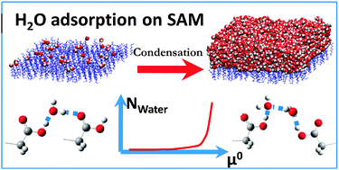
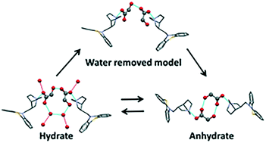
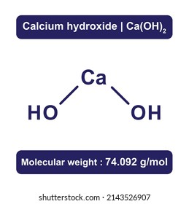
1. Drying of the sample
Unbound water is H₂O, which is sorbed by a substance (hygroscopic moisture)
Chemically bound is crystalline hydrate water - СаС₂О₄·2Н₂О, CuSO₄·5 H₂O.
Constitutional water is included in the structure of the substance Ca(OH)₂, KHSO₄.
When drying the sample, hygroscopic water is removed. They are dried either in air, thereby obtaining an air-dry sample, or in a drying cabinet at 100-105 °C.

Slide 13
2. Decomposition of the sample
For some physical methods of analysis - spectral, X-ray structural - it is not necessary to decompose the sample. But most of the analysis methods are based on conducting a chemical reaction in solutions.
The choice of the method of decomposition of the sample depends on several factors: the nature of the matrix (base) of the substance, and the nature of the determined component. In addition, the method of decomposition also depends on the purpose of the analysis and the chosen method of analysis.

Slide 14
2. Decomposition of the sample
For some physical methods of analysis - spectral, X-ray structural - it is not necessary to decompose the sample. But most of the analysis methods are based on conducting a chemical reaction in solutions.
The choice of the method of decomposition of the sample depends on several factors: the nature of the matrix (base) of the substance, and the nature of the determined component. In addition, the method of decomposition also depends on the purpose of the analysis and the chosen method of analysis.

Slide 15
2. Decomposition of the sample
Dry is fusing, sintering, thermal destruction. For dry decomposition, special substances are used - liquid ones. These are salts and peroxides of alkali metals, sometimes their mixtures are used.
Liquids are alkaline - Na₂CO₃, K₂CO₃, NaOH, Na₂B₄O₇; acidic - K₂S₂O₇, B₂O₃; oxidizing agents – Na₂O₂, Na₂CO₃ + KNO₃, KClO₃.

