Slide 1
CLASS №3
Determination of the purity of medicinal substances
Odessa National Medical University
Faculty of Pharmacy
Department of Pharmaceutical Chemistry

Slide 2
What is an Impurity and Where Does it Come From
According to the ICH guidelines (ICH = International Council for Harmonization of Technical Requirements for Pharmaceuticals for Human Use), an impurity is “any component which is not the chemical entity defined as the active substance or an excipient in the product”
Impurities
Organic
may originate from starting materials, synthetic intermediates, by-products or decomposition products
Inorganic
may arise from the manufacturing process and include catalysts, filter aids, inorganic salts, reagents, etc
Residual solvents
are residues of applied inorganic or organic liquids

Slide 3
The purity estimate refers only to a drug substance synthesized by one specific route. Any change of route may lead to a different impurity profile and must therefore be similarly investigated. The best technique for purity control of the test material is to determine the individual impurities by evaluation against suitable standard solutions of the individual impurities. This technique, however, does require a supply of standard impurities of defined purity. Each development analyst is responsible for finding the most suitable method for the analysis of a well-defined drug substance.

Slide 4
Limits of Impurities
Limits are presented in different ways:
a limit for the total amount of all possible impurities;
limits for individual impurities based upon toxicological properties
actual levels of impurities in batches already manufactured.
Impurities should be kept at as low a level as is reasonably possible and should exceed 0.5% only when purification cannot economically reduce them further.

Slide 5

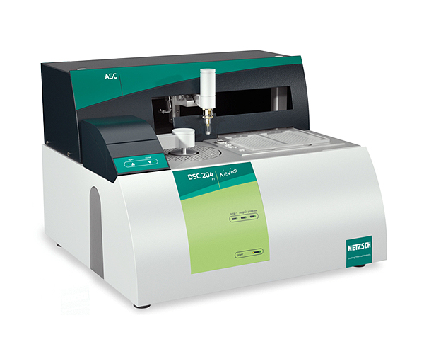
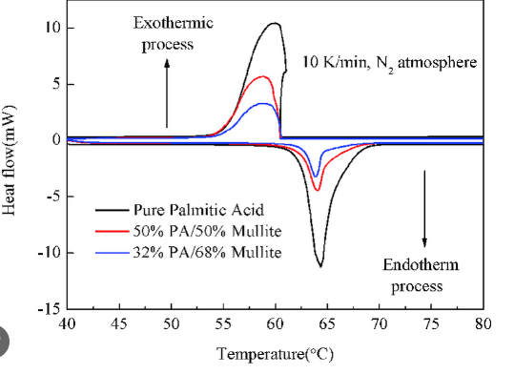
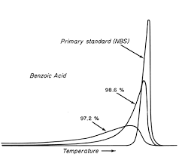
Determination of the unknown impurity
Thermal analysis (TA) may provide information on change of state (e.g. polymorphism, evaporation, transition and melting temperature) and purity of the drug substance. Techniques most often used in TA are differential scanning calorimetry (DSC) and thermogravimetric analysis (TG).

Slide 6
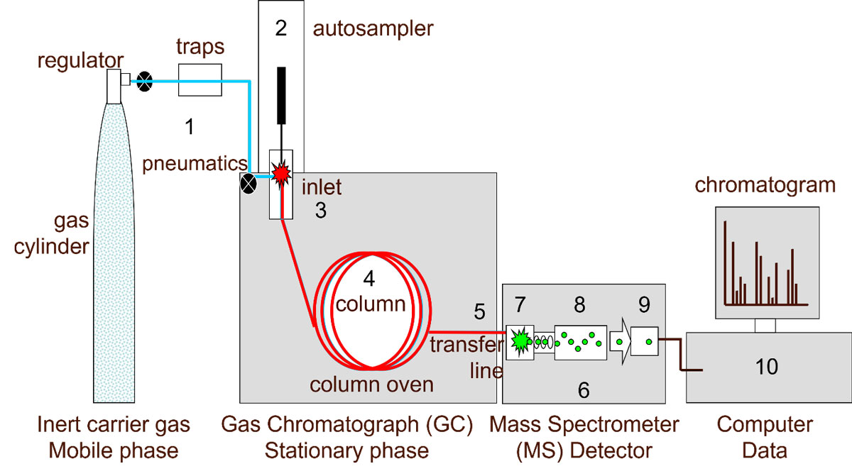
In order to give some meaning to the estimate of purity, batches of the synthesized drug substance are examined under several chromatographic conditions and methods. Structural information on impurities is achieved by chromatography coupled to mass spectrometry (GC-MS or HPLC-MS).
Gas chromatography
The major limitation of GC is that samples or their derivatives must be volatile and thermostable. GC is very well suited for quantitative analysis. For structural studies GC is commonly coupled to a mass spectrometer.

Slide 7
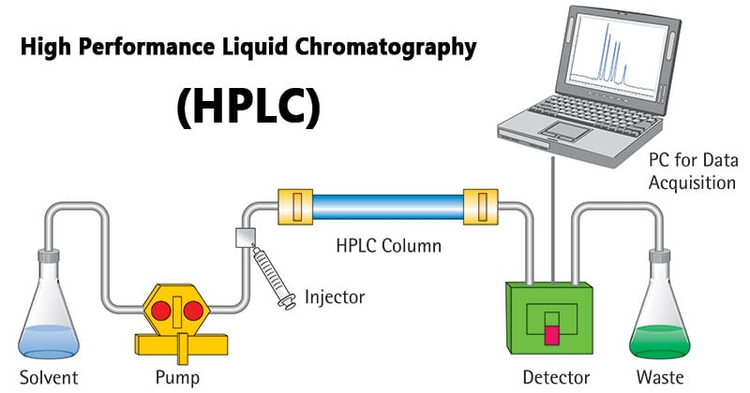
Liquid chromatography
The major advantage of HPLC is that it is a milder method than GC since it operates at ambient temperature. HPLC is suitable for the more polar, less volatile samples that are not amenable to analysis by GC and demonstrate a very high separation power. The introduction of the diode array enables simultaneous measurements to be made at different UV-wavelengths. Despite its high equipment cost, HPLC is often a slow technique even with the use of an autosampler.

Slide 8
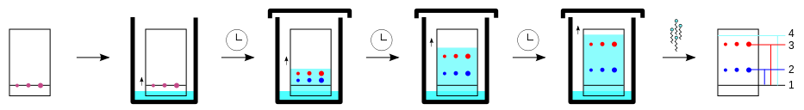
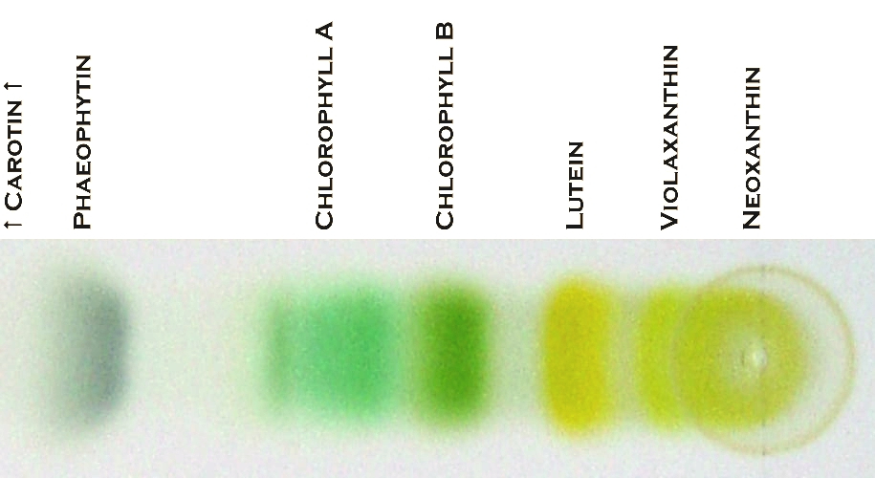
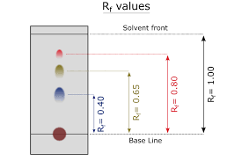
Thin-layer chromatography
TLC is probably the most extensively used method. To visualize the spots on the TLCplate staining with iodine, a UV light source or different specific colour reagents may be used. It offers the advantage of an open bed chromatography.

Slide 9
Testing for the limit content of impurities
Lead Pb²⁺ & heavy metals
Determination of heavy metal admixture is carried out by interaction with the thioacetamide reagent according to a certain method, depending on the nature of the investigated substance:
CH₃–C(S)–NH₂ + H₂O → CH₃COO– + H₂S + NH₄⁺
S²⁻ + Pb²⁺ → PbS↓
The brown color of the tested solution should not be more intense than the color of the standard. Compared to the blank solution, the standard should have a light brown color.

Slide 10
Testing for the limit content of impurities
Ammonium salts NH₄⁺
Method A. The admixture is determined using an alkaline solution of potassium tetraiodomercurate (Nessler's reagent):
After 5 min. The yellow color of the tested solution should not be more intense than the color of the standard.

Slide 11
Testing for the limit content of impurities
Ammonium salts NH₄⁺
Method B. Determination of ammonium salts is recommended to be carried out with paper impregnated with solutions of silver nitrate and manganese (II) sulfate. The solution under investigation is thermostated with heavy magnesium oxide at 40°C.
MgO + H₂O → Mg(OH)₂
2NH₄⁺ + Mg(OH)₂ → 2NH₃↑ + 2H₂O + Mg²⁺
2Ag⁺ + Mn²⁺ + 4NH₃ + 2H₂O → 2Ag↓ + MnO₂↓ + 4NH₄⁺
In parallel, under these conditions, the reaction with the standard solution is carried out.
The gray color of the paper obtained in the experiment with the tested solution should not be more intense than the color obtained in the experiment with the standard.

