Slide 1
CLASS №4
Methods of determining the boiling point, melting point, relative density of a substance and viscosity
Odessa National Medical University
Faculty of Pharmacy
Department of Pharmaceutical Chemistry

Slide 2
Physical properties
Physical properties are are typically observable properties that describe the physical state of matter. In contrast, chemical properties describe the chemical arrangement, composition and reactivity of matter.
Physical properties
Extensive Properties
depend on the "extent" of the system. Volume and mass are extensive, and two gallons of water at 20 deg C have twice the volume and mass as one gallon of water at 20 deg C.
Intensive Properties
do not depend on the "extent" of the system. Density and temperature are intensive, when you combine 2 gallons of water the temperature stays at 20 deg (it does not become 40) and the density stays at approximately 1g/ml. Intensive properties are often constants and can be used to identify a substance.

Slide 3
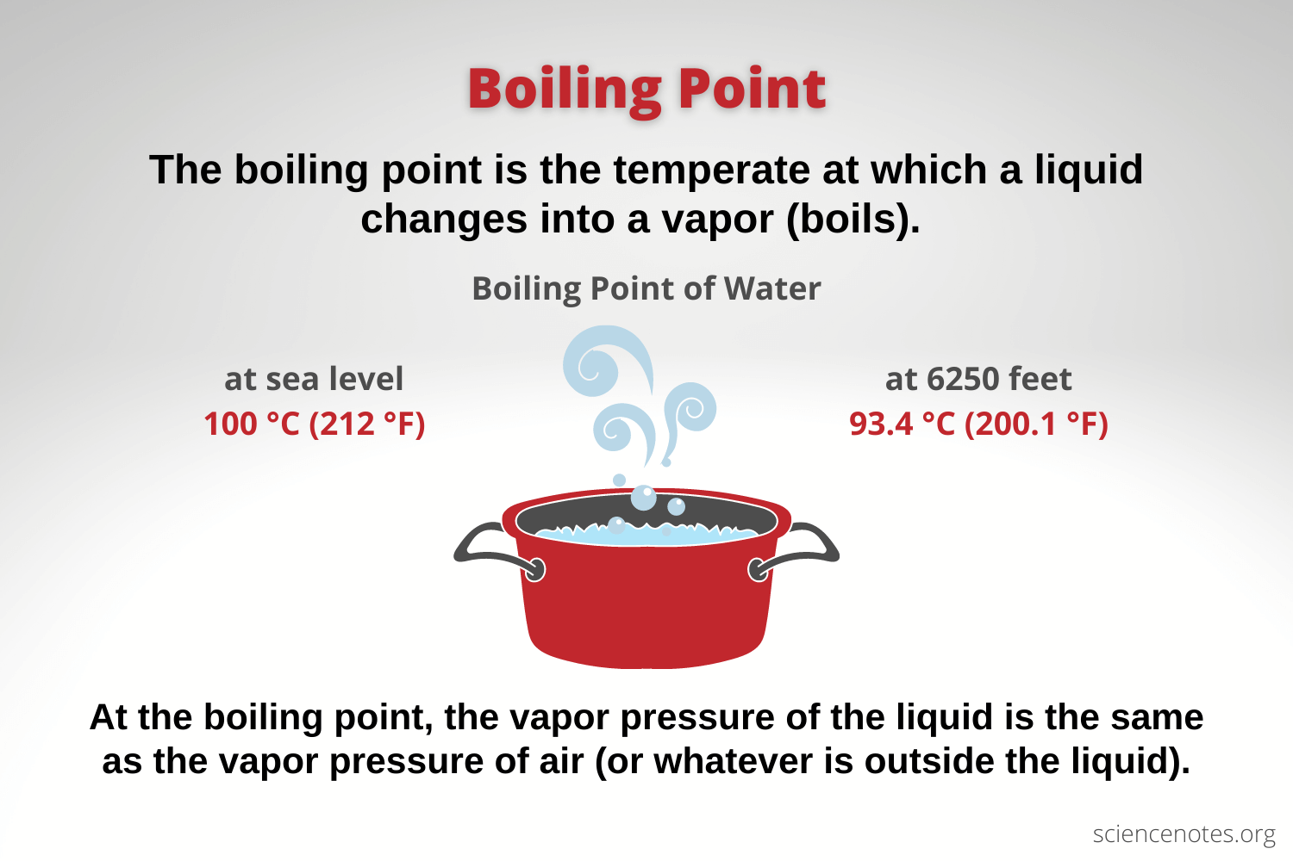

Slide 4
Boiling point
A liquid's boiling point can be determined using the capillary method (Thiele tube), where an inverted capillary is placed in the liquid of interest and the liquid is heated. As the temperature increases, the air in the capillary escapes and is replaced by the vapor of the liquid. The vapor pressure in the capillary increases with temperature. Once it exceeds the atmospheric pressure, the vapor escapes the capillary in a stream of bubbles. When the heat is removed, the liquid cools, and the vapor pressure in the capillary decreases. When the vapor pressure reaches the atmospheric pressure, the liquid begins to fill the capillary. The temperature at which this occurs is the boiling point.
https://www.youtube.com/watch?v=pDmWDOr_3H0&t=216s

Slide 5
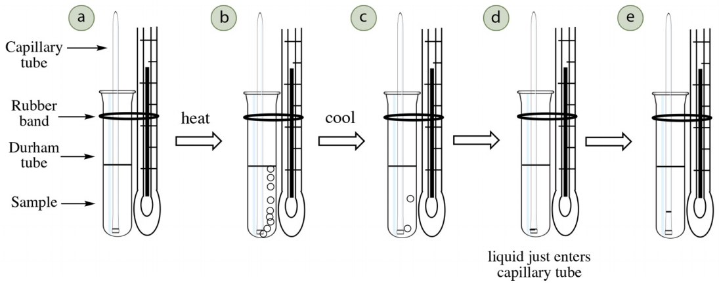

Slide 6
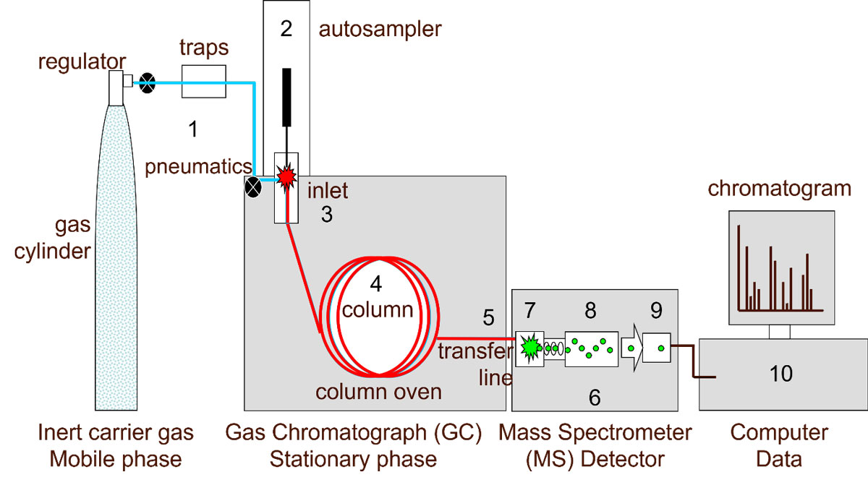
In order to give some meaning to the estimate of purity, batches of the synthesized drug substance are examined under several chromatographic conditions and methods. Structural information on impurities is achieved by chromatography coupled to mass spectrometry (GC-MS or HPLC-MS).
Gas chromatography
The major limitation of GC is that samples or their derivatives must be volatile and thermostable. GC is very well suited for quantitative analysis. For structural studies GC is commonly coupled to a mass spectrometer.

Slide 7
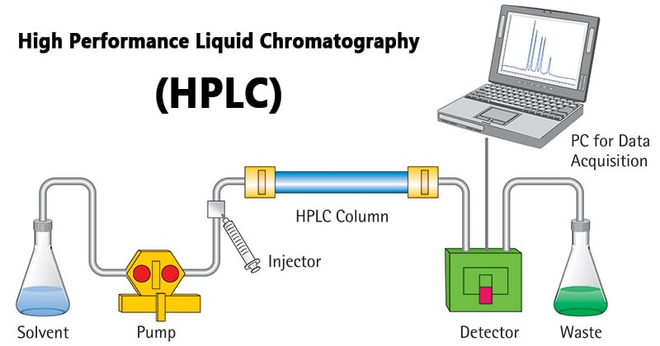
Liquid chromatography
The major advantage of HPLC is that it is a milder method than GC since it operates at ambient temperature. HPLC is suitable for the more polar, less volatile samples that are not amenable to analysis by GC and demonstrate a very high separation power. The introduction of the diode array enables simultaneous measurements to be made at different UV-wavelengths. Despite its high equipment cost, HPLC is often a slow technique even with the use of an autosampler.

Slide 8
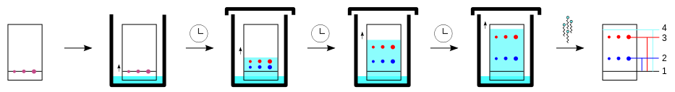
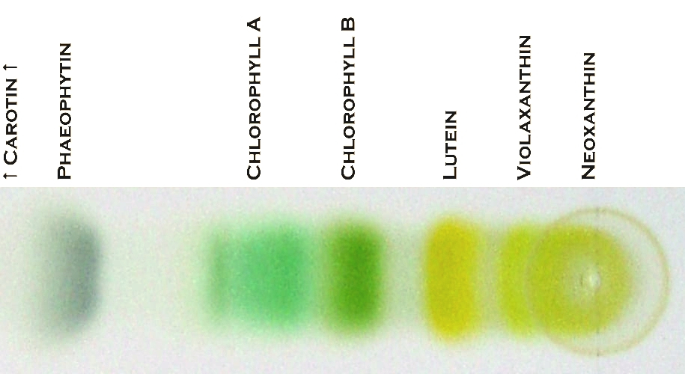
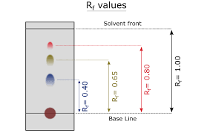
Thin-layer chromatography
TLC is probably the most extensively used method. To visualize the spots on the TLCplate staining with iodine, a UV light source or different specific colour reagents may be used. It offers the advantage of an open bed chromatography.

Slide 9
Testing for the limit content of impurities
Lead Pb²⁺ & heavy metals
Determination of heavy metal admixture is carried out by interaction with the thioacetamide reagent according to a certain method, depending on the nature of the investigated substance:
CH₃–C(S)–NH₂ + H₂O → CH₃COO– + H₂S + NH₄⁺
S²⁻ + Pb²⁺ → PbS↓
The brown color of the tested solution should not be more intense than the color of the standard. Compared to the blank solution, the standard should have a light brown color.

Slide 10
Testing for the limit content of impurities
Ammonium salts NH₄⁺
Method A. The admixture is determined using an alkaline solution of potassium tetraiodomercurate (Nessler's reagent):
After 5 min. The yellow color of the tested solution should not be more intense than the color of the standard.

Slide 11
Testing for the limit content of impurities
Ammonium salts NH₄⁺
Method B. Determination of ammonium salts is recommended to be carried out with paper impregnated with solutions of silver nitrate and manganese (II) sulfate. The solution under investigation is thermostated with heavy magnesium oxide at 40°C.
MgO + H₂O → Mg(OH)₂
2NH₄⁺ + Mg(OH)₂ → 2NH₃↑ + 2H₂O + Mg²⁺
2Ag⁺ + Mn²⁺ + 4NH₃ + 2H₂O → 2Ag↓ + MnO₂↓ + 4NH₄⁺
In parallel, under these conditions, the reaction with the standard solution is carried out.
The gray color of the paper obtained in the experiment with the tested solution should not be more intense than the color obtained in the experiment with the standard.

