Slide 1
Back titration
direct titration
Classification
Titrimetric
Methods
according to
the method of titration
substitution titration

Slide 2
direct titration
the reaction of the interaction of the test substance (A) with the reagent under the conditions of the analysis must be specific;
the interaction between the substance and the titrant must occur stoichiometrically (i.e. proceed strictly according to the reaction equation), with a clear fixation of the end point of the titration;
the reaction must proceed at a sufficient rate and be practically irreversible;
the equilibrium constant must be high enough, the reaction must go to the end, so that the errors that arise from the incomplete reaction do not exceed the allowable values;
the solution should be free of substances that interfere with the course of the main reaction or the fixation of the end point of the titration.
А + Т(titrant) → product

Slide 3
Back titration
slow forward reaction;
there is no corresponding indicator;
possible loss of the analyte due to its volatility.
А + Т₁(excess) → product ₁ + T(remainder)
T(remainder) + Т₂ → product₂
For example, the concentration of an NH₃ solution is determined by back titration due to its volatility. An excess of titrated hydrochloric acid solution is added to the ammonia solution. Unreacted hydrochloric acid is titrated with sodium hydroxide solution..
Back acid-base titration, methyl orange indicator.
NH₄OH + HCl_{excess.} → NH₄Cl + H₂O
HCl + NaOH → NaCl + H₂O

Slide 4
substitution titration
analyte does not interact with this titrant;
the interaction of the analyte and the titrant leads to the formation of a mixture of several products, the quantitative ratio of which is not constant;
titration reaction is not stoichiometrically;
there is no corresponding indicator;
analyte is unstable.
А + В(reagent) → А₁(deputy)
А₁(deputy) + Т → product

Slide 5
substitution titration
For example, potassium dichromate interacts with Na₂S₂O₃ titrant nonstoichiometrically. Therefore, reagent KI is added to a solution of the test substance K₂Cr₂O₇, as a result of which an equivalent amount of iodine is formed, which is then titrated with a standard solution of sodium thiosulfate.
K₂Cr₂O₇ + 6KI + 7H₂SO₄ → 3I₂ + 4K₂SO₄ + Cr₂(SO₄)₃ + 7H₂O
I₂ + 2Na₂S₂O₃ → Na₂S₄O₆ + 2NaI

Slide 6





Calculation formulas in titrimetric analysis
The method of individual measurements :
Pipetting method :
$$\%= \frac{VT × TT/O×КП ×100}{m}$$
$$\%= \frac{VT × TT/O×КП ×100 ×Vм.к.}{m ×Vп}$$
(direct and surrogate titration)
(direct and surrogate titration)
$$\%= \frac{(VT1−VT2) × TT/O×КП ×100}{m}$$
$$\%= \frac{\left(VT1−VT2\right)× TT/O×КП ×100×Vм.к}{m ×Vп}$$
(back titration)
(back titration)
$$TT/O= \frac{Eм ×СN}{1000}$$
Ем – equivalent mass of the substance under investigation; C_{N} – normal titrant concentration.

Slide 7
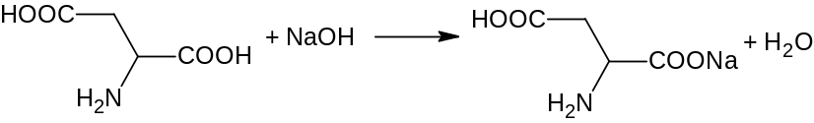





Calculate the weight of glutamic acid (M.m. = 147.13), if 20.06 ml of 0.1 N sodium hydroxide was used for titration by the method of direct alkalimetry, Cf = 1.0000. The percentage content of the active substance is 99.1 %
given:
М.м. = 147,13
V_{(titrant)} = 20,06 ml
C_{N} = 0,1N
Cf = 1,0000
% = 99,1%
The solution:
1. Calculation formula :
$$\%= \frac{VT × TT/O×Cf ×100}{msubstunce}$$
2. Reaction equation :
3. Calculation of the titer of the titrant by the determining substance:
Find :
m_{substunce}- ?
$$TT/O= \frac{Eм ×СN}{1000}$$
$$TT/O= \frac{147,13 ×0,1}{1000}=0,0147 г/мл$$
4. Calculation of the mass of the active substance:
$$m= \frac{VT ×Cf ×TT/O ×100}{\%}$$
$$m= \frac{20,06 ×1,0000 ×0,0147 ×100}{99,1}$$
m = 0,297 г

Slide 8




Calculate the percentage content of diphenhydramine (M.m. = 291.82) in the substance, if 10.49 ml of 0.1N perchloric acid solution was used for the titration of the weight (0.2976 g). Cf = 1.0018. The volume of the titrant in the control study is 0.36 ml.
given:
М.м. = 291,82
m = 0,2976 g.
V_{(titrant)} = 10,49 ml
C_{N} = 0,1N
Cf = 1,0018
Vc = 0,36 ml.
The solution:
1. Calculation formula:
$$\%= \frac{(VT −Vc) × TT/O×Cf ×100}{msubstunce}$$
2. Reaction equation:
3. Calculation of the titer of the titrant by the determining substance:
$$TT/O= \frac{Eм ×СN}{1000}$$
$$TT/O= \frac{291,82 ×0,1}{1000}=0,0292 г/мл$$
Find:
%- ?
4. Calculation of the percentage content of the active substance:
$$\%= \frac{(VT −Vc) × TT/O×Cf ×100}{msubstunce}$$
$$\%= \frac{(10,49 −0,36) ×0,0292×1,0018 ×100}{0,2976}$$
% = 99,5%

Slide 9
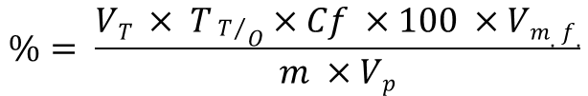
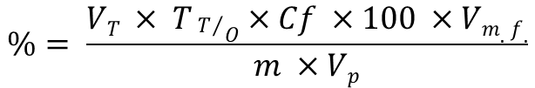
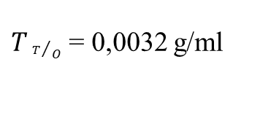


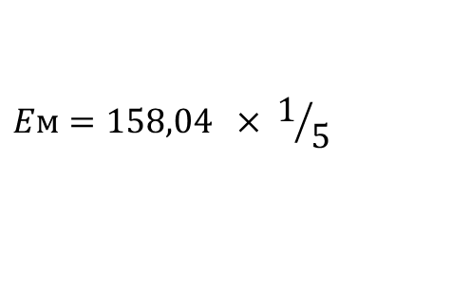


Calculate the weight of potassium permanganate (M.m. = 158.04), if 23.68 ml of 0.1N sodium thiosulfate (Cf = 1.0000) were used for titration by the method of indirect iodometry; the percentage content in the substance is 99.8%. The volume of the measuring flask is 100 ml, the volume of the pipette is 25 ml.
given :
М.м. = 158,04
V_{(titrant)} = 23,68 ml
C_{N} = 0,1N
Cf = 1,0000
% = 99,8%
Vmf. = 100 ml
Vp = 25 ml
The solution:
1. Calculation formula:
$$\%= \frac{VT × TT/O×Cf ×100 ×Vm.f.}{m ×Vp}$$
2. Reaction equation:
KMnO₄ + Na₂S₂O₃ + H₂SO₄ → MnSO₄ + Na₂SO₄ + K₂SO₄ + H₂O
MnO₄⁻ + 8H⁺ + 5e → Mn²⁺ + 4H₂O
3. Calculation of the titer of the titrant by the determining substance :
$$TT/O= \frac{Eм ×СN}{1000}$$
$$Eм=158,04 × 1/5$$
Eм = 31,61
$$Eм=М.м. ×f$$
Find :
m_{substunce} - ?
$$TT/O= \frac{31,61 ×0,1}{1000}$$
$TT/O$ = 0,0032 g/ml
4. Calculation of the suspended mass of the active substance :
$$\%= \frac{VT × TT/O×Cf ×100 ×Vm.f.}{m ×Vp}$$
$$99,8= \frac{23,68 ×0,0032×1,0000 ×100 ×100.}{m ×25}$$
m = 0,3037 г

Slide 10



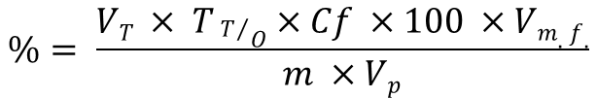
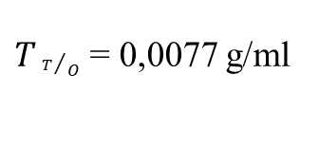
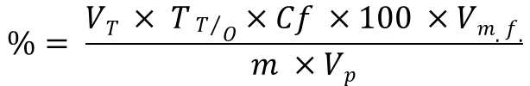
Calculate the percentage content of potassium chloride (M.m. = 77.56) in the substance, if 13.02 ml of 0.1 N silver nitrate solution (Cf = 1.0100) was used for the titration of a weight of 0.9850 g. The volume of the measuring flask is 50 ml, the volume of the pipette is 5 ml.
given :
М.м. = 77,56
m = 0,9850 g.
V_{(titrant)} = 13,2 ml
C_{N} = 0,1N
Cf = 1,0100
Vm.f. = 50 ml
Vp. = 5 ml
The solution:
1. Calculation formula:
$$\%= \frac{VT × TT/O×Cf ×100 ×Vm.f.}{m ×Vp}$$
2. Reaction equation:
KCl + AgNO₃ → AgCl↓ + KNO₃
3. Calculation of the titer of the titrant by the determining substance:
$$TT/O= \frac{Eм ×СN}{1000}$$
$$TT/O= \frac{77,56 ×0,1}{1000}$$
$TT/O$ = 0,0077 g/ml
Find:
%- ?
4. Calculation of the percentage content of the active substance:
$$\%= \frac{VT × TT/O×Cf ×100 ×Vm.f.}{m ×Vp}$$
$$\%= \frac{13,2 ×0,0077×1,0100 ×100 ×50.}{0,9850 ×5}$$
% = 99,5%

Slide 11





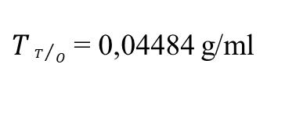
Calculate the volume of 0.1N sodium edetate (Cf = 0.9998), which will be used for the titration of 0.7422 g of calcium gluconate (M.m. = 448.4), if the percentage content in the substance is 99.7%.
given :
М.м. = 448,4
m = 0,7422 g.
C_{N} = 0,1N
Cf = 0,9998
% = 99,7%
The solution:
1. Calculation formula:
$$\%= \frac{VT × TT/O×Cf ×100}{m}$$
2. Calculation of the titer of the titrant by the determining substance:
$$TT/O= \frac{Eм ×СN}{1000}$$
$$TT/O= \frac{448,4 ×0,1}{1000}$$
$TT/O$ = 0,04484 g/ml
Find:
V_{T} - ?
3. Calculation of the percentage content of the active substance:
$$\%= \frac{VT × TT/O×Cf ×100}{m}$$
$$99,7= \frac{VT ×0,04484×0,9998 ×100}{0,7422}$$
V = 16,67 ml

