Slide 1
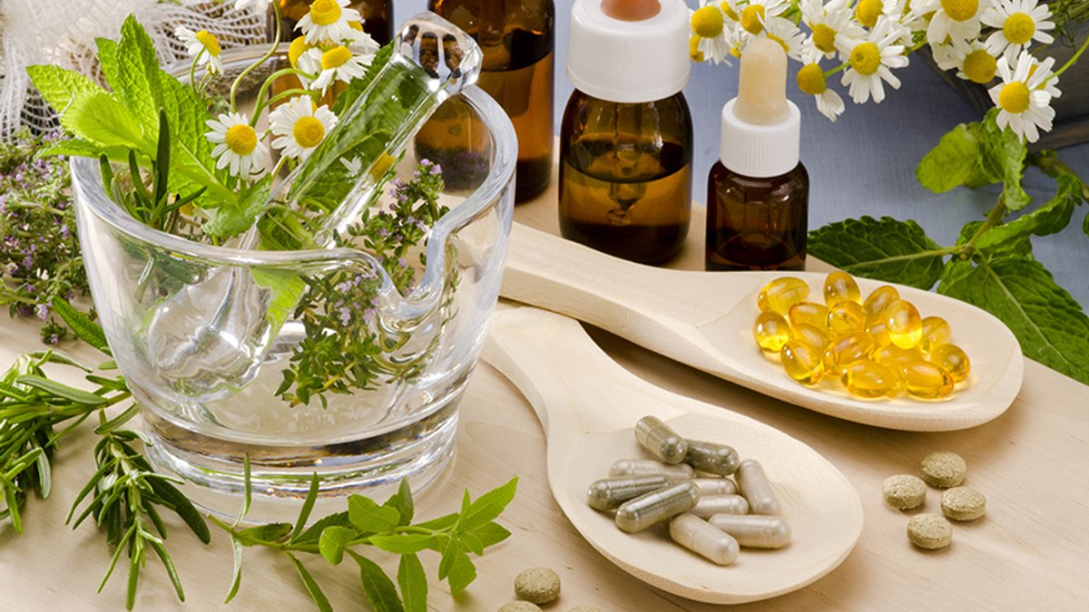

Preparation of homeopathic mother tinctures according to SPhU and control of their quality.
ODESSA NATIONAL MEDICAL UNIVERSITY
DEPARTMENT OF PHARMACEUTICAL CHEMISTRY AND DRUGs TECHNOLOGY
Discipline: Homeopathy
doc. Fizor N.S.

Slide 2
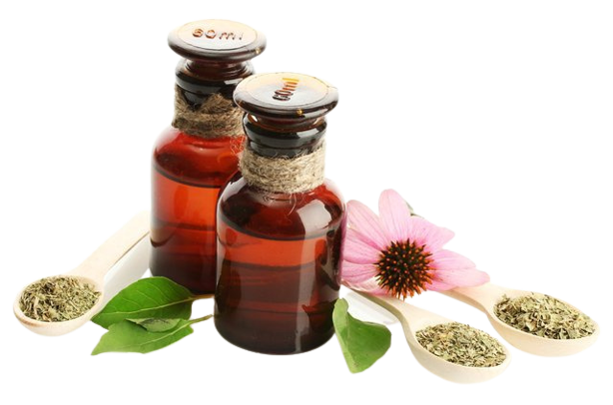
1. Introduction
Homeopathy is: individual regulatory therapy (a form of drug regulatory therapy) that stimulates and normalizes the body's defenses. Its purpose is to influence the processes of self-regulation of the body with the help of drugs selected strictly individually, taking into account the reactivity of the patient.

Slide 3
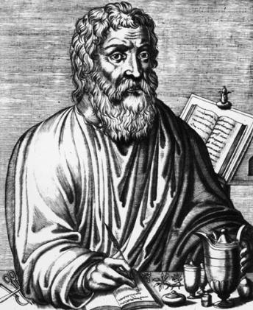
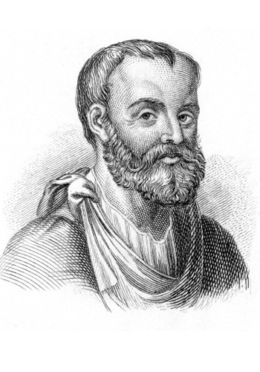
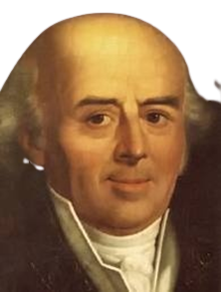
1. Introduction
The historical roots of homeopathy go back to antiquity. The first to begin the creation of scientific medicine was Hippocrates (460-375 ), who laid the foundations of clinical medicine and first formed the principles of treatment of "like like" and "opposite to opposite". (Diarrhea, for example, could be treated by a substance that caused constipation, such as aluminum hydroxide.)
The famous Roman physician and naturalist Galen (131-200 gg.) proposed the use of extracts of various parts of plants, ie methods of preparation of tinctures, extracts, oils and alcohols, which are then used in both allopathic and homeopathic pharmacy. Galen based his treatment on the principle of opposites, divided the drugs according to the symptoms of diseases - painkillers, hypnotics, laxatives, etc.
The founder of homeopathy, as an independent system of treatment in medicine, is rightly considered a German scientist - Friedrich Christian Samuel Hahnemann.

Slide 4
2. Fundamental principles of homeopathy
Fundamental principles of homeopathy
The principle of similarity
Homeopathic doses
Potentiation (dynamization)
Hahnemann believed that, in order to cure disease, one must seek medicines that can excite similar symptoms in the healthy human body. This idea is summarised in the Latin phrase «similia similibus curentur», often translated as ‘let like be treated with like’.
Thus a medicine such as Coffea tosta, made from toasted coffee beans, might be used to treat insomnia.
Doses that cause painful but not toxic effects in the body are called large doses, and doses that treat the same phenomena are called small
As the number of dilutions increases, the content of the substance or its concentration decreases in each subsequent dilution

Slide 5
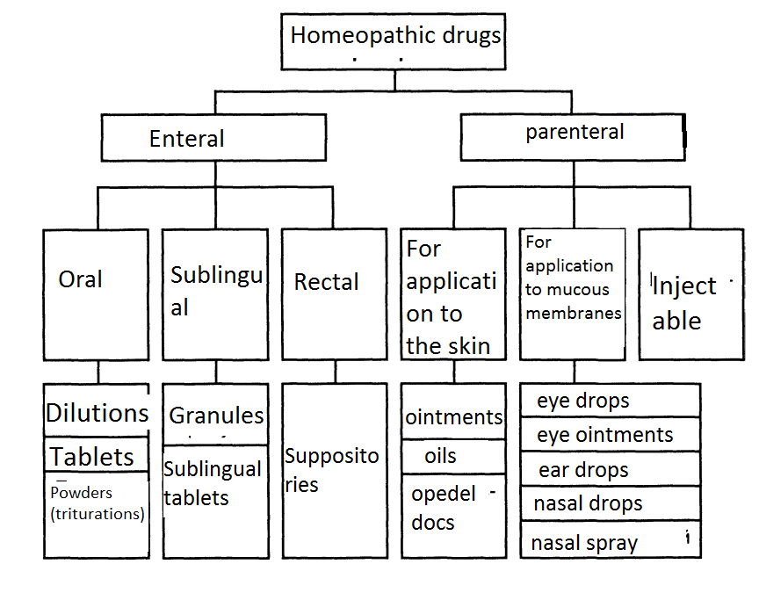
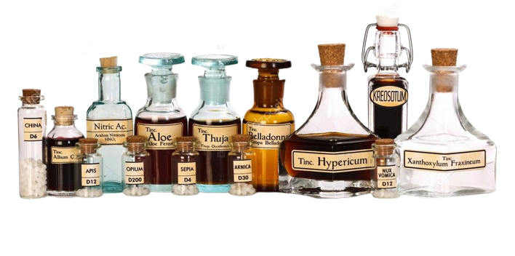
Classification of homeopathic remedies by method of administration

Slide 6
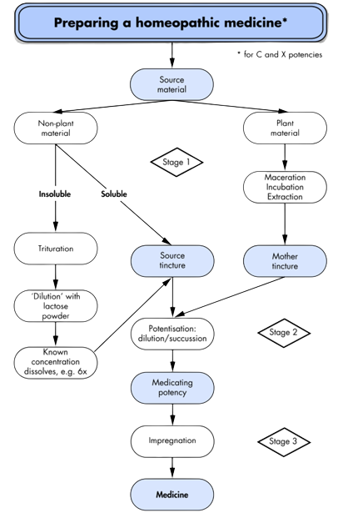
Summary of the manufacturing process.

Slide 7
Basic preparations
Basic preparations - substances, products or preparations used as starting materials for the production of homeopathic medicines.
Basic preparations are usually:
for raw materials of plant, animal or human origin - matrix tincture or glycerin macerate;
for raw materials of chemical or mineral origin - directly the substance itself.

Slide 8
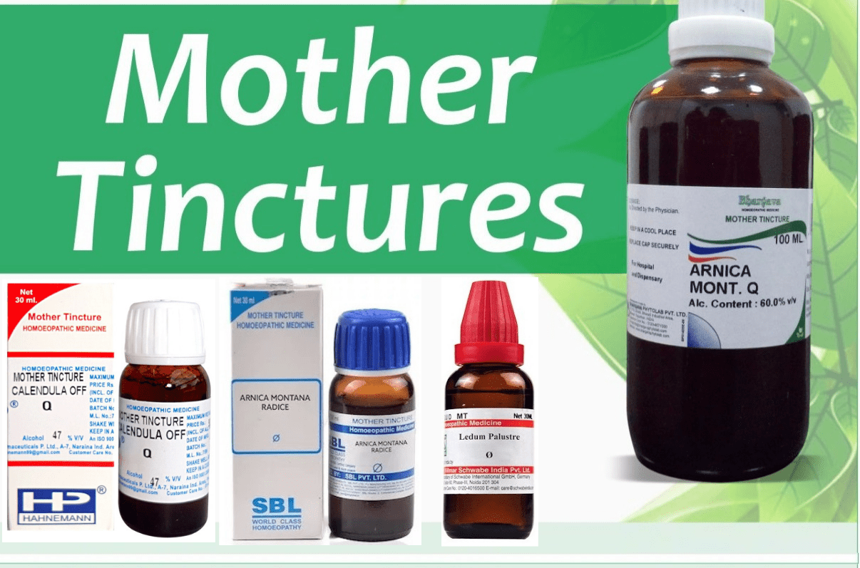
Definition of matrix tinctures (Tincturae maternae)
Mother tinctures are the liquid preparations resulting from the extraction of suitable source material with alcohol/water mixtures which form the starting point for the production of most homeopathic medicines.
If a mother tincture is prescribed, the abbreviation Ø is often used.
Raw materials of plant (freshly harvested or dried) or animal origin are used as raw materials for obtaining homeopathic matrix tinctures.
All homoeopathic mother tinctures and solutions (except a few) should be stored in glass stoppered bottles. However, for certain acids, e.g., fluoric acid, glass-stoppered bottles are not appropriate as the acid eats away the glass, however strong it may be.

Slide 9
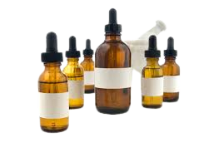
Classification of mother tincture
Dr. Hahnemann classified the drugs obtained from vegetable kingdom and some from animal sources for the preparation of mother tincture into four classes, depending upon their juice content:
• Class - I (most juicy plants).
• Class - II (medium juicy plants).
• Class - III (least juicy plants).
• Class- IV (dried vegetable and animal substances and also from fresh animals).

Slide 10
TECHNOLOGY OF MATRIX TINCTION BY METHOD 1 ACCORDING TO SPhU
Method 1 is used for fresh medicinal plant raw materials, which usually contain more than 70% of squeezed juice and does not contain resin or mucus.
Matrix tinctures made by method 1 are mixtures of equal parts of squeezed juices and 90% ethanol.

Slide 11
ALGORITHM OF MATRIX TINCTURE TECHNOLOGY BY METHOD 1 ACCORDING TO SPhU
1. Fresh MPM
2. Grinding of raw materials
3. Squeeze the juice
4. Weighing
5. Mixing equal parts of juice and 90% ethyl alcohol, shaking
6. Infusion for 5 days
7. Filtering - basic homeopathic drugs
8. Installation in the filtrate of the dry residue and BAS
9. Mixing with the calculated amount of ethanol 45% (Take 2 parts of the essence and 8 parts of 45% ethyl alcohol
The ratio (1: 2).)
10. Standing for 5 days and filtering
11. Registration

Slide 12
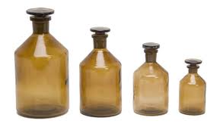
Matrix tincture of stinging nettle - 5.0
Tincturae maternae Urtica urens– 5,0
Technology. The crushed medicinal plant raw materials are squeezed. The resulting juice is weighed and immediately mixed with an equal amount by weight of 90% ethanol. Keep in a closed container at a temperature not exceeding 20 ° C for at least five days, then filtered. Prepared matrix tincture - a basic homeopathic remedy, not subject to release.
Make a label (the name of the raw material in Latin, the designation of the matrix tincture Ø, weight, date of manufacture, the ratio of raw materials and alcohol).This basic drug is then used for the manufacture of homeopathic dosage forms for the treatment of burns and urticaria.
Urtica urens θ
(1:2) 10,0
ethyl alcohol 45 %
02.03.2021 р. (Signature)

Slide 13
Quality control
Quality control of basic homeopathic medicines for internal use is carried out according to general indicators: appearance (transparency, color), odor, relative density, alcohol concentration, identification and quantitative analysis of active substances, if specified in separate articles.
Deviations in the content of medicinal substances in the solution (unless otherwise specified in the articles) should not exceed:
+ 5% with a content of 10% or 1% of the substance (first or second decimal dilution), respectively;
+ 10% with a content of 0.1% of the substance (third decimal dilution).
After the manufacture of homeopathic basic preparations, their weight should not exceed the tolerances.

Slide 14

TECHNOLOGY OF MATRIX TINCTION BY METHOD 2 ACCORDING TO SPhU
Fresh vegetable raw materials, which usually contain less than 70% of squeezed juice and more than 60% of moisture and which do not contain essential oils or resins. Determine the amount of juice X,% in the plant by the formula:
where
a - the moisture content of the raw material
b-dry matter content of juice,%
Simultaneously with determining the amount of juice in the plant, the crushed plant and its parts are weighed. Take half the amount of 90% ethyl alcohol by weight of the plant, moisten the crushed parts with it so that they turn into a thick slurry and grind vigorously.
After determining the juice content, add as much 90% ethyl alcohol so that its weight is equal to the weight of the juice contained in the mass.
The resulting mass is thoroughly mixed and left for 8-14 days for maceration. The mass is squeezed, the liquid is poured into a well-sealed glass and left in a cool place for 8 days to settle, then filtered.
Thus, the content of medicinal substance prepared according to § 2 is equal to 1: 2.

Slide 15
ALGORITHM OF MOTHER TINCTURE TECHNOLOGY BY METHOD 2 ACCORDING TO SPhU
Raw materials
Method 2a
Fresh vegetable raw materials, usually containing less than 70% extracted juice and more than 60% moisture, and not containing essential oils or resins
Alcoholethyl
90%
Alcoholethyl
70%
Method 2b
Fresh vegetable raw materials, usually containing less than 70% extracted juice and more than 60% moisture, and not containing essential oils or resins
Grinding of raw materials
Grinding of raw materials
Determination of weight loss during drying
Determination of weight loss during drying
Weighing
Weighing
Mixing with half the weight of 90% ethyl alcohol
Mixing with half the weight of 70% ethyl alcohol
Calculation of the required amount of 90% ethyl alcohol
Calculation of the required amount of 70% ethyl alcohol
Addition of the remaining 90% ethyl alcohol
Add the remaining 70% ethyl alcohol
Maceration for at least 10 days with periodic stirring
Take 2 parts by weight of the essence and 8 parts of 45% ethyl alcohol and mix.
Squeezing the mixture
Filtering
Quality control
Registration for use

Slide 16
ALGORITHM OF MATRIX TINCTURE TECHNOLOGY BY METHOD 3 ACCORDING TO SPhU
Simultaneously with determining the amount of juice in the plant crushed into a pulp plant is weighed.
Take half the amount of 90% ethyl alcohol by weight of the plant, moisten the crushed part of the plant with it so that it turns into a thick slurry.
After determining the juice content, add the same amount of 90% ethyl alcohol so that its weight is equal to the amount of juice in the plant.
The resulting mass is thoroughly mixed and left for 8-14 days for maceration.
The liquids are drained and the mass is squeezed out with a press.
The two liquids are mixed and placed in a cool place, then filtered.
The essence obtained after filtration should be transparent.
Thus, the content of medicinal substance in the essence prepared according to § 3 is equal to 1: 3
Provides for obtaining a homeopathic matrix tincture from fresh plant materials with a moisture content of less than 60% or containing essential oils, resins and mucus, as well as from fresh mushrooms.

Slide 17
ALGORITHM OF MATRIX TINCTURE TECHNOLOGY BY METHOD 3 ACCORDING TO SPhU
Take 3 parts by weight of the essence and 7 parts by weight of 60% ethyl alcohol and mix.

Slide 18
Preparation of tinctures (tinctures) from dried plants or fresh animal tissues
Method 4
To do this, dry plants are ground into a coarse powder.
Take 1 part of coarse powder and 10 parts by weight of ethyl alcohol (alcohol concentration depends on the instructions of the pharmacopoeia).
The content of medicinal substance in the tincture prepared according to § 4 is equal to 1:10 (corresponds to 1 decimal dilution)

Slide 19
Raw materials
Methods 4a, 4d
Dry vegetable raw materials
Method 4b
Raw materials of animal origin
Method 4c
Processing of vegetable raw materials
Ethyl alcohol of appropriate concentration (96%, 90%, 80%, 70%, 50%, 36%, 18%)
Grinding of raw materials
Weighing
Thorough mixing of 1 part of raw material and 10 parts of ethyl alcohol of appropriate concentration
Settling in a closed container for some time
Preparation by maceration
Preparation by maceration
Separation of residue from alcohol
Percolation at room temperature
Squeezing the mixture
Squeezing the mixture
Connecting liquids
Combining liquid with percolate
Mixing percolate or macerate with the calculated amount of ethyl alcohol of appropriate concentration
Aging for at least 5 days at a temperature not exceeding 200C
Filtering
Quality control
Registration for dispensing

Slide 20

https://www.youtube.com/watch?v=WViJQDHZMkI&t=130s

