Slide 1
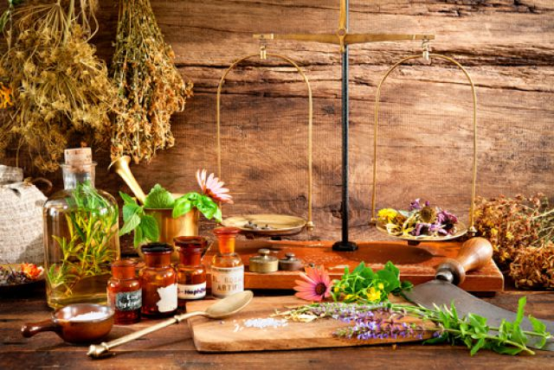

ODESSA NATIONAL MEDICAL UNIVERSITY
DEPARTMENT OF PHARMACEUTICAL CHEMISTRY AND DRUGs TECHNOLOGY
Potentiation of homeopathic mother tincture
Presentation prepared by :
Assoc . Fizor N.S.

Slide 2
Plan
1. Sources raw materials for preparation homeopathic drugs
2. Classification of medicines used in homeopathy.
3. Homeopathic dilution
4. Dynamization , potentiation
5. Work on the preparation of homeopathic medicines
6 . Methods of determining the degree of dissolution of drugs
7. Dilution in decimal and centesimal scale
8. Dilution for the method - according to Korsakov
9. There are the following stages of potentiation
10. Decimal potentials
11. Centisimal potency
12. Potency scale
13. Doses drugs and their frequency reception at homeopathic treatment
14. Terminology
15. Questions for self-control
16. Tests

Slide 3
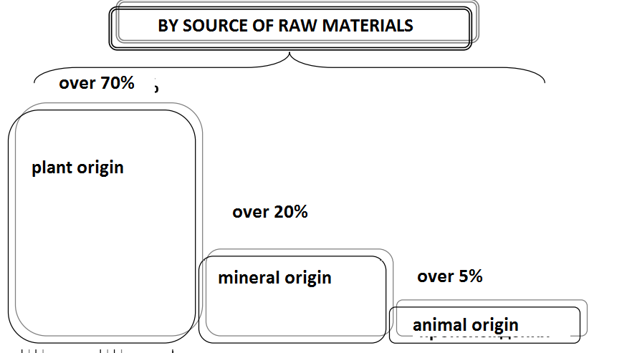
1. Sources raw materials for cooking homeopathic drugs

Slide 4
2. Classification medicinal funds that _ used in homeopathy .
Homeopathic remedies are prepared from basic (basic, or primary) homeopathic remedies with a certain content of medicinal substances.
According to the Homeopathic Pharmacopoeia, the main homeopathic remedies are : essences (45%); tinctures or tinctures (23%); solutions (10%); trituration , or powder rubbing (22%).
Essences (homeopathic matrix tinctures): the source material is fresh juice of plants or their parts, mixed for preservation with 90% - them alcohol .
Tinctures: source material - dried and ground into powder plants or fresh animal substances (bees, ants , etc. ). Extracted with 90 , 60, 45% ethanol , depending on the type of plant by maceration ( soaking) or percolation .
Solutions: the starting materials are preferably soluble salts or acids . Depending on the solubility, they are prepared in the form of aqueous or alcoholic solutions. Rubbing: source material - insoluble minerals, salts, powdered plants or their parts (roots, seeds, etc. ). They are mixed with milk sugar and ground in a mortar for at least 1 hour.

Slide 5
3. Homeopathic dilution
S. Hahnemann made another ingenious discovery - a special way of preparing medicine. S. Hahnemann prepared medicinal substances by successive dilutions, shaking the solution each time. As the number of dilutions increased, the content of the substance or its concentration decreased in each subsequent dilution. In process of consecutive dilutions of medicines and shakes their medical action appears and amplifies. Simple mechanical mixing of the same amount of substance and solvent and creating the same concentration, which was achieved by successive dilutions, does not cause such a therapeutic effect. S. Hahnemann called this method of preparation of drugs " dynamization " ( dinamis - strength). The first dilutions are low, and the next - medium and high.
The working process of preparation of such drugs was called potentiation , and dilution - " potencies ".
Under the term " potency" ( potentia - opportunity, ability ) S. Hahnemann meant "substance that promotes action." He developed the idea of " increasing the strength " of drugs in their dynamization : "Homeopathic dynamization - a real awakening in natural substances of medicinal properties, hidden when this substance is in the untreated state" - he wrote in 1839, ie potentiation - is the development of power or the force hidden in the original gross state of matter.
In modern medicine, this method is used in homeotoxicology , isotherapy , anthroposophy, sanum therapy, in the treatment of Bach drugs, catalysts, metabolites of biochemical processes, nosodes and to remove the blockade of the "great protective system" with chemicals. The latter include common allopathic drugs, such as aspirin, streptomycin, adrenaline, phenobarbital and others.
All these drugs, despite some features in clinical use, are homeopathic.

Slide 6
3 . Homeopathic dilution
Homeopathic dilution (Latin : solutio ( dilutio ) homeopathica ) is a liquid or powdered dosage form obtained from the base drugs by potentiation used for the production of homeopathic preparations, creates the appropriate concentration of substances and provides optimal pharmacotherapeutic effect of drugs selected by similarity. Homeopathic breeding is divided into hundreds, decimal and LM .
Potentiation is carried out by systematic grinding of the substance in its original form. What in homeopathy is performed by sequentially diluting it in a solvent (often in ethyl alcohol) or rubbing with milk sugar. Substances that were initially potent or toxic, by potentiation, decrease in quantity, lose their toxicity and gain healing power.

Slide 7
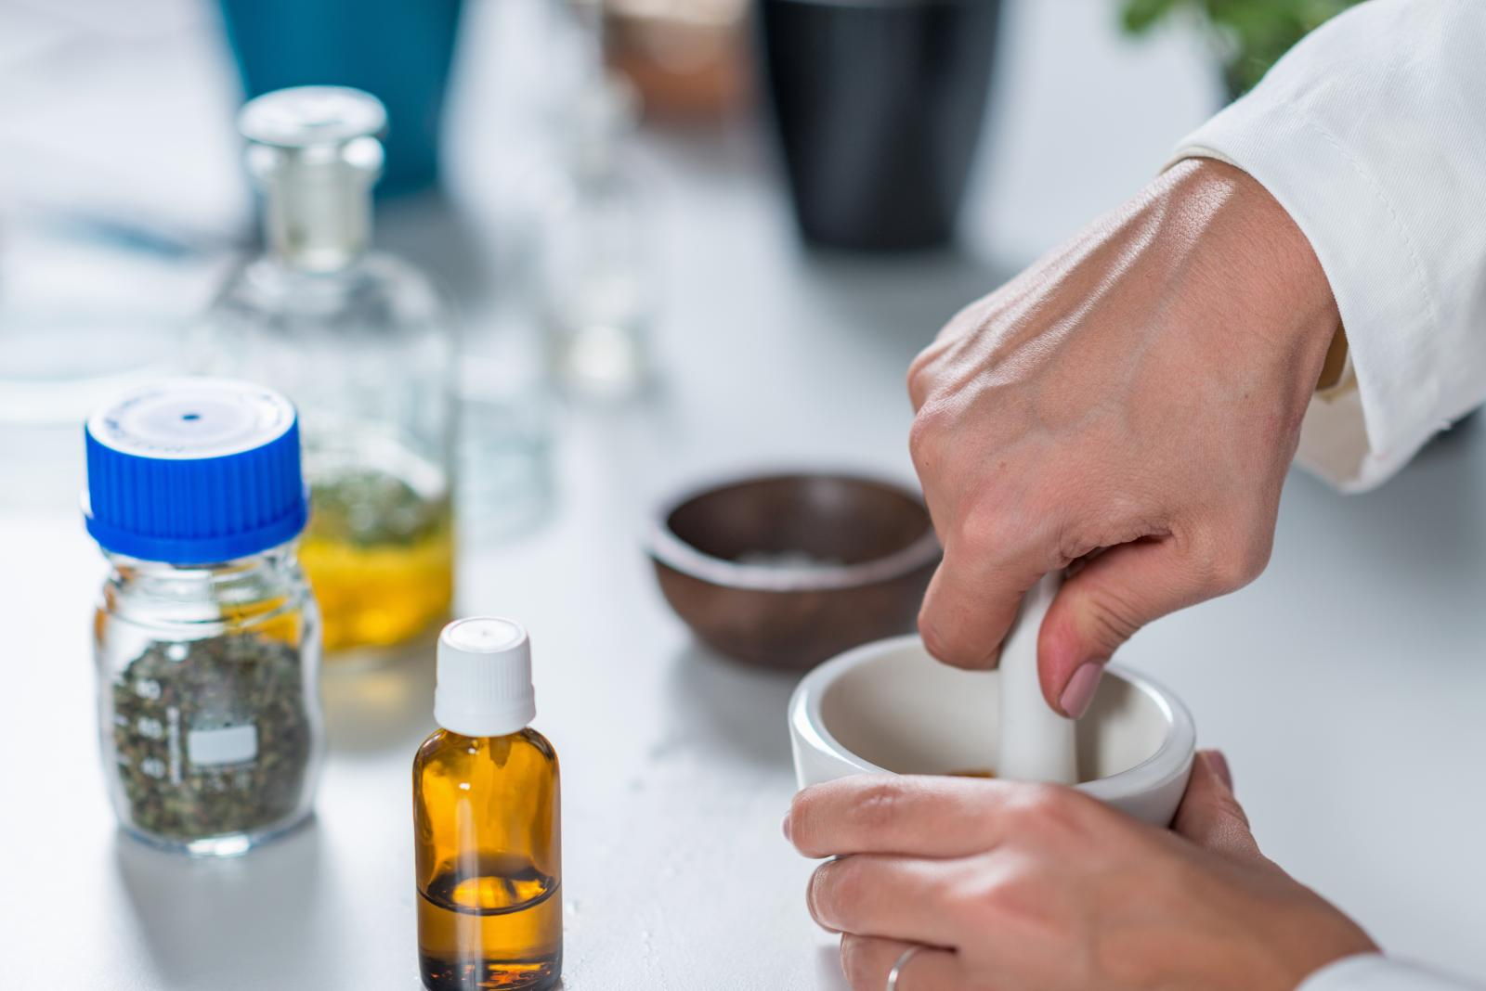
4 . Dynamization , potentiation
Theoretically, the main role in the development of this force is to increase the surface area of the crushed particles of matter. With increasing surface area, the effect of the drug increases. In this case, we can say that the particles, brought to the smallest atomic state, repel each other, which leads to increased action of the substance - dynamization .
Potentiation itself (sequential dissolution and dynamization ) determines the mechanism of action of homeopathic medicines, which at the present stage is represented by 4 directions:
immunostimulating ,
informative,
catalyzing ,
energetic.

Slide 8
5 . Work on the preparation of homeopathic medicines
1) Preparation their source homeopathic drugs ( Fita or Q);
2) potentiation Fit ;
3) preparation of a dosage form of potency.

Slide 9
6 . Methods of determining the degree of dissolution of drugs
In homeopathy, two methods are used to determine the degree of dissolution of drugs:
the decimal (decimal) scale of dilutions is denoted by the letter D or the Roman numeral X (D1, D2, X1, X2);
hundredth ( centisimal ) scale is denoted by the letters C, CH or no letters at all - only the Arabic numeral, which corresponds to the dissolution number (C1, CH1, or 1).

Slide 10
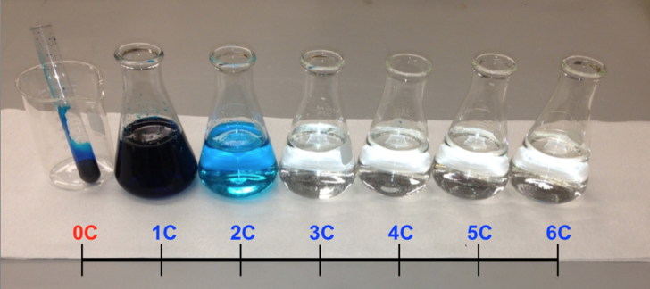
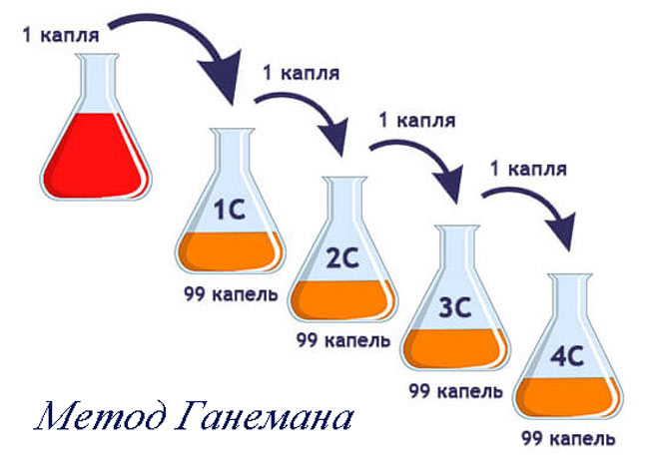
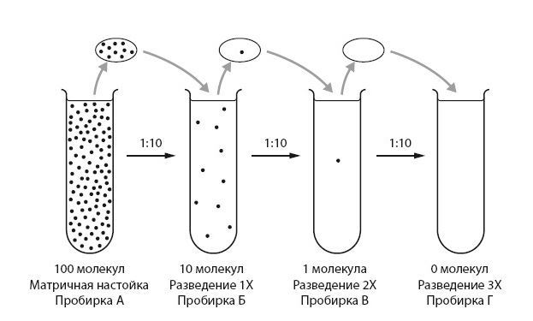
7 . Dilution with a decimal and hundredth scale
Medicine on a decimal scale prepare as follows basic rule: the first decimal dilution should contain 1/10 part medicinal substances (1:10).
Each subsequent dilution is prepared from 1 part of the previous dilution and 9 parts by weight of the indifferent substance (alcohol, sugar, water), ie it is 10 times higher than the previous/.
Dilution drugs on the hundredth scale is carried out according to the following rule: the first hundredth dilution should contain 1/100 part medicinal substances (1: 100).
Each subsequent dilution is prepared from 1 part of the previous dilution and 99 parts by weight of the indifferent substance, ie it is 100 times higher than the previous one.
These examples demonstrate the basic principle of potentiation: from each previous potency a certain part of the substance is added to the next bottle of solvent or mortar with milk sugar, vigorous movements shake 10 times or grind for 10 minutes and so continue potentiation to the required dilution.

Slide 11
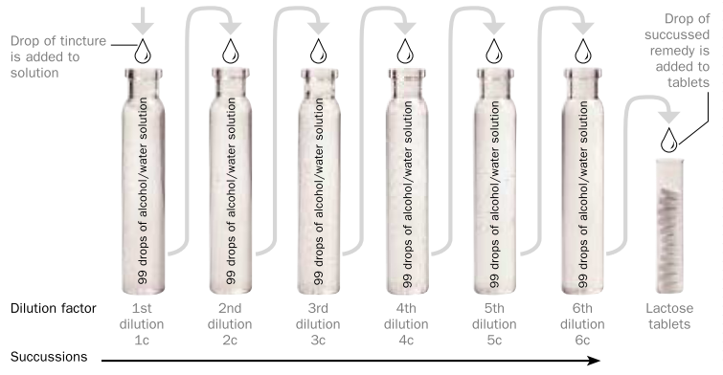
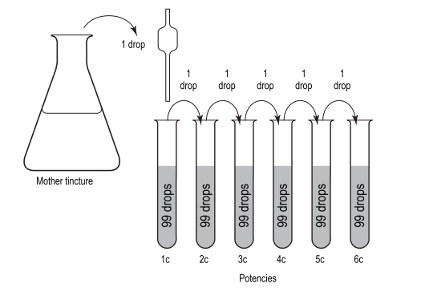
The process of potentiation

Slide 12
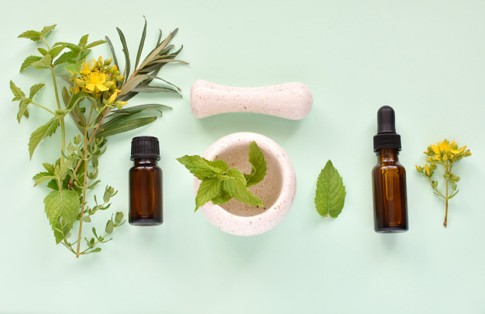
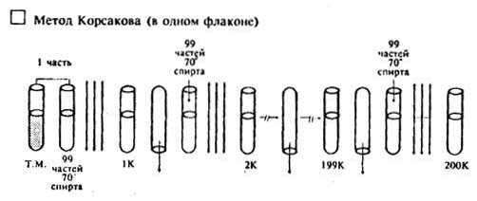
8 . Breeding for the method - according to Korsakov
Along with the stated method of potentiation according to S. Hahnemann , another method is known - according to Korsakov. Russian doctor -homeopath ZN Korsakov in 1829 suggested your own way preparation homeopathic unless day .
By this method step by step dilution is carried out in one flask.
When fast overturning the glass always remains drop liquid ( medicinal substance ), ie always remains information from previous potency previous potency which _ then dissolves 100 times , etc.
For example , in a vial for potentiation weigh 9.9 g of alcohol in necessary concentration and add 0.1 g (3 drops ) of the initial solution , stirred by shaking 10 times , after which is poured into a vessel with the designation C1 (the first hundred dilution ) . Then in the same bottle again weigh 9.9 g of alcohol ethyl and again shake 10 times - pour into a vessel marked C2 (second hundred potency ).
Method Korsakov technically much faster and cheaper than the classic Haneman potentiation in many capacities , although less accurate; used much less often.

Slide 13
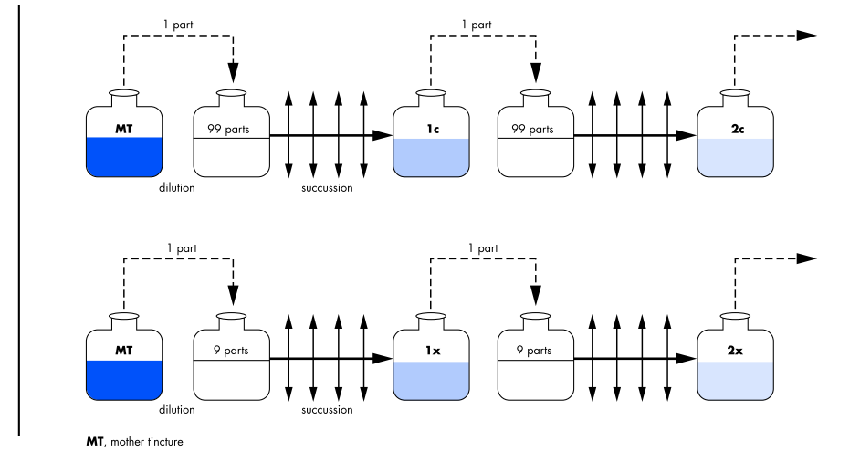

Slide 14
9 . There are the following stages of breeding :
Symbol | The degree of dilution by the step of potentiation
D (X) | Dilution rate 1:10 per potentiation step (decimal)
C (CH) | Degree of dilution 1: 100 per step of potentiation (hundredth)
LM (Q) | Dilution rate 1:50 000 per potentiation step
SC (K) | The degree of dilution 1: 100 per potentiation step (according to the Korsakov method)

Slide 15
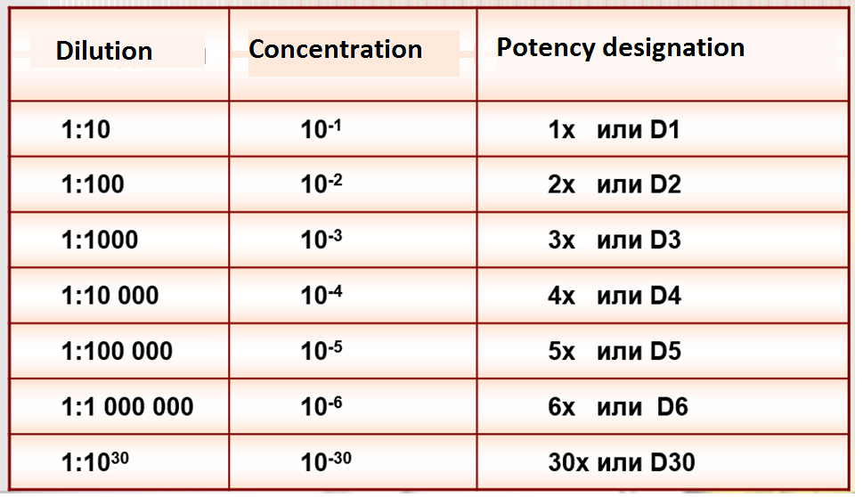
10. Decimal potentials

Slide 16
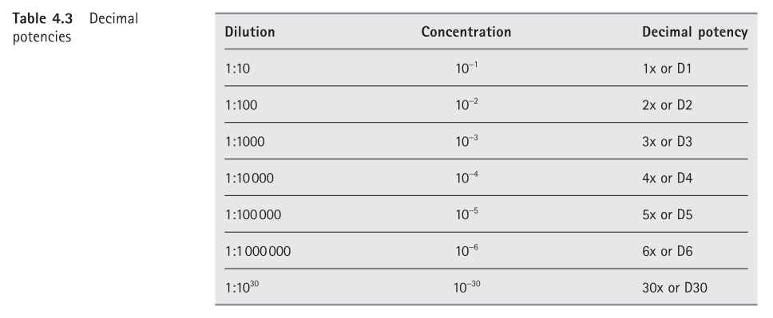

Slide 17
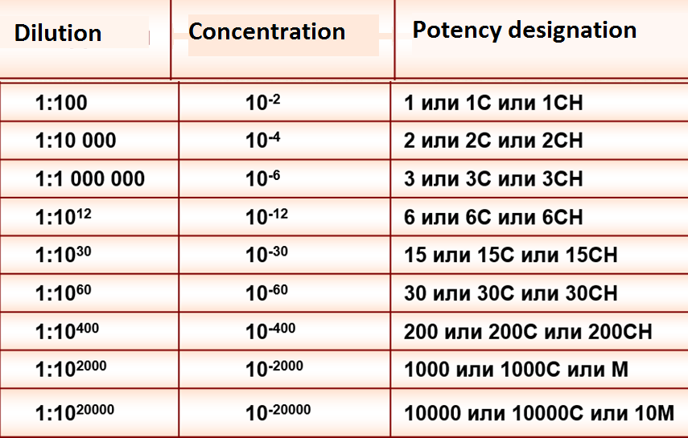
11. Centisimal potentials

Slide 18
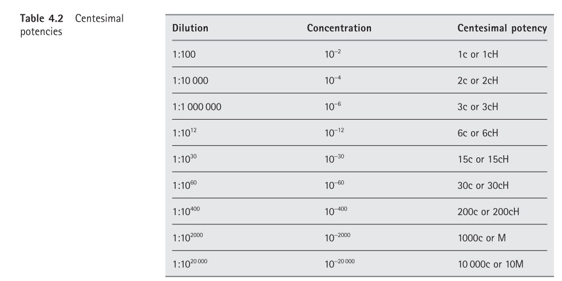

Slide 19
12. Potency scale
№ p / p | Number mixed substances | Number excipient _ | Received correlation | Marking potentials
 | Decimal ( decimal and ) potency
1 | 1 part | 9 parts | 1:10 | XI or D1
2 | 1 part of the 1st potency | 9 parts | 1: 100 | X2 or D2
3 | 1 part of the 2nd potency | 9 parts | 1: 1000 | HZ or D3
4 | 1 part of the 3rd potency | 9 parts | 1:10 000 | X4 or D4
5 | 1 part of the 4th potency | 9 parts | 1: 100,000 | X5 or D5
 | Hundreds ( centisima ) potencies
1 | 1 part | 99 parts | 1: 100 | 1 or C1
2 | 1 part of the 1st potency | 99 parts | 1:10 000 | 2 or C2
3 | 1 part of the 2nd potency | 99 parts | 1: 1000 000 | 3 or NW
4 | 1 part of the 3rd potency | 99 parts | 1: 100,000,000 | 4 or C4
5 | 1 part of the 4th potency | 99 parts | 1:10 000 000 000 | 5 or C5

Slide 20
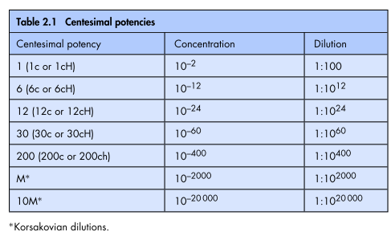

Slide 21
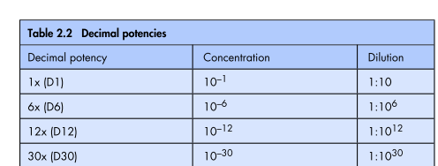

Slide 22

13. Doses drugs and their frequency reception at homeopathic treatment
Potencies of drugs used in clinical homeopathy
low
Tithe potentials
Medium
6C-12C potency
High
Above 18 C potency
Potencies drugs | Values on the scale of dilutions | Levels effects on the body man
Low dilution | +1 - 3 CH | Level fabrics or body, ie symptomatic and local
Medium dilution | 3 CH - 6 CH (others up to 9 CH) | Level systems bodies , ie local - regional and regional
High dilution | 6 CH and above (other than 12 CH) | Level organism as a whole

Slide 23
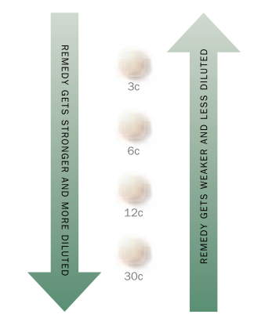
According to Hahnemann's theories , the more dilute the agent, the stronger it is and the higher the amount, or "potency ". Less diluted means are not so strong and have less quantity or potency.

Slide 24

Video
https://www.youtube.com/watch?v=Ymd48YqPzQ0

Slide 25

Video
https://www.youtube.com/watch?v=cmTTfztvsvU

Slide 26
14. Terminology
GD-drug - a drug consisting of complex energy -informational effects of the source substance of plant, animal or mineral origin, providing through the bioresonance effect harmonization of protective bioprocesses in the body.
Dynamization - potentiation (enhancement) of the action of natural matter in the process of its successive dilution and intense shaking.
in GP - similarity of effects of drugs with symptoms of a disease:
true - based on characteristic symptoms, provides therapeutic effect;
formal - based on any symptoms with questionable therapeutic effect.
Potency - the degree of dilution or grinding of the starting material, reflects the number of levels of enhancement of activity:
decimal - based on logarithm 10,
hundredth - based on logarithm 100,
basic - breeding, in which all the symptoms appear in the experiment on healthy people or all the symptoms of the disease disappear in the clinic in patients.
Dilution - reducing the content of the drug due to the greater volume of solvent based on the decimal or hundredth system.

Slide 27
15. Questions for self-control
1. Features and technology potentiation homeopathic matrix tinctures on SFU.
2. The main directions of rationing production homeopathic medicinal drugs .
3. Sources raw materials for cooking homeopathic drugs .
4. Classification medicinal funds that _ used in homeopathy .
5. Assortment homeopathic dosage forms.
6. Necessity creating a GMP document in homeopathy .

Slide 28
16. Tests
1. As in homeopathy are called doses :
A) reproduction
B) stirring
C ) dilution
D ) rarefaction
2. Specify the first basic principle of homeopathy :
A) the principle of similarity
B) the principle of mixing
C) the principle of relief symptoms
D) the principle of using large doses
E) the principle of similarity symptoms
3. Dynamization comes from the word " Dynamis " that means :
A) breeding
B ) strength ( potency )
C ) multiplication
D) shaking
4. Dynamization is : _
A) shaking
B ) homeopathic aggravation
C) life force
D) increase forces number of
5. In the city medicinal substances at the degree dilution C1:
A) 1: 10000
B) 1: 1000
C) 1 : 100
D) 1:10
6. In homeopathy , the sign X (D) denotes :
A)mother tinctures
B) decimal dilution
) hundreds dilution
D) thousands dilution

Slide 29

Thank you!

