Slide 1
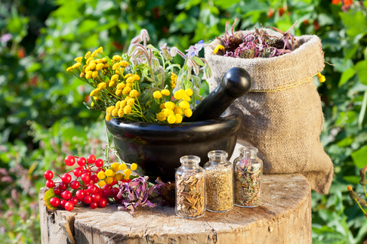

ODESSA NATIONAL MEDICAL UNIVERSITY
DEPARTMENT OF PHARMACEUTICAL CHEMISTRY
AND DRUGs TECHNOLOGY
Dilutions homeopathic . Technology liquid homeopathic dilutions , registration before the dispensing and their control quality .
Presentation prepared by :
Assoc . Fizor N.S.

Slide 2
Plan
GP preparations
Homeopathic breeding
Algorithm of technology of liquid water dilutions (potentials)
A lgorithm of technology of liquid alcohol dilutions (potencies)
Example 1 rp .: Dilutio Aloe X3 - 10.0
DS 5-7 drops 30 minutes before eating
Example 2 rp .: Dilutio rubus C3 - 10.0
DS 7-10 drops according to the schedule
Example 3 rp. : Dilutio magnesium sulfuricum X3 - 10.0
DS 10 drops in the evening 30 minutes before eating
Algorithm of homeopathic oils technology
Example 1 Rp .: Oleum Ledum 10% - 5.0
D. _ S. To lubricate the affected skin surfaces

Slide 3
1. GP preparations
Preparation and preparation of drugs belongs to the section of GP-pharmacy. According to the nature of raw materials, there are about 2,000 items, but the order of the Ministry of Health of the USSR (№166 of 03.08.1989) approved for use 500, of which 378 - basic, the rest - additional. As their lists were reviewed and orders reissued, the number of drugs decreased. In the state register (order №335 of 29.11.1995) there are 266 GP-drugs.
The main sources of HP drugs are:
plants (over 68%),
animals (about 7%) and
minerals (25%).
Among them are those used only in DP: aconite, poisonous fighter Dulkamara (nightshade), heparsulfur (sulfur liver), graphite, lachesus (snake venom), sepia (cuttlefish ink), amber grisea (product of the stomach of a sperm whale). Organs, tissues, dry or live insects, microorganisms, products of their vital activity are used at creation of preparations from animals in DP. Along with drugs of mineral origin, synthetic ones are now used, especially in the creation of modern combined means.

Slide 4
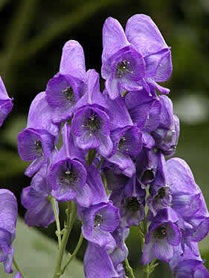
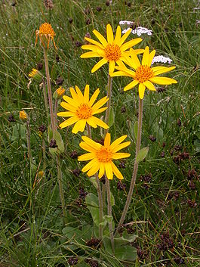
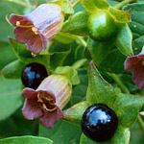
OVERVIEW OF MAIN HOMEOPATHIC DRUGS IV
PLANTS OF VEGETABLE ORIGIN
Aconitum ( Aconitum Napellus )
- Toya ( Poison Fighter)
Arnica mountain ( Arnica montana )
Belladonna _ _ _

Slide 5
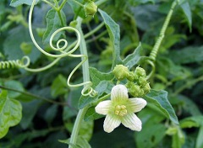
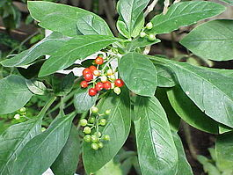
OVERVIEW OF MAIN HOMEOPATHIC DRUGS IV
PLANTS OF VEGETABLE ORIGIN
Brioni alba ( Bryonia alba ) white bryony
Ipecac ( Ipecacuanhae ) - Vomiting root .

Slide 6
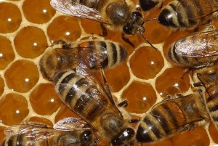
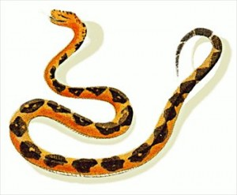
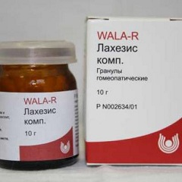
OVERVIEW OF MAIN HOMEOPATHIC DRUGS IV
MEANS OF ANIMAL ORIGIN
Apis . ( Apis mellifica ) - bee
Lachesi ( Lachesi s ) - Poison snakes .

Slide 7
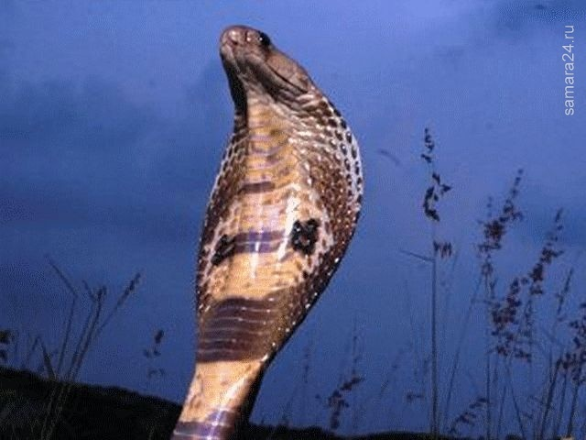
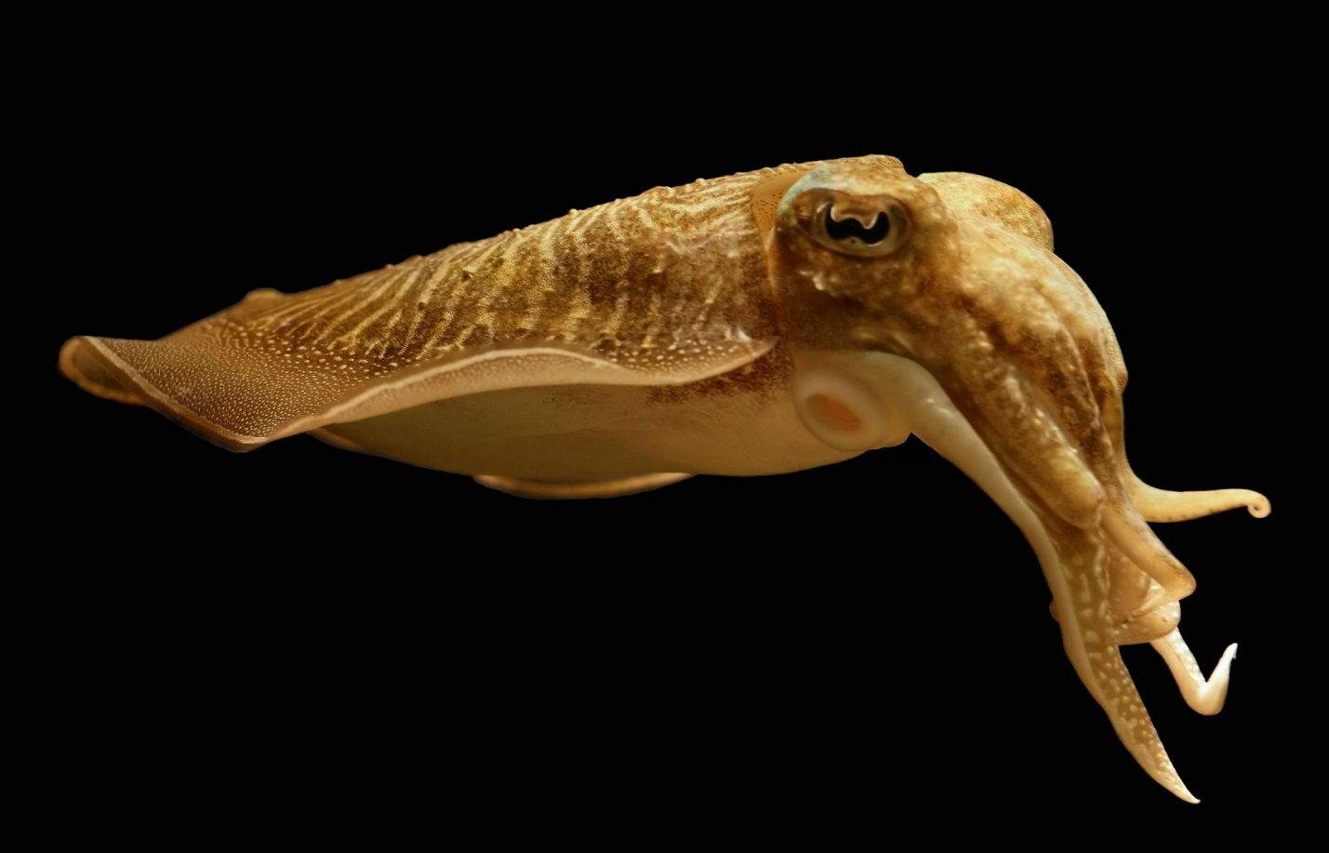
OVERVIEW OF MAIN HOMEOPATHIC DRUGS IV
MEANS OF ANIMAL ORIGIN
Naya ( Naja tripudans ) - Cobra venom.
Sepia ( Sepia ) - Sepia or ink cuttlefish

Slide 8
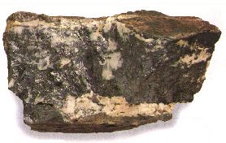
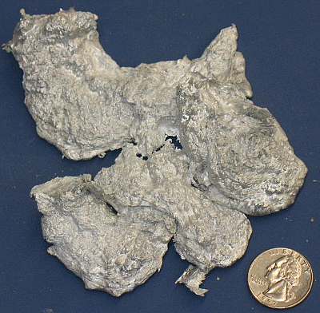
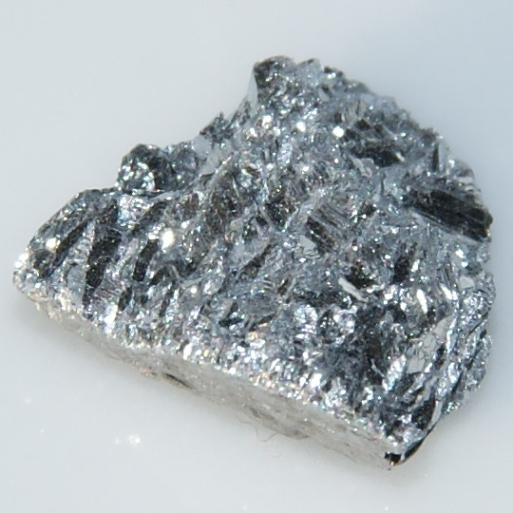
OVERVIEW OF MAIN HOMEOPATHIC DRUGS IV
MEANS OF MINERAL ORIGIN
Alumina ( Alumina ) -
Alumina - alumina .
Antimony tartaricum ( Antim onium tartaricum ) - Vomiting stone .
Argentum nitricum ( Argentum nitrikum ) - Nitric acid silver l o .

Slide 9

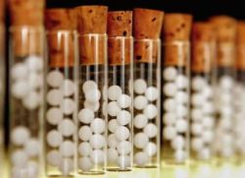
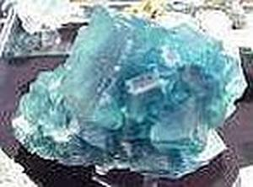
OVERVIEW OF MAIN HOMEOPATHIC DRUGS IV
MEANS OF MINERAL ORIGIN
Aurum ( Aurum ) - Gold . For homeopathic goals use precipitation gold. Very fine powder.
Cheetah sulfur . ( Hepar sulfur ) - Sulfur liver
It connection sulfur with calcium in 1768 described by Curton . It has no natural analogue
Calcarea fluorine . ( Calcarea fluorica ) - Calcium fluoride
Fluoride compounds calcium . The first three dilution are prepared in rubs .

Slide 10
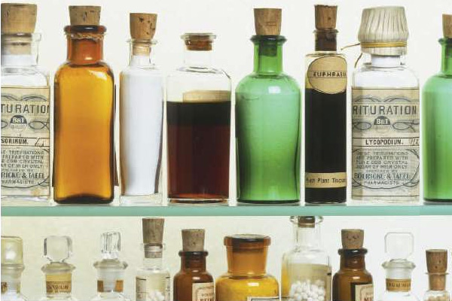
2. Homeopathic breeding
Homeopathic dilution (Latin: s olutio ( dilutio ) homeopathica ) is a liquid or powdered dosage form obtained from the base preparation by potentiation used for the production of homeopathic preparations, creates the appropriate concentration of substances and provides optimal pharmacotherapeutic effect of drugs selected by similarity. Homeopathic breeding is divided into hundreds, decimal and LM -breeding .
DILUTIONS - liquid dosage forms, which are prescribed in drops for resorption in the oral cavity.

Slide 11
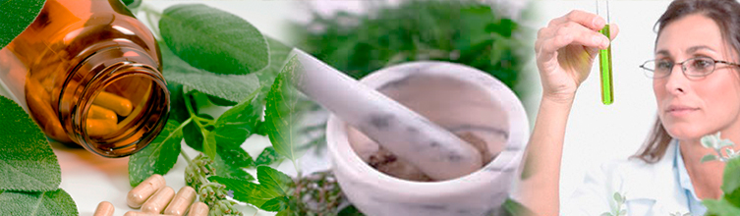
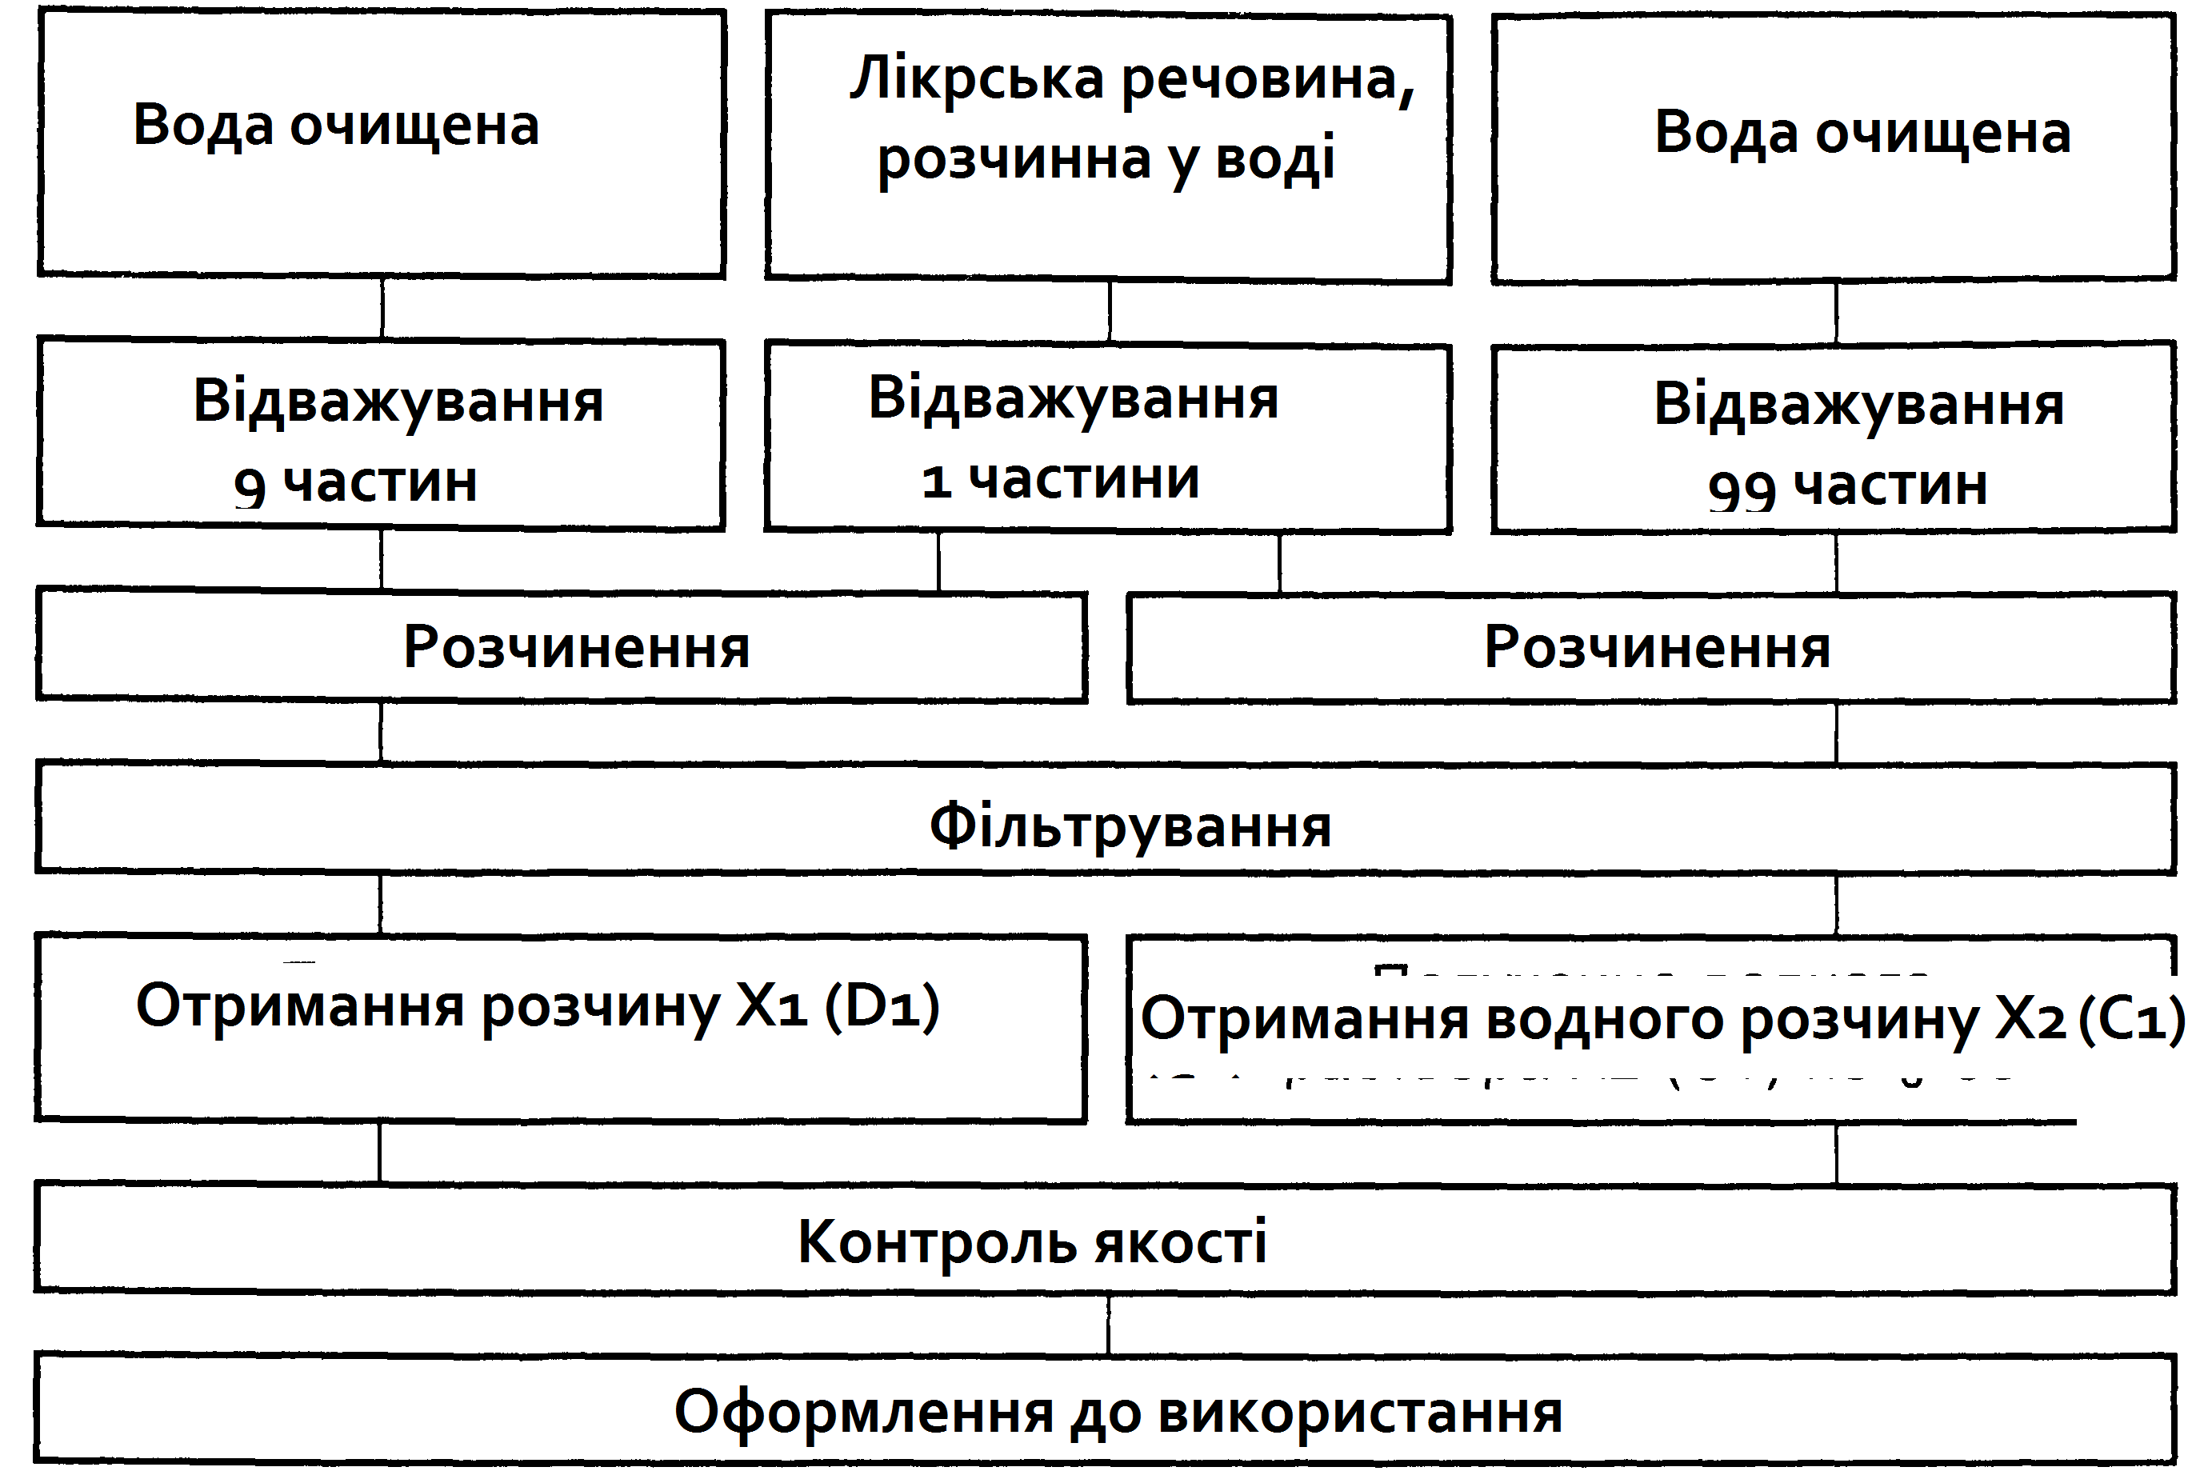
3. ALGORITHM OF TECHNOLOGIES OF LIQUID AQUATIC DILUTIONS ( POTENTIALS)

Slide 12
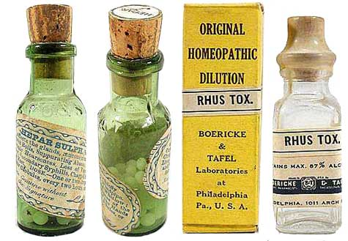
4. ALGORITHM OF TECHNOLOGISTS OF LIQUID ALCOHOLIC DILUTIONS (POTENTIALS)
Prescription recipe
Raw materials
Matrix tinctures and solutions, liquid dilutions, complex dilutions
Ethyl alcohol
90%, 60%, 45%
Weighing or measuring
calibrated dropper 1 part
Weighing or measuring
calibrated drop e rum 9 (X1, D1) / 99 ( C1) parts
Mix
Shake from top to bottom (potentiation) 10 times
Repeat the operations (weighing, mixing, shaking), using the previous dilutions to obtain the next dilution
Quality control
Packing and decoration before the holiday

Slide 13
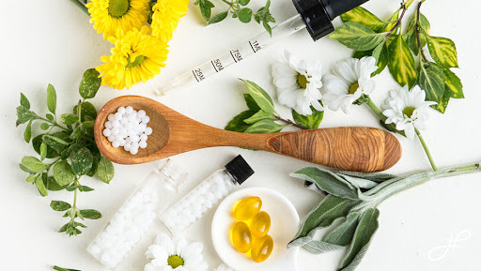
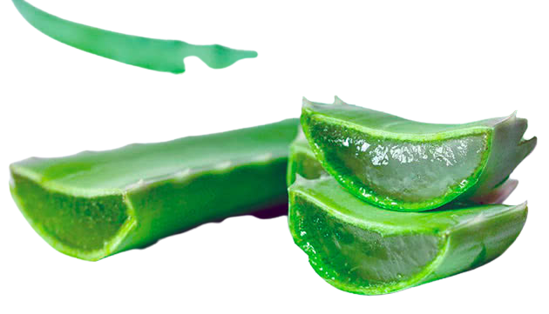
Rp .: Dilutio Aloe X 3 - 10.0
D. S. 5-7 drops 30 minutes before eating
5 . Example 1 Rp .: Dilutio Aloe X3 - 10.0
D. _ S. 5-7 drops 30 minutes before eating
Stamp of medical and preventive institution
Date
Surname , name and patronymic of the patient, age
Last name , first name and patronymic doctor
Rp .: Dilutio A l oe X 3 - 10.0
DS 5-7 drops 30 minutes before eating
Signature doctor
Personal seal of the doctor
Characteristics of the drug . The drug is homeopathic drops , which include raw materials plant origin of aloe.

Slide 14
Technology
5. Example 1 Rp .: Dilutio Aloe X3 - 10.0
DS 5-7 drops 30 minutes before eating
    PWC ( reverse side )
    Dilution Aloe X 1: 1.0 g
    Dilution Aloe X 2: 1.0 g
    45% ethyl alcohol for production dilution X2: 9.0 g
    45% ethyl alcohol for production dilution X3: 9.0 g

Slide 15
Technology . Put on the table 2 vials with corks, numbered them ( X2, X3). 9.0 g of 45% ethyl alcohol are weighed into each vial . Then in a vial with the designation X2 is weighed 1.0 g dilution Aloe X1, close cover and vigorously shake from top to bottom 10 times ( potentiate ). After this from the vial X2 add 1.0 g of dilution in the vial with inscription X3, sealed and shake from top to bottom 10 times ( potentiate ). Paste № recipe. Fill in the PPK ( front side ).

Slide 16
Facial side of the passport of written control (PPK)
5. Example 1 Rp .: Dilutio Aloe X3 - 10.0
DS 5-7 drops 30 minutes before eating
PWC ( front side )
Date № recipe
Spiritus aethylici 45% 9.0
Dilutio Aloe X2 1.0
m = 10.0
Prepared ( signature )
Checked ( signature )
Released ( signature )

Slide 17
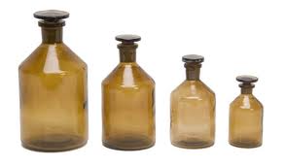
Registration for use
5. Example 1 Rp .: Dilutio Aloe X3 - 10.0
DS 5-7 drops 30 minutes before eating
Make out labels : " Internal " , " Keep cool and protected " from light place "," Save from children ".
This homeopathic remedy is used to treat diarrhea and hemorrhoids.
№ pharmacies_ 8 _
Keep away from children
Store in a cool, dark place
№ recipe_ 1 _
Kharkiv_ _ _ _
INSIDE _
Date 02.03.2021
Homeopathic l and karsky _ _ means
__ Dil. _ Aloe X3 1 0.0 _ __
At and mat and on _ 5-7 drops for 30 min before eating ___________ ___ ____
P and dpis

Slide 18
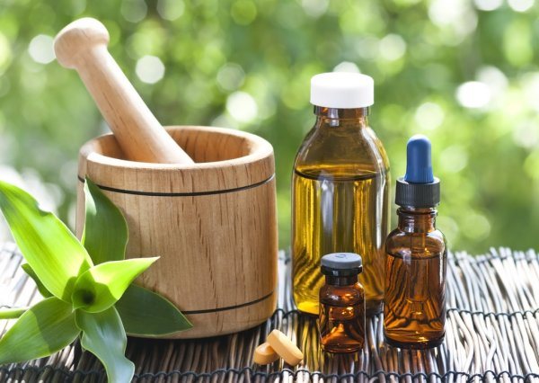
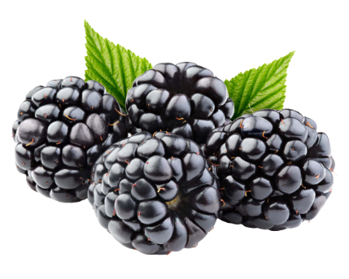
Rp .: Dilutio Rubus C 3 - 10.0
D. _ S. _ 7 - 10 drops according to the
6. Example 2 Rp .: Dilutio Rubus C3 - 10.0
D. _ S. 7-10 drops according to the schedule
Stamp of medical and preventive institution
Date
Surname , name and patronymic of the patient, age
Last name , first name and patronymic doctor
Rp .: Dilutio Rubus C 3 - 10.0
DS 7-10 drops according to the schedule
Signature doctor
Personal seal of the doctor
Characteristics of the drug . homeopathic drops , which include raw materials vegetable origin Blackberry .

Slide 19
Technology
6. Example 2 Rp .: Dilutio Rubus C3 - 10.0
DS 7-10 drops according to the schedule
PPK ( reverse side )
Matrix tincture " Rubus θ": 0.2 g (6 drops )
Dilution Rubus C 1: 0.1 g (3 drops )
Dilution Rubus C 2: 0.1 g (3 drops )
45% ethyl alcohol for production dilution C1: 9.8 g
45% ethyl alcohol for production dilution C2: 9.9 g
45% ethyl alcohol for production dilution C3: 9.9 g
Technology . Put on the table 3 vials with corks, numbered them (C1, C2, C3). In the first vial (C1) weigh 9.8 g of 45% ethyl alcohol, in the other two (C2, C3) - 9.9 g of 45% ethyl alcohol. Then in a bottle marked C1 weigh 0.2 g (6 drops ) of matrix tincture " Rubus θ », close cover and vigorously shake from top to bottom 10 times ( potentiate ). After of this from the vial C1 add 0.1 g (3 drops ) of dilution to the vial with the inscription C2 and again shake from top to bottom 10 times ( potentiate ). Next , 0.1 g (3 drops ) of C2 dilution is weighed into the C3 vial , capped , and potentiated 10 times. Paste № recipe. Fill in the PPK ( front side).

Slide 20
Facial side of the passport of written control (PPK)
6. Example 2 Rp .: Dilutio Rubus C3 - 10.0
DS 7-10 drops according to the schedule
PPK ( front side )
Date № recipe
Spiritus aethylici 45% 9.9
Dilutio Rubus C2 0.1 ( gtts . III)
m = 10.0
Prepared by ( signature )
Checked ( signature )
Released (signature)

Slide 21
Registration for use
6. Example 2 Rp .: Dilutio Rubus C3 - 10.0
DS 7-10 drops according to the schedule
Make out labels : " Internal " , " Keep cool and protected " from light place "," Save from children ".
This homeopathic remedy is used for the treatment and prevention of menopausal conditions.
№ recipe_ 1 _
№ pharmacies_ 8 _
Keep away from children
Store in a cool, dark place
Kharkiv_ _ _ _
INSIDE _
Date 02.03.2021
Homeopathic l and karsky _ _ means
___ Dil. Rubus C3 1 0.0 _ __
At and mat and on _ 7-10 drops according to the schedule ______________
P and dpis

Slide 22
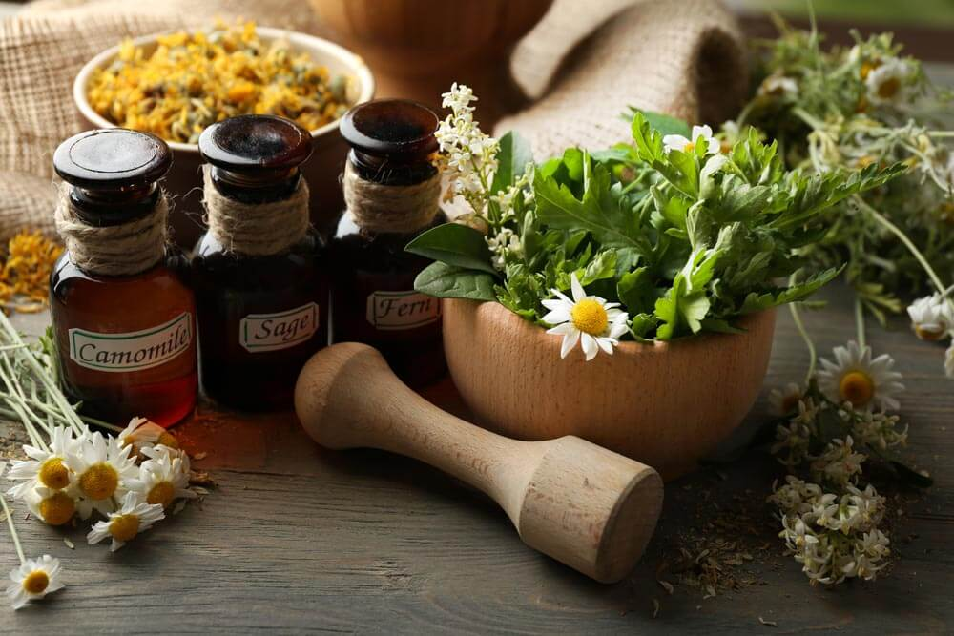
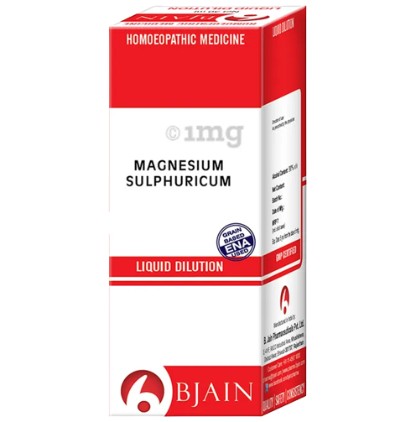
Rp .: Dilutio Magnesium sulfuricum X 3 - 10.0
D. _ S. _ 10 drops in the evening 30 minutes before eating
7 . Example 3 Rp .: Dilutio Magnesium sulfuricum X3 - 10.0
D. _ S. 10 drops in the evening 30 minutes before eating
Stamp of medical and preventive institution
Date
Surname , name and patronymic of the patient, age
Last name , first name and patronymic doctor
Rp .: Dilutio Magnesium sulfuricum X 3 - 10.0
DS 10 drops of dinner in 30 minutes before eating
Signature doctor
Personal seal of the doctor
Characteristics of the drug . homeopathic drops , which include raw materials mineral origin Magnesium sulfate.

Slide 23
Technology
7. Example 3 Rp .: Dilutio Magnesium sulfuricum X3 - 10.0
DS 10 drops in the evening 30 minutes before eating
PPK ( reverse side )
Substances Magnesium sulfuricum : 1.0 g
Dilution Magnesium sulfuricum X 1: 1.0 g
Dilution Magnesium sulfuricum X 2: 1.0 g
45% ethyl alcohol for production dilution X1: 9.0 g
45% ethyl alcohol for production dilution X2: 9.0 g
45% ethyl alcohol for production dilution X3: 9.0 g
Technology . Put on the table 3 vials with corks, numbered them (X1, X2, X3). 9.0 g of 45% ethyl alcohol are weighed into each vial . Then 1.0 g of substance is weighed into a vial marked X1 Magnesium sulfuricum , close cover and vigorously shake from top to bottom 10 times ( potentiate ). After of this from the vial X1 add 1.0 g of dilution in the vial with the inscription X2 and again shake from top to bottom 10 times ( potentiate ). Next , 1.0 g of X2 dilution is weighed into the X3 vial , capped , and potentiated 10 times. Paste № recipe. Fill in the PPK ( front side ).

Slide 24
Facial side of the passport of written control (PPK)
7. Example 3 Rp .: Dilutio Magnesium sulfuricum X3 - 10.0
DS 10 drops in the evening 30 minutes before eating
PPK ( front side )
Date № recipe
Spiritus aethylici 45% 9.0
Dilutio Magnesium sulfuricum X 2 1.0
m = 10.0
Prepared by ( signature )
Checked ( signature )
Released (signature)

Slide 25
Registration for use
7. Example 3 Rp .: Dilutio Magnesium sulfuricum X3 - 10.0
DS 10 drops in the evening 30 minutes before eating
Make out labels : " Internal " , " Keep cool and protected " from light place "," Save from children ".
This homeopathic remedy is used to treat gastroenterocolitis and nervous dyspepsia
№ recipe_ 1 _
№ pharmacies_ 8 _
Keep away from children
Store in a cool, dark place
Kharkiv_ _ _ _
INSIDE _
Date 02.03.2021
Homeopathic l and karsky _ _ means
Magnesium sulfuricum X 3 1 0.0
At and mat and on _ 7 drops in the evening for 30 min. Before food ______________
P and dpis

Slide 26
8. ALGORITHM OF TECHNOLOGISTS OF HOMEOPATHIC OILS
Prescription recipe
Raw materials
Matrix tinctures;
substances soluble in oils
Oil (olive, almond, sunflower, vaseline, etc.)
Weighing or measuring with a
calibrated dropper calculated amount
Weighing
calculated amount of oil
Mixing or dissolving
Shake from top to bottom (potentiation) 10 times
Quality control
Packing and decoration before the holiday

Slide 27
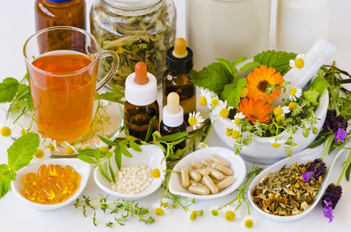
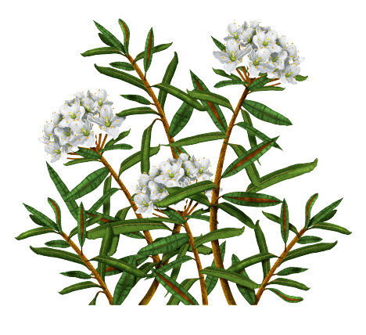
Rp .: Oleum Ledum 10% - 5.0
D. _ S. To lubricate the affected skin surfaces
9. Example 1 Rp .: Oleum Ledum 10% - 5.0
D. _ S. To lubricate the affected skin surfaces
Stamp of medical and preventive institution
Date
Surname , name and patronymic of the patient, age
Last name , first name and patronymic doctor
Rp .: Oleum Ledum 10% - 5.0
DS To lubricate the affected skin surfaces
Signature doctor
Personal seal of the doctor
Characteristics of the drug . Homeopathic oil , which includes raw materials vegetable origin Mud usual . As a solvent it is possible use sunflower , vaseline , or almond , olive , apricot , grape , etc. , oils .

Slide 28
Technology
9. Example 1 Rp .: Oleum But 10% - 5.0
DS For lubrication affected surfaces skin
PPK ( reverse side )
Matrix tincture Ledum : 0.5 g (16 drops )
Oils sunflower : 4.5 g
Technology . Weigh in advance diligent wide- necked bottle of 4.5 g of oil sunflower and add 16 drops (0.5 g) of matrix tincture Ledum , cap , potentiate 10 times. Paste № recipe. Fill in the PPK ( front side ).

Slide 29
Facial side of the passport of written control (PPK)
9. Example 1 Rp .: Oleum Ledum 10% - 5.0
D. _ S. To lubricate the affected skin surfaces
PPK ( front side )
Date № recipe
Oils Helianthi 4.5
Ledum Ѳ 0.5 ( gtts . XVI)
m = 5 , 0
Prepared by ( signature )
Checked ( signature )
Released (signature)

Slide 30
Registration for use
9. Example 1 Rp .: Oleum Ledum 10% - 5.0
D. _ S. To lubricate the affected skin surfaces
Make out labels : " External " , " Keep cool and protected " from light place "," Before use shake "," Save from children ".
This homeopathic remedy is used to treat stab wounds and insect bites.
№ recipe ___
№ pharmacies ___
Kharkiv_ _ _ _
Keep away from children
Store in a cool, dark place
EXTERNAL
Date __02.03.2021 р .___
Homeopathic l and karsky _ _ means
__ Oleum Ledum 10% 5.0 ___
Apply to _ affected areas of skin __________________ ____ ____
P and dpis _____

Slide 31
QUESTION FOR INDEPENDENT WORKS
1. Characteristics of dilutions homeopathic as medicinal forms .
2. Manufacturing technology dilutions homeopathic with basic drugs .
3. Manufacturing technology dilutions homeopathic from raw materials mineral origin .
4. Solvents for manufacturing homeopathic dilutions .
5. Features potentiation dilutions homeopathic .
6. Quality control dilutions homeopathic .
7. Registration for vacation dilutions homeopathic .
8. Auxiliary substances that _ used for cooking homeopathic drugs .

Slide 32

Thank you!

