Slide 1
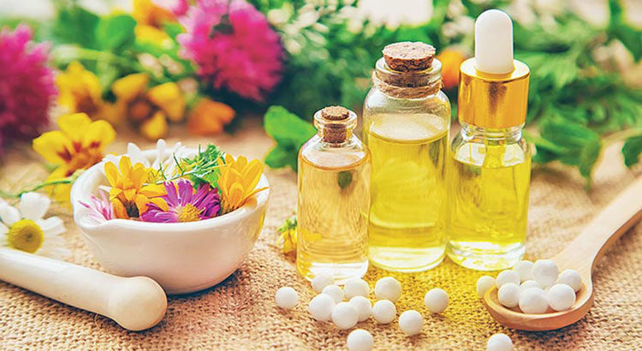

ODESSA NATIONAL MEDICAL UNIVERSITY
DEPARTMENT OF PHARMACEUTICAL CHEMISTRY
AND DRUGs TECHNOLOGY
Technology basic liquid preparations _ homeopathic dosage forms, registration for release and control of their quality .
presentation prepared :
Ph.D. , Assoc. Fizor N.S.

Slide 2
Plan
1. Classification homeopathic funds by state of aggregation
2. Cooking major homeopathic forms
3. Basic preparations
4. Basic technological processes used in obtaining homeopathic solutions .
4.1. Preparation of aqueous solutions according to § 5 of the Schwabe manual
4.2. Preparation of an alcohol solution according to § 6 of the manual v. Shvabe
5. Methods of quality control of basic (basic) homeopathic medicines
6. Breeding essences
7. Solutions and dilution homeopathic for internal application
8. Liquid dissolutions from triturations (powder grindings) of insoluble substances and poisons
8.1. Method 1
8.2. Method 2.
8.3 Example: Z incum metalicum 6 10.0 dil.
          6-8 drops according to the schedule
          9. Preparation of syrups
          10. Preparation of infusions and decoctions
          11. Infusions and decoctions from dried raw materials
          12. Liquids
          13. Liquid homeopathic dosage forms for external use
          14. Oil ( olea )
          15. Question for independent work

Slide 3
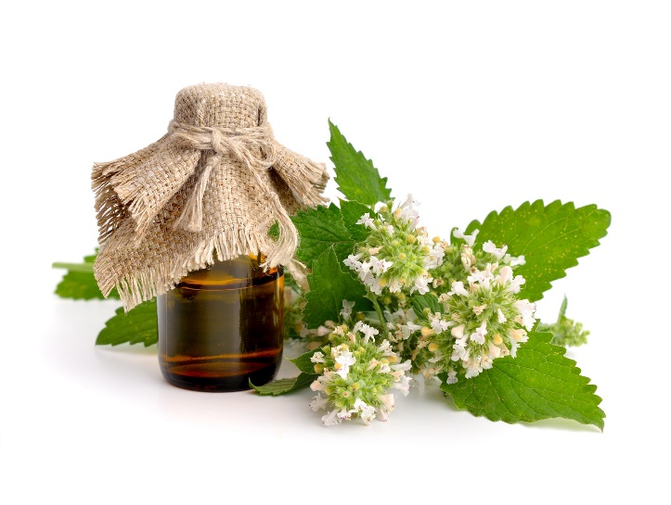
1. Classification homeopathic drugs by state of aggregation
Classification homeopathic medicinal funds by state of aggregation
homeopathic drugs solid consistency – powders, granules , tablets
homeopathic drugs liquid consistency – solutions , injection _ _ preparations , drops , oils, liniments
homeopathic drugs which consistency - ointments , suppositories
homeopathic drugs gaseous consistency - sprays

Slide 4
2 . PREPARATION OF BASIC HOMEOPATHIC FORMS
Everything homeopathic drugs prepared according to the specified paragraphs of the manual. _ medicinal remedies " / Homeopathic Pharmacopoeia /, in which contained 9 such paragraphs .
♦ behind the first three paragraphs cook essences exclusively from fresh plants , and way manufacturing depends from juiciness plants ;
♦ on the fourth - tinctures from dried plants and animals , and from alive animals ;
♦ on the fifth - water solutions ;
♦ behind the sixth - alcohol solutions ;
♦ on the seventh , eighth and ninth - rubbing / trituration / from various dry substances .

Slide 5
3. Basic preparations
Basic preparations ( stocks ) - substances, products or preparations used as starting materials for the production of homeopathic medicines.
Basic drugs certainly are : for raw materials vegetable , animal or human origin - matrix tincture or glycerin materat ; for raw materials chemical or mineral origin - the substance itself .
Basis and homeopathic preparations:
Essences (matrix tinctures) phytes (45%) - are obtained from fresh juice of plants collected at different times of the year, depending on the part of the plants used for this preparation or their parts, preserved with 90% alcohol. Prepared in small quantities and do not store for a long time. (discussed in workshop 1)
Tinctures or tinctures (23%) - are prepared from dried and powdered plants or from fresh animal substances (bees, ants) based on extraction with 70% alcohol by maceration (infusion) or percolation (displacement).
Solutions (10%) - from soluble salts or acids. depending from solubility weekend substances uterine solutions there are water and alcohol . For cooking recent use 90%-60% -45 % alcohols depending from solubility day off substances . Used for lotions , compresses and rinses . (see next slides )
Triturations or powdered triturations (22%) - prepared from insoluble minerals and hard parts plants ( roots , seeds ). Them mixed with milk sugar and carefully grind , and not force in a porcelain ( non-metallic ) mortar no less one hours , when a homogeneous mass is obtained , is visible not only outside but also under microscope .

Slide 6
4 . Main technological processes used in obtaining homeopathic solutions .
Of the mineral substances and chemical compounds available in the homeopathic arsenal of remedies, which also prepare liquid basic preparations in the form of aqueous or alcoholic solutions according to § 5 and 6 , and depending on the required ratio, each paragraph is divided into two subparagraphs.
PREPARATION OF WATER SOLUTIONS ACCORDING TO § 5 OF THE MANUAL V.SHVABE
According to the instructions of the pharmacopoeia, these solutions are prepared as follows :
a ) take 1 weight part of the medicinal substance, dissolve in 9 weight parts of purified water , shake thoroughly (potentiate), then filter. The content of the medicinal substance in the solution is 1:10, i.e. the solution corresponds to the first decimal dilution - XI or D1 ;
b ) 1 weight part of the medicinal substance is dissolved in 99 weight parts of purified water, mixed well, i.e. potentiate, after which the solution is filtered. In this case, the content of the medicinal substance in the solution is 1:100, and the solution corresponds to the first hundredth dilution - X2 or C1.
Example. Prepare the potassium solution bichromicum XI 20.0 .
20g----10parts
Xg------1part
This solution is prepared according to § 5a: 18.0 g of purified water is weighed into a calibrated vial, 2.0 g of potassium dichromate is weighed on a hand-held balance (BP-5) and dissolved in water with stirring. The solution is filtered, quality checked, registered in a special journal, however, it is not labeled for use, since it is only an intermediate product and serves for further dilution (potentization) immediately, therefore this solution is not subject to storage.

Slide 7
Preparation of acid solutions.
Main technological processes used in obtaining homeopathic solutions .
4.1 . PREPARATION OF WATER SOLUTIONS ACCORDING TO § 5 OF THE MANUAL V.SHVABE
For the preparation of acid solutions, an acid is taken as a unit depending on its density and the actual percentage, which is described for each acid separately in the corresponding article in the manual by V. Schwabe .
Ordinary aqueous solutions are immediately used for the preparation of dosage forms. If the solutions are to be stored, then on the label, in addition to the name of the medicinal substance and the dilution , “water ” and the date of preparation must be indicated .
Example. Prepare Acidum solution hydrochloricum XI . To prepare the solution, hydrochloric acid with a density of 1.122-1.124 and a hydrogen chloride content of 24.8-25.2% is used, taken as a unit. the first decimal dilution (XI) is prepared as follows: first, 15.0 g of purified water is weighed into the vial, then 10.0 g of hydrochloric acid is added, corked with a ground glass stopper and shaken thoroughly (potentiated). They check the quality of the solution, register it in a special journal, but do not issue it for use, since it is an intermediate product, from which X2 dilution is immediately prepared, also on water, and subsequent potencies are carried out on 45% alcohol according to the instructions of V. Schwabe. .

Slide 8
Main technological processes used in obtaining homeopathic solutions .
4.2 . Cooking alcohol solution according to § 6 of the manual v. Shvabe
For the preparation of alcohol solutions from medicinal substances that are readily soluble in alcohol , 90, 60 or 45% alcohol is used, depending on the solubility of the starting substance (the concentration of alcohol and the preparation of aqueous-alcoholic solutions of individual substances are indicated for each medicinal substance when it is described in private pharmacopoeial monograph ):
a ) 1 weight part of the medicinal substance is dissolved in 9 weight parts of alcohol and thoroughly shaken (potentiated), the resulting solution corresponds to the content of the medicinal substance 1:10 (first decimal division );
b ) 1 weight part of the medicinal substance is dissolved in 99 weight parts of ethyl alcohol and potentiated ; in this case, the content of the drug in the solution is 1:100 (the first centesimal dilution ).
The label of a water-alcohol solution or its dilution, in addition to the name of the drug substance and dilution, must indicate the concentration of alcohol and the date of preparation.

Slide 9
5. Methods of quality control of basic (basic) homeopathic medicines
Quality control of basic homeopathic medicines can be divided into two stages:
a) control of physical and chemical properties and technological parameters;
b) analytical control of active substances.
Liquid basic preparations (essences, tinctures, solutions) are controlled in accordance with the requirements of the guidelines of V. Schwabe and DF for the following indicators:
1) compliance of smell and taste;
2) transparency ( absence of mechanical inclusions);
3) color matching , since a number of preparations, especially prepared from fresh plants, change their color during long-term storage (for example, a change in green color to brown is often observed, caused in most cases by a change in chlorophyll).
4) capillary and capillary-luminescent analysis
5) Determination of liquid density
6) Determination of the content of extractive substances (dry residue)
7) Determination of the content of fatty vegetable oils
8) Quantity defatted dry residue
9) Definition content insoluble in water precipitation in the extraction remainder tinctures or essences prepared according to method 1-3
10) Definition content ethyl alcohol
11) Definition heavy metal
12) Uniformity distribution medicinal substances

Slide 10
6. Breeding essences
Intermediate potencies are prepared from the original tinctures and substances, or the dilution is dynamized using the appropriate scale. Achieved this consistent fragmentation medicinal substances solvent dilution _ or rubbing with milk sugar . Particles brought to the smallest submolecular state, have a large surface , lose their toxicity and acquire high medical activity for what after each dilution solution vigorously shakes off or solid substances rubbed within 10 seconds (10 movements ).
In GP , mainly 2 degrees of dilution are used:
1 ) Decimal ( Decimal ) scale, denoted by the letter D or the Roman numeral X: D1, X1.
2 ) Hundreds ( centisimal ), denoted by the letters C, CH, CK or no letters at all, but only by Arabic numerals: C1, CH1, CK1, 1. S. Hahnemann worked first with a hundredth scale, and then moved on to 1: 1000 ( scale M) and 1:50000 (LM scale).

Slide 11
7. Solutions and breeding homeopathic for internal application
Solutions and dilution homeopathic (solutions et dilutiones homoeopathscae ) for internal application are liquid _ homogeneous ( homogeneous ) drug system substances in the respective solvent . With them manufacturing sanitary requirements in accordance with the Instruction on sanitary anti -epidemic regime of pharmacies (order of the Ministry of Health of Ukraine No. 139 dated 14.06.1999 ).
Potions ( Mixtural ) in homeopathic practice are used very rarely , sometimes they are used in pediatric practice.
Drops ( Guttal ) - a dosage form that is most often used for treatment, they are dosed with a pipette or stopper - dropmer (cork - dispenser). If the prescription does not specify the amount of the drug, 10.0 g is dispensed.

Slide 12
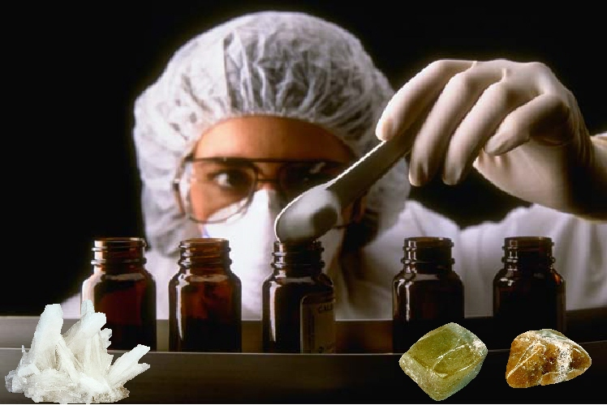
8. Liquid dissolutions from triturations (powder grindings) of insoluble substances and poisons
Necessary note that _ solutions in homeopathy are not always there are true - under the name " dilution " is also understood as suspension insoluble substances .
Yes, rare breeding can prepare from triturations ( powder rubbing ) in two ways.

Slide 13
8.1. Method 1
To obtain the fourth centesimal dilution (C4)
dissolved in 99 parts of water
add 20 parts of ethyl alcohol 86% (by weight) and
shake off
The fifth centesimal (C5) and all subsequent centesimal dilutions are prepared from 1 part of the preliminary centesimal dilution and 99 parts of ethyl alcohol 43% (by weight) with shaking.
1 part trituration of the substance of the third centesimal dilution (C3)

Slide 14
8.2. Method 2.
To obtain the sixth decimal dilution (D6)
1 part of the trituration of the substance of the fourth decimal dilution (D4)
dissolved in 9 parts of water and
shake off
Then 1 part of the resulting dilution is shaken with 9 parts of ethyl alcohol 30% by weight.

Slide 15
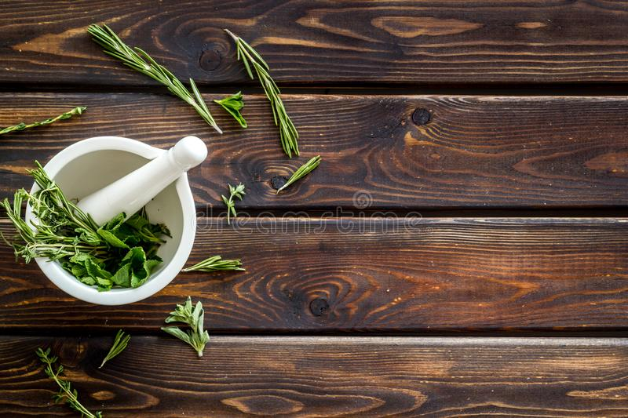
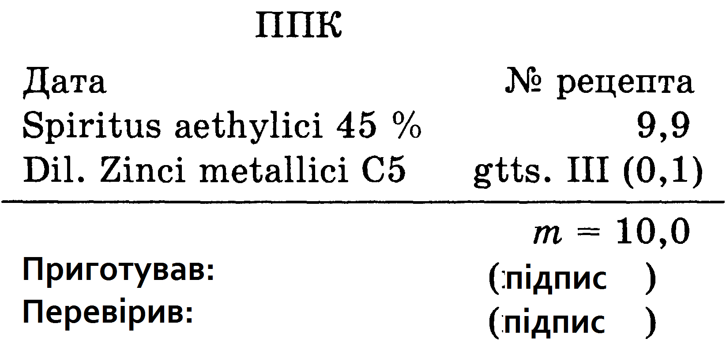
8.3 Example: Zincum metalicum 6 10.0 dil.
          6-8 drops according to the schedule
To obtain the fourth centesimal dilution (C4)
dissolved in 79 parts of water,
add 20 parts of ethyl alcohol 86% (by weight) and
shake off
The fifth centesimal (C5) and all subsequent centesimal dilutions are prepared from 1 part of the preliminary centesimal dilution and 99 parts of ethyl alcohol 43% (by weight) with shaking.
1 part trituration of the substance of the third centesimal dilution (C3)
The pharmacist-technologist must first prepare the initial (basic) Trituration X1 (D 1) from an insoluble substance (metal) in accordance with the instructions of § 7 of V. Schwabe's guide
After that, he weighs 7.9 g of purified water into a tared vial.
adds 2.0 g of ethyl alcohol 90%, puts here 0.1 g of the prepared trituration of zinc metal C3.
then vigorously shakes the vial closed with a stopper for 10 minutes, obtaining a stable suspension of C4.
Then, 9.9 g of 45% ethyl alcohol is weighed into a vial with the designation C5, 0.1 g (3 drops) of C4 dilution is added and shaken 10 times until C5
then potentiate it first on a decimal scale to D 4 (C2), then on a centesimal scale to C3.
After full quality control and clearance for dilution use, C5 is placed on a turntable in the assistant's room. The pharmacist weighs 9.9 g of 45% alcohol into the dispensing vial, adds 0.1 g (3 drops) of dilution here. C5, churning it 10 times and transfers to the control of the relevant parameters
draws up the prescription number, serial number and the label " Internal ", on which the number of the pharmacy, the mass of the drug, the date of manufacture and the signature are indicated cooked .

Slide 16
9 . Preparation of syrups
Homeopathic syrups - a liquid dosage form, which is a concentrated sugar solution containing homeopathic tinctures, homeopathic dilutions, triturations and intended for oral administration.
Syrups are prepared by dissolving sugar in purified water when heated at a temperature of more than 100 C with a concentration of not more than 72%. The resulting solution is filtered hot into a sterile container. Homeopathic tinctures, homeopathic dilutions, triturations or solid substances can be introduced into
The concentration of sugar in the dosage form must be at least 64%. Ethyl alcohol can be used as a preservative. The resulting syrup is filtered through a dense cloth or filtered through a paper filter.

Slide 17
10. Preparation of infusions and decoctions
Homeopathic infusions and decoctions are water lifts from VP or aqueous solutions - specially prepared extracts. They are made by infusing crushed dried or freshly harvested herbs with purified water at a certain temperature.
Use MPS , approved for use in homeopathy and meeting the requirements of ND.
Before infusion, the raw materials are crushed. In the absence of instructions in private RD , freshly harvested raw materials are crushed to obtain a slurry, and dried - to particles passing through a sieve with holes with a diameter of:
- no more than 4 mm - for leaves, flowers, herbs;
- no more than 3 mm - for shoots, bark, roots, rhizomes, bulbs, tubers;
- no more than 2 mm - for fruits and seeds.
For infusion, tightly closed containers ( infunder cups) made of indifferent materials are used. Prior to adding raw materials, porcelain containers must be heated at a temperature above 90 ° C for 15 minutes. Preservatives are not added to infusions and decoctions.

Slide 18
11. Infusions and decoctions from dried raw materials
Produced by weight in the ratio of 1 part of HPC and 10 parts of purified water.
Infusions. The crushed plant material is poured with 3-5 times the amount of water at room temperature, thoroughly mixed and left for 15 minutes. Then the remaining water, preheated to a boil, is added to the mixture and infused in a tightly closed container in a boiling water bath (or in an infunder) apparatus ) for 5 minutes, with frequent stirring. After that, the mixture is left at room temperature until completely cooled.
The infusion is filtered (gently squeezing the APC) through a sterile cloth and weighed.
Decoctions. The crushed plant material is poured with boiling water and insisted on a boiling water bath (or in an infusion) apparatus ) for 30 minutes with frequent stirring. The hot broth is filtered (gently squeezing the raw material) through a sterile cloth and weighed after cooling.
If the mass of the resulting infusion or decoction is less than that proposed, then the required amount of water at room temperature (for infusions) or boiling water (for decoctions) is added to the rest of the plant material, mixed and the raw material is squeezed out again (filtering through the same filter). With an additional squeezed extract, the infusion or decoction is brought to the required mass.
The infusion or decoction corresponds to the first decimal dilution (D1). Dilution of them is prepared in purified water. The second decimal dilution (D2) is made from 1 part infusion or decoction and 9 parts water. Subsequent dilutions are made from 1 part of the pre-dilution and 9 parts of water.

Slide 19
12. Liquids
For injections, drugs are used that are obtained using a new technology ( injel , sarcodes, nosodes , gomacords ) and produced in ampoules. They are used for acute and chronic pathology, the introduction of injections (subcutaneously, intramuscularly , intravenously) depends on the composition of the preparations (tissue, cellular, organ or hormone -containing ) and the technical conditions of production .
Inyel preparations are injectable preparations from one active ingredient in several dilutions. For example, Ingeel Bell-Belladonna contains in one ampoule D10, D20, D200, D1000 belladonna dilution. They are used in acute and subacute conditions .
Sarcodes - HP preparations in the form of extracts from various healthy organs and tissues of young cattle and pigs. These can be preparations from organs, including blood and cell components (from organelles to macromolecules), their hydrolyzate, filtrates and ultrafiltrates from liquids and suspensions, organ secretions (gastric juice, hormones, enzymes), blood serum and its fractions, microbiological preparations. Sarcodes act on the organs or functions of the same name, some of them coincide with their AP counterparts, but differ in their pharmacodynamics : in AP it is a means of substitution therapy, and in GP it is functional .
Nosodes - sterile medicinal products prepared by GP technology from pathologically altered organs or tissues, components or metabolic products of animals, humans and non-virulent microorganisms (including viruses). Nosodes are isopathic ( autonosodes ), which are prepared from the substrates of the patient, and heteropathic ( heteronosodes ) - from foreign substrates. These are actually antigens that stimulate the production of antibodies in the body. This is how specific nosodes from tumor cells act. Non-specific or broad-spectrum (pharyngeal swab) stimulate non-specific immunity factors (γ-globulin). Nosodes contain single potencies (X6, CH6) and there are complex ( mitte ) and even enhanced ( forte ).

Slide 20
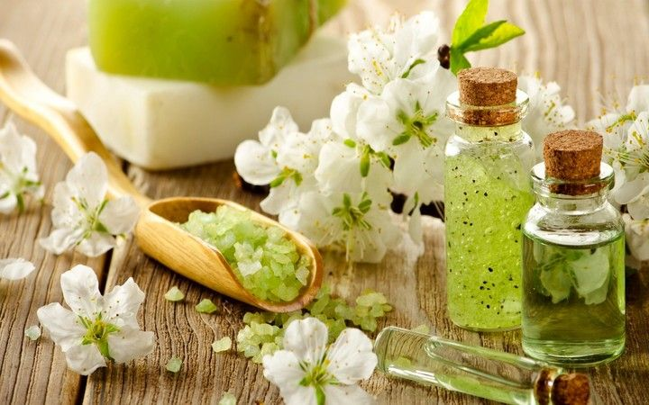
13. Liquid homeopathic dosage forms for external use
To the rare dosage forms for external application include :
alcohol solutions ( alcohols ),
_{oils ,}
_{liniments (opodeldoc).}
In these dosage forms the principle of small doses is not used . Spirits (Spiritus seu solution is spirituosae ) are preparing confusion relevant quantity alcohol tinctures with 60% ethyl alcohol .
_{For example : Spiritus Apis 3%}
_{Spiritus Aconitum 5%}
_{Spiritus Cantharis 5%}
Spiritus Arnica 10% spiritus Spongia 10%*.

Slide 21
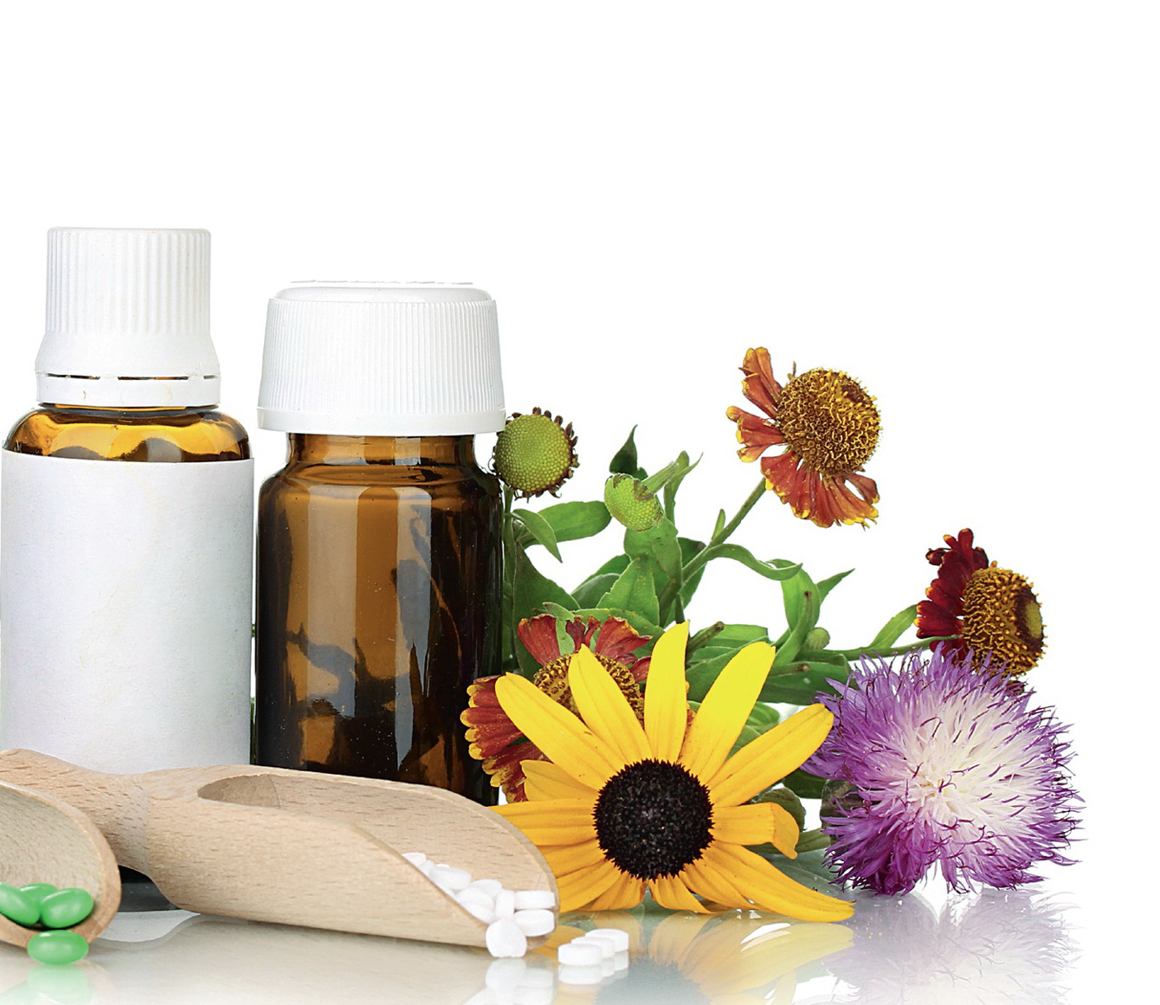
14. Oil (Olea)
Oils (Olea) homeopathic are intended only for external use in the form of 10% . solutions of drugs in olive (Provencal), almond, sunflower, vaseline and other oils. They are prepared according to the general rules, dissolving medicinal substances in oil, or most often - by mixing a certain amount of XI tincture with oil with vigorous shaking. However, for a number of oils , the concentration of the initial tincture differs from the standard one (0.5%, 1%, 3%).
The most commonly prescribed oils are:
_{oleum Apis 3%;}
_{oleum Aconitum 5%;}
_{oleum Bryoniae 10%;}
_{oleum Hamamelis 10%;}
_{oleum Calendulae 10%;}
_{oleum Cantharis 3%;}
_{oleum Camphorae 10%;}
_{oleum Ledum 10%;}
_{oleum Paeoniae 10%;}
_{oleum Chamomillae 10%;}
_{oleum Spongiae 5%;}
_{oleum Thujae 10%;}
_{oleum Chloretonum 0.5%;}
_{oleum Cyclamen 1%;}
_{oleum Cimicifugae 10%.}

Slide 22
15. QUESTION FOR INDEPENDENT WORKS
1. Characteristics of the basic homeopathic drugs , matrix tinctures .
2. Technology manufacturing homeopathic matrix tinctures .
3. Features potentiation homeopathic matrix tinctures .
4. Quality control homeopathic matrix tinctures .
5. Characterization of liquid homeopathic dosage forms.
6. Technology manufacturing liquid homeopathic dosage forms.
7. Quality control liquid homeopathic dosage forms.
8. Registration for vacation liquid homeopathic dosage forms.

Slide 23

Thank you for your attention!

