Slide 1
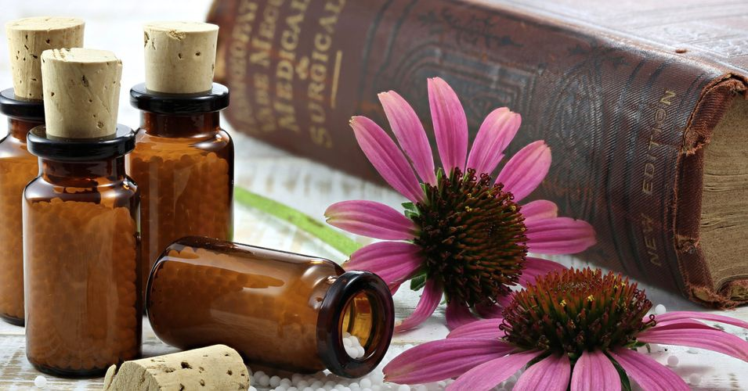

ODESSA NATIONAL MEDICAL UNIVERSITY
DEPARTMENT OF PHARMACEUTICAL CHEMISTRY
AND DRUGs TECHNOLOGY
Triturations homeopathic. Technology of homeopathic triturations , registration for dispensing and quality control
Presentation prepared by :
Assoc . Fizor N.S.

Slide 2
Plan
1. §7.Preparation of triturations from dry matter
1. 2. Example. It is necessary to prepare Triturations Carbo vegetabilis C1 10.0 .
2. Algorithm of trituration technology from liquid substances, according to § 8 of the manual Schwabe
2.1. Example: It is necessary to prepare trituration Acidum sulfuricum C 1 10.0
2.2. Example: Rp .: Triruratio Borax C3 10.0
D. _ S. _ In the morning 30 minutes before eating
3. Algorithm of trituration technology from essences, according to § 9 of the manual Schwabe
3.1. Example. It is necessary to prepare trituration Route X 2 20.0

Slide 3
Triturations homeopathic (powder rubs) - mixtures of dry medicinal substances, essences, tinctures, solutions or their dilutions with milk sugar (lactose) or other excipients permitted for medical use.
Powder rubs are prepared both from dry medicinal substances (mineral or animal origin, chemical compounds) and liquids of various natures (aqueous and alcoholic solutions, essences or tinctures), in accordance with §§7-9.

Slide 4
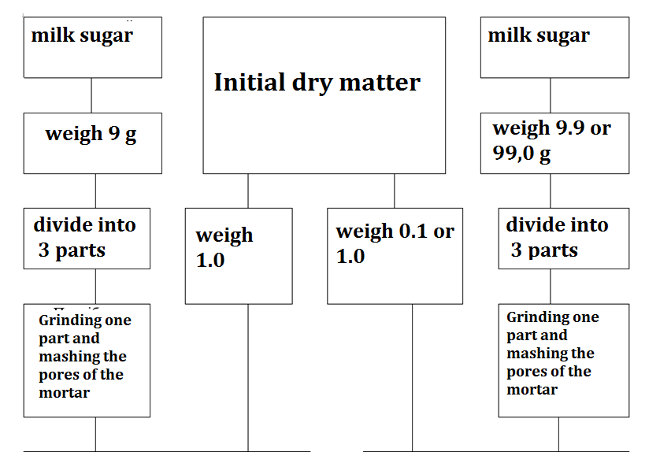
1. §7.Preparation of triturations from dry matter

Slide 5
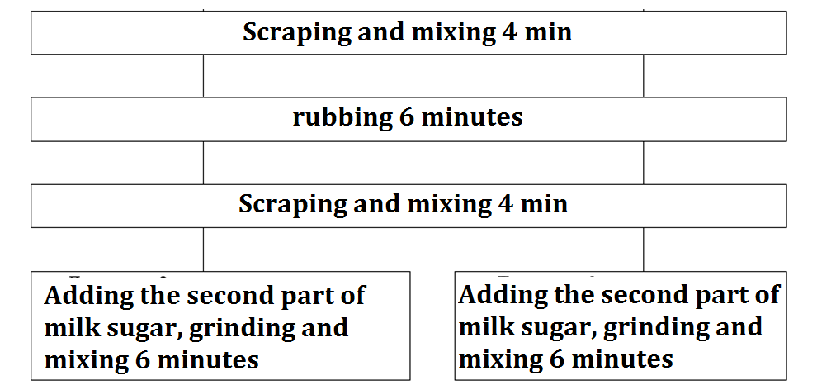
1. §7.Preparation of triturations from dry matter

Slide 6
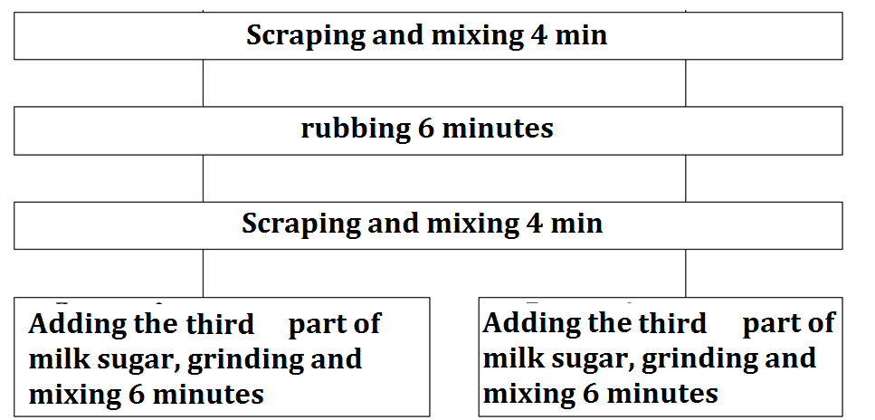
1. §7.Preparation of triturations from dry matter

Slide 7
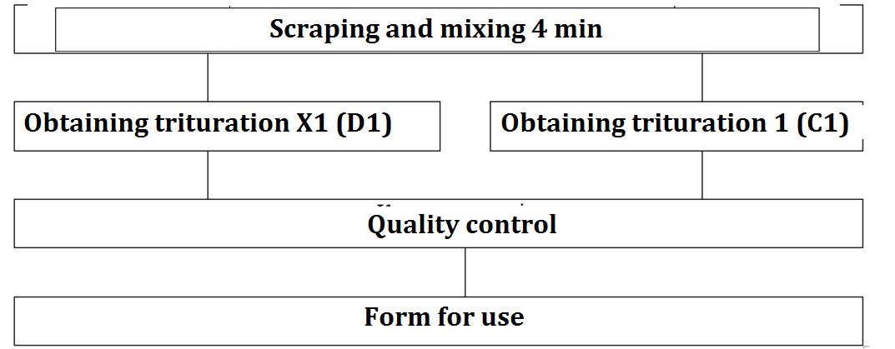
1. §7.Preparation of triturations from dry matter

Slide 8
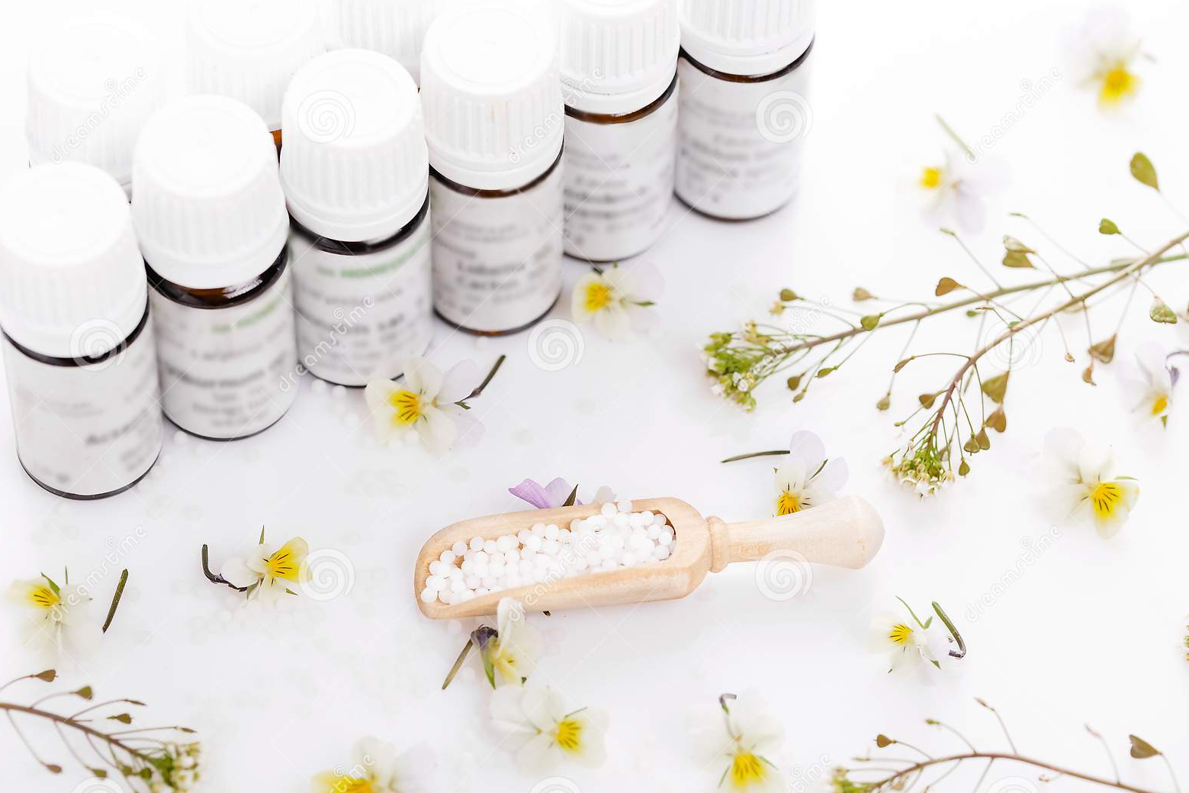
1.2. Example . It is necessary to prepare Triturations
Carbo vegetabilis C1 10.0.
This powder grinding can be prepared, as specified in §7, by two methods:
- immediately dilute C1 (weigh 0.1 substance and 9.9 milk sugar) or
- by potentiation with X1 .
The second method of preparation gives the drug more strength (potency), so it is better to cook it starting with X1.
To do this, weigh 9.0 milk sugar, divide into 3 parts and 1 part rub the pores of the mortar.
1.0 hand charcoal is weighed on hand scales, placed in a mortar and ground according to the rules set out in §7.
Then again weighed 9.0 milk sugar and 1.0 trituration X1 and prepare a powder grind according to all the rules for 1 hour, obtaining a dilution of X2 (C1).
Total preparation time - 2 hours.
The finished trituration is checked for all necessary quality indicators
Then register in the journal of laboratory work and draw up for use with a label
Carbo vegetabilis |  |  | C1 (D2) | 10.0 trit .
Date | Series | Analysis | Signature

Slide 9
Carbo vegetabilis C2 20.0.
D1---1:10
D2---1:100 (С1)
D3---1:1000(C2)

Slide 10
2 . Algorithm of trituration technology from liquid substances, according to § 8 of the Schwabe manual

Slide 11

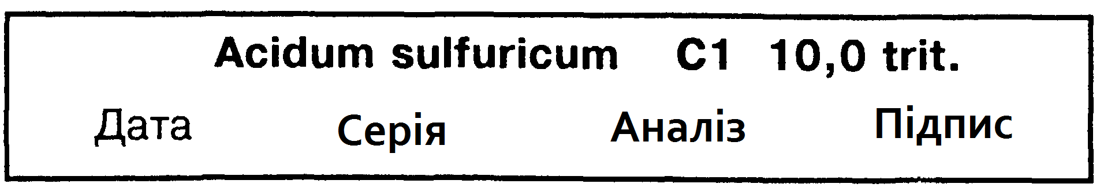
2.1. Example: It is necessary to prepare trituration
Acidum sulfuricum C 1 10.0
2 . Algorithm of trituration technology from liquid substances, according to § 8 of the Schwabe manual
9.9 g of milk sugar is weighed on BP-20, divided into three parts;
The first part is placed in a mortar, grind thoroughly and add a calibrated pipette 2 drops of sulfuric acid (0.1 g, as 1.0 g-20 drops).
Then, according to all the rules of trituration technology, prepare the necessary basic powder grinding, check the quality,
registered in the journal and labeled for use.

Slide 12
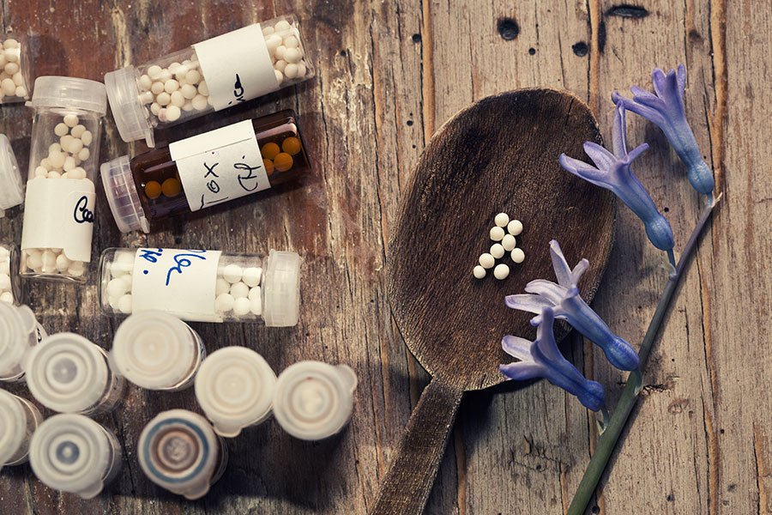
2.2. Example: Rp .: Triruratio Borax C3 10.0
D. _ S. _ In the morning 30 minutes before eating
2. Algorithm of technology of trituration from liquid substances, according to § 8 of the Schwabe manual
Stamp of medical and preventive institution
Date
Surname , name and patronymic of the patient, age
Last name , first name and patronymic doctor
Rp .: Triruratio Borax C3 10.0
Yes . Signa : In the morning 30 minutes before eating.
Signature doctor
Personal seal of the doctor
Characteristics of the drug . Trituration homeopathic , which includes raw materials mineral origin Sodium tetraborate (storm).

Slide 13
Technology
2. Algorithm of technology of trituration from liquid substances, according to § 8 of the Schwabe manual
    PPK (reverse side)
    Dilution Borax C 2: 0.1 g (3 drops )
    sugar : 9.9 g
Technology . For the manufacture of 10.0 homeopathic trituration Borax C3 weigh 9.9 milk sugar and divide into three equal parts. The first part of the milk sugar is rubbed into the pores of the mortar, weigh 0.1 (3 drops) Dil . Borax C2, added to the mortar, grind for 6 minutes , scrape for 4 minutes , grind again for 6 minutes , scrape for 4 minutes. Then add a second portion of milk sugar to the mortar and grind twice again for 6 minutes and scrape for 4 minutes. Then add a third portion of milk sugar to the mixture and repeat the grinding and scraping operations twice for 6 and 4 minutes, respectively. In general, the preparation of trituration takes at least 1 hour. After that, transfer the finished homeopathic trituration to the vial for release. Paste № recipe. Fill in the PPK ( front side ).

Slide 14
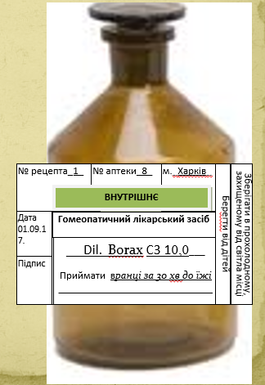
Front side of the passport written control (PPK)
2. Algorithm of technology of trituration from liquid substances, according to § 8 of the Schwabe manual
Registration for use
PPK ( front side )
Date № recipe
Dil. Borax C2 gtts . III (0.1)
Saccharum lacticum 9.9
––––––––––––––––––––––
m = 1 0.0
Prepared by ( signature )
Checked ( signature )
Released (signature)
Make out labels : " Internal " , " Keep cool and protected " from light place "," Save from children ".
This homeopathic remedy is used for the treatment and prevention of aphthous stomatitis

Slide 15
3. Algorithm of technology of trituration from essences, according to § 9 of the Schwabe

Slide 16
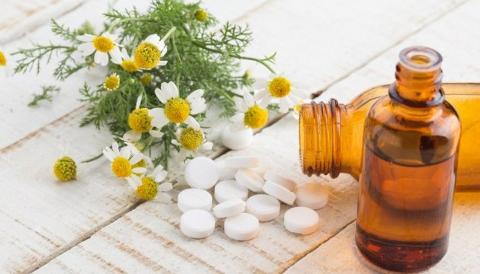

3.1. Example . It is necessary to prepare trituration
Route X 2 20.0
3. Algorithm of technology of trituration from essences, according to
§ 9 Schwabe
Weigh 19.8 g of milk sugar, divide into 3 parts on a paper capsule, place one part in a mortar and grind thoroughly,
then add a calibrated caplemer 6 drops (0.2 g) of Ruta graveolens tincture prepared on 60% (by weight) ethyl alcohol (1.0 g = 32 drops).
The mixture is thoroughly ground for 6 minutes, scraped and stirred for 4 minutes,
then repeat both of these operations according to §7 and leave to air dry for 20-30 minutes.
After that, repeat the grinding and mixing operations 2 more times in two 10-minute cycles, place in a vial with a tightly closed stopper.
The finished trituration is subject to control and registered in the journal and issued before the holiday.

Slide 17
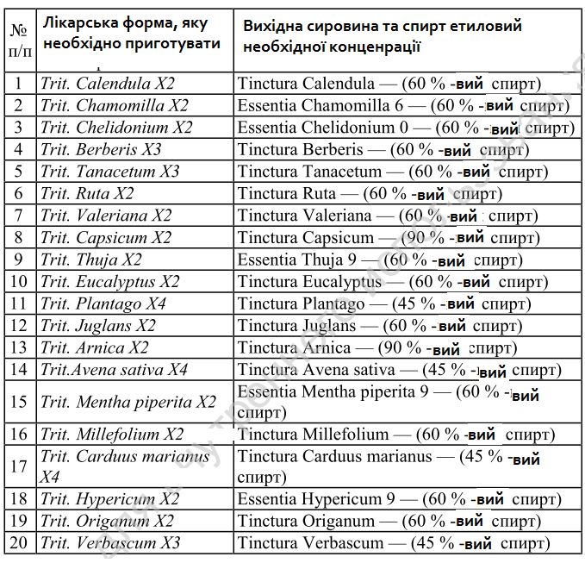
4 . Essences and tinctures for the preparation of homeopathic triturations according to § 8-9

Slide 18
6 . Quality control of homeopathic triturations .
For the manufacture of triturations use lactose or other substances approved for medical use and listed in the relevant parts of the regulations for each drug. The particle size for LV and BB should not exceed 65 μm .
The quality of triturations is assessed by such indicators as appearance, color, homogeneity, particle size (the bulk of the finished trituration should consist of particles of 25 μm or less, there should be no particles larger than 50 μm ). Particle size is determined using a microscope with ocular micrometers or on the outer specific surface (according to a private article).
In the trituration of the 1st, 2nd and 3rd decimal dilutions, the identity and quantitative content of the active substance control compliance with the requirements of private FS or FSP. Triturations containing toxic or potent substances in the 4th decimal dilution are analyzed according to the methods described in the Sun. Deviations in the content of LV should not be more than 5% in the Trituration of the 1st and 2nd decimal dilution, as well as more than 10% in the Trituration of the 3rd decimal dilution.
In trituration containing metals and dyes, the homogeneity of mixing is determined by examination under a magnifying glass with 7-9-fold magnification. No individual particles should be detected during such an inspection. LV should be evenly distributed in trituration . Particle size is determined using a microscope or the size of the specific surface area. The value of the outer specific surface of the trituration made with lactose must be at least 0.65 m2 / g

Slide 19
Conditional designations which _ allowed in homeopathic recipes:
- rare medicine - dilutio , abbreviated - dil .;
- medicine in powder - trituratio , abbreviated - trit .;
- drugs in granules - granulae , abbreviated - gran . ( globuli - glob .);
- ointments - unguentum , abbreviated - ung .;
- rubbing liquids - opodeldoc , abbreviated - opod

Slide 20
4 . QUESTION FOR INDEPENDENT WORKS
1. Characteristics of triturations homeopathic as medicinal forms .
2 . Technology production triturations homeopathic according to the SFU .
3 . Auxiliary substances for manufacture homeopathic triturations .
4 . Features potentiation of triturations homeopathic .
5 . Quality control triturations homeopathic .
6 . Registration for vacation triturations homeopathic .

Slide 21

Thank you!

