Slide 1
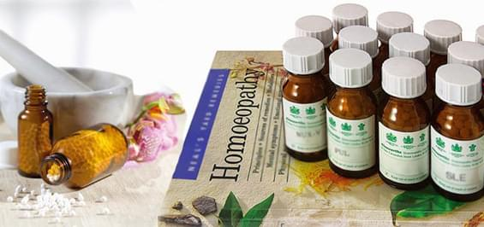

ODESSA NATIONAL MEDICAL UNIVERSITY
DEPARTMENT OF PHARMACEUTICAL CHEMISTRY
AND DRUGs TECHNOLOGY
Technology solid , complex homeopathic dosage forms, registration for dispensing and their control quality .
Presentation prepared by :
Assoc . Fizor N.S.

Slide 2
Plan
1. Homeopathic LF solid consistency
2. Powders ( trituration )
3. Algorithm of technology triturations homeopathic
4. Quality control of triturations
5. Granulae _ _
6. Make granules in several ways.
7. Algorithm of homeopathic granules technology
8. Example of granule 1: Rp : Tabacum C13
9. Example of granule 2: Rp .: Gran ulae Thuja C12 10.0
D. _ S. _ 8 granules 3 times a day
10. Quality control of granules
11. Homeopathic tablets
12. Tablets for homeopathic use
13. Tablet quality control
14. Preparation complex homeopathic medicinal forms in the form of granules

Slide 3
1. Homeopathic medicine solid consistency
Homeopathic dosage forms of solid consistency include:
powders,
granules (pills, granules) and
tablets used for internal use.
These dosage forms are not swallowed, but absorbed in the mouth. In homeopathic practice, grains and powders are most often used.

Slide 4
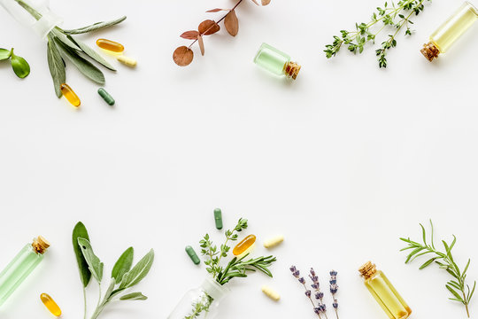
2. Powders ( trituration )
Powders ( Triturationes ) are made and released in the form relevant dilutions solid and different liquid material. For dosing their apply special glass or bone scapulae or just recommend take on tip coffee spoon. Dose for one reception it turns out about 0.2 g
Example 1: Trit . Borax C3 400.0
The main component is sodium tetraborate
Calculation : 0.1 part of the substance and 9.9 parts of milk sugar - C1.
Mass Borax C2: 400.0 / 100.0 = 4.0.
Weight of milk sugar: 400.0 - 4.0 = 396.0.
Manufacturing technology, PPK:
The starting material is ground with milk sugar in a porcelain mortar in the most thorough way and for at least 1 hour. Scraping from the walls of the mortar should also be done very carefully. A portion of milk sugar is divided into three parts. The first part is rubbed into the pores of the mortar, add the substance, grind for 6 minutes, scrape for 4 minutes, again grind for 6 minutes and scrape for 4 minutes. Add the second part of milk sugar and repeat the grinding and scraping operations twice . Add a third of milk sugar and perform the same operations.
Total : 1 year. work.
Subsequent dilutions from the previous one are made in the same way.
Date __________ PPC № 2
Borax C2 4.0 Saccharum lacticum 396.0 M = 400.0
Signatures: _______________

Slide 5
3. Algorithm of technology triturations homeopathic
Prescription recipe
Raw materials
  Matrix tinctures and solutions, their dilution,
  mixtures and complex dilutions
Lactose monohydrate
Rubbing the pores of porcelain mortar with the first part of lactose monohydrate
Weighing 9 parts ( D dilution) or 99 parts (C dilution)
Weighing of 1 part of matrix tincture / solution / their dilution / mixture and complex dilution
Divide into 3 equal parts
Adding raw materials
Rubbing the mixture for 6 minutes
Scrape for 4 minutes with a porcelain spatula
Rubbing the mixture for 6 minutes
Scraping for 4 minutes
Addition of the second part of lactose monohydrate
Rubbing the mixture for 6 minutes
Scraping for 4 minutes
Rubbing the mixture for 6 minutes
Scraping for 4 minutes
Adding a third of lactose monohydrate
Rubbing the mixture for 6 minutes
Scraping for 4 minutes
Rubbing the mixture for 6 minutes
Scraping for 4 minutes
Control quality
Registration for vacation

Slide 6
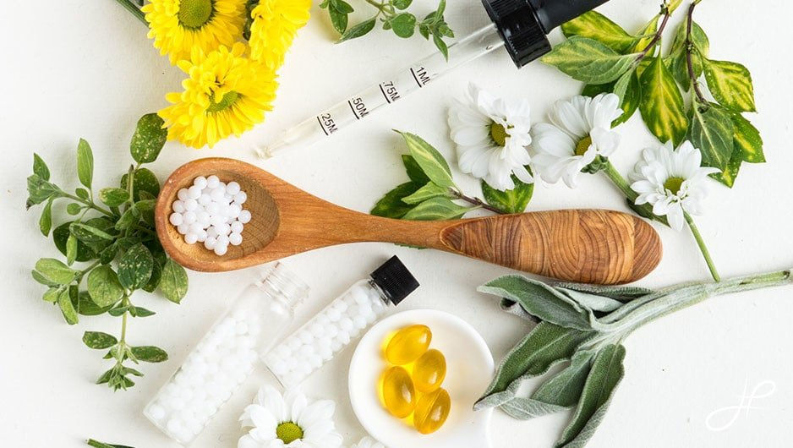

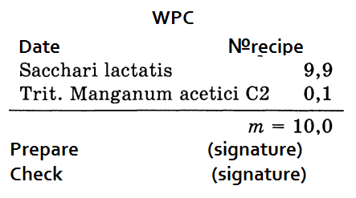
The amount of powder is not specified, so it is necessary to release 10.0 g.
Prepare trituration according to the rules set out in ____________.
To do this, the pharmacist-technologist for basic trituration X1 ( D1) prepares trituration X2 (C1) for 1 hour , mixing 1.0 g of trituration X1 and 9.0 g of milk sugar.
Then prepare the trituration X3 and X4 (C2) in a similar way. The last trituration (C2) must be placed on the turntable in the assistant's room after appropriate quality control and design for use.
The pharmacist weighs 9.9 g of milk sugar and 0.1 g of C2 trituration , after which, according to all the rules, he prepares C3 trituration for 1 hour . The resulting trituration is controlled, then placed in a vial or bag and issued for release with the appropriate prescription number and serial number of the drug in the prescription, indicate the pharmacy number, weight of the drug , date, signature of the pharmacist who prepared the drug.
Filling PPK.

Slide 7
4. Quality control of triturations
The particle size for medicines should not exceed 65 μm .
The quality of triturations is assessed by such indicators as appearance, color, homogeneity, particle size (the bulk of the finished trituration should consist of particles of 25 μm or less, there should be no particles larger than 50 μm ). Particle size is determined using a microscope with ocular micrometers or on the outer specific surface (according to a private article).
In Trituration 1, 2 and 3 decimal dilutions, the identity and quantitative content of the active substance are controlled according to the requirements of private SPh. Triturations containing toxic or potent substances in the 4th decimal dilution are analyzed according to the methods described in the Sun. Deviations in the content of medicine should not be more than 5% in the Trituration of the 1st and 2nd decimal dilution, as well as more than 10% in the Trituration 3rd decimal dilution.
In trituration , containing metals and dyes, determine the homogeneity of mixing by examination under a magnifying glass with 7-9 times magnification. No individual particles should be detected during such an inspection. Medicine should be evenly distributed in trituration . Particle sizes are determined using a microscope or the size of the specific surface area. The value of the outer specific surface of the trituration made with lactose must be at least 0.65 m2 / g
Triturations are also checked for microbiological purity.

Slide 8
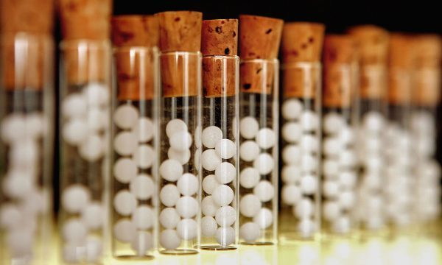
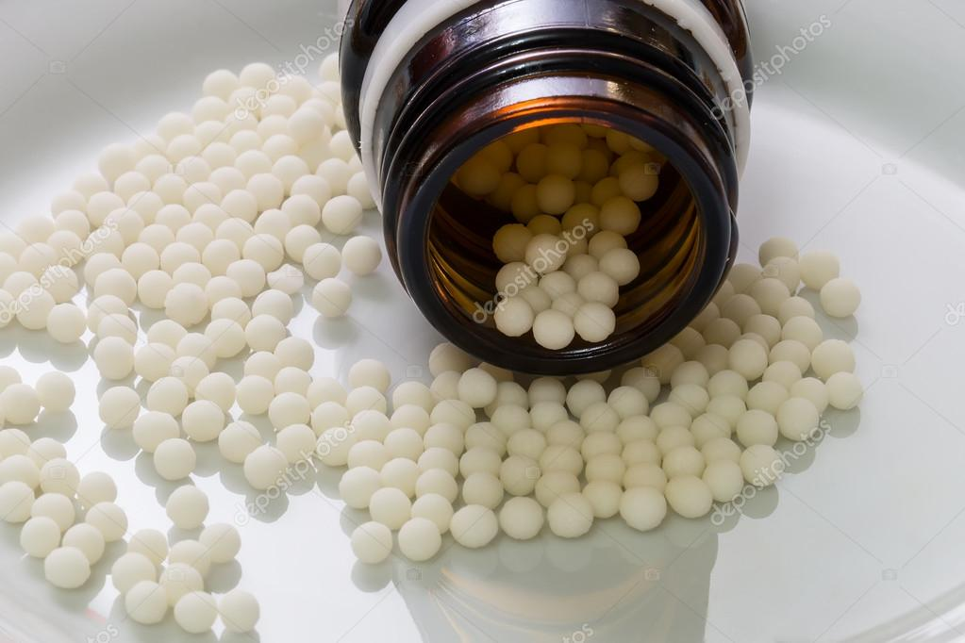
5 . Granulae
granules homeopathic (Lat. granula homeopathica ) - a dosage form for internal use, consisting of solid, dry, strong enough aggregates of dry powders, which are applied potentiated solution, in the form of granules of round, cylindrical or irregular shape .
Granules are made by applying liquid homeopathic dilutions of medicinal substances or mixtures thereof on an auxiliary component - sugar granules obtained from sucrose, lactose and other sugars approved for medical use. To obtain a uniform application of homeopathic dilutions, sugar granules must be of a certain size, which is distinguished by numbers from 1 to 12 or other specified in the private regulations, classified by the number of granules in 1 g or by sieves .
Number of pellets | The number of granules in 1 g | The weight of the sample to calculate their number, g | The average diameter of the granules, mm
1 | 470–530 | 0.1 | 1.4
2 | 220–280 | 0.2 | 1.7
3 | 110–130 | 0.4 | 2.2
4 | 70–90 | 0.6 | 2.5
5 | 40–50 | 1.0 | 3.0
6 | 28–32 | 1.6 | 3.4
7 | 22–28 | 2.0 | 3.7
8 | 16–20 | 2.5 | 4.1
9 | 10 | 5.0 | 5.0
10 | 5 | 10.0 | 6.3
11 | 3 | 15.0 | 7.4
12 | 2 | 25.0 | 8.5

Slide 9
6 . Granules are made in several ways .
Method 1
Method 1. The original granules are applied water-alcohol homeopathic dilution of liquid preparation, triturations or mixtures there of prepared on 70% ethyl alcohol (62% by weight), while the alcohol content in the dilution should be at least 68% by volume (60% by weight). If the concentration of alcohol is below the required, the manufacture of decimal or hundredth dilution intended for application (including mother tinctures) is carried out using ethyl alcohol 70% by volume (62% by weight ).
For uniform distribution of the applied substance, sugar granules are pre-moistened with 70% ethyl alcohol (62% by weight), which is added at the rate of 10 g per 100 g of sugar granules . The application of drugs on sugar granules is performed by mixing in mechanical mixers without moving working parts or manually (for weight up to 1 kg) in glass tightly closed vessels. The working volume of the mixer should be 1.5-2 times the loaded mass of sugar granules. Stirring in mechanical mixers is performed for 3-4 minutes, with the manual method - for 10 minutes. Wet granules are dried in air at room temperature to constant weight.
Sugar granules can be homeopathic dilutions below C3 (third hundredth), derived from volatile and odorous substances, as well as from all acids .

Slide 10
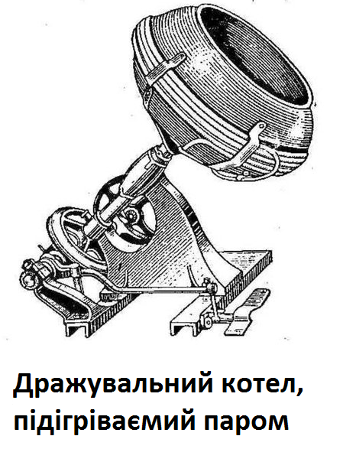
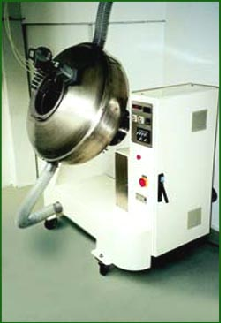
Granules are made in several ways .
Method 2
Method 2. Homeopathic dilution of the drug substance in 64% sugar syrup with drying between operations is repeatedly evenly layered on the sugar granules. This method is used for the application of aqueous liquid preparations (solutions, extracts, etc.) , triturations , mixtures of preparations with low decimal dilutions and in cases where method 1 with the use of alcohol is undesirable.
Layering of liquid drugs. To make 100 g of homeopathic granules 1 g of liquid preparation is shaken from 9 sugar syrup and the obtained 10 g is evenly layered on (100 - X) g of sugar granules, where X is the amount of sugar in sugar syrup (g).
Layering of triturations . To make 100 g of homeopathic granules, 10 g of trituration is shaken from 20 g of sugar syrup, the resulting mixture is evenly layered on (100 X) g of granules.
Layering of mixtures. Mixtures are made by shaking together homeopathic dilutions of liquid drugs and (or) triturations in sugar syrup. To obtain 100 g of granules 1 g of the mixture is shaken from 9 g of sugar syrup and 10 g of this dilution are evenly layered on (100 X-Y) g of sugar granules, where X is the amount of sugar in sugar syrup (g), Y is the amount of excipient, contained in the trituration (d ).
Layering of homeopathic dilutions of medicinal substances in sugar syrup on sugar granules is produced in dragee boilers with adjustable heating. Sugar granules are placed in the coating the boiler, preheated to 37-42 ° C, is slowly rotated until the whole mass of granules is heated to the same temperature. Homeopathic dilutions of medicinal substances in sugar syrup are poured into the dragee boiler gradually, in small equal portions, at regular intervals. After the layering is heated , the coating boiler is stopped, and its rotation is continued to dry the granules to a constant weight.
The amount of drugs applied to the original granules by any of these methods does not significantly change their average diameter and other physical and mechanical parameters.
Composition, calculations and manufacturing technology of some homeopathic dosage forms

Slide 11
7 . Algorithm of homeopathic granules technology
Prescription recipe
Raw materials
Dilutions ( dilutions ) alcohol,
dilutions ( dilutions ) water,
matrix tinctures, complex
dilutions
Excipients
Ethyl alcohol
60%
Sugar grits
Weighing or measuring
calibrated dropper
Weighing or measuring with a calibrated dropper
Weighing
Saturation
Shake from top to bottom (potentiation) for 10 minutes
Drying homeopathic granules on parchment paper at room temperature
Quality control
Packing before the dispensing

Slide 12
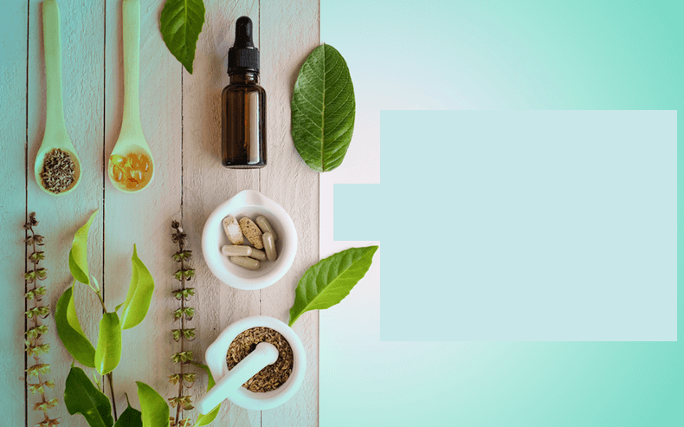
8. Example of granule 1: Rp : Tabacum C13
Calculation:
granules 10.0.
mass : 10.0 / 100 = 0.1.
Weight of ethyl alcohol 62% (by weight): 10.0 / 100 = 0.1.
Manufacturing technology, PPK :
In a jar with a capacity of 30.0 place 10.0 granules of sugar, 4 drops of 62% ethyl alcohol . Then add 0.1 homeopathic dilution of Tabacum C12 , close the vial with a lid wrapped in parchment paper and shake vigorously (potentiate) for 10 minutes . Then the granules are poured on parchment paper and dried at room temperature. The dried granules are poured into a box.
Date __________ PPC № 3
Granulae sacchari 10.0
Spiritus aethylicus 62% 0.1 seu gtt IV
Tabacum C12 0.1 seu gttIV
M = 10.0
Signatures : _______________

Slide 13
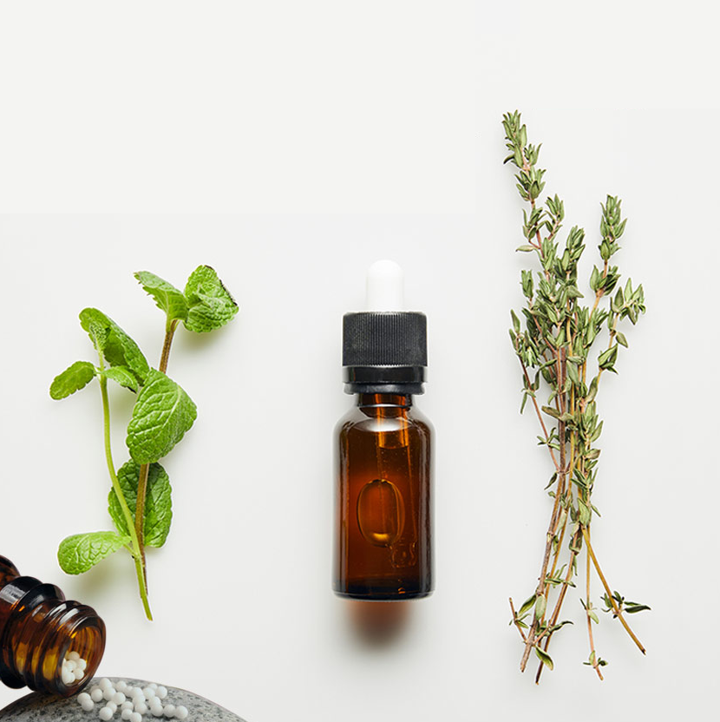
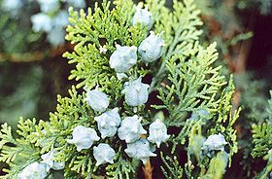
9 . Example of granule 2: Rp .: Gran ulae Thuja C12 10.0
D. _ S. _ 8 granules 3 times a day
Stamp of medical and preventive institution
Date
Surname , name and patronymic of the patient, age
Last name , first name and patronymic doctor
Rp .: Granulae Thuja C12 10.0
Yes . Signa : 8 granules 3 times a day.
Signature doctor _______________
Doctor 's personal seal ____________________
Characteristics of the drug . Homeopathic granules , which include raw materials vegetable origin of Thuja western .

Slide 14
Technology
    PPK ( reverse side )
    Sugar granules 10.0 g
    Dilution Thuja C 11: 0.1 g (3 drops )
    Ethyl alcohol 60 % for moisturizing sugar granules : 0.1 g (3 drops )
Technology . For the manufacture of 10.0 homeopathic granules Thuja C12 weigh 10.0 sugar granules in a vial with a capacity of 30.0 and add 0.1 (3 drops) of 60% ethyl alcohol, shake several times to moisten the sugar granules. Then add 0.1 (3 drops) homeopathic dilution Thuja C11, close the vial with a lid wrapped in parchment paper and shake vigorously (potentiate) for 10 minutes. Then the granules are poured on parchment paper and dried at room temperature. The finished homeopathic granules are transferred to a vial for release. Paste № recipe. Fill PPK (front side).

Slide 15
Facial side of the passport of written control (PPK)
PPK ( front side )
Date № recipe
Granulae saccharati 10.0
Spiritus aethylici 60% gtts . III (0.1)
Dil. T huja C11 gtts . III (0.1)
m = 1 0.0
Prepared by ( signature )
Checked ( signature ) _
Released (signature)

Slide 16
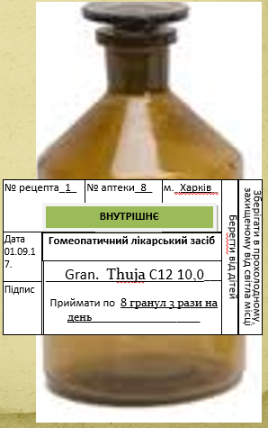
Registration for use
Make out labels : " Internal " , " Keep cool and protected " from light place "," Save from children ".
This homeopathic remedy is used to treat migraines and neuralgia

Slide 17
Quality control of granules
Quality control of homeopathic granules is carried out in accordance with the general FS "Homeopathic granules", assessing the external signs (uniformity of color) and weight, weight of granules in one package, disintegration , shape and microbiological purity .
The identity and quantitative content of BAS are determined in accordance with the requirements of private ND.
Granules should be white with a gray or yellowish tinge. Evaluate the type of granules on visual inspection with the naked eye mass of the sample granules, recommended for counting their number, weighed to the nearest 0.01 g
Check for degradability : 10 g of granules are placed in a conical flask with a capacity of 100 ml, add 50 ml of purified water (37 ° C). The flask is slowly shaken 1-2 times per second. Carry out at least 3 determinations. The granules should disintegrate completely in no more than 5 minutes.
The amount of LR applied to the granules does not change their diameter and physicochemical parameters, so to characterize homeopathic granules use indicators of the original granules.

Slide 18
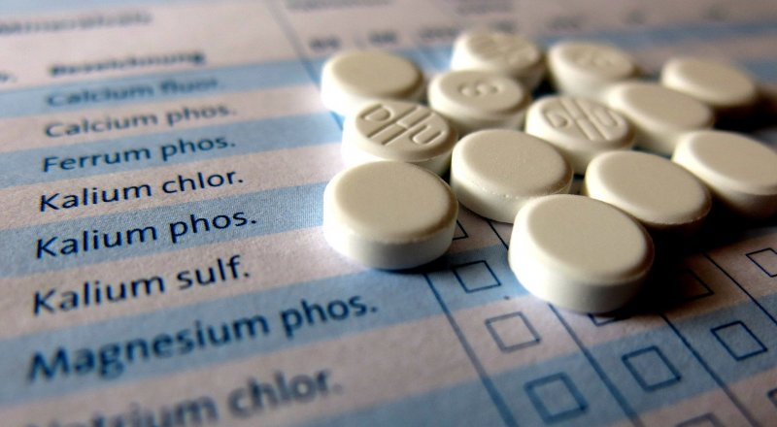
10. Homeopathic pills
Homeopathic tablets -
solid medicinal products obtained using sucrose, lactose or other relevant excipients in accordance with the article "Tablets". They can be obtained by compression of one or more solid active substances with excipients or impregnation of pre-formed tablets by diluting homeopathic basic preparations. Intended for oral or sublingual use.

Slide 19
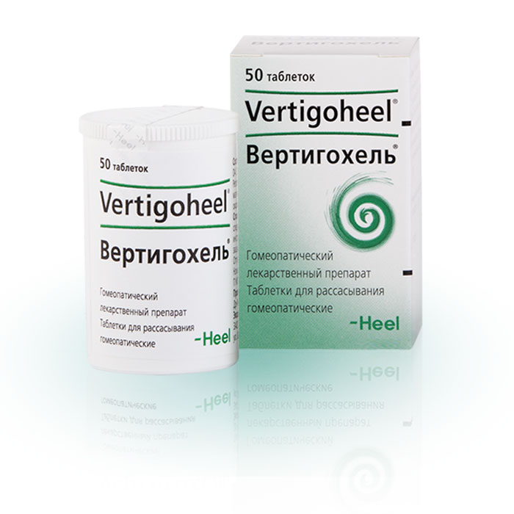
12. Tablets for homeopathic use
Tablets are made with trituration by pressing . As a formative wave substance use starch and with content up to 10% and salt and calcium or magnesium in concentrations up to 2%. By necessity use solution saturated lactose , starch paste or ethanol in the corresponding concentration .

Slide 20
13. Tablet quality control
tablets have the same requirements as allopathic tablets (without shells). Indicators such as appearance, abrasion resistance, disintegration , average weight of tablets, microbiological purity, are evaluated in accordance with the articles of the GF .
The authenticity of medicinal and excipients, the quantitative content and homogeneity of the dosage of drugs and other indicators are determined in accordance with the private FS.
Deviations in the content of active substances at a dosage of up to 0.001 g should not exceed 15%, at a dosage of 0.001 to 0.01 - 10%, from 0.01 to 0.01 g - 7.5%.

Slide 21
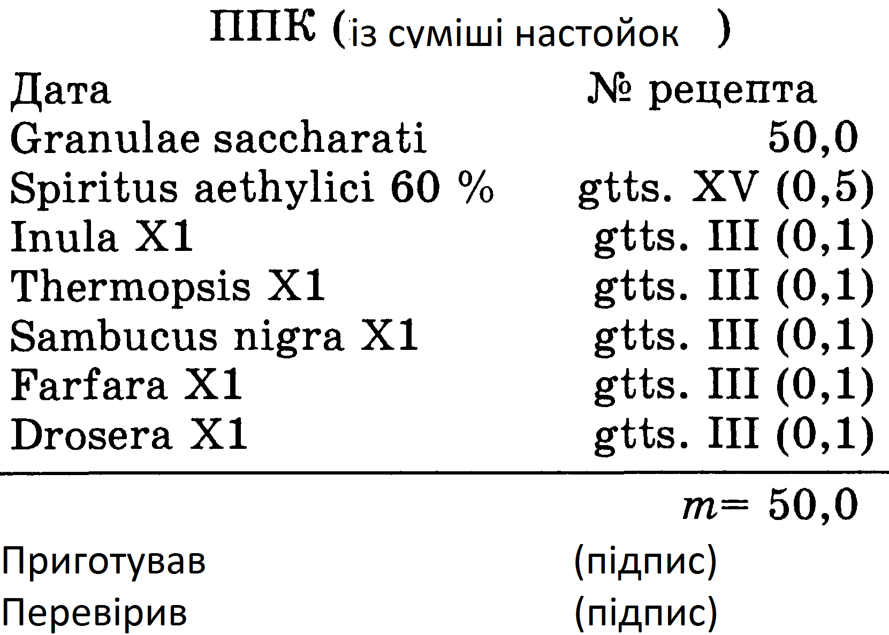
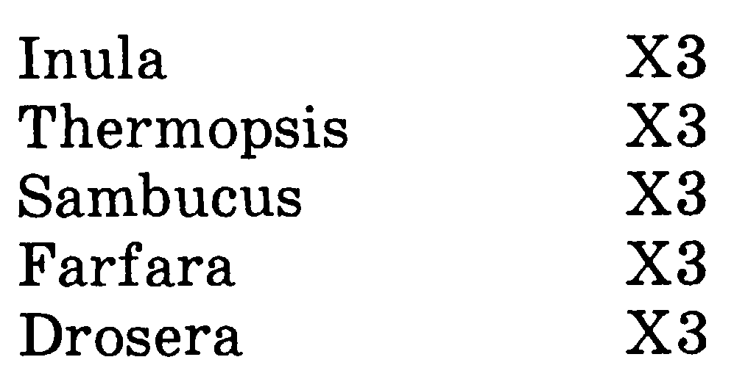
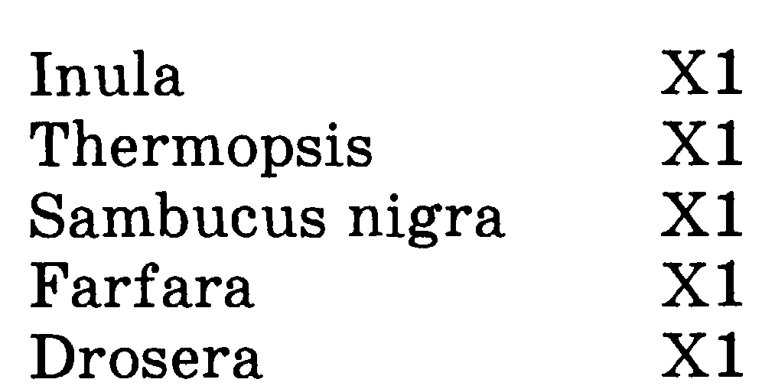
14. Preparation complex homeopathic medicinal forms in the form of granules
Most complex homeopathic remedies are prepared in the form of granules due to the convenience of their use. One such drug is Phytotusin , which has the following composition:
For the preparation of this drug in the form of granules it is necessary to have basic tinctures:
If it is necessary to prepare 50.0 g of Phytotusin , weigh 50.0 granules into a vial with a capacity of 100.0 ml, then add 0.5 g (15 drops) of 60% ethyl alcohol and 0.1 g (3 drops) of each name of tincture.
Thoroughly shake the granules (at least 10 minutes) to fully and evenly saturate them, then pour a thin layer on parchment paper to dry. After drying, transfer the saturated crumbs to a vial (or paper bag), which is issued before the holiday.

Slide 22
Questions for self-control
1. Characteristics of solids homeopathic dosage forms.
2. Technology production solid homeopathic dosage forms.
3. Quality control solid homeopathic dosage forms.
4. Registration for vacation solid homeopathic dosage forms.
5. Characteristics of complex homeopathic drugs .
6. Technology production complex homeopathic drugs .
7. Quality control complex homeopathic drugs .
8. Registration for vacation complex homeopathic drugs

Slide 23

Thank you!

