Slide 1
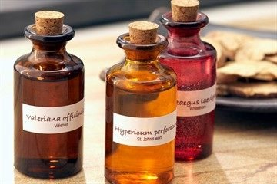

ODESSA NATIONAL MEDICAL UNIVERSITY
DEPARTMENT OF PHARMACEUTICAL CHEMISTRY
AND DRUGs TECHNOLOGY
Technology production liquid homeopathic dosage forms.
Presentation prepared by :
Assoc . Fizor N.S.

Slide 2
Plan
Introduction
I. Homeopathic solutions and dilutions for internal use
I.1. Mixturae _ _
I. 2. Drops ( Guttae )
I.3. Dilution liquid substances ( essences , tinctures , solutions )
I.4. Rare dilutions from
I.5. Quality control of liquid drugs for internal use
II. Liquid dosage forms for external use
II.1. Alcohols
II.2. Olea oils _
II.3. Liniments ( Linimenta )

Slide 3
Introduction
Liquid dosage forms are intended for both internal (potions, drops) and external use ( washing, lotions, oil solutions, liniments, etc. ), and very rarely in the form of primary essences, tinctures or solutions.
                Example. Тhuja θ
                To lubricate warts
According to this recipe, 10.0 g of the finished essence is released, which is used as intended. However, most often from the prepared basic (original) homeopathic remedies prepare appropriate dilutions on decimal or hundredth scales.

Slide 4

Thuja occidentalis
https://www.youtube.com/watch?v=5TJWGLH_TnY

Slide 5
I. Homeopathic solutions and dilutions for internal use
Homeopathic solutions and dilutions ( Solutionese et dilutiones homeopathica ) for internal use are a liquid homogeneous (homogeneous) system of medicinal substances in a suitable solvent .
Sanitary requirements in accordance with the Instruction on the sanitary and anti-epidemic regime of pharmacies must be observed during their production .
In terms of microbiological purity, solutions and dilutions must meet the requirements of the current SPh.
For single ingestion, liquid drugs are prescribed for 5-8 drops in a teaspoon of water (or without water).
The amount of active substance in one drop depends on the degree of dilution (5 drops of D1 corresponds to approximately 0.025 g, D 2 - 0.0025 g, etc.).

Slide 6
I.1. Mixturae
Potions in homeopathic practice are used very rarely . Sometimes they are used in the nursery practice , taking 10 drops of the corresponding decimal or hundredth dilution of 30.0 g purified water and appoint 1 teaspoon several times a day.

Slide 7
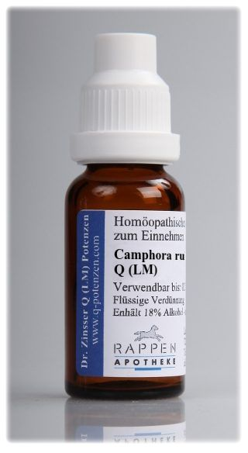
I. 2. Drops ( Guttae )
Drops - one of the most commonly used dosage forms, dosing with a pipette or stopper - a caplemer (stopper-dispenser). If the prescription does not specify the amount of the drug, it is released 10.0 g .
              Example. Camphora Rubies
              3-5 drops per sugar intake 3-4 times a day.
This drug got its name from the Italian professor Rubini, who proposed it. Prepare 10.0 g of a solution consisting of equal parts of camphor and 96% alcohol .

Slide 8
I.3. Dilution liquid substances
( essences , tinctures , solutions )
Dilution liquid substances ( essences , tinctures , solutions ) are carried out in a protected room from direct impact solar light .
When cooking dilutions must be strictly adhered to several technological rules, namely :
1 ) for each dilution use separate utensils that must have volume by 1 / 2-1 / 3 more volume diluted drug ;
2 ) the name of the drug and dilution for which the vessel is appointed , indicate both on a stopper , and on a vessel ;
3 ) in the process preparation each dilution vigorously shake ( potentiate ) 10 times from top to bottom ( in parallel earthly axis ).
Dilution large quantity produce lower in this way, when this work with weights ratios ; when breeding small quantities ( less than 3.0 g) work with drops 1 .

Slide 9
I.3. Dilution liquid substances
( essences , tinctures , solutions )
For decimal scales :
Glasses with the name of the drug and the designation dilutions from C1 to the WHO is placed on the table and starting with C2 , in each pour in 9 parts ethyl alcohol appropriate concentration ( according to instructions private articles ). First decimal dilution ( D 1 ) prepared from the essence or medicinal substances on the rules set out in the relevant paragraphs leadership of V. Schwabe. In a vessel marked D 2 placed 1 part the first decimal dilution solution , essence or tinctures and shake . Then one part received dilution transferred to the next vessel ( D C ) , etc.
What applies concentration of alcohol for cooking dilutions , then according to private articles of leadership V. Schwabe exist the following rules:
- if basic drug and the first decimal dilution of the drug D 1 prepared by 90% - in ohms (by weight ) alcohol , then dilution D 2 and D C are prepared by 90 % alcohol , D 4 - by 60 % alcohol , and D 5, D 6 and on prepared on 45% alcohol ;
- if the drug and dilution D 1 prepared for 60% alcohol (by weight ) , then diluted D 2 and D C prepare also by 60% - vom alcohol , and starting with D 4 or more high dilution are prepared by 45 % alcohol ;
- if essence , tincture, solution cooked on 45% (by weight ) alcohol , then all dilution also cooked by 45% - in ohms alcohol .

Slide 10
I.3. Dilution liquid substances
( essences , tinctures , solutions )
For the hundredth scales :
Vessels with the name of the drug and the designation dilutions from C1 to WHO put on the table in a row and in each , starting with C2, is placed in 99 parts ethyl alcohol appropriate concentration . Of essences , tinctures or solution according to the rules of the relevant paragraph prepare the first hundredth breeding . Then one part of the finished dilution C1 is placed in a vial marked C2, capped and mixed by ten times vigorous shaking from top to bottom, ie Potentiate . One part the obtained second hundredth dilution (C2) is placed in a vessel marked SZ and again shake . Continue in the same way dilution of the drug by placing each time one part previous breeding in the next vessel, which carefully shake 10 times . Similarly cook and more high breeding .
What applies concentration of alcohol for cooking data dilutions , then from the instructions private articles follow the following :
- if essence , tincture, solution prepared on 90% ethyl alcohol , in which case the dilution of C1 ( D 2) is prepared at 90%; C2 ( D 4) - 60%; NW ( D 6) and further - on 45% ethyl alcohol ;
- if basic preparations prepared on 60% ethyl alcohol , then dilution C1 ( D 2) g a otuyut also on 60% alcohol , and dilution of C2 ( D 4) and more high - on 45% alcohol ;
- if drugs _ cooked on 45% alcohol , then all dilution prepare only on 45% alcohol .
So, as we see , starting approximately from the NW all breeding essences , tinctures , alcohols solutions prepared on 45% alcohol .
If basic preparations D 1 and C1 are water-soluble chemical compounds cooked in water purified and her, then all the same from the NW and beyond , ie more high dilution prepared on 45% alcohol and in this form released to the patient.

Slide 11
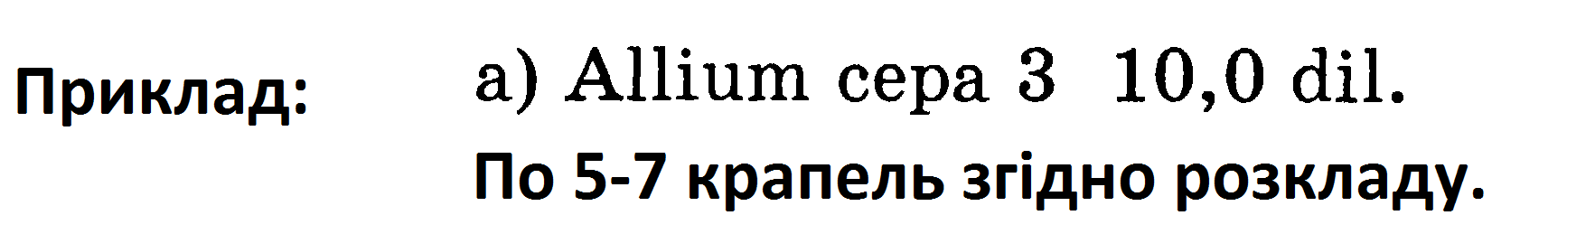
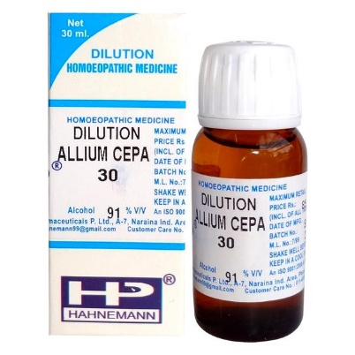
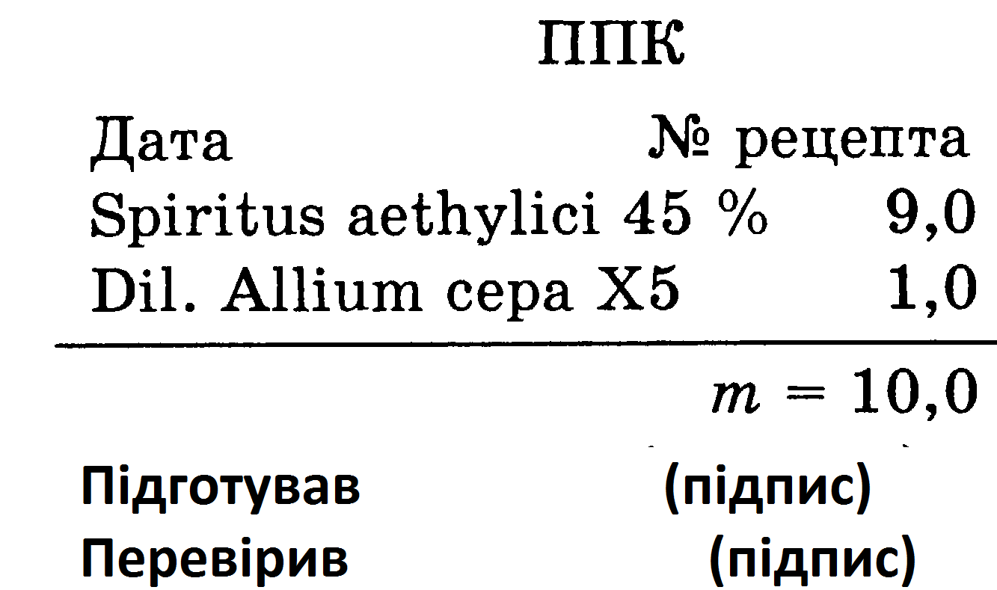
I.3. Dilution liquid substances
( essences , tinctures , solutions )
It should be borne in mind that the label of dilution of aqueous-alcoholic solution in addition to the name of the drug substance and dilution must indicate the concentration of alcohol and date of manufacture.
The pharmacy has the essence of onion, prepared according to § 1 in a ratio of 1: 2, the concentration of alcohol is approximately 45 %. The pharmacist-technologist puts 5 vials with corks on the table, numbers them ( D1, D2, D C, D4, D5) and first prepares the tincture from the essence according to § 1, ie in the first vial weighs 8.0 g of 45% ethyl alcohol , and in the second, third, fourth and fifth - 9.0 g of alcohol of the same concentration. Then bottle with the designation D1 weighs 2.0 g of onion essence, covers the neck with parchment paper or cellophane and vigorously shakes the mixture 10 times from top to bottom . After that, from the vial D1 weigh 1.0 g of dilution in the vial with the inscription D2 and shake again 10 times; from the vial D2 weighs 1.0 g of dilution in the vial labeled D 3, and shake again . Similarly prepares dilutions D4 and D5. The resulting dilution of D5 is analyzed, designed for use and placed on a turntable in the assistant's room. The pharmacist weighs into the vial for the release of 9.0 g of alcohol 45% and 1.0 g of dilution D5, shake 10 times and get the necessary dilutions of SZ ( D6), passes for control, and then draws up a prescription number, the serial number of the drug in the prescription; on the label with the inscription "Internal" indicates the pharmacy number , weight of the drug, date and your signature .

Slide 12

Allium cepa
https://www.youtube.com/watch?v=BuVJU61gOHw

Slide 13
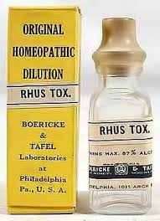
I.4. Liquid dilutions from tyrurations
It should be noted that solutions in homeopathy are not always true - the name " dilutions " can also mean suspensions of insoluble substances.
Thus, liquid dilutions can also be prepared from triturations (powder rubs) in two ways: the first is given in the manual of W. Schwabe, the second - introduced to the latest edition of the German Homeopathic Pharmacopoeia.

Slide 14
Method 1.
I.4. Rare dilutions from
To obtain the fourth hundredth dilution (C4)
dissolved in 79 parts of water,
add 20 parts of 86% ethyl alcohol (by weight) and
shake
The fifth hundredth (C5) and all subsequent hundredth dilutions are prepared from 1 part of the previous hundredth dilution and 99 parts of 43% ethyl alcohol (by weight) by shaking.
1 part of the trituration of the substance of the third hundredth dilution (C3)

Slide 15
Method 2.
I.4. Rare dilutions from
To obtain the sixth decimal dilution (D6)
1 part of the trituration of the substance of the fourth decimal dilution (D4)
dissolved in 9 parts of water and
shake
Then 1 part of the obtained dilution is shaken with 9 parts of ethyl alcohol 30% by weight.

Slide 16
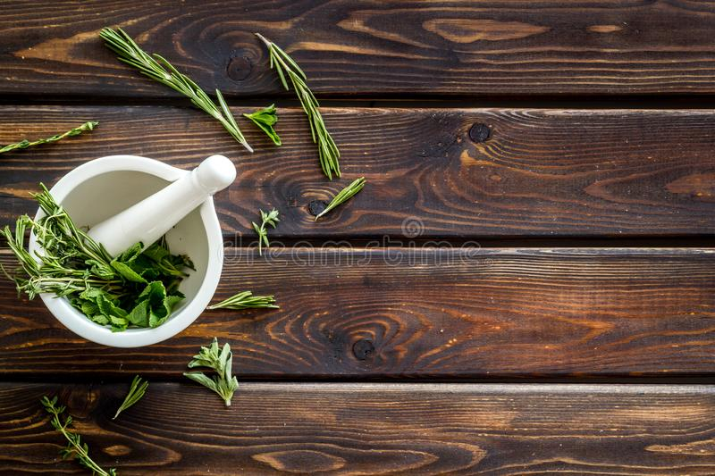
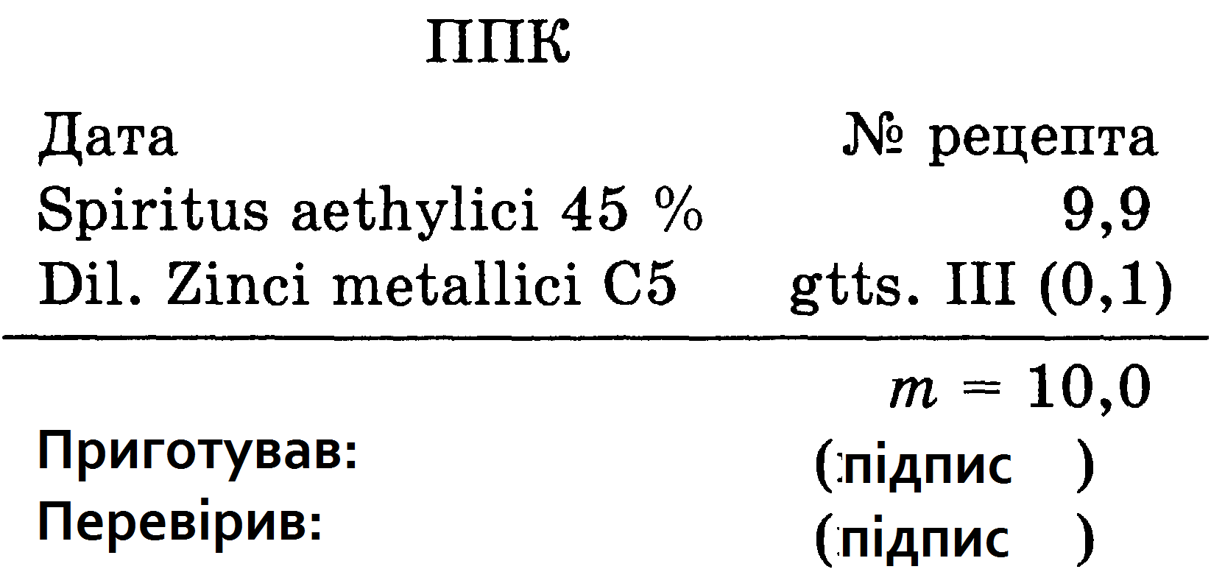
I. _ 4. Example: Zincum metallic 6 10.0 dil.
          6-8 drops according to the schedule
To obtain the fourth hundredth dilution (C4)
dissolved in 79 parts of water,
add 20 parts of 86% ethyl alcohol (by weight) and
shake
The fifth hundredth (C5) and all subsequent hundredth dilutions are prepared from 1 part of the previous hundredth dilution and 99 parts of 43% ethyl alcohol (by weight) by shaking.
1 part of the trituration of the substance of the third hundredth dilution (C3)
The pharmacist-technologist must first prepare from insoluble matter (metal) the original (basic) Trituration X1 ( D 1) in accordance with the instructions of § 7 of the guide V. Schwabe
He then weighs 7.9 g of purified water into a tared bottle
adds 2.0 g of 90% ethyl alcohol, puts here 0.1 g of prepared trituration of zinc metal SZ
then vigorously shake the closed vial for 10 min, obtaining a stable suspension of C4.
Then in a vial labeled C5 weigh 9.9 g of 45% ethyl alcohol, add 0.1 g (3 drops) of dilution C4 and shake 10 times to obtain a dilution of C5
then potentiate it first on the decimal scale to D 4 (C2), then on the hundredth scale to NW.
After full quality control and registration before use, the C5 dilution is placed on a turntable in the assistant's room. The pharmacist weighs 9.9 g of 45% alcohol into the vial for the holiday, adds 0.1 g (3 drops) of dilution C5, shake its 10 times and passes to control the relevant parameters
draws up a prescription number, serial number and label " Internal ", on which the pharmacy number, weight of the drug, date of manufacture and signature are indicated prepared .

Slide 17
I.5. Quality control of liquid drugs for internal use
Quality control of liquid drugs for internal use is carried out on the general indicators:
appearance (transparency, color), odor , density, alcohol concentration, identity and quantitative content of active substances, if it is specified in private articles .
Deviations in the content of the drug in the solution (unless otherwise indicated in private articles) should not exceed:> ± 5% at a content of 10 or 1% of the substance (first and second decimal dilutions),> ± 10% at a content of 0.1% of the substance (third decimal dilution ).
Solutions of the fourth decimal dilution, containing medicinal substances that require careful handling and special storage conditions (mercury, arsenic, silver nitrate, potassium dichromate, potassium dichromate , tinctures of aconite, chilibuhi , strophanth , etc.)> should be tested according to the methods described in private articles.

Slide 18
II. Liquid dosage forms for external use
Liquid dosage forms for external use include:
- alcoholic solutions (alcohols),
- oils,
- liniments (opodeldok).
In these dosage forms the principle of small doses is not used .

Slide 19
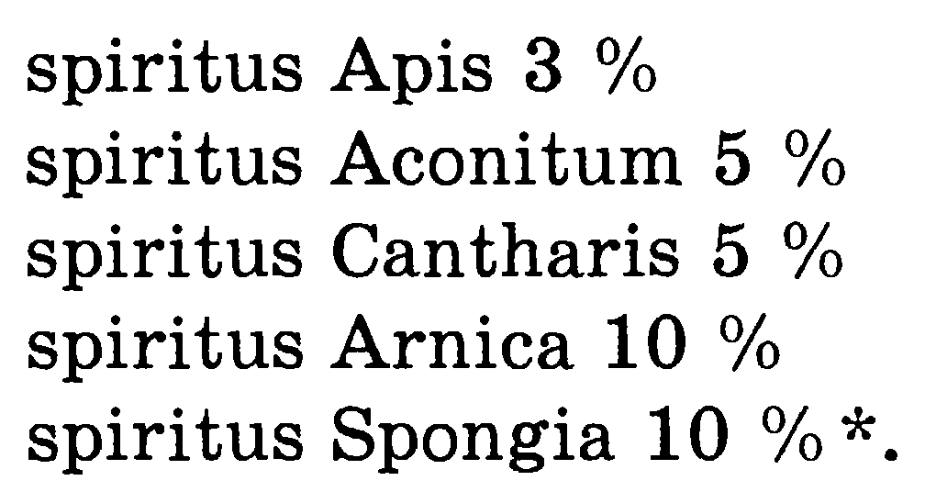
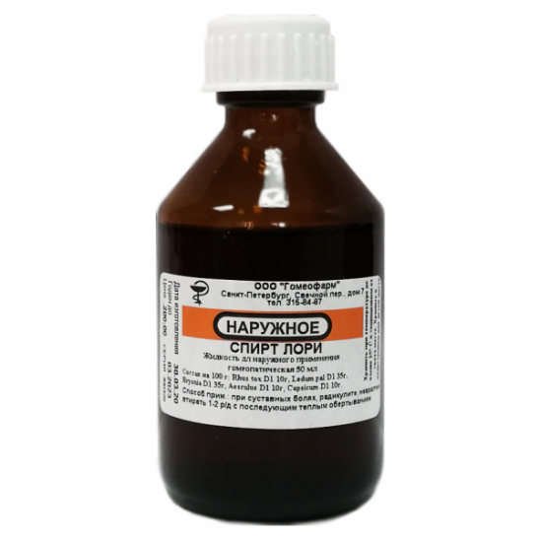
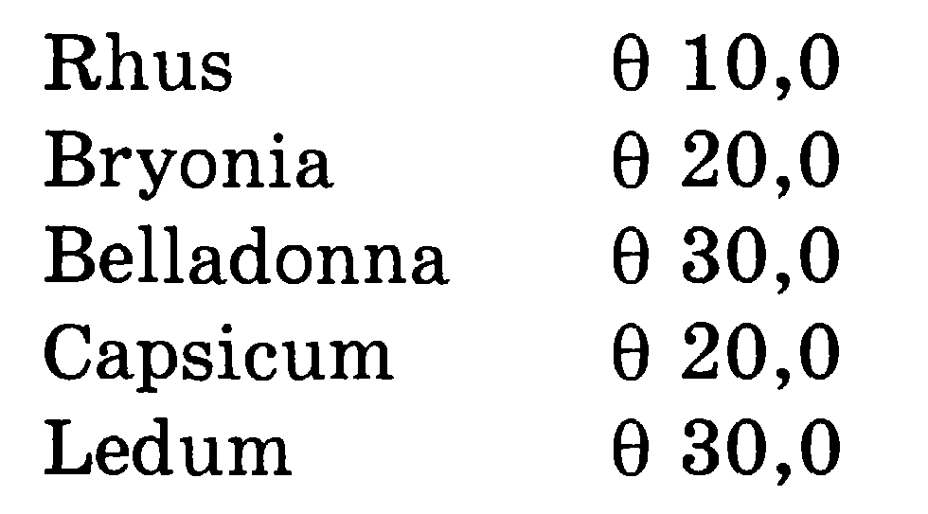
II.1. Alcohols
Alcohols are prepared by mixing the appropriate amount of alcohol tinctures with 60% ethyl alcohol .
In addition to these simple alcohols in homeopathic practice often use a complex alcohol Lori, named after Dr. Lori, author of "Home Homeopathy" in three parts . The drug is used as a rub for muscle pain, radiculitis

Slide 20
II.2. Olea oils _
Homeopathic oils are intended only for external use in the form of 10% solutions of medicines in olive ( Provencal), almond, sunflower, vaseline and other oils. Prepare them according to the general rules, dissolving medicinal substances in oil or most often - by mixing a certain amount of tincture XI with oil with vigorous shaking. However, for some oils the concentration of the original tincture differs from the standard (0.5%, 1%, 3%).
The following oils are most often prescribed:
_{oleum Apis 3%;}
_{oleum Aconitum 5%;}
_{oleum Bryoniae 10%;}
_{witch hazel 10%;}
_{Calendula oil 10%;}
_{oleum Cantharis 3%;}
_{oleum Camphorae 10%;}
_{oleum Ledum 10 %;}
_{oleum Paeoniae 10 %;}
_{oleum Chamomillae 10%;}
_{oleum Spongiae 5%;}
_{oleum Thujae 10%;}
_{oleum Chloretonum 0.5%;}
_{oleum Cyclamen 1%;}
_{oleum Cimicifugae 10%.}

Slide 21

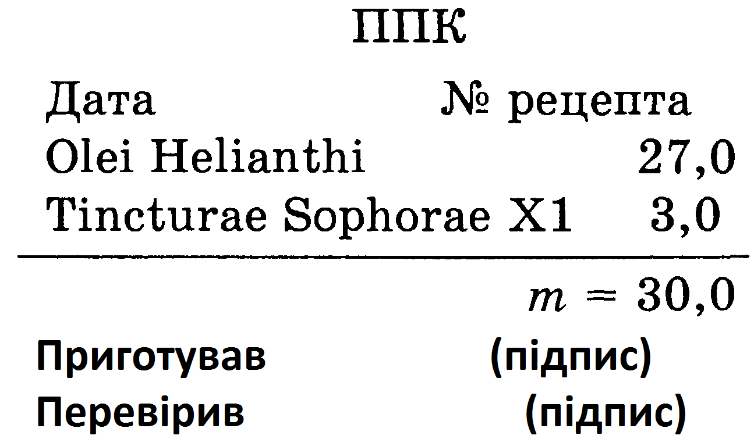
II.2. Olea oils _
Example
The concentration of oil is not specified, so prepare it 10%. The pharmacist weighs 27.0 g of sunflower oil into a tared vial for release, then carefully weighs 3.0 g of sophora X1 tincture and carefully shakes the vial, closing it with a cork. Carry out quality control of the drug on the above indicators and draw up a prescription number, serial number, additional label "Shake before use" and the main label "External", which indicates the pharmacy number, weight of the drug, method of use, date and signature prepared.

Slide 22
II.3. Liniments ( Linimenta )
Liniments - liquid obodeldok, or studnpodbbni liniments are jelly -like solutions of soap in alcohol, which at body temperature turn into a liquid. Compositions include camphor, ammonia (ammonia solution), ethyl and soap alcohols , essential oils and other substances. If a solution is used to prepare the dough and higher fatty acids with high molecular weight, the process of gelatinization of the mixture is faster, so for the preparation of opodelkov use soaps with a significant content of sodium salts of palmitic and stearic acids .
Opodeldok is prepared by mixing 2 parts of soap alcohol, 1 part of water and 1 part of 96% ethyl alcohol. Thus prepared, the mixture is mixed with different tinctures in the appropriate ratio ( 3.5 and 10%). Concentrations of pollen correspond to oils (see Scheme 20) and are 3 or 5% for potent agents and 10% for non-potent agents .

Slide 23
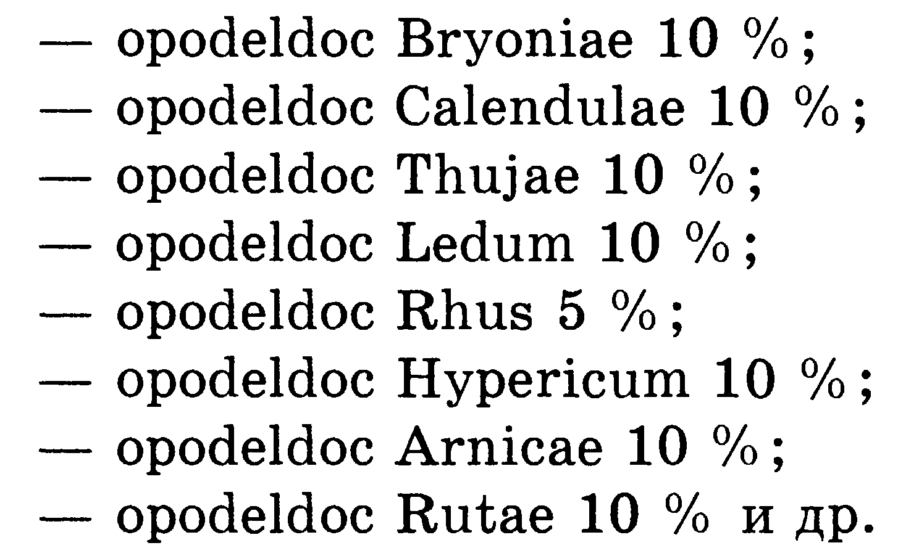
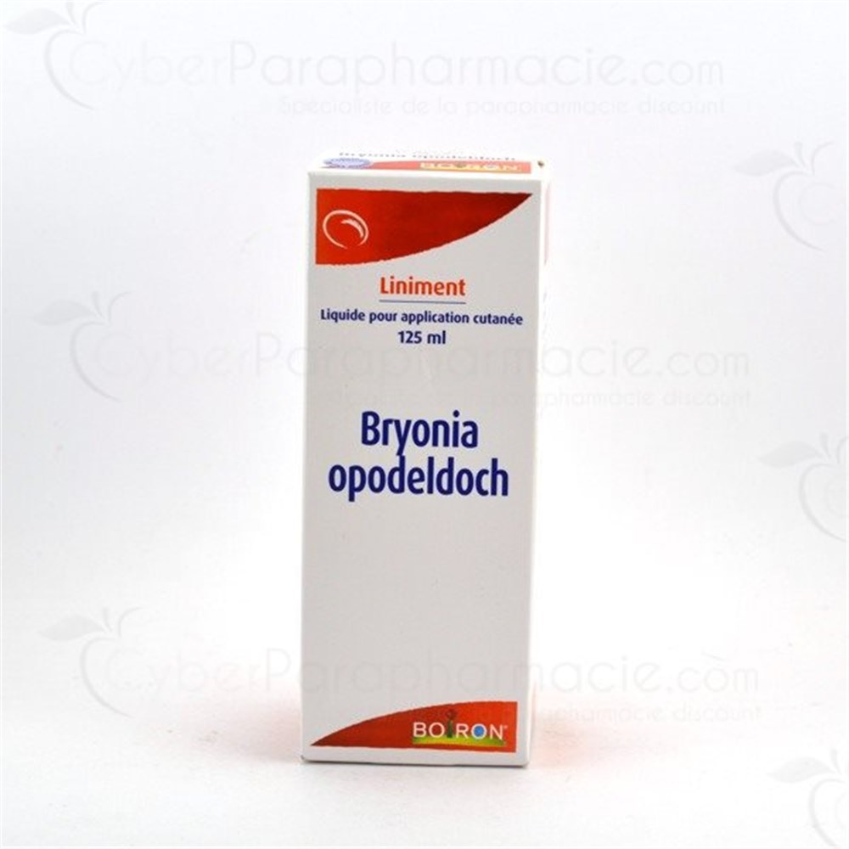
II.3. Liniments ( Linimenta )
Quite often the following names are prescribed:
The composition of soap alcohol is complex
( Alcohol saponis compositions ) :
- green soap - 20 parts;
- purified water - 2 parts;
- lavender alcohol - 3 parts;
-ethyl alcohol - 8 parts.
The composition of lavender alcohol ( Spiritus lavandulae )
- lavender oil - 1 part;
-ethyl alcohol 90% -20 parts;
-ethyl alcohol 70% -74 private .
The quality control of the products is carried out similarly to oils (homogeneity, color and odor, no mechanical inclusions). The label must indicate the name of the drug that is part of the liniment, and its concentration.

Slide 24
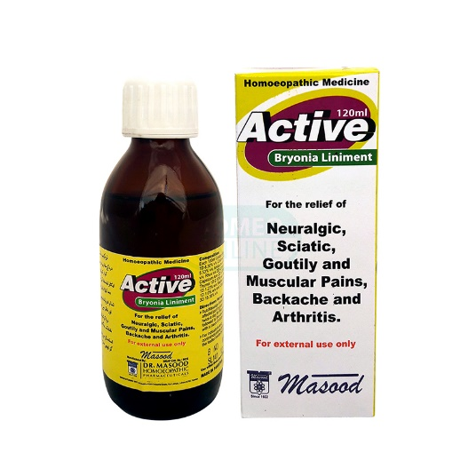
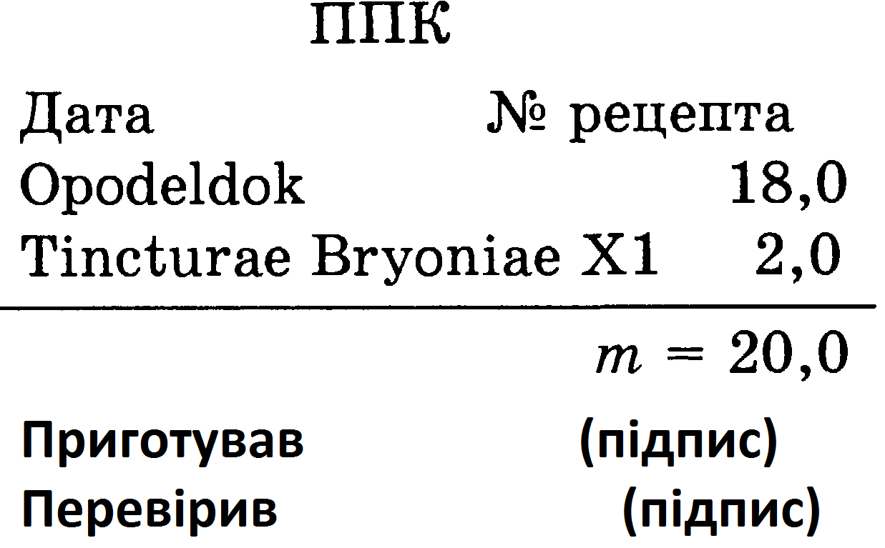
II.3. Liniments ( Linimenta )
Weigh 18.0 g of the prepared base of the trimmings into the tared vial for tempering, add 2.0 g of tincture of brionia X1, close and shake thoroughly. Then check the quality of the prepared drug and issue before release the prescription number, serial number, additional labels "Keep in a cool place", "Shake before use" and the main label "External" indicating the required details.

Slide 25
Questions for self-examination
1 Characteristics of the basic homeopathic drugs , matrix tinctures .
2. Technology production homeopathic matrix tinctures .
3. Features potentiation of homeopathic matrix tinctures .
4. Quality control homeopathic matrix tinctures .
5. Characteristics of liquids homeopathic dosage forms.
6. Technology production liquid homeopathic dosage forms.
7. Quality control liquid homeopathic dosage forms.
8. Registration in liquid homeopathic dosage forms.

Slide 26

Thank you!

