Slide 1
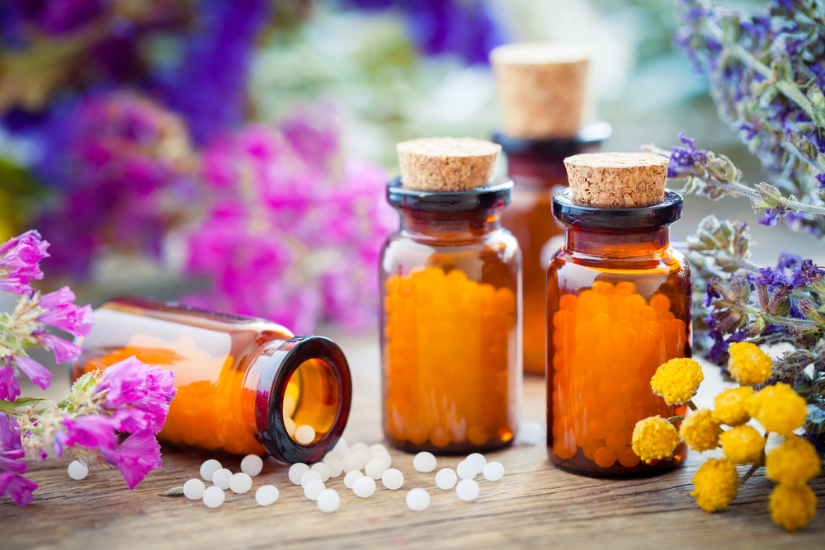

ODESSA NATIONAL MEDICAL UNIVERSITY
DEPARTMENT OF PHARMACEUTICAL CHEMISTRY
AND DRUGs TECHNOLOGY
Complex homeopathic medicine. Technology complex homeopathic medicinal drugs , registration for release and control quality .
Presentation prepared by :
Assoc . Fizor N.S.

Slide 2
Plan
1. Introduction
2. Features of technology of complex drugs
3. Antigrippin _
4. Aflubin _ _ _
5. Broncho - gran _
6. Homeovox _ _ _
7. Cardio -gran ( Cardio-gran )
8. Pump
9. Technology of liquid complex homeopathic dosage forms
10. Features of preparation of combined ointments
11. Controversial moments directed _ against complexes
12. Interactions in complex homeopathic medicinal preparations
13. Comparable homeopathic remedies
14. Modern homeopathic remedies

Slide 3
1. Introduction
Complex homeopathic remedies are homeopathic remedies that contain two or more ingredients in the same or different potencies.
Complex homeopathic remedies are based on commonly used prescriptions , ie on the basis of well-studied and clinically tested for decades combinations.
The pharmaceutical market of Ukraine is rapidly being filled with complex homeopathic remedies of both domestic and foreign production. These drugs are mostly (except for injectable solutions) available without a prescription, which means that they can be purchased and used by any buyer at its discretion. At the same time the preparations of a vegetable, animal and mineral origin prepared on special technology are used. This therapy does not cause side effects, can be used alone or in addition to normal medical practice.
Complex homeopathic remedies are successfully used in therapy, neuropathology, surgery, dermatology, pediatrics, ophthalmology and other fields of medicine.
One of the reasons for this is the efficiency and simplicity in the treatment of chronic diseases. Statistics show that if at the beginning of the XX century only half of all diseases were chronic, nowadays about 90% of diseases are chronic .

Slide 4
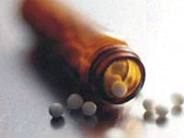
2. Features of technology of complex drugs
Foreign companies produce complex drugs in the form of drops, granules, tablets, ointments, creams, capsules, suppositories , solutions for injection.
Domestic manufacturers produce , mostly complex granules and drops .
HOMEOPATHIC DROPS:
a) weigh into the vial the calculated amount of ethyl alcohol of the required concentration and alternately each dilution ( potentiated an order of magnitude lower than planned), shaking each time after adding the next ingredient;
b) in the vial weigh the calculated amount of ethyl alcohol of the required concentration and the mixture of previously potentiated dilutions (in equal amounts, an order of magnitude lower than planned), shake.
Homeopathic granules:
a) the vial is weighed granules , wet their calculated the amount of 70 % ethyl alcohol and each dilution in turn ; carefully shake , pour slide on parchment drying paper ; _ transferred to the dispensing container;
b) if prepare complexes in large quantities , the granules saturate mixture dilutions prepared as an in- pharmacy preparation.
NB! Insoluble ingredients are ground separately with lactose.

Slide 5
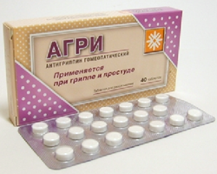
3. Antigrippin
Composition № 1 (3 components ):
Aconitum (pharmacy aconite) C200,
Arsenic iodate (arsenic (III) iodide) C200,
Rhustoxicodendron ( toxicodendrodubolistic ) C200;
Composition № 2 (3 components):
Bryonia ( Brioni ) C200,
Phytolacca (American laconus) C200,
Hepar sulfur (calcareous sulfur liver according to Hahnemann ) C200 .
Pharmacological action.
Anti-influenza - has antipyretic, immunostimulatory and adaptogenic effects, helps to reduce the symptoms of general intoxication in acute respiratory diseases. The drug eliminates headaches and muscle aches, hoarseness, inflammation and cough. In addition, the drug prevents the development of complications in patients with acute respiratory diseases. Antigripin helps to increase the body's defenses and can be used as a preventive measure during seasonal epidemics of influenza and acute respiratory viral infections.
The main indications for use . The drug is used for the treatment and prevention of influenza and acute respiratory diseases of various etiologies.

Slide 6
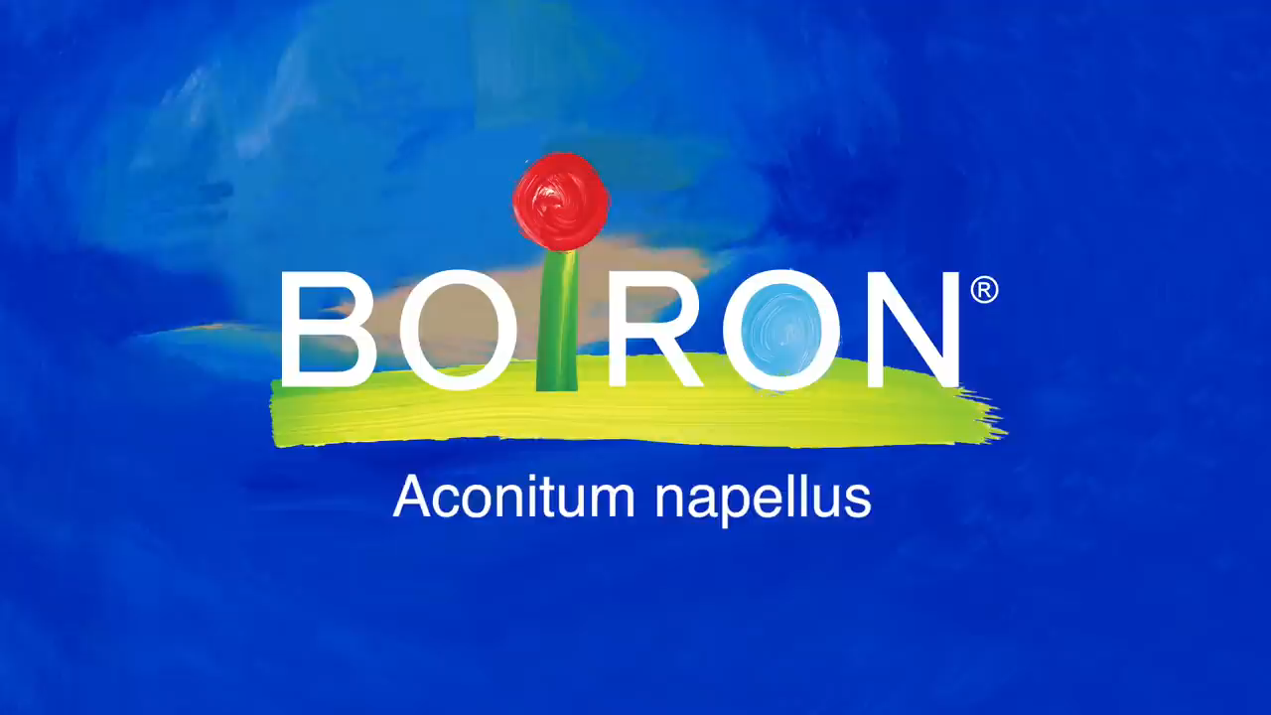
https://www.youtube.com/watch?v=7Dl3izLOX68

Slide 7
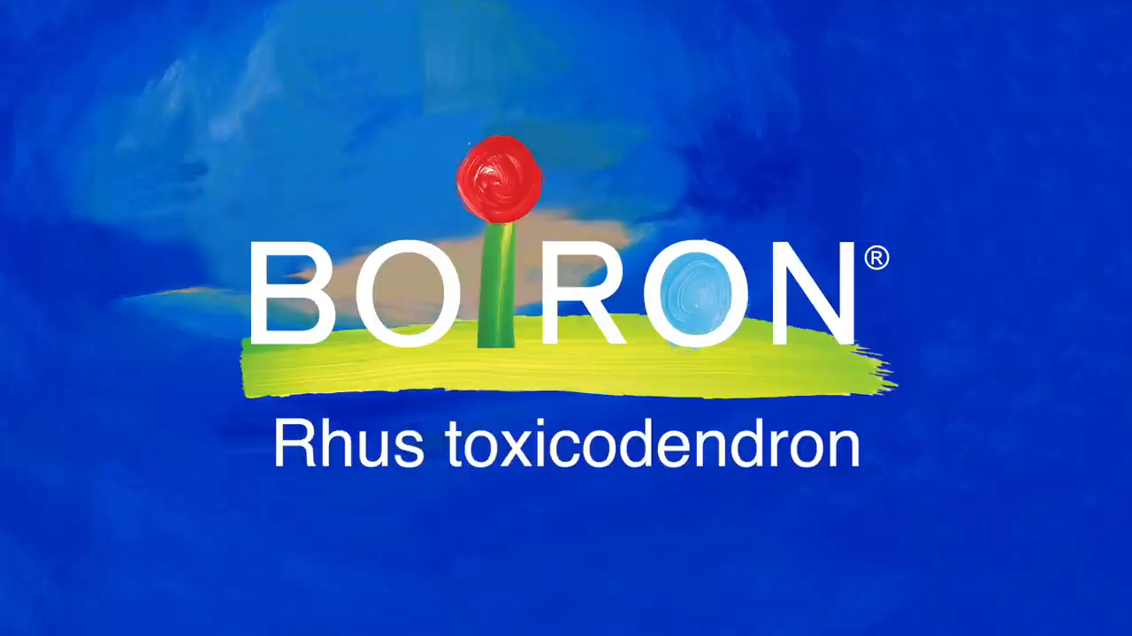
https://www.youtube.com/watch?v=fQPTMGTeErY

Slide 8
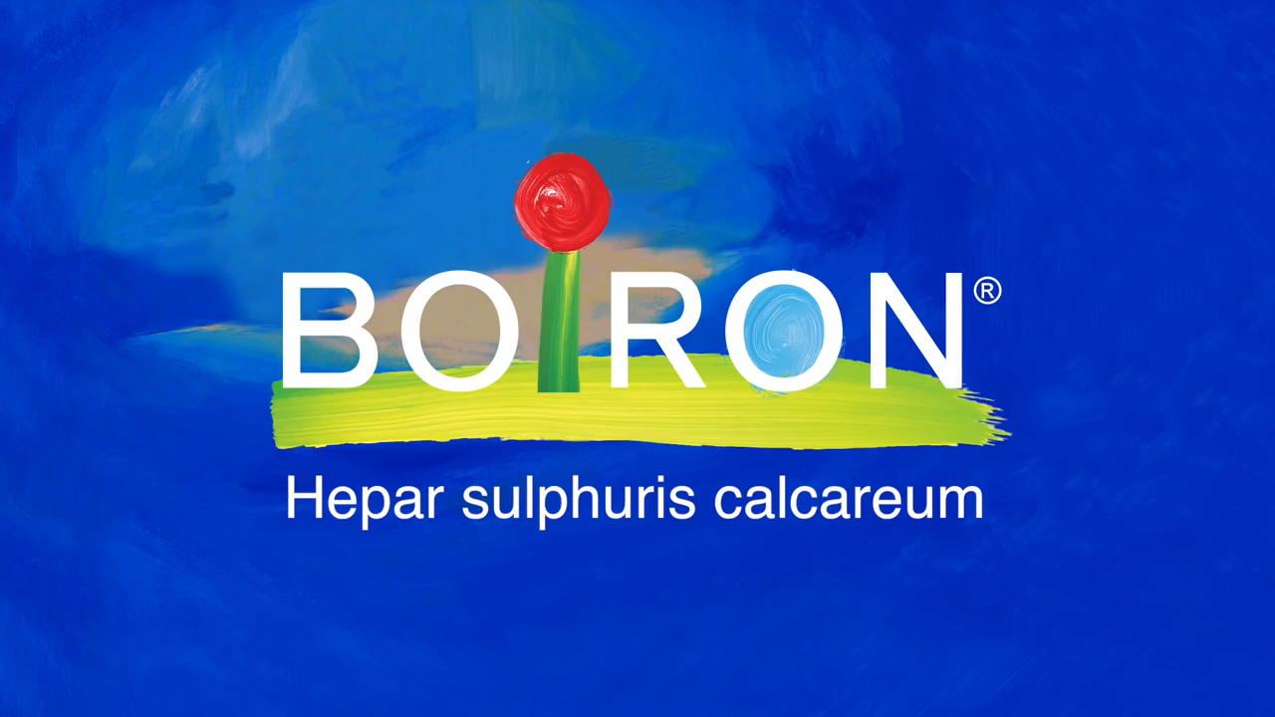
https://www.youtube.com/watch?v=iVRE3o-0huQ

Slide 9
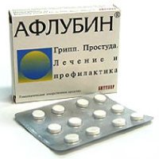
4. Aflubin ( Aflubin )
Storage:
Gentiana D1,
aconite ( Aconitum ) D6,
Bryonia D6 , _
iron phosphate ( Ferrum phosphoricum ) D12,
lactic acid ( Acidum sarcolacticum ) D12.
Pharmacological action.
Aflubin exhibits anti-inflammatory, antipyretic, analgesic, immunomodulatory , detoxifying effects. Stimulates the activity of non-specific protective factors, mainly local immunity. Reduces the severity and duration of intoxication and inflammatory manifestations. Under the influence of aflubin normalizes the protective functions of the nasal mucosa and tracheobronchial tract.
Aflubin increases the body's resistance to influenza, acute viral infections, acute respiratory diseases, inflammatory processes of the ENT organs. The mechanism of action of aflubin is the result of the combined effect of the active ingredients.
The main indications for use. Complex therapy or prevention of influenza, parainfluenza, infectious diseases of the upper respiratory tract. Comprehensive treatment of rheumatic and inflammatory processes that are accompanied by joint syndrome (joint pain ).

Slide 10
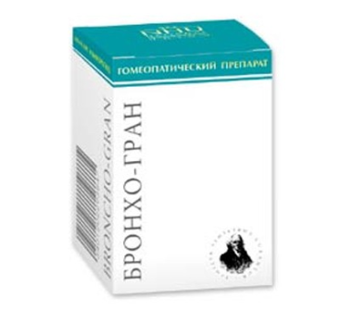
5. Broncho-gran
The composition of 10 g of granules contain:
Bryonia white 200CH 20 mg,
Spongia 200CH 20 mg,
Ipeca cuanha 200CH 20 mg,
Verbascum 50CH 20 mg,
Potassium bichromicum 200CH 20 mg.
Pharmacological action.
The drug has a broad spectrum of action, affects all parts of the pathogenesis of diseases of the respiratory system, as well as related disorders of the body.
The drug has anti-inflammatory action, stimulates the regeneration of cellular elements and eliminates degenerative changes in bronchial tissues, restores the function of the ciliated epithelium of the bronchi. Has an antispasmodic effect on the muscles of the bronchi. Helps to thin the sputum and facilitates its discharge. Reduces obstructive syndrome. Improves the functions of external respiration.
The main indications for use. Acute and chronic bronchitis, tracheitis, laryngitis of various etiologies. Pertussis, bronchitis with measles, influenza, ARI and other infectious diseases, recurrent bronchitis in frequently ill children and adults, bronchial asthma.

Slide 11
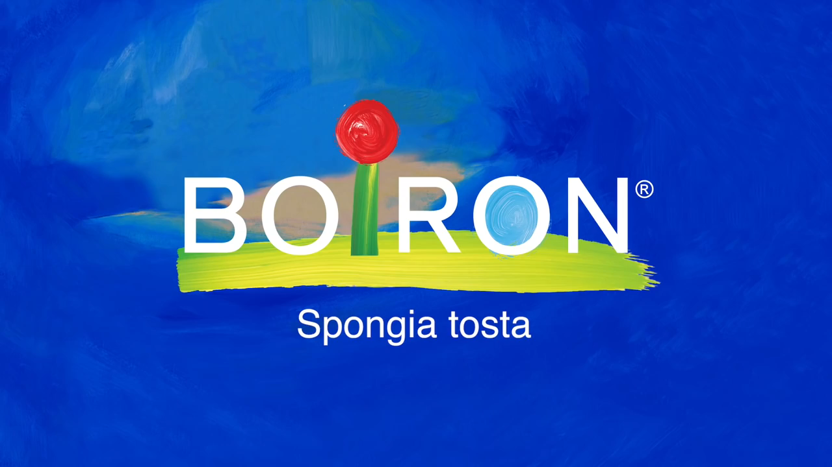
https://www.youtube.com/watch?v=K5222Pw-qw0

Slide 12
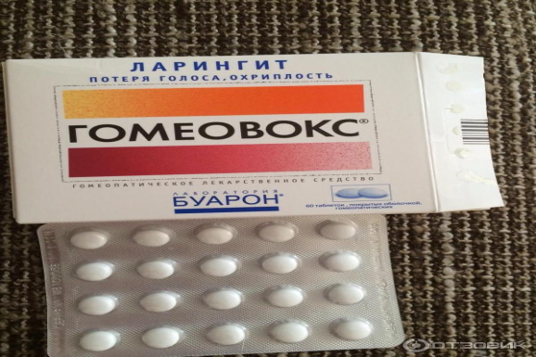
6. Homeovox ( Homeovox )
Storage:
Aconitum napellus (aconite) C3,
Arumtriphyllum (Arum Triphyllum ) C3,
Ferrum phosphoricum ( ferrumphosphoricum ) C6,
Calendula officinalis (calendula) C6,
Spongiatosta ( spongiatosta ) C6,
belladonna C6,
Mercury ssolubilis ( mercury solubilis ) C6,
Hepar sulfur ( heparsulfur ) C6,
Potassium bichromicum ( potassium bichromicum ) C6,
Populus candicans ( populuscandicans ) C6,
Bryonia ( Brioni ) C3 0.091 mg.
Pharmacological action. The drug has anti-inflammatory and antispasmodic action.
The main indications for use . It is used for laryngitis of various etiologies , including with loss of voice, hoarseness, fatigue of the vocal cords.

Slide 13
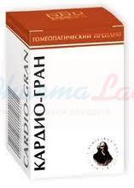
7. Cardio - gran ( Cardio-gran )
The composition of 10 g of granules contain:
Spigelia 200CH 20 mg,
Cactus 200CH 20 mg,
Potassium carbonicum 200CH 20 mg,
Lachesis 1000CH 20 mg,
Ignatia 1000CH 20 mg.
Pharmacological action.
The drug normalizes the regulation of vascular tone, prevents fluctuations in blood pressure, coronary vasospasm, improves conduction and helps to normalize heart rhythm, relieves heart pain. Regular long-term use of the drug improves well-being, mood, improves general condition, stabilizes blood pressure, reduces the risk of hypertensive crises, reduces heart pain, patients are easier to tolerate mental overload and stress.
The main indications for use. Vegetative-vascular dystonia, hypertension of I-II degree (different clinical variants), ischemic heart disease, rheumatic heart disease, arrhythmias (mainly tachyarrhythmias ). The drug is especially indicated if the onset or exacerbation of cardiovascular disease coincided with the transition age periods (adolescence, menopause), as well as the deterioration of the condition after anxiety, anxiety, stress Pharmacological action. The drug has anti-inflammatory and antispasmodic action. The main indications for use. It is used for laryngitis of various etiologies , including with loss of voice, hoarseness, fatigue of the vocal cords .

Slide 14
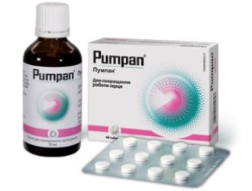
8. Pump
Storage:
- Hawthorn ( Crataegus ) D1 (74.8 mg),
arnica mountain ( Arnica) D6 (37.2 mg ),
potassium carbonate ( Kalium carbonicum ) D6 (37.2 mg),
digital foxglove ( Digitalis ) D12 (37.2 mg),
lily of the valley May ( Convallaria ) D12 (37.2 mg).
Pharmacological action.
The drug manifests antianginal , metabolic , cardiotonic and antihypertensive effects . Reduces adrenergic innervation , antiarrhythmic , mild diuretic , antioxidant and cardioprotective actions . Improves Indexes lipid metabolism ( cholesterol , β - lipoproteins ). Affects rheological _ properties blood , promotes reduction coagulation properties plasma and normalization equal fibrinogen and prothrombin index . The drug normalizes blood circulation , exchange processes and nutrition cardiac muscle , contractile and pumping functions of the myocardium , promotes normalization increased arterial pressure , strengthens walls blood vessels and has antisclerotic action .
The main indications for use. Neurocirculatory dystonia ; in complex treatment chronic ischemic diseases heart , arterial hypertension , dystrophic changes myocardial infarction , disorders heart rate, heart rate insufficiency .

Slide 15
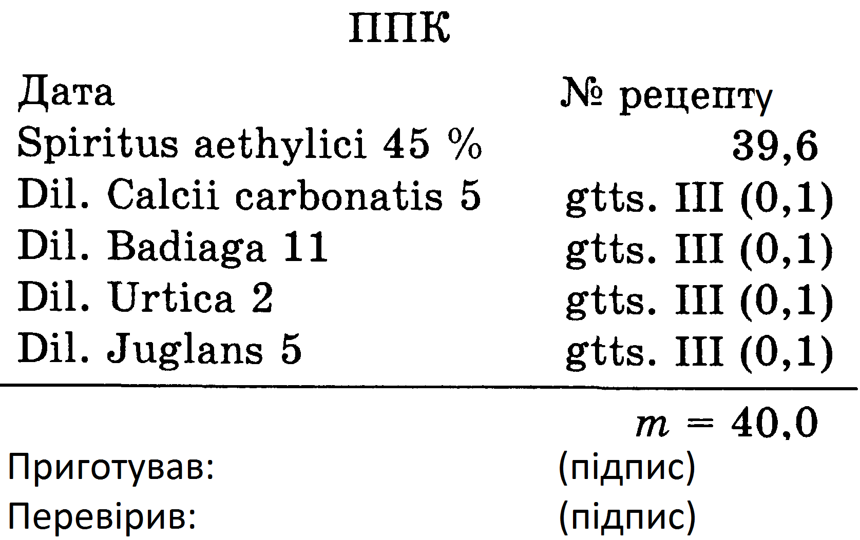
9. Technology of liquid complex homeopathic dosage forms
Allergy :
Calcium carbonicum 6
Badiaga 12
Urtica 3
Juglans 6
To prepare this drug in liquid form, you need to have previously potentiated dilutions an order of magnitude lower than required , namely:
Calcium carbonicum 5
Badiaga 1 1
Urtica 2
Juglans 5
For example, in the case of preparation of 40.0 g of the drug Allergolek in a vial with a capacity of 50.0 ml weigh 39.6 g of 45% ethyl alcohol , then alternately add 0.1 g (3 drops) of each dilution, carefully potentiating 10 times after addition the next ingredient.
The mixture is thoroughly mixed in a vial, shaking again at least 10 times, then draw up before release:

Slide 16
10. Features of preparation of combined ointments
IN in case of preparation of the combined ointment prepare in turn:
ointment-suspension → ointment solution → ointment emulsion → then mix all the ointments → conduct quality control, packaging and design before release.
Ready ointment with celluloid plates are transferred to an ointment jar, periodically tapping the bottom of the jar on the palm for ramming , and plug cover .
Dosages of GP-means are identical, both for monopreparations (consisting of one substance), and complex medicines. They reflect a special system of preparation of the drug - dynamization , which includes the stages of sequential dilution of a unit of active substance with a solvent, with a process of intense shaking after each dissolution. How many times diluted active substance indicated on the packaging of the homeopathic remedy. The frequency and duration of use of complex GP drugs depends on the course and severity of the disease .

Slide 17
11. Controversial moments directed _ against complexes
Using patient complexes masks symptoms for which can be determined constitutional diagnosis .
Sure , but it is does any other form of invasion and when a person is faced with a choice he must accept risk decision _ against benefits as well as quality life for short and long term .
The complexes have not been tested, and thus offer nothing more than symptomatic relief that will disappear when the patient stops taking the drug.
Although most of the drugs used in homeopathy have been tested, there are some drugs, such as Adonis, Ethiopis , Koridalis , etc., that have not been studied, but still continue to be used. There is a lot of experimental and vital evidence confirming the effectiveness of complexes
Not studied, working in a complex, perhaps mixing creates a completely new drug
Scientists who have considered this question have come to the conclusion that if homeopathic remedies are energy models of the matrix tincture from which drugs are made, the complexes are drugs that contain individual fluctuating spectra associated with the initial tincture.

Slide 18
12. Interactions in complex homeopathic drugs _
Interactions in complexes
Chemical
Therapeutic
The possibility of chemical interactions cannot be ruled out in a preparation containing very low potency of the active substance. Assessment of the possibility of such an interaction should be carried out individually, according to toxicological data.
Therapeutic interactions between homeopathic medicines are determined by the rule of similarity: medicines, regardless of their origin, can cause similar effects or have indications for similar or identical diseases . As a result, these drugs must be taken into account in the treatment of a specific associated disease and can be clearly differentiated.

Slide 19
13. Comparable homeopathic remedies
RELATED homeopathic remedies have a similar homeopathic picture. As a rule, the commonality of their characteristics is determined by the presence in their composition of the total active ingredient . They are usually so similar in their effects that they are not used in one recipe.
COMPATIBLE or consent drugs come from different natural kingdoms (mineral, plant or animal) or different classes of chemical compounds. In this case, their effects are similar or comparable. Compatible drugs have proven effective in their consistent and simultaneous use. In this case, their total effect exceeds the effect of any one of them.
ADDITIONAL MEDICINES means are characterized identical orientation therapeutic effect in the field or their main action , or some specific non-core indicator therapeutic application . Using complements medicine may promote successful completion treatment , the beginning of which pledged action another medicinal means . Complements medicine can continue or strengthen effect before or simultaneously applied to it others drugs . Action these drugs can , therefore , be called synergistic ( facilitation and interaction different forces in the creation single result in a specific direction ).

Slide 20
14. Modern homeopathic remedies
Iniel drugs are injectable preparations from one active ingredient in several dilutions. For example, Ingeel Bell-Belladonna contains in one ampoule D10, D20, D200, D1000 dilution of belladonna. Used in acute and subacute conditions.
Mixed iniel preparations consist of several ingredients. Their name corresponds to the main indications: Angio- Ingeel .
Both types of iniel drugs are normal and enhanced ( forte ) action. The latter is achieved by the additional content of low potencies of the main component, used in chronic diseases.
Homocords are injectable and oral drugs in the form of a combination of two or three series of potencies of different GP drugs. There are normal and enhanced action. Prolong, maintain and enhance the effect of drugs. The name is associated with the indication for one of the main components and determines their use.

Slide 21
14. Modern homeopathic remedies
Complex-combined drugs include from 5 to 30 names of potencies.
Complex organ preparations (according to the doctor Blanche Ivo) : mucosa-compositum , discus-compositum , thyroid-compositum .
Sarcodes - GP drugs in the form of extracts from various healthy organs and tissues of young cattle and pigs. These may be drugs from organs, including blood and cell components (from organelles to macromolecules), their hydrolyzate, filtrates and ultrafiltrates of liquids and suspensions, secretions of organs (gastric juice, hormones, enzymes), serum and its fractions, microbiological preparations. Sarcodes act on the organs or functions of the same name, some of them coincide with their AP-analogues, but differ in their pharmacodynamics : in AP - a means of substitution therapy, and in GP -functional.

Slide 22
14. Modern homeopathic remedies
Nosodes - sterile drugs prepared by GP technology from pathologically altered organs or tissues, components or products of metabolism of animals, humans and non-virulent microorganisms (including viruses). Nosodes are isopathic ( autonosods ), which are prepared from the patient's substrates, and heteropathic ( heteronosodes ) - from foreign substrates. These are actually antigens that stimulate the body to produce antibodies. This is how specific nosodes from tumor cells work. Nonspecific or broad-spectrum (throat swab) stimulates nonspecific immune factors (γ-globulin). Nosodes contain single potencies (X6, CH6) and are complex ( mitte ) and even enhanced ( forte ).
Nosodes are used according to the general rules of GP, according to which they, like all GP drugs, act on the whole human body as a signal to launch a complex protective system (program) that corrects the coherence of functions and human health.

Slide 23
14. Modern homeopathic remedies
Catalytic preparations - Enhanced by the rules of GP metabolic products, including citric acid and their salts, quinones and catalysts for cellular respiration, enhance the products of carbohydrate, lipid, protein and pigment metabolism, metabolism of purine and pyrimidine bases. They can be single drugs and combined complexes. They are used in the practice of GP in the field of neurology, dermatology, gastroenterology, hematology, endocrinology, as well as in allergic and autoimmune diseases.
With all the variety of classical and modern GP-drugs there is a single idea of the therapeutic effect as a result of energy -informational influences that provide a bioresonance link between the protective processes in the body and their potentiation .

Slide 24
Questions for self-control
1. Principles integrated homeopathy .
2. Characteristics of complex homeopathic dosage forms.
3. Technology production solid complex homeopathic drugs .
4. Technology production liquid complex homeopathic drugs .
5. Features potentiation complex homeopathic drugs .
6. Quality control complex homeopathic drugs .
7. Registration for vacation complex homeopathic drugs .

Slide 25

Thank you!

