Slide 1
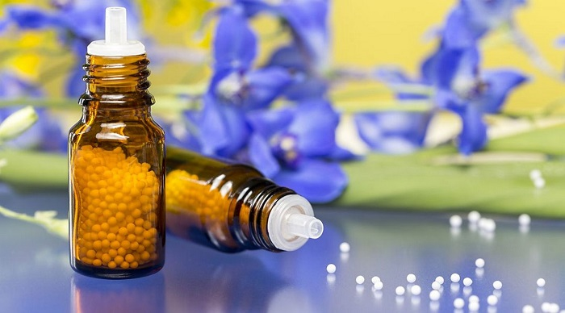

ODESSA NATIONAL AND MEDICAL UNIVERSITY
DEPARTMENT OF PHARMACEUTICAL CHEMISTRY
AND DRUGs TECHNOLOGY
Technology production solid homeopathic dosage forms.
Presentation prepared by :
Assoc . Fizor N.S.

Slide 2
Plan
1. Homeopathic LF solid consistency
2. Powders ( trituration )
2.1. 1st method of manufacture triturations § 7
2.2. 2nd method of manufacture triturations § 8
2.3. 3rd method of manufacture triturations § 9
3. Granulae _ _ _
4. Tablets ( Tabulettae )
5. Evaluation quality , storage and release homeopathic drugs
6. Improvement homeopathic medicinal drugs

Slide 3
1. Homeopathic LF solid consistency
Homeopathic dosage forms of solid consistency include:
powders,
granules (pills, granules) and
tablets used for internal use.
These dosage forms are not swallowed, but absorbed in the mouth. In homeopathic practice, grains and powders are most often used.

Slide 4
2. Powders ( trituration )
Triturations (powder rubs) are prepared from a variety of means (essences, tinctures, metals, minerals, substances of animal origin, etc. ). As a solvent use lactic sugar because _ he least hygroscopic . Prepare by one of such methods .

Slide 5
2.1. 1st method of manufacture triturations §7
1st method ( used for grinding dry medicinal substances different origin ). Certain number medicinal substances rubbed with milk sugar in porcelain mortar ( respectively 1.0 g of substance and 9.0 g of milk sugar per decimal and 0.1 g of substance and 9.9 g of milk sugar on the hundredth scale).
At the same time amount of milk sugar divided by 3 approximately levels parts . The first part placed in a porcelain mortar and mixed sprat times to mash the pores of the mortar, then add weekends substances and grind carefully with effort for 6 minutes after _ what for 4 minutes scrape and stir again grind for 6 minutes and scrape again for 4 minutes . Then add a second third of milk sugar , again grind for 6 minutes , scrape, stir for 4 minutes and repeat both operations again . Finally add the rest of the milk sugar and again twice repeat both operations as indicated above .
Given that the process of grinding is particularly important (increasing the strength of the drug), according to the guide "Homeopathic Medicines", each Trituration is prepared by carefully grinding and mixing the substance and milk sugar for 1 hour .
Calcarea iodate 3 trit .
At the tip teaspoon 3-4 times a day
Prepare according to this recipe Trituration by the 1st method and accordingly draw up before the holiday as an undivided powder. Because _ the amount of powder is not specified , release 10.0 g

Slide 6
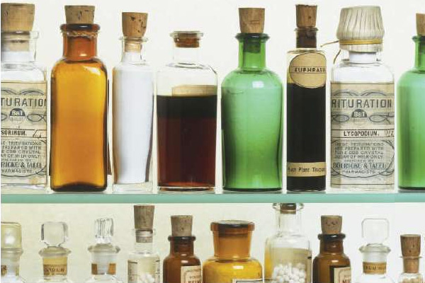
2.2. 2nd method of manufacture triturations §8
2nd method ( applied for cooking trituration with liquids - solutions water or alcohol ). For this take 2 drops of aqueous solution or 4 drops of an alcoholic solution of the basic substance (0.1 g), grind as described above the rules with 9.9 parts milk sugar and get the first hundredth or the second decimal breeding . From snake venom first receive trituration with dairy sugar to the third breeding , after what diluted with alcohol and released in liquid kind of or granules ( pills ), as indicated below .

Slide 7
2.3. 3rd method of manufacture triturations §9
3rd method ( applied for cooking trituration of essences and tinctures ). To do this, 2 weights parts essences prepared by the 1st and 2nd methods are mixed and ground according to the rules with 99 weight parts of milk sugar , while get the first hundred breeding . Others dilution prepare usually .
To receive the first dilution of the essence obtained by the 3rd method, take 3 weight parts essences and grind with 99 weights parts of milk sugar . When mixing 1 weight parts tincture (which is already the first decimal potency ) with 99 weight parts of milk sugar the first hundred turns out breeding . Others dilution prepare usually .
Liquid dilution of powders ( trituration ) is prepared as follows. 1 weight part trituration medicinal substances in the third hundredth dilution dissolved in 79 weight parts of water, add 20 wt parts of 90% ethyl alcohol and shake 10 times in a vessel filled with two thirds . It turns out breeding 4 ( fourth hundreds ). One weight part dilution 4 is mixed with 99 weight parts of 45% ethyl alcohol, shake 10 times - it turns out breeding 5.
The following hundreds dilution prepare mixing 1 weight parts previous breeding and 99 weight parts of 45% ethyl alcohol.

Slide 8
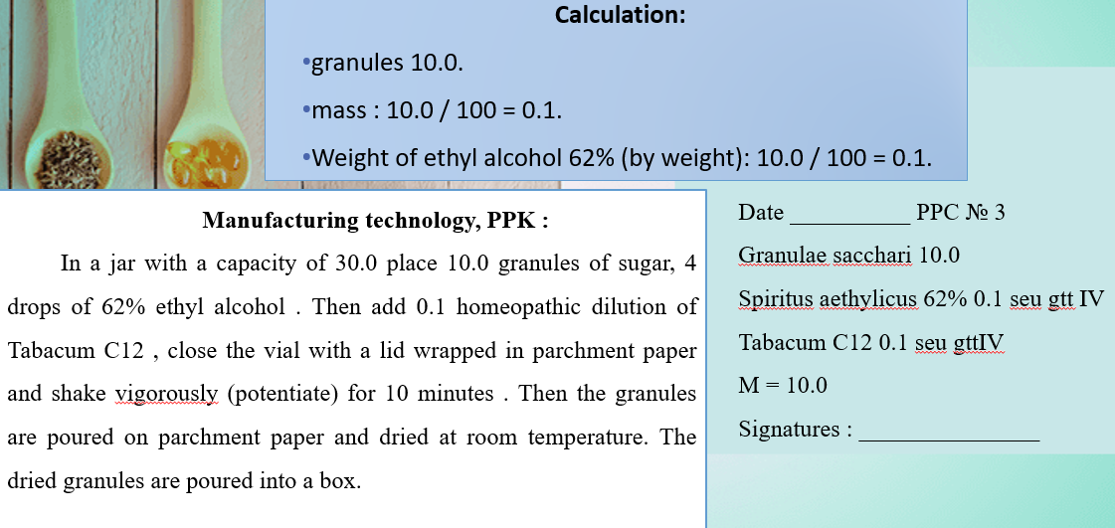
3. Granules ( Granulae )
Granules ( Granulae ) are prepared from cane sugar higher quality . If necessary, in homeopathic pharmacies granules are saturated certain quantity liquid drugs ( essences , tinctures , solutions , etc.). After this grain is dried , each has a weight of 0.032-0.033 g
If in the recipe the number of grains is not specified, then them release 10.0 g. Saturation of the granules is as follows. The vessel is loaded granules by calculation per 1 kg of granules take 10.0 g of the corresponding dilution medicinal substance , add 10.0 g of 60% ethyl alcohol, tightly clog and shake for 10 minutes manually or 3-4 minutes when using mechanization .
Granules air dried , after _ what their pour into a suitable container. It is impossible saturate granules drugs prepared from volatile , odorous substances , as well as from all acids in concentration lower third hundredth breeding .
1 kg (1000 g) of granules -10 g of dilution
10g - hg dilution
X = 10 * 10/1000 = 0.1 g of dilution
Tabacum C12

Slide 9
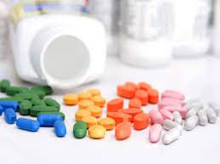
4. Tablets ( Tabulettae )
Tablets ( Tabulettae ) are the same triturations , because they are compressed without the addition of any excipients, and each tablet corresponds to a single dose of trituration , ie about 0.2 g. Take tablets in the same way as triturations and granules. Abroad , tablets are currently being prepared using sucrose and magnesium as fillers stearate , wheat starch , talc.

Slide 10
5. Evaluation quality , storage and release homeopathic drugs
The quality of liquid preparations is determined by the following indicators: liquid density, content of ethyl alcohol, extractives, fatty oils, alkaloids, reducing agents; coloring of essences, tinctures and liquid dilutions; capillary and capillary-luminescent analysis of liquid dilutions, triturations , and others.
Uniformity of drug distribution in Trituration determined with a magnifying glass or microscope. In the low breeding it is possible to determine color , smell, taste appropriate medicinal substances . In some cases for verification trituration use phenomenon recrystallization medicinal substances from supersaturated solutions . The size of the particles of metals and coal in Trituration measured under microscope .
In the ointment determine homogeneity , in suppositories - full time deformation . Authenticity drugs determined by _ general , specific colored reactions as well methods thin layer chromatography . This method is used as a guide for installation benign matrix tinctures . In the analysis chromatograms are usually not specified current substances , and given only her description from indication sequence location of zones.
Quantitative content of BAS is indicated only in rare cases , in particular, in the analysis of tinctures containing toxic substances, as well as preparations of arsenic, mercury, cadmium. Quality tinctures guaranteed by chromatographic parameters analysis given the amount of sample applied as well test of the fourth decimal breeding , which exposed to tinctures that contain poisonous and potent substances ( aconite , stanza , nux vomica , Ignatius , belladonna ).
In the homeopathic pharmacopoeias of some countries (USA, Belgium ) medicinal means are given in homeopathic breeding which _ also are being tested . Yes, French Boaron firm in certificates _ quality leads tests of the fourth decimal , second and fourth hundredth dilution with reference to the pharmacopoeia article , and sometimes - to the standard of the firm .
In homeopathic pharmacies, various complex remedies with appropriate names are available without a prescription: anti- influenza , anticlimacterin , antinervin , anti- asthmatic drops , gold, pertussis, and Dr. Fleming's ointment.
Homeopathic poisons and potent drugs are stored according to the general rules of pharmacy and are issued with appropriate labels. Strong medicinal substances and poisons it is possible let go , starting only from the fourth decimal breeding .
Homeopathic medicinal drugs depending _ from the type of drug forms released in vials, boxes, packages. On the labels indicate the pharmacy number, prescription number and serial number of the drug in the prescription , weight dispensed drug, date and signature of the pharmacist. Order and priority reception prescription drugs are listed separately the schedule written out doctor .

Slide 11
6. Improvement homeopathic medicinal drugs
In order to improve homeopathic remedies, with positive results of clinicians' testing of homeopathic remedies, it is necessary to resolve contradictions in their nomenclature, technology, regulation and quality control. Must be held scientific research aimed at reviewing the arsenal of homeopathic drugs , enrichment him modern effective means , research domestic analogues imported funds . Assortment regulated in homeopathy drugs and forms should be expand by _ injectable solutions , ocular dosage forms, aerosols , pills , therapeutic systems, etc. Effectiveness homeopathic funds it is possible increase by using modern auxiliary substances - macromolecular compounds, surfactants substances , solvents , stabilizers , emulsion and hydrophilic bases for ointments , etc. Need to to improve technological processes homeopathic essences , tinctures , granules, drops and other forms.
Modern sensitive methods of physicochemical analysis can be used to study and control the quality of homeopathic medicines in different concentrations (dilutions).
The urgent task is to study the quality of medicinal and animal raw materials, as well as the stability of various homeopathic remedies during storage, including those used in submicroconcentrations .

Slide 12
Questions for self-examination
1. Characteristics of solid homeopathic dosage forms.
2. Technology of manufacturing solid homeopathic dosage forms.
3. Quality control of solid homeopathic dosage forms.
4. Registration for the release of solid homeopathic dosage forms.

Slide 13

Thank you!

