Slide 1
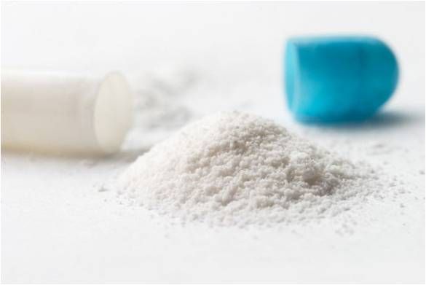
ODESA NATIONAL MEDICAL UNIVERSITY
Department of Pharmaceutical chemistry and Drug Technology
lesson № 1:
«Auxiliary operations in the manufacture of drugs. I manufactured solid drugs (powders)».
Odesa 2023

Slide 2
plan
Characterization of powders as a dosage form (DF).
Classification of powders.
Advantages and disadvantages of powders such as DF.
Technological operations for the preparation of powders in an industrial environment.

Slide 3
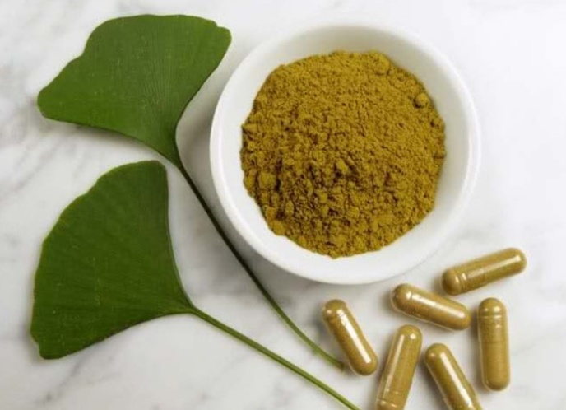
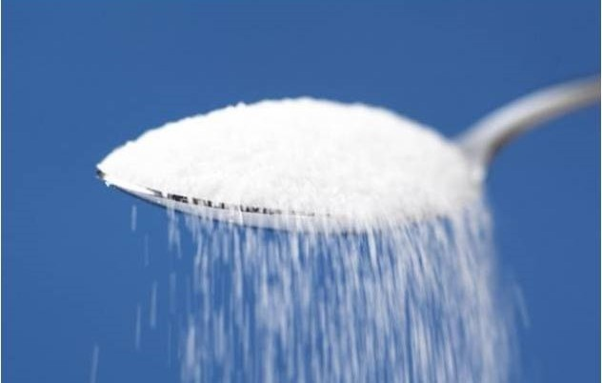
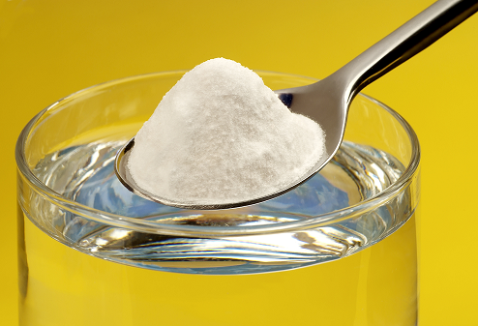
Powders are a solid dosage form for internal and external use, consisting of one or more crushed substances and having the property of flowability.

Slide 4
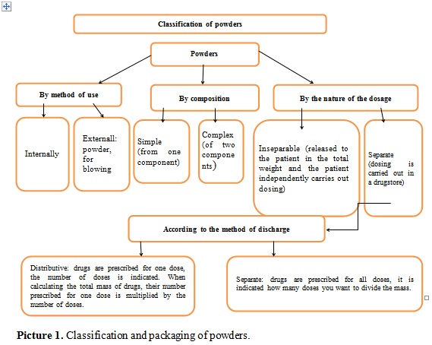

Slide 5
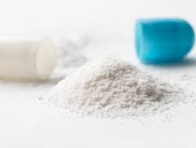
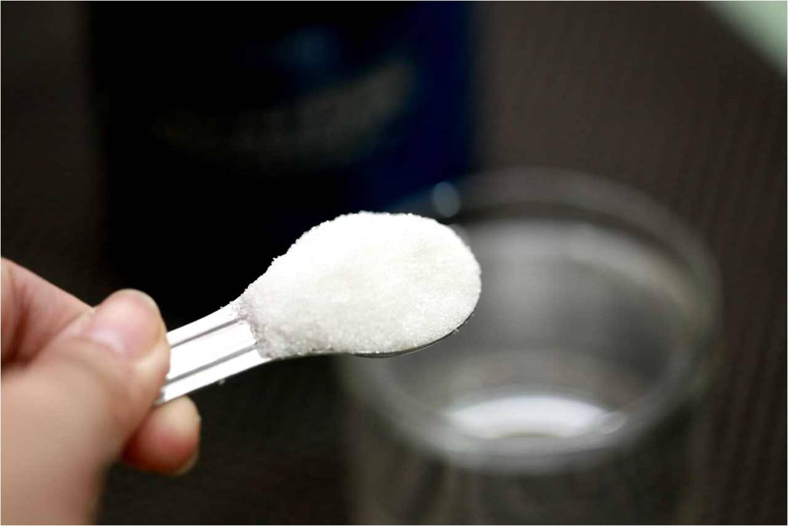
Benefits
The versatility of the composition, since they can contain substances of organic and inorganic nature, animal and vegetable origin, small amounts of liquid and other substances.
- Relative simplicity of the technological process.
- Sufficiently high pharmacological activity due to the high dispersion of medicinal substances.
- The ability to provide both local and general effects on the body.
- Dosing accuracy.
- Portability.
- Greater storage stability than liquid dosage forms.
- Possibility of intra-pharmacy preparation and use of semi-finished products in the technological process.

Slide 6
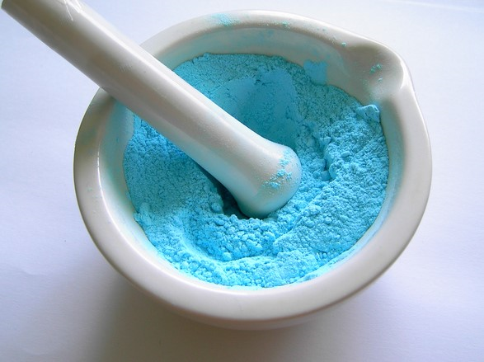
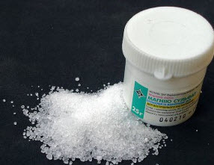
Disadvantages:
- Slower, in comparison with solutions, the onset of the pharmacological effect.
- Changes in the properties of some substances under the influence of the environment (loss of crystallization water, absorption of water vapor, carbon dioxide, oxidation and other chemical processes when moistening powders).
- Irritant effect on mucous membranes.
- The inconvenience of using powders with substances of bitter taste, aromatic and coloring ingredients.

Slide 7
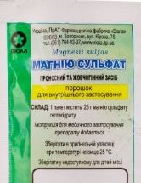
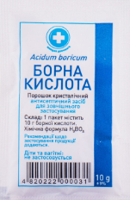
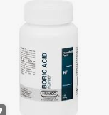
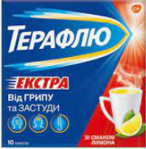


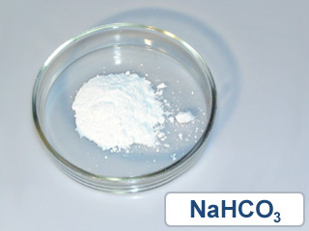
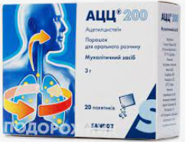

Simple powders
Complex powders

Slide 8
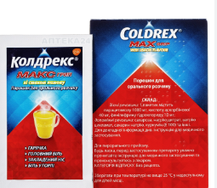
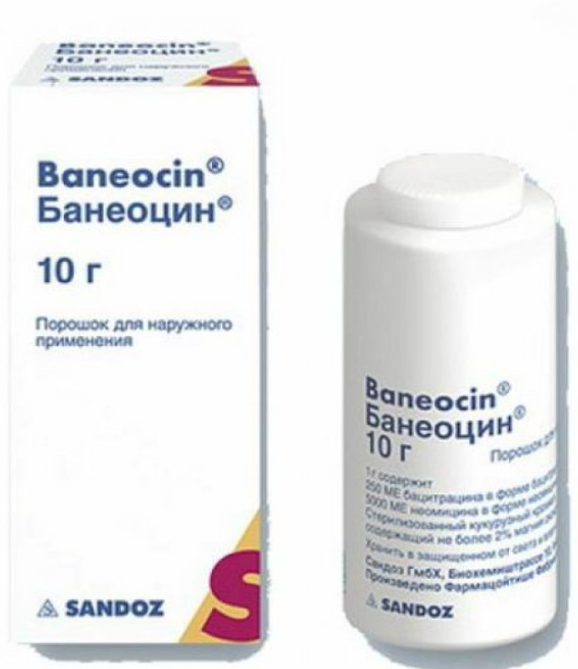
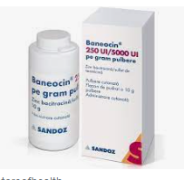
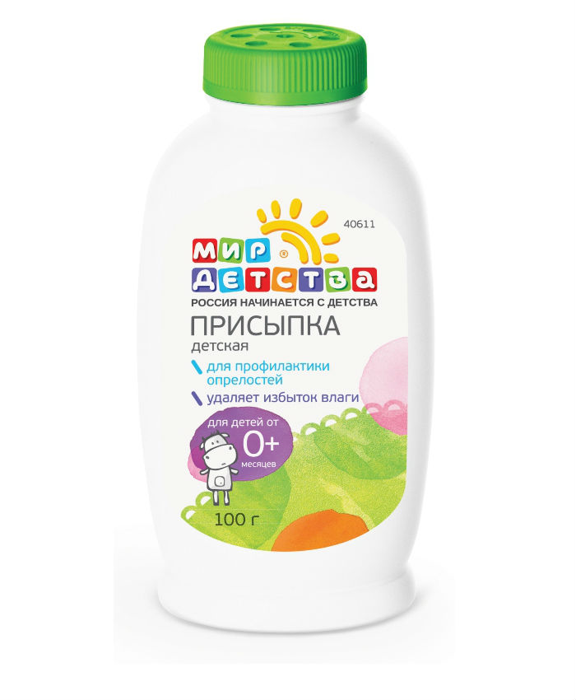


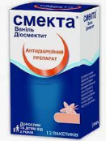
Powders for internal use
Powders for external use

Slide 9
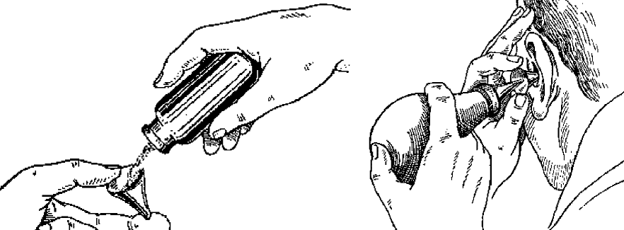
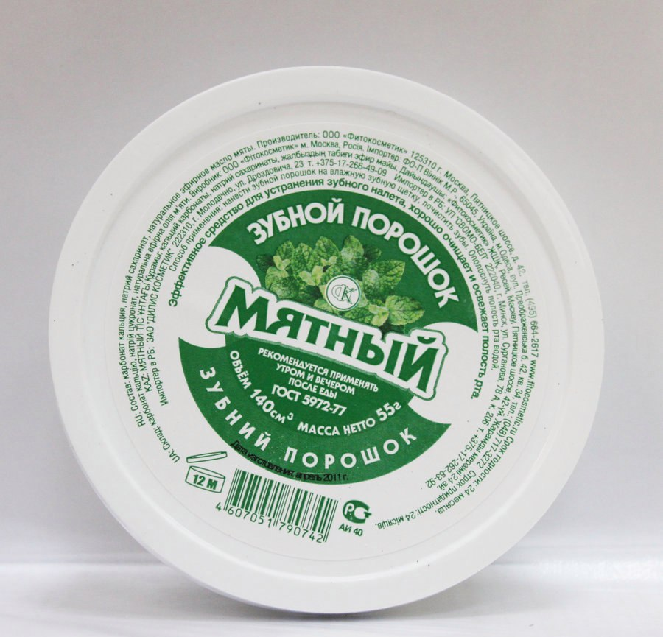

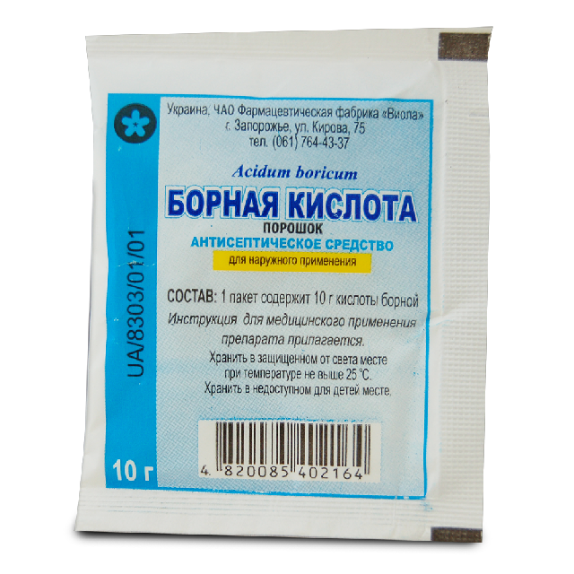
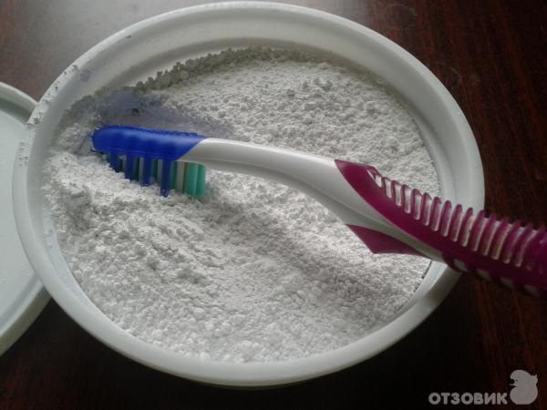
Injection powders
Tooth powders

Slide 10
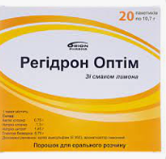

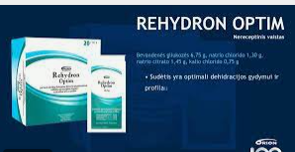
Powders for preparing solutions

Slide 11
For greater consistency and convenience of consideration, the technological stages used in the preparation of powders can be divided into two stages:
- Converting coarsely dispersed substances into a powdery state and obtaining a homogeneous mixture consisting of particles of more or less the same size. For this, the following technological stages are used: grinding, sieving (rarely used in a pharmacy) and mixing.
Obtaining from a powder mixture of individual, appropriately designed doses. Stages: dosing, packaging and design.
The preparation of powders consists of the following technological operations:
1. Calculation of the amount of powder ingredients.
2. Weighing of powders.
3. Grinding and mixing.
4. Dosage.
5. Packaging and decoration for vacation.
6. Registration of a written control passport.
7. Evaluation of the quality of the powder.

Slide 12
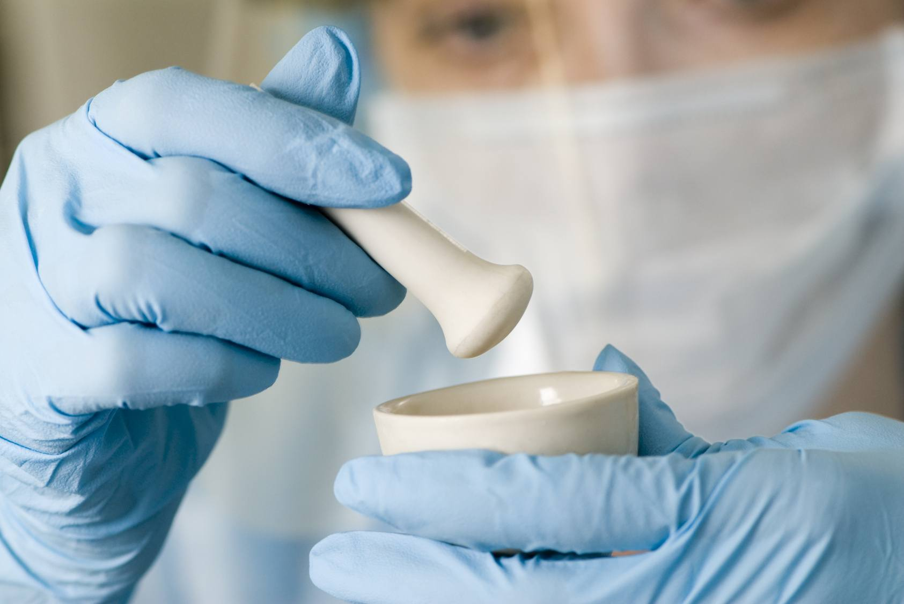
Shredding
Grinding is the process of reducing the particle size of solid drugs using a variety of devices.
At the grinding stage, the correct choice of grinding machines is important: the physicochemical properties of the material, the size of the starting material and the final product, the total amount of material to be crushed are taken into account.
When carrying out the grinding process, they are guided by the requirements of the NTD for the size of the particles of the crushed material, and the choice of machines is determined by the given degree of grinding and the properties of the material being ground.
Shredding machines can be classified according to various criteria:
- by purpose: preliminary and final grinding;
- by the method of grinding the material: cutting (grass cutters, root cutters), crushing and abrasive (rolls, runners, millstone, excelsior), impact-centrifugal mills (hammer, cruciform, disintegrator, dismembrator), impact-abrasive (ball) and rod mills ultrafine grinding machines (vibrating mills, colloidal and jet mills);
- according to the degree of grinding of the material (crushers of coarse, medium and fine crushing, mills of fine and colloidal crushing);
- by the nature of the working tool (disc, ball, knife, rotary machines, etc.).

Slide 13
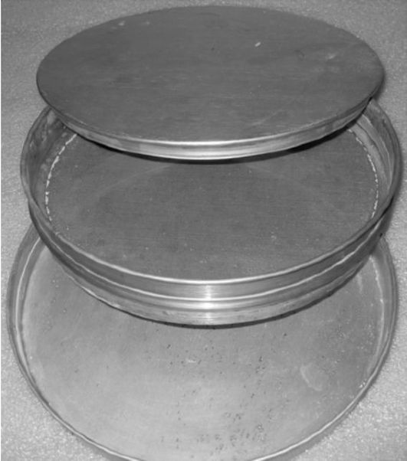
Screening
Sieve for sifting powders
When complex powders are obtained under industrial conditions, each substance included in the mixture is ground separately and sieved through a suitable sieve.
In industrial conditions, mechanical sieves are used: rotating, swinging, vibrating. By the design of the vibration device, there are 3 types of vibrating sieves: electromagnetic, gyratory, inertial.
Screening of the crushed material is carried out using screening mechanisms of various designs: rotating, swinging and vibrating. Damp material can be sieved on vibrating screens.

Slide 14
Mixing
Blending is a process that achieves the same ratio of constituent particles in any part of the resulting mixture.
Mixing of powdered products is carried out in special mixers, which are classified:
- by the nature of the mixing process (convective or diffuse);
- by design feature (drum mixers with a rotating body and rotating blades);
- according to the methods of influence on the mixture (gravitational, centrifugal);
- by the nature of the flow of the mixing process (periodic or continuous) and other signs.
A qualitative characteristic of the mixing process is the uniformity of the composition of any of the samples taken from different zones of the mixer.
The simplest and easiest mixing method is one in which the ingredients are included in the powder in approximately equal amounts, with particles of the same size, close in density. All components are poured into the mixer and mixed until a homogeneous mixture is obtained. If, under the indicated equal conditions, the specific gravity of the powders that are mixed is different, then the duration of mixing increases.

Slide 15
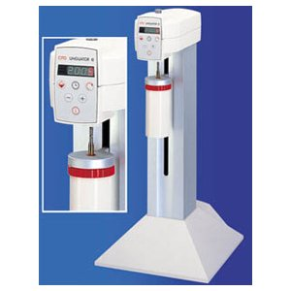
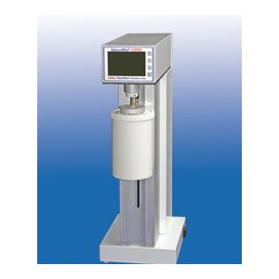
Modern mills

Slide 16
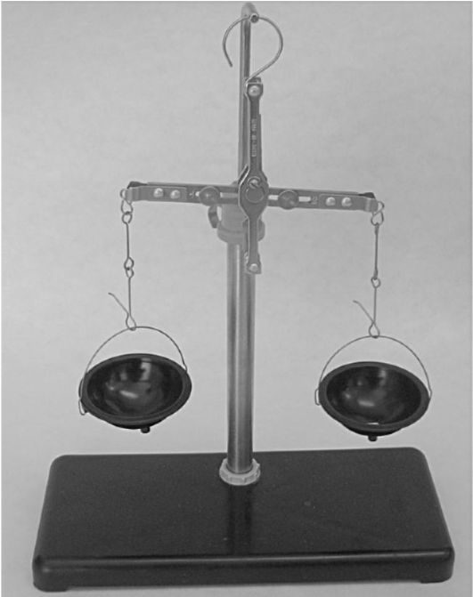
Dosing
1) By mass
More accurate
Using a hand scale

Slide 17
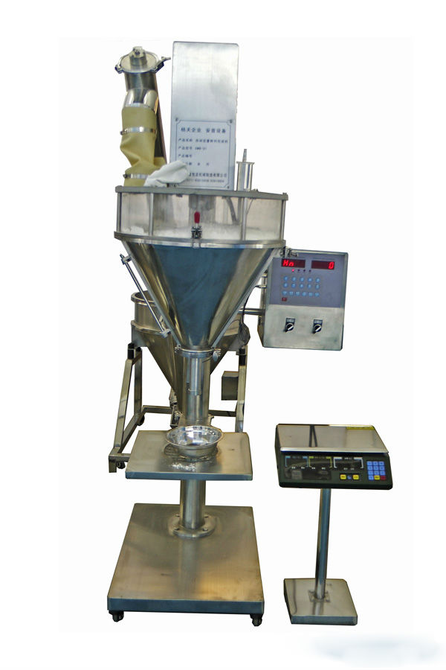
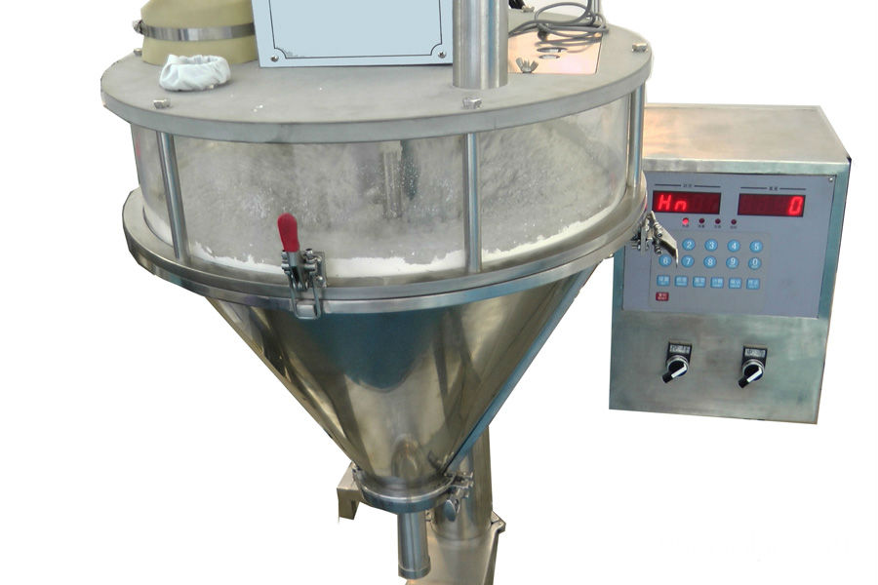
2) By volume
Less accurate, but more productive
With dispensers

Slide 18
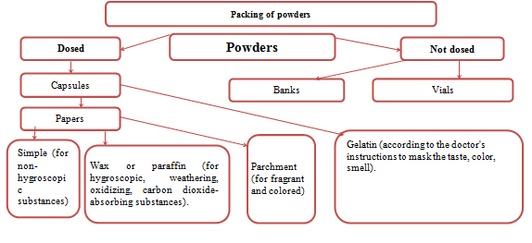

Slide 19
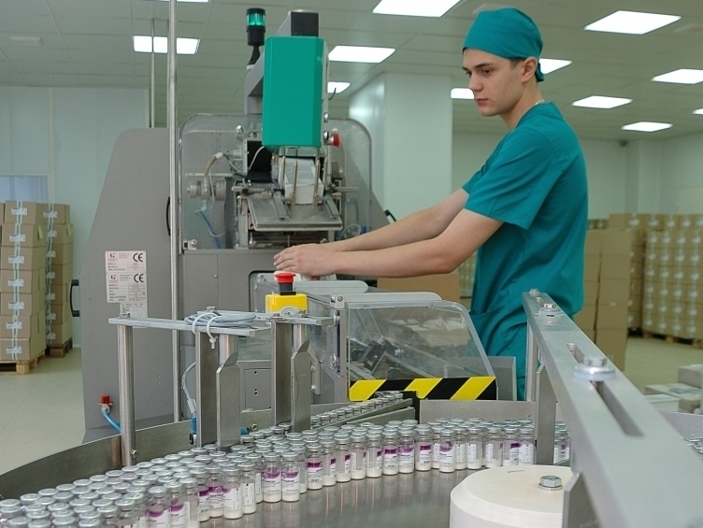
Packaging

Slide 20
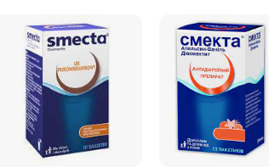

Registration

Slide 21
Thanks for attention

