Slide 1
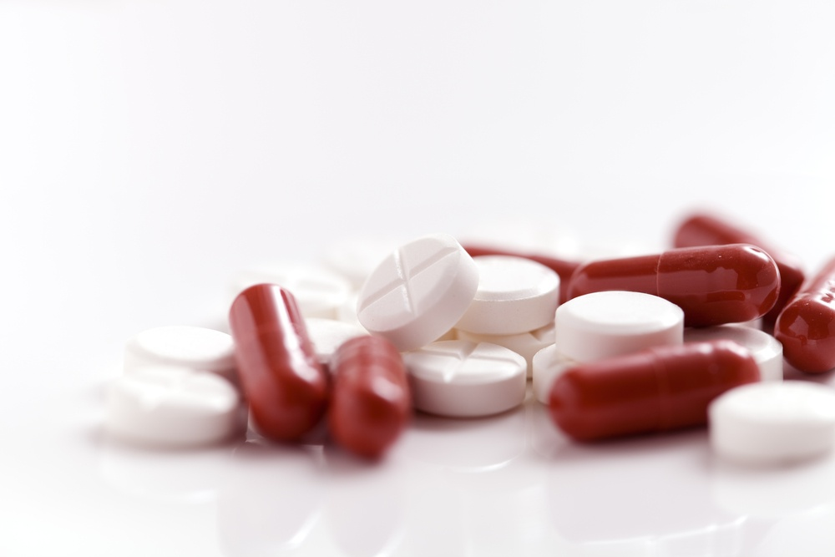
lesson № 2: «Manufacturing technology of solid dosage forms».
Odesa 2023
ODESA NATIONAL MEDICAL UNIVERSITY
Department of Pharmaceutical Chemistry AND Drug Technology

Slide 2
plan
1. Characterization of tablets as a type of solid dosage form. 2. Characteristics of modern types of granulation. 3. Process and stages of structural granulation. 4. The main groups of excipients in the production of tablets. 5. Fillers in the manufacture of tablets. Range, properties and applications. 6. Modern binders for the production of tablets. 7. Types and use of corrective substances in the production of tablets.

Slide 3
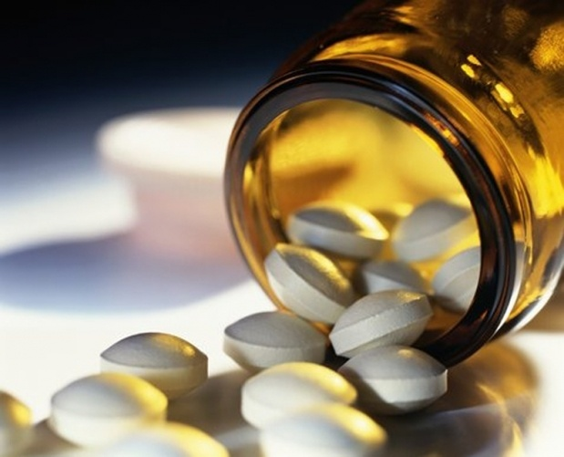
Solid dosage forms include powders, tablets, capsules, pills, granules, lozenges, caramels, pencils, polymer plates.
.
Tablets are a solid dosage form obtained by pressing medicinal substances, a mixture of medicinal and excipients or forming medicinal masses and intended for internal, sublingual, external or parenteral use.

Slide 4
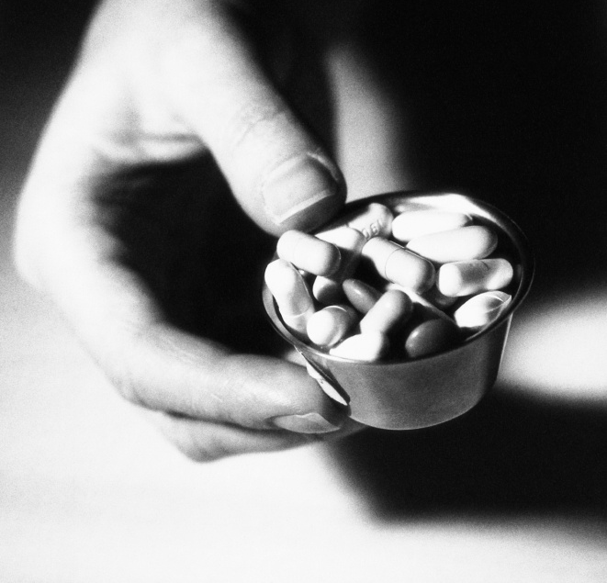
Positive qualities include:
ease of use by the patient;
ease of transportation;
ease of storage (in comparison with powders, tablets are less exposed to moisture, air and light);
dosing accuracy of medicinal substances introduced into tablets in conditions of mass production:
the possibility of prescribing medicinal substances in tablets that have a destructive effect on tooth enamel;
regulation of sequential absorption of individual medicinal substances from a tablet of complex composition (multilayer tablets);
prolonged action of medicinal substances;
small volume (portability);
less discomfort from the bitter or unpleasant taste or smell of the drug.
Along with this, the pills have some disadvantages:
drugs in tablet form start to act more slowly than drugs in powder form, since the tablets must first disintegrate; only then do medicinal substances begin to dissolve and be absorbed in the body;
with long-term storage of tablets, chemical changes may occur in them;
in some cases, tablets lose their ability to disintegrate in the digestive tract;
tablets can cause mechanical or chemical irritation of the mucous membrane of the digestive tract;
pills cannot be prescribed to children and people who cannot swallow them or who have lost this ability for one reason or another.

Slide 5
Among the tablets are gastro-resistant, uncoated, coated, effervescent, for use in the oral cavity, with modified release.
Among the tablets are gastro-resistant, uncoated, coated, effervescent, for use in the oral cavity, with modified release.
Gastro-resistant - tablets that are stable in gastric juice and release the drug or substances in the intestinal juice.
Uncoated - single-layer or multi-layer tablets obtained by single or multiple compression.
Coated - tablets coated with one or more layers of various substances, such as natural and synthetic materials, carbohydrates, possibly with the addition of surfactants.
Effervescent - uncoated tablets usually contain acidic substances and carbonates or bicarbonates, which react quickly in water to release carbon dioxide.
For use in the oral cavity - usually uncoated tablets obtained using a special technology with the aim of releasing a drug or substances in the oral cavity and providing a local or general resorptive effect (cheek tablets, sublingual tablets, etc.).
Modified release - coated or uncoated tablets containing special excipients or obtained using a special technology that allows you to program the rate or place of drug release.

Slide 6
Certain requirements are imposed on the substances used in the manufacture of tablets, which, as a rule, are in accordance with strictly defined properties:
physical - density, shape, size, nature of the surface of particles, specific surface area of particles, forces of adhesion (sticking on the surface) and cohesion (sticking of particles inside the body), surface activity, melting point, etc .;
chemical - solubility, reactivity, etc .;
technological - bulk density, flowability, moisture, degree of compaction, fractional composition, dispersity, porosity, ability to press, etc .;
structural and mechanical - plasticity, strength, viscosity of crystal lattices, etc.

Slide 7
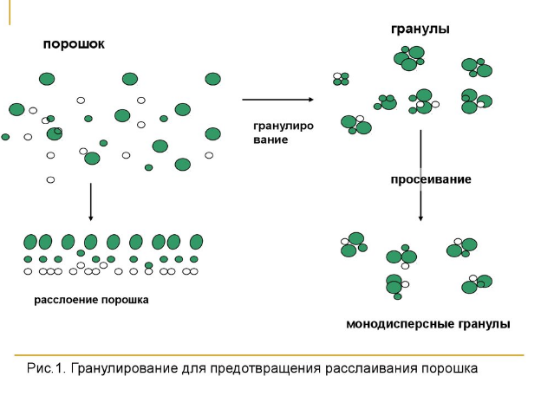
In case of unsatisfactory technological properties of powdery masses, namely, poor compaction and flowability, to ensure the required quality of tablets, it is necessary to carry out granulation in advance.
Granulation is a directional enlargement of particles, that is, it is the process of converting a powdery material into grains of a certain size, which is necessary for: 1) improving the flowability of the tablet mixture, 2) improving compaction; 3) preventing stratification, 4) ensuring the accuracy of dosing, 5) reducing the dustiness of the working rooms.
Currently existing granulation methods are divided into the following main types:
1) dry granulation or grinding granulation;
2) wet granulation, or squeeze granulation;
3) structural granulation;
4) mixed granulation.
granules
powder
granulation
screening
powder lamination
monodisperse granules
Granulation for early powder granulation

Slide 8
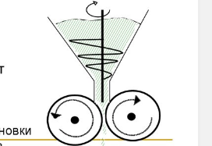

Dry granulation method (fracture granulation)
2 methods are used: 1. granulation by pressing;
2. granulation by rolling.
Compression granulation (aggregation) - a mixture of powders is poured into a mold and compressed into compacts under the action of a press that forms the plates. The compressed mass is called a "blank". Granulation is carried out using tablet presses or special briquetting presses with large dies.
Rolling granulation - extrusion of a powder mixture by rotating cylinders into solid powders. Billets or roller compacts are then crushed and sieved to obtain granules. To obtain compacts, roller installations are used.
Scheme of a roller installation for obtaining compacts

Slide 9
Dry granulation method. Consists of mixing powders and moistening them with solutions of adhesives in enamel mixers, followed by drying to a lumpy mass. Then the mass with the help of rollers or mill "Excelsior" is converted into a large powder.
Grinding by grinding is used in cases where the moistened material reacts with the material during wiping. In some cases, if drugs decompose in the presence of water, and during drying enter into chemical reactions or undergo physical changes (melting, softening, discoloration) - they are subjected to briquetting. 3 For this purpose, briquettes are pressed from powder on special briquetted presses with matrices of large sizes (25-50 mm) under high pressure. The resulting briquettes are crushed on rollers or mill «Excelsior», fractionated with sieves and compressed on tablet machines tablets of a given weight and diameter.
Briquetting granulation can also be used when the drug substance has a good compressibility and does not require additional binding of particles with adhesives.
Now, with the dry granulation method, dry adhesive substances (eg microcrystalline cellulose, polyethylene oxide) are introduced into the composition of the tableted mass of powders, which provide under pressure the adhesion of particles, both hydrophilic and hydrophobic substances.

Slide 10
Wet granulation method
Wet granulation method. In production, wet granulation is often carried out in granulators type 3027 (Mariupol WTO). The working body of the device consists of the screw and six strong cores that allows to move granular material in the axial direction. There is a right and a left execution. Productivity - 150-1000 kg / h.
Promising are the press granulators of the company «HUTT» (Germany), the working body of which are pressing rollers in the form of hollow cylinders with teeth on the surface, between which there are radial holes in the walls for pushing the powder mass. High-quality granules of the same lenticular shape are formed. Granulation or wiping of the wet mass is carried out to compact the powder and obtain uniform grains - granules that have good flowability. Powders having poor flowability and insufficient adhesion between particles are subjected to this method of granulation.
In both cases, an adhesive solution is added to the mass, which improves the adhesion between the particles.
The stage of wet granulation includes the following operations:
1. mixing powders;
2. moistening powders with a solution of binders and mixing;
3. granulation of wet mass;
4. drying of wet granules;
5. processing of dry granules.

Slide 11
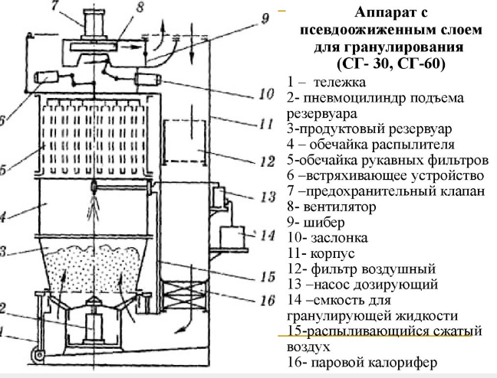
Fluidized Bed Granulation Machine (SG-30 MG-60)
1- trolley
2-pneumatic cylinder for lifting the tank
3-productive reservoir
4-spray shell
5-shell of bag filters
6- shaking device
7-safety valve
8-fan9 gate
10-layer
11-building
12- air filter
13-dosing pump
14-capacity for granulating liquid
15-spray compressed air16-steam heater

Slide 12
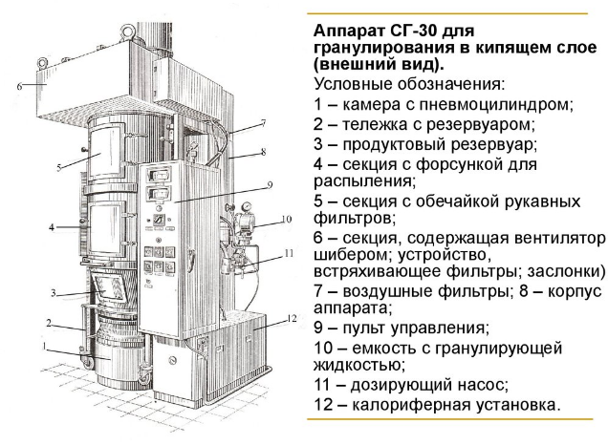
Apparatus SG-30 for granulation in a fluidized bed (appearance)
Legend:
1 chamber with pneumatic cylinder
2-cart with tank
3-product tank
4-section with spray nozzle
5-section with bag filters
6-section containing a fan with a gate valve; filter shaking device
7-air filters
8-unit body
9-control panel
10-capacity with granulating liquid
11-dosing pump
12-calorific unit

Slide 13
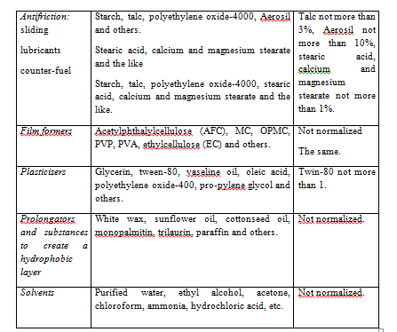
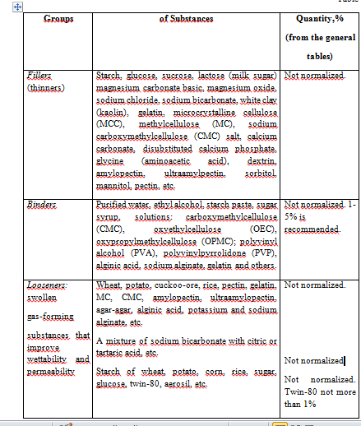
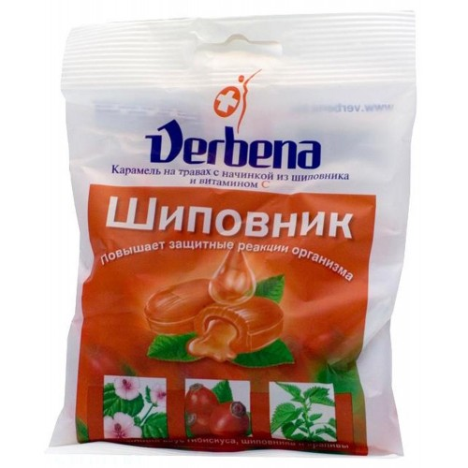
Recently, a common variety has been used in production - mixed granulation, carried out by mixing medicinal and excipients, moistening the mixture, a binder, decomposing the wet mass with a thin layer of the resulting mass, dusting dry granules.

Slide 14
Fillers are excipients or materials that are part of pharmaceutical compositions in order to modify their properties, facilitate production (processing), reduce their cost, as well as obtain the required volume when using API in a small amount (0.01-0.001 g).
Corrective substances are added to tablets to improve their taste, color and odor. Natural and synthetic substances in the form of solutions, syrups, extracts, essences are currently proposed for use as corrective substances. Among syrups, the most common are sugar, cherry, raspberry; with sweeteners - sucrose, lactose, fructose, sorbitol, saccharin. Also, to correct the taste, various IUDs are used, the macromolecules of which envelop the molecules of the drug substance and taste buds of the tongue. These include agar-agar, alginates, MC and pectins.
Dyes are added to improve the appearance of tablets, as well as to indicate a therapeutic group of medicinal substances, for example, hypnotics, poisonous.
• mineral pigments (titanium dioxide - white pigment, iron oxide), which are used in the form of fine powders;
• dyes of natural origin (chlorophyll, carotenoids), although they have the following disadvantages: low coloring ability; low resistance to light rays, oxidizing agents, reducing agents, pH and temperature changes;
• synthetic dyes: indigo (blue), tartrazine (yellow), acid red 2C, tropeolin, eosin. Sometimes a mixture of indigo and tartrazine is used, which is green.
Binders are of particular importance in the compression of complex powders, which may delaminate during the operation of the tablet machine, and this leads to the production of tablets with an unequal content of incoming ingredients. The use of a certain type of binders, their amount depends on the physical and chemical properties of the substances that are pressed. Use purified water, ethyl alcohol, BMC solutions, polyvinylpyrrolidone (PVP), etc.

Slide 15
Coating tablets
To protect medicinal substances from the influence of external adverse factors, reduce their irritating effect when taken, mask the unpleasant organoleptic properties of drugs, create a prolongation effect, localize the pharmacological action, solid forms of medicinal substances are covered with special membranes.
Coating tablets, depending on their composition and method of application, are divided into three groups:
1. coated coatings;
2. film coatings;
3. pressed coatings.
Coating tablets with coatings provides not only protective but also many other functions. Of all the currently existing types of coatings, the most popular are film coatings, which have a number of advantages. Dispersed film coatings are becoming more and more popular.

Slide 16
Thanks for attention!

