Slide 1
lesson № 8:
«Methods of microbiological control of drugs (ending)».
Odesa 2023
ODESA NATIONAL MEDICAL UNIVERSITY
DEPARTMENT OF PHARMACEUTICAL CHEMISTRY AND DRUG TECHNOLOGY

Slide 2
plan
1. The influence of microorganisms on the quality of medicines.
2. Sterility tests. Nutrient media.
3. Research on microbiological purity. Quantitative determination of microorganisms. Determination of antimicrobiological activity of antibiotics by agar method.
4. Analysis of drugs and their metabolites in biological fluids.
5. Microflora of finished dosage forms. Microflora of non-sterile dosage forms. Ways to increase the microbial purity of non-sterile drugs. Sterile and aseptic dosage forms.
6. The main phases of the process of proper development of microbiological techniques.

Slide 3
INTRODUCTION
A feature of microbiological types of analyzes is the specificity of the object of research - a living microorganism with individual properties. The most significant features of drugs that affect the results of the analysis include the following:
• The presence of antimicrobial action of the drugs themselves or their components, as well as the presence in some of them of preservatives that prevent the detection of microorganisms.
• Advance growth of accompanying microflora, which makes it difficult to identify contaminating microorganisms.
• Possibility of presence of microorganisms in analytical samples in a “stressful” state under the influence of the conditions of the technological process of drug production, and uneven distribution of contaminants in the samples.

Slide 4
FACTORS
The main factors affecting the variability of the results of microbiological studies are: the specificity of the sample (physicochemical properties and biological characteristics of the isolated population of microorganisms), the competence of personnel and their working conditions, sampling and sample preparation, incubation conditions, characteristics of the nutrient media used. The last three factors are subject to mandatory standardization and validation.

Slide 5
CONTAMINATION
Microorganisms contained in the dosage form can cause decomposition of active and auxiliary substances. This leads to the loss of the therapeutic effect of the drug, changes in the appearance of the dosage form, and sometimes to the formation of toxic products. Unlike pathogenic microorganisms, many saprophytes have a large set of enzymes and are able to decompose the very substances, proteins, lipids, and others.
The intensity of destruction of dosage forms and substances depends on their concentration, humidity, ambient temperature, as well as the nature and degree of initial contamination. The shelf life of medicinal products is also important.
Contamination (contamination) by microorganisms of the drug poses a danger to the patient.

Slide 6
Sources of microbial contamination of medicines (in the pharmacy and in the factory can be:
Indoor air.
Initial medicinal and auxiliary substances of animal, vegetable and synthetic origin (glucose, talc, starch, agar).
Dispersion media, including purified water, microbial contamination of which occurs during transportation, storage.
Auxiliary materials (filtering - cotton wool, paper, gauze; packaging - paper, bottles, cans, boxes, corks).
Person. In a calm state, a person secretes up to 200 thousand different particles (scales, epidermal cells, etc.) in 1 minute, while moving - up to 1 million.
Pharmacy staff.
Sources of pollution are mainly the mouth and nose.
Technological process (equipment, devices, apparatus, etc.).

Slide 7
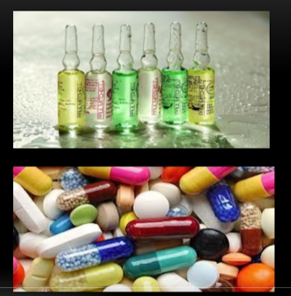
MICROBIOLOGICAL CONTROL
The level of microbial purity is one of the main indicators of the quality of pharmaceutical products. For this indicator, all drugs are divided into:
• Sterile - preparations in which the content of viable cells of microorganisms is not allowed (~ 20% of the total amount of drugs);
• Non-sterile - preparations in which the content of live microorganisms is allowed, the requirements for the quantity and quality composition of which depend on the dosage form and method of drug administration and are standardized by the relevant documentation (~ 80% of the total amount of drugs).

Slide 8
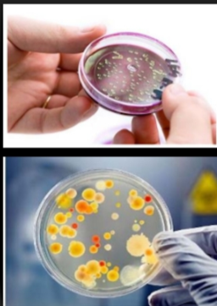
MICROBIOLOGICAL CONTROL OF NON-STERILE MEDICINES
The main tasks of microbiological control of non-sterile products:
Does the sample contain viable microorganisms (bacteria, fungi)? (qualitative analysis)
If so, how much? (quantitative analysis)
What exactly? (identification analysis). Microbiological requirements for non-sterile products:
- must contain a limited number of microorganisms;
- should not contain certain types of microorganisms; - the permissible number and types of microorganisms depend on the dosage form and route of administration of the drug;

Slide 9
In non-sterile dosage forms, determine:
1.microbial number - the number of bacteria and fungi in 1 g (ml).
Norms of microbes in non-sterile dosage forms:
1. In 1 g (ml) of the drug for oral administration, no more than 1000 bacteria and 100 fungi.
2 In 1 g (ml) of a preparation for topical use - no more than 100 microbes, incl. mushrooms.
3. Tableted preparations should not contain pathogenic microflora, and the total contamination should not exceed 10 thousand microbial cells per tablet.
4. The presence of Escherichia coli, Staphylococcus aureus, Pseudomonas aeruginosa is not allowed.
Ways to improve the microbial purity of non-sterile drugs
If microbial contamination is caused by ingestion with the raw material, then to achieve the required level of microbial purity, it is sufficient to clean the raw material from microorganisms. If microbial contamination occurs during the manufacturing process, then the finished dosage form is decontaminated. Preliminary disinfection can be achieved by pressing bulk materials (in the absence of spore microorganisms, low moisture content of the original powder and high pressure). In practice, four methods are used for decontamination of raw materials and finished medicines.

Slide 10
Ways to improve the microbial purity of non-sterile drugs
Thermal method. A widely used industrial decontamination method. Not suitable for processing thermolabile dosage forms for which heating to 60-70 ° C with hot air, infrared and high-frequency radiation is used.
Chemical method. Suitable for sterilizing light-proof substances (bactericidal effect is realized at a depth of 1 mm). It is most commonly used to treat packaging material and process water. It is possible to treat the forming substances (starch, talc, sugar) in a dispersed state (with stirring) with UV rays.
Ionizing radiation. The most promising method for decontamination of raw materials and finished dosage forms. Ionizing radiation has a high penetrating power. Irradiation does not generate carcinogenic, mutagenic, toxic substances, the physicochemical and biological properties of the processed drugs are preserved. The method is used to treat antibiotics, vitamins, enzymes, hormones and alkaloids.

Slide 11
MICROBIOLOGICAL PURITY OF NON-STERILE MEDICINES
1. Method of plating on Petri dishes with nutrient medium:
deep sowing method;
- surface sowing method.
2. Membrane filtration method.
3. Most probable number method (least accurate method, used for very low bioburden products).
Principle: the methods are based on inoculation on / in nutrient media of a certain amount of a sample of the drug, incubation, counting the grown colonies and identifying specific microorganisms, interpretation of the results.
Microorganisms | Nutrient media
The total number of aerobes (LCA) | Aggregate medium based on casein and bean hydrolyzate (agar medium -№1)
The total number of mushrooms (LCG) | Saburo dextrose agar (agar medium - № 2)
Escherihis coli | Broth based on casein and soybean hydrolyzate, McConkey broth, McConkey agar

Slide 12
DETERMINATION OF MICROBIOLOGICAL PURITY: TESTS FOR THE PRESENCE OF SPECIFIC MICROORGANISMS
Example: Detection of Escherichia coli (plate count method).
The sample is prepared in the same way as for the detection of OCA and OCG.
An amount equivalent to 1 g or 1 ml of the product is tested.
A suitable amount of casein and soybean hydrolyzate broth is inoculated, mixed, incubated at 30-35 ° C for 18-24 hours.
Shake the container, transfer 1 ml of the sample obtained in step 3 into 100 ml of McConkey broth and incubate at 42-44 ° C for 24-48 hours. - enrichment
Subculture a suitable amount of the sample obtained in step 4 onto McConkey agar plates and incubate at 30-35 ° C for 18-72 hours. - indication
Interpretation of results: The growth of characteristic colonies indicates the possible presence of Escherichia coli. The result is confirmed by identification tests.
The product passes the test if no similar colonies are found or if identification tests are negative.

Slide 13
Check of nutrient media (sterility, growth properties)
Checking the presence / absence of antimicrobial action of the product
The drug has no antimicrobial action
The drug has antimicrobial action
Direct seeding from a Petri dish with agar medium
Neutralization of antimicrobial action (dilution, addition of neutralizing action (dilution, addition of neutralizing agent, combined method, membrane filtration)
Direct seeding on a Petri dish, taking into account the results of the elimination of antimicrobial action
Membrane filtration and transfer of filters to the surface of agar media
Incubation, counting the colonies that have grown, the interpretation of the results

Slide 14
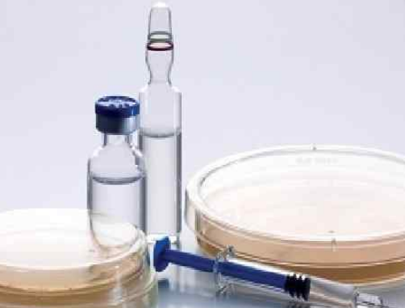
MICROBIOLOGICAL CONTROL OF MEDICINAL STERILITY
Sterility is the absence of living microorganisms. The purpose of the sterility test is to confirm the complete absence of viable bacteria and fungi in the test object.
For sterile dosage forms, the presence of microorganisms, even in small numbers, can become lethal, given the unhindered entry of microorganisms into the blood or mucous membranes of the body, provided that a person's immunity is weakened.
The test is used for products that must be sterile:
• drugs for parenteral use (solutions, freeze-dried and sterile packaged powders for injections and infusions);
• Ophthalmic drugs;
• Solutions of antiseptics for external use;
• Ointments, gels for external use (for application to the wound surface);

Slide 15
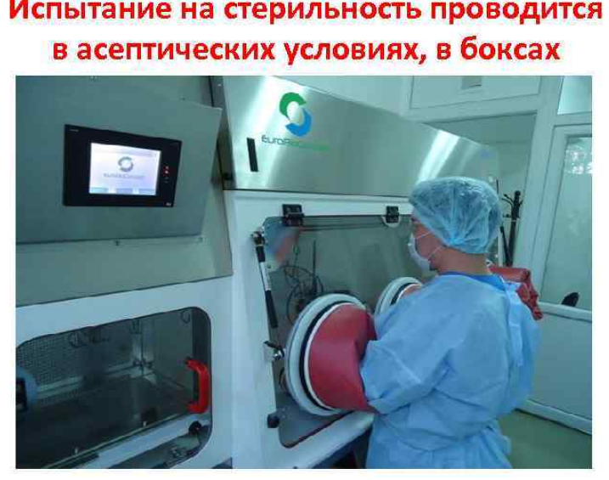
Sterility tests are carried out under aseptic conditions, in boxes
The sterility test is performed in aseptic conditions, in boxing

Slide 16
MICROBIOLOGICAL CONTROL OF STERILE MEDICINES
Methods for determining sterility:
Membrane filtration is the best method if the test drug is filtered;
1. Advantages:
- the possibility of effective elimination of antimicrobial action;
- high reliability of detection of non-sterility of antimicrobial drugs due to lack of dilution, takes place when eliminating antimicrobial action;
- the ability to filter a large volume;
- statistically more reliable;
- more sensitive: high efficiency of detection of microbial contamination at low concentration of cells per unit of the sample due to the possibility of concentration or content on the membrane of even individual cells (1 CFU per type).
2. Restrictions:
- unfiltered samples, membrane occlusion.
Direct sowing method.
A) Advantages:
- fast, simple, economical;
- unfiltered samples.
B) Restrictions:
- limited sample size: low sensitivity;
- problems with antimicrobial action.

Slide 17
Conditions for the sterility test:
• Sterility tests should be performed under the same conditions as aseptic production.
• Preparation of air supplied to a clean room using HEPA filters (HEPA - High Efficiency Particulate Absorption). These filters are used for almost complete purification of air from even the smallest particles, up to 0.1 microns.
• Access to the premises must be organized through air locks - structures with unidirectional one-way passages. The airlock prevents the movement of air between rooms. When all the doors of the airlock are closed, the air entering it dilutes the pollution that came from the external corridors through the door, or released by the staff present.
The tested products must be fed through the transfer windows.
• Performers must be disguised in sterile clothing.
• Performers must be properly trained.
• Precautions taken against contamination should not affect any of the micro-organisms that may be detected during the test.
• The test conditions should be monitored regularly by sampling the air and surfaces of the work area.
Notes:
17

Slide 18
Nutrient media used to determine sterility:
• Liquid thioglycol medium: reduces the redox potential and promotes the growth of anaerobic microorganisms
• Detection of anaerobic bacteria - Aerobic bacteria
• Liquid medium based on casein and soybean hydrolyzate (Saburo medium)
• Detection of fungi
• Detection of aerobic bacteria.
Nutrient media are prepared in the laboratory using dry nutrient media of industrial production or individual components. Ready-to-use environments with a manufacturer's certificate may be used. The nutrient media prepared in the laboratory are checked for sterility and their growth properties are determined. The nutrient media and filter washes are sterilized in an autoclave at 121 ° C for 15 minutes, unless otherwise specified in the pharmacopoeial article or regulatory documentation.

Slide 19
Each batch of manufactured nutrient media (5% of the quantity in the batch is subject to suitability testing, which consists in checking for sterility and checking the growth properties.
Checking the sterility of nutrient media
After sterilization of nutrient media, the sample of each batch is thermostated for 14 days at a temperature of 30-35 C for thioglycol medium and 20-25 C for Saburo medium. At the end of a given period in nutrient media should be absent visually identifiable signs of growth of microorganisms.
Check of growth properties. The following microorganisms are used for this purpose:
thioglycol medium: Staphylococcus aureus, Pseudomonas aeruginosa, Clostridium sporogenes.
Saburo medium: Bacillus subtilus, Candida albicans, Aspergillus brasiensis.
A small amount of each of the microorganisms (not more than 100 CFU) is made in a nutrient medium and incubated for up to 3 days at a temperature of 30-35 C (for thioglycol medium) and up to 5 days at 20-25 ° C (for Saburo medium).
Notes:
19

Slide 20
Prior to the sterility test, it should be determined whether the test specimen has antimicrobial activity that may significantly affect the test results.
To do this, a certain amount of the studied drug is placed in thioglycol medium and in Saburo medium. Add the microbial suspension and incubate: 1st on Wednesday at 30 -35 ° C for two days, 2nd on Wednesday at 20-25 ° C for three days.
In parallel, control: in the nutrient medium instead of this drug make a similar amount of distilled water or a suitable solvent. Then compare the growth of test microorganisms in control and experimental crops on visual inspection.
If the results are the same, the drug does not have antimicrobial action. And if different, that is, in the control observed growth of the test microorganism, and in the experience of growth is absent, it is believed that the test sample has a bacteriostatic or fungistatic effect.
If the test drug has antimicrobial activity, the test is performed after neutralization with a suitable neutralizing agent that does not inhibit the growth of microorganisms (eg, para-aminobenzoic acid for sulfonamides, penicillinase for penicillins and cephalosporins, etc.), or by diluting in a sufficient medium. . Sometimes these methods are combined. If all methods are ineffective and the drug is soluble, use the method of membrane filtration

Slide 21
Minimum number of units to test
Number of production units in the production series | Minimum number of units for each medium (unless the use of other quantities is justified or not allowed)
Drugs for parenteral use
no more than 100 containers | 10% or 4 containers, whichever is greater
- 100 -500 containers | 10 containers
- more than 500 containers | 2% or 20 containers, whichever is less
Ophthalmic and other non-injectable drugs
no more than 200 containers 5% or 2 containers, whichever is greater | more than 200 containers 10 containers

Slide 22
Determination of sterility by direct seeding A certain amount of the tested drug is placed directly in the nutrient medium. And, if necessary, dissolve in a suitable solvent and sown in the amounts indicated in the table.
The volume of the content of one unit, ml | The volume of the drug for sowing, ml | The amount of nutrient medium
Less than 1 | The entire volume | 10 times more sample for sowing
1 -4 | 1
5 -19 | 2
20 -100 | 2 -4
More 100 | 10
When testing ointments and solutions of drugs in oils, they are pre-emulsified. The choice of emulsifier and its amount depend on the nature of ointments and solutions of drugs in oils. Most often used twin-80 in a concentration of up to 2, 5%, which has no antimicrobial action. The cultures are incubated for at least 14 days at the appropriate temperature for each medium.

Slide 23
Determination of sterility by membrane filtration In determining the sterility of drugs with pronounced antimicrobial action, and drugs spilled in a container of more than 100 ml, use the method of membrane filtration. In addition, this method is best used when testing ointments and solutions in oils.
Tests of drugs for sterility are performed using a filtration unit. The filter unit is sterilized in the assembled form.
Sterilization can be carried out in various ways (ionizing radiation, ethylene oxide, etc.).
The essence of the method: a membrane filter with the appropriate pore size is installed in the filtration system and the sample is filtered. The microorganisms present in the test sample settle on the surface of the membrane filter. Growth inhibitors can be removed by rinsing with sterile water. Immediately after that, the membrane filter is placed on a nutrient medium and incubated for 7 days.

Slide 24
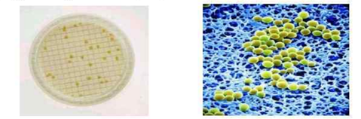
The following requirements apply to membrane filters:
- the microstructure of the membrane and the pore size (0, 45 -0, 65 μm) should maximally promote the germination of microorganisms retained on the membrane; - high porosity, which allows you to quickly filter samples, including viscous;
the membrane material must not contain substances toxic to microorganisms
use inert materials (cellulose ether);
membranes must be sterile packaged and ready for immediate use.
For convenience of counting of colonies filters make with the put grid.
Membrane filter with applied mesh Micrograph of bacteria on the membrane filter
Membrane filter with applied mesh
-

Slide 25
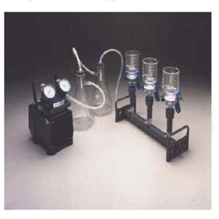
The tests are performed using open and closed filter units using vacuum pumps.
The installation of open type consists of a comb, a filter holder with funnels, membrane filters, the vacuum pump, glass kolbpriyemnikov of a filtrate. In open-type membranes, the nutrient medium is completely transferred or, under aseptic conditions, it is divided into two equal parts, each of which is placed in thioglycol medium and Saburo medium and incubated.

Slide 26
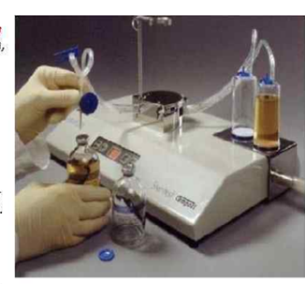
The closed type installation is a closed system that excludes contact of drugs, washing liquid and nutrients with the external environment. The membranes are not removed after filtration, and sterile nutrient medium is added to the canister with the membrane after filtration, which eliminates the risk of re-contamination. Therefore, the advantage of this method is to exclude false positive results. These settings are diverse. The Steritest system is shown as an example.

Slide 27
The main phases of the process of proper development of microbiological techniques
There are three successive phases in the process of proper micro development
Development of a technique on the reduced quantity of a sample, solvents, environments at preservation of their certain ratio.
The first stage includes theoretical analysis of drug properties, determination and selection of research conditions, development of methods for determining the total number of microorganisms in insoluble drugs, development of methods for determining the total number of microorganisms in soluble drugs by membrane filtration.
2. Scaling of the method and confirmation of its suitability on the quantities that will be used in routine control (performed on one batch of product). The second stage is scaling the methodology and checking the suitability. In contrast to the procedures for developing the method, which allow scaling in the process of sample preparation of the drug, when checking the suitability of the method it is necessary to strictly follow the specified methods (quality control management - MCC) conditions: weight of the drug, solvent volume breeding and the like.

Slide 28
3. Validation of the method to confirm the suitability and reproducibility of the method regardless of the product series of the studied personnel, series of media and other conditions (performed on at least three product series using three batches of nutrient media).
The third stage - validation of the methodology - has the following features. Validation of microbiological control methods - minimally statistically confirmed the suitability of the method, which is carried out on three different batches of the drug, taking into account all possible factors influencing the reliability of the results of experimental studies. Therefore, to assess the impact on the suitability of the method of possible variable properties of batches of drugs and batches of nutrient media and solutions, validation studies are performed on three different batches of the drug and three different batches of nutrient media and solutions. Thus, in the process of validation conditionally accounted for, specified in the method of the conditions of research to determine the microbiological purity of the drug allow to obtain reliable results of quality control of this drug as a whole, regardless of the series.

Slide 29
Thanks for attention

