Slide 1
Practical lesson No. 1
Theme №. 1 "Historical aspects of the formation and development trends of pharmaceutical technology in the countries of the world and in Ukraine".

Slide 2
Goal. Formation of theoretical foundations and important professional skills in students regarding the organization of provision of medicines to the population, knowledge of the basics of proper pharmacy practice; formation of students' primary professional knowledge regarding the requirements for the production activity of pharmacies, safety rules and the sanitary and anti-epidemic regime of the production department of the pharmacy.
Basic concepts.
Healers - were written for the people and home treatment, not by doctors for doctors. The amount of medicine was indicated in spoons, handfuls, and glasses. In scientific treatises, where there is a reference to foreign doctors, there are Latin names, the weight is indicated in the scrolls.
Herbalists - they include the Russian folk names of medicinal plants and a description of the area where they grow.
Windmills - are translated works that contained many foreign terms, many Latin names, doses given in apothecary measure.
Equipment: computer, multimedia equipment.

Slide 3
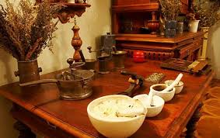

In the conditions of the formation of market relations in Ukraine, great attention is paid to the professional training of specialists in the pharmaceutical industry. The discipline is the basis for the study of ethics and deontology in pharmacy, pharmacy technology of drugs, pharmacognosy, industrial technology of drugs, which involves the integration of teaching with the above-mentioned disciplines for the formation of skills to apply knowledge in the process of further education and professional activity.
In the second half of the 9th century the Old Kievan Rus state was formed with the capital in the city of Kyiv.
It was in Kyiv that the first healers appeared who used antlers (young deer horns), onions, radishes, horseradish, garlic, and plantain. Plantain was widely used for purulent wounds externally, and garlic was used internally for intestinal diseases and in the form of garlic water for washing the whole body during epidemics (plague, dysentery).

Slide 4
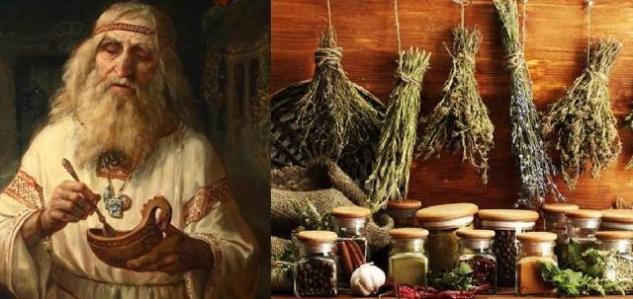
The medical profession had a craft character and was considered an honorable occupation. Practical experience was passed down from generation to generation. City doctors had benches to sell medicines, mainly of herbal origin. In Kievan Rus', the legal status of "lychee" was in effect, that's how folk healers were called. The law established payment for the work of a layman: a person who was wounded had the right to demand from the offender 3 hryvnias for the treatment of his wound. Later, this reward was called "healing".
In Kievan Rus, surgery was developed as an important branch of practical treatment. The need for surgery was caused by frequent wars and domestic injuries. Wine, birch water, solutions of common salt were used to treat wounds.
Medicine in Kievan Rus is characterized by the beginning of the formation of state medicine, which begins to form alongside folk and monastic medicine.

Slide 5
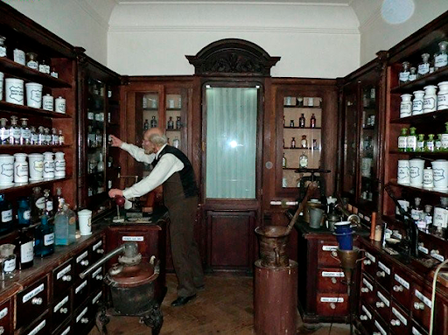
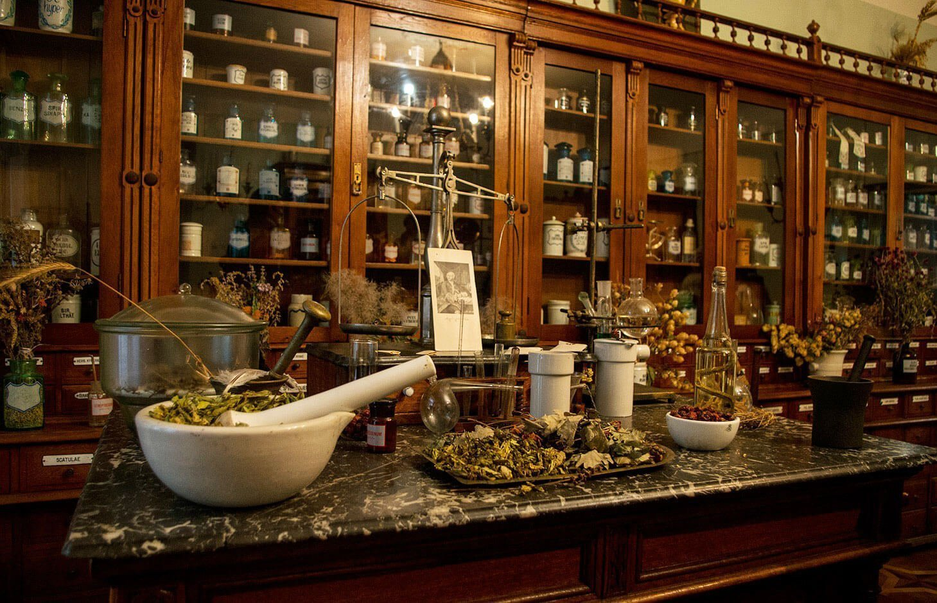
Healers, herbalists and herbalists gained the widest distribution in Russia. These collections described the healing properties of plants and gave advice on how to treat certain diseases. The healers and herbalists lacked any elements of religion and mysticism.
Pharmacy network of Ukraine since the beginning of the 19th century. is developing intensively, pharmacies are opening in all large settlements, and their number is increasing in cities. In 1873, the government was forced to issue "Rules for opening pharmacies". The permission to open a pharmacy was issued by the governor, while it was necessary to take into account the population and the number of operating pharmacies. Thus, in large cities, one pharmacy was supposed to serve 12,000 people and 30,000 prescriptions, in provincial cities – 10,000 people and 15,000 prescriptions. In other settlements, it was allowed to open pharmacies at a distance of at least 15 versts.

Slide 6
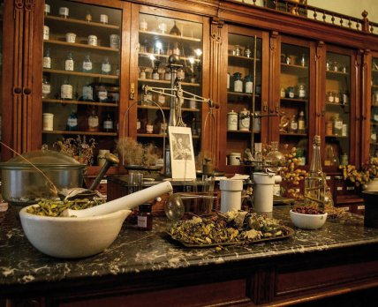
In 1865, 14 pharmacies operated in Kyiv. Almost all pharmacies were private. State pharmacies were preserved only in provincial and administrative centers, and even they, as a rule, were leased to private pharmacists.
In the 80s of the XIX century. advanced zemstvo intelligentsia, with the aim of improving medical care for low-income groups of the population, obtained permission to open free pharmacies, which were created at the expense of zemstvos. Medicines from independent pharmacies were dispensed free of charge or at prices lower than in private pharmacies.

Slide 7
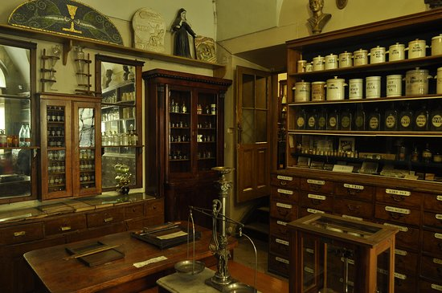
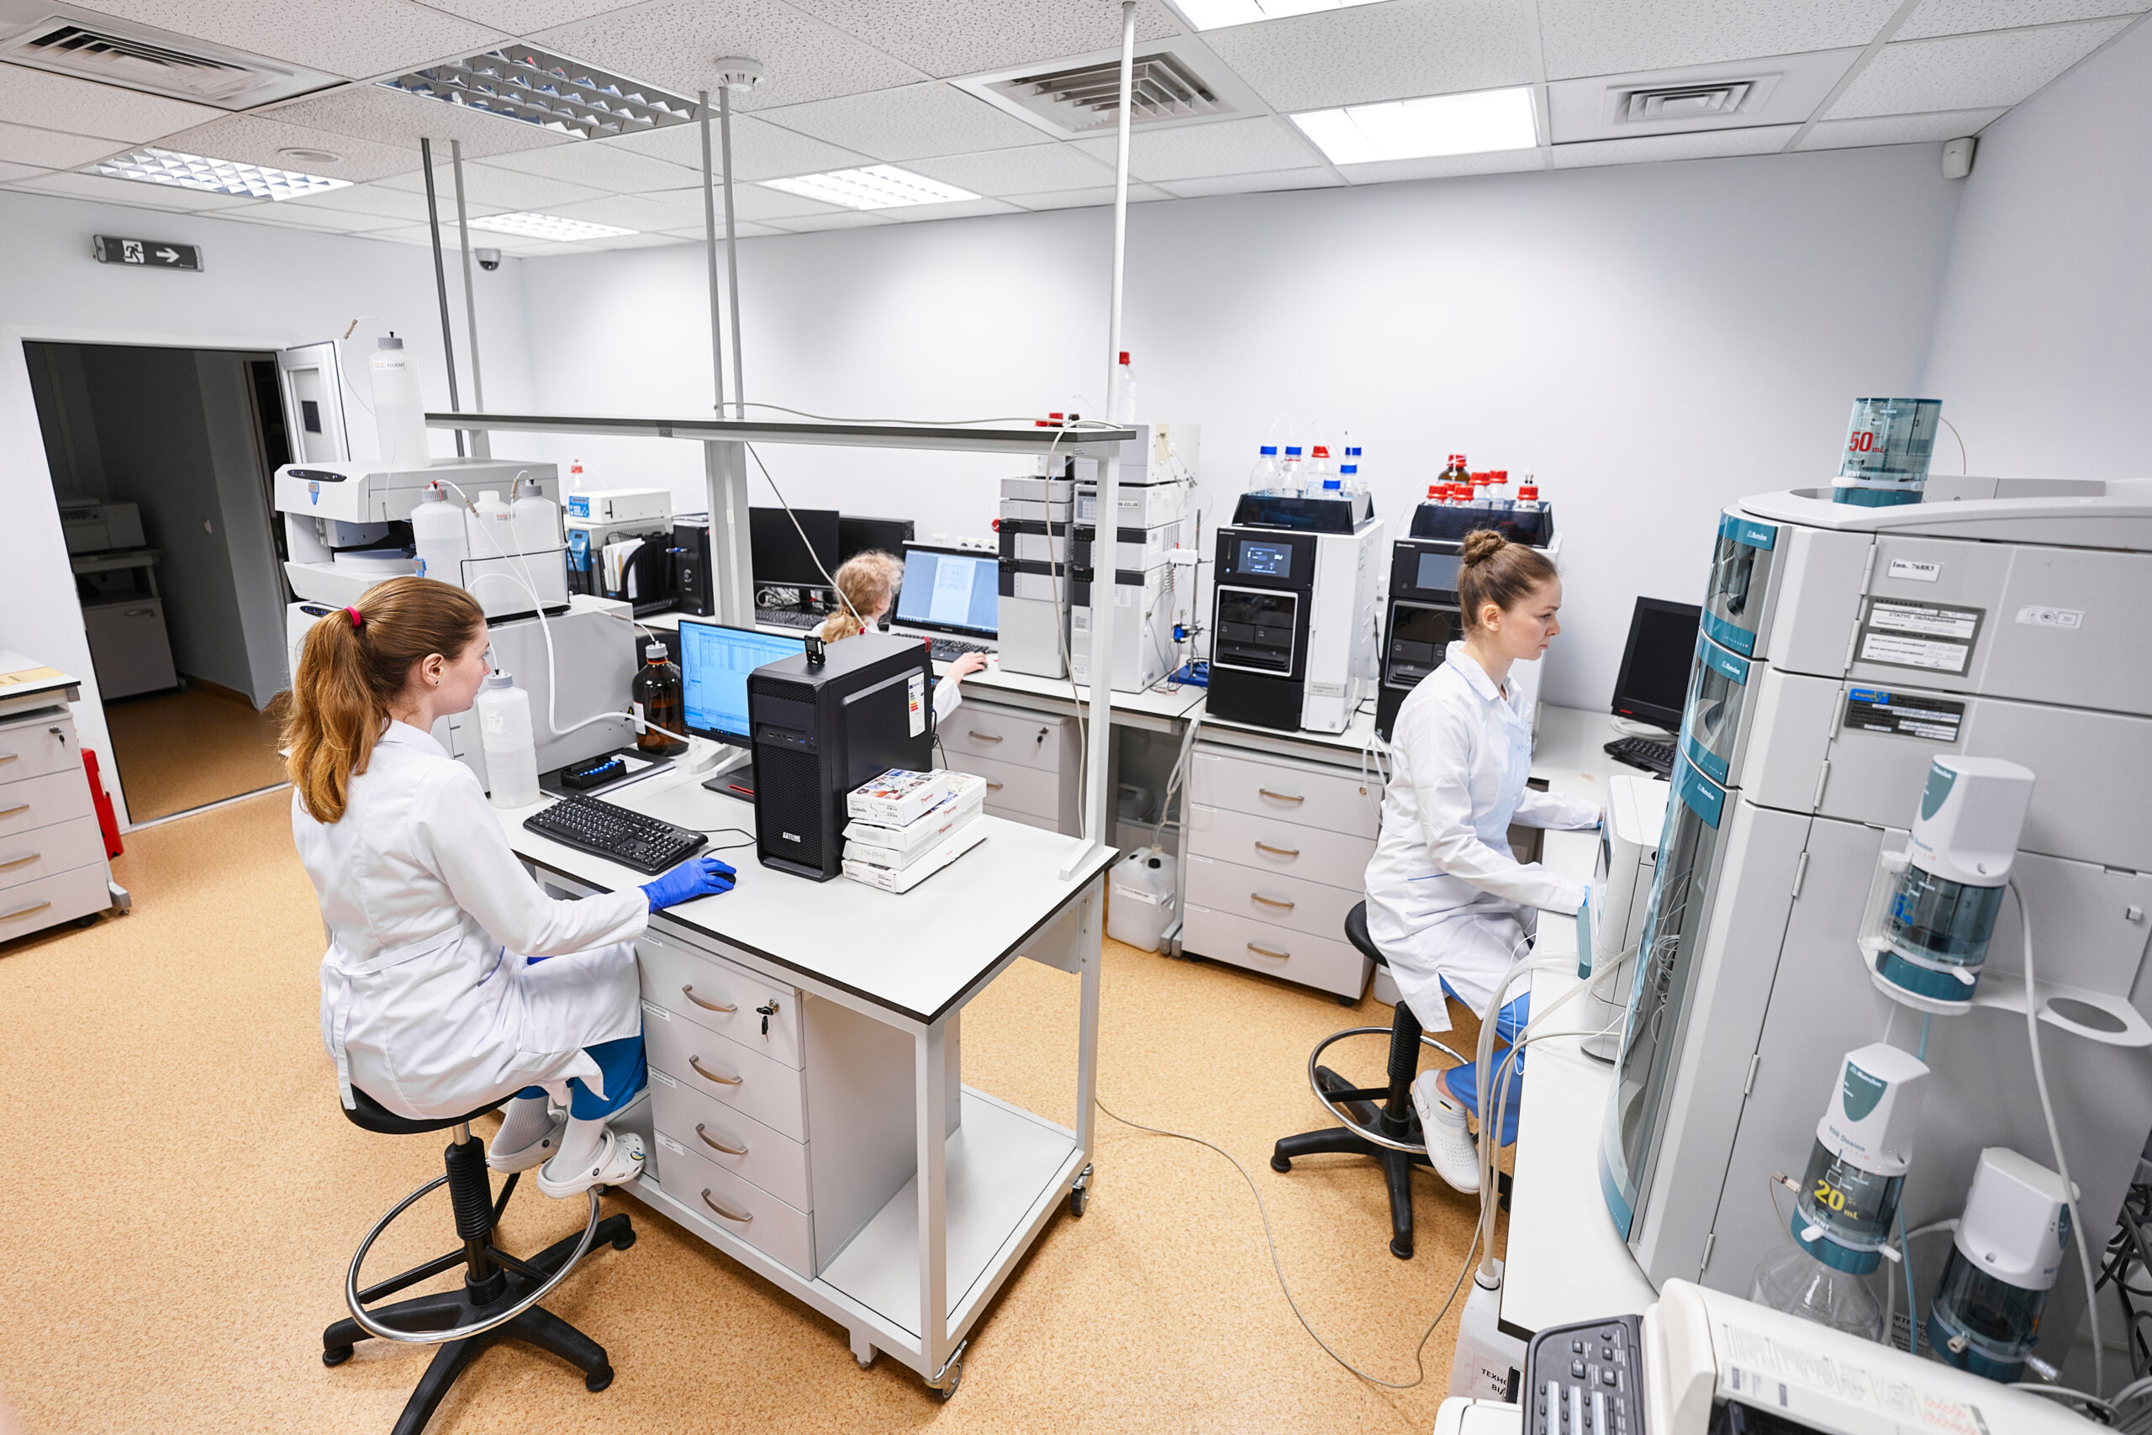
During the times of the Soviet Union, pharmaceutical education was not given due attention. There were only six pharmaceutical higher education institutions. Basically, pharmacists were trained at pharmaceutical faculties of medical institutes. The financial support of pharmaceutical faculties was very poor, as the main focus was on the training of doctors. The needs of the entire industry were met by specialists of only one specialty. Specialists with the same training worked in the pharmacy, pharmaceutical company, and hospital.
The first steps of independent Ukraine in this direction in the early 1990s were the birth of a national system of institutions designed to regulate the creation, analysis, research, introduction into medical practice and production of pharmaceuticals.

Slide 8
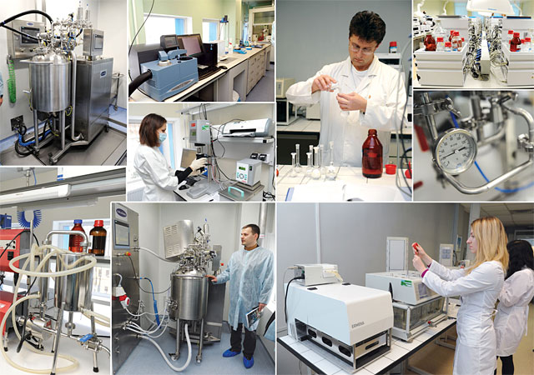
National Pharmacological and Pharmacopoeial Committees were created as guarantors of the quality of domestic and imported medicinal products entering the pharmaceutical market of Ukraine, the Committee for Drug Control, the Committee for Immunobiological Medicines, the State Inspectorate for Quality Control of Medicines, the Medicines Registration Bureau, etc.
With the declaration of independence of Ukraine in 1991, the form of ownership of pharmaceutical enterprises and pharmacy establishments underwent significant changes.
The modern stage of development of health care in Ukraine, which is characterized by the growth of the production of medicines, enterprises of various forms of ownership, with the use of mostly imported substances, as well as the arrival of large volumes of imported medicines on the domestic pharmaceutical market, puts forward strict requirements for their quality and requires improvement of the service their control.

Slide 9
Tasks for fixing the material
№ | Main tasks | Instructions | Answers
1. | Development of medicine and pharmacy in Ukraine? | your answer
2 | Pharmacy in Kyevan Rus in the XVI-XVII centuries? | your answer
3 | Name the main achievements in pharmacy in Kyevan Rus? | your answer
4 | Prominent figures in the field of medicine in Kyevan Rus? | your answer
5 | Creation of the first pharmacies in Ukraine? | your answer
6 | The development of pharmacy in Europe during the XVI-XVII centuries? | your answer
7 | Name the outstanding figures in the pharmacy of Europe? | your answer
8 | What diseases were noted in the period of the XVI-XVII centuries? The main ways of treatment? | your answer
9 | What was the basis of the apothecary order. | your answer
10 | Name the owners of the first pharmacies opened in Ukraine? | your answer

Slide 10
Tests
1. In Kievan Rus, surgery was developed as an important branch of practical treatment, and the main antiseptic for treating wounds was:
A wine
B snake venom,
C water,
D mushrooms,
E saliva.
2. Define the term herbalists...
A were written for the people and home treatment, not by doctors for doctors,
B they include the Russian folk names of medicinal plants and a description of the area where they grow,
C -,
D translated works containing many foreign terms, many Latin names, doses given in apothecary measure,
3. In the handwritten "Uvariv herbalist" (1614), all known in Russia are described ....
A medicinal plants,
B mushrooms,
C bacteria,
D diseases,
E -.
4. In 1865, pharmacies functioned in Kyiv. Specify their number at the moment:
A 14,
B 20,
C 30,
D 25,
E 15.
5. The special development of the pharmaceutical industry in the 20th century was observed in:
А Galicia,
B Odeshchyna,
C Donetsk,
D Lviv region
E-.
6. The first information about pharmacies in Western Ukraine is dated to the end of:
A of the seventeenth century,
B of the 16th century
C of the 14th century,
D of the 18th century,
E of the 15th century.

Slide 11

Tests
7. At the end of the XX century. on the pharmaceutical market of Ukraine there are about ……. pharmaceutical companies
A 200;
B 150,
C 300,
D 50,
E 100.
8. The first steps of independent Ukraine in the early 1990s were the birth of a national system of institutions designed to regulate the creation, analysis, research, and pharmaceutical products, therefore the following were created:
A Pharmacological and Pharmacopoeial Committees,
B Pharmacies,
C Pharmaceutical enterprises,
D State Inspection,
E -.
9. Home pharmacies were more often created in small towns or provinces to help doctors. The main condition for opening such pharmacies was….
A lack of a pharmacy within a 1-mile radius of the doctor's residence,
B the presence of a population that could purchase medicine,
C if the pharmacist was a doctor part-time,
D the presence of a railway,
E –
10. An outstanding event in Ukraine in the 1970s was the opening of a pharmaceutical enterprise. Specify the name of the company?
A Lvivfarm,
B Odesafarm,
C Kharkivfarm,
D Kyivfarm,
E -

Slide 12
Questions for self-control:
1. The development of medicine and pharmacy in Ukraine from Ancient Rus to the beginning of the 20th century.
2. Pharmacy in Kyevan Rus during the XVI–XVII centuries.
3. Medical professions of the 16th century. Pharmacy order.
4. Pharmacy at the beginning of the 18th century.
5. Development of Ukrainian medicine and pharmacy in the XIII–XIX centuries.
6. Development of the pharmacy business in Ukraine in the 18th century.
7. Historical aspects of pharmaceutical education in Ukraine and abroad.
8. Outstanding scientists and their contribution to the development of medicine and pharmacy.
9. Development of pharmaceutical production in European countries.

Slide 13
List of recommended literature (main, additional, electronic information resources):
Basic literature:
1. Gladukh E.V. Theoretical foundations of pharmaceutical technology. Study guide for extracurricular independent work / E.V. Gladukh, I.V. Saiko, A.A. Sichkar, D.P. Soldatov. Kh.: NFaU, 2016. - 202 p.
2. Technology of drugs of industrial production (vol. 2 of 2). Chuyeshov V. I., Gladukh E. V., Saiko I. V., Lyapunova O. O., Sichkar A. A., Krutskikh T. V., Ruban O. A. Kh.: National University of Applied Sciences; Golden Pages, 2013. - 638 p.
3. Technology of drugs of industrial production (vol. 1 of 2). Chuyeshov V. I., Gladukh E. V., Saiko I. V., Lyapunova O. O., Sichkar A. A., Krutskikh T. V., Ruban O. A. Kh.: National University of Applied Sciences; Golden Pages, 2012. - 694 p.

Slide 14
Additional literature:
1. Technological equipment of the pharmaceutical and biotechnological industry: tutorial. for university students education closing III-IV accreditation level / M.V. Stasevych and others; 2nd ed., revision. and added – Lviv: Novy svit-2000, 2018. – 410 p.
2. Yarnykh, T. G. Extemporaneous formulation (technology, analysis, application): method. rec. / T. G. Yarnykh, Fr. I. Tikhonov, I. S. Hryshchenko and others. - Kh., 2015. -379 p.
3. State Pharmacopoeia of Ukraine / State enterprise "Ukrainian Scientific Pharmacopoeia Center for the Quality of Medicinal Products" - 2nd edition. - Kharkiv: State Enterprise "Ukrainian Scientific Pharmacopoeia Center for the Quality of Medicinal Products", 2015. - Vol. 1. -1128 p.
4. Extraction of plant raw materials: training. Guide / Yu. I. Sidorov, I. I. Gubytska, R. T. Konechna, V. P. Novikov. – Lviv: View of the National Lviv Polytechnic University, 2018. - 336 p.
5. History of medicine and pharmacy: teaching. manual for pharmacy students. education closing and pharmacy Faculty of Higher Education of the Ministry of Health of Ukraine / A. A. Kotvitska, V. V. Gorbanev, O. O. Surikov and others. – Kharkiv: National Institute of Economics and Technology: Golden Pages, 2016. – 168 p.

Slide 15
Thank you for attention!

