Slide 1
Practical lesson No. 2
Theme № 2 "Pharmaceutical technology. Modern tasks and prospects of pharmaceutical technology. Basic terms and concepts of pharmaceutical technology".

Slide 2
Goal. Formation of students' knowledge of regulatory and technical documentation in the industrial production of medicinal products. To study the general principles of the organization of pharmaceutical production. To master the principles of classification of medicinal forms.
Basic concepts.
Pharmaceutical technology – (pharmaceutical technology; medicinal technology) is a branch of science that studies the theoretical foundations of the technological processes of obtaining and processing medicinal products into prophylactic, therapeutic, rehabilitative, diagnostic and other medicinal products in the form of various medicinal forms.
Pharmacy drug technology - is carried out by preparing drugs according to individual prescriptions, preparing intra-pharmacy blanks, packaging, and is carried out in a pharmacy. It is distinguished by a large range of small-batch products. Manufactured medicinal products are unstable during storage, have a complex composition and individual dosages;

Slide 3
Тechnology of pharmaceutical production (factory (industrial) drug technology) - is characterized by large-scale production and is produced by mechanized pharmaceutical enterprises, plants and factories.
Technological parameter - a physical or chemical parameter that has a quantitative or qualitative scale of measurements, which determines the limits of the technological norm and / or safety, the departure of which exceeds the limit values, leads to a decrease in the quantity or quality of the product obtained and / or the occurrence of extraordinary situations.
Equipment: computer, multimedia equipment.

Slide 4
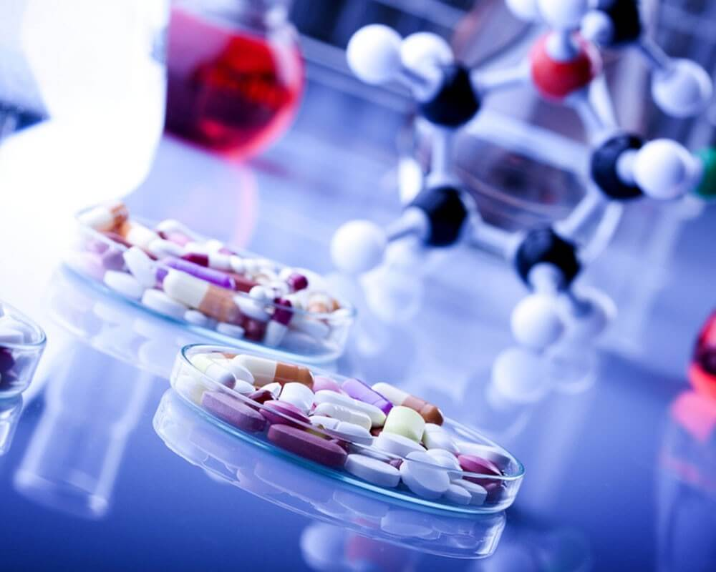
Pharmaceutical drugs are products of interdisciplinary importance and wide application, on which the life, health and well-being of a person primarily depend. Saturation of the Ukrainian market with domestically produced pharmaceuticals is associated with the formation of new approaches to the organization of production, assessment of the quality of raw materials used and finished products, and the use of new technologies. Solving these problems is within the power of specialists who have appropriate training in solving issues arising in the pharmaceutical industry.

Slide 5


The main tasks of pharmaceutical technology as a science:
- development of technological foundations and methods of production of new medicinal substances and preparations;
− improvement of existing medicines;
- search, study and use of new auxiliary substances in the production of medicinal products;
- studying the stability and establishing the expiration date of medicinal substances, preparations, semi-finished products and other products;
- study of the effectiveness of the technological process, the main indicators of which are: specific consumption of raw materials, energy and labor costs per unit of production; output and quality of finished products; intensity of technological process; production cost.

Slide 6
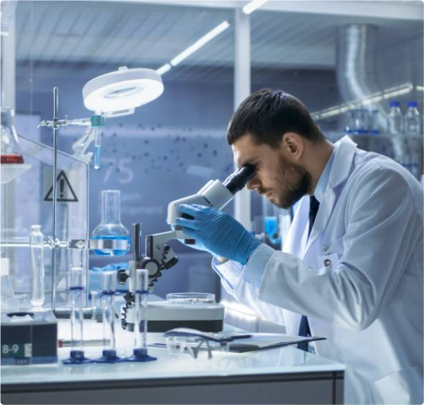
Pharmaceutical technology:
If auxiliary work (dissolution and drying of raw materials, preparation of solutions of a given concentration, etc.) is carried out in separate equipment for one stage of the main technological process, then such auxiliary work is included in this stage of the main technological process.
Auxiliary work carried out in separate equipment for several stages of the same production or several productions are allocated to independent stages of auxiliary work (for example, preparation of demineralized water, solutions of acids or alkalis with a given concentration for the entire workshop, etc.).
If waste processing or their disposal is carried out as independent work, they may not be included in the technological scheme of production. At the same time, the technological scheme with an arrow indicates where the waste goes for processing (disposal)

Slide 7


Technical means - a set of production tools necessary for the implementation of the technological process.
Intermediate products are partially processed products obtained at any stage of the technological process, excluding the final stage, and intended for further processing before they become finished products.
An intermediate product is a product received by a manufacturing company from a supplier that has undergone one or more stages of processing (at the supplier) necessary for the production of finished products (from the consumer). An intermediate product for a supplier is a finished product.

Slide 8

Waste is a modified or low-quality residue of raw materials, materials or semi-finished products, which cannot be used for the preparation of a finished product without appropriate processing.
If production waste has consumer value and can be further processed, they are called by-products. Production waste, which is not subject to further processing and does not represent consumer value, is called emissions.
A series of finished medicinal products is a set of units of a medicinal product, which is manufactured from one series of raw materials, materials and intermediate products in one technological process, including the same sterilization stage.
The State Register of Medicinal Products of Ukraine (Law of Ukraine "On Medicinal Products and Medicinal Products") is a regulatory document containing information on medicinal products that are permitted for production and use in medical practice.
The quality of a medicinal product is a set of properties that give the medicinal product the ability to satisfy consumers in accordance with its purpose and meet the requirements established by law.

Slide 9
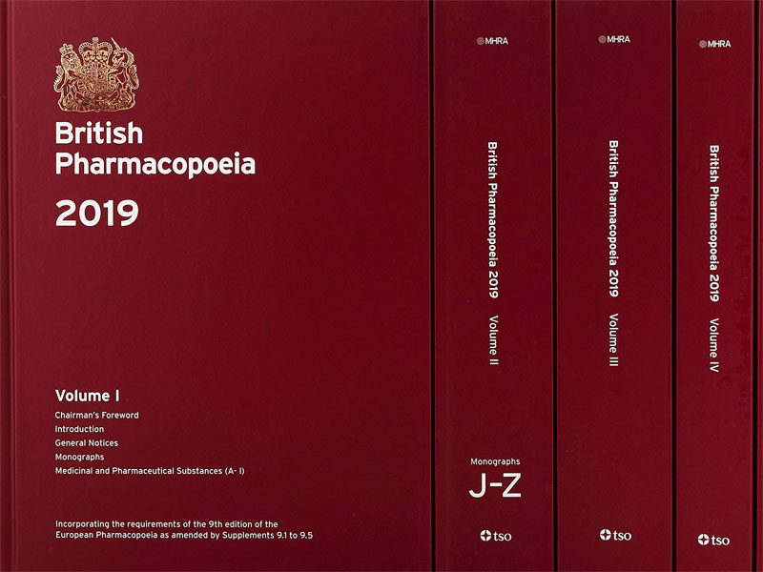
The quality of the medicinal product is standardized by the Pharmacopoeia article - a regulatory document that defines the composition, packaging, expiration date and requirements for the quality of the medicinal product (medicinal substance or excipient) and has the status of a state standard.
The certificate is a written certificate (guarantee) that the quality of the medicinal product (efficacy, safety) meets the established requirements of the specification, and the production process meets the rules of good manufacturing practice (GMP).
Stability is the ability of a medicinal product (preparation) to retain its physicochemical and microbiological properties for a certain period of time from the moment of its release.

Slide 10


Expiry date - approved by the legislative body on the basis of the results of special studies, the storage time of the medicinal product (preparation), during which it retains its physico-chemical, microbiological and therapeutic properties in an unchanged form or within the limits established for them, subject to compliance with the storage conditions.
Medicinal (pharmaceutical) raw materials - medicinal products, medicinal plant raw materials, auxiliary substances allowed for medical use for the purpose of the production of medicinal products or other pharmaceutical products or semi-finished products. In fact, the composition of raw materials includes all raw materials that enter production for processing in order to obtain a finished product or semi-finished product, with the exception of packaging materials.

Slide 11
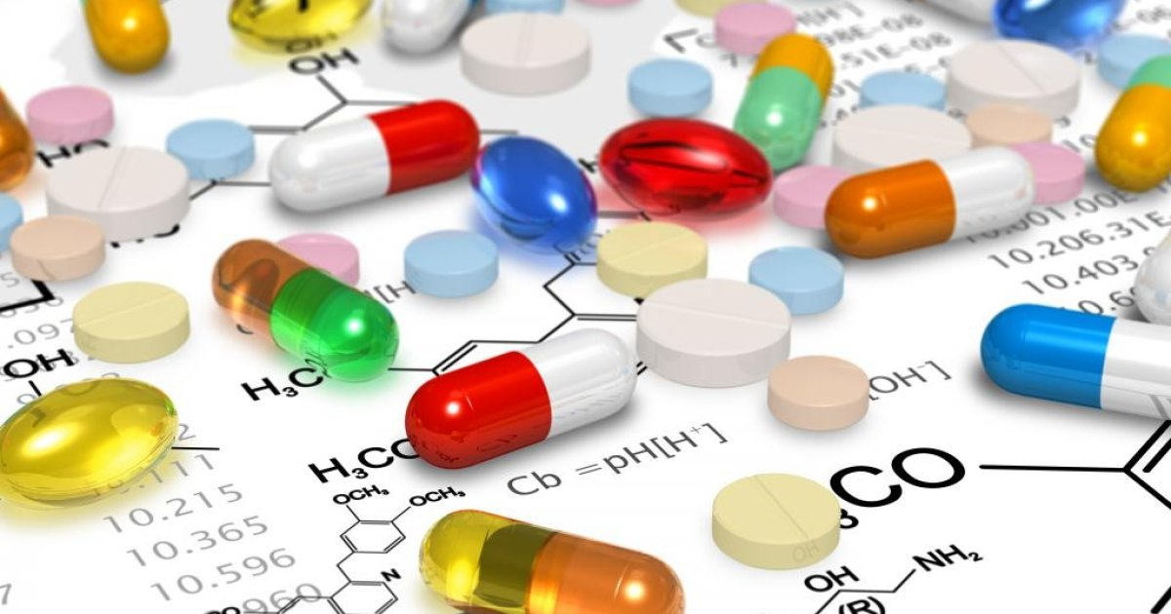
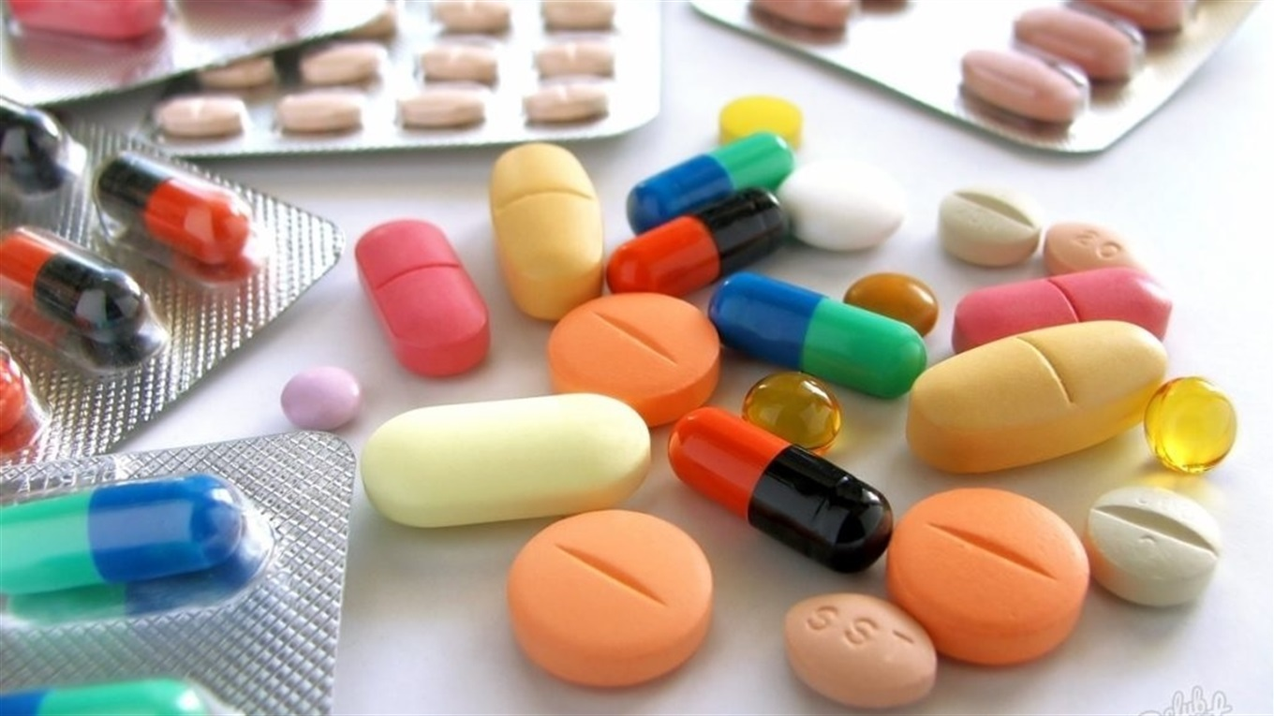
Active substances (Law of Ukraine "On Medicinal Products") are biologically active substances that can change the state and functions of the body or have a prophylactic, diagnostic or therapeutic effect and are used for the production of finished medicinal products.
Medicinal product (medicinal substance) - a substance (mixture of substances) of synthetic or natural origin, which has a certain biological activity and is allowed for medical use, production and import for the purpose of diagnosis, prevention or treatment of humans or animals.

Slide 12
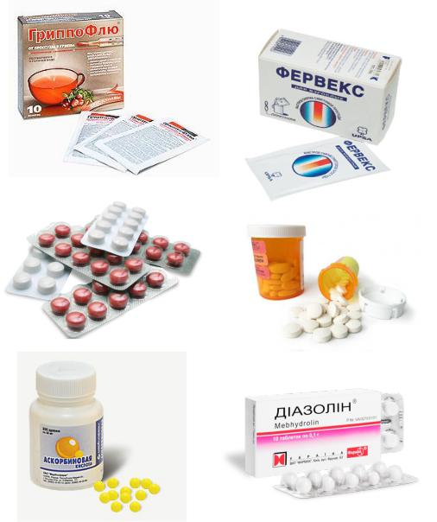
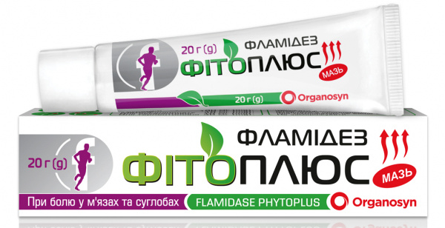
Auxiliary substance - a chemically and biologically indifferent substance, allowed for medical use for the purpose of obtaining a dosage form, providing or preserving certain properties of the medicinal product.
Medicinal form - the form given to a medicinal product or medicinal plant material, convenient for use and providing the necessary therapeutic effect.
Medicinal product (medicinal product, medicinal product) is a medicinal form in a packaged, packaged and labeled form in accordance with the requirements of regulatory and technical documentation, which has a certain expiration date and is convenient for medical use, transportation and storage.

Slide 13
Tests
1. Define the term validation:
A is a documentary confirmation of compliance of the equipment, production conditions, technological process, quality of the intermediate product and the finished product with the current regulations and / or requirements of regulatory documentation.
B is a documentary confirmation of the conformity of production equipment.
C is the conformity of production conditions, technological process.
D is a documentary confirmation of the quality of the intermediate product and the finished product in accordance with current regulations and / or requirements of regulatory documentation.
E -.
2. The State Register of Medicinal Products of Ukraine is...
A regulatory document containing information on medicinal products approved for production and use in medical practice.
B a set of properties that give the medicine the ability to satisfy consumers in accordance with its purpose and to meet the requirements established by law.
C the ability of a medicinal product (preparation) to retain its physico-chemical and microbiological properties for a certain period of time from the moment of its release.
D form given to the medicinal product or medicinal plant material is convenient for use and provides the necessary therapeutic effect.

Slide 14
3. Biologically active substances that can change the state and functions of the body, diagnostic or therapeutic effect and are used for the production of ready-made medicinal products are called...
A Active substances,
B Pharmaceutical form,
C Medicine,
D Certificate,
E -.
4. A written certificate that the quality of the medicinal product meets the established requirements of the specification, and the production process - the rules of good manufacturing practice (GMP) is called...
A Certificate,
B Patent for an invention,
C Mark of quality,
D Utility model patent,
E Article.

Slide 15
5. Solid, soft, liquid and gaseous dosage forms are classified according to...
A aggregate state,
B composition of auxiliary components,
C by the presence of active substances,
D stages of production.
E-.
6. A mixture of several types of chopped, ground into coarse powder or whole medicinal plant raw materials, sometimes with the addition of other medicines is called...
A fee,
B powders
C granules,
D dragee
E capsules.

Slide 16
7. Systems in which a solid substance is suspended in a liquid and the particle size ranges from 0.1 to 10 μm are called:
A suspension;
B emulsions,
C liniments,
D mucus,
E solutions.
8. The classification of dosage forms, depending on the routes of administration, is divided into:
A enteral and parenteral;
B injectable and inhaled,
C rectal and vaginal,
D sublingual and percutaneous,
E -.

Slide 17
9. The State Pharmacopoeia is...
A set of mandatory national standards and norms that regulate the quality of medicinal products,
B some norms that regulate the quality of medicinal products,
C a set of selective criteria that indicate a certain quality of medicinal products,
D articles on individual medicinal substances and medicinal products,
E –
10. The Commission of the European Pharmacopoeia currently has... members:
A 38 countries,
B 40 countries,
C 20 countries,
D 5 countries,
E 15 countries

Slide 18
Tasks for fixing the material
№ | Mein tasks | Instructions | Ansvers
1 | Name the main tasks of technology? | your answer
2 | Name the main criteria for the organization of pharmaceutical production? | your answer
3 | Main departments in a pharmaceutical company? | your answer
4 | Define the term pharmaceutical technology? | your answer
5 | State the common and distinctive features between pharmacy drug technology and pharmaceutical manufacturing technology? | your answer
6 | Define the term validation? | your answer
7 | Name the main principles of classification of dosage forms? | your answer
8 | How is the quality of the medicinal product determined? | your answer
9 | Indicate the classification of medicinal forms depending on the method of introduction into the body? | your answer
10 | Name the main regulatory and technical documents for the industrial production of medicinal products? | your answer

Slide 19
Questions for self-control:
1. The main tasks of pharmaceutical technology as a science.
2. General principles of pharmaceutical production organization.
3. Basic terms and concepts in the field of drug production.
4. Principles of classification of dosage forms.
5. Classification of dosage forms depending on the method of administration of drugs into the body.
6. Classification of dosage forms depending on the field of action.
7. Classification of dosage forms according to Yu. I. Khadzhai.
8. Regulatory and technical documentation for the industrial production of medicinal products. 9. State Pharmacopoeia of Ukraine.

Slide 20
List of recommended literature (main, additional, electronic information resources):
Basic literature:
1. Gladukh E.V. Theoretical foundations of pharmaceutical technology. Study guide for extracurricular independent work / E.V. Gladukh, I.V. Saiko, A.A. Sichkar, D.P. Soldatov. Kh.: NFaU, 2016. - 202 p.
2. Technology of drugs of industrial production (vol. 2 of 2). Chuyeshov V. I., Gladukh E. V., Saiko I. V., Lyapunova O. O., Sichkar A. A., Krutskikh T. V., Ruban O. A. Kh.: National University of Applied Sciences; Golden Pages, 2013. - 638 p.
3. Technology of drugs of industrial production (vol. 1 of 2). Chuyeshov V. I., Gladukh E. V., Saiko I. V., Lyapunova O. O., Sichkar A. A., Krutskikh T. V., Ruban O. A. Kh.: National University of Applied Sciences; Golden Pages, 2012. - 694 p.

Slide 21
Additional literature:
1. Technological equipment of the pharmaceutical and biotechnological industry: tutorial. for university students education closing III-IV accreditation level / M.V. Stasevych and others; 2nd ed., revision. and added – Lviv: Novy svit-2000, 2018. – 410 p.
2. Yarnykh, T. G. Extemporaneous formulation (technology, analysis, application): method. rec. / T. G. Yarnykh, Fr. I. Tikhonov, I. S. Hryshchenko and others. - Kh., 2015. -379 p.
3. State Pharmacopoeia of Ukraine / State enterprise "Ukrainian Scientific Pharmacopoeia Center for the Quality of Medicinal Products" - 2nd edition. - Kharkiv: State Enterprise "Ukrainian Scientific Pharmacopoeia Center for the Quality of Medicinal Products", 2015. - Vol. 1. -1128 p.
4. Extraction of plant raw materials: training. Guide / Yu. I. Sidorov, I. I. Gubytska, R. T. Konechna, V. P. Novikov. – Lviv: View of the National Lviv Polytechnic University, 2018. - 336 p.
5. History of medicine and pharmacy: teaching. manual for pharmacy students. education closing and pharmacy Faculty of Higher Education of the Ministry of Health of Ukraine / A. A. Kotvitska, V. V. Gorbanev, O. O. Surikov and others. – Kharkiv: National Institute of Economics and Technology: Golden Pages, 2016. – 168 p.

Slide 22
Thank you for attention!

