Slide 1
Aldehydes and ketones

Slide 2
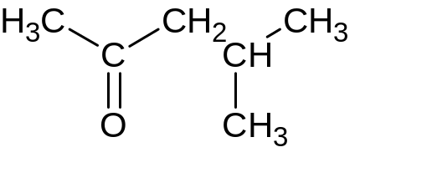
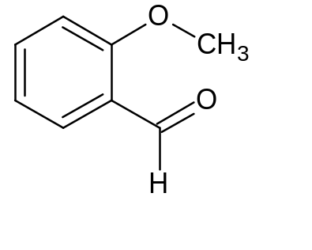
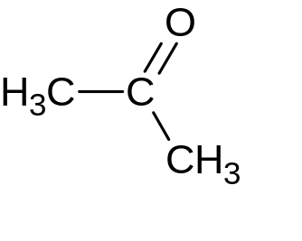
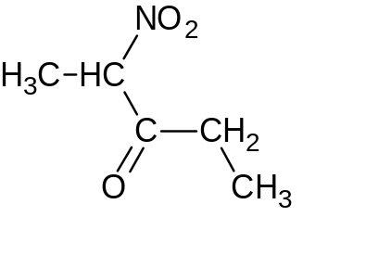
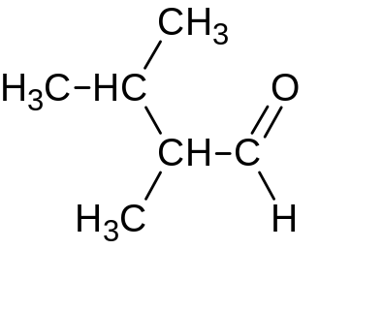
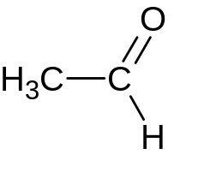
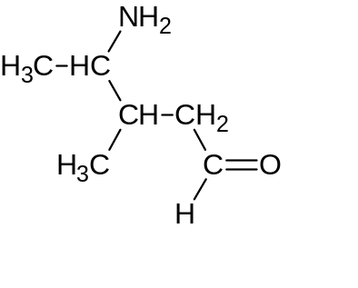
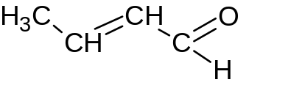
Name the compounds below according to the IUPAC nomenclature and trivial names, where possible
4-methylpenthanon-2
Isobutyl methyl ketone
o-methoxybenzanal
2-methoxybenzoic aldehyde
Propanone-2
dimethylketone
2-nitropenthanone-3
2,3-dimethylbutanal
Ethanal
Ethanoic aldehyde
But-2-enal
4-amino-3-methylpenthanal

Slide 3
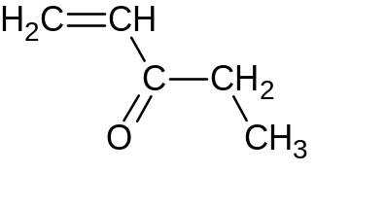
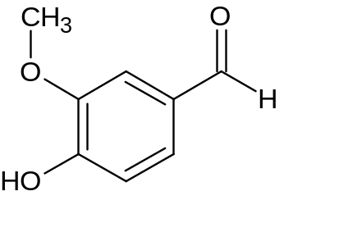
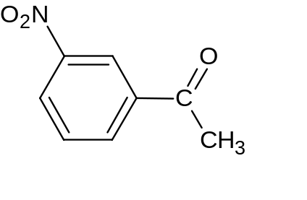
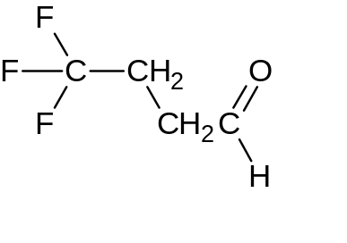
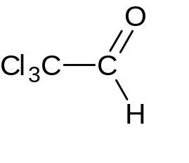
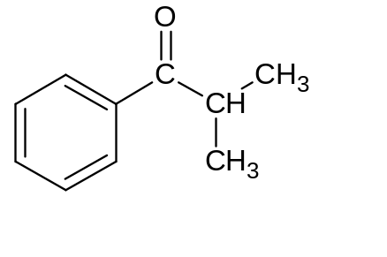
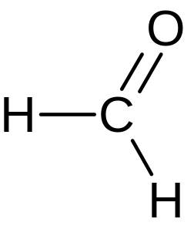
Name the compounds below according to the IUPAC nomenclature and trivial names, where possible
Penth-1-enone
4-hydroxy-3-methoxybenzanal
4-hydroxy-3-methoxybenzaldehyde
3-nitrophenylmethylketone
4,4,4-trifluorobutanal
Tricholoroacet aldehyde
Trichloroethanal
(Chloral)
isopropylphenylketone
Methanal
Formic aldehyde

Slide 4
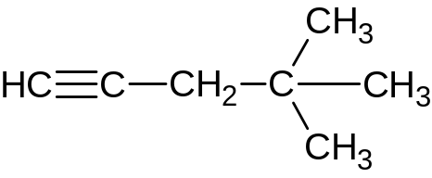
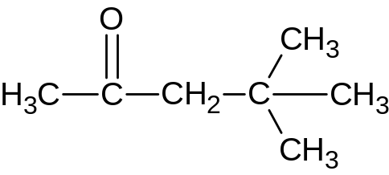
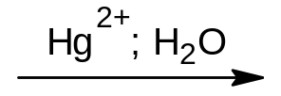
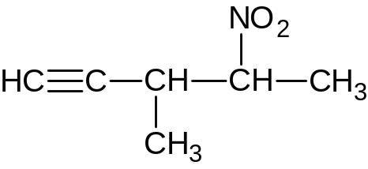
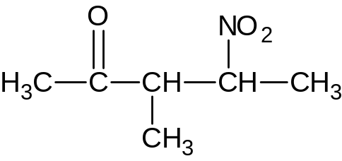
Hydration of the corresponding alkyne gives:
4,4-dimethylpentanone-2
3-methyl-4-nitropentanone-2

Slide 5
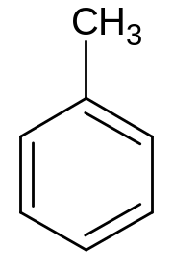
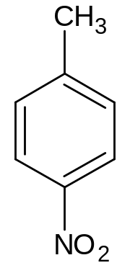
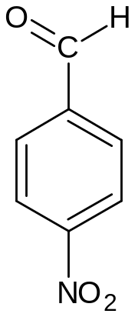
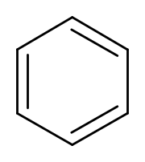



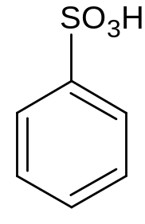
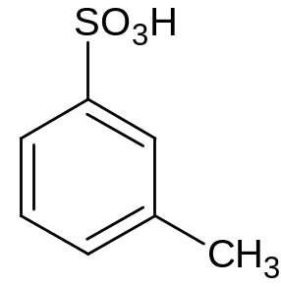
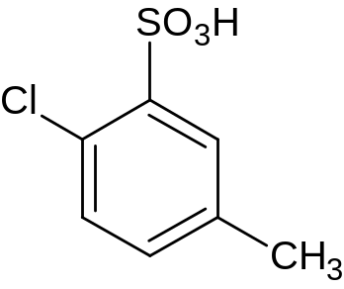
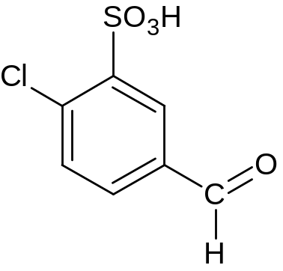

Make a scheme for synthesis 4-nitrobenzaldehyde from benzene
Make a scheme for synthesis 3-sulfo-4-chlorobenzaldehyde from benzenesulfonic acid

Slide 6
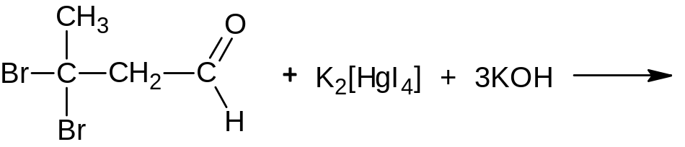
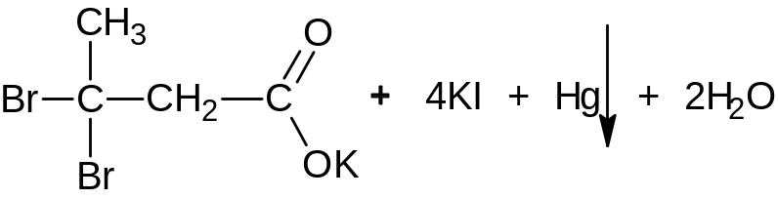
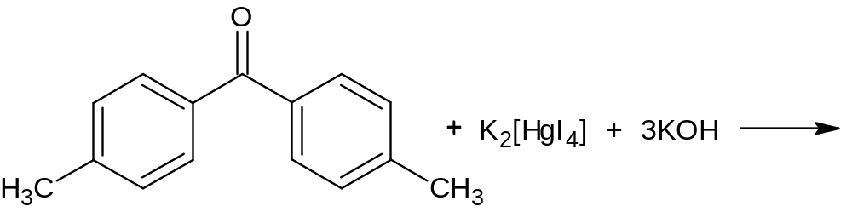
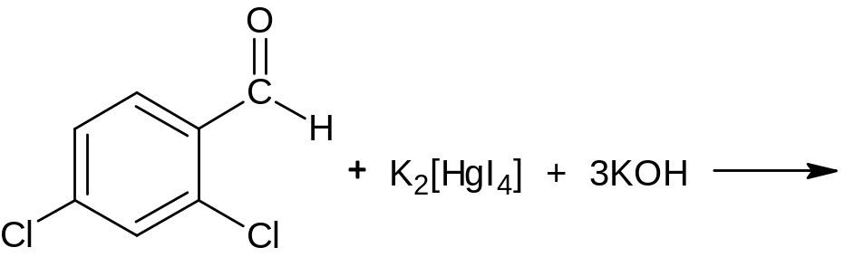
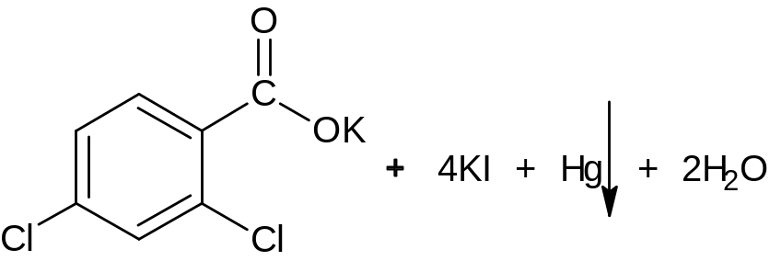
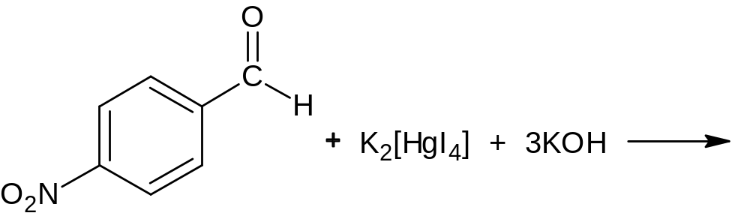
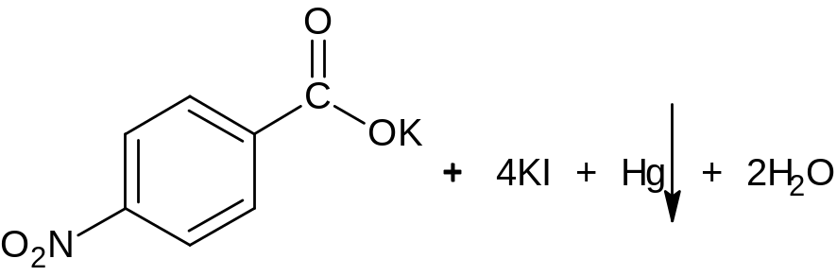
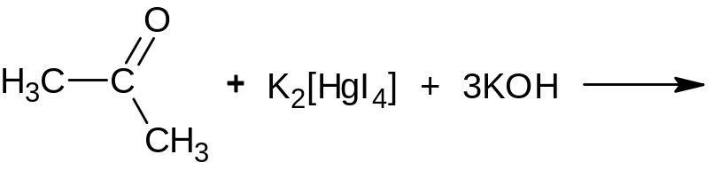
Which of the compounds will interact with Nessler's reagent (potassium tetraidomercurate (II))
3,3-dibromobutanal
4,4`-methylbenzophenone
2,4-dichlorochlorobenzaldehyde
p-nitrobenzaldehyde
dimethyl ketone

