Slide 1
Features of carbon compounds, their diversity, the role of living nature and practical human activity.
Organic chemistry is a branch of chemistry that studies carbon compounds. The term was introduced by the Swedish chemist Y.Ya. Berzelius in 1808.
Organic chemistry studies the properties of organic compounds and methods of their preparation
Organic compounds are hydrocarbons and their derivatives. Hydrocarbon derivatives contain functional groups - atoms or groups of atoms that determine the characteristic chemical properties of the compound and its belonging to a certain class of compounds.

Slide 2
Why compounds of one element - carbon - must be considered separately from the rest?
The number of carbon compounds is huge
Carbon atoms are able to bond with each other, forming stable chains and cycles, which makes the number of carbon compounds in principle infinite.
Carbon is able to form single, double and triple bonds and stable bonds with other elements. This determines the huge variety of organic compounds.
Organic chemistry
Inorganic chemistry
Number of compounds
~12 millions. (1999)
~ 7 millions. (1999)

Slide 3
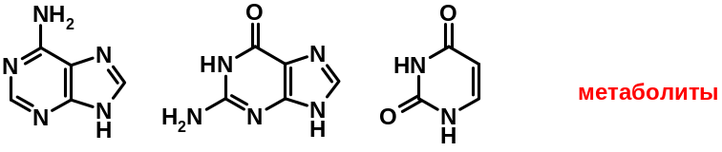
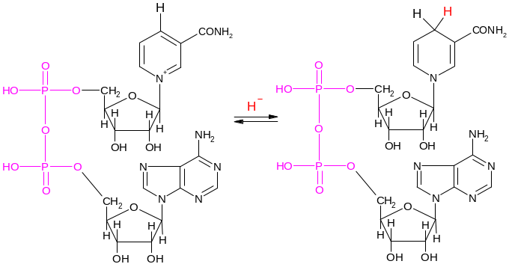
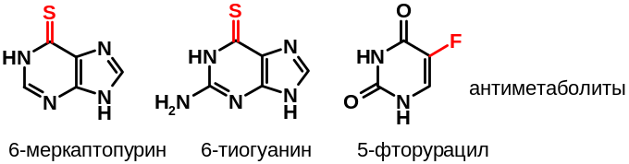
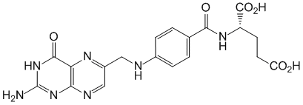
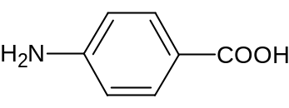
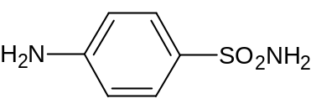
2. Carbon compounds are of great practical importance
Organic chemistry is the basis of biological chemistry, molecular biology and pharmacology and the theoretical basis for the production of plant protection products, detergents, dyes, polymers, various petroleum products, etc..
Metabolites
Antimetabolites
6-mercaptopurine 6-thioguanine 5-fluorouracil
NAD⁺ NADH
Folic acid
PABA
Sulfanilamide

Slide 4
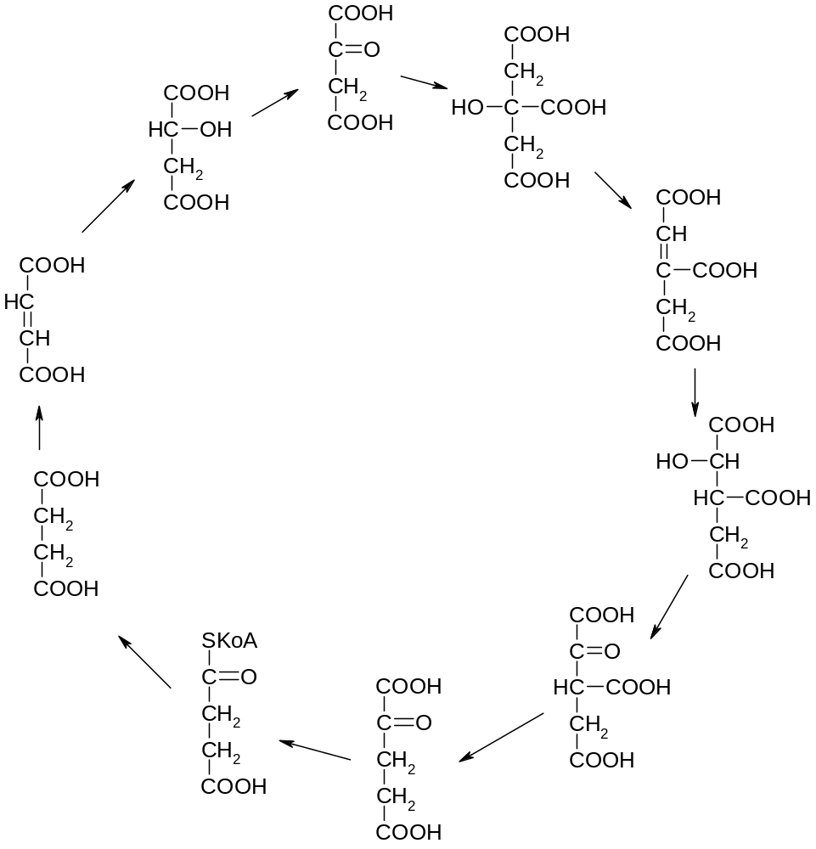
Cycle of tricarboxylic acids

Slide 5
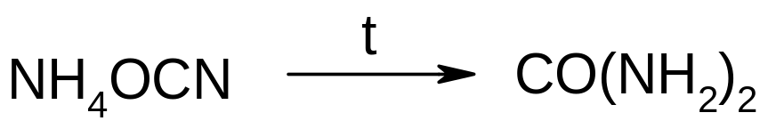
A brief history of organic chemistry
Empirical period
In the 17th and 18th centuries a large number of organic compounds were obtained in individual form, such as, for example, oxalic, citric, malic, uric, formic acids, urea, etc.
Analytical period
This is the 18th century - the middle of the 19th century.
All organic compounds contain carbon.
Two theories were created - the theory of radicals and the theory of types. The concept of "vital force" and the concept of "vitalism", which asserted the presence of a certain intangible "vital force" (vis vitalis) in organisms, with the help of which the body synthesizes complex organic substances.
The first organic synthesis was carried out by the German chemist F. Weller in 1828 by heating an inorganic compound - ammonium isocyanate, while urea was formed:

Slide 6
Structural stage
19th century - beginning of the 20th century
German chemists A. Kekule and G. Kolbe established the tetravalency of carbon and expressed an opinion about the ability of carbon atoms to connect into long chains.
Chemist A.M. Butlerov created a structural theory :
" structure " - sequence of atoms and bonds between atoms in a molecule
structure determines the chemical and physical properties of substances
  The Dutch chemist Y.Kh. Van't-Hoff and the French chemist J.A. Le Bel's idea of the spatial three-dimensional structure of organic molecules (1874).

Slide 7
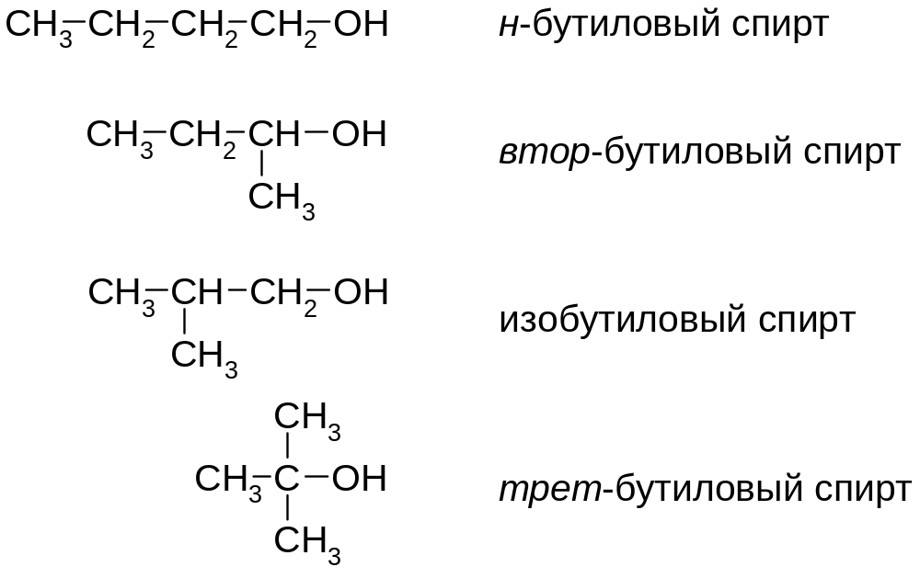
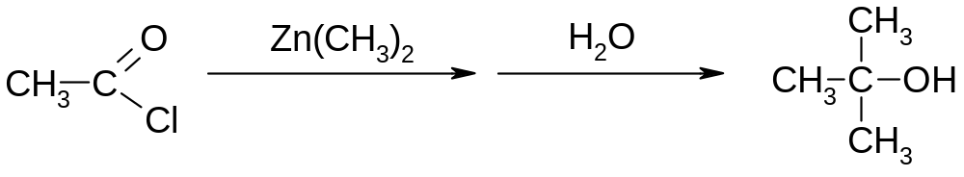
n-butyl alcohol
sec-butyl alcohol
iso-butyl alcohol
tert-butyl alcohol

Slide 8
Modern period
Development of synthetic organic chemistry;
Introduction of quantum-mechanical concepts and physical methods of studying substances;
Close connection with other disciplines - with physical, inorganic, biological and coordination chemistry.

Slide 9
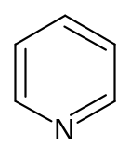
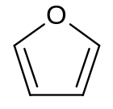
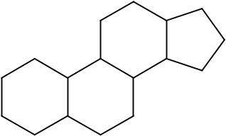
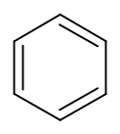
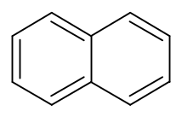




Classification of organic compounds
Classification of organic compounds according to the carbon skeleton.
Hydrocarbons
Acyclic aliphatic
(open chain)
Saturated
(alkanes)
Unsaturated
(Alkenes, alkynes, alkadienes, etc.)
Cyclic
(closed circuit)
Alicyclic
(cycloalkanes, cycloalkenes, etc.)
Aromatic
(arenas)
Heterocyclic

Slide 10
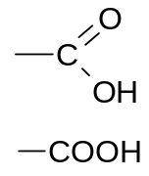
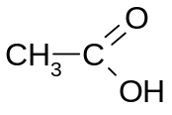
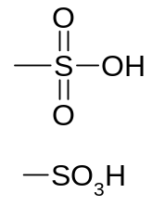
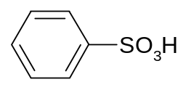
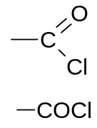
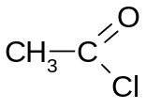
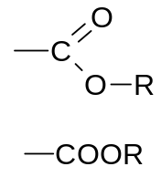
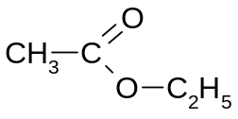
Classification of organic compounds by functional groups
Class | Functional group |  | Example
carboxylic acids |  | carboxyl group
sulfonic acids |  | sulfo group
halides |  | halocarbonyl
esters |  | Alkoxycarbonyl
Таблица 1. Классы органических соединений

Slide 11
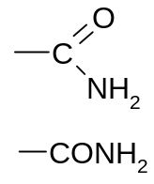
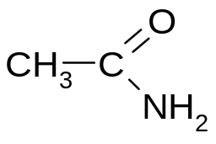
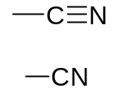

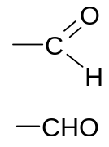
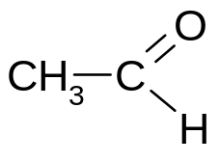

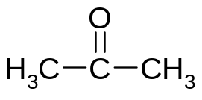


amides |  | carboxamide (amide)
nitriles |  | nitrile
aldehydes |  | formal, aldehyde
ketones |  | oxo group, keto group, carbonyl group
alcohols and phenols |  | hydroxy group, oxy group

Slide 12






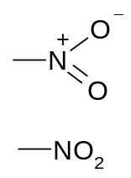

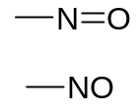
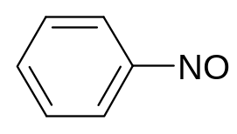

mercaptans, thiols |  | mercapto group, thio group, sulfanyl group
amines |  | amino group
simple ethers (Ethers) |  | Alkoxy group
nitro compounds |  | nitro group
nitrosocompounds |  | nitroso group
halogen derivatives | -F, -Cl, -Br, -I | halogen

Slide 13
Chemical bond in organic compounds
A chemical bond is an interaction between atoms that leads to the formation of molecules or crystals.
There are two main types of chemical bonds in organic compounds: covalent and ionic.
Chemical bond
Covalent
Covalent polar
Covalent non-polar
Ionic

Slide 14
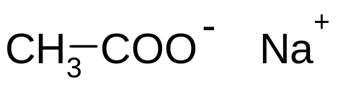
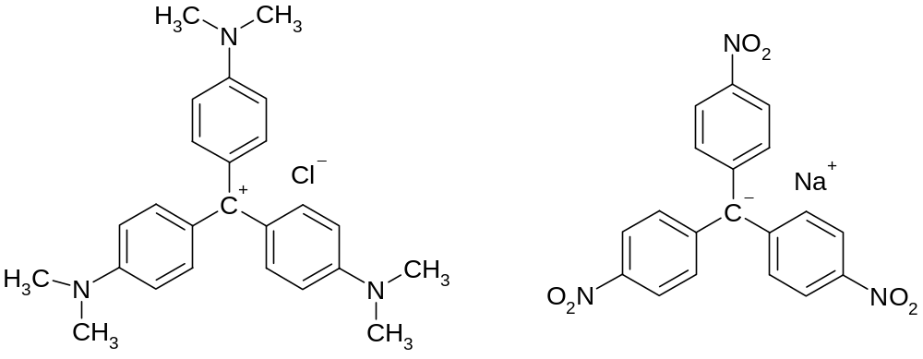
Ionic bond
It is rarely found in organic compounds

Slide 15
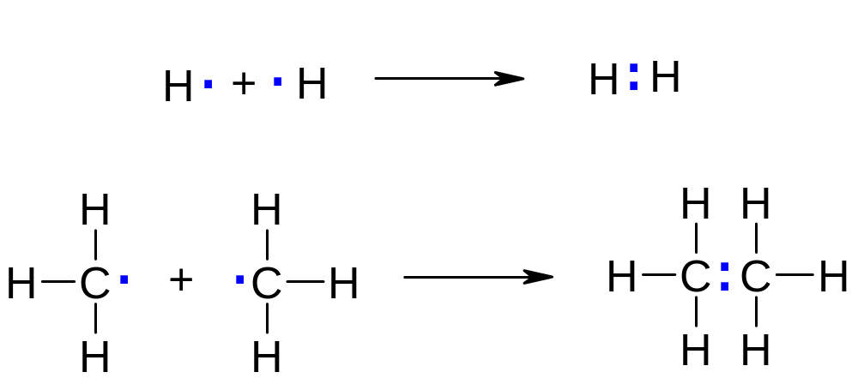
Covalent bond
The covalent bond is the main one in organic compounds. Such a connection is formed by sharing a pair of electrons of two atoms.

Slide 16
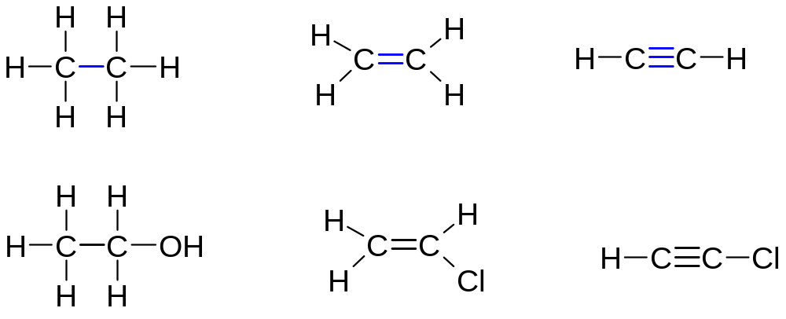
Classification of covalent bonds
By polarity

Slide 17
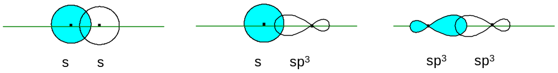
By the symmetry of the orbitals
σ-bond – covalent bond formed when atomic orbitals overlap along the axis connecting the nuclei of atoms:

Slide 18
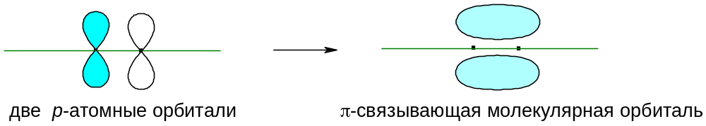
π-bond – covalent bond arising from lateral overlap of non-hybrid p-orbitals. At the same time, localized p-atomic orbitals are delocalized, forming p-orbitals:
Two p-atomic orbitals
π- bonding molecular orbital

Slide 19
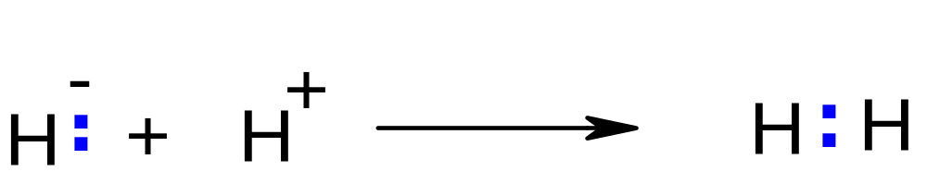
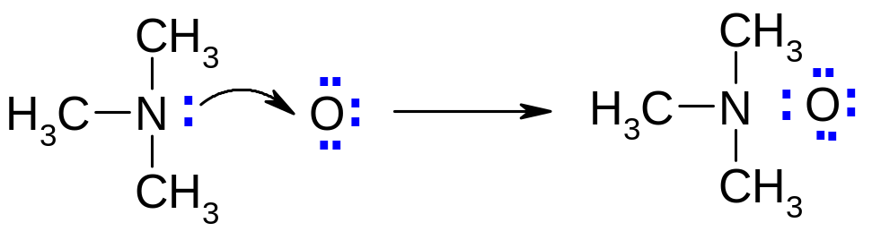
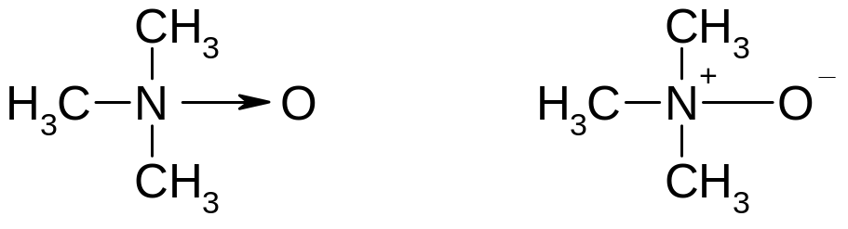
Donor-acceptor mechanism.
Bond formation takes place due to a pair of donor electrons and a vacant (free) orbital of the acceptor.
Semipolar bond, which is the result of both covalent interaction and the attraction of opposite charges :

Slide 20
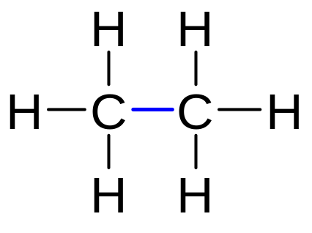
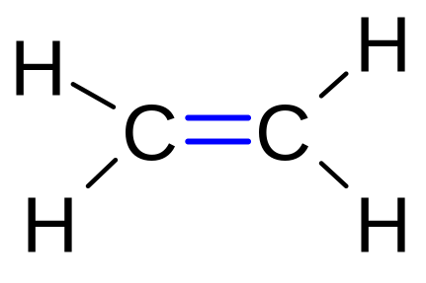
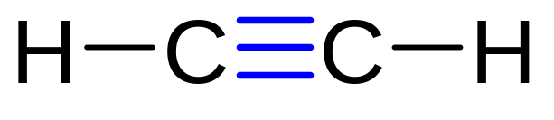
Classification of covalent bonds by bond order
Single (one σ-bond), for example, between carbons in the ethane molecule;
Double (1 σ-bond and 1 π-bond), for example, in the ethylene molecule;
Triple (1 σ-bond and 2 π-bonds), as, for example, in the acetylene molecule.

Slide 21
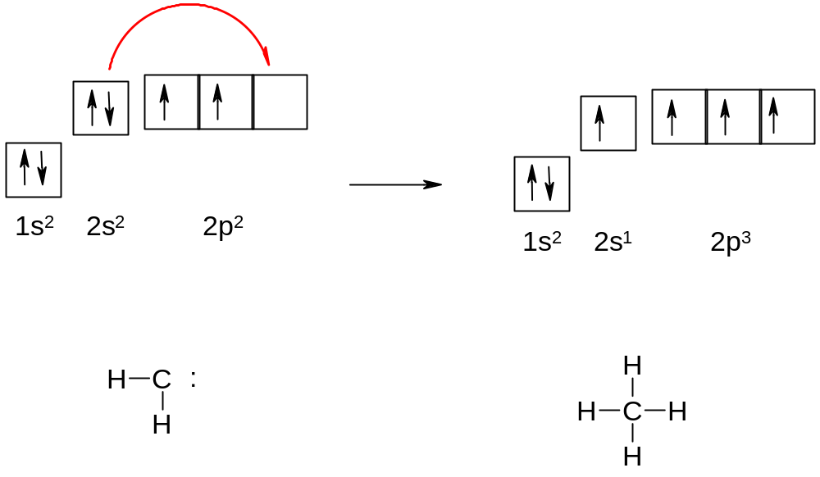
Hybridization
Electronic structure of a carbon atom

Slide 22
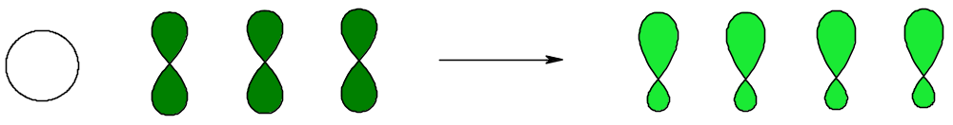
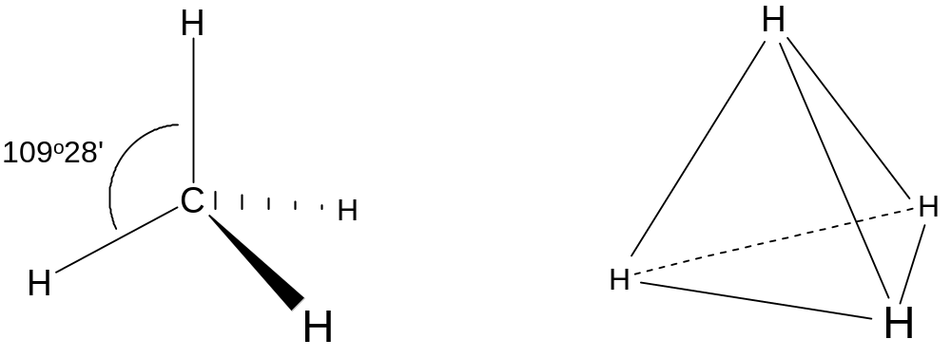
sp³- hybridization
In this case, the energies of one 2s and three 2p-orbitals are equalized, while 4 identical sp3-orbitals are formed :

Slide 23
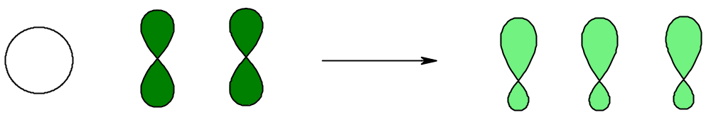
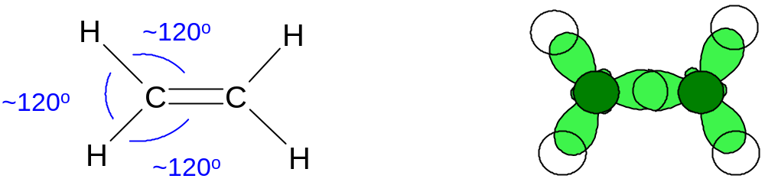
sp²- hybridization
The energies of one 2s and two 2p-orbitals are equalized, while 3 identical sp²-orbitals are formed and one non-hybrid p-orbital remains :
Three sp²-hybrid orbitals participate in the formation of three σ-bonds: for example, in ethylene :

Slide 24
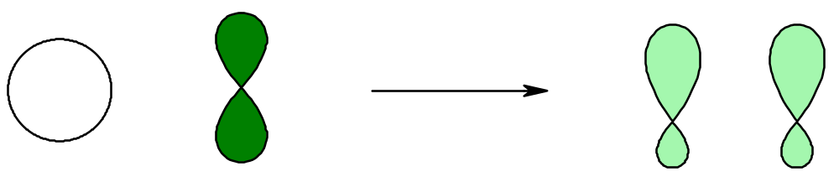


sp- hybridization
In this case, the energies of one 2s and one 2p-orbital are equalized, while 2 identical sp-orbitals are formed and two p-orbitals remain non-hybrid :
Two sp-hybrid orbitals repel each other, while the electron density maxima are located on the same straight line
Two non-hybrid p-orbitals are located perpendicular to each other in the same plane, which is perpendicular to this line x:

Slide 25



The acetylene molecule contains carbon atoms in the state of sp-hybridization
Due to hybrid orbitals, bonds with hydrogen atoms and σ-bond between carbon atoms are formed:
Non-hybrid π-orbitals overlap, forming two π-bonds:

Slide 26

Other types of interactions
Hydrogen bond - the attraction of a protonated hydrogen atom attached to an atom of an electronegative element to another atom carrying a negative charge.

Slide 27

In the α-structure of proteins, every first and fifth amino acid residues form hydrogen bonds with each other, forming a helix:

Slide 28

Hydrogen bonds between complementary bases in the DNA double helix: three hydrogen bonds form between adenine and thymine, and two bonds form between guanine and cytosine:

