Slide 1
Lecture 4
Mononuclear arenas. Polynuclear arenas

Slide 2

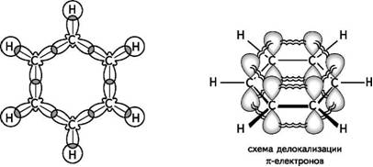
Arenas
Mononuclear arenas
The simplest representative of mononuclear arenes is C₆H₆ benzene (first obtained by M. Faraday in 1825 from condensed residues of lighting gas). The formula of benzene in the form of a six-membered cycle with alternating single and double bonds was proposed in 1865 by A. Kekule. In the framework of modern concepts, the bond system in the benzene molecule includes a σ-backbone based on sp²-hybrid AOs and a delocalized π-conjugated system (an aromatic sextet of p-AOs):
or

Slide 3
The combination of specific properties of benzene (high stability, inertness in addition reactions, tendency to substitution reactions) has received the general name aromaticity. According to the Hückel rule (1931), the aromaticity criterion is the presence in its structure of a planar cycle containing a closed conjugated system, including (4n + 2)π-electrons (n = 0, 1, 2, 3, etc.). Hückel's rule is applicable to condensed aromatic systems (naphthalene, anthracene, etc.), as well as to non-benzenoid systems such as cyclopentadienyl anion, etc.

Slide 4
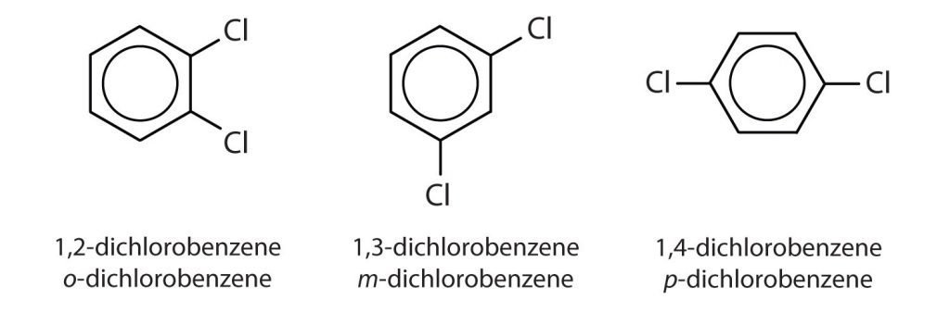
nomenclature and isomerism
According to the IUPAC nomenclature, mononuclear arenes are considered as benzene substitution products: methylbenzene, ethylbenzene, etc. If there are two or more substituents in the benzene ring, their position is indicated by numbers; along with the digital designation of the position of the substituents, prefixes are also used: ortho- (o-) position - 1.2; meta- (m-) position - 1.3; para- (p-) position - 1.4.

Slide 5

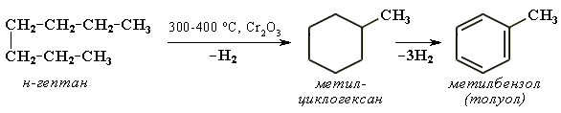
Ways to obtain
Natural sources
Obtaining from petroleum by aromatization - heating at high temperature and pressure in the presence of catalysts, for example :
As a result of aromatization, the feedstock containing about 10% arenes and 65% alkanes is converted into a product containing 50–65% arenes.

Slide 6

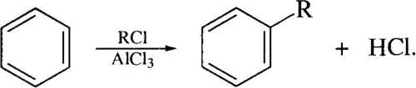
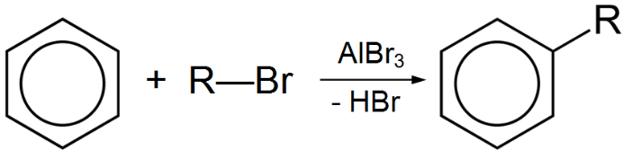
Obtaining from coal. When coal is heated without air access to 1000 - 1300 ºС, coke, coke oven gas and coal tar are formed. Fractional distillation of coal tar produces a mixture of mono- and multinuclear arenes, heterocyclic compounds, etc.
Synthesis
1. Alkyne cyclotrimerization:
2. Wurtz-Fittig reaction :
С₆Н₅Br + 2Na + С₂Н₅Br → С₆Н₅–С₂Н₅ + 2NaBr.
3. Alkylation of aromatic hydrocarbons according to Friedel-Crafts :

Slide 7

Chemical properties
Arenes, in contrast to unsaturated compounds, when interacting with electrophilic reagents are more prone to substitution rather than addition reactions, since their aromatic system is preserved in this case. These reactions are called S_{E} electrophilic substitution reactions.
The most important reactions of electrophilic substitution in the benzene ring include the reactions of nitration, halogenation, sulfonation, alkylation and acylation.
1. Nitration (action with a nitrating mixture of conc. HNO₃ и H₂SO₄):

Slide 8


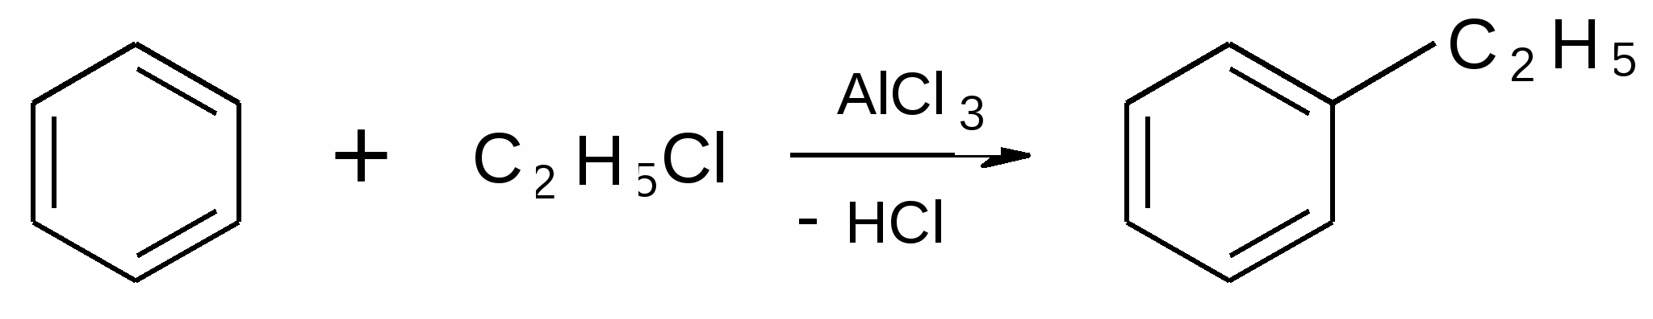
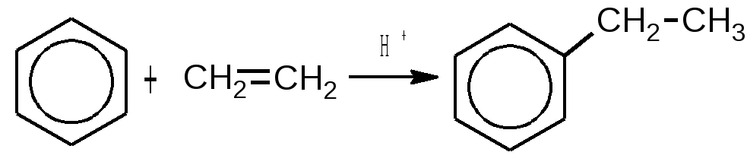
2. Sulfonation (action of concentrated H₂SO₄ or oleum):
3. Halogenation (in the presence of catalysts - Lewis acids, for example AlCl₃, FeCl₃, FeBr₃):
4. Alkylation according to Friedel-Crafts (in the presence of Lewis acids):

Slide 9
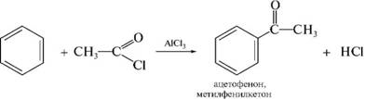

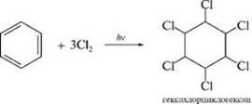
5. Friedel-Crafts acylation:
Addition reactions
This type of transformation is not typical for arenas; reactions are carried out under harsh conditions.
Hydrogenation and chlorination:

Slide 10

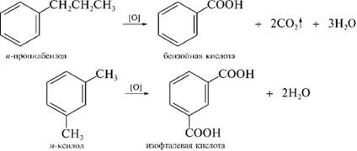
Oxidation reactions
Under harsh conditions, under the action of atmospheric oxygen in the presence of V₂O₅ at 400 - 500 ºС, benzene is oxidized with the formation of maleic anhydride:
Oxidation of benzene homologues. It flows much more easily compared to unsubstituted benzene. Under the action of strong oxidizing agents (KMnO₄, K₂Cr₂O₇, etc.), side chains undergo oxidation:

Slide 11
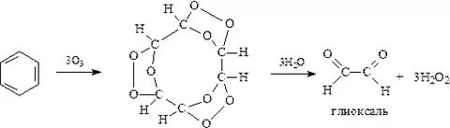
Ozonation. Like alkenes, benzene and its homologues react with ozone to form triozonides, which decompose under the action of water to form dicarbonyl compounds and their further oxidation products - dicarboxylic acids:
glyoxal

Slide 12
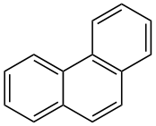
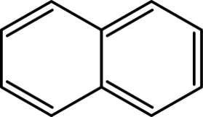

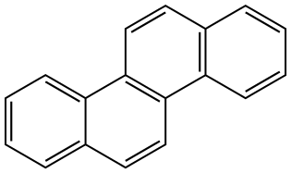

Polynuclear arenas
Polynuclear arenes with condensed cycles contain two or more benzene nuclei having common carbon atoms.
There are two main types of condensed systems: with linear and angular arrangement of cycles :
naphthalene
anthracene
phenanthrene
tetracene
chryzen

Slide 13
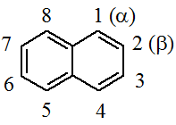
Naphthalene
It was first isolated from coal tar in 1819. The elemental composition was established by the A.A. Vosnesensky in 1838, the structure was proved by the German chemist K. Grebe in 1898.
Nomenclature and isomerism
The numbering of the carbon atoms of the naphthalene core in accordance with the IUPAC rules is carried out as follows:
In the structure of naphthalene, C-atoms are unequal: in positions 1, 4, 5, 8 they differ from atoms in positions 2, 3, 6, 7. In this regard, four equivalent positions - 1, 4, 5, 8 are usually called α-positions , and four other equivalent positions 2, 3, 6, 7 are β-positions.

Slide 14


Due to the non-equivalence of positions, monosubstituted naphthalenes exist in the form of two isomers:
Synthesis
Naphthalene, its monomethyl and some dimethyl derivatives are isolated from coal tar (the content is up to 10% naphthalene).
Naphthalene (along with benzene) is formed by passing acetylene through tubes heated to 700 - 800 ºС :

Slide 15

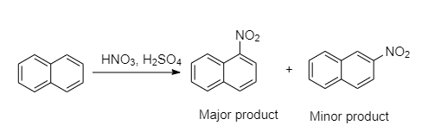
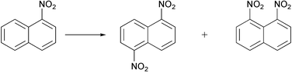
Naphthalene and its homologues are obtained by dehydrocyclization of alkylbenzenes with a side chain ≥ C4:
Chemical properties
Electrophilic substitution reactions
1. Nitration :

Slide 16
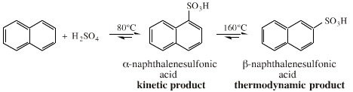
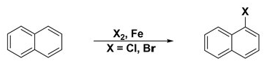
2. Sulfonation - depending on the temperature, the sulfonation reaction can proceed predominantly in the α- or β-position:
3. Halogenation - bromination in the α-position is carried out easily in the absence of a catalyst, chlorination - in the presence of FeCl₃ :

Slide 17
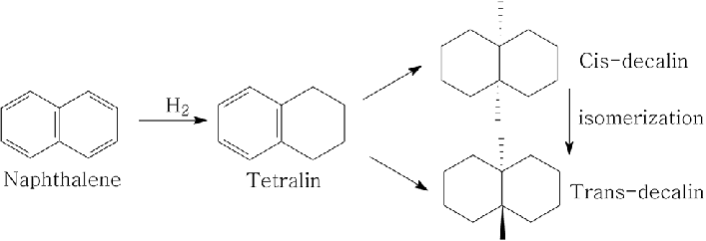

Addition reactions
The catalytic hydrogenation of naphthalene (Ni-catalyst) proceeds stepwise according to the following scheme:
Реакции окисления
Oxidation of naphthalene with atmospheric oxygen in the presence of a V₂O₅ catalyst leads to phthalic anhydride:

Slide 18
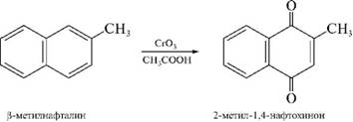
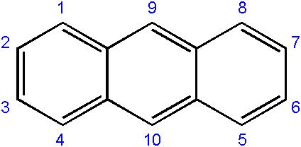
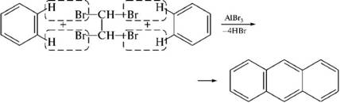
The oxidation product of β-methylnaphthalene CrO₃ is 2-methyl-1,4-naphthoquinone:
Anthracene
Synthesis
In industry - from the anthracene fraction of coal tar.
According to the Friedel-Crafts reaction from benzene and 1,1,2,2-tetrabromomethane in the presence of AlBr₃ :

Slide 19
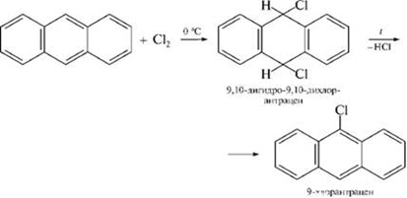
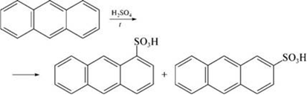
Chemical properties
Electrophilic substitution reactions proceed at position 9:
The sulfonation process leads to the formation of a mixture of isomeric 1- and 2-anthracenesulfonic acids :

Slide 20
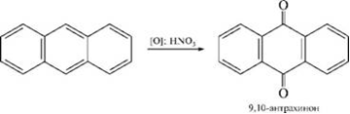
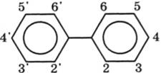


Anthracene is relatively easily oxidized with concentrated nitric acid to give 9,10-anthraquinone:
Biphenyl
Synthesis
Biphenyl is isolated from coal tar.
Benzene dehydrogenation :
According to Ulmann's reaction

Slide 21

Structure and chemical properties
Around the σ-bond in the biphenyl molecule, free rotation is possible, while the rotation barrier is small. But if the ortho-positions of both benzene rings contain bulky substituents, then the rotation around the σ-bond connecting the rings is very difficult or becomes impossible..
If there are different substituents in the ortho positions of each benzene nucleus of the biphenyl molecule, then such compounds exhibit optical activity. This is due to the fact that although these compounds do not contain an asymmetric carbon atom (the center of chirality), they also do not have a symmetry plane. Their molecule is asymmetric as a whole. So, 6,6'-dinitrodifenic acid exists in the form of two enantiomers (mirror isomers):

Slide 22
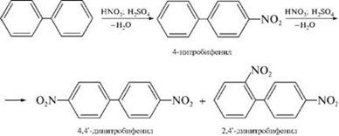
The chemical properties of biphenyl are similar to those of mononuclear arenes. Biphenyl enters into the electrophilic substitution reaction somewhat more easily than benzene (mutual electron-donating effect of two phenyl groups) with the formation of predominantly para- and ortho-substitution products:

Slide 23

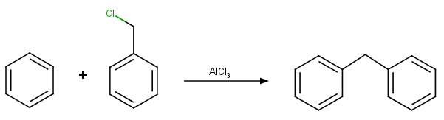
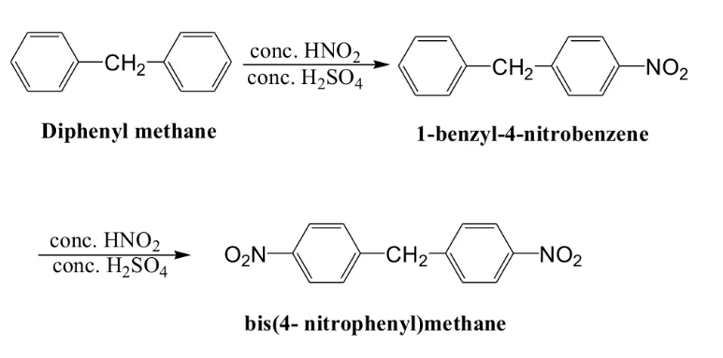
Diphenylmethane
According to the Friedel-Crafts reaction by alkylation of benzene with benzyl chloride or dichloromethane:
The reactivity of diphenylmethane is due to the presence of benzene rings and an active methylene group in its structure:

Slide 24


Typical reactions of diphenylmethane on the methylene group are easily occurring oxidation and halogenation:

Slide 25
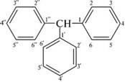
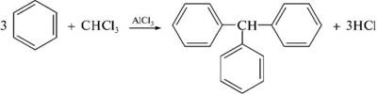
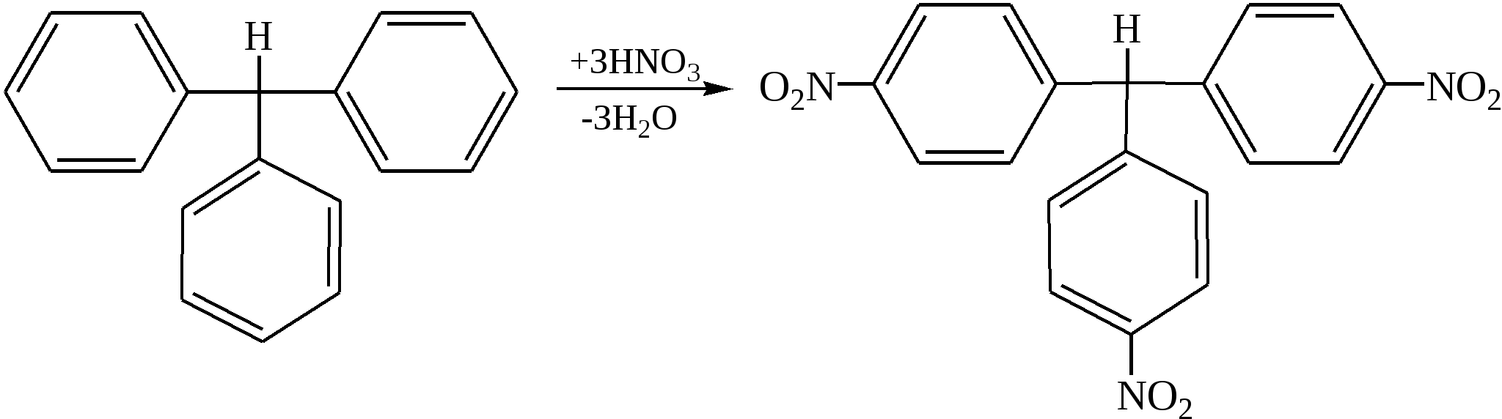
Triphenylmethane
Obtained by the Friedel-Crafts reaction by alkylation of benzene with chloroform:
In terms of chemical properties, triphenylmethane resembles diphenylmethane: it is characterized by electrophilic substitution reactions involving benzene rings, which go mainly to para positions:

Slide 26
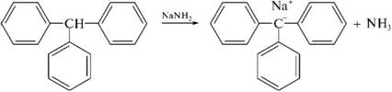
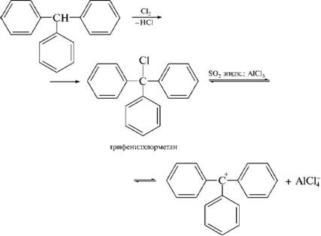
Phenyl radicals shift the electron density from the carbon atom of the CH group, as a result of which the hydrogen atom of this group acquires mobility and is easily replaced by metals and halogens. Due to the methine group, triphenylmethane is easily oxidized:

Slide 27
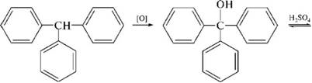

Derivatives of polynuclear arenes are used in the production of dyes and drugs.

