Slide 1
Halo derivatives of hydrocarbons
Lecture 5

Slide 2



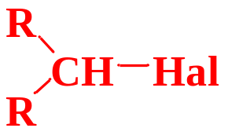
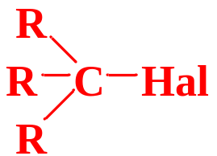
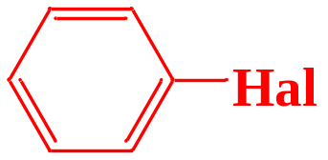
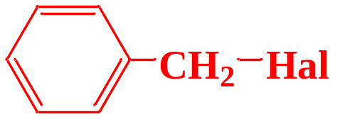
Halohydrocarbons – are derivatives of hydrocarbons in which one or more hydrogen atoms are replaced by halogens.
halohydrocarbons
Alkyl halides
Vinyl halides
Allyl halides
primary
secondary
Aryl halides
Benzyl halides
tertiary

Slide 3
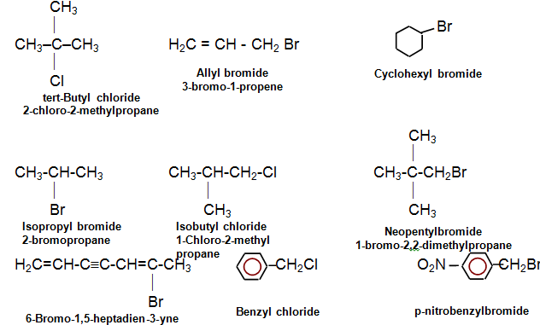
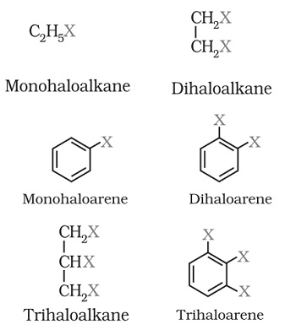
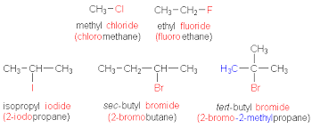
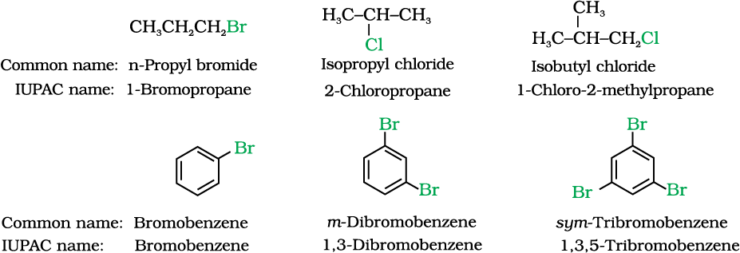
According to IUPAC replacement nomenclature the names of halogen derivatives of hydrocarbons are, adding to the name of the halogen atoms, the name ancestral structure (main carbon chain or cycle).

Slide 4
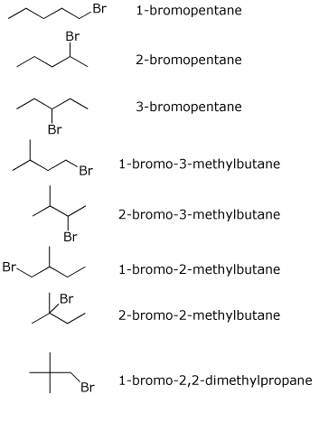
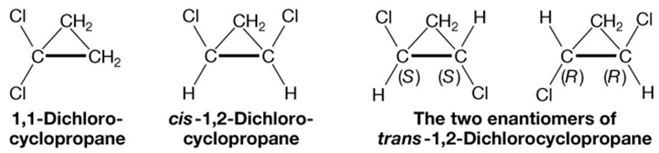
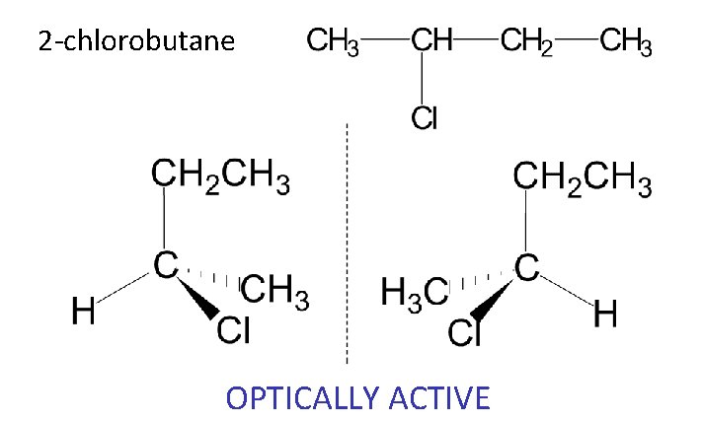
Isomerism
For halogen derivatives of hydrocarbons, structural, geometric and optical isomerism.

Slide 5

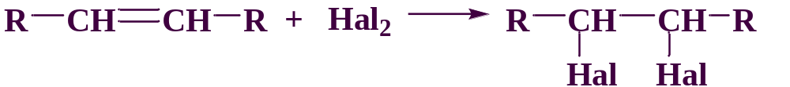
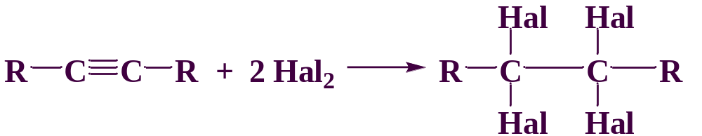
Methods for preparation halohydrocarbons
Halogenation of saturated hydrocarbons
Halogenation of unsaturated hydrocarbons

Slide 6
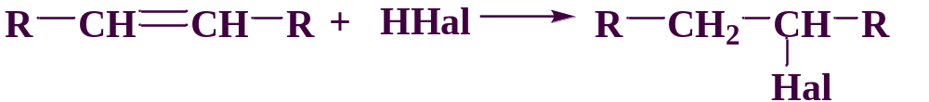
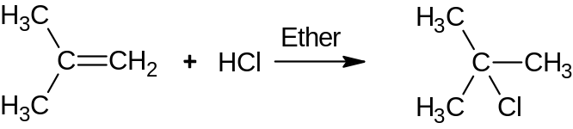
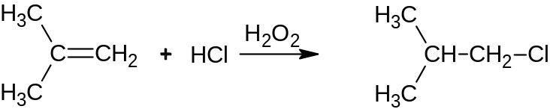
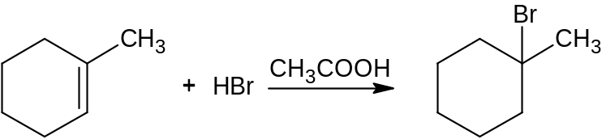
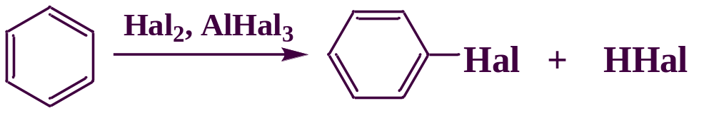
Methods for preparation halohydrocarbons
Hydrohalogenation of unsaturated hydrocarbons
Halogenation of aromatic hydrocarbons

Slide 7
Methods for preparation halohydrocarbons
Substitution of a hydroxy group in alcohols by a halogen
Convenient reagents for replacing the OH group in alcohols are phosphorus (III), phosphorus (V) halides, thionyl chloride.

Slide 8
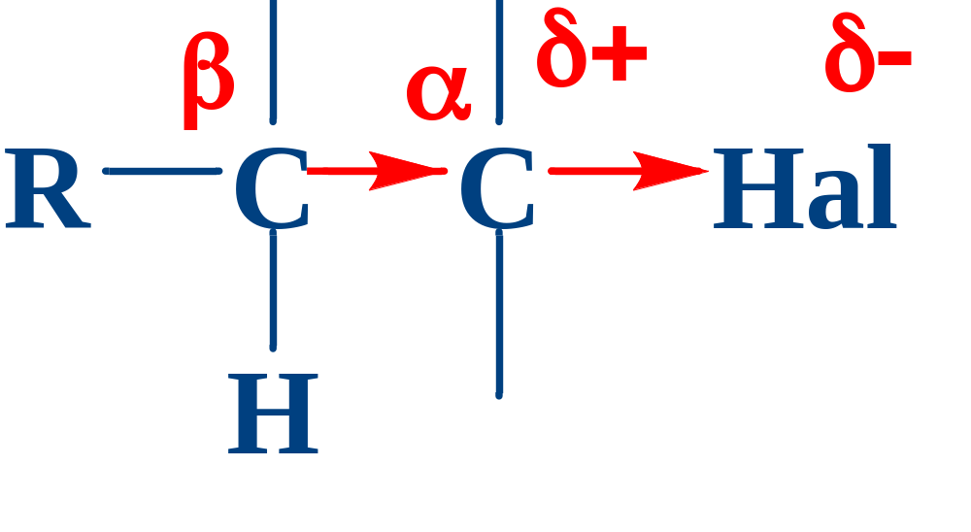
Reaction centers in halohydrocarbons
CH-acid center
(elimination reactions E)
Electrophilic Center
(reactions of nucleophilic substitution S_{N})

Slide 9
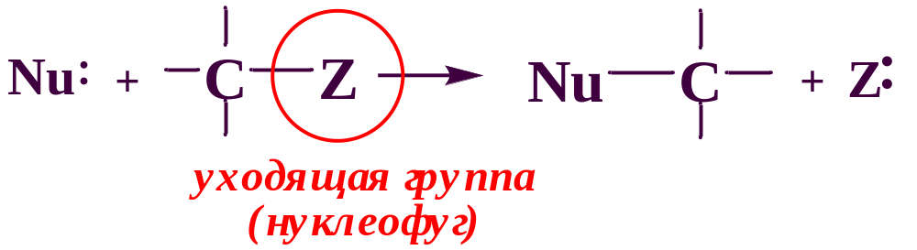
Nucleophilic substitution reactions
The more stable the leaving group is as a free particle (or the stronger its conjugate base), the more easily it is replaced.
F ⁻ Cl ⁻ Br ⁻ I ⁻
leaving group (nucleofuge)
Ease of splitting out leaving groups

Slide 10
Nucleophiles
Oxygen-containing nucleophiles (NaOH, RONa, RCOONa)
Carbon-containing nucleophiles (NaCN, RC≡CNa)
Halogen-containing nucleophiles (MeHal)
Sulfur containing nucleophiles (NaSH, H₂S, RSNa, RSH)
Nitrogen containing nucleophiles (NH₃, RNH₂, R₂NH, R₃N, NaNO₂, NaN₃)

Slide 11
Nucleophilic substitution R-Hal + Nu → R-Nu + Hal⁻
Nucleophile Nu | Reaction product R-Nu
НО– or Н₂О | Alcohol R-OH
R₁O⁻ or R₁OH | Ether R-O-R₁
N≡C⁻ | Nitrile carboxylic acid R-C≡N
NO₂⁻ | Nitro compound R-NO₂ and/or R-ONO
NH₂– | Amine R-NH₂
NH₃ | Primary amine salt RNH₃⁺X⁻
R₁NH₂, R₁R₂NH | Salt of a secondary or tertiary amine RR₁NH₂⁺X⁻, RR₁R₂NH⁺ X⁻
R₁R₂R₃N | Quaternary ammonium salt RR₁R₂R₃N⁺ X⁻
R₁C≡C⁻ | Alkynes R₁C≡C-R
R₁C⁻ | R₁C-R (Wurtz reaction)
I⁻ | iodides R-I
SH⁻, R₁–S⁻, ⁻S–S⁻ | Thiols R-SH, sulfides R₁-S-R, disulfides R-S-S-R

Slide 12

1. Hydrolysis of haloalkanes:
C₂H₅Br + H₂O ⇄ C₂H₅OH + HBr,
C₂H₅Br + NaOH → C₂H₅OH + NaBr.
2. Interaction with alcoholates and phenolates (Williamson reaction):
C₂H₅Br + C₂H₅ONa → C₂H₅–O–C₂H₅ + NaBr,
C₂H₅Br + C₆H₅ONa → C₂H₅–O–C₆H₅ + NaBr.
3. Interaction with salts of carboxylic acids:
C₂H₅Br + CH₃COONa → CH₃COOC₂H₅ + NaBr.
4. Interaction with ammonia, alkyl- and arylamines:
C₂H₅Br + NH₃ → [C₂H₅NH₃]⁺Br⁻
C₂H₅NH₂ + NH₄Br.
5. Interaction with hydrocyanic acid salts:
C₂H₅Br + NaCN → C₂H₅–С≡N + NaBr.

Slide 13
6. Interaction with salts of nitrous acid:
C₂H₅Br + NaNO₂ → C₂H₅-NO₂ + NaBr
7. Interaction with salts of hydrohalic acids (reaction Finkelstein – is of practical importance for obtaining primary fluorine- and iodalkanes from the more available chlorine, bromo derivatives).
C₂H₅Br + NaI → C₂H₅I + NaBr↓
8. Interaction with hydrosulfides and sulfides of alkali metals:
C₂H₅I + NaSH → C₂H₅SH + NaI
2C₂H₅I + Na₂S → C₂H₅-S-C₂H₅ + 2NaI
9. Interaction with metals
Obtaining Grignard reagents:
Ether
CH₃―CH₂―Br + Mg
CH₃―CH₂―Mg―Br

Slide 14
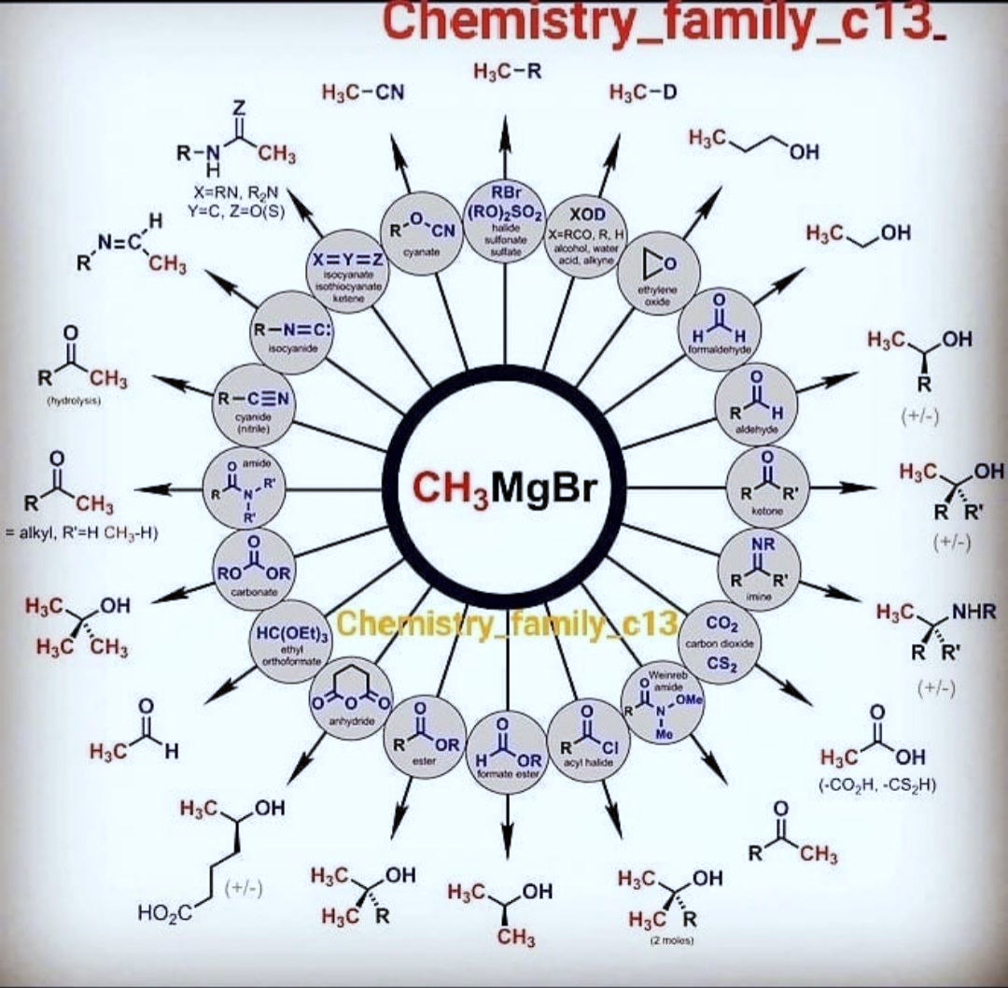

Slide 15
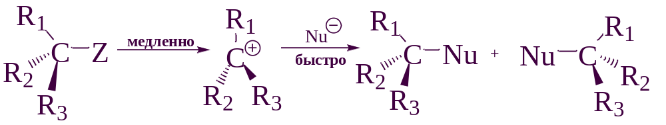
Monomolecular nucleophilic substitution (S_{N}1)
slowly
fast
The rate-limiting step of the reaction is the ionization of the substrate, leading to the formation of a planar carbocation. The more stable the resulting carbocation, the higher the rate of the reaction. Thus, the reactivity of alkyl halides increases in the series: primary < secondary < tertiary.
The reaction rate does not depend on the nature and concentration of the nucleophile.
The stereochemical result of the reaction is racemization.
The reaction may be accompanied by rearrangements of carbocations at an intermediate stage.

Slide 16
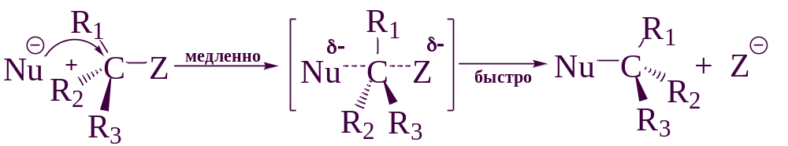
Bimolecular nucleophilic substitution (S_{N}2)
slowly
fast
The reaction is a one-step synchronous process that proceeds through a transition state with a pentacoordinated carbon atom. The more accessible the reaction center for attack by the nucleophile, the higher the reaction rate. Thus, the reactivity of alkyl halides increases in the series : tertiary < secondary < primary.
The reaction rate depends on the nature and concentration of the nucleophile.
The stereochemical result of the reaction is the inversion of the configuration (the nucleophile attacks "from the rear").

Slide 17
Nucleophilicity
Nucleophilicity – is the ability to donate a pair of electrons to an electrophilic carbon atom or another positively charged atom other than a proton.
the nucleophilicity of negatively charged nucleophiles is higher than that of the corresponding conjugated acids;
in the PTE period, nucleophilicity changes in parallel with basicity
NH₂⁻ > RO⁻ > OH⁻ > R₂NH > ArO⁻ > NH₃ > F⁻ …
in the PTE group, nucleophilicity increases from top to bottom (whereas basicity decreases)
I⁻ > Br⁻ > Cl⁻ > F⁻

Slide 18
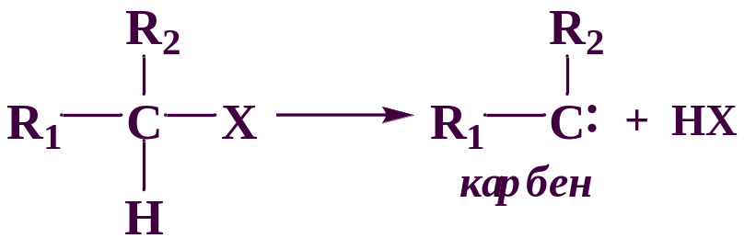
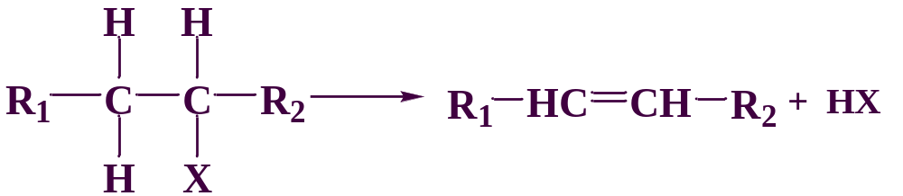
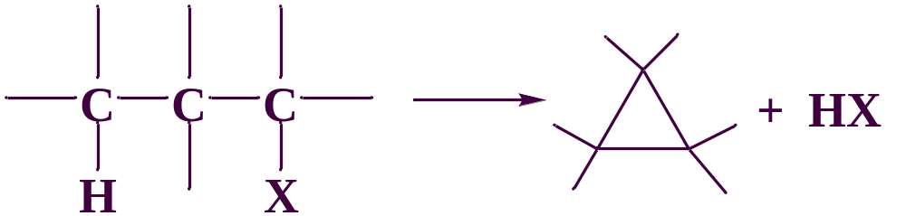
Elimination reactions
α-elimination
β-elimination
γ-elimination
NaOH / C₂H₅OH
carbene
NaOH / C₂H₅OH
NaOH / C₂H₅OH

Slide 19
Zaitsev's rule
If a haloalkane molecule contains several alternative routes for the elimination of hydrogen halide, then one of them is predominantly implemented in which hydrogen leaves the least hydrogenated neighboring carbon atom together with the halogen.
The reactivity of haloalkenes depends on the mutual arrangement of the double bond and the halogen atom in the molecule: if they are separated by two or more C–C bonds, then each of these groups behaves independently of each other. In vinyl halides, due to the mutual influence of C=C and C–Hal bonds, they are characterized by low reactivity: addition reactions of electrophilic reagents and nucleophilic halogen substitution reactions are more difficult. The addition of hydrogen halides follows the Markovnikov rule.

Slide 20
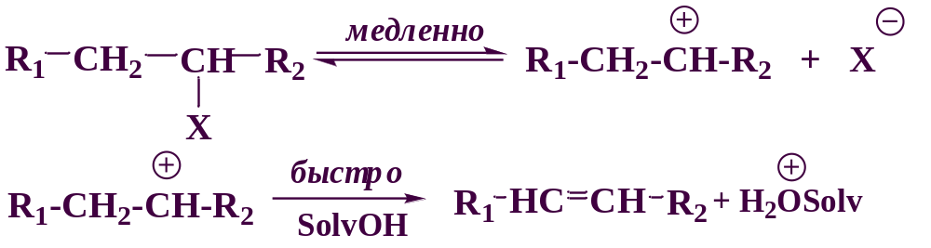
Monomolecular elimination Е1
slowly
fast
The rate-limiting step of the reaction is the ionization of the substrate. The reactivity of alkyl halides increases in the series: primary < secondary < tertiary.
The reaction is accompanied by rearrangements of intermediately formed carbocations.
The reaction obeys the Zaitsev rule.

Slide 21
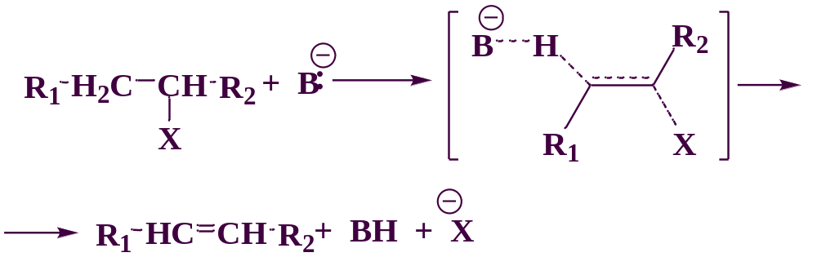
Bimolecular elimination Е2
The reaction is a one-stage synchronous process. The reactivity of alkyl halides increases in the series: tertiary < secondary < primary.
The reaction is stereospecific, since the leaving group and the proton can only be cleaved off simultaneously from the anti-conformation.

Slide 22
Reaction competitiveness S_{N} и E
In more polar solvents, nucleophilic substitution reactions proceed more preferentially than elimination reactions.
(alcohol solution of alkali - elimination reaction; alkali aqueous solution - substitution reaction).
Nucleophiles, which are strong bases, direct the reaction in the direction of elimination by the E2 mechanism rather than in the direction of nucleophilic substitution.
Increasing the temperature promotes the elimination reaction.

Slide 23
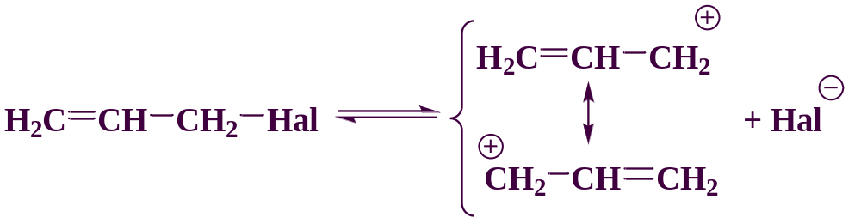
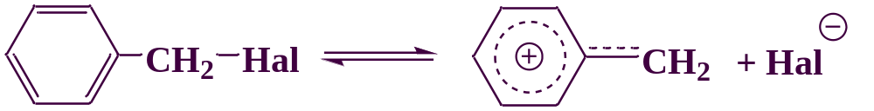
Reactivity of allyl and benzyl halides
Easily enter into nucleophilic substitution reactions both by the S_{N}1 mechanism and by the S_{N}2 mechanism.
The SN1 mechanism is realized more often, since a stable carbocation is formed at the intermediate stage.

Slide 24
Reactivity of vinyl and aryl halides
Vinyl- and aryl halides contain a halogen atom conjugated with a multiple bond or a benzene ring, so they are resistant to nucleophilic substitution by the mechanisms S_{N}1 and S_{N}2.
Aryl halides enter into nucleophilic substitution reactions by alternative mechanisms:

