Slide 1
Lecture 6. Nitrogen-containing hydrocarbon derivatives.
Nitro compounds

Slide 2
Nitrogen-containing organic compounds include those containing nitrogen atoms directly bonded to carbon atoms. They are divided into: nitro compounds (RNO₂), nitroso compounds (RNO), amines (RNH₂, R₂NH, R₃N), nitriles of carboxylic acids or cyanides (RC≡N), azo compounds (RN═NR), hydroxyl amine derivatives (RNH―OH), etc. . In all the above formulas, R is an alkyl, cycloalkyl or aryl radicale.
The most important are nitro compounds and amines.

Slide 3
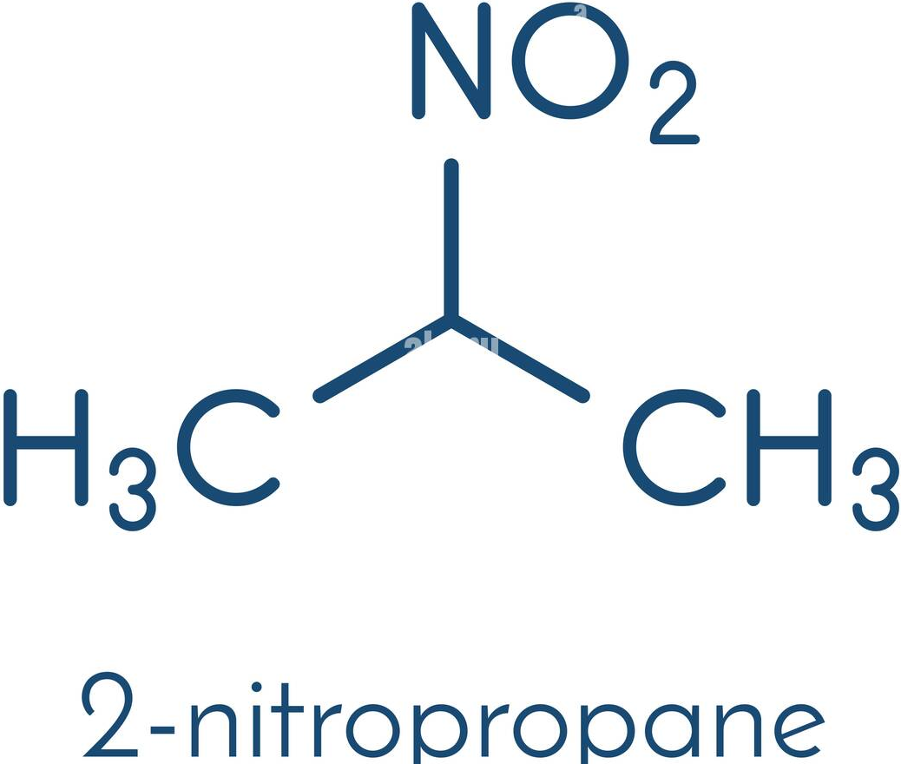
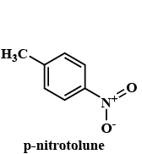
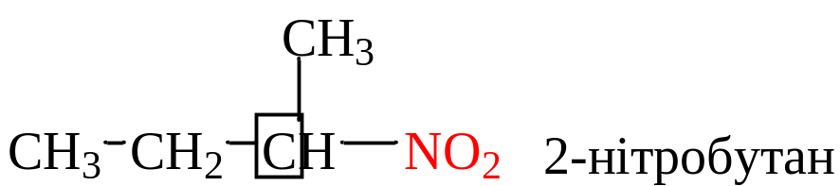
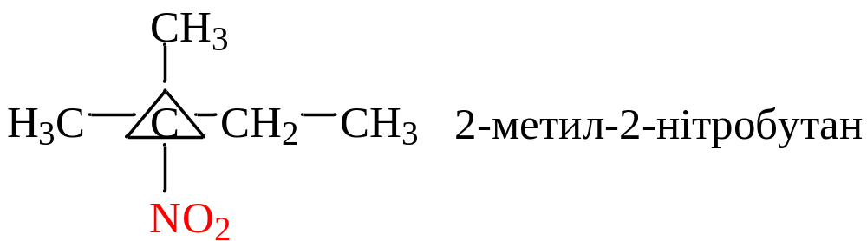
Nitro compounds are derivatives of hydrocarbons in which one or more hydrogen atoms are replaced by a nitro group —NO₂. The general formula of saturated nitro compounds C_{n}Н_{2n+1}NО₂.
aliphatic
а) by nature R
aromatic
б) from the placement of the NO2– group :
primary
nitroethane
secondary
2-nitrobutane
tertiary
2-methyl-2-nitrobutane
3

Slide 4
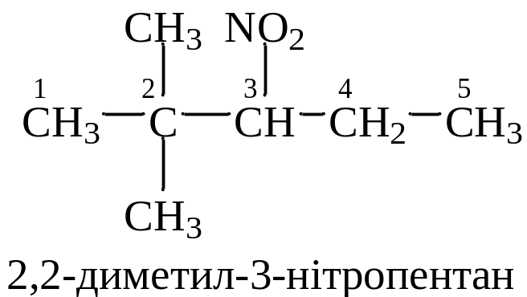
Nomenclature
According to the substitute nomenclature, the names of nitroalkanes and nitro compounds with a nitro group in the benzene ring are formed by adding the prefix nitro- to the name of the parent hydrocarbon, indicating the position of the nitro group in the carbon chain
CH₃–CH(NO₂)–CH₂–CH₃ CH₃–CH(NO₂)–CH(CH₃)–CH₃ C₆H₅–NO₂
2-nitrobutane 2-methyl-3-nitrobutane nitrobenzene
Nitro compounds with a nitro group in the side chain are considered as derivatives of nitroalkanes containing an aromatic radical as a substitute
IUPAC nitro- (prefix) + the name of the alkane
2,2-dimethyl-3-nitropenthane

Slide 5
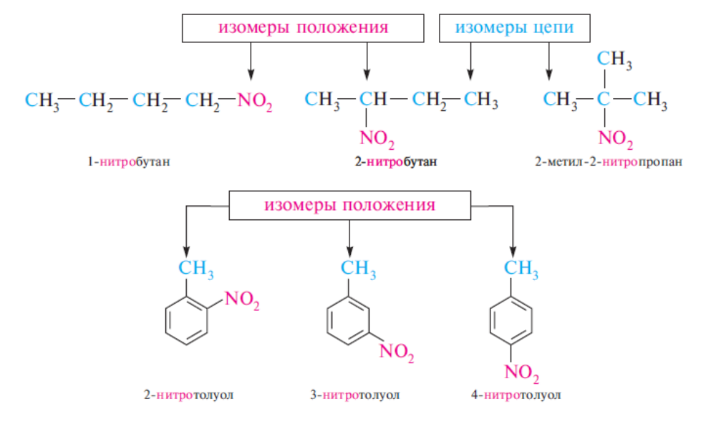
Isomerism
Isomerism of nitro compounds can be caused by a different structure of the carbon skeleton (chain isomerism) and a different position of the nitro group in the carbon chain (positional isomerism).
Position isomers
Chain isomers
Position isomers

Slide 6
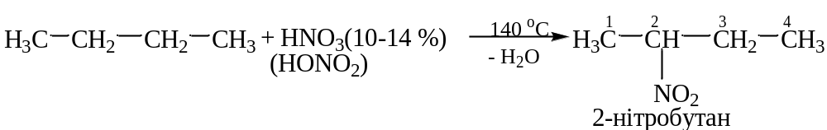
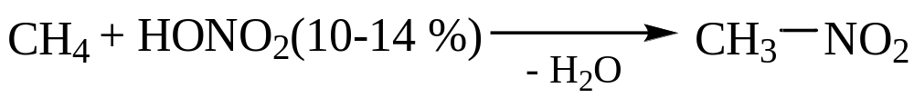
Methods of obtaining
a) nitration of alkanes in the liquid phase. (reaction of M.I. Konovalov in 1899)
2-nitrobutane
In industry, nitration is carried out in the gas phase (300-500 °C) (Hess, 1930)
b) interaction of iodo-, bromoalkanes with AgNO₂:

Slide 7

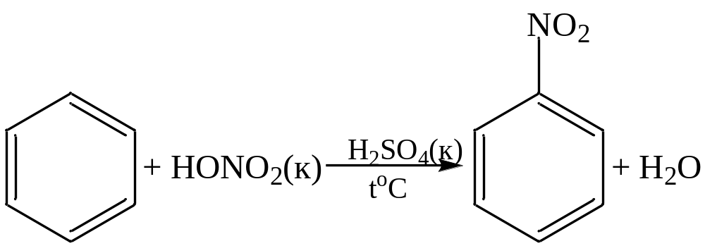
Methods of obtaining
c) Oxidation of tert-alkylamines:
d) nitration of arenes with a nitrating mixture:

Slide 8
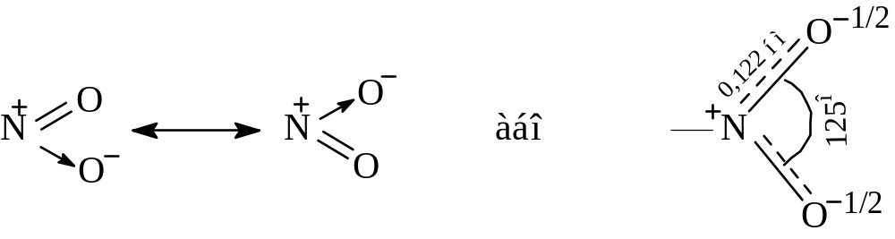
Physical properties
Nitro compounds of the aliphatic series are high-boiling, poorly soluble in water, strongly polar liquids or crystalline substances with a density, as a rule, greater than 1.
The reason for the strong polarity of the nitro group lies in its structure. The nitro group contains a semipolar bond.
Due to the conjugation of the π-electron system in the nitro group, both nitrogen-oxygen bonds are aligned and both oxygen atoms are connected to nitrogen by the same bonds :
or
It can be seen from these formulas that the nitrogen atom of the nitro group carries an entire positive charge, which is the main reason for the manifestation of a strong -I effect by the nitro group, and the presence of a semipolar bond determines the high dipole moment of the nitro group

Slide 9
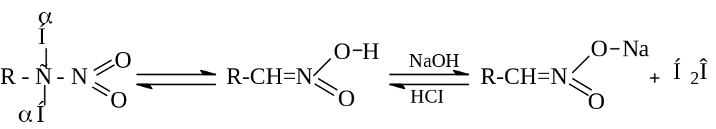
Chemical properties
1. Tautomerism of primary and secondary nitro compounds
As a result of the manifestation of strong electron-accepting properties by the nitro group, hydrogen atoms at the carbon atom combined with the nitrogen atom (at the α-carbon atom) are protonated and acquire increased mobility. This allows primary and secondary nitro compounds to exist in the form of two tautomeric forms: the nitro form and the acinitro form.
Nitro form Acinitroform Sodium salt (nitronic acid) of nitronic acid
Although aciform has acidic properties, it does not have electrical conductivity. Such compounds are called "pseudoacids". In alkaline environments, they form salts. In an acidic environment, the equilibrium shifts to the left. Tertiary nitro compounds are not capable of such tautomerism (there is no hydrogen atom in the α-position).

Slide 10
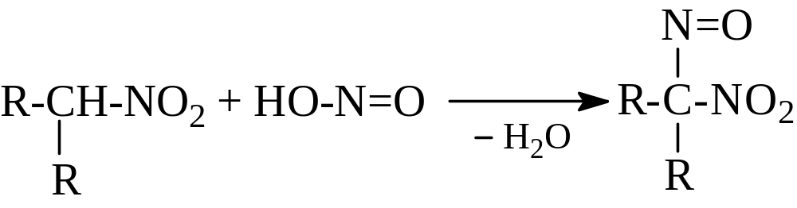
Chemical properties
2. Reaction with nitrous acid (with salts of nitrous acid)
This reaction makes it possible to distinguish between primary, secondary and tertiary nitro compounds.
Primary nitroalkanes form nitrolic acids, which with alkali give red salts:
Secondary nitro compounds form pseudonitroles, the solutions of which have a blue or green color:
Tertiary nitro compounds do not react with nitrite acid.

Slide 11
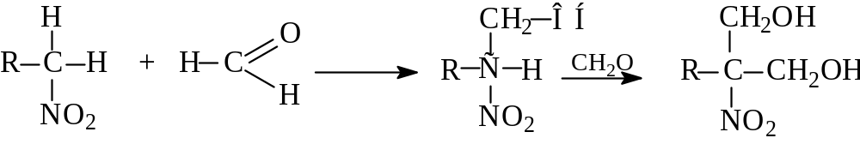
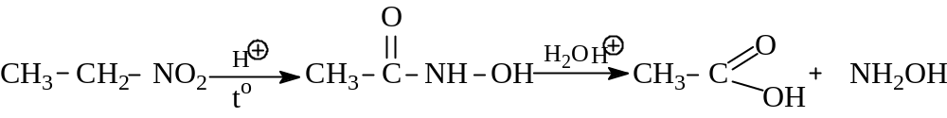
Chemical properties
3. Interaction with aldehydes or ketones
During the interaction of primary and secondary nitro compounds with aldehydes, nitro alcohols are formed :
4. Action of strong acids(80-90% Н₂SО₄ )
Primary nitroalkanes form carboxylic acids and hydroxylamine in an acidic environment (the industrial method of extracting hydroxylamine). The reaction proceeds through the stage of formation of hydroxamic acid.

Slide 12
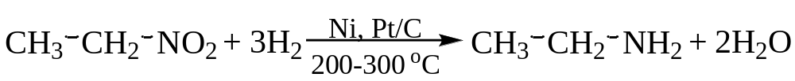
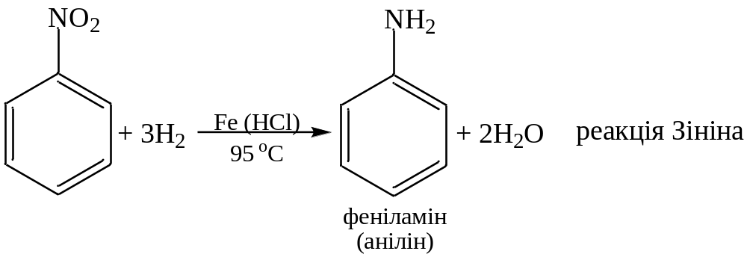
Chemical properties
5. Reduction of nitro compounds:
Zinin's reaction
Phenylamine (Anline)

Slide 13
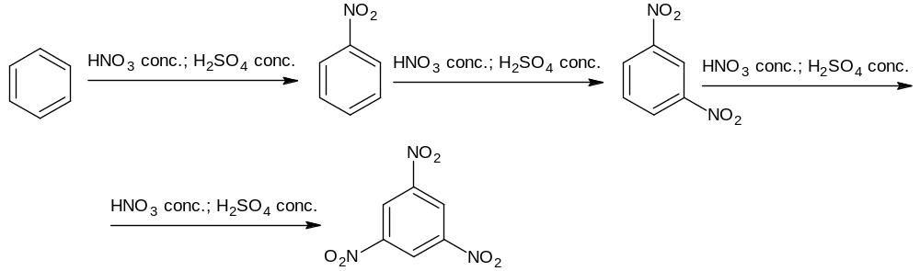
Aromatic nitro compounds
Methods of obtaining
1. Nitration of arenes :
The introduction of the second nitro group requires harsher conditions: high temperature, concentrated acids, prolonged heating. Introduction of the third nitro group occurs with difficulty.
In the presence of electron-donating substituents in the nucleus, the nitration reaction is significantly facilitated, which illustrates the synthesis of 2,4,6-trinitrotoluene under normal conditions.

Slide 14
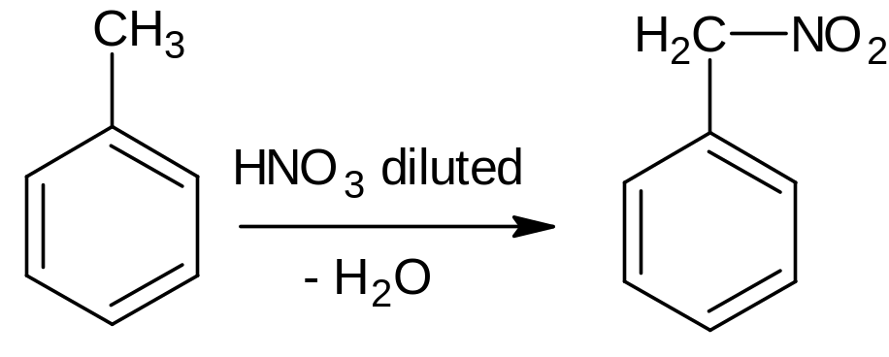
Aromatic nitro compounds
Methods of obtaining
The introduction of the nitro group into the side chain of the arene is carried out by the Konovalov reaction :
Physical properties
Nitroarenes are liquids or crystalline substances, colorless or pale yellow, insoluble in water, with the smell of bitter almonds. Nitroarenes containing several nitro groups are yellow, explosive crystalline substances.

Slide 15
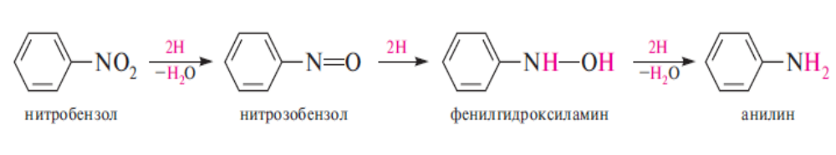
Aromatic nitro compounds
Chemical properties
1. Reduction of nitroarenes (Zinin's reaction):
C₆H₅NO₂ + 6[H] → C₆H₅NH₂ + 2H₂O
Depending on the pH of the reaction medium, the recovery process can follow two directions.
In a neutral and acidic medium :
When restored in a neutral environment, the reaction can be stopped at any stage. In an acidic environment, it is impossible to isolate intermediate products.

Slide 16
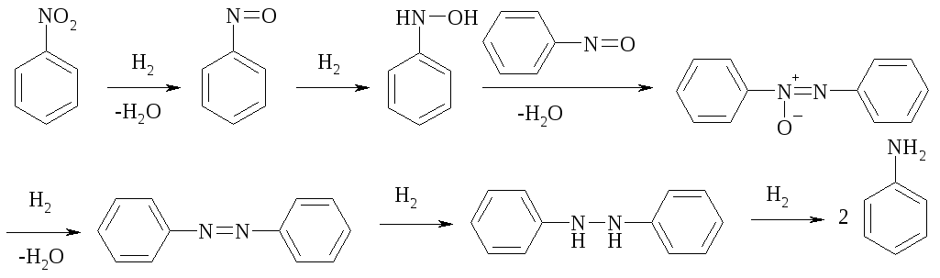
Aromatic nitro compounds
Chemical properties
When restored in a neutral environment, the reaction can be stopped at any stage. In an acidic environment, it is impossible to isolate intermediate products.
In alkaline medium :
The reduction reaction of nitroarenes in an alkaline environment can be stopped at any of the following stages. It serves as the main way of obtaining azo and hydrazo compounds.

Slide 17
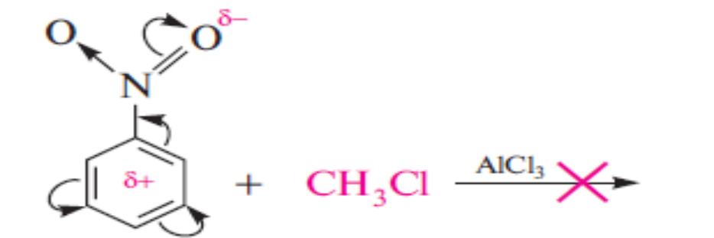
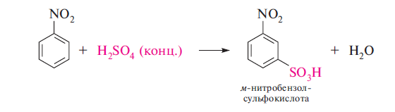
Aromatic nitro compounds
Chemical properties
2. Reactions from the aromatic nucleus.
Reaction of electrophilic substitution (S_{E}). The nitro group, which has electron-withdrawing properties, deactivates the benzene nucleus in S_{N} reactions. Thus, nitrobenzene is not alkylated under the conditions of the Friedel-Crafts reaction, but it can undergo nitration, sulfonation, halogenation reactions with the formation of corresponding meta-substituted ones, for example :
conc.

Slide 18
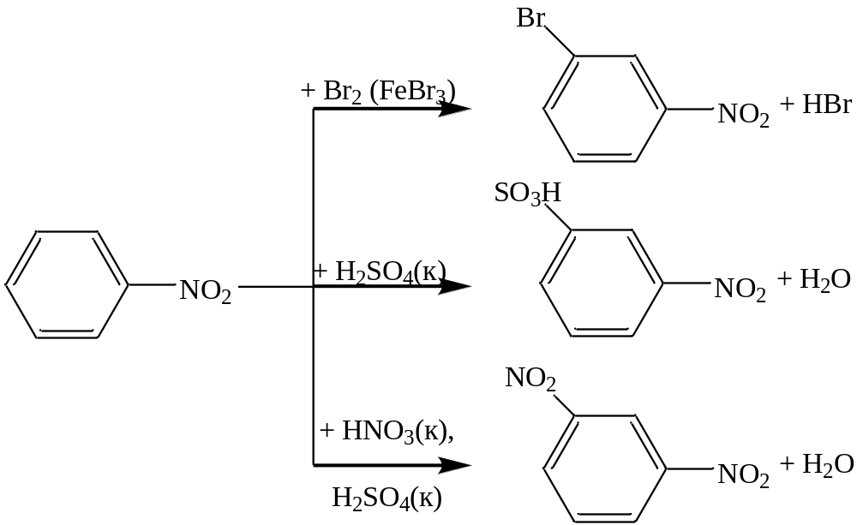
Aromatic nitro compounds
Chemical properties
Reaction of electrophilic substitution (S_{E}). Due to the electron-accepting properties of the nitro group, it has –I and –M effects. Therefore, it guides the entry of the next substituent only in the meta-position relative to the nitro group.

Slide 19
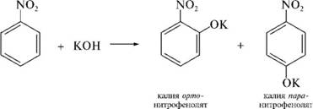
Aromatic nitro compounds
Chemical properties
Reaction of nucleophilic substitution (S_{N}). The electron-accepting effect of the nitro group creates an opportunity for S_{N}-reactions to occur, and the nitro group directs the substituent to the ortho and para positions. For example, when nitrobenzene is heated with solid KOH, a mixture of potassium o- and p-nitrophenolates is obtained :

Slide 20
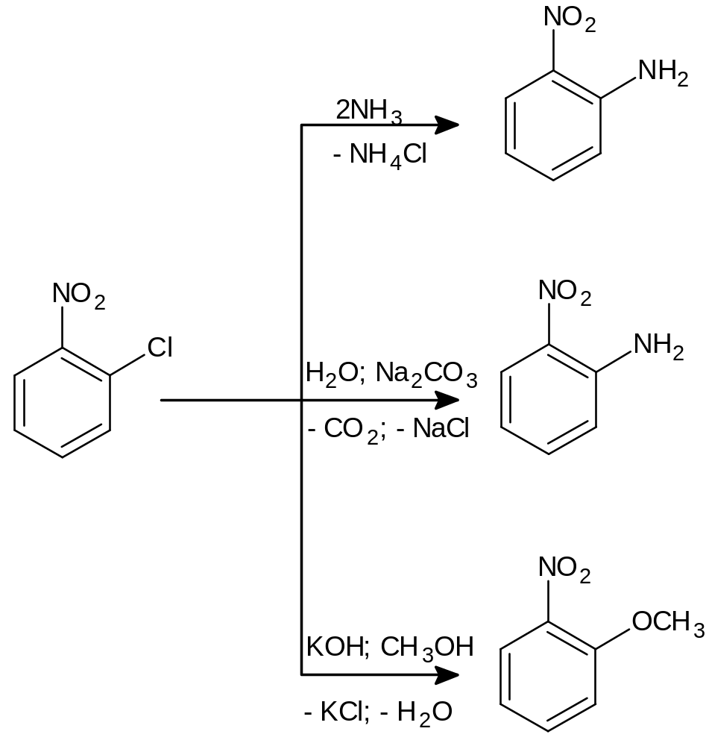
Aromatic nitro compounds
Chemical properties
By reducing the electron density in the nucleus, the nitro group increases the mobility of the substituents in the ortho- or para-position relative to it. This makes it possible to obtain various nitroderivatives of the aromatic series :

Slide 21
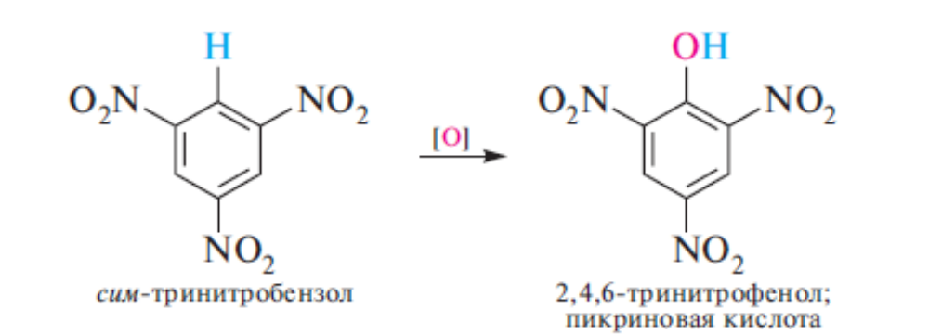
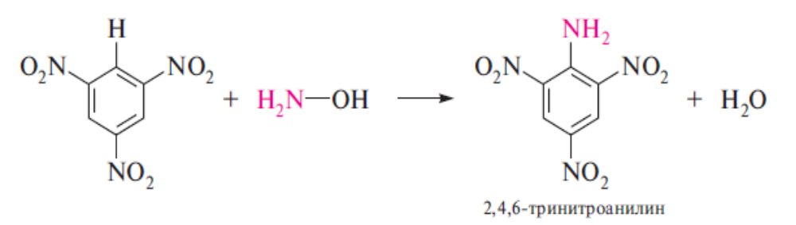
Aromatic nitro compounds
Chemical properties
The presence of three nitro groups in the benzene ring dramatically increases the mobility of the hydrogen atom in the benzene nucleus.

Slide 22
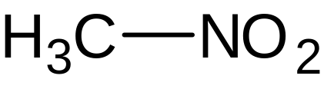
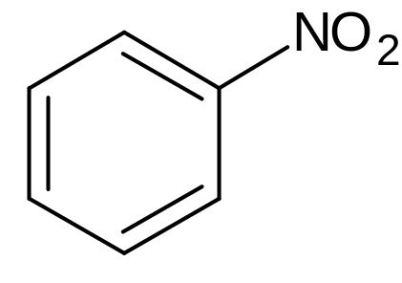
Individual representatives
Nitromethane is used as an independent liquid frost-resistant liquid that does not mix with water, as well as as a component of ammonia-nitrite mixtures and aluminum-containing ones. Nitromethane is also used as a solvent for the extraction of aromatic hydrocarbons from mixtures with aliphatic and alicyclic ones; as an intermediate product for the synthesis of chloropicrin, nitroalcohols, explosives, as a fuel for the engines of cars participating in drag racing competitions and as an additive (5-30%) to methanol in fuel for aircraft engines.
Nitrobenzene is obtained by nitration of benzene. It is used as a solvent, as well as in organic synthesis.

Slide 23
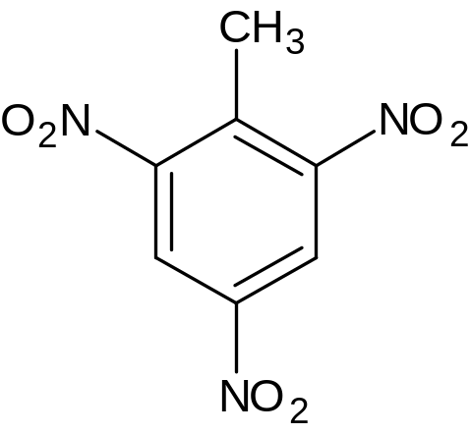
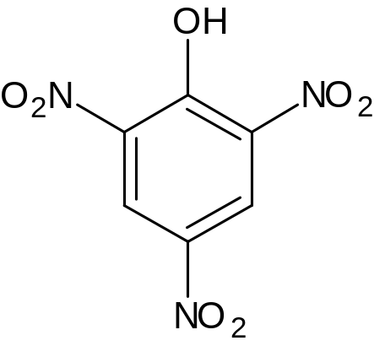
Individual representatives
Trinitrotoluene is obtained by nitration of nitrotoluenes with concentrated HNO₃ in a mixture with concentrated H₂SO₄. Used as an explosive (Tol, TNT).
Picric acid (trinitrophenol) is used as a dye, a high-explosive substance (high-explosiveness is the ability of an explosive substance to shred and pierce the environment adjacent to the charge during the explosion).

