Slide 1
Lecture 7. Nitrogen-containing hydrocarbon derivatives.
Amines

Slide 2
Nitrogen-containing organic compounds include those containing nitrogen atoms directly bonded to carbon atoms. They are divided into: nitro compounds (RNO2), nitroso compounds (RNO), amines (RNH2, R2NH, R3N), nitriles of carboxylic acids or cyanides (RC≡N), azo compounds (RN═NR), hydroxyl amine derivatives (RNH―OH), etc. In all the above formulas, R is an alkyl, cycloalkyl or aryl radical.
The most important are nitro compounds and amines.

Slide 3

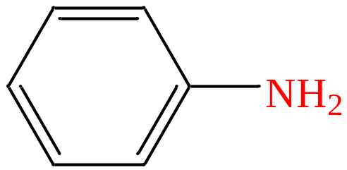
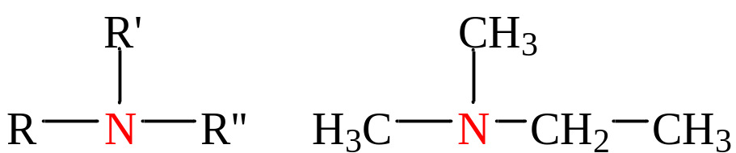
Amines are ammonia derivatives, in the molecule of which one, two or three hydrogen atoms are replaced by hydrocarbon radicals.
According to the number of hydrocarbon radicals, primary, secondary and tertiary amines are distinguished:
Classification of amines
aliphatic
a) by nature R
aromatic
b) from the number of hydrogen atoms substituted for R:
primary
tertiary
secondary

Slide 4
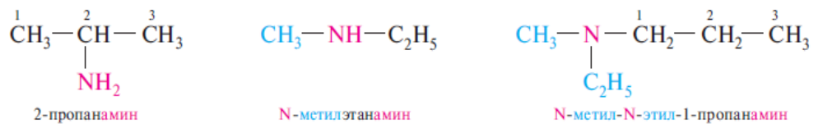
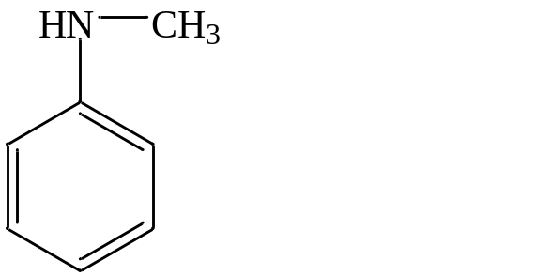
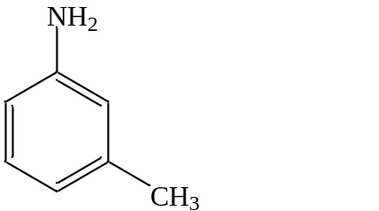
Nomenclature
According to the substitute nomenclature of IUPAC, the names of primary amines are formed by adding the suffix -amine to the name of the hydrocarbon followed by the indication of the position of the amino group in the carbon chain. When compiling the names of secondary and tertiary amines, they are considered as derivatives of the primary amine with substituents at the nitrogen atom. In this case, the most structurally complex radical bound to a nitrogen atom is taken as the original primary amine.
2-propanamine N-methylethylamine N -methyl-N-ethyl-1-propanamine
The names of primary aromatic amines, as well as mixed amines, are usually formed on the basis of the name of the parent representative - aniline.
N- methylaniline
3- methylaniline

Slide 5
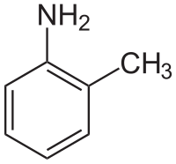
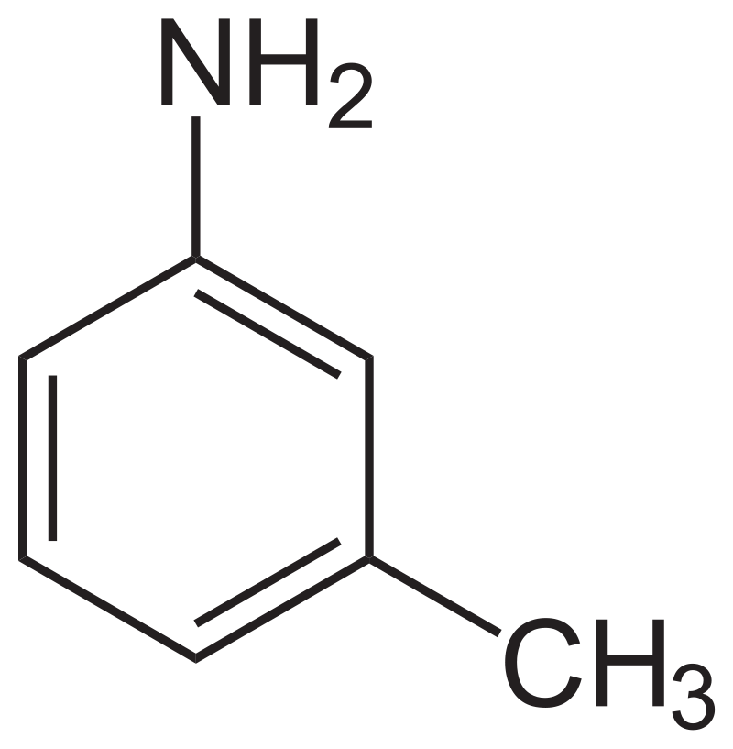
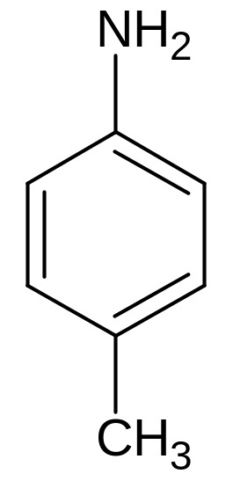
Nomenclature
Toluene derivatives containing an amino group in the benzene nucleus are called toluidines (o-, m-, p-toluidine)

Slide 6
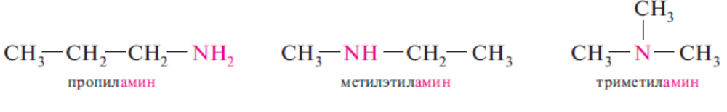
Isomerism
The isomerism of amines is caused by the different structure of hydrocarbon radicals, the different position of the amino group, and metamerism. The essence of metamerism is that amines with the same gross formula can be primary, secondary and tertiary. Yes, there are metamers:
Propylamine Methylethylamine Trimethylamine

Slide 7
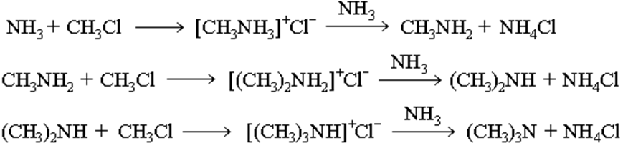
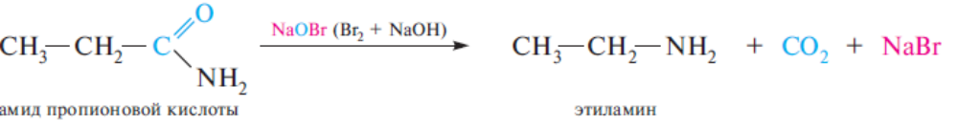
Alkylamines. Methods of obtaining
1. Interaction of haloalkanes with ammonia (Hoffman reaction). When heating an alcoholic solution of ammonia with haloalkanes, a mixture of primary, secondary and tertiary amines, as well as a salt of a quaternary ammonium base is formed :
2. Hoffman's rearrangement – cleavage of amides of carboxylic acids with sodium hypobromite. At the same time, primary amines containing one less carbon atom than the original amide are formed:

Slide 8
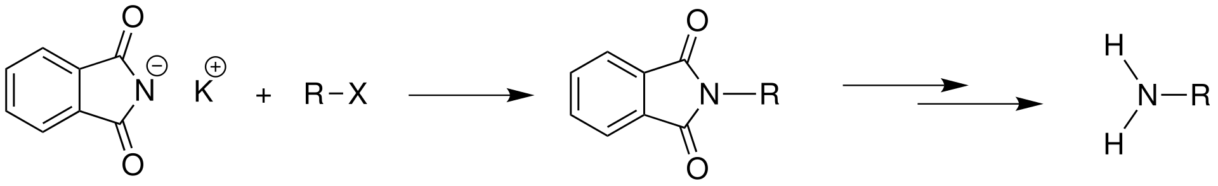
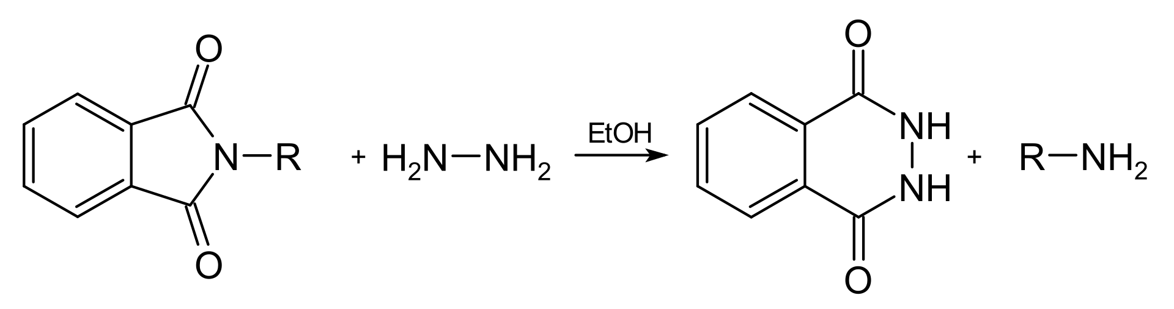
Alkylamines. Methods of obtaining
3. Synthesis of Gabriel. Allows to obtain primary alkylamines by the interaction of potassium phthalimide and haloalkanes with subsequent hydrolysis of the resulting N-alkylphthalimide :
Hydrolysis of the phthalimide complex, both alkaline and acidic, proceeds rather slowly, so other methods of its decomposition are used. The most common is the Inga-Manske procedure, which consists in the decomposition of phthalimide with hydrazine (hydrazinolysis) under slight heating :

Slide 9
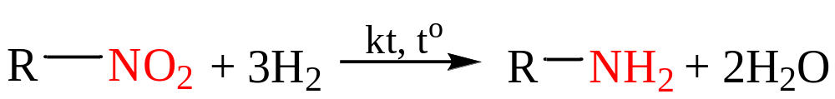
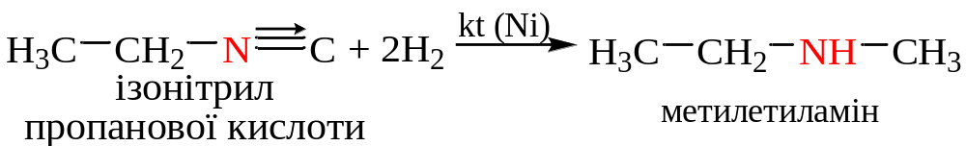
Alkylamines. Methods of obtaining
4. Reduction of nitroalkanes:
5. Reduction of nitriles and isonitriles:
propanoic acid nitrile
propylamine
propanoic acid isonitrile
methylethylamine

Slide 10
Alkylamines. Physical properties
Under normal conditions, methyl-, dimethyl-, and trimethylamine are gases, C₄-C₁₅ alkylamines are liquids, and higher amines are solids. Lower amines dissolve well in water, with an increase in M solubility decreases. Gaseous amines have the smell of ammonia, liquid amines have a sharp unpleasant smell, solid ones have no smell. Primary and secondary amines are associated due to H-bonds NH···N

Slide 11
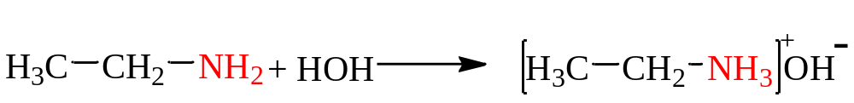
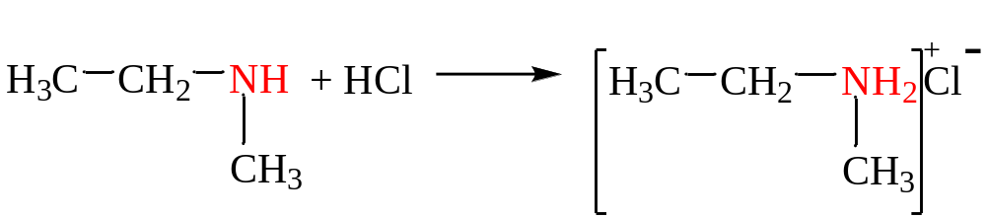
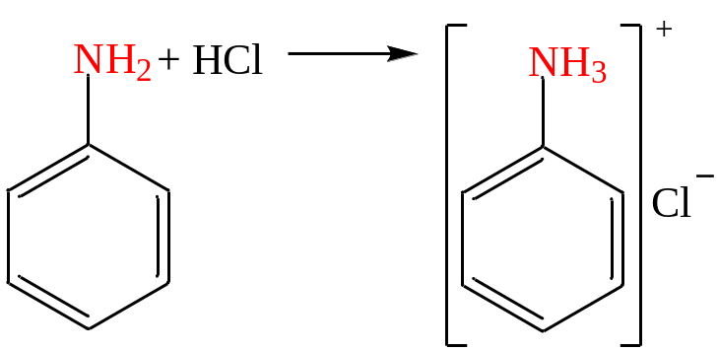
Alkylamines. Chemical properties
Chemical properties are determined by the amino group, whose nitrogen contains a free pair of electrons
1. Aqueous solutions of alkylamines have an alkaline environment :
2. With alkylamine acids, they form alkylammonium salts :
methylethylammonium chloride
phenylammonium chloride

Slide 12
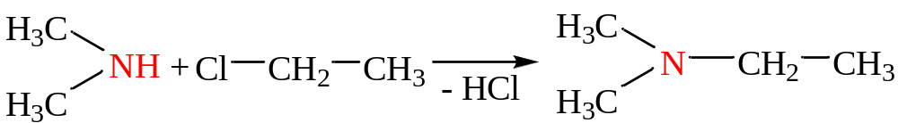
Alkylamines. Chemical properties
Weak acid properties with:
3. Interactions with Na_{metalic}:
ethyl amide
(unstable)
easily
4. Alkylation (production of secondary and tertiary amines) :
diethylamine
dimethylethylamine

Slide 13
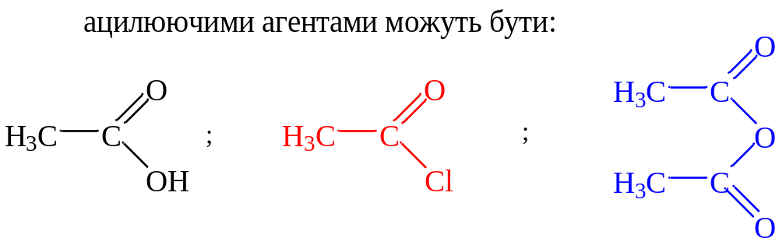
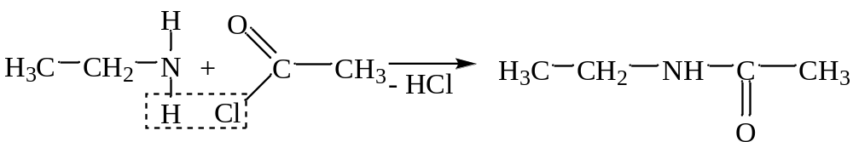
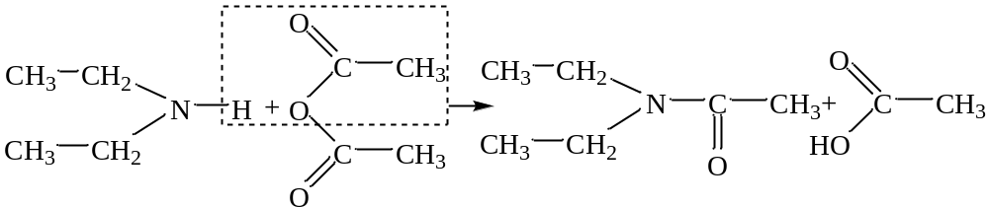
Alkylamines. Chemical properties
5. Acylation (substitution of H on a carboxylic acid residue) :
acetylethylamine
acetyldiethylamine

Slide 14
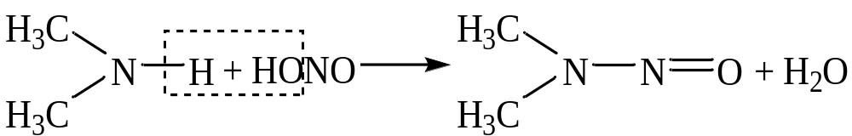
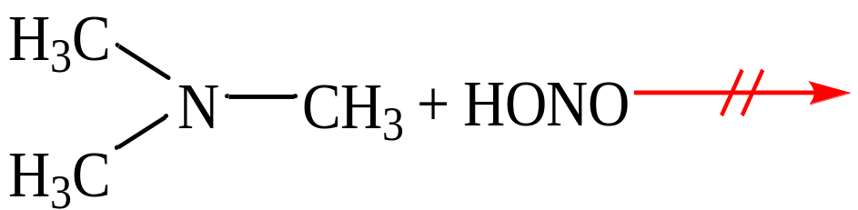
Alkylamines. Chemical properties
6. Reaction with HNO₂ (HONO) or its salts :
primary amines alcohols + N₂ + H₂O
+HОNO
secondary amines nitrosoamines + H₂O
+HОNO
tertiary amines do not interact
+HОNO

Slide 15
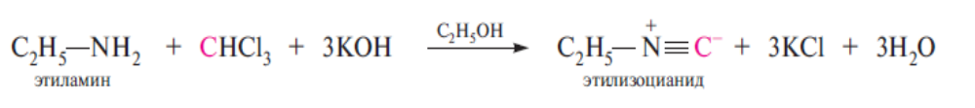
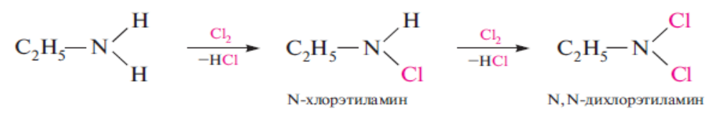
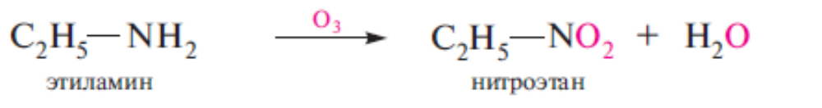
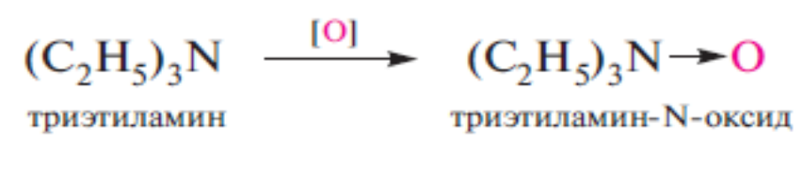
Alkylamines. Chemical properties
7. Isonitrile reaction (carbylamine) – it is characteristic only for primary amines. When primary alkylamines are heated with chloroform in the presence of alkalis in an alcoholic medium, isonitriles (isocyanides) are formed, which have a very strong unpleasant odor:
The use of the isonitrile reaction for the qualitative detection of primary amines is based on this property
8. N-halogenation, (for primary and secondary):
9. Oxidation: primary amines are oxidized to nitro compounds, tertiary amines to N-oxides.

Slide 16
Arylamines
Arylamines are ammonia derivatives in the molecule of which one, two or three hydrogen atoms are replaced by aromatic hydrocarbon residues.
Aromatic amines. Methods of obtaining
Reduction of nitroarenes (Zinin reaction):
С₆Н₅–NO₂ + [H] → С₆Н₅–NH₂ + Н₂О
2. Interaction of haloarenes with ammonia and amines (harsh conditions – high pressure and temperature, catalysis by copper and its salts):

Slide 17
Aromatic amines. Methods of obtaining
3. Schmidt's reaction:
4. Alkylation of primary arylamines (the method allows obtaining mixed N-alkyl- and N,N-dialkylarylamines; haloalkanes or alcohols in the presence of acids are usually used as alkylating agents):
С₆Н₅–NH₂ + CH₃I → С₆Н₅–NH–CH₃ + HI
С₆Н₅–NH–CH₃ + CH₃I → С₆Н₅–N(CH₃)₂ + HI

Slide 18
Aromatic amines. Physical properties
Under normal conditions, arylamines are colorless high-boiling liquids or crystalline substances with a weak unpleasant odor; sparingly soluble in water, highly toxic, oxidized by oxygen in the air (due to which they acquire a yellowish color during storage).

Slide 19
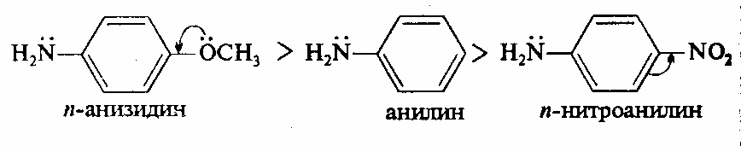
Aromatic amines. Chemical properties
The basicity of arylamines is noticeably lower than the basicity of alkylamines. The basicity of arylamines is significantly affected by the substituents in the benzene ring: electron-donating substituents increase the basicity, and electron-withdrawing substituents decrease it. For example, aniline is a stronger base than p-nitroaniline, but less strong than p-anisidine:
p-anisidim Aniline p-nitroaniline
The basicity of arylamines strongly decreases among ArNH₂>Ar₂NH>Ar₃N. For example, triphenylamine has practically no basic properties.
Arylamines are characterized by reactions involving the nitrogen atom and carbon atoms of the aromatic ring

Slide 20
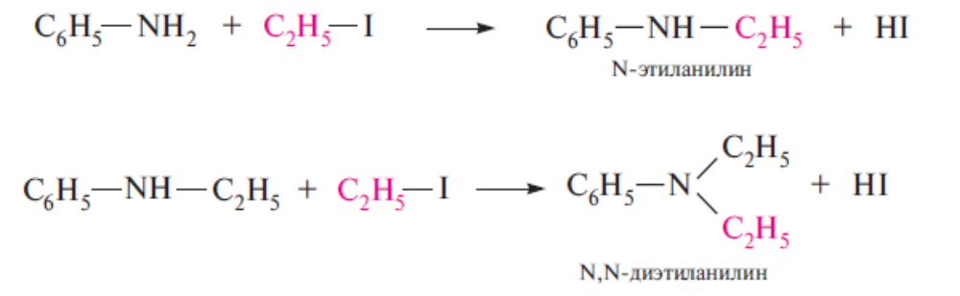
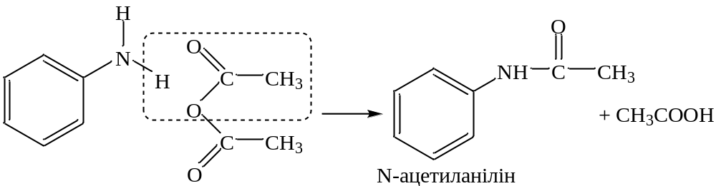
Aromatic amines. Chemical properties
1. Reactions involving the nitrogen atom.
Alkylation reactions :
Acylation reactions :
N-acethylaniline

Slide 21
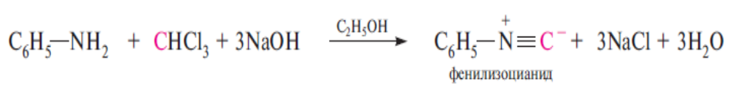
Aromatic amines. Chemical properties
Formation of isocyanides. Similarly to alkylamines, primary aromatic amines when heated with chloroform and alkali in an alcoholic medium form isocyanides - substances with an unpleasant, nauseating smell:

Slide 22
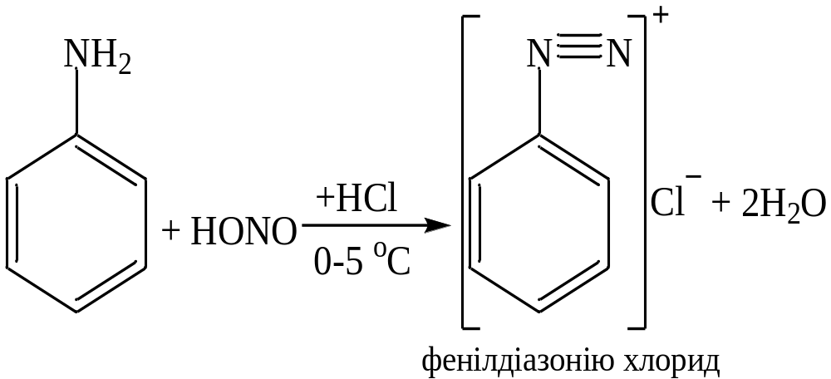
Aromatic amines. Chemical properties
Interaction of aromatic amines with HNO₂ (HОNO):
Interaction of primary aromatic amines with nitrous acid. Diazotization reaction followed by condensation of a diazonium salt with β-naphthol (azo coupling reaction). At the same time, a red azo dye is formed
Phenildiazonium chloride

Slide 23
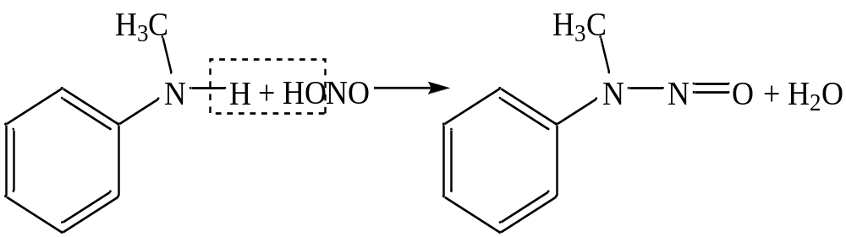
Aromatic amines. Chemical properties
Interaction of aromatic amines with HNO₂ (HОNO):
Secondary arylamines and N-alkylarylamines react with nitrous acid, similar to alkylamines, to form N-nitrosoamines:
N-nitroso-N-methylaniline

Slide 24
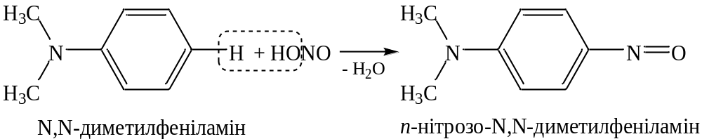
Aromatic amines. Chemical properties
Interaction of aromatic amines with HNO₂ (HОNO):
Tertiary N,N-dialkylarylamines under the action of nitrous acid undergo nitrosation in the para-position of the benzene ring, and if it is occupied - in the ortho-position :
N,N-dimethylphenilamine
p-nitroso-N,N-dimethylphenylamine

Slide 25
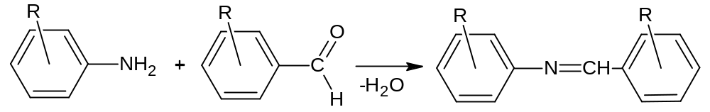
Aromatic amines. Chemical properties
Interaction with aromatic aldehydes (azomethines are formed - Schiff bases):

Slide 26
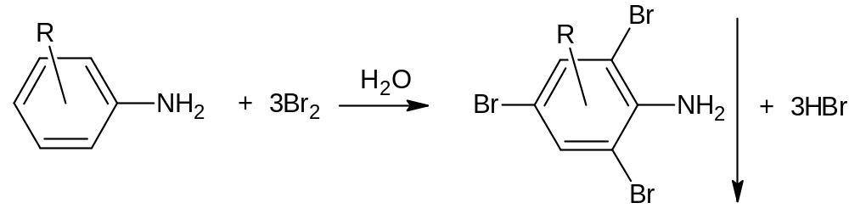
Aromatic amines. Chemical properties
2. Reactions involving an aromatic ring :
Arylamines are characterized by reactions of electrophilic substitution along the aromatic cycle, in which the amino group as an orientant of the first kind directs the substituents to the ortho- and para-positions.
Halogenation

Slide 27
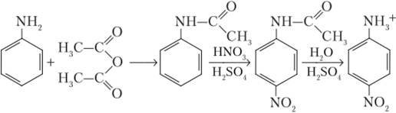
Aromatic amines. Chemical properties
Nitration
Arylamines are easily oxidized by concentrated nitric acid; to protect the amino group from oxidation, arylamines are pre-acylated. The acetylamino group orients the nitration process in the ortho and para positions. After nitration, N-acyl derivatives are hydrolyzed in an acidic or alkaline medium to obtain ortho- and para-nitroanilines o-О₂NC₆H₂NH₂ and p-О₂NC₆H₂NH₂

Slide 28
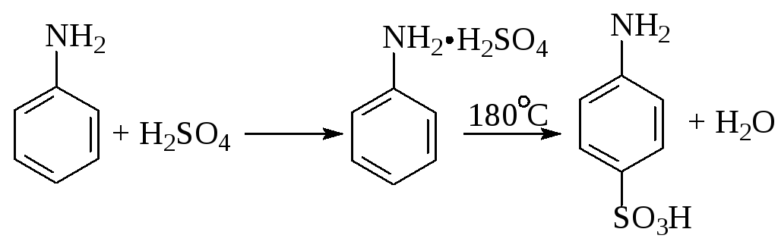
Aromatic amines. Chemical properties
Sulfation

