Slide 1
Lecture 8. Diazo compounds. Azo compounds. Azo dyes

Slide 2
Diazo compounds
Diazo compounds are organic substances containing in their structure a group of two nitrogen atoms connected to a hydrocarbon radical and a residue of a mineral acid.
Aromatic diazo compounds have the general formula ArN₂X, where Ar is an aromatic radical and X is an acidic residue. If X is the residue of a strong mineral acid (Cl–, Br–, HSO₄–, NO₃–), diazo compounds have an ionic structure and are called diazonium salts (Ar–N⁺≡NX–), and if X is the residue of a weak mineral acid (CN–, HSO₃–, OH–, SH–), then they have the covalent structure Ar–N=N–X. Diazo compounds of the general formula Ar–N=N–O–М⁺, where M is a metal, are called diazotates.

Slide 3
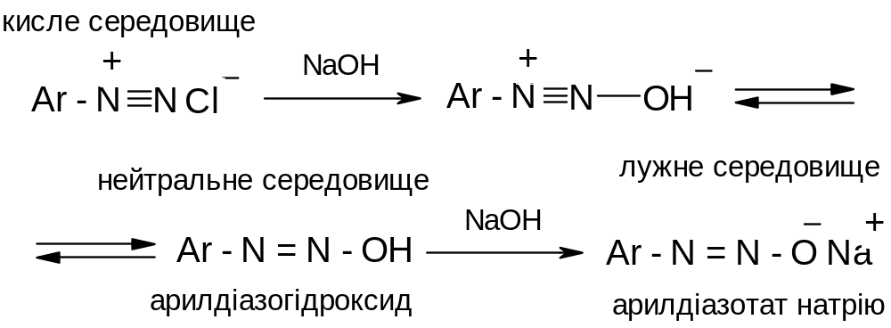
Diazo compounds
Depending on the pH of the environment, these forms are able to transform into each other. In an acidic environment, diazo compounds exist in the form of diazonium salts, in an alkaline environment - in the form of diazotates, in a close to neutral environment - in the form of isomeric diazohydrates.
Acidic medium
Neutral medium
Alkali medium
Aryldiazonium hydroxide
Sodium aryldiazotate

Slide 4
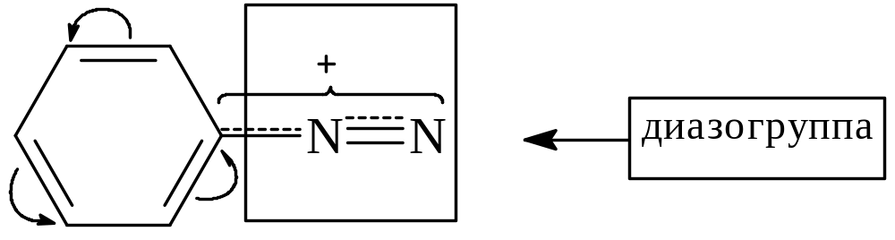
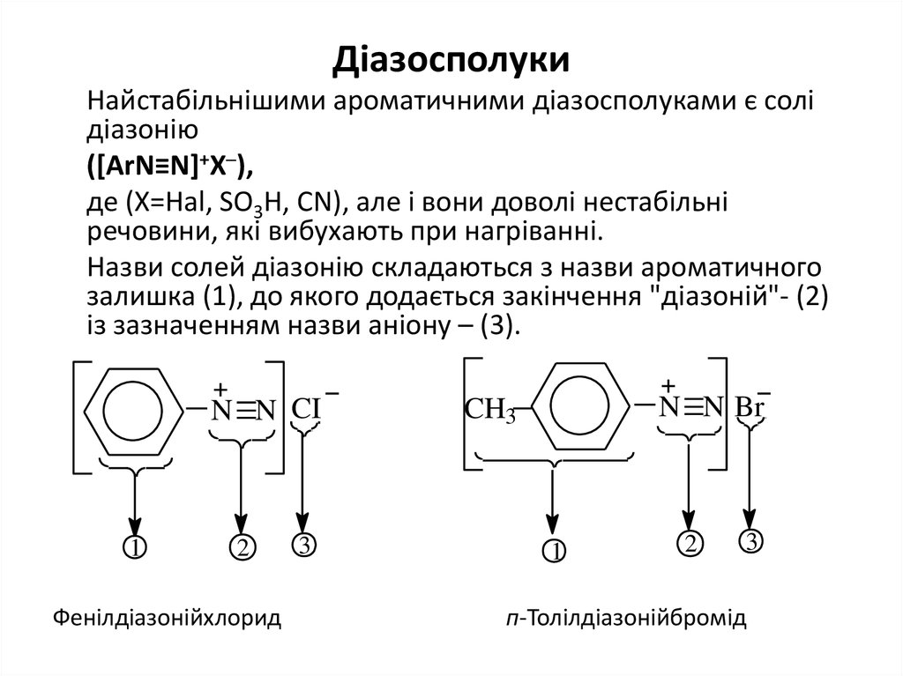
Diazo compounds
Nomenclature
According to the IUPAC nomenclature, the names of aromatic diazo compounds are formed by adding the suffix -diazo to the name of the hydrocarbon, and the names of diazonium salts are formed by adding the ending -diazonium followed by the anion :
Diazo group
Phenyl diazonium chloride
P-tolyldiazonium bromide

Slide 5
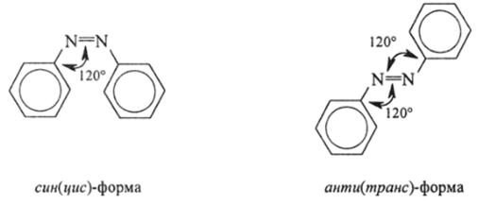
Diazo compounds
Isomerism
Since covalently constructed diazo compounds contain a double bond in their composition, they are characterized by geometric isomerism, or the so-called syn-(cis-) and anti-(trans-) isomerism, for example :
sin-(cis)-form
anti-(trans)-form

Slide 6
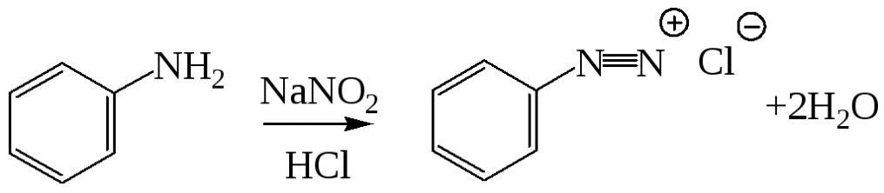
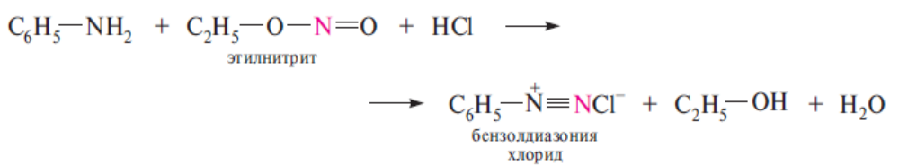
Diazo compounds
Methods of obtaining
1. Diazotization reaction (P. Griess, 1858):
2. Interaction of primary aromatic amines with alkylnitriles :
Ethyl nitrite
Benzenediazonium chloride

Slide 7
Diazo compounds
Physical properties
Diazonium salts are colorless crystalline substances, easily soluble in water, unstable, decompose with an explosion when heated and mechanically affected. Their freshly prepared aqueous solutions are usually used in reactions.

Slide 8
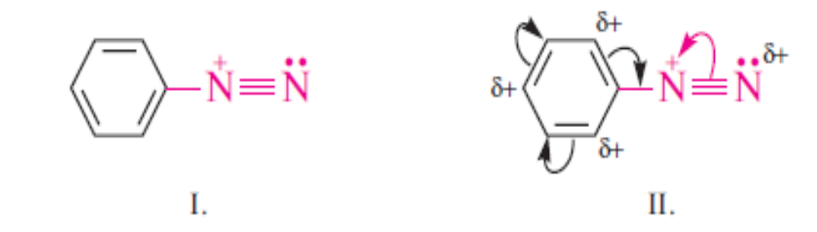
Diazo compounds
Chemical properties
Diazonium salts are very reactive compounds. Their activity in chemical transformations is related to the presence of a diazo cation. The nitrogen atoms in the diazo cation are in a state of sp-hybridization. One of them has an unshared electron pair, and the second contains a positive charge, which is distributed mainly between two nitrogen atoms and partially along the π-electron system of the benzene ring. Due to dialization, each nitrogen atom acquires a partial positive charge, which can be represented in the form of resonance structures :

Slide 9
Diazo compounds
Chemical properties
All reactions of diazonium salts can be divided into two groups: with release and without release of nitrogen.
Reactions with nitrogen release:
These reactions are accompanied by the breaking of the C–N bond and the replacement of the diazo group by other atomic groups.

Slide 10
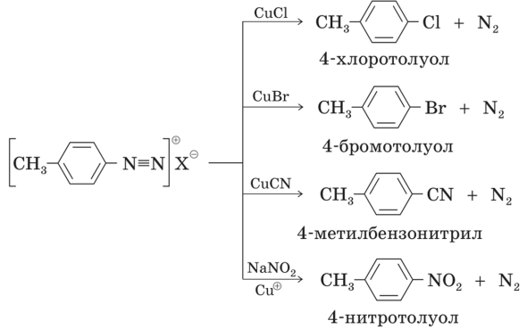
Diazo compounds
Chemical properties
Sandmeyer reaction (catalyzed by copper(I) salts, the diazo group is replaced by chlorine, bromine, nitro-, cyano-, chlorosulfonyl and other groups):
4-chlorotoluene
4-bromotoluene
4-methylbenzonitrile
4-nitrotoluene

Slide 11
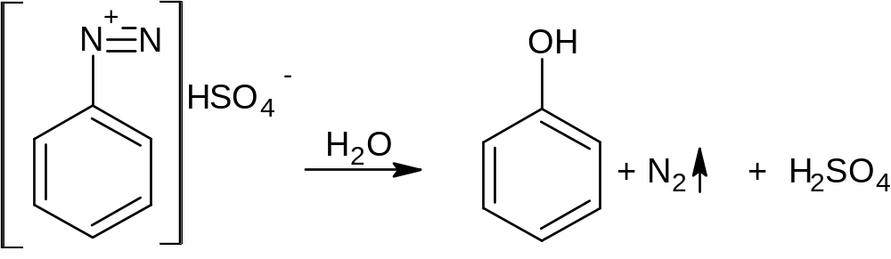

Diazo compounds
Chemical properties
Substitution of a diazo group by a hydroxyl group (leads to phenols):
Substitution of a diazo group by a hydrogen atom (in the presence of reducing agents). When used as a reductant of alcohols, along with the reduction, a side process occurs with the formation of simple ethers :

Slide 12
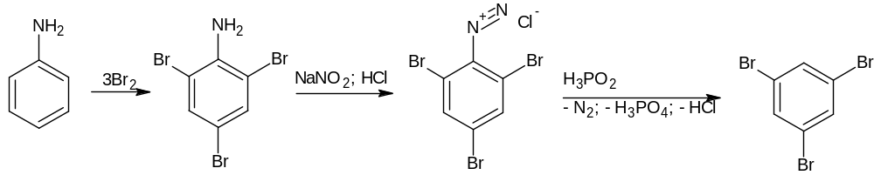
Diazo compounds
Chemical properties
The reaction of the substitution of a diazo group on a hydrogen atom is used for the synthesis of benzene derivatives, which cannot be obtained in any other way. Example:

Slide 13
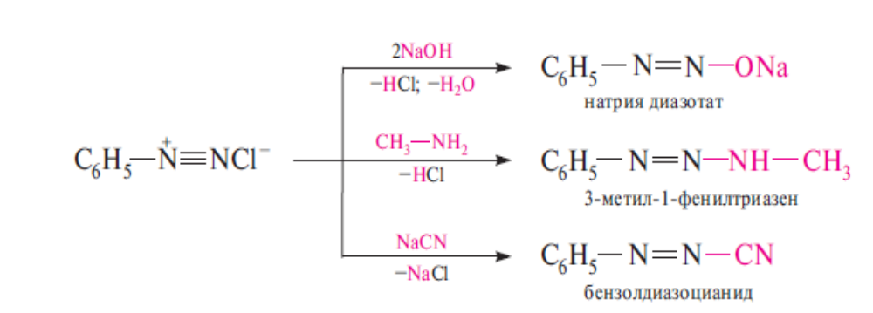
Diazo compounds
Chemical properties
2. Reactions without nitrogen release:
Formation of diazo derivatives. Being electrophilic reagents, diazonium salts react with nucleophilic reagents, forming diazo derivatives, for example:
Sodium diazotate
N-methyl-phenyltriazene
Benzenediazonium cianide

Slide 14
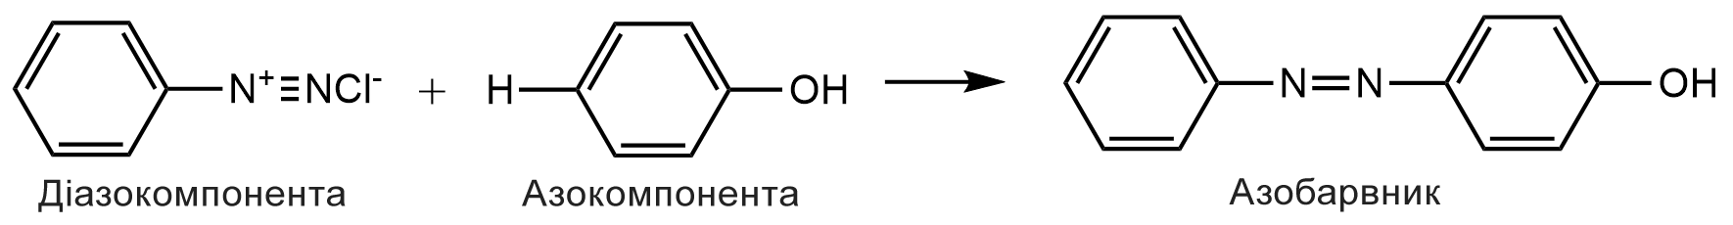
Diazo compounds
Chemical properties
Azo coupling reaction. Aryldiazonium salts interact with phenols and aromatic amines, forming azo compounds of the general formula Ar–N=N–Ar. These reactions are called azo-compound reactions and proceed according to the electrophilic S_{E} substitution mechanism :
Benzenediazonium chloride
Phenole
Azo dye

Slide 15
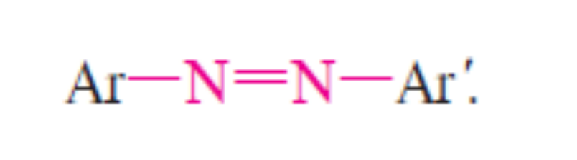
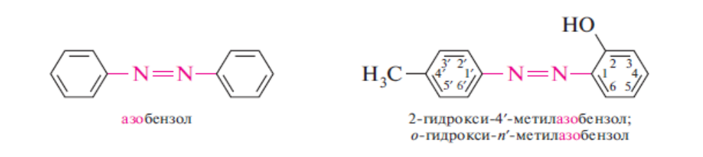
Azo compounds
Organic substances containing the group –N=N– (azo group) connected to two hydrocarbon radicals are called azo compounds.
Depending on the nature of the hydrocarbon radical, aliphatic and aromatic azo compounds are distinguished. The latter are the most important.
The names of azo compounds with the same radicals consist of the prefix azo- and the name of the hydrocarbon. The position of the substitutes is indicated by numbers or locants ortho-, meta-, para-.
Azobenzene
2-hydroxy-4'-methylazobenzene (o-hydroxy-p'-methylazobenzene)

Slide 16
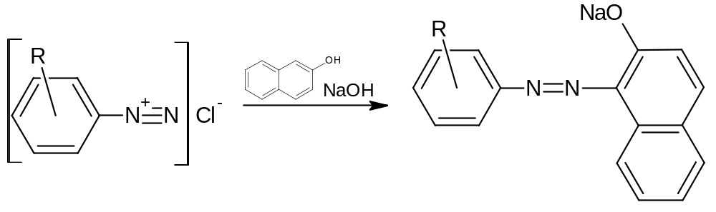
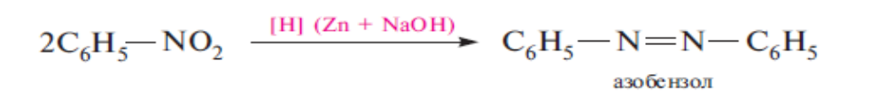
Azo compounds
Methods of obtaining
1. Azo coupling reaction (the most important method of obtaining azo compounds, which is widely used in industry).
2. Reduction of nitroarenes in an alkaline environment (Zinin reaction):
Azobenzene

Slide 17
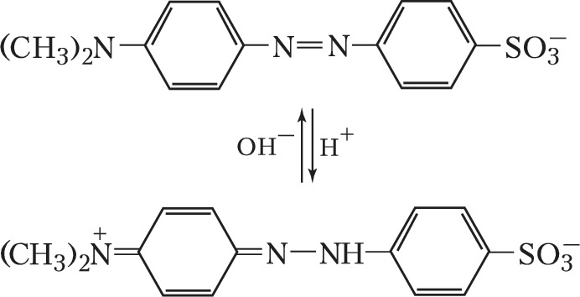
Azo compounds
Chemical properties
1. The reactivity of azo compounds is due to the presence in that structure of the azo group –N=N–. Due to the presence of AEP on nitrogen atoms, azo compounds exhibit weak basic properties:

Slide 18

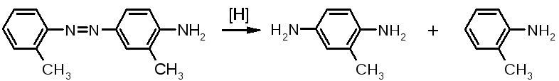
Azo compounds
Chemical properties
2. With the participation of the azo group, azo compounds undergo oxidation and reduction reactions. Thus, under the action of peroxyacids, oxidation occurs with the formation of azoxy compounds :
Azoxybenzene
3. Reduction under mild conditions leads to hydrocoupling, and by the action of tin(II) chloride in hydrochloric acid, arylamines are obtained.

Slide 19
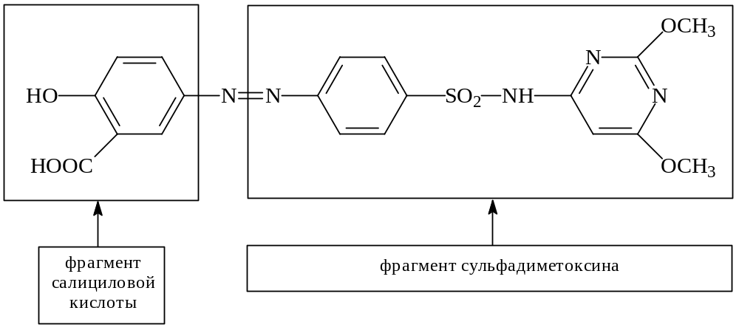
Azo compounds
SALAZODIMETOXIN
Salicylic acid part
Sulfodimetoxyni part

Slide 20
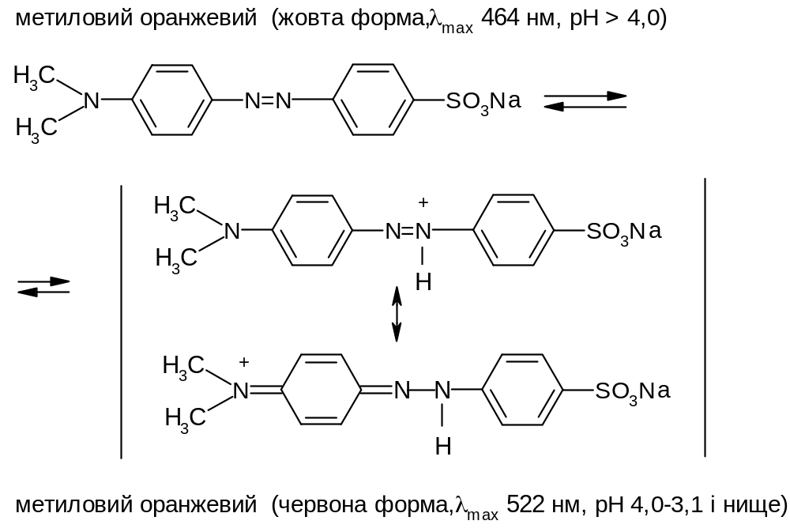
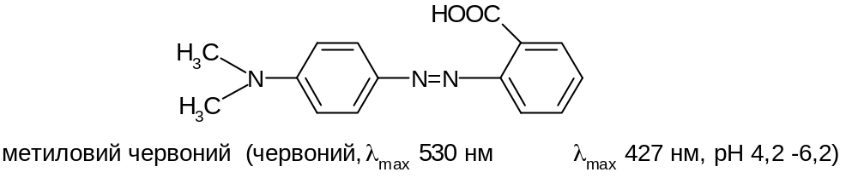
Azo compounds
Methyl orange. Yellow form
Methyl orange. Red form
Methyl red. Red form

