Slide 1
Lecture 10
Aldehydes and ketones

Slide 2
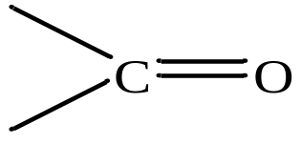
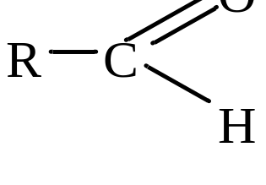
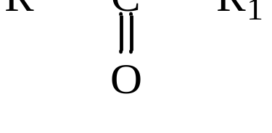
Aldehydes and ketones
Aldehydes and ketones are derivatives of hydrocarbons whose molecules contain a carbonyl group
General formula of aldehydes
Ketones are organic compounds of the general formula:
where: R і R₁ – the same or different hydrocarbon radicals.

Slide 3
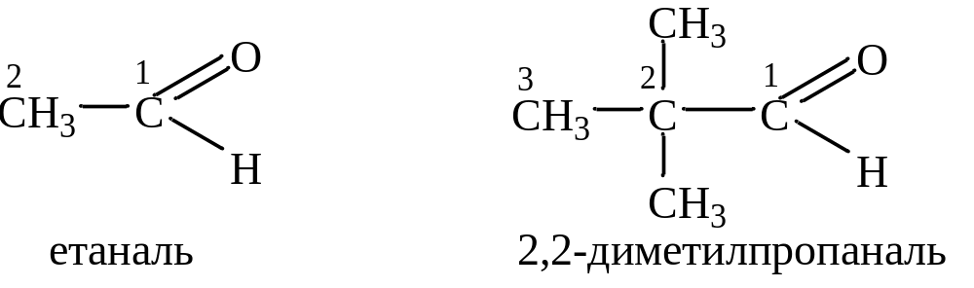
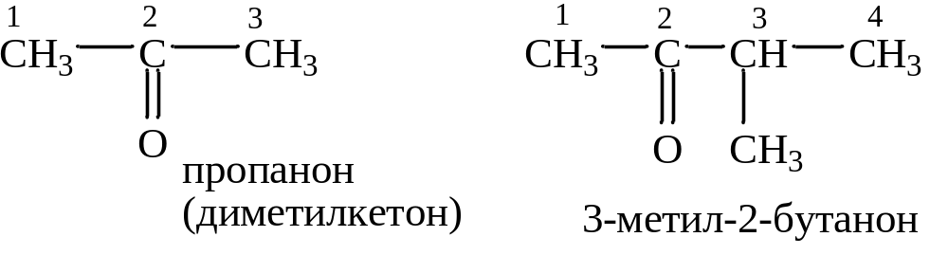
Nomenclature
According to the IUPAC nomenclature, the names of aldehydes are formed from the names of the corresponding hydrocarbons with the addition of the suffix -al. Example :
ethanal
2,2-dimethylpropanal
The names of ketones are formed from the names of the corresponding hydrocarbons with the addition of the suffix -one and the location of the carbonyl group. Example :
Propanone
Dimethylketone
3-methyl-2-butanone

Slide 4
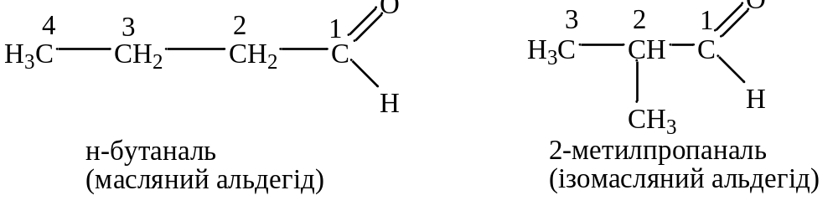
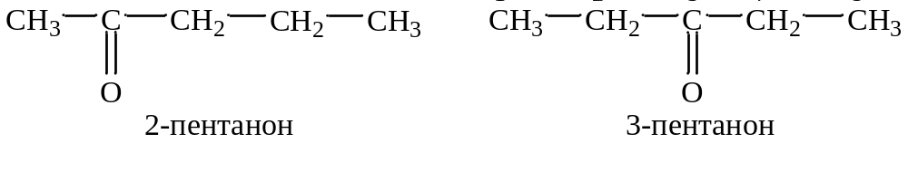
Isomerism
In aldehydes, isomerism begins with the fourth member of the homologous series:
n-buthanal
2-methylpropanal
Butyric aldehyde
Isobutyric aldehyde
In ketones, isomerism begins with compounds that contain 5 carbon atoms, for example:
2-pentanone
3-pentanone

Slide 5
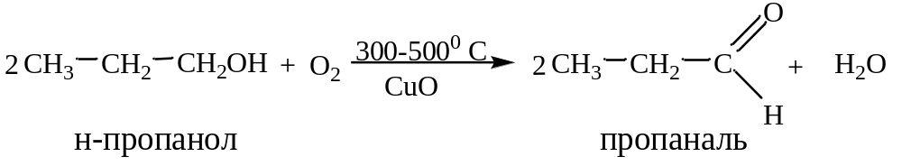
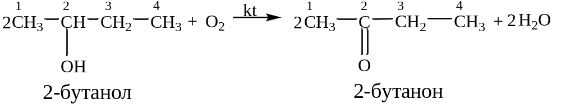
Methods of obtaining
а) oxidation of alcohols
n-propanol
propanal
2-butanol
2-butanone

Slide 6
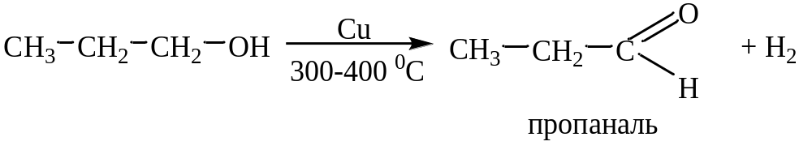
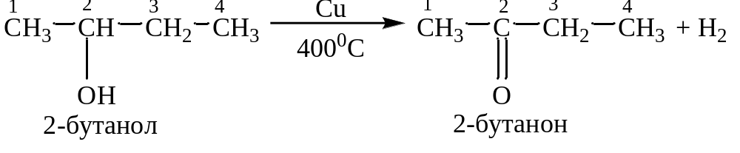
Methods of obtaining
b) dehydrogenation of alcohols
propanal
2-butanol
2-butanone

Slide 7
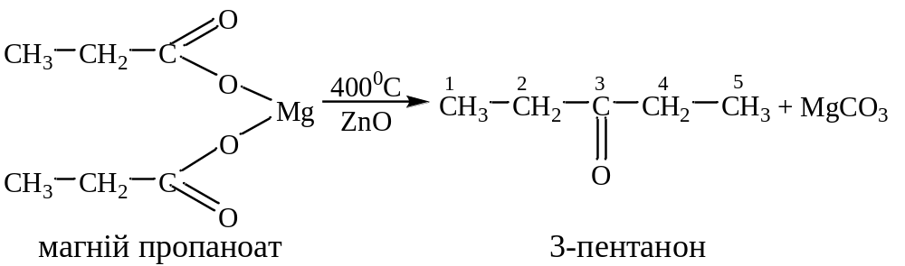
Methods of obtaining
c) pyrolysis of magnesium salts of carboxylic acids
Magnesium propionate
3-pentanone

Slide 8
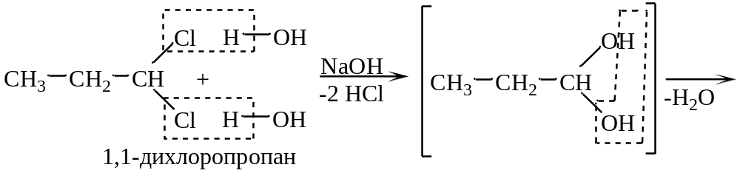
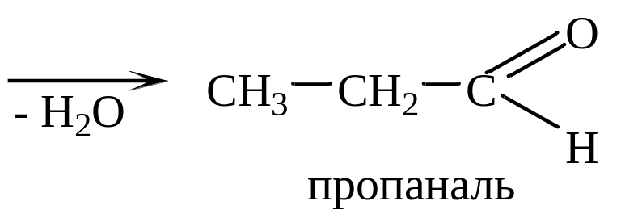
Methods of obtaining
d) hydrolysis of geminal dihaloalkanes
1,1-dichloropropane
propanal

Slide 9
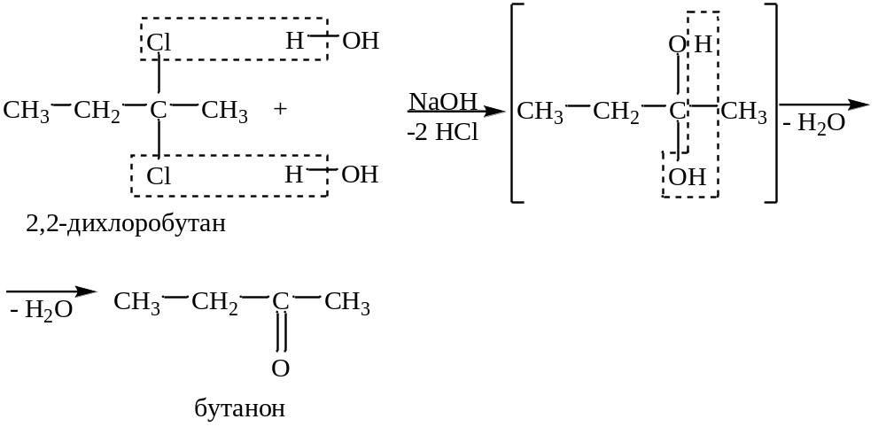
Methods of obtaining
2,2-dichloropropane
butanone

Slide 10
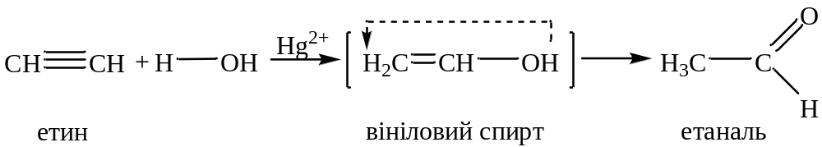
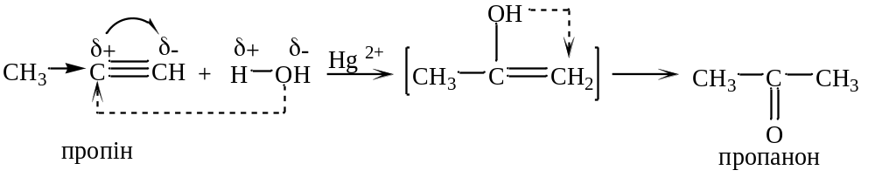
Methods of obtaining
e) hydration of ethyne and its homologues
Hydration of ethyne leads to the formation of ethanal:
ethyn
Vinyl alcohol
ethanal
When ethyne homologues are ethyne, ketones are formed:
propyn
propanone

Slide 11
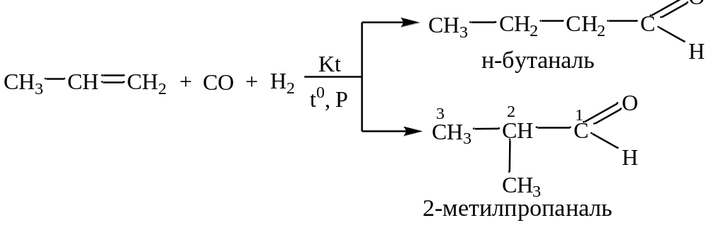
Methods of obtaining
f) industrial method
Oxosynthesis - direct addition of CO and H₂ to alkenes.
n-butanal
2-methylpropanal

Slide 12
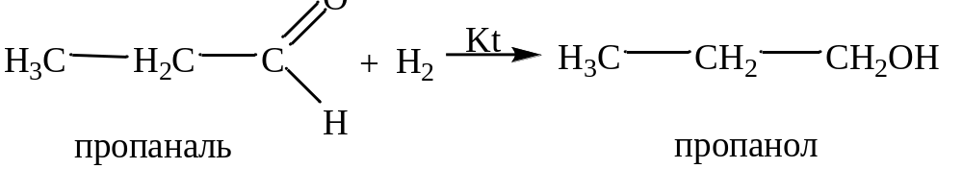
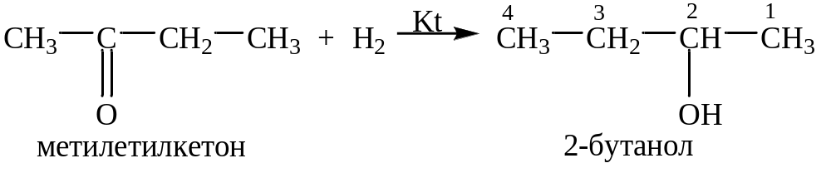
Chemical properties
Addition reactions
1) Hydrogenation (addition of H₂)
propanal
propanol
methylethylketon
Butanol-2

Slide 13
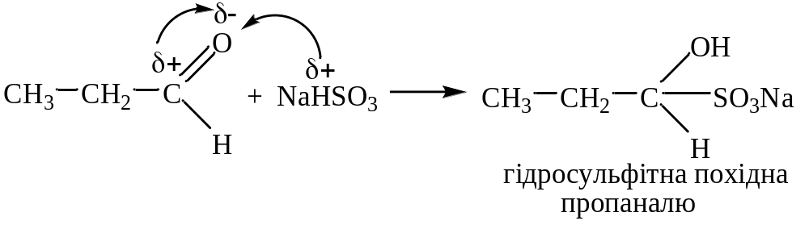
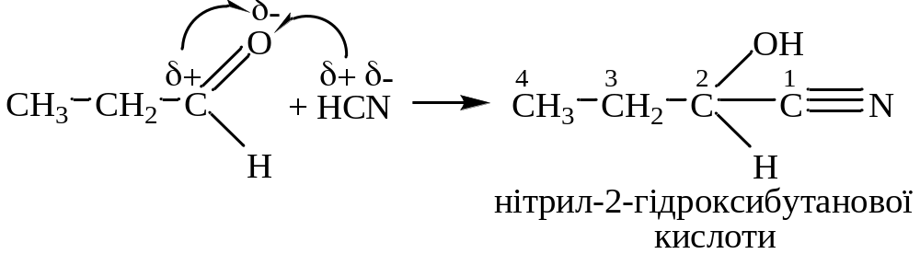
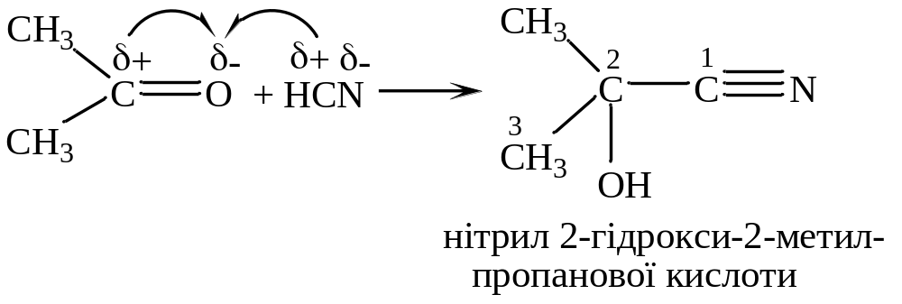
Chemical properties
2) addition of sodium hydrosulfite - NaHSO₃ - a qualitative reaction to the carbonyl group
Hydrosulfite derivastive
of propanal
3) addition of HCN (formation of hydroxynitriles)
2-hydroxybutanoic acid nitrile
2-hydroxy2-methylpropanoic
acid nitrile

Slide 14
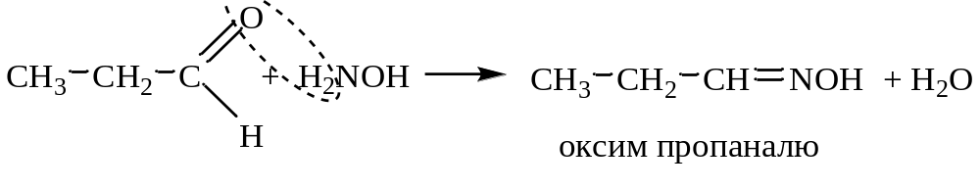
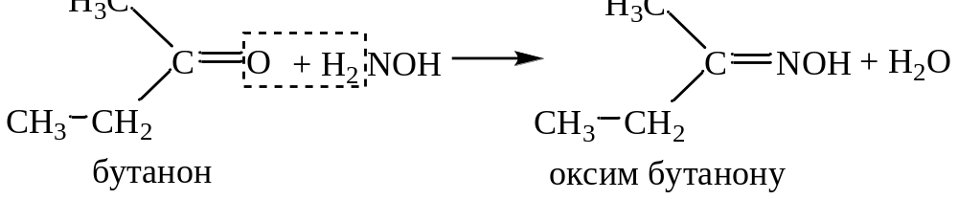
Chemical properties
1) Oxygen substitution reactions of the carbonyl group.
а) with NH₂OH (formation of oximes)
Propanal oxime
butanone
Butanal oxime

Slide 15
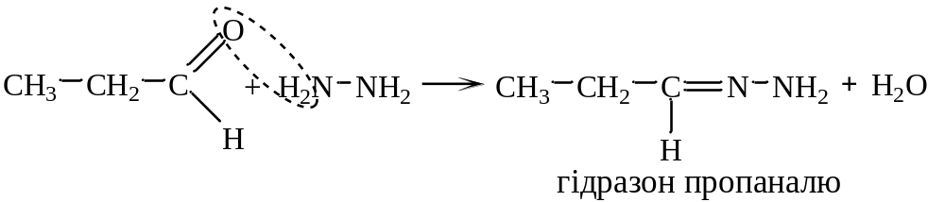
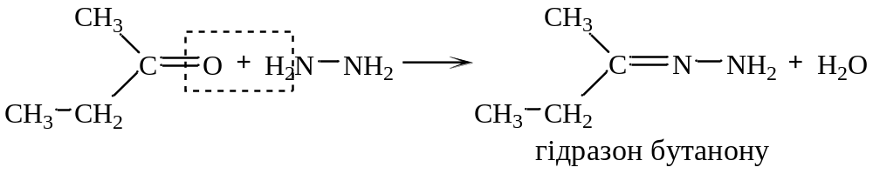
Chemical properties
b) with hydrazine H₂N – NH₂ (formation of hydrazones)
Propanal hydrozone
Butanal hydrozone

Slide 16
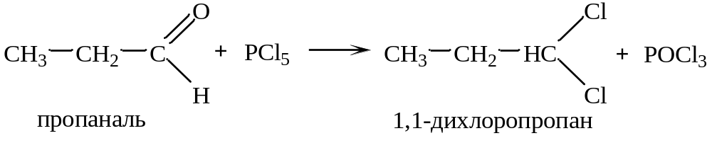
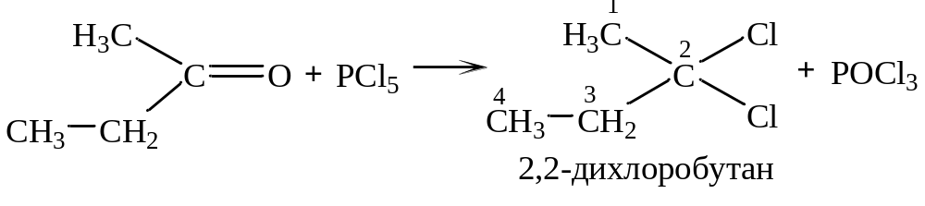
Chemical properties
c) With PCl₅
Propanal
1,1-dichloropropane
2,2-dichlorobutane

Slide 17
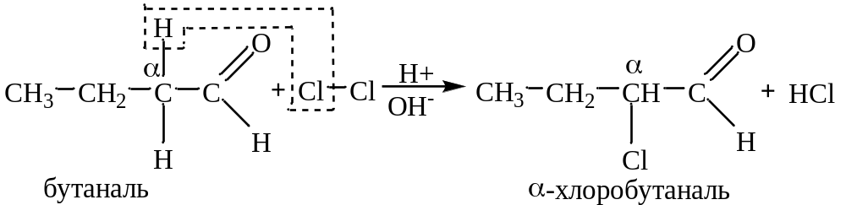
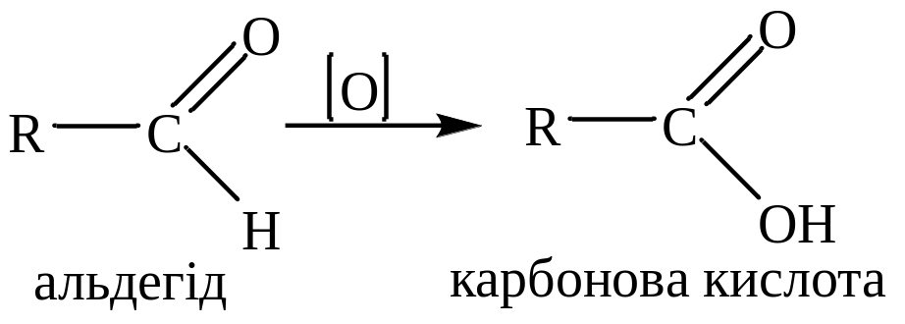
Chemical properties
Substitution reactions
Replacement of hydrogen atoms in a hydrocarbon residue
butanal
α-chlorobutanal
Oxidation reactions
Aldehyde
Carboxylic acid

Slide 18
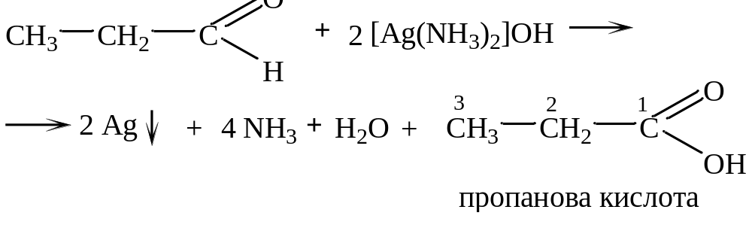
Chemical properties
Propionic acid
The "silver mirror" reaction is characteristic only for aldehydes.

Slide 19
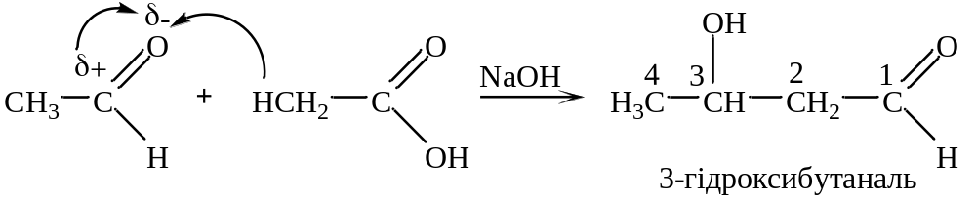
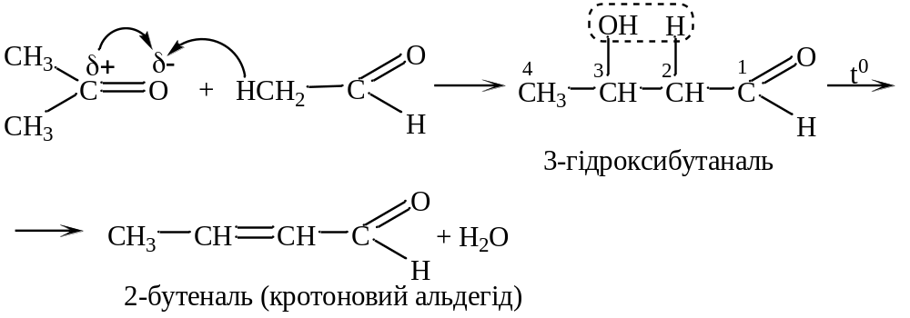
Chemical properties
Condensation reactions are reactions of combining aldehydes and ketones with the formation of new carbon-carbon bonds
3-hydroxybutanal
3-hydroxybutanal
2-butenal (Crotonaldehyde)

