Slide 1
Lecture 11
Monocarboxylic acids. Dicarboxylic acids.
Functional derivatives of carboxylic acids

Slide 2
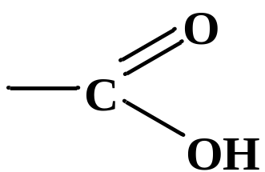
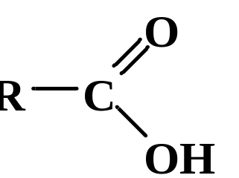
Carboxylic acids
Carboxylic acids are derivatives of hydrocarbons that contain one or more carboxyl groups
General formula of carboxylic acids
where: R is a hydrocarbon radical

Slide 3
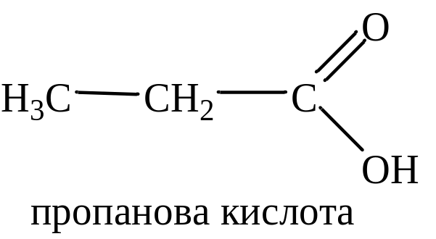
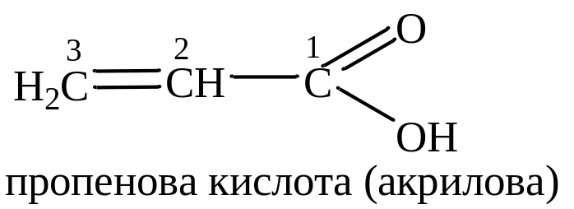
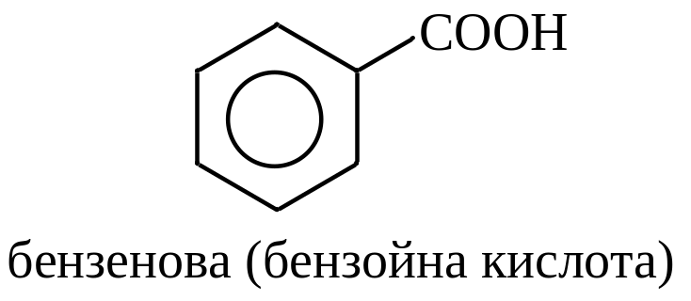
Classification
Carboxylic acids are distinguished depending on the nature of the R radical:
a) saturated:
Propanoic acid
b) unsaturated:
Propenoic acid (acrylic acid)
c) aromatic:
Benzenoic (benzoic acis)

Slide 4
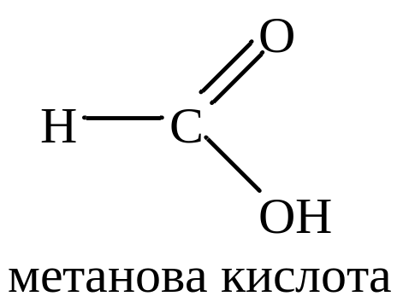
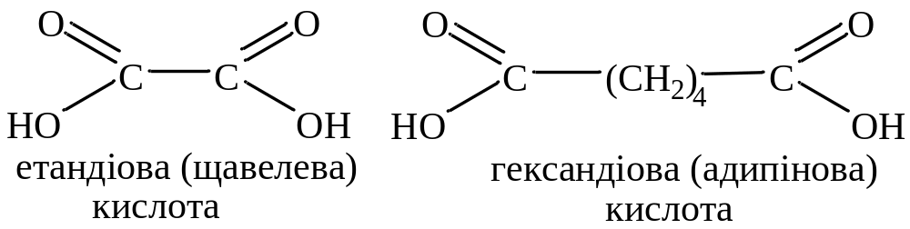
Classification
According to the number of carboxyl groups, carboxylic acids are divided into:
a) monobasic (monocarbon):
Methanoic acid
b) dibasic (dicarbon):
Ethandioic (oxalic acid)
Hexandioic (adipic acid)

Slide 5
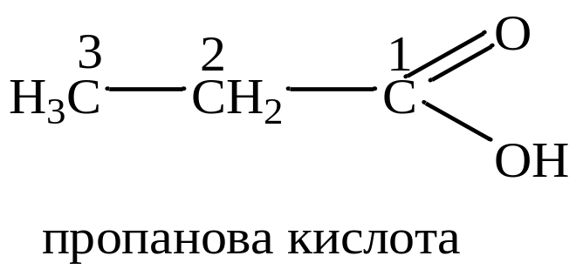
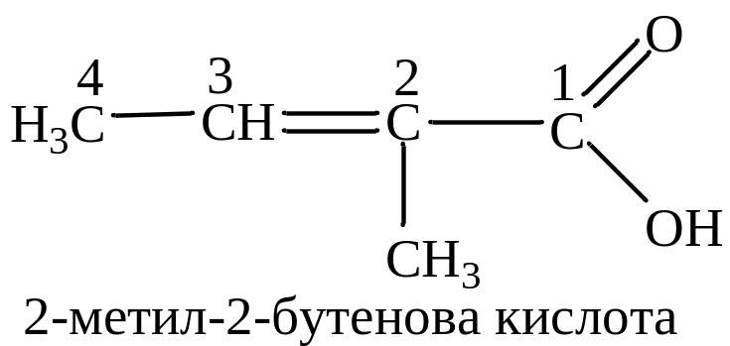
Nomenclature
According to the IUPAC nomenclature, the name of saturated carboxylic acids is formed from the name of the corresponding alkane with the addition of the suffix -ova and the word "acid"
Propanoic acid
Note that the carboxyl group is always in the main chain and is in position 1.
2-methyl-2-betenoic acid

Slide 6
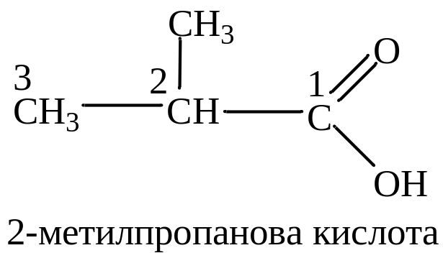
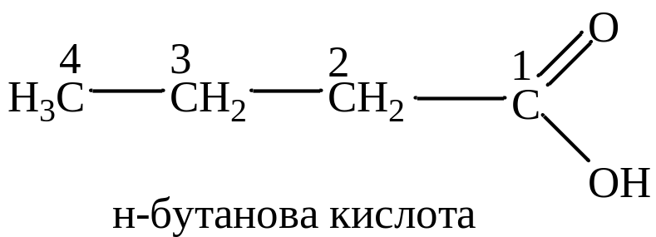
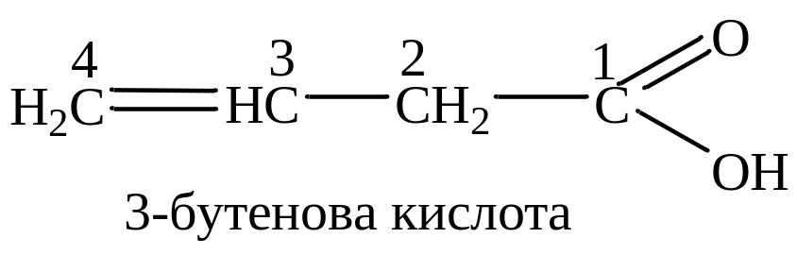
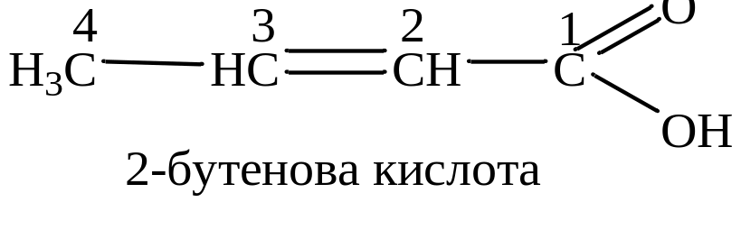
Isomerism
Saturated acids
n-butanoic acid
2-methylpropanoic acid
Unsaturated acids
3-butenoic acid
2-butenoic acid

Slide 7
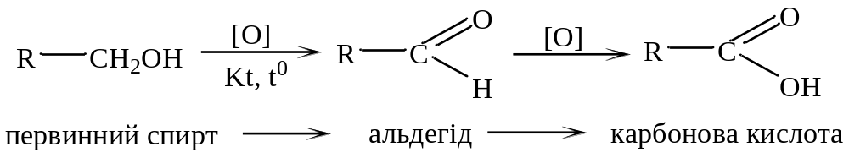
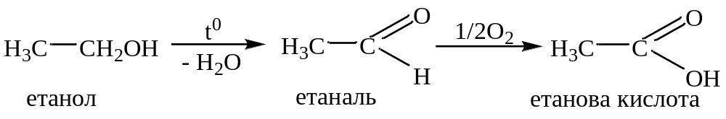
Methods of obtaining
a) oxidation of primary alcohols
primary alcohol
aldehyde
carboxylic acid
ethanol
ethanal
ethanoic acid

Slide 8
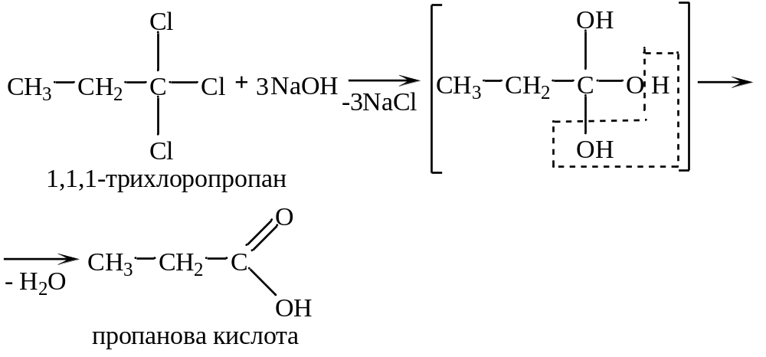
Methods of obtaining
b) hydrolysis of geminal trihaloalkanes
1,1,1-trichloropropane
Propanoic acid

Slide 9
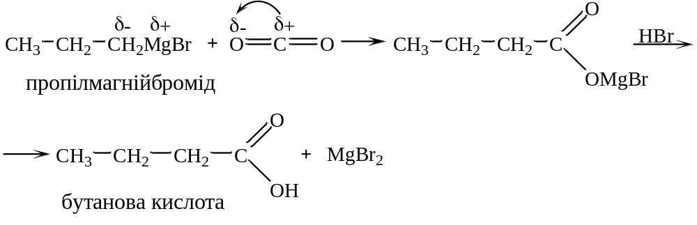
Methods of obtaining
c) interaction of Grignard reagents with carbon (IV) oxide
Propylmagnesium bromide
Butanoic acid

Slide 10
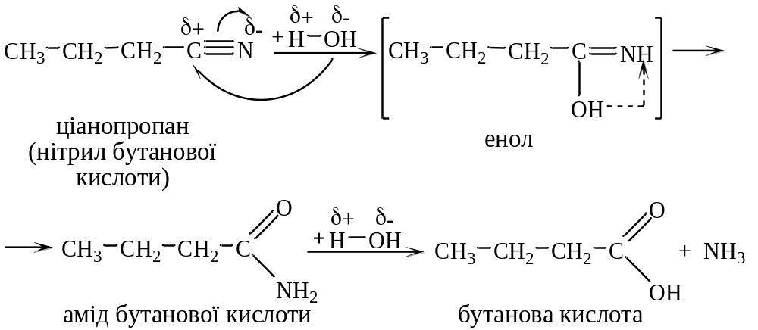
Methods of obtaining
d) hydrolysis (saponification) of nitriles
Cianopropane
(butanoic acid nitrile)
enol
Butanoic acid amide
Butanoic acid

Slide 11
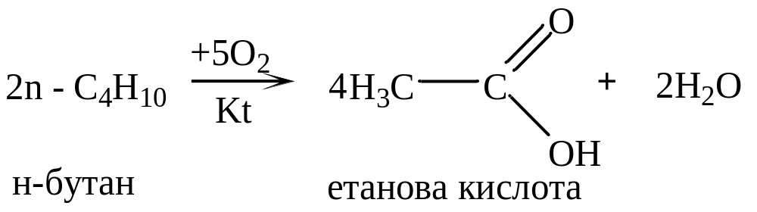
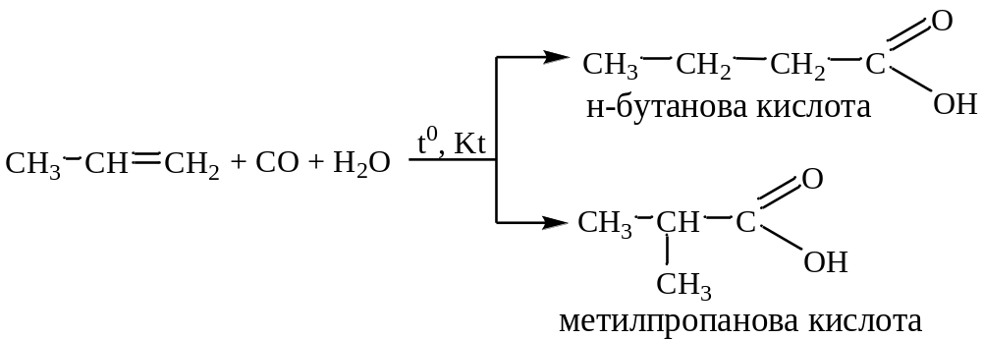
Methods of obtaining
e) industrial methods of obtaining carboxylic acids
1) oxidation of alkanes in the presence of catalysts at high temperatures and pressure:
n-butane
ethanoic acid
2) oxosynthesis (interaction of alkenes with CO and H₂O).
n-butanoic acid
2-methylpropanoic acid

Slide 12
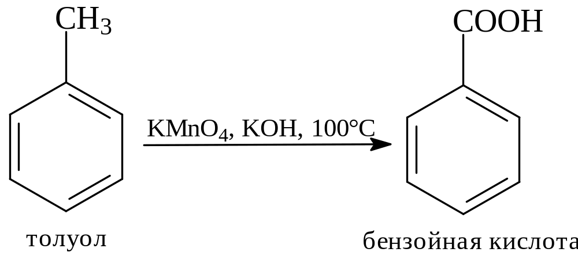
Methods of obtaining
Derivation from homologues of benzene
Toluene
Benzoic acid

Slide 13


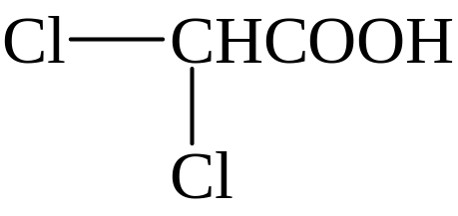
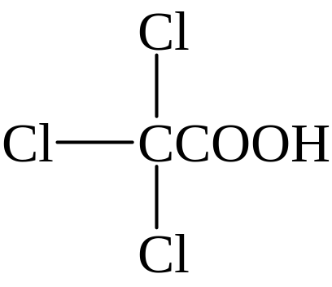
Chemical properties
Acid properties
pKa
Increased acidity
acetic acid 4,76
monochloroacetic acid 2,85
dichloroacetic acid 1,25
trichloroacetic acid 0,66

Slide 14
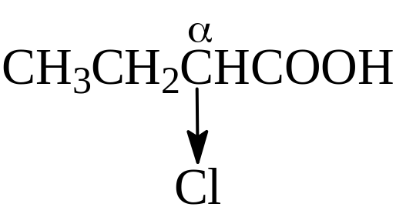
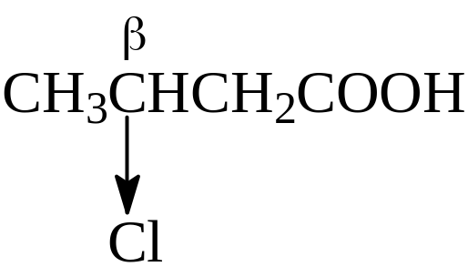
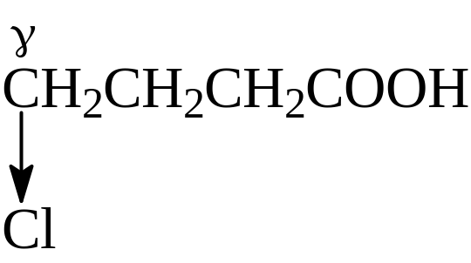

Chemical properties
Acid properties
pKa
Reduction of acidity
α- chlorobutyric acid 2,84
β- chlorobutyric acid 4,06
γ- chlorobutyric acid 4,52
chlorobutyric acid 4,82

Slide 15
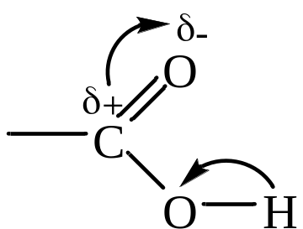
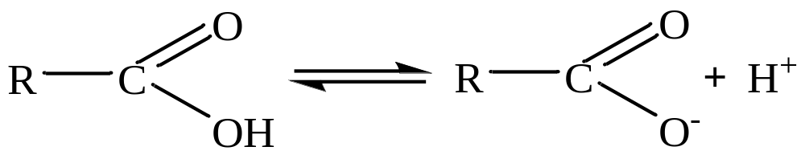
Chemical properties
The chemical properties of carboxylic acids are determined by the structure of the carboxyl group
Two types of reactions are characteristic of carboxylic acids:
substitution of a Hydrogen atom in the carboxyl group;
substitution of a Hydrogen atom in a hydrocarbon radical.

Slide 16
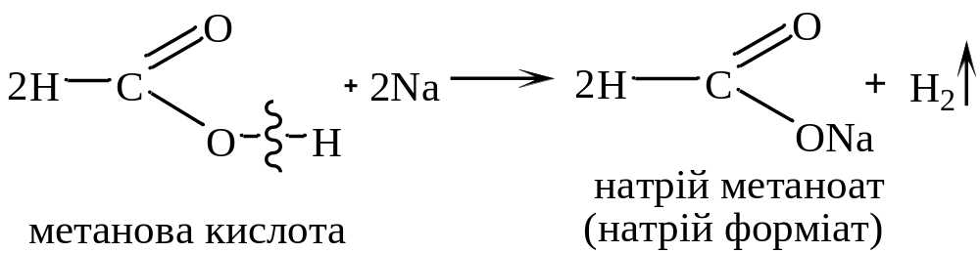
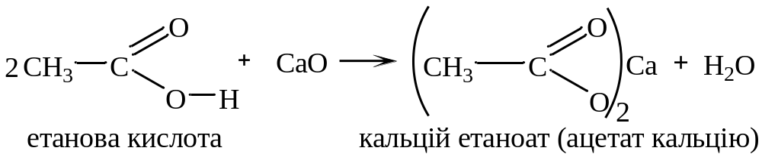
Chemical properties
Carboxylic acids are able to form salts with:
a) metals
Sodium methanoate
(Sodium formate)
Methanoic acid
b) metal oxides
Ethanoic acid
Calcium ethanoate (calcium acetate)

Slide 17
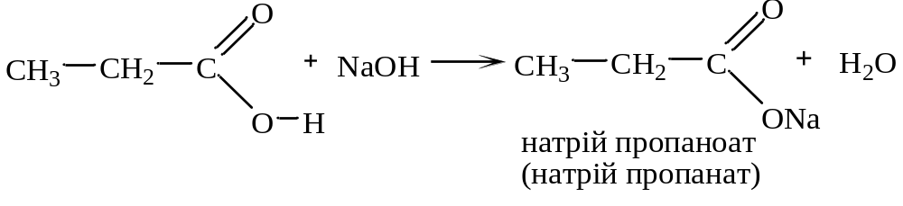
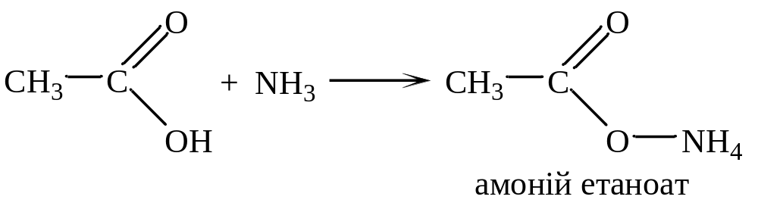
Chemical properties
c) metal hydroxides
Sodium propanoate
d) ammonia with the formation of ammonium salts
Ammonium ethanoate

Slide 18
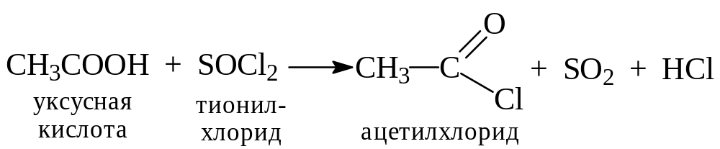
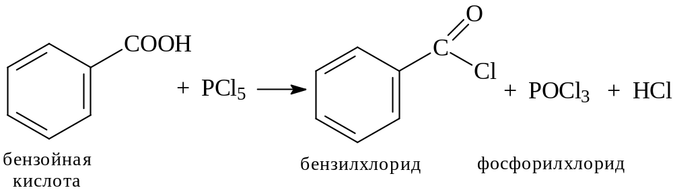
Chemical properties
e) with PCl₅, PCl₃, SOCl₂
Acetic acid
Thionyl chloride
Acetyl chloride
Benzoic acid
Benzoyl chloride
Phosphoryl chloride

Slide 19
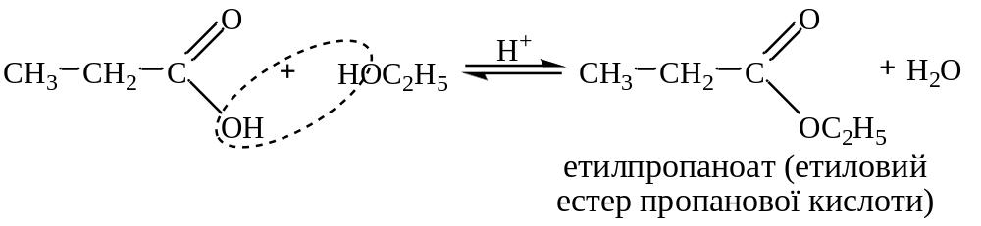
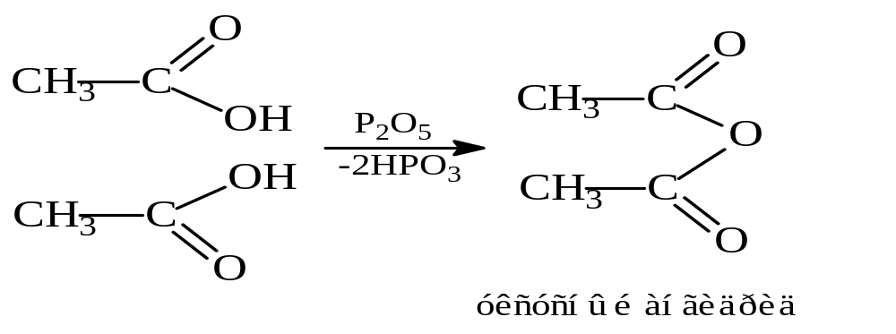
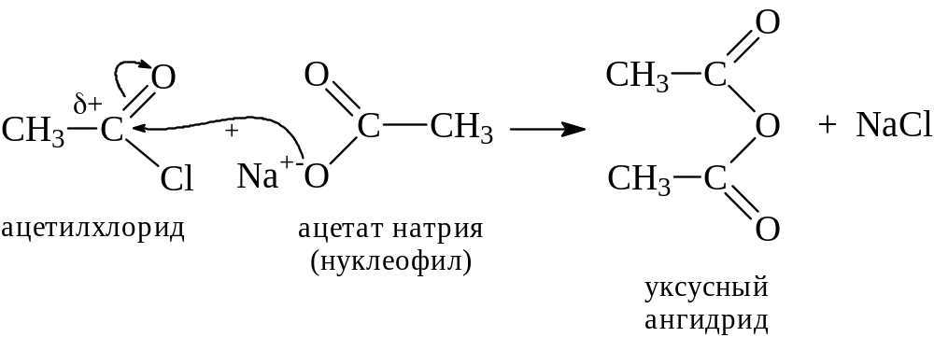
Chemical properties
f) alcohols (formation of esters)
Ethyl propanoate
g) formation of carboxylic acid anhydrides
Acetyl chloride
Sodium acetate
Acetyl unhydride
Acetyl unhydride

Slide 20
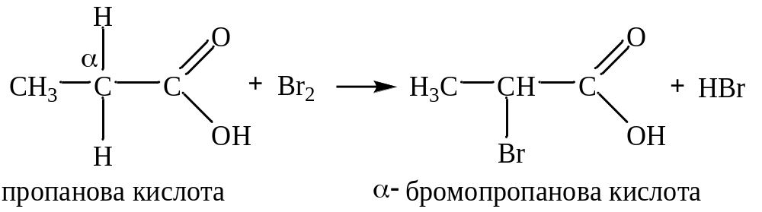
Chemical properties
Substitution of H in the radical
Propanoic acid
α-bromopropanoic acid

Slide 21
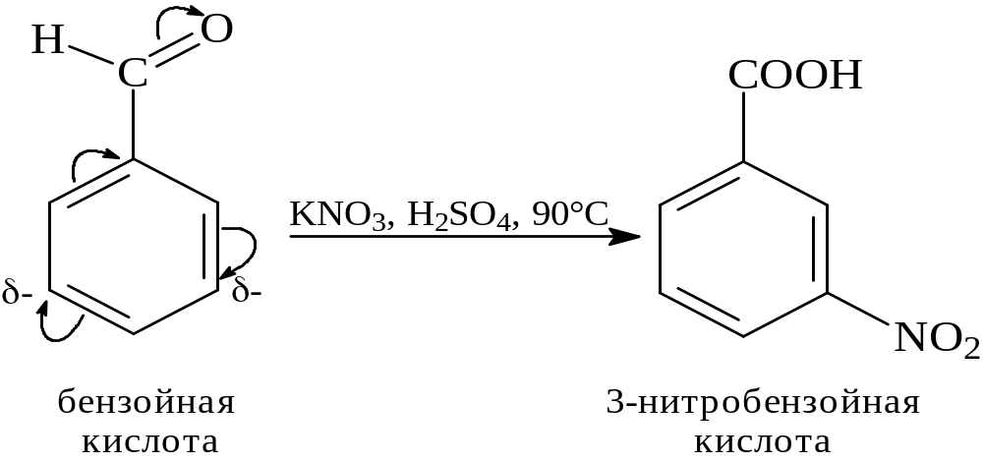
Chemical properties
Reactions of electrophilic substitution in aromatic acids
Benzoic acid
3-nitrobenzoic acid

Slide 22





Dicarboxylic acids
Nomenclature, isomerism and physical properties
Name | Structural formula | pK_{a1} | pK_{a2}
Aliphatic
Ethandioic (oxalic) |  | 1,27 | 4,27
Propandioic (malonic) |  | 2,86 | 5,70
Butandioic (amber) |  | 4,21 | 5,64
Pentandioic (glutaric) |  | 4,34 | 5,27
Hexandioic (adipic) |  | 4,41 | 5,28

Slide 23
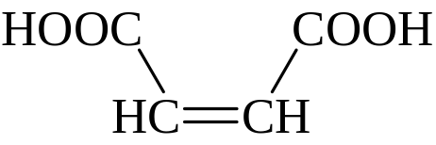
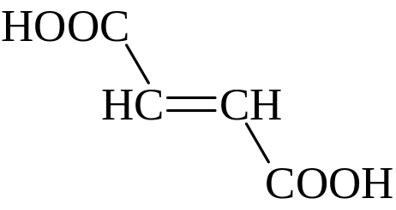
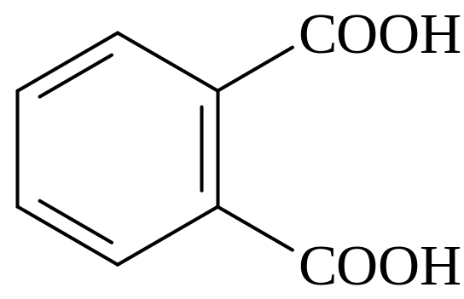
Dicarboxylic acids
Nomenclature, isomerism and physical properties
Name | Structural formula | pK_{a1} | pK_{a2}
Unsaturated
cis-Butandioic (maleic) |  | 1,92 | 6,23
trans-Butandioic (fumaric) |  | 3,02 | 4,38
Aromatic
Benzene-1,2-dicarboxylic (phthalic) |  | 2,58 | 5,64

Slide 24
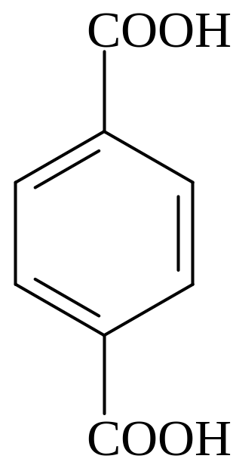
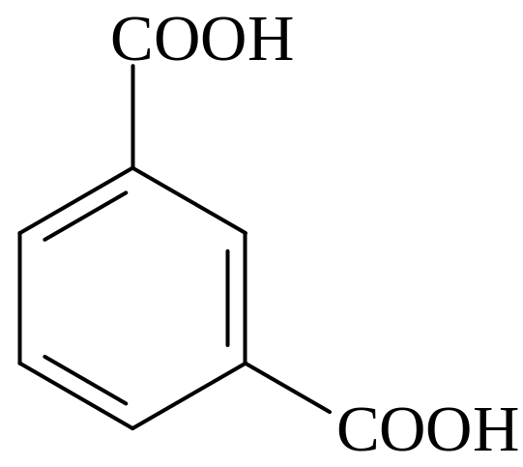
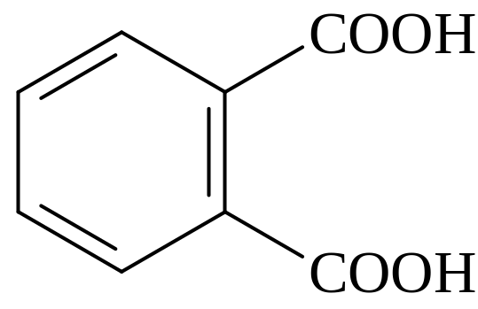
Dicarboxylic acids
Nomenclature, isomerism and physical properties
Benzene-1,2-dicarboxylic
(phthalic acid)
Benzene-1,3-dicarboxylic
(isophthalic acid)
Benzene-1,4-dicarboxylic
(terephthalic acid)

Slide 25
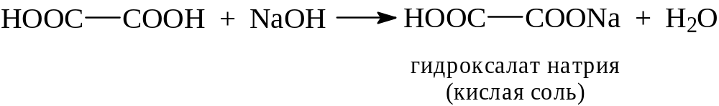
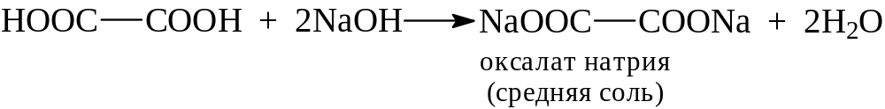
Dicarboxylic acids
Chemical properties
Acid properties
Sodium hydroxalate
Sodium oxalate

Slide 26
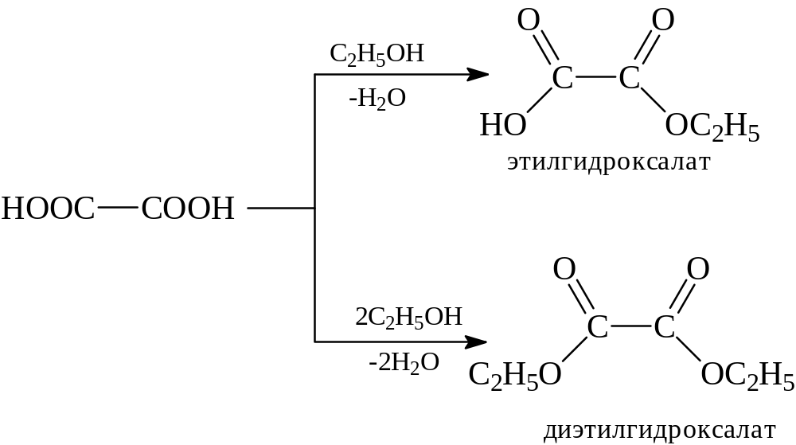
Dicarboxylic acids
Chemical properties
Nucleophilic substitution reactions
Ethyl hydroxolate
Diethyl oxolate

Slide 27
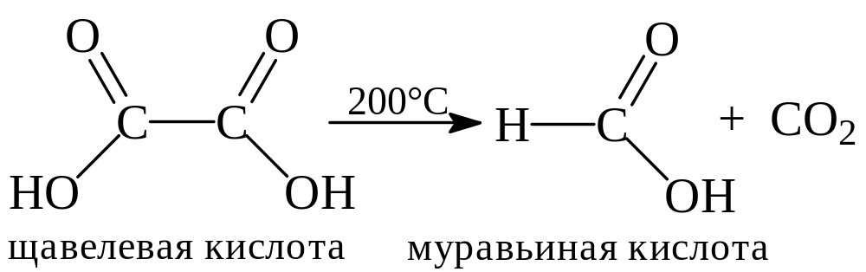
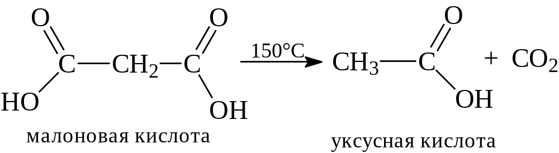
Dicarboxylic acids
Chemical properties
Specific reactions of dicarboxylic acids
Oxalic acid
Formic acid
Malic acid
Acetic acid

Slide 28

Dicarboxylic acids
Chemical properties
Specific reactions of dicarboxylic acids
Succinic acid
Succinic unhydrate

Slide 29
















Synthesis based on malonic ester

Slide 30




Synthesis based on malonic ester

