Slide 1

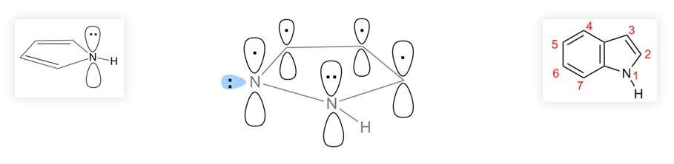

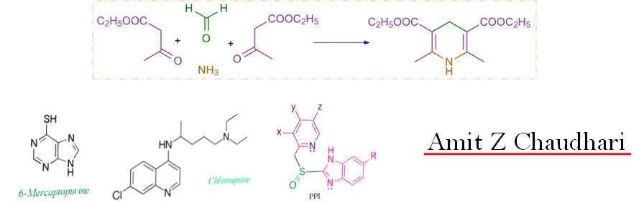
ONMedU
Department of pharmaceutical chemistry
Amit Z Chaudhari

Slide 2
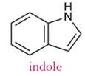
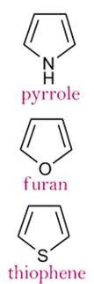
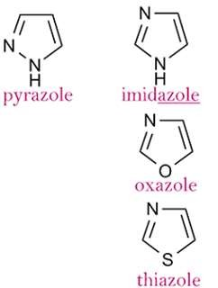
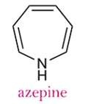
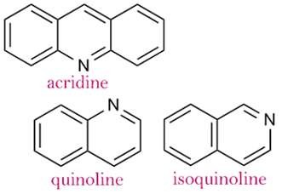
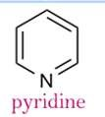
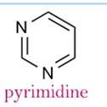
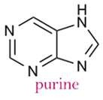
CO N TEN T
Properties, synthesis, reactions & medicinal uses of…

Slide 3


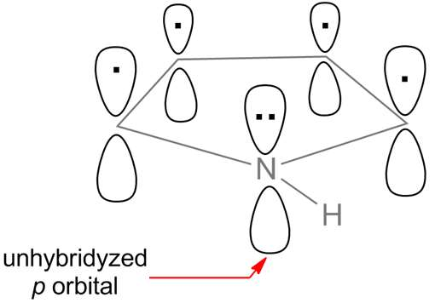
PYRRO LE
Properties
1. Aromaticity

Slide 4
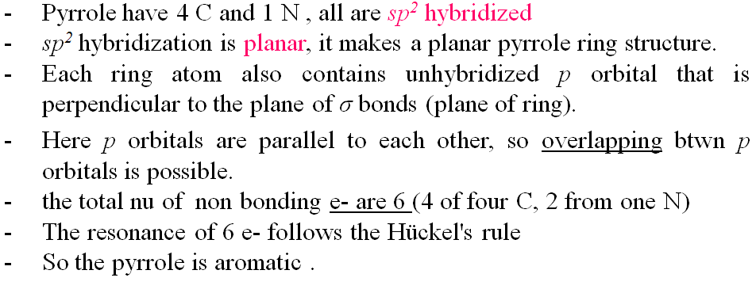
PYRRO LE
Properties
1. Aromaticity

Slide 5

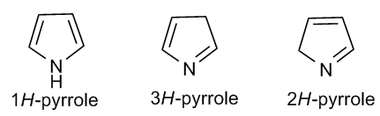

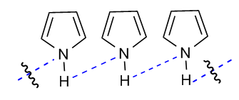
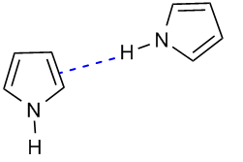


PYRRO LE
Properties

Slide 6
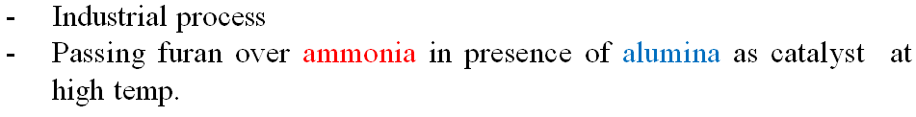
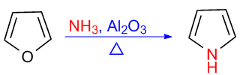
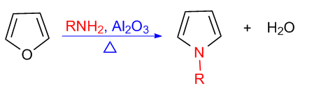
PYRRO LE
Synthesis
1. From Furans

Slide 7
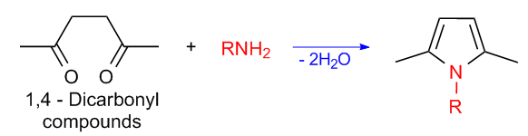
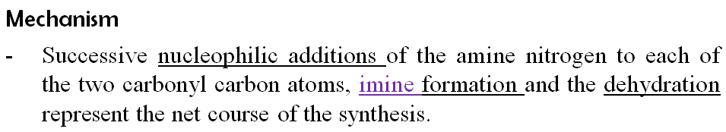
PYRRO LE
Synthesis
2. Paal-Knorr synthesis

Slide 8
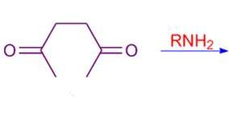
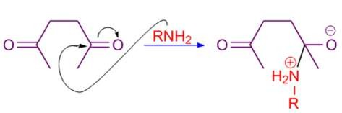
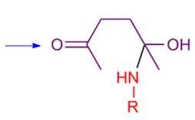
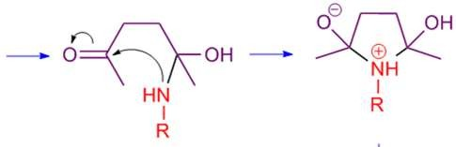
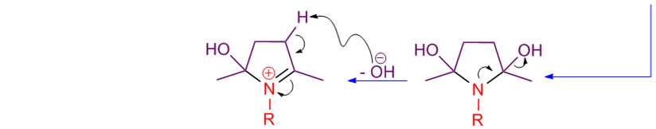

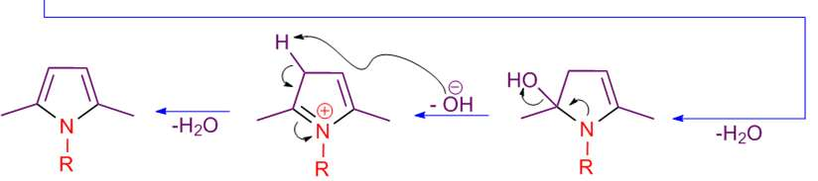
PYRRO LE
Synthesis
2. Paal-Knorr synthesis

Slide 9
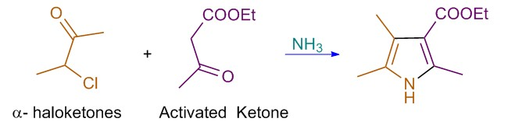

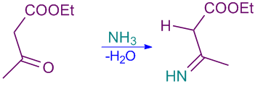
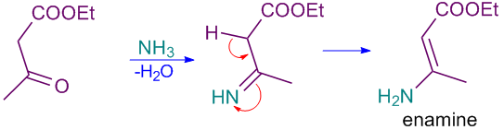
PYRRO LE
Synthesis
3. Hantzsch Pyrrole synthesis

Slide 10
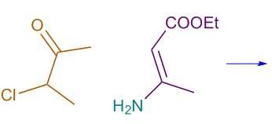
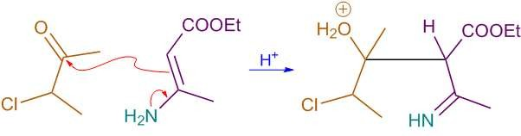
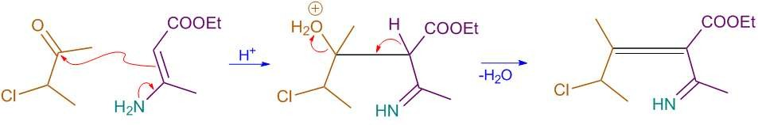
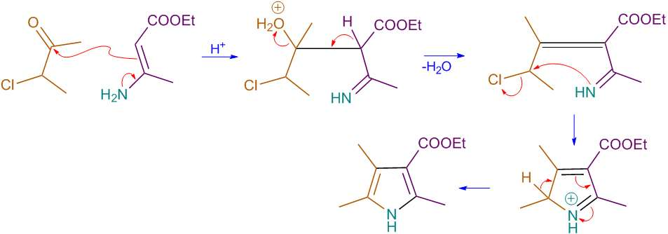
PYRRO LE
Synthesis
3. Hantzsch Pyrrole synthesis

Slide 11
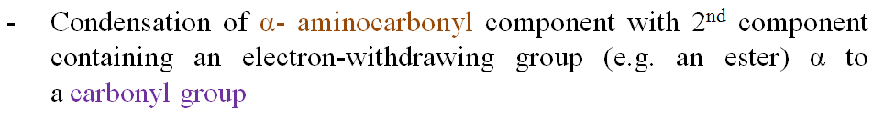
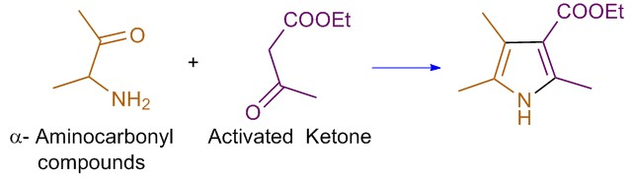
PYRRO LE
Synthesis
4. Knorr synthesis

Slide 12
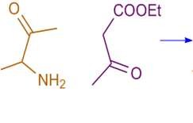
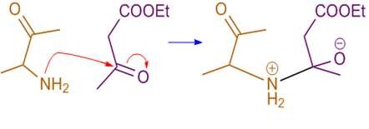
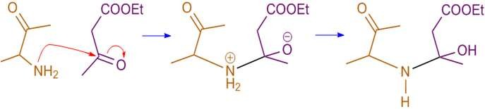
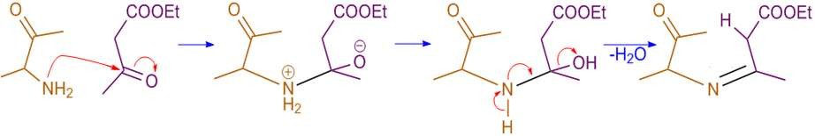
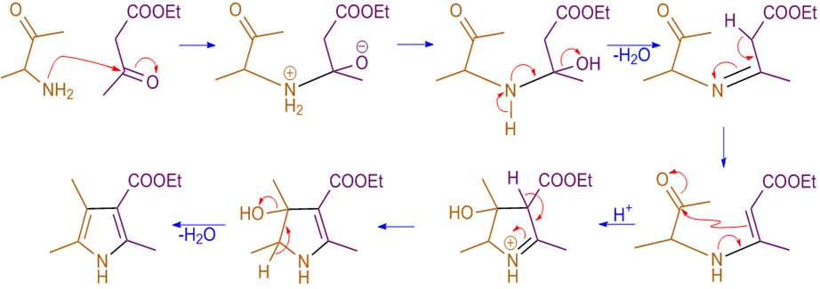
PYRRO LE
Synthesis
4. Knorr synthesis
Mechanism

Slide 13
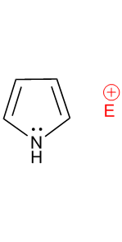
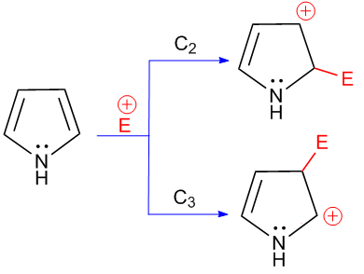
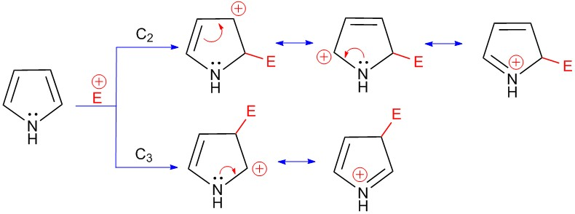
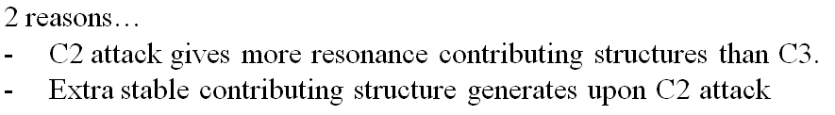
PYRRO LE
Reactions
1. Electrophilic substitution

Slide 14
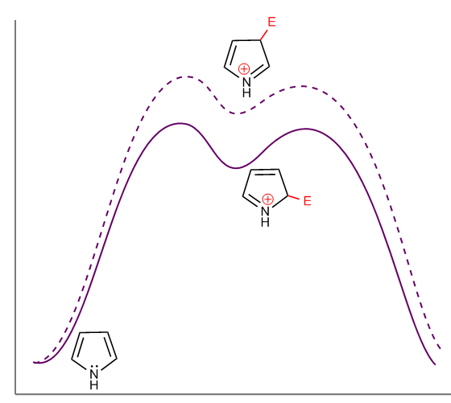
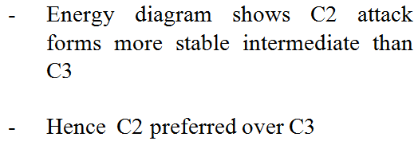
PYRRO LE
Reactions
1. Electrophilic substitution
Pyrrole undergoes electrophilic at 2nd position
substitution
reaction

Slide 15
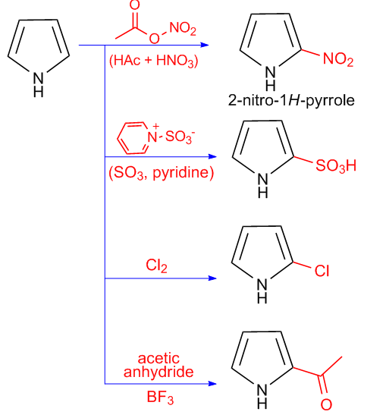
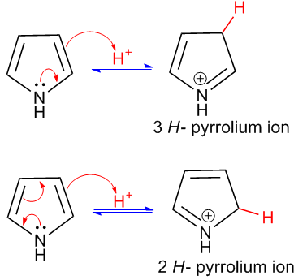
PYRRO LE
Reactions
1. Electrophilic substitution

Slide 16
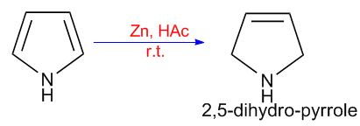
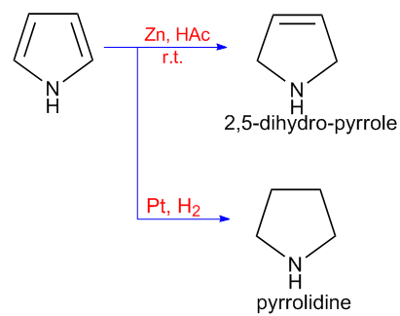
PYRRO LE
Reactions
2. Reduction

Slide 17



PYRRO LE
Reactions
3. Reimer Tiemann reaction

Slide 18


PYRRO LE
Reactions

Slide 19


PYRRO LE
Medicinal uses

Slide 20


FU RA N
Properties
1. Aromaticity

Slide 21

FU RA N
Properties
1. Aromaticity

Slide 22

FU RA N
Synthesis
1. Paal-Knorr synthesis of furan

Slide 23




FU RA N
Synthesis
1. Paal-Knorr synthesis of furan

Slide 24

FU RA N
Synthesis
2. Feist – Benary Synthesis

Slide 25





FU RA N
Synthesis
2. Feist – Benary Synthesis
Mechanism

Slide 26


FU RA N
Synthesis
3. From carbohydrate

Slide 27





FU RA N
Reactions
1. Electrophilic substitution
furan undergoes electrophilic substitution reaction at
₂nd
position

Slide 28


FU RA N
Reactions
1. Electrophilic substitution

Slide 29

FU RA N
Reactions
1. Electrophilic substitution

Slide 30

FU RA N
Reactions
2. Reduction

Slide 31

FU RA N
Reactions
3. Diels-Alder reaction

Slide 32


FU RA N
Reactions
3. Diels-Alder reaction

Slide 33


FU RA N
Reactions
4. Pyrrole synthesis

Slide 34



FU RA N
Medicinal uses

Slide 35


TH I O PH EN E
Properties
1. Aromaticity

Slide 36

TH I O PH EN E
Properties
1. Aromaticity

Slide 37


TH I O PH EN E
Properties
1. Aromaticity

Slide 38

TH I O PH EN E
Synthesis
1. Paal-Knorr synthesis of thiophene

Slide 39




TH I O PH EN E
Synthesis
1. Paal-Knorr synthesis of furan
Mechanism

Slide 40

TH I O PH EN E
Synthesis
2. From sod. succinate

Slide 41



TH I O PH EN E
Synthesis
3. Hinsberg Synthesis

Slide 42





TH I O PH EN E
Reactions
1. Electrophilic substitution
thiophene undergoes electrophilic substitution reaction at 2nd position

Slide 43


TH I O PH EN E
Reactions
1. Electrophilic substitution

Slide 44

TH I O PH EN E
Reactions
1. Electrophilic substitution

Slide 45

TH I O PH EN E
Reactions
2. Reduction

Slide 46

TH I O PH EN E
Reactions
3. reaction

Slide 47


TH I O PH EN E
Medicinal uses

Slide 48

TH I O PH EN E
Medicinal uses

Slide 49



PYRA ZO LE
Properties
1. Aromaticity

Slide 50

PYRA ZO LE
Properties
1. Aromaticity

Slide 51





PYRA ZO LE
Properties

Slide 52


PYRA ZO LE
Synthesis
1. From pyrimidine

Slide 53




PYRA ZO LE
Synthesis
1. From pyrimidine

Slide 54

PYRA ZO LE
Synthesis
2. Knorr pyrazole synthesis
- .

Slide 55






PYRA ZO LE
Synthesis
2. Knorr pyrazole synthesis
mechanism

Slide 56



PYRA ZO LE
Synthesis
2. Knorr pyrazole synthesis
Examples

Slide 57

PYRA ZO LE
Synthesis
3. From Nitrile Imines

Slide 58


PYRA ZO LE
Synthesis

Slide 59

PYRA ZO LE
Reactions

Slide 60





PYRA ZO LE
Reactions

Slide 61

PYRA ZO LE
Reactions

Slide 62







PYRA ZO LE
Reactions

Slide 63


PYRA ZO LE
Reactions

Slide 64




PYRA ZO LE
Reactions
N-bromosuccimide

Slide 65


PYRA ZO LE
Reactions

Slide 66







PYRA ZO LE
Reactions

Slide 67



PYRA ZO LE
Medicinal Use
tartazine

Slide 68


I MI D A ZO LE
Properties
1. Aromaticity

Slide 69


I MI D A ZO LE
Properties
1. Aromaticity

Slide 70





I MI D A ZO LE
Properties

Slide 71



I MI D A ZO LE
Synthesis

Slide 72


I MI D A ZO LE
Synthesis
2. From an α- Halo - Carbonyl Component
What is α- Halo - Carbonyl Compound ????

Slide 73


I MI D A ZO LE
Synthesis
3. From Dehydrogenation of Imidazoline

Slide 74



I MI D A ZO LE
Reactions
1. Electrophilic addition to N
???

Slide 75






I MI D A ZO LE
Reactions
1. Electrophilic addition to N

Slide 76

I MI D A ZO LE
Reactions
1. Electrophilic addition to N

Slide 77



I MI D A ZO LE
Reactions
2. Electrophilic substitution to C
???
???

Slide 78


I MI D A ZO LE
Reactions
2. Electrophilic substitution to C

Slide 79



I MI D A ZO LE
Reactions
3. Imidazole catalyzed ester HL
Slow reaction due to weak Nu: (H2O)

Slide 80




I MI D A ZO LE
Reactions
3. Imidazole catalyzed ester HL

Slide 81





I MI D A ZO LE
Medicinal uses

Slide 82


I MI D A ZO LE
Medicinal uses

Slide 83



O XA ZO LE
Properties
1. Aromaticity

Slide 84

O XA ZO LE
Properties
1. Aromaticity

Slide 85

O XA ZO LE
Synthesis
1. Robinson-Gabriel synthesis

Slide 86




O XA ZO LE
Synthesis
1. Robinson-Gabriel synthesis
Mechanism

Slide 87

O XA ZO LE
Synthesis
2. From an α- Hydroxy - Carbonyl Component
α- Hydroxy - Carbonyl Component ????

Slide 88



O XA ZO LE
Synthesis
2. From an α- Hydroxy - Carbonyl Component
E.g.

Slide 89

O XA ZO LE
Synthesis
3. From Isocyanides
E.g.

Slide 90

O XA ZO LE
Reactions
1. Electrophilic addition to N

Slide 91

O XA ZO LE
Reactions
2. Electrophilic substitution to C

Slide 92


O XA ZO LE
Reactions
3. Diels-Alder Reaction

Slide 93


O XA ZO LE
Reactions
3. Diels-Alder Reaction
(2) Kondrat'eva pyridine synthesis

Slide 94


O XA ZO LE
Reactions
3. Diels-Alder Reaction
(2) Kondrat'eva pyridine synthesis

Slide 95




O XA ZO LE
Medicinal uses

Slide 96


TH I A ZO LE
Properties
1. Aromaticity

Slide 97

TH I A ZO LE
Properties
1. Aromaticity

Slide 98

TH I A ZO LE
Synthesis
1. Gabriel synthesis

Slide 99



TH I A ZO LE
Synthesis
1. Gabriel synthesis
Mechanism

Slide 100

TH I A ZO LE
Synthesis
2. From an α- Hydroxy - Carbonyl Component ( Hantzsch Thiazole Synthesis)

Slide 101





TH I A ZO LE
Synthesis
2. From an α- Hydroxy - Carbonyl Component ( Hantzsch Thiazole Synthesis)
Mechanism

Slide 102

TH I A ZO LE
Synthesis
3. From an thiocyanate salts

Slide 103



TH I A ZO LE
Reactions
1. Electrophilic addition to N
a. Protonation (basic property)

Slide 104




TH I A ZO LE
Reactions
2. Electrophilic substitution to C

Slide 105




TH I A ZO LE
Reactions
2. Electrophilic substitution to C

Slide 106

TH I A ZO LE
Reactions

Slide 107




TH I A ZO LE
Medicinal uses

Slide 108

TH I A ZO LE
Medicinal uses

