Slide 1

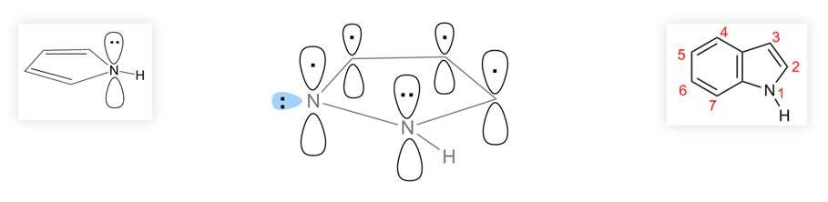

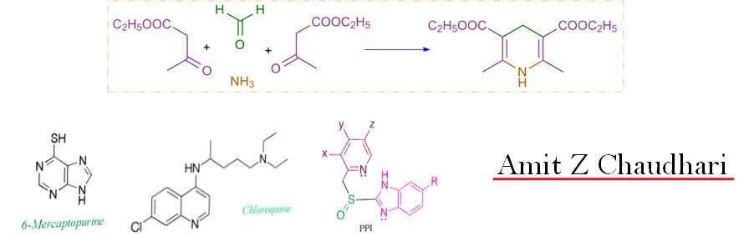
ONMedU
Department of pharmaceutical chemistry
Amit Z Chaudhari

Slide 2

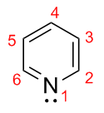
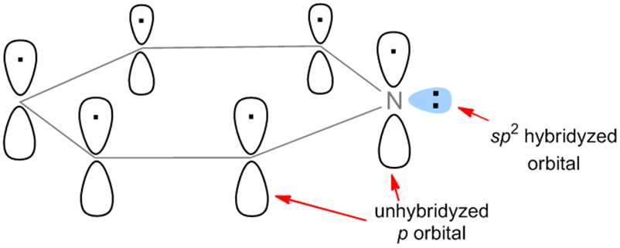
P Y R I D I N E
Properties
1. Aromaticity

Slide 3
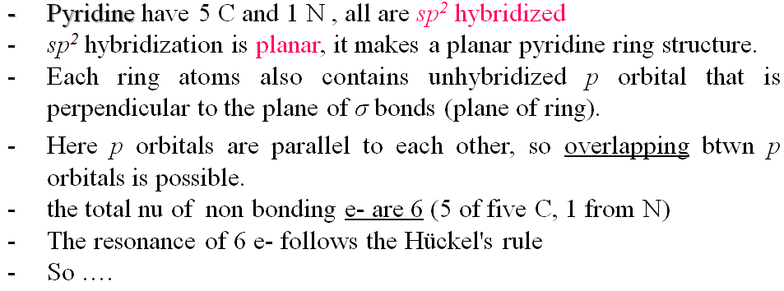
P Y R I D I N E
Properties
1. Aromaticity

Slide 4
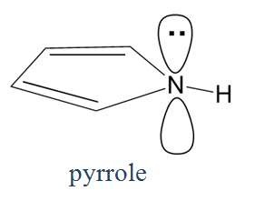
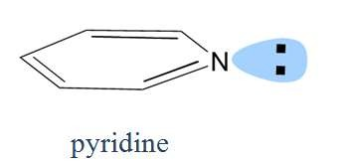


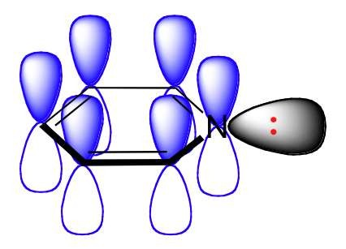
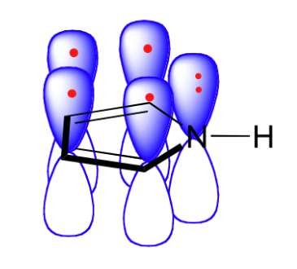
P Y R I D I N E
Properties
2. Basicity

Slide 5
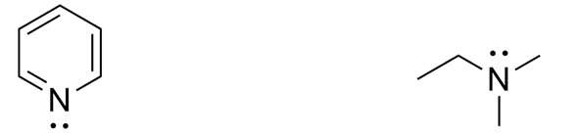
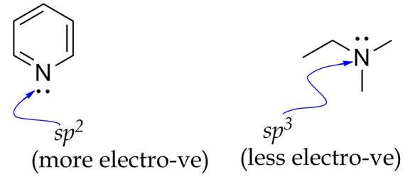


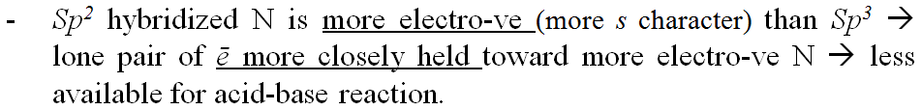
P Y R I D I N E
Properties
2. Basicity

Slide 6
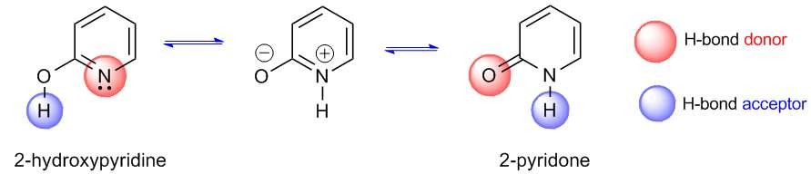


P Y R I D I N E
Properties
3. Tautomerism

Slide 7
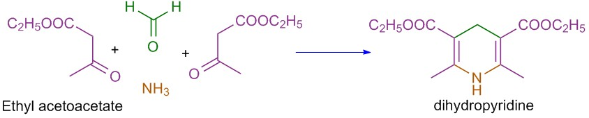
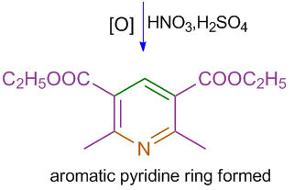
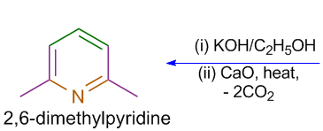
P Y R I D I N E
Synthesis
1. Hantzsch pyridine synthesis

Slide 8

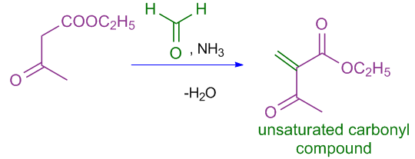
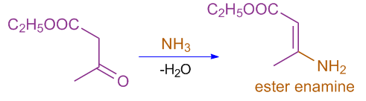
P Y R I D I N E
Synthesis
1. Hantzsch pyridine synthesis

Slide 9

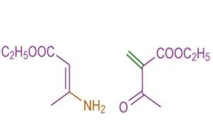
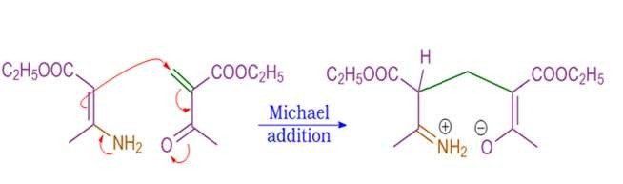
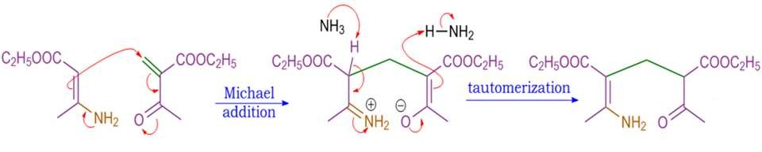
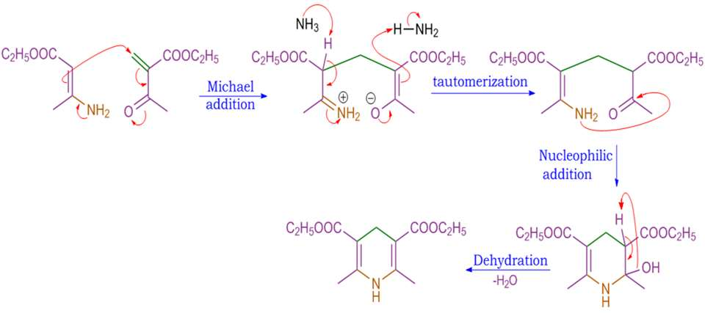
P Y R I D I N E
Synthesis
1. Hantzsch pyridine synthesis

Slide 10
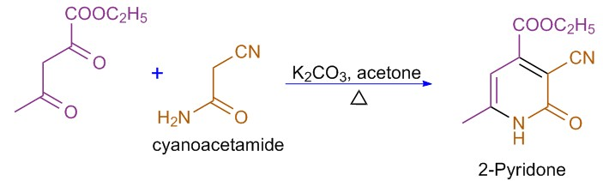
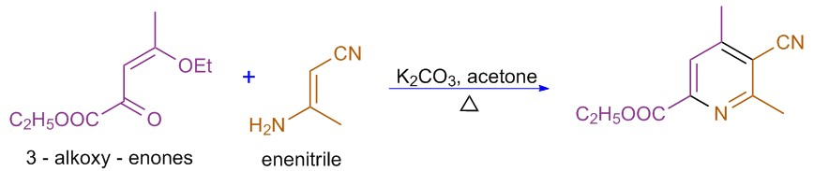
P Y R I D I N E
Synthesis
2. The Guareschi Synthesis

Slide 11
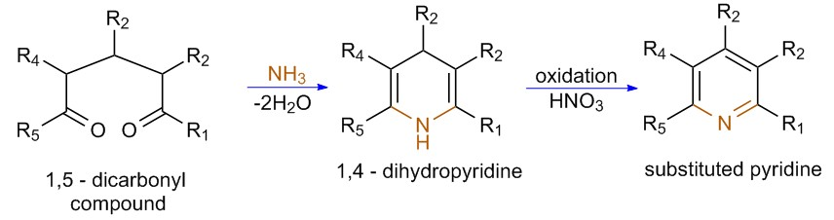
P Y R I D I N E
Synthesis
3. From 1,5 - Dicarbonyl Compounds

Slide 12

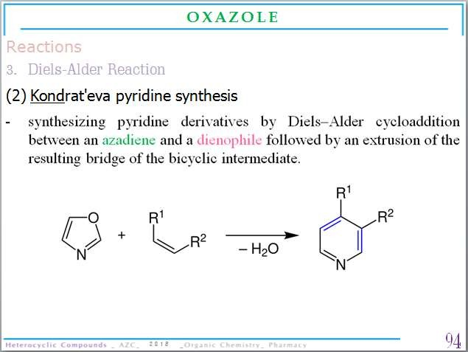
P Y R I D I N E
Synthesis
4. From Oxazoles Kondrat'eva pyridine synthesis

Slide 13
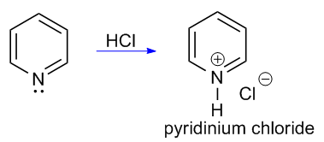

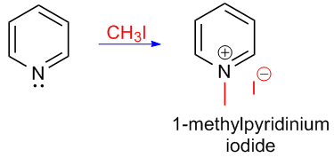
P Y R I D I N E
Reactions
1. Electrophilic addition to N

Slide 14
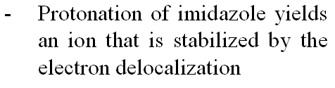
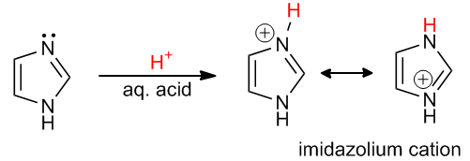
P Y R I D I N E
Reactions

Slide 15
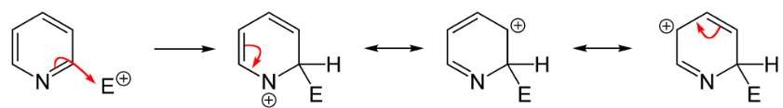
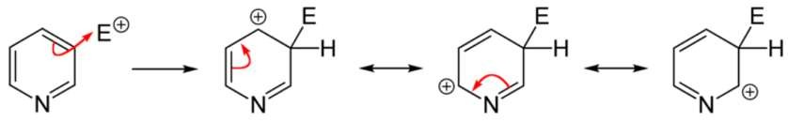
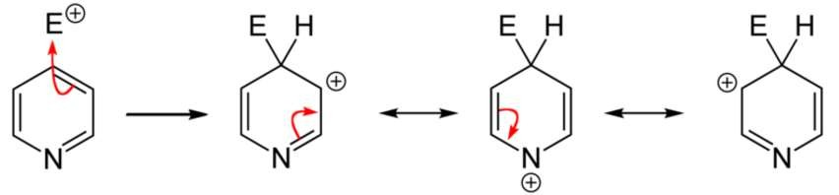
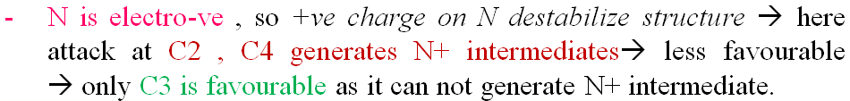
P Y R I D I N E
Reactions
2. Electrophilic substitution to C
C2
C3
C4

Slide 16

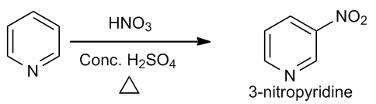

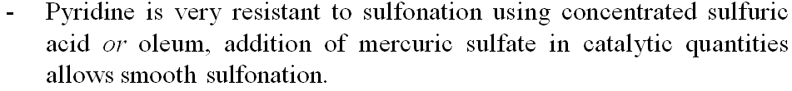
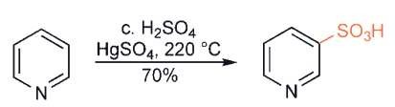
P Y R I D I N E
Reactions
2. Electrophilic substitution to C

Slide 17

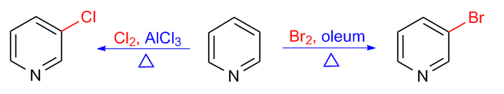
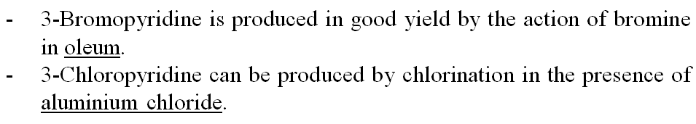
P Y R I D I N E
Reactions
2. Electrophilic substitution to C

Slide 18
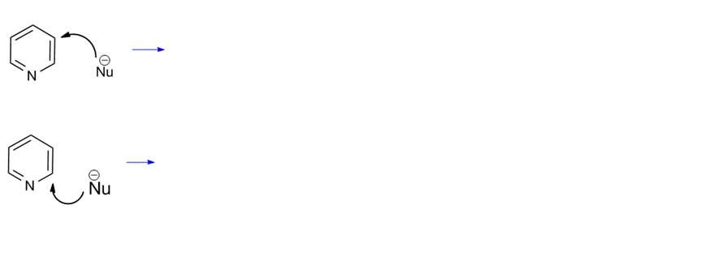
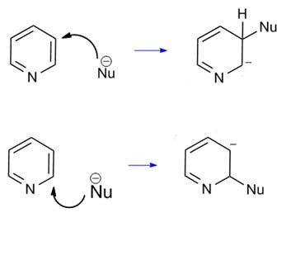
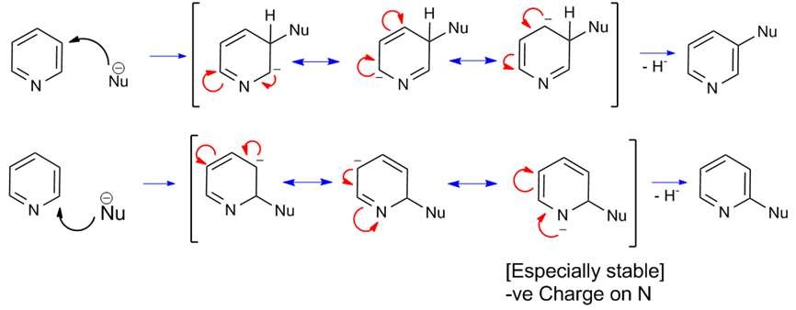
P Y R I D I N E
Reactions
3. Nucleophilic substitution
Why pyridine undergoes reaction at 2-position.
nucleophilic
substitution
C3
C2

Slide 19

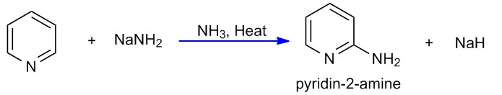

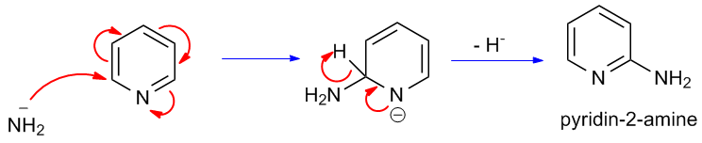
P Y R I D I N E
Reactions
3. Nucleophilic substitution

Slide 20
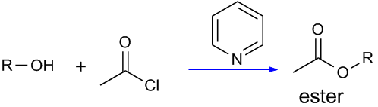

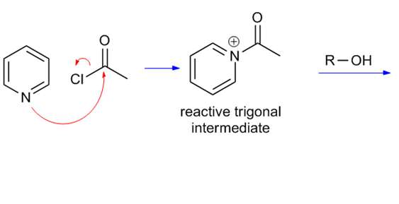
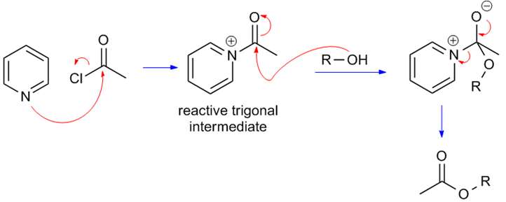
P Y R I D I N E
Reactions
4. Pyridine as Nucleophilic catalyst

Slide 21
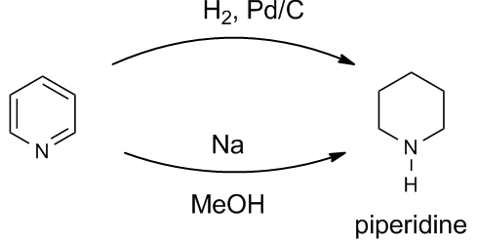
P Y R I D I N E
Reactions
5. Reduction

Slide 22
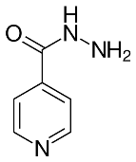

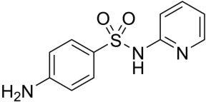


P Y R I D I N E
Medicinal uses

Slide 23


P Y R I D I N E
Medicinal uses

Slide 24


P Y R I D I N E
Medicinal uses

Slide 25


A Z E P I N E S
Properties
1. Aromaticity

Slide 26

A Z E P I N E S
Properties
2. Tautomerism

Slide 27



A Z E P I N E S
Synthesis
1. Valence-bond Isomerization

Slide 28




A Z E P I N E S
Synthesis
2. From Phenylazide

Slide 29






A Z E P I N E S
Synthesis
3. From Nitrobenzene

Slide 30




A Z E P I N E S
Reactions

Slide 31

A Z E P I N E S
Reactions
3. Diels-Alder reaction
- 6+2 π electron reaction

Slide 32



A Z E P I N E S
Medicinal Uses

Slide 33





Q U I N O L I N E
Properties
1. Aromatic

Slide 34

Q U I N O L I N E
Synthesis
1. Skraup Quinoline synthesis

Slide 35

Q U I N O L I N E
Synthesis
1. Skraup Quinoline synthesis
Mechanism

Slide 36







Q U I N O L I N E
Synthesis
1. Skraup Quinoline synthesis

Slide 37

Q U I N O L I N E
Synthesis
2. Doebner-Miller Synthesis

Slide 38



Q U I N O L I N E
Synthesis
3. Friedlander Synthesis

Slide 39


Q U I N O L I N E
Reactions
1. Electrophilic addition to N

Slide 40

Q U I N O L I N E
Reactions
2. Electrophilic aromatic substitution

Slide 41


Q U I N O L I N E
Reactions
3. Reduction reactions

Slide 42

Q U I N O L I N E
Reactions
4. Oxidation

Slide 43


Q U I N O L I N E
Reactions
5. Nucleophilic substitution

Slide 44


Q U I N O L I N E
Medicinal uses

Slide 45



Q U I N O L I N E
Medicinal uses

Slide 46




I S O Q U I N O L I N E
Properties
1. Aromatic

Slide 47



I S O Q U I N O L I N E
Synthesis
1. Bischler-Napieralski Isoquinoline synthesis

Slide 48

I S O Q U I N O L I N E
Synthesis
2. The Pictet – Gams synthesis

Slide 49

I S O Q U I N O L I N E
Synthesis
3. Pomeranz–Fritsch synthesis

Slide 50

I S O Q U I N O L I N E
Reactions
1. Electrophilic addition to N

Slide 51

I S O Q U I N O L I N E
Reactions
2. Electrophilic aromatic substitution

Slide 52


I S O Q U I N O L I N E
Reactions
3. Reduction reactions

Slide 53


I S O Q U I N O L I N E
Reactions
4. Oxidation

Slide 54


I S O Q U I N O L I N E
Reactions
5. Nucleophilic substitution

Slide 55


I S O Q U I N O L I N E
Medicinal uses

Slide 56

I S O Q U I N O L I N E
Medicinal uses

Slide 57




A C R I D I N E
Properties
1. Aromatic

Slide 58




A C R I D I N E
Synthesis
1. From diphenyl amine-2-carboxylic acid

Slide 59

A C R I D I N E
Synthesis
2. Bernthsen acridine synthesis

Slide 60

A C R I D I N E
Reactions
1. Electrophilic addition to N

Slide 61

A C R I D I N E
Reactions
2. Electrophilic aromatic substitution

Slide 62

A C R I D I N E
Reactions
3. Reduction reactions

Slide 63

A C R I D I N E
Reactions
4. Oxidation

Slide 64


A C R I D I N E
Reactions
5. Nucleophilic substitution

Slide 65




A C R I D I N E
Medicinal uses

Slide 66




I N D O L E
Properties
1. Aromatic

Slide 67



I N D O L E
Synthesis
1. Fischer indole synthesis

Slide 68








I N D O L E
Synthesis
1. Fischer indole synthesis
Mechanism

Slide 69

I N D O L E
Synthesis
1. Fischer indole synthesis
Mechanism

Slide 70



I N D O L E
Synthesis
1. Fischer indole synthesis

Slide 71

I N D O L E
Synthesis
2. Bischler–Möhlau indole synthesis

Slide 72

I N D O L E
Synthesis
3. Madelung synthesis

Slide 73




I N D O L E
Synthesis
3. Madelung synthesis
E.g.

Slide 74




I N D O L E
Reactions
1. Electrophilic addition to N

Slide 75




I N D O L E
Reactions
2. Electrophilic aromatic substitution

Slide 76





I N D O L E
Reactions
2. Electrophilic aromatic substitution

Slide 77





I N D O L E
Reactions
2. Electrophilic aromatic substitution

Slide 78




I N D O L E
Reactions
2. Electrophilic aromatic substitution

Slide 79


I N D O L E
Reactions
2. Electrophilic aromatic substitution

Slide 80

I N D O L E
Reactions
3. Reduction reactions

Slide 81



I N D O L E
Reactions
4. Nucleophilic substitution

Slide 82




I N D O L E
Medicinal uses
(1) Indole alkaloids :

Slide 83




I N D O L E
Medicinal uses

Slide 84

I N D O L E
Medicinal uses

Slide 85



P Y R I M I D I N E
Properties
1. Aromatic

Slide 86



P Y R I M I D I N E
Synthesis
1. From 1,3 - Dicarbonyl Compound

Slide 87



P Y R I M I D I N E
Synthesis
1. From 1,3 - Dicarbonyl Compound

Slide 88

P Y R I M I D I N E
Synthesis
2. From α , β - Unsaturated Ketones

Slide 89




P Y R I M I D I N E
Synthesis

Slide 90

P Y R I M I D I N E
Reactions
1. Electrophilic addition to N

Slide 91


P Y R I M I D I N E
Reactions
2. Electrophilic aromatic substitution

Slide 92


P Y R I M I D I N E
Reactions
3. Nucleophilic substitution

Slide 93

P Y R I M I D I N E
Reactions
3. Nucleophilic substitution

Slide 94






P Y R I M I D I N E
Medicinal uses

Slide 95






P Y R I M I D I N E
Medicinal uses

Slide 96




P Y R I M I D I N E
Medicinal uses

Slide 97



P U R I N E
Properties
1. Aromatic

Slide 98

P U R I N E
Properties
3. Tautomerism

Slide 99

P U R I N E
Synthesis
1. Traube Synthesis

Slide 100



P U R I N E
Synthesis
1. Traube Synthesis

Slide 101

P U R I N E
Synthesis
2. From formamide

Slide 102


P U R I N E
Synthesis
3. From substituted imidazole

Slide 103

P U R I N E
Reactions
1. Electrophilic addition to N

Slide 104



P U R I N E
Reactions
2. Electrophilic aromatic substitution

Slide 105


P U R I N E
Reactions
3. Nucleophilic substitution

Slide 106



P U R I N E
Medicinal uses

Slide 107



P U R I N E
Medicinal uses

