Slide 1

Biopharmaceutics as the theoretical basis of drug technology .
Historical overview of the development of biopharmacy . Modern requirements for the assessment of the quality of medicinal products
Odessa National Medical University
Pharmaceutical Faculty
Department of Pharmaceutical Chemistry and Drug Technology
Associate Professor Zamkova A.V.
Odesa 2025

Slide 2
Lecture plan
2
Biopharmaceutics as the theoretical basis of drug technology.
Historical stages of the development of biopharmacy as a science.
Basic concepts and terms of biopharmacy .
Modern requirements for assessing the quality of medicines.

Slide 3

1. Biopharmaceutics as the theoretical basis of drug technology.
3
Biopharmacy is a science that studies the dependence of the therapeutic effect of drugs on the body on various variable factors.
studies the influence of the physical and physicochemical properties of active and auxiliary substances in medicinal products, in different dosage forms in the same doses , on their therapeutic effect effect​
The goal of biopharmacy there is a theoretical and experimental justification
creation of new drugs and improvement of existing ones taking
into account​​ increasing their therapeutic effect​​​ and reduction side effects on the body and mind
Biopharmaceutics is the study of the physical and chemical properties of a drug, and its dosage
form , as related to the onset, duration and intensity of drug action, including coconstituents
and mode of manufacture .
Farlex Partner Medical Dictionary © Farlex 2012

Slide 4
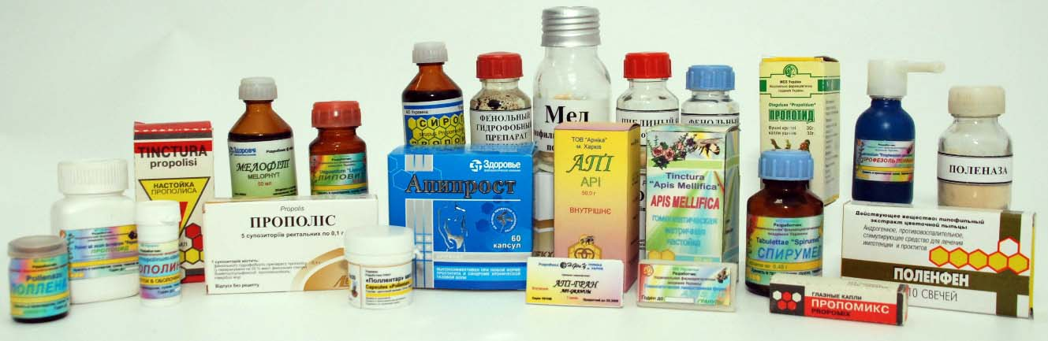
1. Biopharmaceutics as the theoretical basis of drug technology.
4
Biopharmaceutics currently constitutes the theoretical and practical basis for the development of new drugs, allowing for the prediction of the type and strength of the expected pharmacological activity and possible side effects, taking into account the type of selected dosage form, excipients, manufacturing method, etc.
special course “ Biopharmacy ” was implemented at the Department of ATL since 1986.

Slide 5
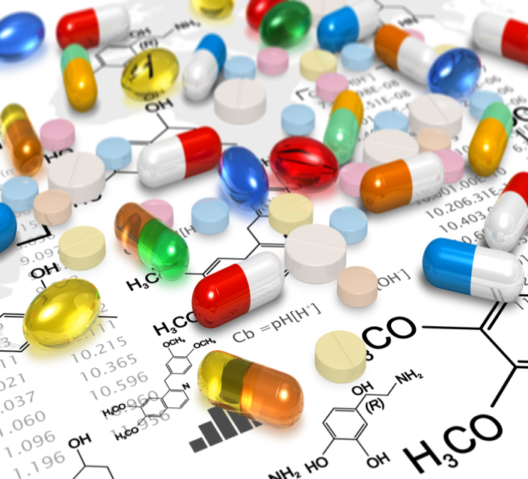
1. Biopharmaceutics as the theoretical basis of drug technology.
5
Biopharmacy is based on knowledge of mathematics, physics, inorganic and organic chemistry, pharmaceutical chemistry, physiology, anatomy, biochemistry, pharmacology, and drug technology, so its terminology often uses pharmacological, chemical, and technological terms.
Unlike pharmacology, biopharmacy does not study the mechanisms of action and the site of administration of a medicinal or excipient substance.
It investigates the unique influence of variable factors on the pharmacodynamics and pharmacokinetics of drugs.

Slide 6
1. Biopharmaceutics as the theoretical basis of drug technology.
6
The main directions of development of modern biopharmacy :
- development of experimental and theoretical foundations of biopharmaceutical screening;
- study of the influence of pharmaceutical and other variable factors on the processes of release and absorption of medicinal substances from dosage forms;
- study of the pharmacokinetics of drugs to optimize the composition of excipients and methods of drug administration;
- study of the mechanisms of biopharmaceutical processes that occur during the interaction of the components of the finished dosage form with proteins and lipids of the membranes of various cells;
- development of highly sensitive and selective methods for the analysis of pharmacologically active substances in human and animal biological fluids;
- search for new bioavailability modulators;
- creation of new dosage forms with specified biopharmaceutical properties that should ensure optimal bioavailability of active substances;
- studying the bioequivalence of drugs.

Slide 7
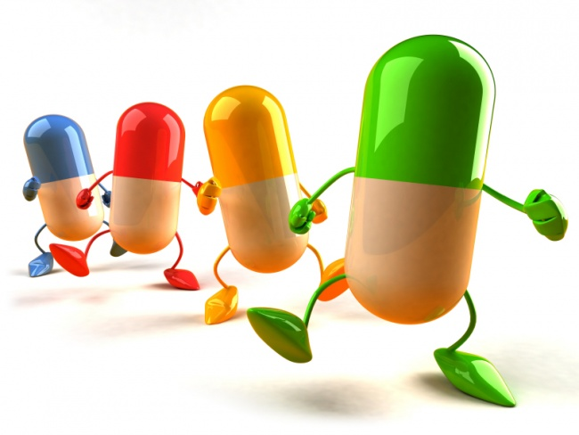
2. Historical stages of the development of biopharmacy as a science.
7
The prerequisite for the formation of biopharmacy as a science is the establishment of the facts of therapeutic non-equivalence of drugs (drugs from different manufacturers with the same active ingredient in similar quantities exhibit different therapeutic activity).
This was due to a number of reasons: the organization of the technological process, the use of a variety of excipients, the degree of grinding of substances, etc. Thus, the term "pharmaceutical factors" appeared.

Slide 8
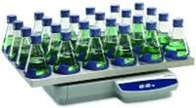
2. Historical stages of the development of biopharmacy as a science.
8
Founders American scientists Levy and Wagner are considered biopharmaceuticals , thanks to whose work the term " biopharmacy " was adopted, which is used in most European countries as the equivalent of the English term " biopharmaceutics ".
The term " biopharmacy " itself first appeared in scientific pharmacy in the United States in the 1960s and soon gained general international recognition.

Slide 9

2. Historical stages of the development of biopharmacy as a science.
9
The first case (which received wide publicity) of precisely established therapeutic inadequacy, the non-equivalence of drugs containing the same doses of the same substance, was recorded in the USA.
When prescribing pills of a drug that acts specifically on blood clotting processes in one of the US clinics, purchased from two different pharmaceutical companies containing the same doses, it was unexpectedly discovered that the pills from one company were 2 times more active than the pills from another company.
Chemical analysis did not reveal any abnormalities in
the content of the medicinal substance in the pills of both companies.
Later, a similar phenomenon was discovered in many
antibiotics (tetracycline, chloramphenicol, erythromycin)
zinc), steroid hormones ,

Slide 10

2. Historical stages of the development of biopharmacy as a science.
10
Founders biopharmaceuticals in Ukraine and the CIS countries there are Senov P.L., Tentsova A.I. , Azhg i k i n I.S. , Salo D.P. , Khadzhai Ya.I.
Ukrainian scientists continued and developed research in this direction : A. I. Tikhonov , I. M. Pertsev, G. S. Bashura , N. A. Kazarinov , N. A. Lyapunov , G. V. Obolentseva, M. V. Shteyngardt , D. I. Dmitrievskiy , V. A. Spiridonov , E. E. Borzunov etc., and Russian scientists I.A. Muravyo , P.L. Senov, M.T. Alyushin , A.E. Dobrotvorsky , L.M. Kozlova etc.​​

Slide 11
3. Basic concepts and terms of biopharmacy .
11
Factors | Simultaneously acting forces, states, or other conditions that affect the final outcome of the processes, data, or parameters being studied.
Effective substance | The biologically active part of a drug that is responsible for the therapeutic effect.
Efficiency | The ability of a medicinal substance or drug to achieve the desired effect.
Clinical factors | Factors that arise during pharmacotherapy in clinical settings (choice of dosage regimen, time of drug administration, side effects, interaction of simultaneous or sequentially administered drugs, patient's bedriddenness , physical activity, severity of the disease, dysfunction of the gastrointestinal tract, liver, kidneys, cardiac activity, etc. ).

Slide 12
3. Basic concepts and terms of biopharmacy .
12
" Equivalence " | Compliance of the quantity of medicinal substance (agent) or medicinal product with the analytical regulatory documentation or identity of the effect of the investigated agent with the reference drug.
Pharmaceutical equivalent | This is a medicinal product containing the same amount of a therapeutically similar substance in a specific dosage form that meets the requirements determined by technological standards.
Clinical equivalent | An equivalent of a medicinal product that, after using the same doses, produces the same therapeutic effect, tested on a certain symptom or in the treatment of a disease.

Slide 13
3. Basic concepts and terms of biopharmacy .
13
Bioequivalence | Equivalent drugs are drugs prepared by different manufacturers or the same factory, but of different batches, which, when administered in the same dosage form to the same patients in the same doses, exhibit the same biological (therapeutic) effect.
Therapeutic non-equivalence | Inequality of therapeutic effects of the same drugs in the same doses, prepared by different manufacturers or the same factory, but of different batches.
Biological accessibility | A condition that allows a medicinal substance introduced into the body to reach the site of action.
Relative bioavailability | Expressed as a percentage, the amount of drug substance released from a dosage form that, after administration, reaches the receptor in an amount sufficient to cause a biological effect.

Slide 14
3. Basic concepts and terms of biopharmacy .
14
Absolute biological accessibility | The amount of a drug substance administered in a dosage form intravenously or intravascularly that enters the bloodstream without the effect of the first passage through the liver (the " first pass" effect) or after correlation with this effect, and the rate of this process.
Physiological accessibility | Synonymous with "bioavailability" or "bioavailability."
System availability | The fraction of the total absorbed dose of a drug substance that enters the circulatory system after oral administration. Synonymous with "bioavailability" and "bioavailability."
Absorption ( suction ) | The process of transferring a medicinal substance from the site of administration to the bloodstream.

Slide 15
3. Basic concepts and terms of biopharmacy .
15
Resorption | Synonym of "absorption".
Rate constant release | A general constant that determines the rate of penetration of a medicinal substance from the site of administration into the body through a biological membrane.
Biotransformation | A complex process in which lipid-soluble molecules of a drug substance are converted into metabolites by catalytic enzymes during biochemical reactions (oxidation, reduction, hydrolysis, synthesis).
Purity | The hypothetical volume of a body area that has been saved from a given substance per unit of time.
Cleanliness of everything bodies | The purity of the hypothetical volume of plasma in moles (volume of distribution) by which the body gets rid of the drug substance, excreting it through the kidneys, bile, lungs, skin, etc. and metabolizing.
Distribution | The process by which a drug substance is distributed or dispersed from the blood into one or more parts, tissues, and organs of the body.
Rate constant distributions | The rate constant of the transfer of a drug substance from the circulatory system to some or all parts of the body.

Slide 16
3. Basic concepts and terms of biopharmacy .
16
Area under pharmacokinetic curve | A surface bounded in a coordinate system by a segment (x-axis and curve) that characterizes the concentration of a drug substance in the blood (serum, plasma, urine) as a function of time. It is limited in time or extrapolated to infinity.
Excretion​​​ | The process by which a drug (drug) is eliminated from the circulatory system through the kidneys, into the urine, through bile and saliva into the intestines and feces, through the skin, mammary glands, and sweat glands.
Suction constant | A general constant that determines the rate of penetration of a drug substance from the site of administration into the body through a biological membrane.
Elimination | The rate constant of the process during which an active substance is eliminated from the body by excretion or biotransformation processes .

Slide 17
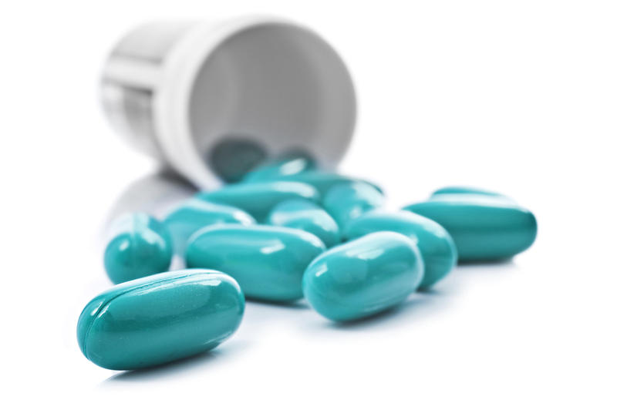
3. Basic concepts and terms of biopharmacy .
17
Pharmacokinetics | Description of changes in the concentrations of an administered drug and its metabolites in the body over time; covers such transport processes of the active substance and its metabolites in the body as absorption, distribution, biotransformation and elimination.
LADMER | General term that​ characterizes separate plots interactions medical of the agent with the body ( Liberation, Absorption, Distribution, Metabolism, Elimination, Response)

Slide 18

4. Modern requirements for assessing the quality of medicinal products.
18
on medicinal products. First of all, the drug must have high activity, selectivity and duration of medicinal action. It must also be harmless and not cause undesirable side effects. The drug must contain highly pure components and be sufficiently stable during storage. In addition, there are some economic requirements - the drug must be available, and the ratio of cost price to possible price - to ensure a sufficiently high profit from the sale of the drug on the pharmaceutical market. All these factors determine the shelf life of this drug among other drugs that have a similar effect and are used in international medical practice.

Slide 19

4. Modern requirements for assessing the quality of medicinal products.
19
Quality control of extemporaneous and industrial medicinal products is carried out in accordance with the State Federal University of Ukraine, current orders, instructions of the Ministry of Health of Ukraine, methodological recommendations, and information sheets.
For example, the SFU 2.0. contains articles for each dosage form, which provide general requirements and indicate which analysis methods should be used.

Slide 20
4. Modern requirements for assessing the quality of medicines.
20
The State Pharmacopoeia of Ukraine 2.0 contains a detailed description of the methods for conducting:
physical and physicochemical methods;
identification;
testing for maximum impurity content;
methods of quantitative determination;
biological tests;
biological methods of quantitative determination;
methods of pharmacognosy;
pharmaco-technological research.

Slide 21
Literature
21
Biopharmacy : textbook . for students . of higher . pharmaceutical . education . schools . and pharmaceutical . f- tiv higher . educational . conclusion . I V level of accreditation / O.I. Tikhonov, T.G. Yarnykh , I.A. Zupanets and others.; Edited by O. I. Tikhonov. – Kh.: NPhA: “Golden Pages”, 2010. – 240 p .
Biopharmaceuticals . Lectures for English students of the specialty "Pharmacy": a handbook for the out-of-class work of students / A . I.​ Tikhonov , T. G.​​ Yarnykh , A. B.​​ Yuryeva , L.​ N.​ Podorozhna , S.​ S.​ Zuykina ; Edited by A. I.​ Tikhonov . – Kharkiv : NUPh ; Original, 2011. – 140 p .
Contemporary state and prospects for the development of biopharmacy . Lecture for students of "Pharmacy" and "Clinical pharmacy" specialties: Study help ​for external audit . studio work / Tikhonov A.Y., Yarnykh T.G., Bogutskaya E.E., Azarenko Y.N. - Kh.: NFAU Publishing House, 2006. – 32 p .
The influence of pharmaceutical factors on the therapeutic effectiveness of medicinal products. Lecture for students of "Pharmacy" and "Clinical pharmacy" specialties: Textbook. help ​for external audit . studio work / Tikhonov A.Y., Yarnykh T.G., Bogutskaya E.E., Azarenko Y.N. - Kh.: Izd-vo NFAU, 2007; Ch. 1 – 32 pp.; Ch. 2 – 32 s .
Pharmaco -technological methods of evaluating the disintegration , dissolution and release of medicinal substances from medicinal preparations. Lecture for students of "Pharmacy" and "Clinical pharmacy" specialties: Textbook. help ​for external audit . studio work / Tikhonov A.Y., Yarnykh T.G., Bogutskaya E.E., Azarenko Y.N. - Kh.: Izd-vo NFAU, 2006. - 44 p .
Biological availability of medicinal products and methods of its determination. Lecture for students of the "Clinical Pharmacy" specialty: Textbook. help ​for external audit . studio work / Tikhonov A.Y., Yarnykh T.G., Chushenko V.N., Azarenko Y.N. - Kh.: Izd-vo NFAU, 2008. - 32 p .
Bioequivalence. Its role in the assessment of the quality of medicinal products. Brands. Generics . Lecture for students of the "Clinical Pharmacy" specialty: Textbook. help ​for external audit . study work / Tikhonov A.Y., Yarnykh T.G., Chushenko V.N., Azarenko Y.N. - Kh.: Izd-vo NFAU, 2008. - 36 p .
The role of biopharmacy in the development of medicinal products. Modern requirements for the assessment of the quality of medicinal products. Lecture for students of the "Clinical Pharmacy" specialty: Textbook. help ​for external audit . studio work / Tikhonov A.Y., Yarnykh T.G., Chushenko V.N., Azarenko Y.N. - Kh.: Izd-vo NFAU, 2008. - 40 p .
Pertsev I.M., Piminov O.Kh., Slobodyanyuk M.M. and others. Pharmaceutical and medical-biological aspects of drugs. Textbook / Ed. I.M. Pertsev / Second edition, revised and supplemented. – Vinnytsia: NOVA KNYGA, 2007. – 728 p.
Pertsev I.M., Piminov O.Kh., Slobodyanyuk M.M. and others. Pharmaceutical and medical-biological aspects of drugs. Textbook / Ed. I.M. Pertsev / Second edition, revised and supplemented. – Vinnytsia: NOVA KNYGA, 2007. – 728 p .
Tentsova A.I., Azhgykhin I.S. Pharmaceutical form and therapeutic efficacy of drugs (Introduction to biopharmacy ). - M.: Medicine, 1974. - 334 p .
Polovko N.P., Vyshnevska L.I., Shpychak O.S. Assessment of biopharmaceutical factors in the development and production of new drugs // Modern advances in pharmaceutical technology and biotechnology: collection of scientific papers, issue 2. – X.: Publ. NUPh, 2017. – pp. 155-160.

Slide 22
Thank you for your attention!

