Slide 1

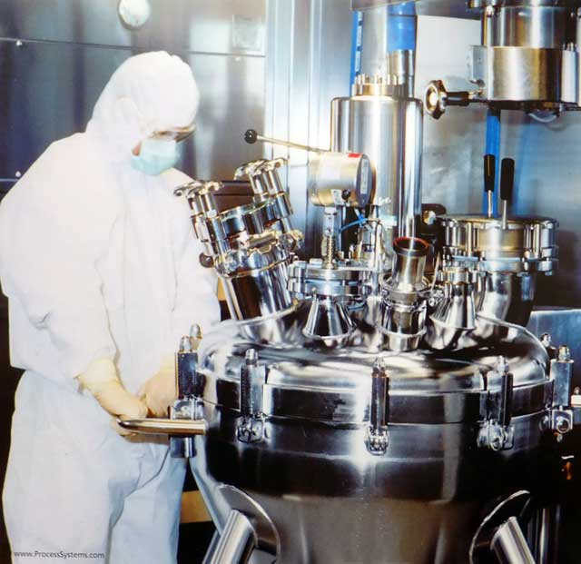
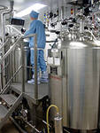
Lecture
Biopharmacy – the theoretical basis of drug production
ODESSA NATIONAL MEDICAL UNIVERSITY
PHARMACEUTICAL FACULTY
DEPARTMENT OF PHARMACEUTICAL CHEMISTRY
AND DRUG TECHNOLOGY
Associate Professor Zamkovaya A.V.
Odesa 2025

Slide 2
Plan
Basic directions modern biopharmaceutical research
The influence of pharmaceutical factors on the therapeutic effect of drugs.
Classification of factors.
Simple chemical modification - salts, acids, esters, alkalis.
Physical state of medicinal substances.
Excipients and their nature.
Dosage form and ways of its administration into the body.

Slide 3
A thorough study of known cases of therapeutic non-equivalence of drugs has shown that the activity of the active substance (drug), its release from the dosage form, and absorption are closely dependent on pharmaceutical factors.
Therefore, the study of pharmaceutical factors is mandatory from the point of view of biopharmaceutics, given their significant impact on the dynamics of bioavailability of medicinal substances, the stability of medicinal products during storage, and many other indicators.

Slide 4
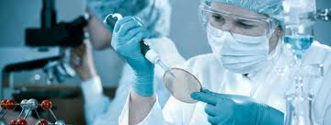
Biopharmacy is a science that studies the dependence of the therapeutic effect of drugs on the body on various factors (pharmaceutical, biological).
The main thing in biopharmacy is the recognition of the biological significance of pharmaceutical processes that occur during the production of drugs, as complex physicochemical systems capable of entering into certain interactions with the system of a living organism.
It appeared after establishing the facts of therapeutic non-equivalence of drugs, that is, drugs of the same composition, but manufactured by different pharmaceutical companies, had different therapeutic efficacy.

Slide 5
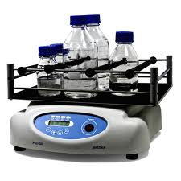
Main directions of modern biopharmaceutical research
Study of pharmaceutical factors.
Study of the bioavailability of drugs.
Creation of methods and devices for determining the content of active substances in biological fluids.
Study of the conditions of absorption, transport and excretion of substances in connection with variable factors of the internal and external environment.

Slide 6
Study of the impact of simple chemical modification on the release processes of substances from drugs, their pharmacokinetics, as well as the stability of the drug itself.
Research into the influence of the physical state of medicinal substances on the rate of release - absorption of medicinal substances, on the stability and properties of medicinal products.
Research into the influence of the nature and quantity of excipients on the release and pharmacokinetics of medicinal substances, as well as on the stability of the medicinal product during its storage and use.
Research into the impact of production processes and drug preparation methods on the release of medicinal substances from the dosage form and the kinetics in the body, as well as the stability of the drug.
Study of the effect of drug type on release and pharmacokinetics.

Slide 7
Pharmacy is designed to create a drug in a certain dosage form, convenient for administration, storage, and transportation. For this purpose, medicinal substances are crushed, dissolved, and mixed. They are given different dosage forms, various excipients are used, mechanical techniques, machines, devices, and so on are used. In this case, some aspects of the biological action may be enhanced, others weakened, and sometimes the activity of the drug is completely nullified.
The study of these changes, processes, and factors that influence the therapeutic efficacy of drugs is the main task of biopharmacy.

Slide 8
All pharmaceutical factors that affect the biological action of drugs can be divided into five groups:
chemical modification of the drug (salt, acid, presence of ester bonds, complex compounds);
physicochemical states of the medicinal substance (crystal shape, dimensions, presence or absence of charge on their surface, etc.);
excipients, their nature, quantity;
type of dosage form and route of administration;
pharmaceutical technology.

Slide 9
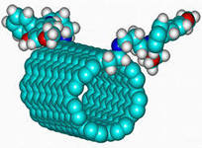
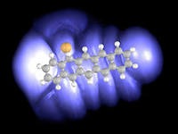
Chemical modification of a drug substance is necessarily taken into account when developing drugs.
The term simple chemical modification of drugs is understood to mean when the same substance can be used as a drug in different chemical compounds (salt, base, acid, ester, complex compound, etc.), in which the part of the substance molecule responsible for the pharmacological effect is fully preserved .

Slide 10
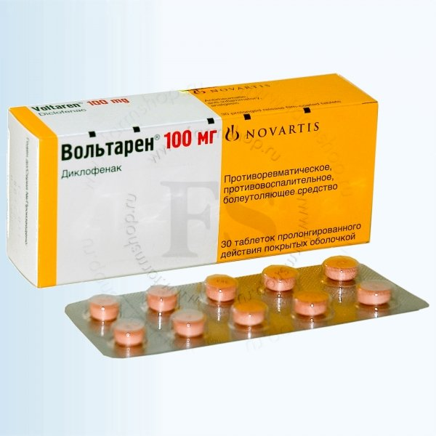
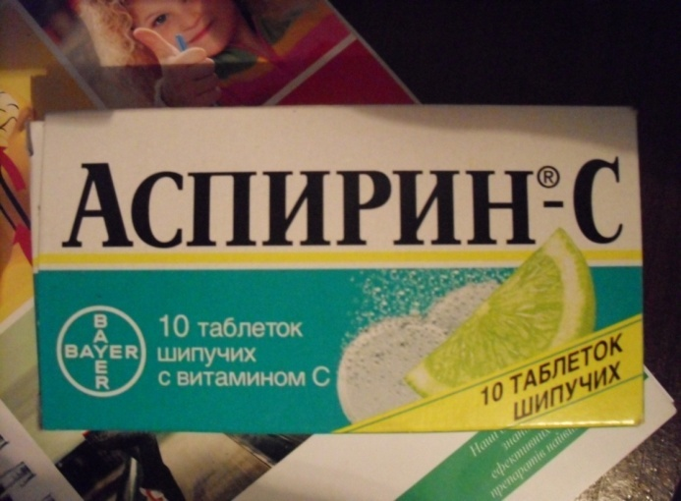
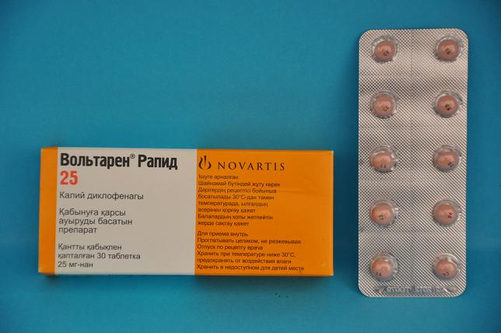
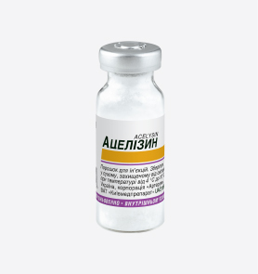
For example: novocaine - base and novocaine hydrochloride salt ; codeine - base and codeine phosphate - salt; caffeine - base and caffeine-sodium benzoate - salt, diclofenac sodium - potassium
Diclofenac sodium
Acetylsalicylic acid
Diclofenac potassium
Lysine acetylsalicylate

Slide 11
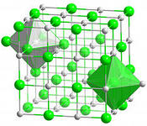
The influence of the physicochemical state of a medicinal substance on its biological activity.
It is known that chemical compounds have a different structure, characterized in each case by a specific set of properties. The geometric shape and composition of the crystals formed depend significantly on the nature of the solvent, the rate of crystallization, the temperature of the process, impurities, the magnitude of the pressure, and other factors.

Slide 12
Simple chemical modification (replacing a drug in the form of a salt with one cation with a chemically similar drug in the form of a salt with another cation or a drug in the form of an acid, ester, etc.) occurs more often in factory production.
Biopharmaceutics pays the most serious attention to the study of the factor of simple chemical modification, because taking into account its influence on the pharmacokinetics of medicinal substances allows to significantly increase the effectiveness of medical intervention, reduce the consumption of medicinal products, and dramatically increase the stability of many medicinal substances and their preparations.
Based on biopharmaceutical research, it has been proven that arbitrary replacement of any ion in a drug molecule, based on purely technological or economic considerations, is unacceptable.

Slide 13
Physical state of a medicinal substance
The physical state of medicinal substances is understood to mean:
Degree of grinding or dispersion (size of particles) of medicinal substances;
Polymorphism of medicinal substances;
Aggregate state (amorphism, crystallinity, shape and nature of crystals), pH, solubility, optical activity, electrical conductivity, melting point.
Physicochemical properties (pH, solubility, optical activity, electrical conductivity, melting point).
Surface properties of the drug substance (surface tension, philicity, etc.).
Degree of purity (type and amount of contamination, including the presence of microorganisms, allergens, binding substances, etc.).

Slide 14
Homogeneous – single-phase ionic or molecular-disperse systems (particle sizes for low-molecular-weight ones up to 1 nm , and for VMS from 1 to 100 nm).
Heterogeneous – two-phase coarse-disperse systems with particle sizes from 100 to 1000 nm and more.
According to the degree of dispersion, medicinal disperse systems are classified into:
Homogeneous
Heterogeneous

Slide 15
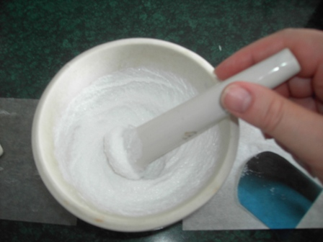
Grinding of medicinal substances is the simplest, but at the same time one of the most important technological operations performed by a pharmacist (druggist) in the preparation of various dosage forms. The dispersion of the medicinal substance affects not only the flowability of powdered materials, bulk density, homogeneity of mixing, and accuracy of dosing. It is especially important that the speed and completeness of absorption of the medicinal substance, as well as its concentration in biological fluids, mainly in the blood, depends on the size of the particles, with any methods of its administration in various types of dosage forms.

Slide 16
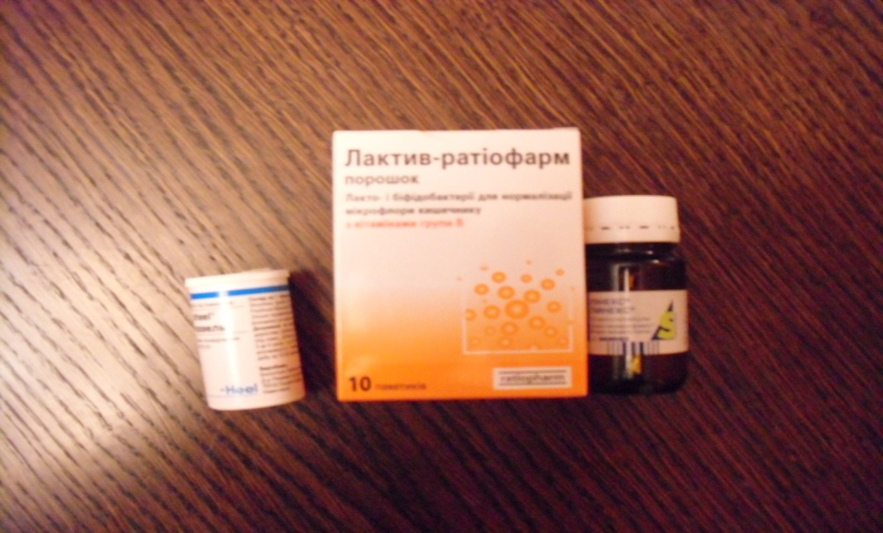
In tablets dissolved in the stomach, the particle size significantly exceeds the particle size of the powder, as a result of which the concentration of the active substance after taking the tablet is lower than after taking the powder. The particle size of drugs in suspensions, emulsions and liniments is one of the main
characteristics of these dosage forms .

Slide 17
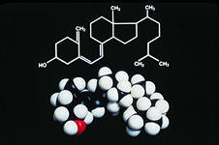
The effect of particle size on therapeutic activity was first proven for sulfonamide and steroid drugs, then furan derivatives , salicylic acid, antibiotics, antispasmodics , diuretics, antituberculosis, antidiabetic and cardiotonic agents. It was established that when using micronized sulfadiazine , its maximum concentration in the blood of people is reached two hours earlier than when administered in the form of a powder of a normal degree of grinding. In this case, the maximum concentrations of sulfadiazine in the blood are 40% higher, and the total amount of the substance absorbed is 20% greater.
The drug calciferol is able to be absorbed and have a therapeutic effect only when the particle size is less than 10 microns.

Slide 18
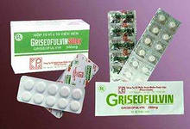
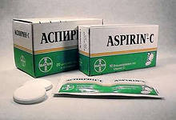
When reducing the size of griseofulvin particles from 10 to 2.6 microns, its absorption in the gastrointestinal tract increases, which allows you to reduce the therapeutic dose by half. By obtaining the molecular degree of dispersion of griseofulvin in polyvinylpyrrolidone, it was possible to increase the biological activity of this antibiotic by 7-11 times, even in comparison with the micronized form of the drug.
When reducing the size of acetylsalicylic acid to micronized, its analgesic and antipyretic effects increased by about 2 times.

Slide 19
However, the choice of the degree of grinding of the medicinal substance should be scientifically justified. It cannot be considered correct to strive to obtain a micronized powder in every case. Because in some cases, a sharp decrease in the particle size of the medicinal substance can cause inactivation of the substance, its rapid elimination from the body or may manifest an undesirable (toxic) effect on the body, as well as a decrease in the stability of the drug. In particular, with a sharp increase in the degree of dispersion of erythromycin, its antimicrobial activity decreases when taken orally. This is explained by the intensification of the processes of hydrolytic destruction or a decrease in its stability in the presence of digestive juices, as well as an increase in the surface area of contact of the medicinal substance with biological fluids.

Slide 20
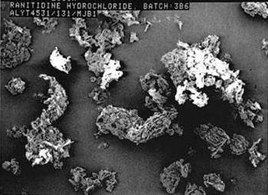
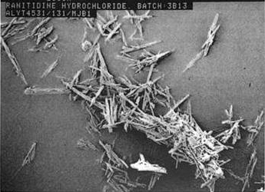
Polymorphism (from the Greek words " poli " - many, " morphe " - form) is the property of a chemical substance to form crystals under different crystallization conditions that differ from each other in symmetry class or shape, physical, and sometimes chemical properties.
Polymorphic modifications form many chemical and, including, medicinal substances. Since the discovery of carbon polymorphism by Davy (1809) (graphite, coal and diamond), the transitions of some polymorphic modifications into others have been studied in detail. It is emphasized that the chemical composition remains unchanged , which is mainly taken as an assessment of quality.

Slide 21
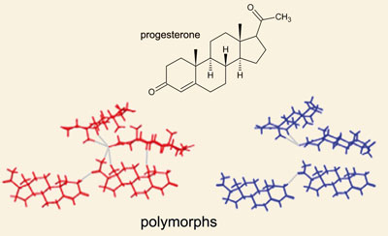
The formation of various polymorphic modifications can occur in both liquid and soft dosage forms. This is observed: when replacing solvents; when introducing various excipients into liquid or soft dosage forms; when drying, purifying, preparing medicinal products and during their storage.
The phenomenon of polymorphism among medicinal substances is especially common among salicylates, barbiturates , sulfonamides, and hormonal agents .

Slide 22
Taking into account and rational use of the phenomena of polymorphism of medicinal substances are of exceptional importance for pharmaceutical and medical practice. Polymorphic modifications of the same substance are characterized by different stability constants, phase transition temperature, solubility, which ultimately determines both the stability of the substance and its pharmacological activity. In this case, the solubility of various polymorphic modifications is of particular importance, because the absorption (absorption) of medicinal substances depends on it.

Slide 23
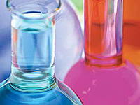
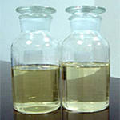
There are several ways to increase solubility of poorly soluble substances and thus bioavailability .
1. 3a by solubilization . Solubilization is defined as the process of spontaneous transition into a stable solution by surfactants insoluble or sparingly soluble in a given solvent. In domestic literature, this process is also called colloidal or conjugate solubility.
2. Using individual or mixed solvents (benzyl benzoate, benzyl alcohol, propylene glycol, polyethylene glycol, ethyl cellulose, dimexide, glycerin, etc.).

Slide 24
3. Using hydrotropy , which provides the formation of hydrophilic complexes with organic substances containing electron donors and substituents - polar radicals. Examples of hydrotropic substances include sodium salicylate, sodium benzoate, hexamethylenetetramine, novocaine, antipyrine, urea, glycerin, amino acids, oxyacids, proteins, etc.
4. Synthetic route - introduction of hydrophilic groups into the structure of the molecule: -COOH, CH2-COOH, -NROH, -CH2ROH. Example: unithiol.

Slide 25
5. By the formation of salts and complexes:
a) sparingly soluble substances: bases, the acidic form of compounds in alkalis or with sodium bicarbonate turns into a readily soluble salt. In this way, phenobarbital, norsulfazole, streptocide, osarsol, and other substances can be converted into soluble compounds;
iodine solutions using readily soluble iodine complexes with alkali metal iodides;
c) to obtain aqueous solutions of polyene antibiotics (nystatin, levorin, etc.) polyvinylpyrrolidone is used, with which they form complex compounds, where the water-insoluble substance and the solubilizer are linked by a coordination bond. These complexes are well soluble in water. Scientific research initiated in this direction allows us to reveal new patterns in the relationship "drug substance-excipient" in complex physicochemical systems, which are drugs.

Slide 26
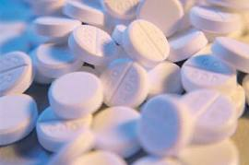
The therapeutic activity of medicinal substances is also significantly influenced by their optical properties . There is no chemical difference between optical isomers, but each of them rotates the plane of polarization in a certain direction. Despite the fact that chemical analysis fully confirms the presence of the same substance in medicinal products with different isomers, they will not be therapeutically equivalent.

Slide 27
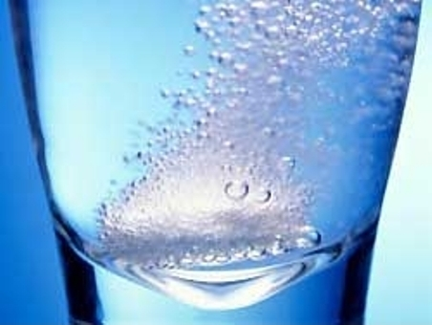
Anhydrous drug substances or crystal hydrates have different solubility , which leads to changes in their pharmacological action. For example, anhydrous forms of caffeine, ampicillin, theophylline dissolve faster than their crystal hydrates, and therefore are absorbed faster.

Slide 28
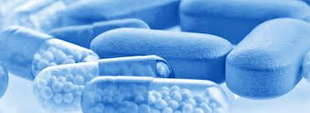
Excipients
Until recently, excipients were seen as only indifferent form-forming agents, the meaning of which was reduced to providing the appropriate form and volume of the medicinal substance for the purpose of its convenience of administration, transportation, and storage.
However, discoveries in recent decades have led to the realization of the biological role of excipients. They can enhance, reduce the effect of medicinal substances or change their nature under the influence of various reasons (complexation, molecular reactions, etc.)

Slide 29
The use of fine highly sensitive methods of drug analysis ( gas- liquid, thin-layer chromatography, X-ray structural analysis, spectrophotometry) allowed us to establish the closest interactions between drugs and excipients.
Based on biopharmaceutical work, it was established that excipients are not an indifferent mass used in a purely technological sense.
The interaction between drugs and excipients can occur both in the process of preparing drugs and in the process of their storage.

Slide 30
It is impossible to draw a clear line between the active substance and the excipient in a dosage form, and therefore modern pharmaceutical science sets a requirement when developing new medicines: to establish the degree of influence of excipients on the therapeutic efficacy of the medicine.
In other words, the excipient should not be used in general, but specifically with an individual substance. Unjustified use of an excipient can lead to a decrease, increase, change in the therapeutic effect or complete loss of the therapeutic effect of the medicinal substance.
In the available literature, there are known examples of the influence of excipients on therapeutic efficacy. For example, lactose minimizes the effect of isoniazid, but enhances the effect of testosterone, slows down the effect of barbitol. Tween-80 enhances the adsorption of vitamins A, D, E.

Slide 31
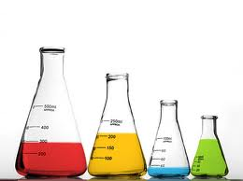
Excipients are of natural, synthetic and semi-synthetic origin. When preparing dosage forms, they can perform various functions: solvents, solubilizers, stabilizers, bases, surfactants, thickeners, emulsifiers, preservatives, flavoring agents, dyes.
Such substances include: starch, glucose, purified water, ethyl alcohol, petroleum jelly, oil, cocoa, talc, bentonite, aerosil, paraffin, wheat flour, polyethylene oxides, various cellulose derivatives, etc.

Slide 32
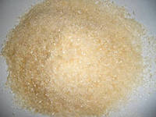
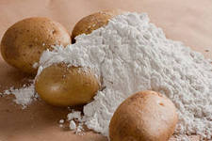
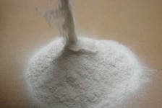
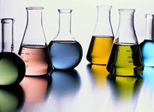
Such commonly used excipients as gelatin, starch, polyethylene oxides, cellulose derivatives, and nonionic surfactants are capable of entering into interaction reactions (in particular, complexation) with medicinal substances of the most diverse nature, forming compounds characterized by properties different from those of the original substances.

Slide 33
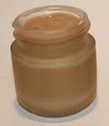
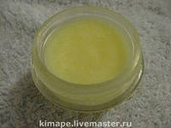
excipients in ointments and suppositories
The effect of the type of base varies depending on the route of administration of the drug substance. It has been established that boric acid does not have a bacteriostatic effect when using fatty bases, but is effective in the manufacture of ointments on hydrophilic bases, which contain a large amount of water. Iodine, on the contrary, is inactive in bases containing a large amount of water.

Slide 34
The introduction of emulsifiers, surfactants, and other absorption activators into the composition of ointment and suppository bases is one of the important factors that influence the activity of medicinal substances. Sodium lauryl sulfate contributes to an increase in the resorption of microcrystalline sulfapyridazine from a hydrophilic base.
The ability of dimethyl sulfoxide to easily penetrate intact skin, transport, deposit, and prolong the entry of medicinal substances into the body has been demonstrated.
A promising excipient in the technology of ointments, suppositories, injection solutions, ophthalmic medicinal films, and other dosage forms is collagen. It is assumed that the medicinal substance, entering the “loops” of collagen molecules, forms a compound – an inclusion of the clathrate type, thereby providing a prolonged effect.

Slide 35
Thus, according to biopharmaceutical and pharmacokinetic indicators, excipients must provide the entire range of pharmacological properties of medicinal substances in order to meet the modern requirements of pharmacotherapy. The main role of excipients is reduced to modifying the pharmacokinetics of medicinal substances and only then to form. This approach to excipients allows to a greater extent to ensure the selectivity of the action of medicinal substances and reduce, or even completely eliminate, the side effects of drugs. In other words, the scientifically substantiated use of excipients is the basis for the creation of new medicinal products of a given type and direction: for children, geriatric patients, veterinary purposes, etc. .
The selection of excipients is carried out on a scientific and rational basis (economic, aesthetic, etc.), which assumes their functional purpose, ensuring bioavailability, technological characteristics, technological properties, cost-effectiveness and availability. Thus, the variety of properties of medicinal and auxiliary substances and the rapid growth of their assortment obliges the specialist to abandon attempts to transform any auxiliary material into a universal one, used with any medicinal substance.

Slide 36
Dosage form and routes of administration
Numerous studies on the influence of dosage form on the therapeutic efficacy of drugs have established that the optimal activity of a drug substance is achieved only when it is prescribed in a rational dosage form. In addition, in this case, many side effects of drugs on the body can be avoided.

Slide 37

A dosage form is a pharmacologically rational, convenient form of a medicinal substance for administration and storage, which ensures its optimal therapeutic effect with a minimum of side effects.
According to modern concepts, a dosage form is a material norm for the manifestation of the dialectical unity of active and auxiliary substances, as well as technological operations that ensure the optimal therapeutic effect of a medicinal product.

Slide 38
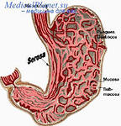

The most important task in the development and preparation of a dosage form is to ensure optimal conditions for the release and subsequent absorption of the substance. All other requirements that the dosage form must meet are subordinate to these conditions.
The extent of the influence of the dosage form on the absorption processes is determined by the ability to release the active substance from the oral dosage form and the possibility of contact with the mucous membranes of the stomach and intestines and interaction with their secretions. Hence, according to the degree of release and, accordingly, better bioavailability, all oral drugs can be placed in the following series:
solution-emulsion-suspension-powders-granules-tablets.

Slide 39
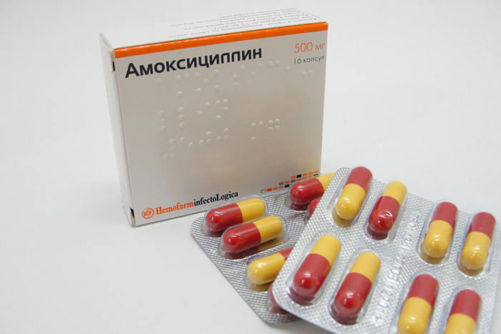
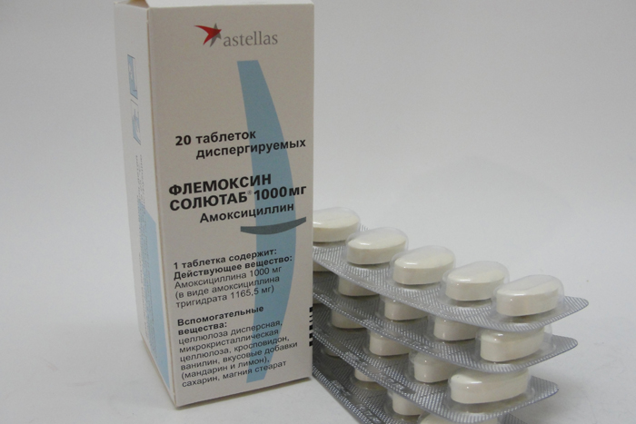
According to statistics, approximately 30% of patients have difficulty taking tablets and capsules, so they crush tablets and open capsules. 23% of patients prefer soluble dosage forms.
Amoxicillin – capsules
(bioavailability-75%)
Amoxicillin – soluble tablets
(bioavailability-95%)

Slide 40
The choice of dosage form simultaneously determines the method (route) of administering the drug into the body.
Each route of administration has its advantages, but not all of them are effective. For one reason or another, sometimes even intravenous administration of the drug does not provide bioavailability. In cases of cardiac decompensation, injections and rectal dosage forms should be considered rational dosage forms of cardiac glycosides, because oral administration causes intestinal irritation (ulcer, bleeding, pain), which is associated with impaired absorption of the mucous membranes in such patients. Long-term therapy with metindol (indomethacin) in suppositories proceeds without complications, with a good therapeutic effect, while the use of the drug in tablets is accompanied by dyspeptic phenomena, disorders of the central nervous system, and other complications.
Thus, the dosage form should be profitable and rational not only from the economic, aesthetic, and convenient for use aspects, but primarily from the point of view of the pharmacodynamics of the drug and ensuring modern requirements of pharmacotherapy.

Slide 41
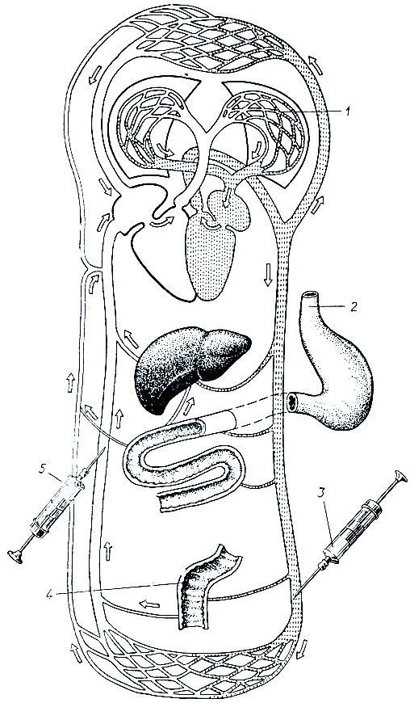
Routes of administration of drugs
Internally ulnar
Intravenous
Subcutaneous
Oral
Sublingual
Subbuccal
Inhalant
Rectal
Vaginal

Slide 42
Pharmacokinetics studies qualitative and quantitative changes in active substances in biofluids and organs, covering the stages of absorption, distribution, biotransformation and excretion of medicinal substances from the body, as well as the mechanisms causing these changes.
Absorption is the uptake of an active ingredient by the blood or lymph from the body's border surfaces after its release from the drug.

Slide 43
In order for the process of absorption of a substance to take place, the following conditions are absolutely necessary :
1) the active substance must be easily released from the medicinal product;
2) the released substance must reach the absorption surface (diffusion to the site of absorption).
3) The active substance must be stable and not change during storage.

Slide 44
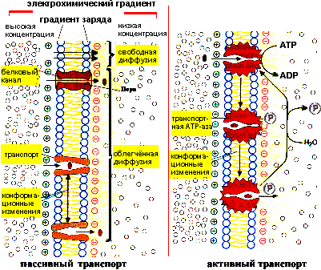
Further transport of the active substance is carried out passively (diffusion, convection) and actively (transport proteins of the body). The action of the main substance is the result of its interaction with the cells of the corresponding tissues and, ultimately, the entire organism. Therefore, the first stage of transport of substance molecules from the absorption surface begins with its penetration through the cell membrane. The type of substance transport in this case depends on the structure and properties of the cell membrane.

Slide 45
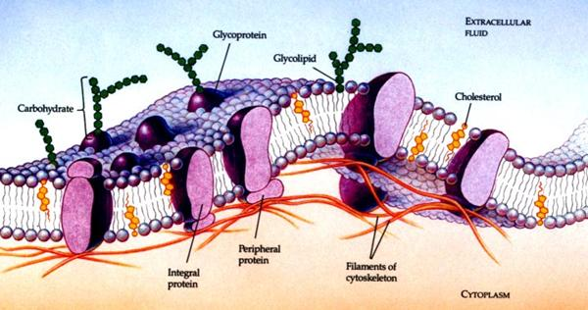
There are four types of cell membranes:
a membrane that has pores, where convection (mostly) and diffusion of substance molecules through water-filled pores are possible;
a membrane that has no pores, where only lipid-soluble non-ionized molecules can diffuse;
a membrane that has pores and semipermeable layers through which molecules of non-electrolyte substances with a relatively large molecular weight can diffuse;
A membrane without pores, but can provide active transport using molecules of specific substances that function as carriers.

Slide 46
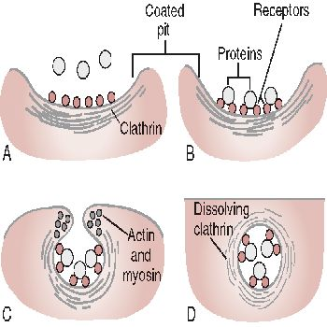
Active transport of large and poorly soluble molecules of medicinal substances (enzymes, hormones, etc.) into the cell can occur by moving the membrane and creating ultramicroscopic bubbles - vacuoles - around the particles. This transport mechanism is called pinocytosis.
Therefore, at the first stage of the kinetics of active substances in the body, the main role belongs to the cell membrane.

Slide 47
In order for drugs to have a therapeutic effect, it is necessary to deliver the active substance to those organs and tissues in which its specific action is carried out.
The substance is delivered to the organ affected by the pathological process using a transport system - blood.
Active substances that enter the blood by any means are carried throughout the body and evenly distributed throughout the blood volume until a state of mobile equilibrium is established in the body's organs.
In the initial period of circulation of the active substance, its concentration in the tissues is lower than in the serum, then they level off and, finally, exceed the concentration in the blood. The accumulation of the active substance in the tissues in higher concentrations than in the blood depends on the pH gradient, the ability of the substance to bind to intracellular elements, and its distribution in adipose tissue.

Slide 48
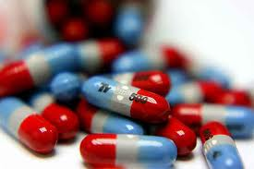
The active substance in the body undergoes a complex of physicochemical and biochemical transformations (biotransformation, metabolism) with the creation of more polar and, therefore, water-soluble components (metabolites), which are more easily excreted from the body by the kidneys.
In most cases, biotransformation of active substances occurs in the liver, but enzymes involved in their metabolism may be present in the blood or other tissues. As a result of metabolism, less active, mostly inactive and very rarely toxic compounds are formed compared to the original substances.
The final stage of the active substance's presence in the body is the removal of it or its metabolites from the blood. Some substances can be excreted with milk, tears, saliva, and sweat.

Slide 49
Technological process
Technological (production) processes are methods consisting of certain technological techniques and operations.
Until the 1960s, the method of preparing medicinal products as a factor affecting the effectiveness of the medicinal product was not given significant importance. This largely contributed to the alienation of the science of methods of preparing medicinal products from clinical disciplines, its transformation into one of the branches of general technology, general commodity science.
With this approach to medicinal products, it was not taken into account that their behavior in the body may depend on pharmaceutical technology. In pharmacies and factories, medicinal products were prepared in strict accordance with the provisions of general technology and were evaluated based on commodity science principles in terms of mass, consistency, geometric shape, content of active substances, etc.

Slide 50
The discovery in clinical settings of the dependence of the therapeutic efficacy of drugs on the methods of their preparation meant a fundamentally new understanding of the processes of pharmaceutical technology. Often, changes in a substance cannot be determined by chemical methods, and only biological assessment is reliable in determining the good quality of a drug.

Slide 51
Thank you for your attention!

