Slide 1

ODESSA NATIONAL MEDICAL UNIVERSITY
PHARMACEUTICAL FACULTY
DEPARTMENT OF PHARMACEUTICAL CHEMISTRY
AND DRUG TECHNOLOGY
Pharmaceutical factors: chemical and physical state of medicinal substances. Excipients. The influence of the technology of preparation of medicinal preparations, the type of dosage form, the routes of its administration on the therapeutic efficacy of drugs
Associate Professor Zamkovaya A.V.
Odesa 2025

Slide 2
Plan
The influence of pharmaceutical factors on the therapeutic effect of drugs.
Classification of factors.
Physical state of medicinal substances.
Simple chemical modification - salts, acids, esters, lyes.
Excipients and their nature.
Interaction of auxiliary and medicinal substances, principles of selection of auxiliary substances.
The importance of variable pharmaceutical factors in the manufacture of medicinal products.
The influence of technological operations on the process of manufacturing medicinal products.
The importance of developing scientifically based methods for obtaining medicinal products
Types of dosage forms.
Routes of administration of drugs.
Routes of access of medicinal substances in the body.
Rationality of choosing the type of dosage form

Slide 3
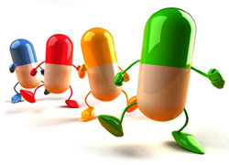
All pharmaceutical factors that influence the biological action of drugs can be divided into five groups:
- physical state of medicinal substances;
- simple chemical modification of a medicinal substance;
- auxiliary substances (their nature, physical state and quantity);
- dosage form and routes of its administration into the body;
- technological process.

Slide 4
According to the degree of dispersion, drug disperse systems are classified into
Homogeneous
Heterogeneous
Homogeneous – single-phase ionic or molecular-dispersed systems (particle sizes for low-molecular up to 1 nm, and for high-molecular from 1 to 100 nm).
Heterogeneous – two-phase coarsely dispersed systems with particle sizes from 100 to 1000 nm and larger.

Slide 5
Physical state of the drug
The physical state of medicinal substances is understood as:
The degree of grinding or dispersion (size of parts) of medicinal substances;
Polymorphism of drugs;
State of aggregation (amorphous, crystalline, shape and character of crystals), pH , solubility, optical activity, electrical conductivity, melting point.
Surface properties of the drug (surface tension, etc.).
Degree of purity (type and amount of contaminants, including the presence of microorganisms, allergens that bind substances, etc.).

Slide 6
Grinding of medicinal substances is the simplest, but at the same time one of the most important technological operations performed by a pharmacist in the preparation of various medicinal forms. The dispersion of a medicinal substance affects not only the flowability of powdered materials, bulk density, homogeneity of mixing, and accuracy of dosing. It is especially important that the speed and completeness of absorption of the medicinal substance, as well as its concentration in biological fluids, mainly in blood, depend on the size of the parts, in any way it is administered in the form of various medicinal forms.

Slide 7
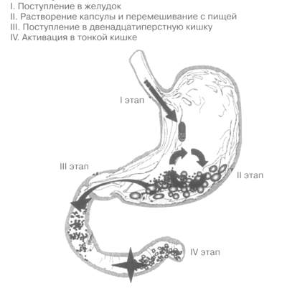
For example
In tablets dissolved in the stomach, the size of the parts significantly exceeds the size of the powder parts, as a result of which the concentration of the active substance after taking the tablet is lower than after taking the powder. The size of the parts of drugs in mixtures-suspensions, emulsions and liniments is one of the main characteristics of these dosage forms.

Slide 8
The influence of the particle size on the therapeutic activity was first proven for sulfanilamide and then steroid drugs, as well as furan derivatives, salicylic acid, antibiotics, and currently for antispasmodics, which relieve pain, diuretics, anti-tuberculosis, antidiabetic and cardiotonic agents. For example, it was found that when using micronized sulfadiazine, its maximum concentration in the blood of people is achieved two hours earlier than when it is prescribed in the form of a powder of normal grinding. In this case, the maximum concentrations of sulfadiazine in the blood are 40% higher, and the total amount of the substance that is absorbed is 20% more. The drug calciferol is capable of being absorbed and performing a therapeutic effect only when the particle size is less than 10 μm.
When griseofulvin particles are reduced from 10 to 2.6 µm, its absorption in the gastrointestinal tract increases sharply, which allows its therapeutic dose to be reduced by half. By obtaining the molecular degree of dispersion of griseofulvin in polyvinylporolidone, it was possible to increase the biological activity of this antibiotic by 7-11 times even in comparison with the micronized form of the drug. Therefore, the industry produces tablets of micronized griseofulvin, digoxin, and acetylsalicylic acid.

Slide 9
Polymorphism (from the Greek words “ poli ” - many, “ morphe ” - form) is the property of a chemical substance to form crystals under different crystallization conditions that differ from each other in their symmetry class or form, physical, and sometimes chemical properties.
As is known, polymorphic modifications form many chemical substances, including medicinal substances. Since the discovery of carbon polymorphism by Davy (1809) (graphite, coal and diamond), the transitions of some polymorphic modifications into others have been thoroughly studied. It is emphasized that the chemical composition remains unchanged, which is mainly taken as an assessment of quality. A review of works on the study of polymorphism in medicinal substances is given in the works of Tentsova , Haleblein , Bushe, Halabal .

Slide 10
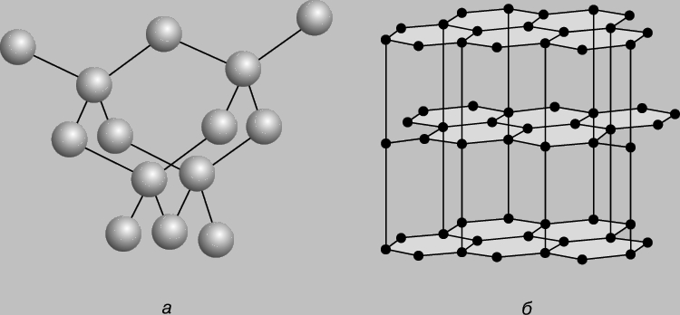
STRUCTURE of diamond (a) and graphite (b).

Slide 11
Formation of various polymorphic modifications can occur in both liquid and soft medicinal forms. This is observed: when replacing solvents; when introducing various auxiliary substances into liquid or soft medicinal forms; when drying, cleaning, preparing medicinal products and during their storage.
The phenomenon of polymorphism among medicinal substances is especially common among salicylates , barbiturates, sulfonamides, and hormonal agents. For most modifications, there are no special names and they are marked with letters or numbers І , II, III, etc.

Slide 12
The consideration and rational use of the phenomena of polymorphism of medicinal substances are of exceptional importance for pharmaceutical and medical practice. Polymorphic modifications of the same substance are characterized by different stability constants, phase transition temperatures, solubility, which ultimately determines both the stability of the substance and its pharmacological activity. In this case, the solubility of different polymorphic modifications is of particular importance, because the absorption (sucking) of medicinal substances depends on it.

Slide 13
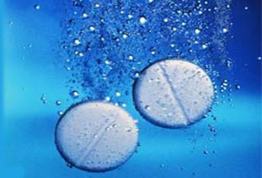
There are several ways to increase the solubility of poorly soluble substances and thus their bioavailability .
1. By solubilization . Solubilization is defined as a process of spontaneous transition to a stable solution by means of PAR of insoluble or poorly soluble substances in a given solvent. In domestic literature, this process is also called colloidal or combined solubility.
2. Using individual or mixed solvents ( benzyl benzoate , benzyl alcohol, propylene glycol , polyethylene glycol , ethyl cellulose , dimexide , glycerin, etc.).
3. Using hydrotropy , which ensures the formation of hydrophilic complexes with organic substances that contain electron-donating substituents - polar radicals. Examples of hydrotropic substances include sodium salicylate , sodium benzoate , hexamethylenetetramine , novocaine, antipyrine, urea, glycerin, amino acids, oxyacids , proteins, etc.

Slide 14
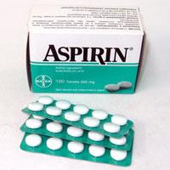
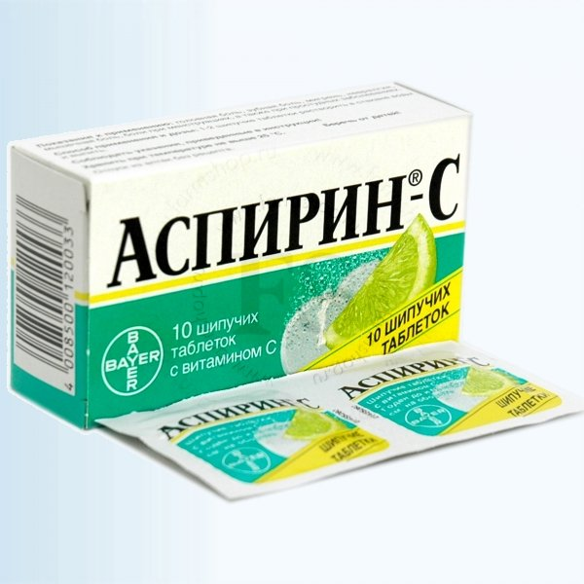
4.By forming salts and complexes:
a) poorly soluble substances: bases, acidic form of compounds in the lute or from sodium bicarbonate passes into a readily soluble salt. In this way, phenobarbital , norsulfazole, streptocide, osarsol and other substances can be converted into soluble compounds;
b) obtaining aqueous solutions of iodine using readily soluble complexes of iodine with alkali metal iodides;
c) to obtain aqueous solutions of polyene antibiotics ( nystatin , levorin , etc.) polyvinylpyrrolidone is used , with which they form complex compounds, where the water-insoluble substance and the solubilizer are linked by a coordination bond. These complexes are highly soluble in water. The scientific research initiated in this direction allows us to discover new patterns in the "drug -solvent-auxiliary substance" relationship in complex physicochemical systems, which are drugs.
5. Synthetic route - introduction of hydrophilic groups into the structure of the molecule: -COOH, CH2-COOH, -HPO3H -CH2PO3H. Example: unithiol .

Slide 15
Chemical modification
The term simple chemical modification of drugs is understood to mean that the same substance can be used as a drug in different chemical compounds (salt, base, acid, ester, complex compound, etc.), in which the part of the substance molecule responsible for the pharmacological effect is completely preserved.
For example: novocaine is the base and novocaine hydrochloride salt; codeine is the base and codeine phosphate is the salt; caffeine is the base and sodium caffeine benzoate is the salt.

Slide 16
Simple chemical modification (replacing a drug in the form of a salt with one cation with a chemically similar drug in the form of a salt with another cation or with a drug in the form of an acid, ester, etc.) is more common in factory production.
Biopharmacy pays the most serious attention to the study of the factor of simple chemical modification, because taking into account its influence on the pharmacokinetics of medicinal substances allows to significantly increase the effectiveness of medical intervention, reduce the cost of medicinal drugs, and sharply increase the stability of many medicinal substances and their preparations.
Based on biopharmaceutical experiments, it has been proven that arbitrary replacement of any ion in a drug molecule, based on purely technological or economic considerations, is unacceptable.

Slide 17
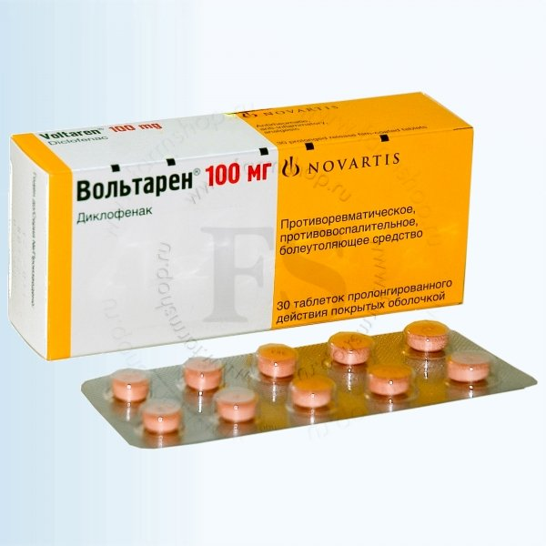
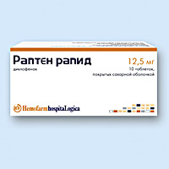

Diclofenac sodium Diclofenac potassium

Slide 18
Excipients
Excipients can be of natural, synthetic and semi-synthetic origin. When preparing dosage forms, they can perform different functions: solvents, solubilizers, stabilizers, bases, surfactants, thickeners, emulsifiers, preservatives, flavoring agents, dyes, etc.
These substances include: starch, glucose, purified water, ethyl alcohol, petroleum jelly, butter, cocoa, talc, bentonites, aerosil, paraffin, wheat flour, polyethylene oxide, various cellulose derivatives, etc.

Slide 19
Based on biopharmaceutical studies, it was established that excipients are not an indifferent mass used in a purely technological sense. They have certain physical and chemical properties and, depending on the nature of the substance, can enhance, reduce, change the nature of the action of medicinal substances under the influence of various causes and compounds ( complexation and adsorption, molecular reactions, etc.), as a result of which the speed and completeness of absorption of the drug can change dramatically. The interaction between medicinal and excipients can occur both in the process of preparing drugs and in the process of their storage.
Thus, the mechanism of influence of excipients on bioavailability may be different.

Slide 20
It is impossible to draw a clear line between the active substance and the auxiliary substance in a medicinal form, and therefore modern pharmaceutical science sets a requirement when developing new drugs: to establish the degree of influence of auxiliary substances on the therapeutic effectiveness of drugs. In other words, the auxiliary substance should be used not in general, but specifically with an individual substance. Unreasonable use of an auxiliary substance can lead to a decrease, increase, change in the therapeutic effect or complete loss of the therapeutic effect of the drug.
The available literature contains examples of the influence of excipients on therapeutic effectiveness. For example, lactose minimizes the effect of isoniazid , but enhances the effect of testosterone, slows down the effect of barbitol . Tween-80 enhances the absorption of vitamins A, D, E.

Slide 21
Thus, according to biopharmaceutical and pharmacokinetic indicators, excipients should provide the entire range of pharmacological properties of drugs in order to meet modern pharmacotherapy requirements . The main role of excipients is reduced to modifying the pharmacokinetics of drugs and only then to shaping. This approach to excipients allows to a greater extent to ensure the selectivity of the action of drugs and to reduce or even completely eliminate the indirect effects of drugs. In other words, scientifically sound use of excipients underlies the creation of new drugs of a given type and direction: for children, geriatric patients, veterinary purposes, etc.
The choice of auxiliary substances is carried out on a scientific and rational basis (economic, aesthetic, etc.), which provides for their functional purpose, ensuring bioavailability , technological characteristics, technological properties, cost-effectiveness and availability. Thus, the diversity of the properties of medicinal and auxiliary substances and the rapid growth of their range obliges the specialist to abandon attempts to transform any auxiliary material into a universal one, used with any medicinal substance.

