Slide 1

ODESSA NATIONAL MEDICAL UNIVERSITY
PHARMACEUTICAL FACULTY
DEPARTMENT OF PHARMACEUTICAL CHEMISTRY
AND DRUG TECHNOLOGY
Pharmaceutical factors. Physical state of drug substances. Polymorphism, solubility, chemical modification, excipients
Associate Professor Zamkovaya A.V.
Odesa 2025

Slide 2
Plan
Characteristics of the concept of "Pharmaceutical factors".
The influence of pharmaceutical factors on the therapeutic effect of drugs.
Classification of factors.
The impact of technological operations on the manufacture of medicinal products.
The influence of dosage form and route of administration of drugs.

Slide 3
In the previous lecture, we considered the concept of “pharmaceutical factors.” Recall that the therapeutic activity of medicinal substances is influenced by physiological, biochemical, and pharmaceutical factors.
Physiological factors include age, gender, and body condition (healthy or pathological).
Biochemical ones include the state of cell membranes, cell activity, and the presence of endogenous substrates that accumulate in various diseases (bilirubin, fatty acids, etc.).
Pharmaceutical factors - factors that affect the process of release and absorption of drugs from a dosage form.
The therapeutic effect of a drug depends on the combined effect of various factors on the presence of the drug in the body.
At the same time, various factors influence each stage of the drug's presence in the body (Table 1).

Slide 4
Table 1
" life cycle " of a drug in the body
 | Adsorption stages | Factors affecting
 |  | speed and completeness of the degree
 |  | absorption of drugs
1. | Medicines (MEDs in LF) in place | Pharmaceutical
entry
2. | Medicines in biosimilarity on | Physiological and pharmaceutical-
suction point |  | Czech
3. | Medicines in biosimilarity (in | Biochemical and physiological
blood, tissues) |  | ski
4. | Elimination of bio-products | Biochemical
transformation of drugs (through the kidneys,
gastrointestinal tract, lungs, etc.)

Slide 5
Stages of adsorption of medicinal substances
Stage 1. Direct route of administration of the drug (oral, rectal, application to the skin or mucous membrane, injection, etc.). At this stage, the drug is released from the form (tablet, suppository, ointment, etc.) and diffuses to the intended site of absorption (adsorption).
Stage 2. Characterized by the transition of the drug into the biological fluid and its absorption. The peculiarities of the reaction to LH in aging are largely due to pharmacokinetic reasons: impaired absorption, distribution, metabolism and excretion of LH.
Stage 3. Differs from the two in that the drug or its metabolites are distributed in the bloodstream or tissues.
Stage 4. The movement is characterized by the biotransformation of drugs and their metabolites and the elimination (excretion) of end products through the kidneys, gastrointestinal tract, lungs, and sweat glands. Biochemical factors are important in this.

Slide 6
Let us recall that the activity of the active substance (drug), its release from the dosage form, and absorption are closely dependent on pharmaceutical factors, which include :
- physical state of the medicinal substance;
- Simple chemical modification of the drug substance ;
-excipients (their nature, physical state and quantity);
- Dosage form and routes of administration into the body;
-technological process.
In the previous lecture, we examined the following pharmaceutical factors: “physical state of the drug substance”, “simple chemical modification of the drug substance”. In today's lecture, we will get acquainted with two more pharmaceutical factors – the dosage form and the routes of its administration into the body and the technological process, which also affect the biological effect of drugs.

Slide 7
Type of dosage form and route of administration
Numerous studies of the influence of dosage form on the therapeutic efficacy of drugs have established that the optimal activity of a medicinal substance is achieved only when it is administered in a rational dosage form.
A dosage form is a rational, from a pharmacological point of view, convenient form of a medicinal substance for administration and storage, which ensures its optimal therapeutic effect with a minimum of side effects.
A dosage form is a material norm for the manifestation of the dialectical unity of active and auxiliary substances, as well as technological operations that ensure the optimal therapeutic effect of a medicinal product.
The most important task in the development and preparation of a dosage form is to ensure optimal conditions for the release and subsequent absorption of the substance. These conditions are subordinate to other requirements that the dosage form must meet.

Slide 8
The degree of influence of the dosage form on the absorption processes is determined by the ability to release the active substance from the oral dosage form and the possibility of contact with the mucous membranes of the stomach and intestines and interaction with their secretions. According to the degree of release and in accordance with the best bioavailability , all oral drugs can be arranged in the following series: solutions-emulsions-suspensions-powders- granules-tablets.
Based on numerous biopharmaceutical studies and scientific substantiation of the influence of this factor, it is possible to create drugs with specified pharmacokinetic properties, which have a certain pharmacological effect: synergism, potentiation, antagonism, prolongation , differentiated or directed action, expansion of the antibacterial spectrum, etc.

Slide 9
Replacing tablet forms of neophylline , euphylline , diprofylline, and digoxin with rectal suppositories significantly increases their bioavailability. The use of rectal forms of these drugs allows for a reduction in their dosage.
Suppositories can replace the administration of these drugs in the form of injections, since the rectal route of administration has bioavailability equivalent to that of injections and allows you to avoid traumatizing the patient.
widely known anti-ischemic drug " Trinitrolong " is better administered in the form of plates. This dosage form allows for individual dosing of drugs, ensuring uninterrupted and maximum therapeutic effect. Thus, instead of conventional amoxicillin capsules (BD 75%), the drug " Flemoxin" is produced. solutab » (DB 95%).
Thus, the dosage form should be convenient to use, profitable and rational not only from an economic and aesthetic point of view, but primarily from the point of view of the pharmacodynamics of the drug and ensuring modern requirements of pharmacotherapy.

Slide 10
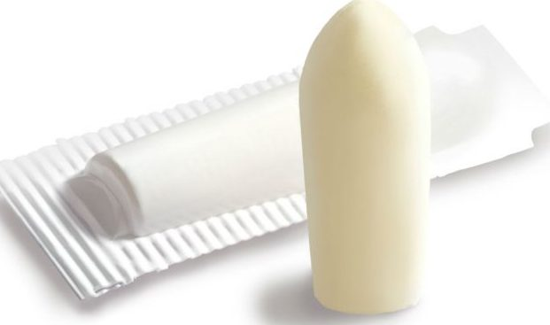
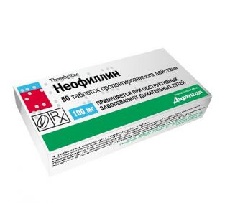

Slide 11
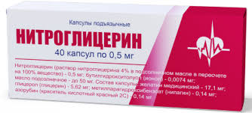
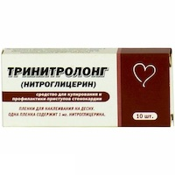

Slide 12
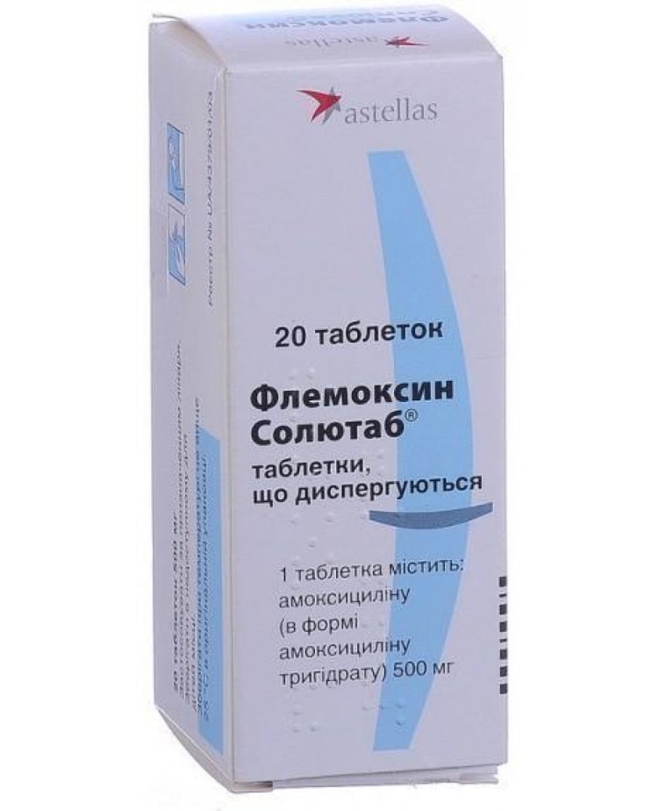
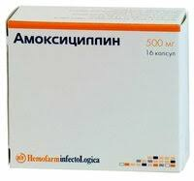

Slide 13
Routes of administration drugs into the body
All routes of drug administration into the body are divided into two groups.
Enteral (through the digestive tract) – oral, transbuccal, sublingual , rectal, into the duodenum.
Parenteral (bypassing the digestive tract) – subcutaneously, intramuscularly , intravenously , subarachnoidly, inhaled, etc.
Each of these routes of drug administration has positive and negative aspects.

Slide 14
Enteral routes of administration
 | Mouth | Vena cava (upper) |  |  | Total blood flow
Medicines | Gastrointestinal tract | BB | Liver | PV
 | Rectum​ | Vena cava (lower)

Slide 15
Parenteral routes of administration
In medical life under the name " Parenteral "routes of administration " usually mean injection of the drug under the skin, muscle, vein, body cavity (abdominal, pleural, joint bags, etc.). In a broader sense , parenteral Routes of administration include any route of administration of drugs into the body, changing the enteral route.

Slide 16
Parenteral steps introduction medical substances that​ most frequently used
Intranasal administration
Inhalation administration
Transdermal administration
Intravenous administration
Intramuscular administration​
Subcutaneous injection
Local administration

Slide 17
The route of drug administration largely determines the speed of onset of the pharmacological effect, the active substance reaching the inflammation site, the manifestation of negative side effects, and the effectiveness and safety of its use.
For example, magnesium sulfate (bitter salt) has multifaceted pharmacological activity and is used in medical practice for various indications and for various purposes.
Magnesium sulfate, taken by adults orally (orally) in a dose of 20-30 g in ½ glass of water, is poorly absorbed (no more than 20%), causes fluid retention, increases osmotic pressure in the gastrointestinal tract, enhances intestinal peristalsis and has a laxative effect. And taken orally (on an empty stomach) 20-25% solution of magnesium sulfate in 1 tbsp. spoon 3 times a day irritates the nerve endings of the duodenal mucosa, increases the secretion of cholecystokinin and has a choleretic effect.

Slide 18
When administered parenterally, magnesium sulfate has a calming effect on the central nervous system, and depending on the dose administered, a sedative, hypnotic, narcotic effect. In large doses, it inhibits the effect on neuromuscular transmission and can exhibit anticonvulsant, curare-like effects. Magnesium sulfate reduces the excitability of the respiratory center and in large doses can easily cause respiratory paralysis.
With intravenous (slow) or intramuscular administration of 5-20 ml of 20 or 25% magnesium sulfate solution, a hypotensive effect occurs, which is associated with the presence of myotropic antispasmodic properties and a sedative effect. Along with this, the drug reduces the symptoms of angina pectoris and is used to eliminate arrhythmias (ventricular tachycardia and arrhythmias associated with an overdose of cardiac glycosides). It is used for pain relief during childbirth, with colic, urinary retention and other indications.

Slide 19
The route of administration greatly affects the duration of action of a drug. With enteral routes of administration, the onset of action (latency period) and duration of action of the drug are increased compared to parenteral (inhalation and injection) routes.
The potency of a drug depends on the route of administration. When the same dose of active ingredient is administered into the body, the effectiveness of the pharmacotherapeutic effect of the drug will be 5-15 times greater when administered intravenously than when administered orally.

Slide 20
Effect of composition and temperature food
For efficiency actions medical substances big influence provide the composition and temperature of the food.
Ordinary mixed food contains substances vegetable , animal and mineral origin : proteins , fats , carbohydrates , amino acids , fatty acids acids , glycerin , tannins substances (in tea , persimmons ), caffeine (in tea , coffee), serotonin (in nettle , peanuts , bananas, pineapples), tyramine (in cheese , bananas, beans , herring , coffee, beer , wine , liver) chickens ), oxalates (in rhubarb , celery , sorrel , spinach ), sterols , phytosterols , ions heavy metals and others chemically and pharmacologically active substances .
Except moreover, they are introduced into food different food Additives : preservatives ( sorbic , acetic , citric) acids ), antioxidants , emulsifiers , colorings , sweeteners substances that can actively interact with medicinal products substances and influence them​ physiological availability :

Slide 21
in some cases, to increase the solubility and absorption of drugs, in others, to form soluble or sparingly soluble complexes (e.g., with proteins, tannins, dipeptides) with food components, reducing their absorption.
Depending on its composition, food affects the peristalsis and secretory function of the digestive tract, which affects the extent and rate of drug absorption.
Protein foods (eggs, cheese, milk, peas, beans) reduce the pharmacological effect of digitoxin, chiridine, cimetidine, caffeine, theophylline, tetracycline and penicillin drugs, anticoagulants, cardiac glycosides, and sulfonamides.
Fats (especially those containing higher fatty acids) reduce the secretion of gastric juice, slow down the peristalsis of the stomach, which leads to a delay in digestive processes and transportation of food mass. Under the influence of food rich in fats, the absorption of many medicinal substances, especially fat-soluble ones, for example, anthelmintics, significantly increases.

Slide 22
anticoagulants, sulfonamides, griseofulvin, anaprilin, diphenin, fat-soluble vitamins A, D, E, K, carbamazepine, lithium preparations, seduxen, metronidazole, etc. Deficiency of fats in food slows down the metabolism of ethylmorphine hydrochloride. Prior intake of fatty food reduces the activity of salol and besalol.
The presence of a large amount of carbohydrates in food (sugar, sweets, jam) slows down the motility of the stomach, delays the intestinal absorption of isoniazid, calcium chloride. The effect of carbohydrates in food can also be indirect - through intermediate metabolism, food slows down the absorption of phenoxymethylpenicillin, sodium salt of oxacillin, ampicillin, rifampicin, lincomycin hydrochloride, acetylsalicylic acid, glibenclamide. Sulfur-containing medicinal substances, when interacting with heavy metal ions that are constantly present in food, form insoluble compounds that have low bioavailability.

Slide 23
The absorption of medicinal substances from the digestive tract is also delayed by low-molecular products of hydrolysis of food substances: glucose, amino acids, fatty acids, glycerin, as well as sterols contained in food.
Food rich in vitamins and minerals affects the metabolism of drugs. Food containing ascorbic acid stimulates the function of oxidases, accelerating the metabolism of drugs, and sometimes reduces their toxicity; containing folic acid accelerates the metabolism of pyridoxine hydrochloride, reduces the effectiveness of levodopa. In patients who eat foods rich in vitamin K (spinach, white cabbage), the prothrombin time changes significantly, as well as the metabolism of anticoagulants, barbiturates, nosepam, phenacetin. In some cases, food increases the bioavailability of drugs, for example, veroshpiron, dicoumarin, beta-blockers, etc.

Slide 24
The temperature of food also has a certain influence. Very cold (below 7 °C), as well as excessively hot (above 70 °C) food and drinks cause digestive disorders. Cold food increases the secretory function and acidity of the stomach contents, with a subsequent decrease and weakening of the ability of gastric juice to digest. Excessive consumption of hot food leads to atrophy of the gastric mucosa, which is accompanied by a sharp decrease in the secretion of gastrointestinal enzymes. These changes in the secretion of the gastrointestinal tract, in turn, affect the bioavailability of drugs.
The influence of the nature of the liquid used to wash down the medication
The nature of the liquid with which the medicine is taken plays a certain role in the bioavailability of medicinal substances. Often, to mask the unpleasant taste and smell of medicinal substances, various fruit and berry or vegetable juices, tonic drinks, syrups, milk are used. Most fruit and berry and vegetable juices are acidic and can destroy acid-labile compounds, for example, ampicillin sodium salt, cycloserine, erythromycin (base), benzylpenicillin potassium salt.

Slide 25
Juices can slow down the absorption of ibuprofen, furosemide, enhance the pharmacological effect of adebit, barbiturates, diacarb, nevigramon, nitrofurans, salicylates. Fruit juices and drinks contain tannins, digitoxin, caffeine-sodium benzoate.
The tonic drinks "Baikal" and "Pepsi-Cola" contain iron ions that form insoluble complexes in the gastrointestinal tract with lincomycin hydrochloride, oleandometacin phosphate, tetracycline hydrochloride, sodium thiosulfate, and unithiol, slowing down the absorption of the latter.
Tea and coffee, which are widely used for this purpose, contain, in addition to caffeine and theophylline, tannin and various tannins and can potentiate the pharmacological effect of paracetamol, acetylsalicylic acid, form poorly soluble compounds with aminazine, atropine sulfate, haloperidol, paverine, codeine. Therefore, it is not recommended to wash down medications with them, with the exception of hypnotic barbiturates, washed down with 1/2 cup of warm, weak and unsweetened tea.

Slide 26
When sweetened with syrups or milk sugar, the absorption of isoniazid, ibuprofen, calcium chloride, tetracycline hydrochloride, and furosemide is dramatically slowed.
Some medications that irritate the gastrointestinal mucosa are washed down with milk. Medications are mixed with milk and dairy products for infants to take. Milk can change the drug substance and reduce bioavailability, for example, benzylpenicillin, cephalexin. A glass of whole milk reduces the blood concentration of tetracycline hydrochloride, oxytetracycline and methacycline hydrochloride by 50-60%, having a slightly smaller effect on the absorption of doxycycline hydrochloride. It is not recommended to wash down drugs with an acid-resistant coating (enteric), for example, bisacodyl, pancreatin, pancurmen, with milk, due to the risk of premature dissolution of the protective coating. For the same reason, it is not advisable to wash down these drugs with alkaline mineral waters (Borjomi, Luzhanska, Svalyava, Smirnovska).

Slide 27
On the contrary , alkaline mineral waters should drink pancreatin, PASK, salicylates, citramon, phtazine, novocephalgin and sulfonamides drugs. Latest are acetylated in the body , and acetylated connection in neutral and acidic do not dissolve in the medium and precipitate in the form of stones. In an alkaline environment acetylation sulfonamides are in solution condition and are easily removed with organism .
Reception children medication mixed with milk may cause a violation accuracy their Dosage . Drink those medicinal pills with milk. funds that​ annoying surface gastrointestinal mucosa , which do not change their activity at the pH of milk (6.4), do not bind to proteins and calcium in milk ( butadione, indomethacin, prednisolone, reserpine, trichopol, potassium salts, nitrofurans, vibramycin , ethoxide , mefenamic acid, the drug iodine, etc.).

Slide 28
Influence food products ( diet )
In the prevailing majority cases when prescribing medicines necessary select and appropriate diet to​ food components were not changed bioavailability drugs and did not cause unwanted side effects.
Irrational nutrition during the period diseases affects the entire move treatment can promote disease individual organs and cause relapses . For example , excess sodium chloride in food contributes increase arterial animal pressure fats - development atherosclerosis , diseases organs digestion . Irrational diet may lead to inactivation drugs , education difficult to digest complexes , for example , in the case of connection ions calcium ( cheese , kefir , milk) with tetracyclines . At the same time , eating vegetables and fruits , you can regulate function intestines , replenish deficit macro- and microelements , phytoncides , essential oils and aromatic substances that affect immune status , regulate secretion digestive glands , lactation , etc.
Deficiency in the body potassium can fill by eating dried apricots, raisins , beets , apples , pumpkins , dried fruits .

Slide 29
Raise efficiency antianemic medical funds can use products with high content iron (strawberries, apricots , apples , beets , pomegranates ) in combination with ascorbic acid acid . In the treatment inflammatory diseases kidney and urinary tract is recommended use watermelons . Use low-calorie vegetables ( cabbage , carrots , turnips , cucumbers , tomatoes , eggplants , zucchini , etc.) reduces calorie content diet , prevents absorption cholesterol , enhances its breeding with the body , which promotes bowel emptying .
Correct selection medical food on request medicines allows significantly to increase their bioavailability , and therefore reduce their dosage, avoid unwanted side effects when stored dependent efficiency .

Slide 30
Technological process
The effectiveness of a medicinal product depends not only on the nature and dose of the medicinal substance, but also on the technological stages of its production and equipment. The human factor is of great importance. The technological process determines the choice of excipients that give the medicinal product certain properties. It is also associated with the dosage form. Therefore, they should be considered in relation to each other.
In pharmacies and factories, medicines are prepared in strict accordance with the provisions of general technology and are evaluated based on commodity principles by mass, consistency, geometric shape, content of active substances, etc.
The discovery in clinical settings of the dependence of the therapeutic efficacy of drugs on the methods of their preparation meant a fundamentally new understanding of the processes of pharmaceutical technology.

Slide 31
For example, due to the popularity of tablets, their predominant use compared to other dosage forms, they became one of the main dosage forms in the middle of the 20th century. and turned out to be the most studied in pharmaceutical and biopharmaceutical relations. Moreover, all stages of tablet production are widely studied in order to clarify the influence of stage-by-stage operations on their physicomechanical properties and pharmacotherapeutic efficacy. Such operations as granulation, pressing, drying, etc. have undergone particularly thorough experimental study. ed. Theoretically and experimentally, the need for a rational selective approach to the choice of tableting stages in the preparation of tablets was substantiated already in the 60s of the last century.

Slide 32
It has now been proven that the method of obtaining a medicinal product largely determines the stability of the medicinal substance, the rate of its release from the dosage form, the intensity of absorption and, ultimately, its therapeutic efficacy.
Technological stages have their own parameters and modes, which are specified in the technological regulations. Failure to comply with these parameters leads to a certain change in medicinal substances during processing, since all types of mechanical, radiation, thermal, sound and other influences cause destruction ( mechano -cracking) of molecules.
The phenomena of cryolysis , pyrolysis, photolysis, radiolysis, and mechanolysis are known , which cause mechanical transformations in a substance that are responsible for the inactivation of active substances or for the toxicity of the resulting compounds.
As a result of mechanical cracking of molecules, free radicals appear, which can enter into a chemical bond with oxygen, forming toxic peroxide compounds or can interact with each other, forming inactive polymers.

Slide 33
Literature
1. Biopharmacy: Textbook for students of pharmacy at universities and faculties / A.I. Tikhonov, T.G. Yarnykh, I.A. Zupanets, O.S. Dankevich, E.E. Bogutska; Ed. A.I. Tikhonov. - Kh.: Publishing House of the National University of Pharmacy; Golden Pages, 2003. - 240p.: 18 ill.
2. Biopharmacy Workshop: Textbook for university students/A.I. Tikhonov, E.E. Bogutska, T.G. Yarnykh and others; edited by A.I. Tikhonov.- Kharkiv: Publishing house of the National University of Pharmacy: Zoloti stanytsii, 2003.- 96p.

Slide 34
THANK YOU
ATTENTION!

