Slide 1

ODESSA NATIONAL MEDICAL UNIVERSITY
PHARMACEUTICAL FACULTY
DEPARTMENT OF PHARMACEUTICAL CHEMISTRY
AND DRUG TECHNOLOGY
Bioequivalence
as a type of clinical trial
Associate Professor Zamkovaya A.V.
Odesa 2025

Slide 2
LECTURE PLAN
Stages of creating a medicinal product (original, generic)
The concept of bioequivalence, bioavailability
Requirements for generic drugs
Methods for studying bioequivalence
Requirements for the reference drug (comparator)

Slide 3
of them:
Creating an innovative drug
2,000 (6.7%) – are in preclinical research
200 (0.67%) - reach phase I clinical trials
40 (0.13%) – reach phase II clinical trials
12 (0.04%) – reach phase III clinical trials
8 (0.027%) – enter the pharmaceutical market
1 (0.003%) - remains after several years

Slide 4
The fate of an innovative drug
{
Innovative (original) drug
Marketing support, market positioning
20 years
Brand
Aspirin ® , Essentials ® ,
No-shpa ®
Blockbuster - sales exceed $ 1 billion.
Brand and blockbuster are economic concepts
Reproduction of generic drugs

Slide 5
Historical aspect
1938 – The first law regulating the production of generic drugs was passed in the USA
1986 – the first modern definition of the term “Generic” was given

Slide 6
Generics -
copies of original drugs, the production and sale of which is possible after the expiration of the patent protecting the innovative drug.
drug in the same dosage form
with similar qualitative and quantitative composition of active ingredients
bioequivalent to the original drug

Slide 7
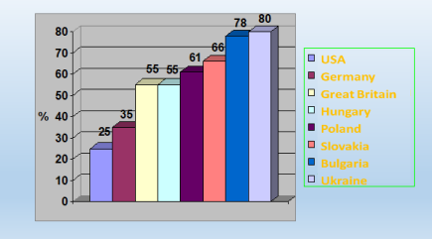

Current market situation generic drugs

Slide 8

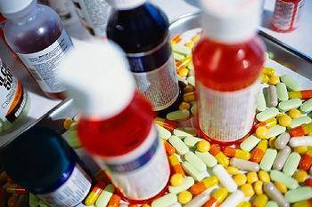
Bioavailability and bioequivalence
Problems of Ukrainian generics
Market capacity of domestic generics
compared to domestic
innovative drugs – 80-90%
Researched on
bioequivalence – 0,….1%
How did the other 99.9% get into the market?
UKRAINE

Slide 9
The ratio of brands and generics in the global pharmaceutical market
Country | Brands | Generics
USA | 78 | 22
Japan | 70 | 30
Germany | 65 | 35
France | 50 | 50
England | 45 | 55
Italy | 40 | 60
Canada | 36 | 64
Russia | 10 | 90
Ukraine | 18 | 82

Slide 10
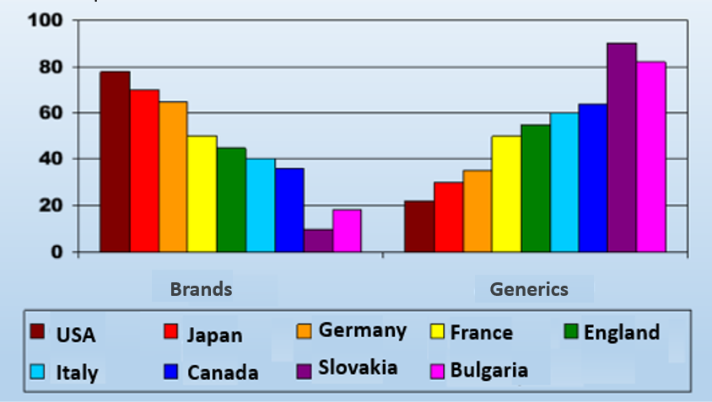


The ratio of brands and generics in the global pharmaceutical market

Slide 11
Ways to create brands and generics
Brands
Generics
Stage 1
Scientific idea and
its justification
Not held
Stage 2
Directed synthesis
or random screening
Not held
Stage 3
Development of production technology
Adaptation of technology for "own" production
Development of analytical control methods
Playback
already developed
control method
Stage 4
Extensive preclinical study in an experiment
on animals
Stage 5
Not held
Stage 6
Clinical testing
Phases I, II, III, IV
Study
bioequivalence
Commercial success

Slide 12
Financial costs at the stages of creating original and generic drugs
Brand
GENERIC
}
}
Stage I
Scientific idea and
its justification
Not held
15%
0%
Stage II
Directed synthesis
or random screening
Not held
}
}
Stage III
Technology development
production
Technology adaptation
for "your" production
15%
5-10%
Stage IV
Method development
analytical control
Validation of methods
analytical control
Stage 5
Extensive preclinical
study in an experiment
on animals
15%
Not held
0 %
Stage VI
Clinical testing
Phase I, II and III clinical trials
tests
Study
bioequivalence
22-25%
30-40%
Stage VII
Development, implementation in
production and
market promotion
Development, implementation in
production and movement
to the market
50-6 0%
27-30%
?
?
Total costs

Slide 13
Temporary economic benefits
`
BE | from task setting to report | 1-2 months
GKI | ---------------------- | 3-6 months
MKI | ------------------------ | up to several years

Slide 14

"For" and "against" brands and generics
The cost of development in
tens of times cheaper than the brand
Market launch through
several years after the patent for the original drug expires
Efficiency and safety,
that match the brand
Availability for wide use socially
unprotected layers
population
Development cost -
millions of dollars
The time interval from the creation of an active substance to its appearance on the market is about 15 years.
High efficiency and safety, confirmed
clinical trials
in compliance with GCP and the principles of evidence-based medicine
Unavailability for widespread use socially
unprotected layers
population
GENERIC
Brand

Slide 15


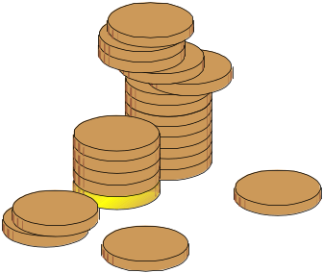

"For" and "against"
brands and generics
Security
efficiency
GENERIC
Brand

Slide 16
Similarities and differences between generic and original drugs
Similarity
Substance
Dose
Dosage form
Differences
Excipients
Production technology
NB!
Pharmaceutical equivalence
does not guarantee pharmacokinetic equivalence
Even bioavailability
Bioequivalence

Slide 17
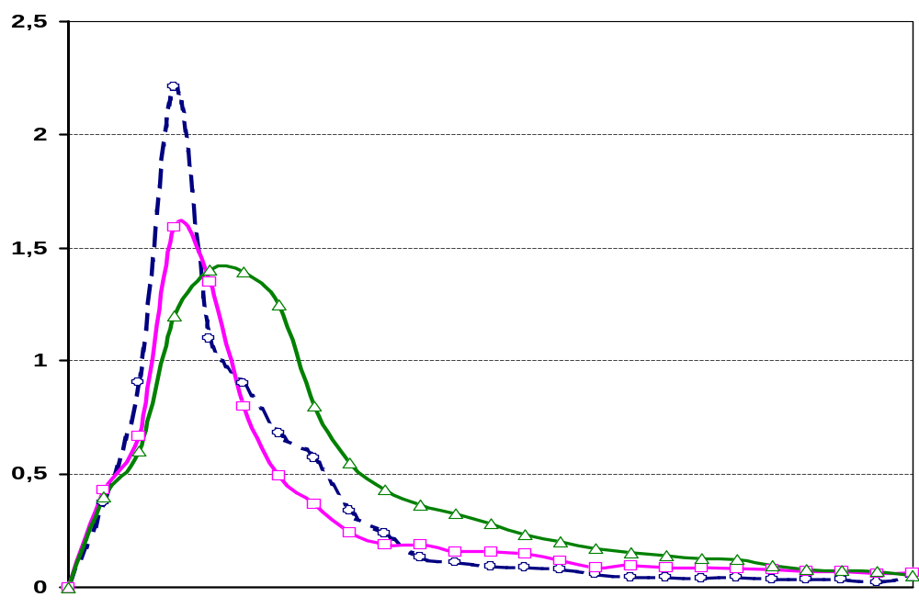
Bioequivalence study of diclofenac sodium tablets
C, μg/ml
Diclofenac sodium tablets production
firm X (highest maximum
concentration C _{max} )
Diclofenac sodium tablets production
firm Y (lowest maximum
concentration C _{max} , longer lasting
half-life)
Diclofenac sodium tablets production
firm Z (average value of maximum C
_{max} concentration has the most dramatic decrease
drug concentration in the blood)
Time, hour

Slide 18

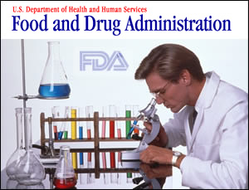
Ways to ensure proper safety of generic drugs
USA
" Orange Book" (Approved Drug Products with Therapeutic Equivalence Evaluation), FDA
Code B – a category of drugs that, for various reasons, are not available in this
the moment cannot be considered
therapeutically equivalent to the corresponding drugs
comparison
Spasokukotsky A., 2000

Slide 19
Ways to ensure proper safety of generic drugs
Ukraine
Resolution of the Cabinet of Ministers (No. 1419 of October 28, 2004) “Some measures to ensure the quality of medicinal products”
Guideline 42-7.1: 2005 "Research and Accessibility and Equivalence"​​
UKRAINE

Slide 20
Pharmaceutical factors that influence
on the bioequivalence of drugs
Physico-chemical
properties
substances
Auxiliary
substances
Quality
substances
BIOEQUIVALENCE
Technological
process
Packaging type
(glass,
plastic,
paper)
Storage conditions

Slide 21
Quality of substance
Pharmaceutical factors that influence
on the bioequivalence of drugs
Different synthesis methods
Simple chemical modification
Degree of purification from reaction intermediates
The cost of the substance is approximately half the cost of producing generics
Substances are often produced in countries inaccessible to control (China, India, Vietnam)

Slide 22
Pharmaceutical factors that influence
on the bioequivalence of drugs
Quality of substance
Simple chemical modification – changing a part
molecules with the preservation of the structure responsible for
pharmacological effect (salt, ester, base, etc.)
C
H
About
H
H
C
H
2
About
H
H
2
.
.
HSO ₄ ⁻
About
H
C
l-​
About
H
About
C
l
H
About
H
H
H
H
About
H
H
About
H
H
H
About
H
N
H
3
+
About
H
N
H
3
+
glucosamine hydrochloride
glucosamine sulfate

Slide 23
Pharmaceutical factors that influence
on the bioequivalence of drugs
Quality of substance
Degree of purification from reaction intermediates (toxic impurities, degradation products)
Comparable property | Hydrochloride glucosamine | Sulfate glucosamine
Purity (of a specific salt) | 99% | 80%
Bioactive glucosamine (as free base) | 83.1% | 62.8%
Equivalent dose (based on activity) | 1500 mg | 1995 mg
.

Slide 24
As a result of a comparative study in the USA (2003) of Clarithromycin (Abbott) and 40 generics from 13 countries in Asia and Latin America, it was established:
In 8 drugs, the content of the active substance did not meet the standards of the developing company
In 28 generics, the amount of active ingredient released upon dissolution was significantly lower than in the original drug.
24 drugs exceeded the 3% limit of permissible impurities
Belousov Yu., 2004

Slide 25
Physico-chemical properties of the substance
Pharmaceutical factors that influence
on the bioequivalence of drugs
Dispersion
steroids
sulfonamides
solubility
speed and extent of resorption
digitalis glycosides
concentration in biological fluids
anti-tuberculosis
ASK
pharmacological effect
antibiotics
nitrofuran derivatives

Slide 26


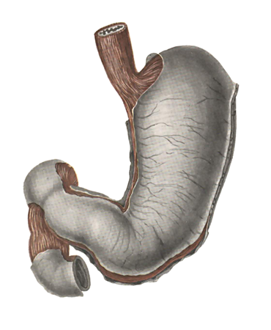
Pharmaceutical factors that influence
on the bioequivalence of drugs
Physico-chemical properties of the substance
Dispersion
Amorphous zinc-insulin suspension
2 microns
10-40 microns
Short
effect
Extended
action
Crystalline ASA powder with size
particles around 1680 microns cause more
frequent and intense stomach pains
bleeding than fine powder
(about 125 microns)

Slide 27




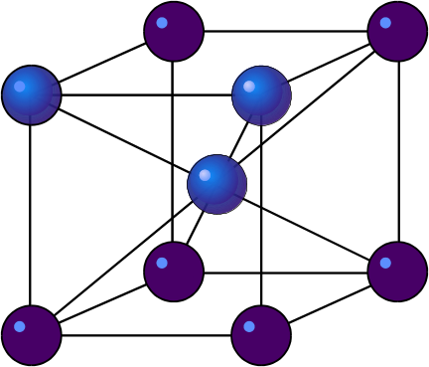
Pharmaceutical factors that influence
on the bioequivalence of drugs
Physico-chemical properties of the substance
Polymorphism
(Ability to change crystal structure)
ASA – 6 crystalline forms (2 active)
Levomycetin - 4 modifications (100% activity only in 1 form)

Slide 28




Pharmaceutical factors that influence
on the bioequivalence of drugs
Physico-chemical properties of the substance
Optical properties
L-shape
chloramphenicol
(chloramphenicol)
racemate
chloramphenicol
(synthomycin)
ketamine
hydrochloride
D-form (CNS ↑)
L-form (CNS ↓)

Slide 29

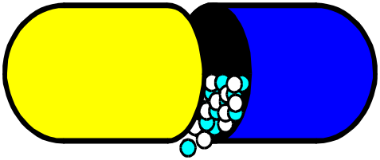
Pharmaceutical factors that influence
on the bioequivalence of drugs
Excipients
Lactose reduces the effects of isoniazid, barbiturates, and enhances the effects of testosterone.
Magnesium trisilicate and magnesium oxide → destruction of steroids
TWIN-80 enhances the adsorption of vitamins
A, D, E
Kaolin delays the release of alkaloids, anesthetics, antibiotics

Slide 30
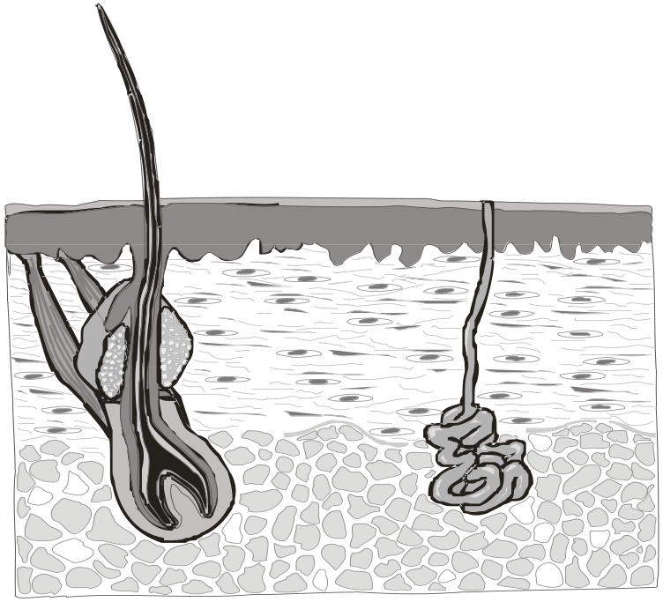
Pharmaceutical factors that influence
on the bioequivalence of drugs
Excipients
Skin absorption activators change
the structure of the epidermis due to the dissolution of lipids.
Alcohols
(ethyl,
cetyl)
Broadcasts
(cetyl palmitate,
cetyl myristate)
Dimethyl sulfoxide
sulfonamides,
steroids,
antihistamines,
anticoagulants,
salicylic
acid
Oil
turpentine

Slide 31
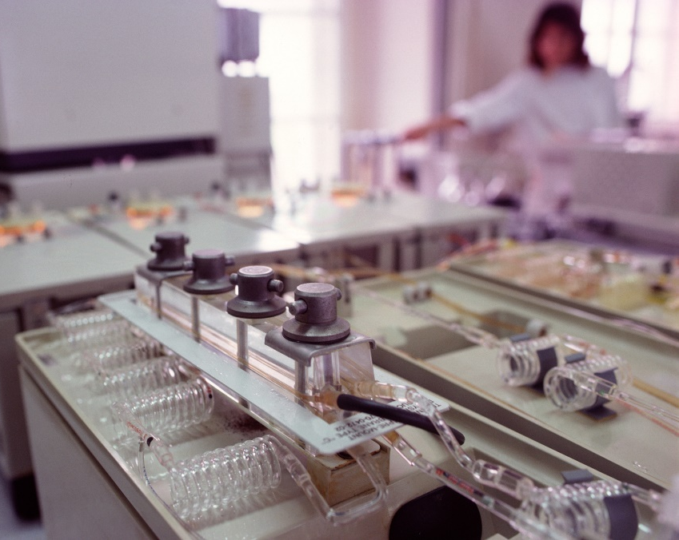
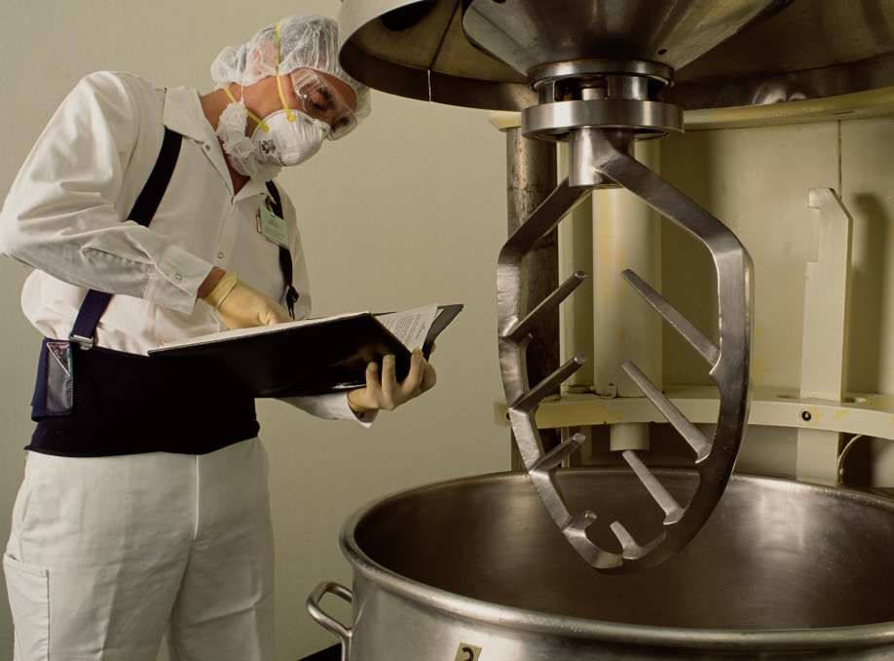
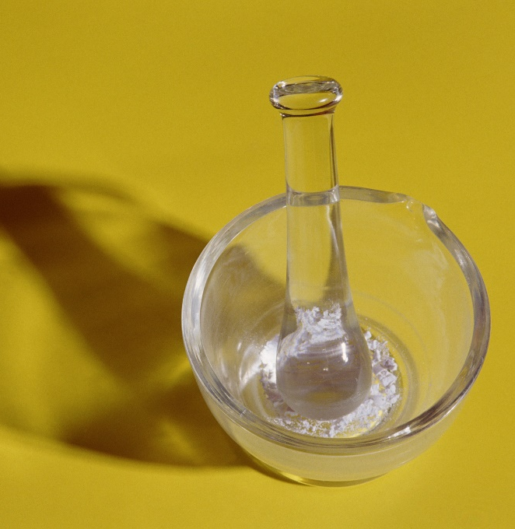
Technological process
Pharmaceutical factors that influence
on the bioequivalence of drugs
Lack of standardization in the manufacturing process
Problems reproducing some production operations
Industrial equipment

Slide 32
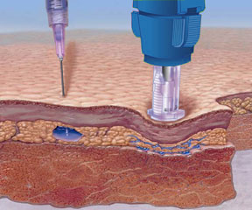
Equivalence
Pharmaceutical - a generic drug completely reproduces the composition and dosage form of the original drug
Pharmacokinetic (bioequivalence) - similarity of pharmacokinetic parameters
Therapeutic – similar to the original drug
efficiency and safety
the drug is generic
with pharmacotherapy

Slide 33

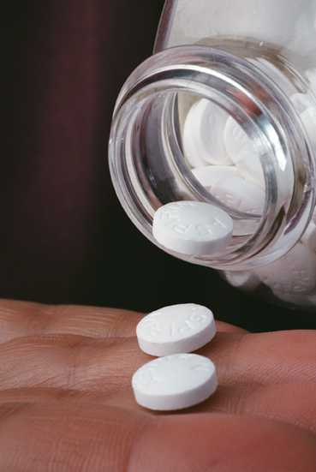
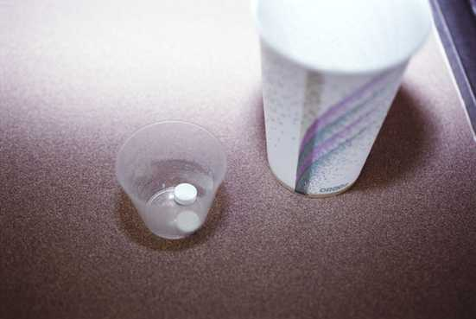
Bioequivalence (WHO definition)
Two drugs are considered bioequivalent if they are pharmaceutically equivalent, have the same bioavailability, and provide adequate efficacy when administered in the same dose.
and safety.

Slide 34
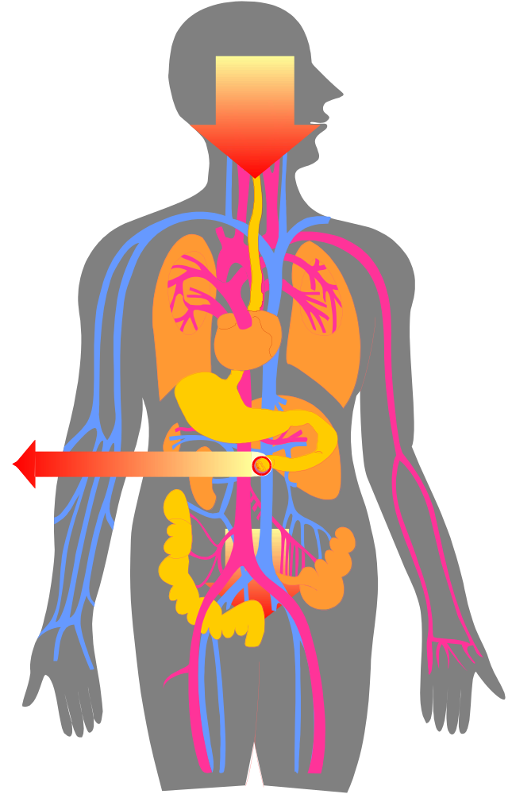

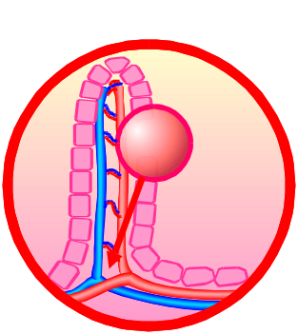



Bioavailability
Bioavailability is the rate and extent to which an active substance is absorbed.
from a ready-made medicine
forms and accumulates
in the place of its intended
actions.

Slide 35

Requirements for medicines, included in the form
proven pharmacotherapeutic properties based on numerous clinical (including multicenter) trials
A drug should be a leader in its pharmacotherapeutic group
(in the nitrate group, the leaders are nitroglycerin and isosorbide 5-mononitrate)
pharmacoeconomic
advantages
proven
bioequivalence
generics

Slide 36
Definitely appreciate
drugs for the treatment of conditions where a guaranteed therapeutic effect is required
drugs with a narrow therapeutic safety margin
drugs whose pharmacokinetics are complicated by a decrease in absorption of less than 70% or with high elimination (over 70%)
drugs with unsatisfactory physicochemical properties (low solubility, instability, polymorphism)
drugs with documented bioavailability problems

Slide 37
Comparison drug – comparator
Problems:
it is difficult to establish a brand
the brand was discontinued
sold the patent
merger of pharmaceutical companies
choosing a market "leader"
"Photocopies of copies"
WHO – development of the “gold standard”
regarding bioequivalence
1999 - 1st ^{version} of comparators
LIST A
LIST B

Slide 38
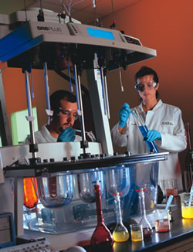
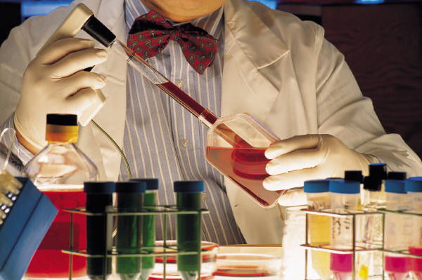
Research methods
Physico-chemical
  HPLC method – 80-90% of all used means
  Chromatography-mass spectrometry method: combines GC and LC and MS – sensitivity up to 10 ⁻¹² g of substance in the sample
Microbiological methods
  agar diffusion method
  serial dilution method
  turbidimetric method
Immunological methods
  radioactive label
  free radical label
  fluorescent label
  enzyme label
In vitro dissolution

Slide 39
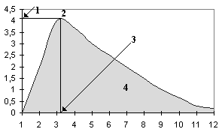
Drug parameters determined for bioequivalence

Slide 40
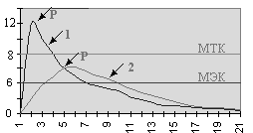
Drug parameters determined for bioequivalence
4

Slide 41
Bioequivalent
medications
these are pharmaceutically equivalent or pharmaceutically alternative drugs that have comparable bioavailability when tested under similar experimental conditions

Slide 42
Bioequivalence studies
carried out if:
· There is a risk of lack of bioequivalence and/or
· There is a risk of reducing the pharmacotherapeutic effect and clinical safety of the drug.

Slide 43
The importance of definition
bioequivalence
The cost of raw materials for generic drugs is about 50% of the cost of production, which may encourage unscrupulous manufacturers to search for cheaper (and lower quality) raw materials.

Slide 44
The importance of definition
bioequivalence
Excipients play an important role in the safety of medicinal products. When creating generic drugs, it is necessary to require the preservation of the original composition of excipients, which is not always known. The use of excipients in generic drugs is regulated based on WHO recommendations.

Slide 45
Formulary system – health care doctrine
The doctor prescribes only those medications and uses those standards of treatment that are optimal in terms of effectiveness, safety, and affordable.
In today's conditions, a doctor is not free to use all his scientific knowledge and guide the patient, since he is recommended
this or that scientist, this or that school.
We cannot allow this today,
although in some cases this approach is legitimate.

Slide 46
Requirements for medicines, included in the form
proven pharmacological properties based on numerous clinical studies
(including multicenter) trials
A drug should be a leader in its pharmacotherapeutic group
(in the nitrate group, the leaders are nitroglycerin and isosorbide 5-mononitrate)
pharmacoeconomic advantages
proven bioequivalence of generics

Slide 47
Research objects
The objects of bioequivalence studies are reconstituted medicinal products intended for extravascular (but not parenteral) administration, provided that their effect is recognized by the appearance of the medicinal product in the systemic bloodstream.
The corresponding original drug should be used as a comparator drug, if it is officially registered in Ukraine , or its analogue, which has found the widest medical use in Ukraine .
The drug content in the study drug and the comparator drug should not differ by more than 5%.

Slide 48
LITERATURE
Additional guidance for organizations performing in vivo bioequivalence studies / WHO TRS N 937 (2006). - Annex 9.
CPMP/EWP/QWP/1401/98/Rev.1/Corr Guideline on investigation of bioequivalence. EMEA, 2010.
Clinical trials of drugs / Edited by V.I. Maltseva, T.K. Efimtseva, Yu.B. Bilousova, V.M. Kovalenko. - 2nd ed., Revised and supplemented. - K.: Morion, 2006. - 456 p.
Guideline ST-N MOZU 42-7.0:2008 “Medicines. Good clinical practice”. - K., 2009. - 48 p.
Procedure for conducting clinical trials of medicinal products and examination of clinical trial materials and Model Regulations on the Ethics Commission (approved by Order of the Ministry of Health of Ukraine dated September 23, 2009 No. 690 as amended by Order of the Ministry of Health of Ukraine dated July 12, 2012 No. 523).
Clinical Research Manual. “Medicines.
Principles of application of mathematical statistics methods for determining bioequivalence: Methodological recommendations / Chubenko A.V., Babich P.N., Lapach S.N., Efymtseva T.K., Maltsev V.I., Rudyk Y.S.: "Avicenna", 2004. - 66 p.
World Medical Association Declaration of Helsinki: Ethical Principles for Medical Research Involving Human Subjects (2004).

Slide 49

Thank you for your attention!

