Slide 1
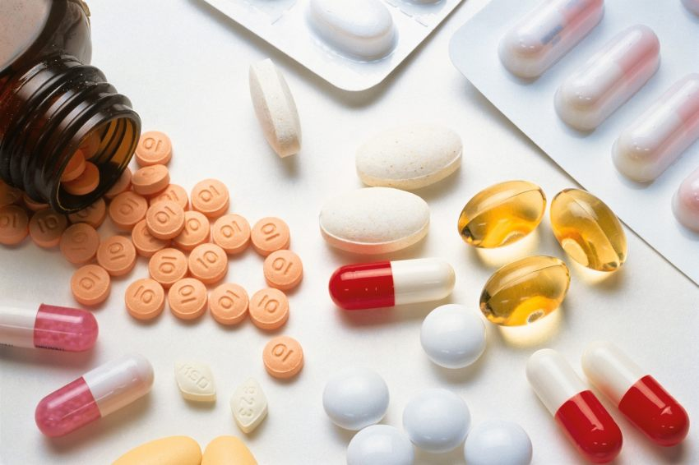
Topic:
"Bioavailability of medicinal substances"
Odessa National Medical University
Faculty of Pharmacy
Department of Pharmaceutical Chemistry and Drug Technology
Associate Professor Zamkovaуa A.V.
Odesa 2025

Slide 2
The biological effect of medicinal substances is largely determined by the features of their entry into the systemic bloodstream, as well as those organs and tissues in which their specific action occurs. In modern biopharmaceutical research, the criterion for assessing the degree of influence of pharmaceutical factors on the therapeutic activity of a medicinal product is bioavailability.
It is precisely with differences in bioavailability that differences in the therapeutic efficacy of drugs containing the same active substances are most often associated.

Slide 3
Biological availability (DB) – part of the administered drug substance that enters the systemic bloodstream during oral , intramuscular, inhalation, and other routes of administration.
Biological availability (DB) is determined relative quantity medical substances that have reached systemic blood flow ( degree of DB) and the speed at which this process occurs ( speed suction ), as well as duration finding him in a certain concentrations in the body .
It is obvious that with intravascular administration, the DB of the substance will be 100%, while with other routes of administration (oral, rectal, intramuscular, etc.) it is much lower and almost never reaches 100%.

Slide 4
The main task Determining the bioavailability of drugs is to ensure their maximum effectiveness and prevent therapeutic inequivalence at a certain concentration in the body.
Bioavailability research answers the question:
• what part of the dose of the medicinal substance was absorbed;
• how quickly the absorption occurred;
• how long the drug was in the body;
• at what concentration the medicinal substance was distributed in the internal environment of the body.

Slide 5
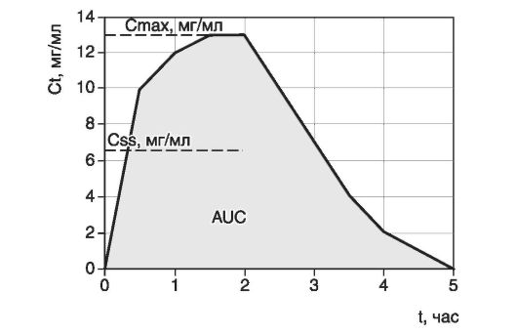
on bioavailability of drugs is affected next factors :
- way entry drug ( enteral , parenteral );
- features organism sick person ;
- biopharmaceutical factors ( structure of LV, composition medical forms , features technology production ) .
The dynamics of changes in the concentration of any LH is characterized by approximately the same dependence;

Slide 6
Two method definition bioavailability :
Pharmacokinetic method ;
Pharmacodynamic method ;
The pharmacokinetic method is based on measuring the change in the concentration of a drug substance in the blood plasma over time or by determining the total amount of the drug substance or its metabolites excreted in the urine after administration of a single or repeated doses.
The pharmacodynamic method is based on the measurement of pharmacodynamic or biochemical responses to a drug substance or its active metabolites. The second method is more complex, so the determination of the DB is more often carried out using the pharmacokinetic method.

Slide 7
The degree of BD is the ratio of the amount of unchanged drug substance absorbed and detected in the blood after its administration in the form of an investigational dosage form to its amount in the blood after administration in a standard dosage form, expressed as a percentage.
The degree of BD is determined in comparison with a standard dosage form that is well absorbed. This uses the same doses of the standard and the study drug.
DB degree = A / B * 100%
B – the amount of drug substance absorbed after its administration in the studied dosage form (mg);
A is the amount of drug substance absorbed after administration in a standard dosage form (mg).

Slide 8
There are absolute and relative bioavailability.
As a standard dosage form for determining absolute bioavailability, a solution for intravenous administration is used , which ensures immediate and complete entry of the drug substance into the large circle of blood circulation. In the annotations to medicinal products, the absolute BD is indicated , which is most often denoted as F%.
The absolute bioavailability of orally administered drugs is optimal when the BD is within 40 - 60%; high when the BD is over 60%; low when the BD is less than 40%.
For example, the F% of Cavinton tablets containing 0.005 vinpocetine is 70%, and of 0.005 vinpocetine tablets is 54%.

Slide 9
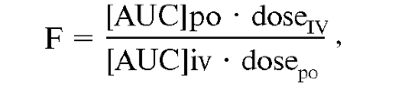
Absolute bioavailability (F) used to estimate the total amount of LH that has entered the patient's blood from a given drug, compared to a solution of the same substance administered intravenously
d e [ AUC ] po , [AUC]iv – areas under the curve of concentration dynamics ;
dose _{po} , dose _{iv} – dosage of a medicinal substance by oral ( po ) and intravenous ( iv ) methods.

Slide 10
In fact, it is more common to determine the relative BD , in which case the standard is a solution or other dosage form for oral administration that is well studied and well absorbed.
When studying rectal dosage forms, the standard dosage form for relative DB is a solution - an enema , and for low solubility of the drug substance - a suspension of micronized powder .
The relative DB is determined by comparative assessment of the interchangeability of the original and reproduced medicinal products, as well as when developing other dosage forms of the medicinal substance.
In the study of bioequivalence of reconstituted drugs, the original drug or its analogue is used as a comparison if it is the most effective in this therapeutic group. The studied and standard drugs are bioequivalent (interchangeable) if the value of the relative BD is in the range from 75 to 125%.
Thus, the choice of a standard dosage form is a crucial stage of biopharmaceutical research that cannot be conducted arbitrarily and unreasonably.

Slide 11
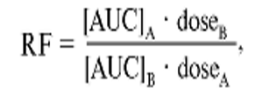
Relative bioavailability measured in comparison with a reference drug using the same route of administration. Relative bioavailability is used to compare different drug series, for drugs with changed production technology, for drugs manufactured by different manufacturers, and for different dosage forms.
d e [ AUC ] po , [AUC]iv – areas under the curve of the dynamics of dosage forms A and B . ;
dose _{A} , dose _{B} – dosage of the medicinal substance in

Slide 12
The bioavailability of the same drugs made by different companies (example: cocarboxylase of Polish origin and made in Dnipropetrovsk) is determined by comparing chemical, biological and therapeutic equivalence.
CHEMICAL EQUIVALENCE is the coincidence of not only the chemical formula of the drugs, but also the coincidence of isomerism, the spatial configuration of atoms in the molecule of the medicinal substance.
BIOLOGICAL EQUIVALENCE means the same, equal concentration of the active substance in the blood when taking a drug from different companies.
THERAPEUTIC EQUIVALENCE implies the same, equivalent therapeutic effect.

Slide 13
When administered intravenously, the bioavailability of various drugs is maximal, i.e. equal to 100%. With any other route of administration, it never reaches its maximum, since the completeness and rate of absorption depend on many biological and pharmaceutical factors.
Biological factors include the individual characteristics of the patient's body (gender, age, body weight), the state of the absorption systems (depending on the site of administration), and the characteristics of the distribution, biotransformation, and excretion of LH.
Of the pharmaceutical factors, the main importance is given to the chemical and physicochemical properties of the drug, the dosage form in which it is prescribed, the nature of the excipients used to manufacture the dosage form, the features of the production technology of the dosage form , etc.
The entry of a drug into the systemic bloodstream occurs through its release from the dosage form and subsequent absorption through biological membranes. The release of a drug is determined by the rate of disintegration of the dosage form and the time of dissolution of the substance in biological fluids.

Slide 14
a linear relationship between the rate of dissolution of LH in biological fluids and its bioavailability . The most objective data is provided by the method of direct measurement of drug concentrations in plasma and/or urine.
For example, absolute bioavailability can be determined by comparing the plasma concentrations of any LH after intravenous administration of its solution and after administration by another route.
Bioavailability can also be determined by comparing concentrations of LH administered by the same route in different dosage forms, one of which is the reference.
Bioavailability assessment is one of the important stages in the development process and in the introduction of new drugs and preparations.

Slide 15
General scheme for determining the bioavailability of drugs
Bioavailability can be determined by determining the content of the substance in the blood or excretion of the drug substance or its metabolite with urine after a single or multiple administration of the drug. These methods determine the BD for parenteral, oral, rectal routes of administration. The bioavailability of ointments, liniments, patches is determined when applied to the skin. The bioavailability of rectal dosage forms of local action is assessed after applying the drug to the mucous membrane of the rectum, vaginal dosage forms - to the mucous membrane of the vagina.

Slide 16
General scheme for determining the bioavailability of drugs
The degree of absorption of drugs depends on both pharmaceutical and physiological and biochemical factors. Physiological factors include age, sex, physical condition of the patient, time of drug administration, route of administration, nature of food gruel and degree of filling of the digestive tube. In order to take into account the influence of physiological factors, bioavailability is determined by a double-blind cross-over method (A/B and B/A) in humans who follow the appropriate instructions on the regimen and diet depending on the type of drug under study. In this case, the subjects are prescribed the drug in the form of a standard dosage form and the concentration of the drug substance is determined for the required time, then after the complete elimination of the drug substance from the body, after a set time interval, the drug is prescribed in the form of the studied dosage form, and the concentration of the drug in the blood or other biofluid is similarly determined.

Slide 17
General scheme for determining the bioavailability of drugs
The first stage in studies on DB is the introduction of the drug substance in a dosage form, the manufacture of which used various pharmaceutical factors. At this stage, a mandatory requirement is the equivalence of the conditions of drug administration to the entire group of subjects (same weight, sex of the animal, diet and content).
The second stage of research involves the sequential collection of samples of biological fluids of the body over a strictly defined period of time. At this stage of research, the time and frequency of sampling are of great importance. The half-life of a drug in the body is the time during which the concentration of the drug substance in the plasma decreases by 50%.

Slide 18
The start of sampling and the frequency depend on the type of dosage form and the route of administration. With intravenous administration, blood sampling begins 5 minutes after injection and continues at 10-15 minute intervals. In this case, the DB of the drug is the most complete, almost 100%.
With other methods of drug administration, it is necessary to determine the time of reaching the peak concentration of the pharmacokinetic curve after the beginning of the decrease in the concentration of the drug in the blood. As a rule, with a single administration of the drug, 12-16 blood tests are sufficient during the experiment. • strictly justified sampling frequency to accurately record the drug excretion lag time and peak concentration.

Slide 19
With a single administration of a drug, the urine collection time is equal to 7-10 periods of the biological half-life of the drug in the body, since it is during this period that 99.9% of the administered drug substance has time to be eliminated from the body. The disadvantages of the method of determining the DB based on data on the excretion of the drug with urine are the possible loss of a urine sample and the need for the subjects to take a large amount of fluid: 400 ml of water 1-2 hours before the start of the experiment and 200 ml of water every hour during all studies. In some cases, the method of multiple administration of the drug is used to determine the DB. In this case, the following conditions must be observed: 1. The DB is determined only after achieving a stable concentration of the drug in the blood, which is observed after taking 5-10 doses. 2. Reasonable intervals for administering the drug, taking into account the period of its biological half-life, in order to avoid cumulation. 3. The frequency of sampling for analysis should provide a clear limit of peak concentrations. 4. Accurate determination of the minimum and maximum concentration of the drug over time.

Slide 20
The positive aspects of the method of multiple administration of the drug are:
• relatively high content of the drug in the blood, which facilitates analytical operations and increases the accuracy of determination;
• limited number of blood samples. However, for the correct determination of bioavailability, the physiological state of the patient is important. In some cases, the DB of the drug should be determined in individuals with various pathological conditions: - with renal failure, if medicinal substances are excreted through the kidneys; - with hepatic failure, if medicinal substances are metabolized and metabolites are pharmacologically active; - with lesions and dysfunctions of the gastrointestinal tract, etc.

Slide 21
The third stage of determining the DB is the determination and calculation of the drug concentration in the biofluid. The determination of the concentration of the drug substance in a biofluid sample is carried out by various chemical or physicochemical methods. Correction factors are used in the calculations, since in biofluids the drug substance is bound in complexes with other endogenous substances of the body, which are being removed during the analysis.
At the fourth stage, the obtained experimental results are subjected to statistical processing. Tables of the obtained data are compiled and graphs are constructed that reflect the kinetics of a particular drug in the body (Fig. 1). The fifth stage of research includes analysis of the obtained indicators and substantiation of the experimental conclusions.

Slide 22
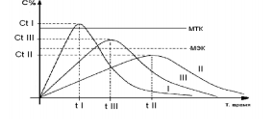
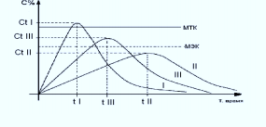
The degree of absorption of the drug and the time of its appearance in biofluids are characterized by the sum of the following indicators: 1. The area under the curve on the graph that records the transport of the drug substance in the body (AUC). 2. The maximum peak concentration of the drug substance in the biofluid Сt . 3. The time of reaching the maximum peak concentration (t). One of the main indicators is the area under the curve on the graph that reflects the kinetics of diffusion. The area under the pharmacokinetic curve AUC indicates the total content of the drug substance in the biofluid of the macroorganism for the entire time of the study, but does not reflect the rate of its sequential entry, is not an expression of biological or therapeutic equivalence.
Fig. 1. Hypothetical curves reflecting the content of a medicinal substance in the blood after its administration in equal doses in the form of three identical oral dosage forms, differing in the method of manufacture [A.I. Tentsova , 1974],
where MEK – minimum effective concentration of substances in the blood, MTK – minimum toxic concentration of substances in the blood; CtI – “peak” concentration of substances after administration in dosage form I, Сt II – “peak” concentration of substance after administration in dosage form II, СtIII – “peak” concentration of substance after administration in dosage form III, tI – time of reaching the “peak” concentration after administration in dosage form I, t II – time of reaching the “peak” concentration after administration in dosage form II, t III – time of reaching the “peak” concentration after administration in dosage form III; I, II, III – curves of concentration of substance prescribed in dosage forms I, II, III, respectively.

Slide 23
Fig. 1 shows that the areas under the curve of the same drug substance administered in different oral dosage forms (AUC I, AUC II, AUC III) are equal, however, when analyzing the pharmacokinetic curves, the non-equivalence of the dosage forms is clearly visible. Drug II does not provide the minimum effective concentration necessary for therapeutic action. When prescribing a drug in form I, the minimum toxic concentration and the level of therapeutic concentrations are exceeded. The time to achieve the maximum peak concentration also varies significantly. The most difficult and responsible decision regarding bioavailability is to make a decision on the bioequivalence of drugs. It is generally accepted that drugs are bioequivalent if the difference in DB does not exceed 25%.

Slide 24
Factors affecting the DB
The influence of drug administration routes on bioavailability: oral route of drug administration.
Most medicinal substances are administered orally, that is, through the mouth.
Bioavailability can be affected by:
- gastrointestinal enzymes;
- composition and temperature of food;
- the nature of the liquid used to wash down the medication;
diets.

Slide 25
The rectal route of administration of drugs ensures their rapid absorption (after 7-10 minutes). It is used for the purpose of both local and general action. With rectal administration of drugs, a minimum therapeutic concentration is created in the blood after 5-15 minutes. This is explained by the presence of a dense network of blood and lymphatic vessels in the rectum, good absorption of drugs soluble in both water and fats through the mucous membrane of the rectum. Substances absorbed in the lower part of the rectum enter the systemic bloodstream through the lower hemorrhoidal veins, bypassing the hepatic barrier. The fact that with rectal administration of drugs is not destroyed by the enzyme system of the liver as a result of the "first-pass effect" significantly increases their bioavailability compared to oral administration.
With rectal administration, bioavailability may be affected by individual characteristics of the blood supply to the rectum and the condition of its mucous membrane .

Slide 26
When administered by inhalation, the drug substance is rapidly absorbed through the bronchial mucosa into the systemic bloodstream, without being exposed to primary metabolism in the liver. With this route of administration, the bioavailability of drugs can be affected by concomitant diseases of the bronchopulmonary system, smoking, and the state of blood circulation in the bronchopulmonary system.
Body and environmental temperature significantly affect the course of physiological and biochemical processes in the body.
In conditions of increased temperature and humidity, the transfer of heat from the body to the environment becomes difficult and can only be carried out when the mechanisms of physical thermoregulation are stressed. Difficulty in heat transfer leads to overheating of the body. An increase in body temperature is accompanied by a sharp excitation of the CNS, respiration and blood circulation, and increased metabolism. Profuse sweating leads to dehydration of the body, thickening of the blood, a decrease in the volume of circulating fluid, and electrolyte imbalance. All this, in turn, affects the processes of absorption, distribution and metabolism of drugs, their bioavailability .
The influence of temperature on the pharmacokinetics of drugs must be taken into account in clinical practice in cases where drugs are prescribed to patients with severely impaired thermoregulation.

Slide 27
Age also affects the bioavailability of drugs. Young patients are characterized by higher rates of absorption, excretion, and the shortest time to reach maximum drug concentration; older patients have higher drug half-lives.
When prescribing medications to children, it is important to remember that in children under one and a half years of age, the bioavailability of drugs taken orally differs only slightly from that in adults. However, their absorption is very slow. As a result, small concentrations are created in the blood plasma, often insufficient to achieve a therapeutic effect.
One of the most powerful factors affecting a person and the effectiveness of drug therapy is the action of biorhythms . Every cell in our body feels the alternation of day and night. For a person, an increase in daytime hours and a decrease in nighttime physiological functions are characteristic.
The question of the effect of medicinal substances on the body depending on the time of day and seasons is studied by chronopharmacology , which establishes the principles and rules of rational drug administration, and seeks schemes for their use for the treatment of desynchronosis . When the body's biorhythms do not match the time sensors , desynchronosis develops , which is a sign of physiological discomfort. The intensity of absorption, transport, and breakdown of various medicinal substances fluctuates significantly throughout the day .

Slide 28
The influence of pathological processes and individual characteristics of the organism
The body's response to drugs is of great importance in its initial state. Many pathological processes lead to disruption of the barrier function of biological membranes, changes in the permeability of biological barriers. Also important are processes accompanied by changes in the electrolyte homeostasis of tissues, which causes mechanical stretching of membranes. The presence of pathological processes also causes altered reactivity of cells and tissues to medicinal substances.
The influence of alcohol.
Alcohol negatively affects the therapeutic effect of many drugs and is the cause of dangerous complications. Ethanol affects the pharmacodynamics and pharmacokinetics of drugs in various ways.

Slide 29
The impact of smoking.
The action of drugs can be influenced by substances that enter the body during smoking. Nicotine activates H-cholinergic receptors, which leads to activation of sympathetic and parasympathetic ganglia, adrenal medulla, and CNS dysfunction. Stimulation of the adrenal medulla leads to peripheral vasoconstriction, which disrupts the blood supply to many organs and tissues. Activation of parasympathetic ganglia increases the secretion of acidic gastric juice, which plays a role in the absorption of drugs. In some cases, the effect of smoking on the bioavailability and therapeutic efficacy of drugs requires further study.
Thus, when prescribing drugs and assessing their therapeutic efficacy and toxicity, it is imperative to take into account the effects of numerous factors of the external and internal environment.

Slide 30
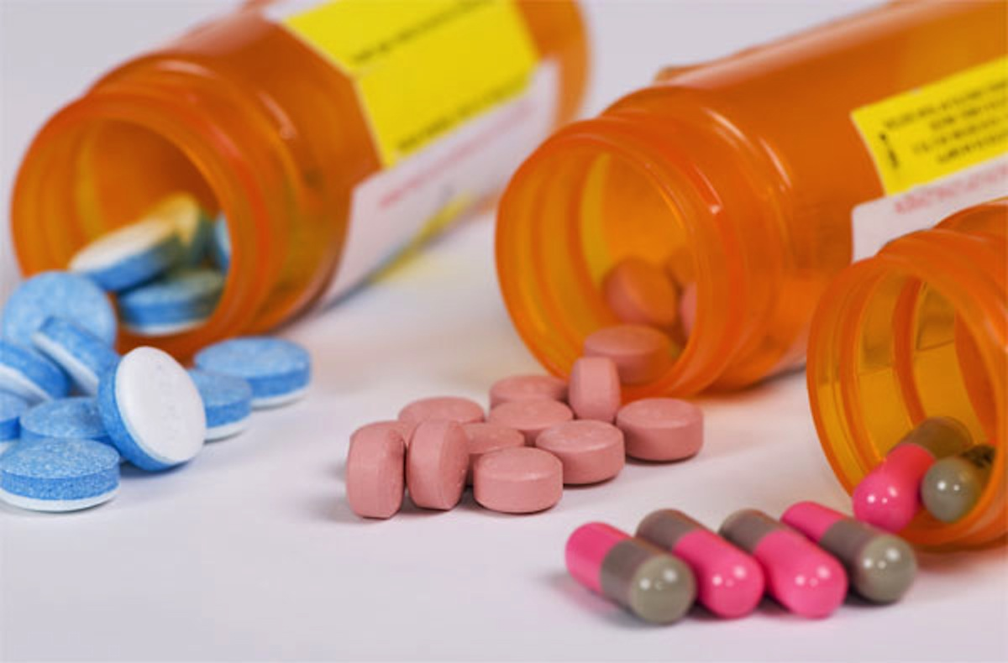
Thank you for your attention!

