Slide 1

ODESSA NATIONAL MEDICAL UNIVERSITY
PHARMACEUTICAL FACULTY
DEPARTMENT OF PHARMACEUTICAL CHEMISTRY
AND DRUG TECHNOLOGY
Molecular weight, solubility, acidity, alkalinity, state of aggregation and polymorphism as physicochemical factors affecting bioavailability Leaky
Associate Professor Zamkovaya A.V.
Odesa 2025

Slide 2
In recent decades, several generations have changed among dosage forms.
1. Traditional dosage forms are tablets, ointments, suppositories, injection solutions and other drugs with a short biopharmaceutical phase, their bioavailability is unsatisfactory; in addition, they are characterized by single use.
2. Prolonged dosage forms are slowly dissolving tablets, injection solutions with a complexing agent, oil solutions, etc. They slowly release active ingredients and, therefore, provide a therapeutic effect for a longer period of time, creating a depot of the drug in the body.
3. Controlled-release dosage forms. Such forms are necessary for drugs that are taken for a long time (weeks, months, years), which is especially important for the treatment of chronic diseases.

Slide 3
The third generation dosage forms are characterized by:
- continuous, long-term LH supply (from several weeks to several months);
- Ability to choose the drug release rate;
the possibility of delivering minimal amounts of active ingredients into the body, which reduces their consumption;
- Medicinal substances are isolated from the internal environment of the body, which significantly reduces their side effects.

Slide 4
Third-generation dosage forms are divided into two groups:
1 - reservoir systems with programmed release of medicinal substances (C-1);
2 - systems for targeted delivery of medicinal substances (C-2).

Slide 5
C-1 systems provide a stable supply of medicinal substances to the body, reduce their side effects, contain a certain amount of medicinal substances that are released from C-1 over a given period of time. These are the so-called reservoir systems, consisting of 4 main components:
- Reservoir for medicinal substances;
- Device for monitoring the receipt of drugs;
- Energy source;
- Element of communication with the biological system

Slide 6
C-2 - targeted drug delivery systems - create good prospects in the field of drug therapy associated with the targeted delivery of medicinal substances to a given target organ (tissue). These systems allow significantly reducing the toxicity of drugs and their economical use (since 90% of the drugs used do not reach the target), reduce side effects and reduce the dose of drugs administered.
C-2 is liposomes, nanoparticles, and navocapsules. With the help of special drug delivery systems, the following can be delivered:
- In a given organ (lungs, liver);
- organ-specific cells (endothelial cells and organs);
- into specific cell structures (lysosomes, cytoplasm, etc.).

Slide 7
Therapeutic delivery systems (TDS) are devices or dosage forms that release a drug substance at a programmed rate at specific intervals.

Slide 8
Depending on the route of administration, TK can be classified into systems:
oral;
transdermal;
intraocular;
intracavitary (intrauterine, rectal, etc.);
implant (silicone);
infusion.
The delivery of drugs to a given area of the body occurs in several stages:
- Release of drugs from the system;
- Diffusion into the local bloodstream;
- transportation to the organ.

Slide 9
Oral TK
They are coated pills with holes. They are also called elementary osmotic pumps. The release of LH here is influenced by the following factors:
- nature of excipients;
- Ratio of polymer and drug amounts;
- Matrix tablet shape;
- Presence of a shell.
Depending on the nature of the BP matrices, they are divided into hydrophilic, hydrophobic, inert, and inorganic.

Slide 10
The porosity of the matrix significantly affects the drug release rate, which is regulated by the force of the pressing pressure, the degree of grinding of the matrix components, and the amount of easily soluble substances - converters. Sodium chloride, PEG, etc. are used as converters.

Slide 11
"Oros" pills perform the functions of an osmotic pump. They consist of a core with water-soluble medicinal substances and BP, as well as a semi-permeable soluble membrane, in which a hole is made using a laser. As water penetrates through the film, the substance in the core dissolves slowly. The resulting saturated solution absorbs, under the action of osmotic pressure, a new portion of water penetrating through the membrane, and continuously squeezes the solution with the active substance out through the hole (into the stomach or intestines) (Fig. 1).
The advantage of this form is that the introduction of active substances does not depend on pH and the possibility of accurately calculating the degree of release.

Slide 12
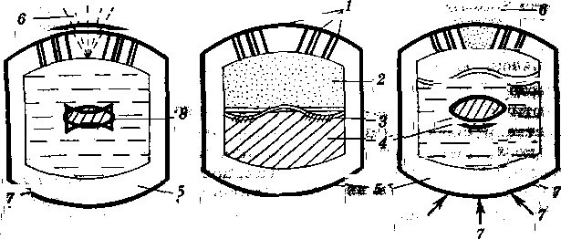
Fig. 1. Oral therapeutic systems of the “OROS” type:
1 - two-tier device ; 2 - chamber with a suspension of the medicinal substance;
3 - semipermeable partition; 4 - chamber with osmotic agent
5 - water-permeable membrane; 6 - medicinal suspension
substances; 7 - water; in - the core of the tablets and

Slide 13
Ocular therapeutic systems
GTS is the most modern technological achievement in the creation of long-acting drugs used in the treatment of various eye diseases.
Advantages:
- Dosing accuracy fluctuating over time +20%;
- avoiding contact with the eyes of BP, which are usually included in eye drops;
- Stability of the pH of tear fluid;
- Ensuring long-term action;
- Reducing the number of injections to once a week;
- Reduction of substance consumption.

Slide 14
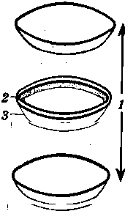
Fig. 2. Structural diagram of the diffusion therapeutic system.
1 – drug-releasing membrane;
2 – reservoir with medicinal substance;
3 – painted rim

Slide 15
Intracavitary therapeutic
systems
This group includes intrauterine, rectal and other
types of intracavitary therapeutic systems (ITS). For example, an example of an intrauterine device is the Progestosert system, which has a T-shape and contains 38 mg of progesterone in the form of a suspension in silicone oil with the addition of barium sulfate, which improves its radiolocalization.
This IUD is an improved contraceptive device, which is a horizontal arm and two thin threads that help to hold it in the uterus (Fig. 3.). The reservoir with the drug is contained in the vertical arm. The released progesterone, as a result of diffusion, passes through the copolymer shell (which controls the rate of its release), and then falls into the body cavity.

Slide 16
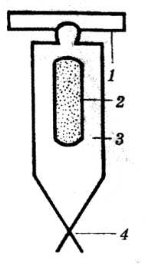
Fig. 3. Intra-band therapeutic system:
1 – horizontal arm;
2 – progesterone reservoir;
3 – a shell that controls the release rate;
4 – nylon threads

Slide 17
Implantable therapeutic systems (silicone systems)
These systems are used in the form of capsules, balls, pencils and contribute to high physical, chemical, biological stability. Silicones, depending on the type of base, play the role of a reservoir for medicinal substances.
The release rate is equal to the diffusion rate, which depends on the concentration of medicinal substances in the silicone, their solubility in it, and the thickness of the silicone surface forming the system.

Slide 18
Infusion therapy systems
Infusion therapy systems (ITS) are very diverse in terms of structure and location of application. They use the phenomenon of diffusion, mechanical energy or electricity as a source of energy. They can be in the body (implanted under the skin) and placed externally (in the forearm or around the chest).

Slide 19
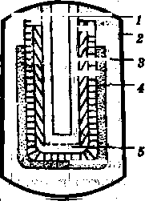
Fig. 4. Infusion osmotic pump
1 – dosing hole;
2 - shell, permeable to water;
3 – osmotically active substance,
4 – impervious elastic shell;
5 - tank with LV

Slide 20
Transdermal therapeutic systems are a dosage form that is a small film size.
Medicinal substances introduced into the body using TTS must:
have sufficient permeability through the skin to reach the bloodstream in the required quantities;
- be highly effective, i.e. have a therapeutic effect in small quantities;
— have good skin tolerance;
be suitable for prophylactic, long-term use or replacement therapy.

Slide 21
Advantages and disadvantages of TTS
Advantages:
Quick action
Ability to easily remove TTS,
Ensuring constant concentration in the blood
Prolonged action
Elimination of patient complementarity (easy way to use the drug).
Reducing the required dose of the drug,
Disadvantages
Skin irritation
More time is needed for therapeutic effect
A small amount of the drug enters the bloodstream through the skin.

Slide 22
As substrates , where the entire TTS is attached, fabrics, paper, polymer films, metallized coatings are used, since they are substances impermeable to LH and water.
The reservoir , i.e. the layer in which the active substance is located, consists of a carrier , which is made of various polymeric materials .
Ethanol, methyl ether of ethylene glycol, and glycerol monooleate are used
as membranes , which promote the dosed release of drugs from the reservoir and tissue, obtained from polypropylene, ethylene-vinyl acetate copolymer, block copolymers, silicone resins, etc. They are used with medicinal substances that penetrate through the skin into the general bloodstream.
The drug diffuses through the membrane, epidermis, and, naturally, through the skin into the bloodstream. Thus, the drug enters gradually, reducing its side effects.

Slide 23
Chemical, biological, and physical methods are used to understand the penetration of a medicinal substance through the skin.
Biological method – in this case, the drug molecule is subjected to physical modification. This facilitates its movement through the horny layer. The modified molecule is inactive
Chemical method - chemical substances are used to help the drug penetrate the skin barrier
Physical method – uses stimuli or force to drive the drug through the skin. Three approaches are used:
A) iontophoresis - uses electric current
B) sonophoresis – uses ultrasonic waves.
B) electrophoresis – uses a millisecond volt pulse.

Slide 24
In order to increase the selectivity of the effect of medicinal substances on the body, their targeted delivery to the target organ, finely dispersed magnetic materials can be used . The method of magnetically controlled transport of medicinal substances is based on the ability of colloidal particles of magnetic material to mix and concentrate in the required area of the body under the influence of a magnetic field. This allows you to selectively concentrate magnetic particles with the application of their medicinal substances to the surface directly in the tissues of the affected organ, limited by the focus of an external magnetic field source .

Slide 25
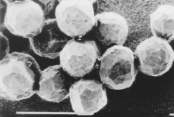

Slide 26
Such forms are intended for use in oncology, in which, due to the toxicity of the drugs used in treatment, there has always been a problem of their retention in the affected area of the body.
Attempts to find ways of such localization have been made for a long time. One of them was the option of transporting drugs to the tumor site along with the blood stream (which is quite possible, since the tumor is permeated with a network of blood vessels) and further braking using a magnetic bandage. It goes without saying that the drugs must be guided by a magnet, that is, each of its grains must be covered with a film of magnetic metal. Such a capsule, stopped in the blood stream, penetrates through the walls of the vessel into the tumor, where it begins to release the drug after the magnetic shell dissolves. First, the metal from which the shell is made must be both soluble and absolutely harmless to humans. And secondly, the size of the capsule cannot exceed the diameter of the blood vessel, and, therefore, the film must be extremely thin. As for the metal, it can only be iron, since nickel and cobalt are carcinogenic, and iron, as is known, even is contained in our blood .

Slide 27
Applying the thinnest iron film to a grain of the drug is a very complex process. It requires quite high temperatures, at which, unfortunately, the drug decomposes. A vacuum plasma-chemical installation was created in which iron, which is in a gaseous state, settles on the surface of the grains. The drug itself does not have time to heat up much, and therefore does not decompose.

