Slide 1

Odessa National Medical University
Faculty of Pharmacy
Department of Pharmaceutical Chemistry
and Drug Technology
Therapeutic non-equivalence of drugs. Causes of its occurrence. Influence of variable factors on the stability of drugs.
Associate Professor Zamkovaya A.V.
Odessa 2025

Slide 2
Plan
1. Therapeutic non-equivalence of medical forms. The essence and reason for its occurrence.
2. The influence of pharmaceutical (thermal) factors on the stability of drugs. Interrelation.
3. The influence of food composition and temperature on the therapeutic equivalence of drugs.
4. The influence of alcohol and smoking on the therapeutic equivalence of drugs.

Slide 3
Therapeutic non-equivalence - inequality of therapeutic action of the same drugs in the same doses, prepared by different manufacturers or the same plant, but in different batches.

Slide 4
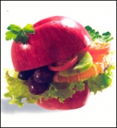
Influence of composition and
food temperature
The effectiveness of medicinal substances is greatly influenced by the composition and temperature of food. Regular mixed food contains substances of plant, animal and mineral origin: proteins, fats, carbohydrates, amino acids, fatty acids, glycerin, tannins (in tea, persimmon), caffeine (in tea, coffee), serotonin (in nettles, peanuts, bananas, pineapples), tyramine (in raw bananas, beans, herring, coffee, beer, wine, chicken liver), oxalates (in rhubarb, celery, sorrel, spinach), sterol, phytosterol , heavy metal ions and other chemically and pharmacologically active substances.

Slide 5
Depending on the composition, food affects peristalsis and secretory function of the digestive tract, which affects the degree and rate of absorption of drugs.
Protein foods (eggs, cheese, milk, peas, beans) reduce the pharmacological effect of digitoxin , quinidine , cimetidine , caffeine, theophylline , tetracycline and penicillin preparations , anticoagulants, cardiac glycosides and sulfanilamide.
Fats (especially those that retain higher fatty acids) reduce gastric juice secretions, slow down gastric peristalsis, which leads to a delay in digestive processes and the transportation of food mass. Under the influence of food rich in fats, the absorption of many medicinal substances increases significantly, especially fat-soluble substances, such as anthelmintics, anticoagulants, sulfanilamide, griseofulvin, anaprilin , diphenin , fat -soluble vitamins A, D, E, F, K, carbamazepine , lithium preparations, seduxen , metronidazole , etc. A deficiency of fats in food slows down the metabolism of ethylmorphine hydrochloride.

Slide 6
The temperature of food also has a certain effect. Very cold (below 7°C) and excessively hot (above 70°C) food and drinks cause digestive disorders. Cold food increases the excretory function and acidity of the stomach contents with a subsequent decrease and weakening of the ability of the gastric juice to digest food. Excessive consumption of hot food leads to atrophy of the gastric mucosa, which is accompanied by a sharp decrease in the secretion of GCS enzymes. These changes in GCS secretion in turn affect the bioavailability of drugs.

Slide 7
The influence of the nature of the liquid used to wash down medications
A certain role in the bioavailability of drugs is played by the nature of the liquid with which the drugs are washed down. Often, to mask the unpleasant taste and smell of drugs, various fruit, berry or vegetable juices are used. Most fruit, berry and vegetable juices are acidic and can destroy an acidic unstable compound, for example, ampicillin sodium salt, cycloserine , erythromycin , potassium salt of benzylpenicillin . Juices can slow down the absorption of ibuprofen, furosemide , enhance the pharmacological effect of barbiturates, diacarb , nevigramon , nitrofurans , salicylates . Fruit juices and drinks contain tannins that precipitate digitoxin , caffeine- sodium benzoate .

Slide 8
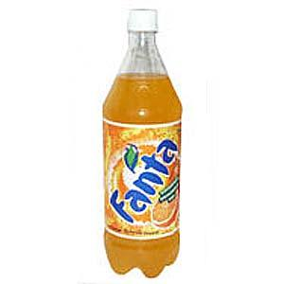
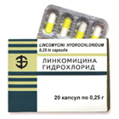
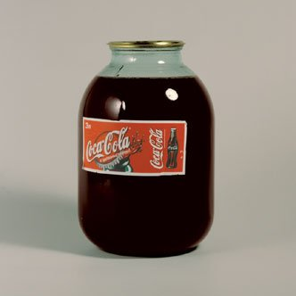
The tonic drinks Fanta, Pepsi-Cola, Coca-Cola contain iron ions, which in the SHKT form insoluble complexes with lincomycin hydrochloride, oleandometacin phosphate, tetracycline hydrochloride, sodium
thiosulfate,
unithiol,
slowing down absorption
the last ones.

Slide 9
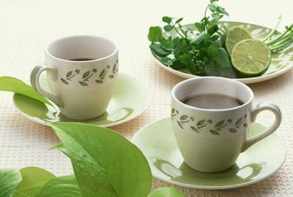

Widely used tea and coffee contain, in addition to caffeine and theophylline , tannin and various tannins and can potentiate the pharmacological effect of paracetamol, acetylsalicylic acid, form poorly soluble compounds with aminazine , atropine sulfate, haloperidol , codeine, morphine hydrochloride and papaverine hydrochloride. Therefore, it is not recommended to wash down medications with them, with the exception of sleeping pills barbiturates, which are washed down with 1/2 glass of warm, weak and unsweetened tea.

Slide 10
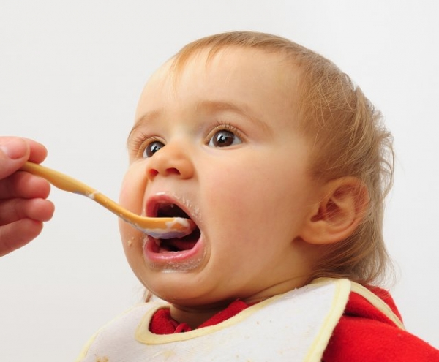
Children's reception of the account
mixed with milk
may lead to
violation of the accuracy of their dosing. Those drugs that irritate the surface of the mucous membrane of the gastrointestinal tract, do not change their activity at the pH of milk (6, 4), do not bind to proteins and calcium of milk ( butadion , indomethacin , prednisolone , reserpine, trichopolum , potassium salts, nitrofurans , vibramycin , ethoxide , mefenamic acid, iodine preparations, etc.) are washed down with milk.

Slide 11
Some patients, when taking medications, do not wash them down at all, which is not recommended, since capsules, tablets, and pills, sticking to certain parts of the inner surface of the esophagus and gastrointestinal tract, are destroyed without reaching the absorption site. In addition, they cause irritation at the site of adhesion, and the lack of sufficient liquid delays their absorption.

Slide 12
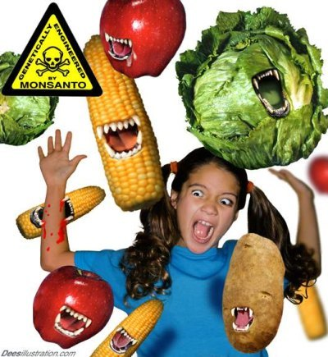
The influence of food products (diet)
In the vast majority of cases, when prescribing a bill, it is necessary to select an appropriate diet so that food components do not change the bioavailability of drugs and do not cause unwanted side effects.

Slide 13
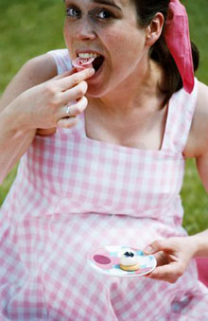
Unhealthy diet during illness
affects the entire course of treatment,
may contribute to the disease
individual organs and cause relapses.
For example, excess sodium chloride in food
contributes to the increase
blood pressure,
animal fats - development of atherosclerosis, diseases of the digestive system. An irrational diet can lead to inactivation of drugs, formation of poorly soluble complexes, for example, in the case of calcium ions (cheese, kefir, milk) with tetracyclines.
At the same time, by eating vegetables and fruits, you can regulate bowel function, replenish the deficiency of macro- and microelements, phytoncides, essential oils and aromatic substances that affect the immune status, regulate the secretion of digestive glands, lactation, and so on.

Slide 14
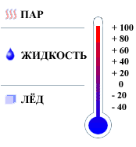

The influence of body temperature and the environment
Body and environmental temperature significantly influence the course of physiological and biochemical processes in the body.

Slide 15
In conditions of increased temperature and humidity, heat transfer from the body to the environment is difficult and can only be achieved with increased physical thermoregulation mechanisms (dilation of peripheral vessels, increased sweating ). Difficulty in heat transfer leads to overheating of the body. Increased body temperature is accompanied by sharp disturbances of the central nervous system, breathing and blood circulation, increased metabolism. Excessive sweating leads to dehydration of the body, thickening of the blood, a decrease in the volume of circulating fluid, and electrolyte imbalance. All this, in turn, affects the processes of absorption, distribution and metabolism of drugs, their bioavailability .

Slide 16
When the absorption temperature increases, the metabolism and transport of drugs proceed faster, and when it decreases, they slow down. Local cooling of body tissues leads to vascular spasm. This sharply slows down absorption, which must be taken into account when administering a drug locally. The influence of the temperature factor on the pharmacokinetics of drugs must be taken into account in clinical practice in cases where drugs are prescribed to patients with severely impaired thermoregulation.

Slide 17


The influence of age and gender of a person
Age of a person also affects bioavailability of the drug. Young patients are characterized by higher rates of absorption, excretion, and the shortest time to reach the maximum concentration of the drug; old patients have higher values of half-life periods of drugs.

Slide 18
When prescribing the bill to children, it is necessary to remember that in children under one and a half years of age, the bioavailability of the bill taken orally differs only slightly from that of adults. However, their absorption (both active and passive) occurs very slowly. As a result, small concentrations are created in the blood plasma, often insufficient to achieve a therapeutic effect. Children have a delicate, easily irritated mucous rectum, reflexes lead to rapid bowel movements and a decrease in the bioavailability of drugs that are administered rectally. With inhalation, the mucous of the respiratory tract is also easily irritated and reacts to it by secretion and swelling, which significantly complicates the absorption of drugs. At the same time, when applying drugs to the skin of children, it is worth keeping in mind that through it, absorption of any substances occurs much easier than in adults.

Slide 19
Since ancient times, differences in the action of drugs have been noted, due to the article. The time of stay of drugs in the body of women is much longer than in men, and accordingly, the level of concentration of drugs in the blood of women is higher. It is believed that this is due to the relatively large reserve of "inert" fatty tissue in women, which plays the role of a depot.

Slide 20
The influence of pathological processes and individual characteristics of the organism
Many pathological processes lead to disruption of the barrier function of biological membranes, changes in the permeability of biological barriers. First of all, these are pathological processes that promote free-radical (peroxide) oxidation of lipids, inflammatory processes that lead to activation of phospholipases and hydrolysis of membrane phospholipids by them .
Of great importance are also the processes that are accompanied by a change in the electrolyte homeostasis of tissues, which leads to mechanical (osmotic) stretching of membranes. The general stress reaction of the body also leads to a mandatory change in the properties of all biological barriers, which cannot but affect the bioavailability of drugs and the effectiveness of medical therapy in this category of patients.

Slide 21

The influence of alcohol
Alcohol negatively affects the therapeutic effect of many medications and is the cause of dangerous complications.

Slide 22
The effect of ethanol on the pharmacodynamics and pharmacokinetics of drugs is carried out in various ways. The following factors directly affect bioavailability :
Changes in the permeability of histohematic barriers as a result of disruption of the fluidity of lipid membranes during their interaction with ethanol.
Changes in the structure and function of cell membranes, disruption of the penetration of drugs through biomembranes .
Changes in the structure and function of enzymes (5-nucleotidase, acetylcholinesterase , adenylate cyclase , mitochondrial enzymes electron transport chain).
Increased secretion of gastric mucus and decreased absorption of drugs in the stomach.

Slide 23
- Switching of the microsomal non-specific enzymatic oxidase system of the liver, which oxidizes ethanol, resulting in a decrease in the oxidation level of other endogenous and exogenous ligands .
- Induction of liver microsomal enzymes and, as a consequence, changes in the rate and level of biotransformation of drugs.
- When drugs and ethyl alcohol are prescribed simultaneously, their interaction can occur through several mechanisms at once, which has important clinical significance.

Slide 24
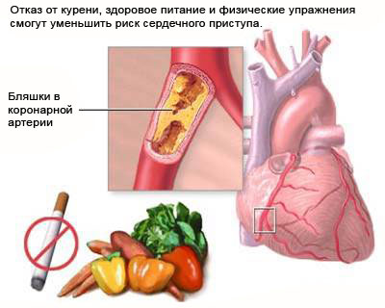
The impact of smoking
On the action
medicinal preparations
may be influenced by substances that
enter the body when smoking. Nicotine, as an N-cholinomimetic, leads to activation of sympathetic and parasympathetic ganglia, adrenal medulla, and disruption of the central nervous system. Stimulation of the adrenal medulla leads to narrowing of peripheral vessels, which disrupts the blood supply to many organs and tissues. Activation of parasympathetic ganglia increases the secretion of acidic gastric juice, which plays a role in the absorption of drugs.

Slide 25
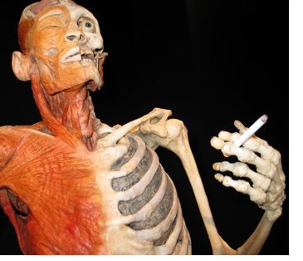
Nicotine, benzopyrene and their
derivatives change
enzyme activity
metabolism. Smoking
stimulates the oxidative metabolism of phenacetin, propranolol , theophylline , noxiron , aminazine , diazepam , as a result of which their effectiveness decreases. Smoking reduces the therapeutic effect of dexamethasone , furosemide ( lasix ), propoxyphene and oral contraceptives . Flavored cigarettes contain coumarins , which can enhance the effect of anticoagulants - coumarin derivatives.
In a number of cases, the effect of smoking on the bioavailability and therapeutic efficacy of drugs requires further study.

Slide 26


Slide 27


Slide 28


Slide 29
Thank you for your attention!

