Slide 1
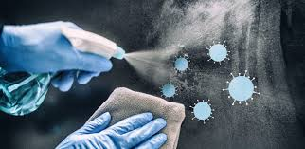
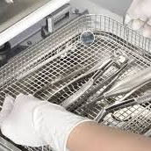
MINISTRY OF HEALTH OF UKRAINE
ODESSA NATIONAL MEDICAL UNIVERSITY
Department of Pharmacy Organization and Economics
with post-diploma specialization
Commodity analysis of
equipment for
disinfection and sterilization. .
Prepared by senior teacher
Stepanova Oksana

Slide 2
AGENDA
The concepts of disinfection, sterilization and pre-sterilization treatment.
Methods of disinfection and sterilization used in pharmacy and medicine.
Physical methods of disinfection and sterilization of medical devices.
Chemical methods of disinfection and sterilization of medical devices.
Agents used for chemical disinfection and sterilization.

Slide 3
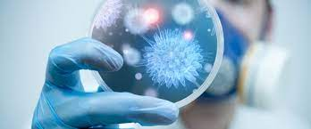
Basic concepts
Disinfection is a set of measures aimed at the elimination of pathogenic and opportunistic microorganisms in the environment, which are potential factors of infectious disease transmission, by physical, chemical and biological methods.
Disinfectant is a substance of chemical or biological origin or a mixture of substances used to destroy infectious agents in the human environment (disinfection) and their vectors - insects, ticks, etc. (disinsection) and rodents (deratization).

Slide 4
Sterilization
Sterilization is a process that ensures the death of vegetative and spore forms of pathogenic and non-pathogenic microorganisms
Sterilization describes a process that destroys or eliminates all forms of microbial life and is carried out in health-care facilities by physical or chemical methods Sterilization procedures kill all microorganisms.
Sterility Assurance Level - the probability of a microorganism surviving
on an item subjected to treatment is less than one in one million.
Methods used in sterilization procedures include heat, ethylene oxide gas, hydrogen peroxide gas, plasma, ozone, liquid chemicals and radiation.

Slide 5
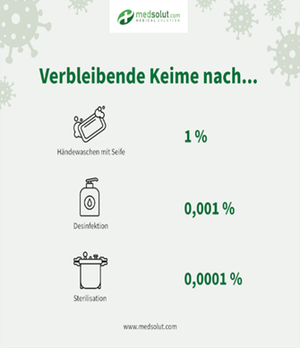
Cleaning is the removal of visible soil (e.g., organic and inorganic material) from objects and surfaces and normally is accomplished manually or mechanically using water with detergents or enzymatic products.
Thorough cleaning is essential
before high-level disinfection and
sterilization because inorganic and organic materials that remain on
the surfaces of instruments
interfere with the effectiveness of
these processes.

Slide 6
Ideal Properties of Disinfectant
They should have a wide spectrum of activity, should be active against all pathogens.
They should be cidal (capable of killing bacteria) and chemically stable.
They should be cheap and should not produce any stains.
They should not damage any non-living materials.
They should act in presence of organic matters.
They should have high penetrating power and rapid action.
They should be non-toxic and non-corrosive.
They should be relatively safe for humans and other animals.
They should be easily soluble in hard water and should be active at any pH.
They should have good cleaning properties and should be non-inflammable.
They should not damage the environment on disposal.
Disinfectants are broadly classified into two categories viz. physical methods and chemical methods.
:

Slide 7
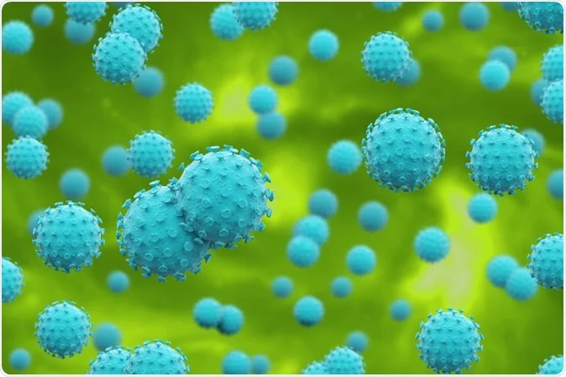
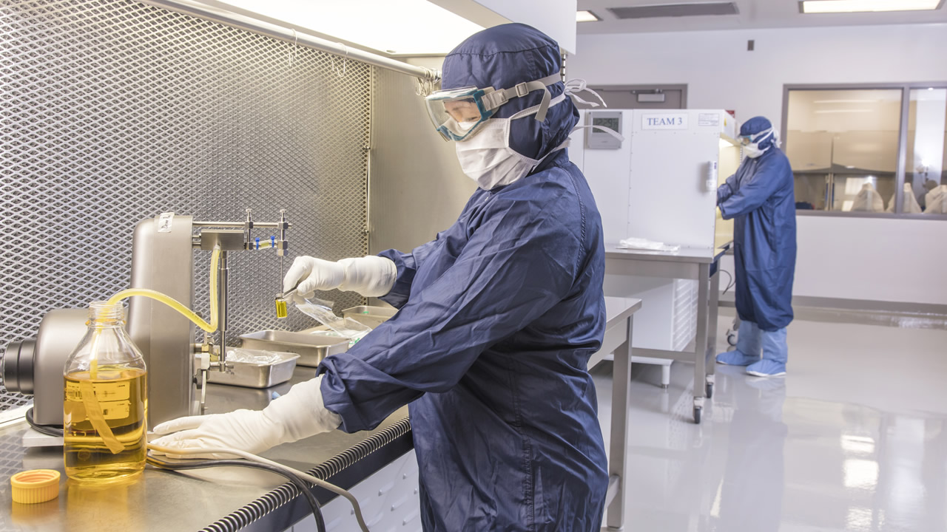
Asepsis is the prevention of potential pathogens from entering the surfaces/organs/cavities of the body.
Antisepsis - methods of chemical and biological neutralization of pathogens and other microorganisms to prevent wound infection.

Slide 8
The following disinfection methods are used for disinfection:
Disinfection methods
Physical:
Heat (application of high or low temperature, water steam, drying, burning, etc;)
Chemical (based on the use of disinfectants that have the ability to destroy pathogens);
Combined (a method based on a combination of several of the above (wet cleaning followed by ultraviolet irradiation).
Radiation (ultraviolet irradiation, infrared irradiation);
Filtration

Slide 9
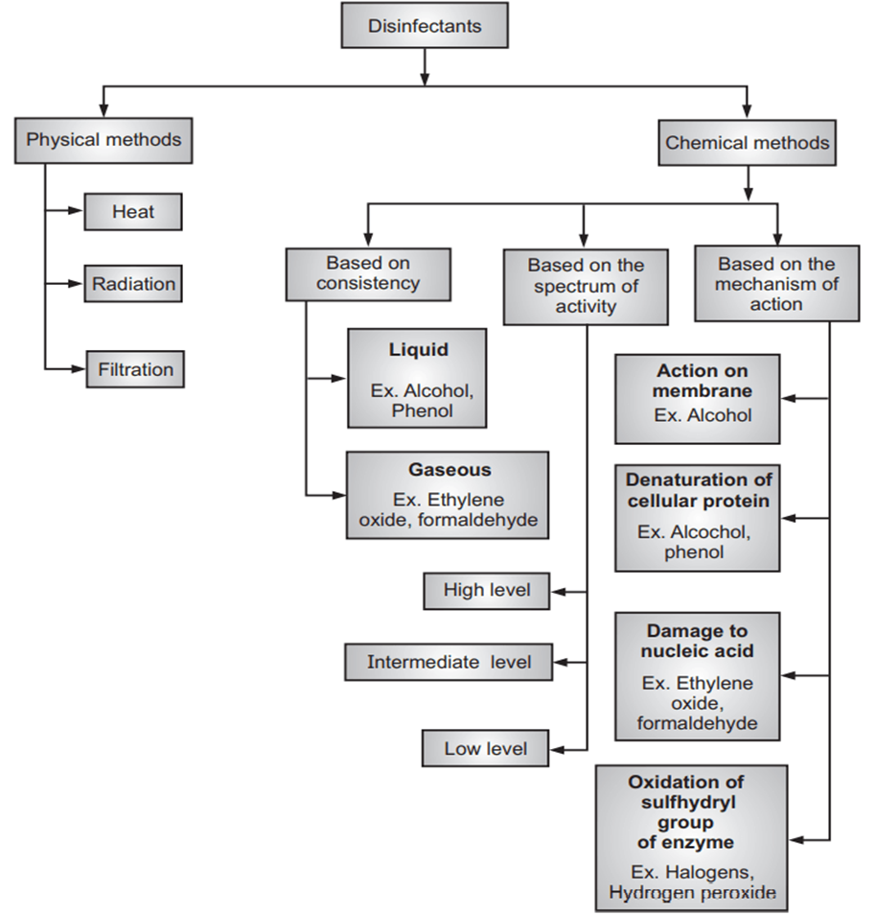

Slide 10
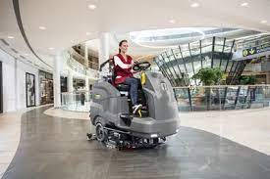
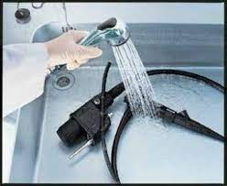
Mechanical disinfection methods are designed to decontaminate objects and remove contaminants from them. Sometimes these methods are practised as standalone methods, but more often they precede chemical disinfection and increase its effectiveness (e.g. cleaning endoscopes before cleaning of endoscopes before chemical disinfection).

Slide 11

HEAT methods of disinfection
Boiling is a simple, affordable and reliable way to disinfect items that do not spoil in boiling water. Most bacteria are killed in boiling water either instantly or within 30 minutes. Boiling is widely used for disinfecting dishes, linen, towels, and gowns.
Exposure to high-pressure, saturated steam is carried out in a steam sterilizer at 110 °C for 20 minutes. Dry hot steam sterilization is performed in an air sterilizer at 180 °C for 60 minutes.
Heating to high temperatures kills all microorganisms, including spore forms. This is used to quickly disinfect metal objects by burning them over a gas burner or alcohol flame.

Slide 12
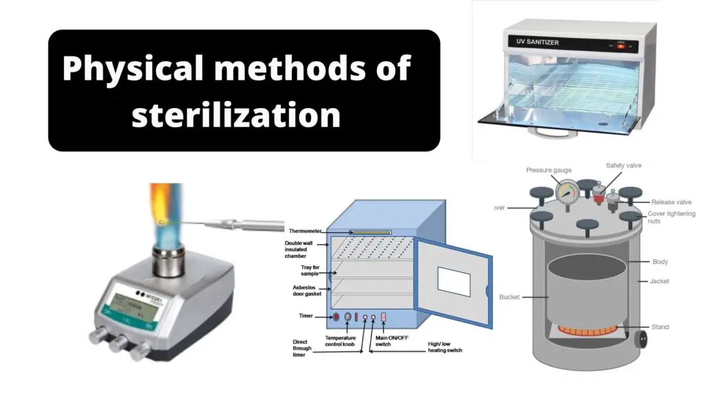
HEAT methods of disinfection
Thermal methods of disinfection are
the most effective and, compared to mechanical methods, are more often used independently, especially
boiling, disinfection in disinfection
chambers, air or steam sterilizers. .

Slide 13
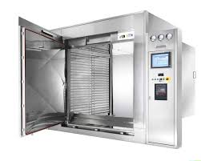
Heat
Heat is a mostly used method of sterilization. Moreover, it is a highly effective and most reliable process. There are two major methods of using heat in sterilization which are dry heat and moist heat. The principle behind both of these methods is similar. Dry heat induces the denaturation of protein, oxidative damage and toxic
effect due to the high level of electrolytes. Moreover, the dry heat can also damage the DNA of the microorganism. As a result, the microorganism got killed.
Moist Heat kills the microorganisms by denaturation and coagulation of proteins.

Slide 14
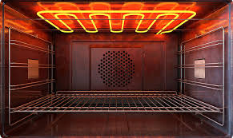
Heat
There are several factors that can influence the heat killing procedure. Such as
Temperature and Duration: The duration and temperature are inversely connected to each other. Therefore, in the case of the long duration of heat provided for sterilization, the temperature will be reduced while in case of high temperature the duration will be reduced.
Characteristic of the Microorganism: Microorganisms can be present in both
vegetative and spore form. Spore forms are generally heat resistant. Therefore,
The sterilization process will vary on the basis of the characteristic of the microorganism.
Type of Material: Organic substances often provide protection to the vegetative and spore form of microorganisms which reduces the lethal property of heat. Apart from that, the materials containing the substances are also needed to be heat stable for proper sterilization.

Slide 15
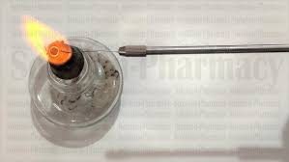
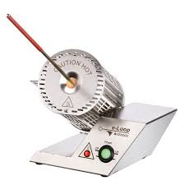
Heat
Red Heat
Inoculation loops, wires, forceps tips, needles are needed to be sterilized to inhibit microbial contamination. These instruments are held in the flame of a Bunsen burner until they become red hot.
Incineration
This procedure is used to reduce the infective material into ashes by burning. The incinerator is used for the process. Soiled dressings, animal carcasses, bedding, and pathological materials are dealt with this method.

Slide 16
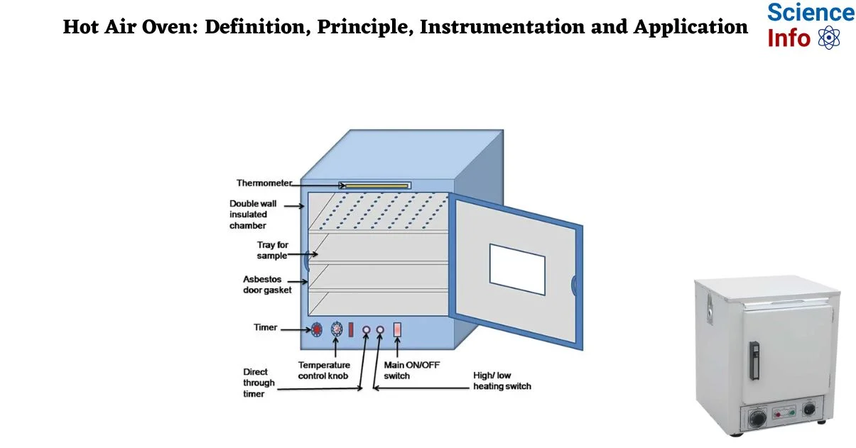
Heat
Hot Air Oven
It is a widely used method of sterilization by dry heat. The heat inside the oven is maintained by electricity and a fan fitted inside it provides the adequate distribution of hot air inside the chamber. A thermostat is also connected which maintains the temperature inside the chamber. 160⁰C for two hours is required for sterilization. There are also some alternative temperatures and holding time which include 170⁰C for 1 hour and 180⁰C for 30 minutes.
Uses: Sterilization of
Glasswares like glass syringes, Petri dishes, flasks, pipettes, and test tubes.
Surgical instruments like scalpels, scissors, forceps, etc.
Chemicals such as liquid, paraffin, fats, sulphonamides powders etc.

Slide 17
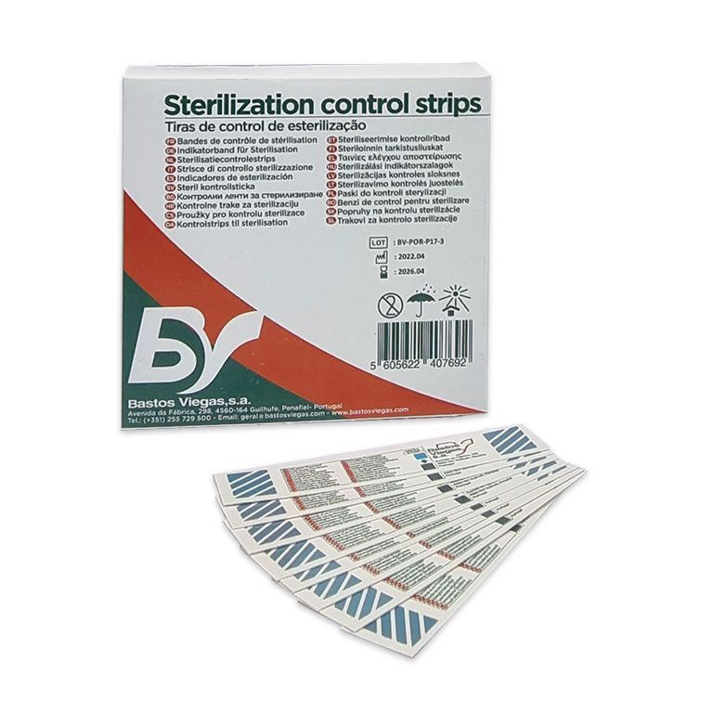
Sterilization control
Sterilization control
The spores of Bacillus subtilis subsp. Niger (NCTC 10075 or ATCC 9372) are kept inside the oven. These spores should be destroyed if the sterilization is proper.
Thermocouples may also be used.
Browne’s tube with a green spot is available. After proper sterilization, a green color is produced (after two years at 1600C).

Slide 18
Moist Heat Sterilization
Moist Heat Sterilization: Procedure
Temperature below 100⁰C
Pasteurization
There are two different types of pasteurization methods that are used for sterilization of milk, Holder method (63ºC for 30 minutes) and flash method (72⁰C for 20 seconds followed by cooling quickly to 13⁰C). This method is effective against all non-sporing pathogens such as mycobacteria, Salmonella, etc. except which survives the holder method due to heat resistant characteristics. Coxiella burnetii

Slide 19
Heat
Autoclave
Steam above 100⁰C or saturated steam has a better killing capacity than
dry heat. Bacterial proteins coagulate rapidly at moist heat. Saturate steam has the ability to penetrate any porous material. When steam comes into contact with the cooler surface it condenses into water and releases its
latent heat to the surface. The large reduction in volume sucks in more
steam to the same site and the process continues until the temperature of
the substance raised to that of steam. The condensed water produced
moist conditions for killing the microbes present.
Sterilization control
Thermocouple
Bacterial spores of Bacillus stearothermophilus used at test organisms.
Browne’s tubes contain red solution which turns into green when exposed to the specific temperature for 15 minutes in an autoclave.
Autoclave tips.

Slide 20
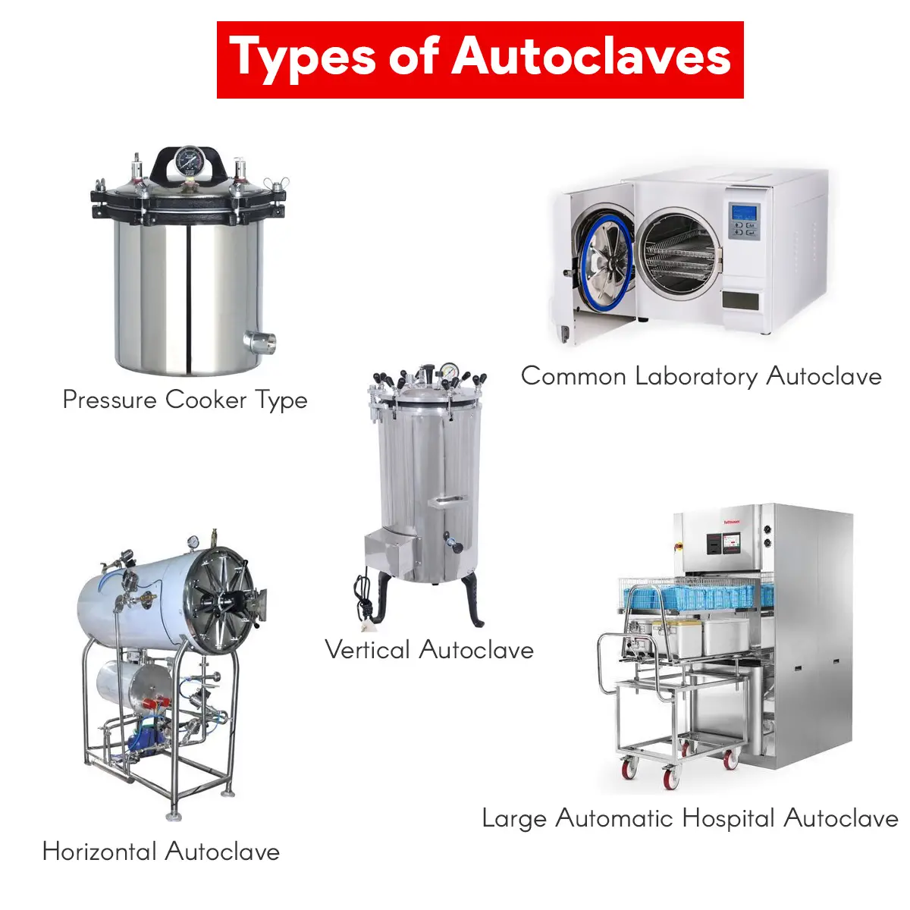
Sterilizers used for heat sterilization are classified by:
location of the sterilization chamber - horizontal and vertical;
shape of the sterilization chamber - round and rectangular;
operating conditions - single-sided and double-sided;
sterilizing agent - gas and air steam;
source of steam supply;
method of heating;
method of steam production.

Slide 21
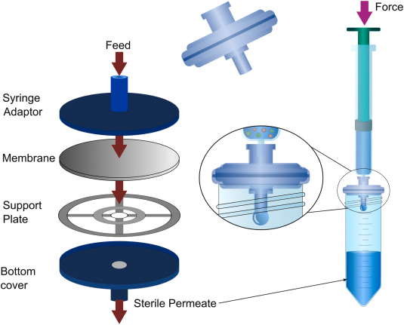
Filtration:
Filtration: This method is carried out
for fluids that are heat-labile like
antibiotics, vitamins, and other growth factors with very fine pore membrane filters
below 0.45 microns in diameter.
These fluids are checked for sterility
by subculture before use. Filtration of air is necessary for the disinfection of
the laboratory. Sterile filters are used
for the separation of toxins and other soluble products of bacterial growth
and are also used for the purification of water.

Slide 22
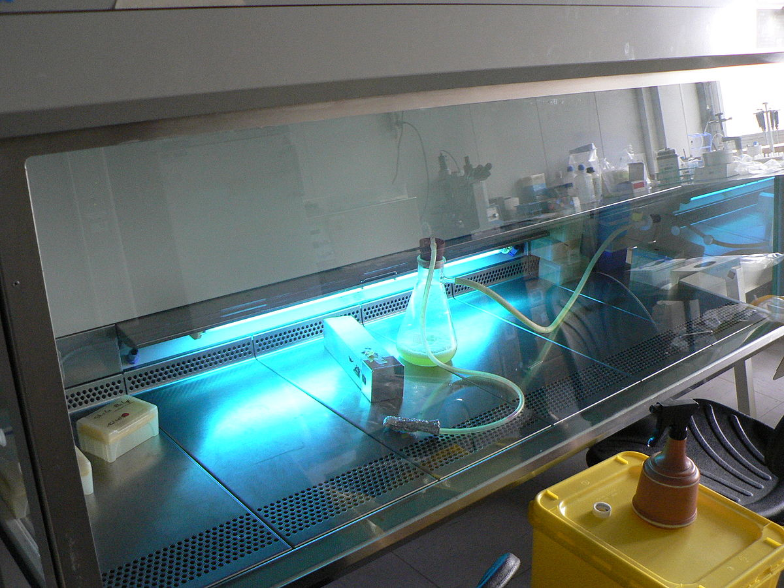
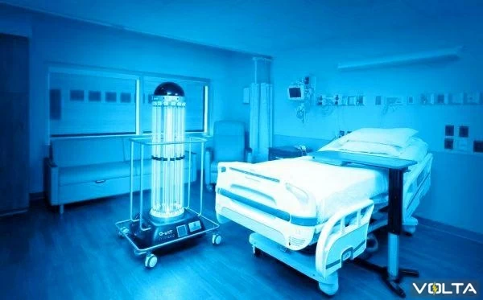
Radiation
methods of disinfection
The ultraviolet rays of bactericidal lamps have a high bactericidal capacity and are widely used for disinfection of premises. The industry produces wall-mounted, ceiling-mounted, stationary, mobile and combined ultraviolet installations of various radiation powers, which are used in microbiological laboratories and some food enterprises.

Slide 23
Radiation
methods of disinfection
Ionizing radiation
Ionizing radiations such as gamma rays, X rays, and cosmic rays are used for sterilization process. Due to the high penetrating power, these radiations are lethal for cells. The bacterial cells are killed by damage in the DNA. Gamma radiations from a cobalt 60 source are commercially used for sterilization of disposable items. This procedure is also known as cold sterilization.
Non-ionizing radiation
Infrared radiation and UV radiation comes under this of radiation. Infrared radiation is used for mass sterilization of syringes and catheters. UV radiation with a wavelength of 240nm to 280nm has bactericidal capacity. The UV radiation causes protein denaturation and interferes with DNA replication of bacteria. UV radiations are used for sterilization of close areas, surfaces, operation theaters, laminar airflow, etc.

Slide 24
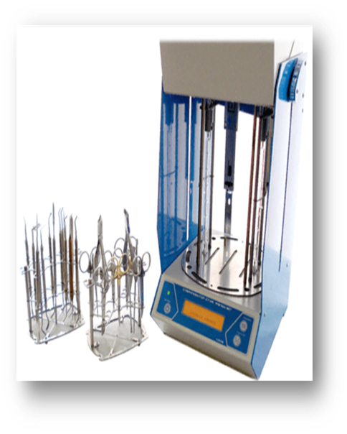
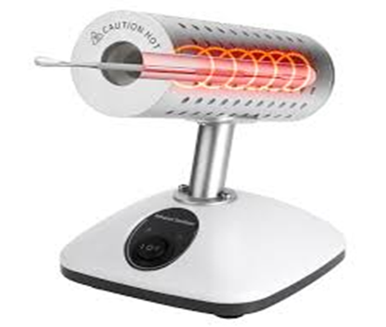
INFRARED STERILIZER
New methods of sterilization are reflected in the infrared sterilizer designed for the treatment and sterilization of metal medical instruments in dentistry, microsurgery, ophthalmology and other medical fields. The high efficiency of the infrared sterilizing action ensures the complete destruction of all tested microorganisms, including: S. epidermidis, S. aureus, S. sarina flava, Citrobacterdiversus,
Str. pneumonia, Bacillus cereus. Fast, within 30 seconds, access to the mode of 200±3°C, short cycle of the sterilization process - from 1 to 10 minutes, depending on the selected mode, along with low energy consumption, are incomparable in efficiency with any of the sterilization methods used so far

Slide 25
Chemical disinfectants
Classification of chemical disinfectants
mild disinfectants (used for disinfecting skin, surgical instruments, slightly soiled linen);
powerful disinfectants (for the treatment of highly contaminated materials, street shoes, furniture, toilets, and patient care items);
chemical disinfectants for indoor air, furniture surfaces, equipment, lighting fixtures

Slide 26
Several chemical agents are used as antiseptic and disinfectants. The properties of a chemical antiseptic or disinfectant are following
The chemical disinfectants need to have a broad spectrum of activity against all microorganisms such as bacteria, viruses, protozoa and fungi.
The chemical agents should act in the presence of organic matter.
High penetration power is an important property of the chemical agents
The chemical agent needs to be chemically stable under both acidic and basic environments.
The chemical substances should not have any corrosion activity in metals.
The disinfectants are needed to be non-toxic if absorbed into circulation.
Finally, the chemical agents are needed to be easily available and less expensive.

Slide 27
Thank you for your attention!

