Slide 1
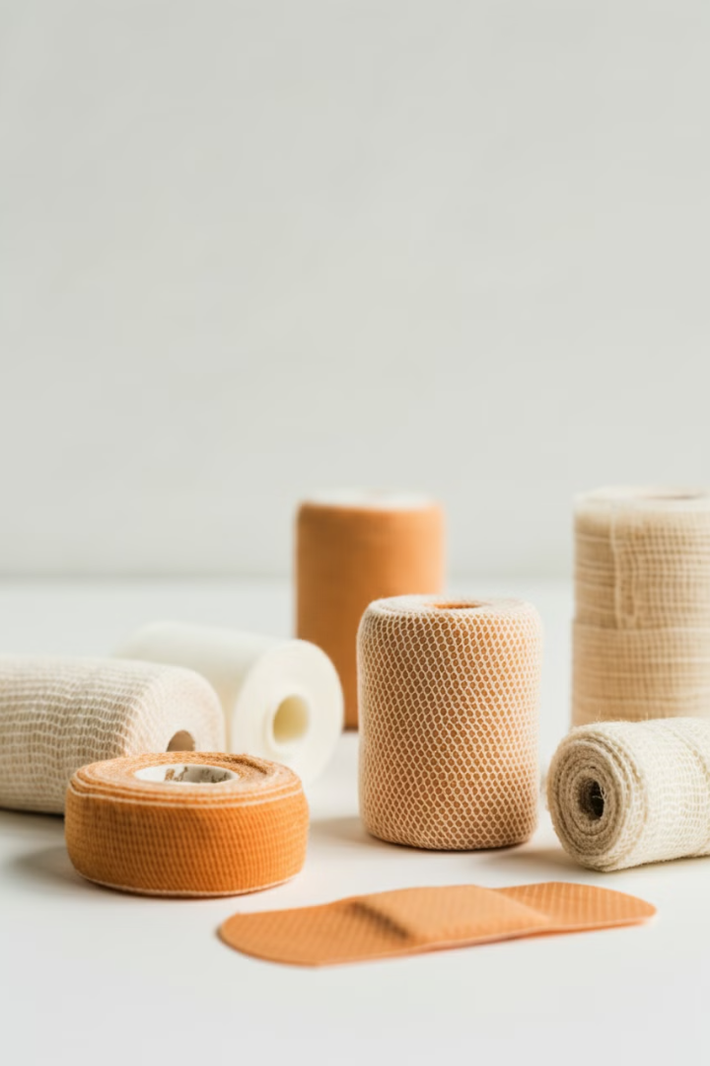
MINISTRY OF HEALTH OF UKRAINE
ODESSA NATIONAL MEDICAL UNIVERSITY
Department of Pharmacy Organization and Economics
with post-diploma specialization
Commodity analysis of wound dressings and bandages
О
Prepared by senior teacher
Stepanova Oksana

Slide 2
Wound Dressings and Bandages: Protecting and Promoting Healing
Wound dressings and bandages play a crucial role in protecting injuries and promoting the healing process. From traditional gauze to advanced bioactive materials, a wide range of products are available to address different wound types and healing needs. This overview explores the history, types, and latest developments in wound care materials, highlighting how proper dressing selection can optimize healing outcomes and patient comfort.
О

Slide 3
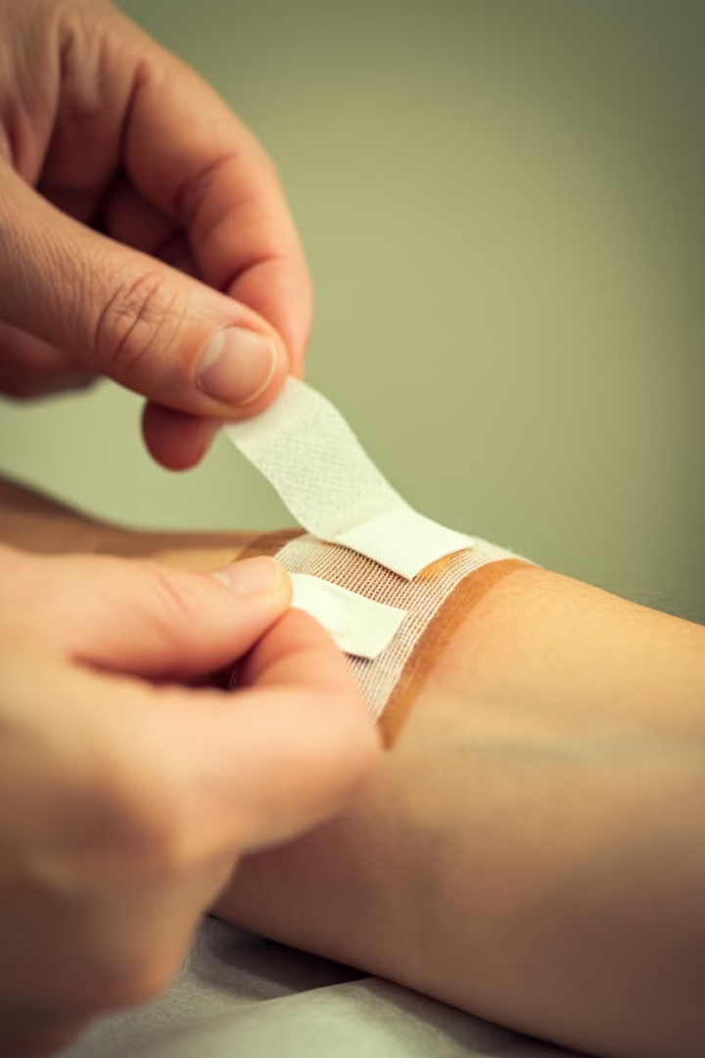
The Purpose of Wound Dressings
Wound dressings serve multiple important functions in the healing process. The primary aims are to protect the wound from infection, ease pain, promote healing, and avoid maceration. Dressing selection depends on the specific wound type and characteristics. While traditional materials like honey and turmeric paste were used historically, modern dressings are designed to create an optimal healing environment by managing moisture, preventing bacterial contamination, and supporting the body's natural healing mechanisms.
1
Infection Protection
Creates a barrier against external contaminants
2
Pain Relief
Reduces discomfort and protects sensitive tissue
3
Healing Promotion
Maintains ideal moisture and temperature for cell regeneration
4
Maceration Prevention
Manages excess fluid to protect surrounding skin

Slide 4
Historical Development of Wound Dressings
The history of wound dressings dates back to ancient times. In 1600 BC, linen strips soaked in oil or grease were used to cover wounds. Mesopotamians used clay tablets for wound treatment around 2500 BCE. Hippocrates in ancient Greece (460-370 BCE) cleaned wounds with wine or vinegar and used honey, oil, and wine for further treatment. The 19th century saw major breakthroughs in antiseptic techniques, while the 20th century introduced modern wound dressings designed to promote faster healing through maintaining optimal wound environments.
1600 BC
1
Linen strips soaked in oil used as wound coverings
2
2500 BCE
Mesopotamians use clay tablets for wound treatment
460-370 BCE
3
Hippocrates introduces wine and honey for wound care
4
19th Century
Major breakthroughs in antiseptic techniques
20th Century
5
Development of modern wound dressings

Slide 5
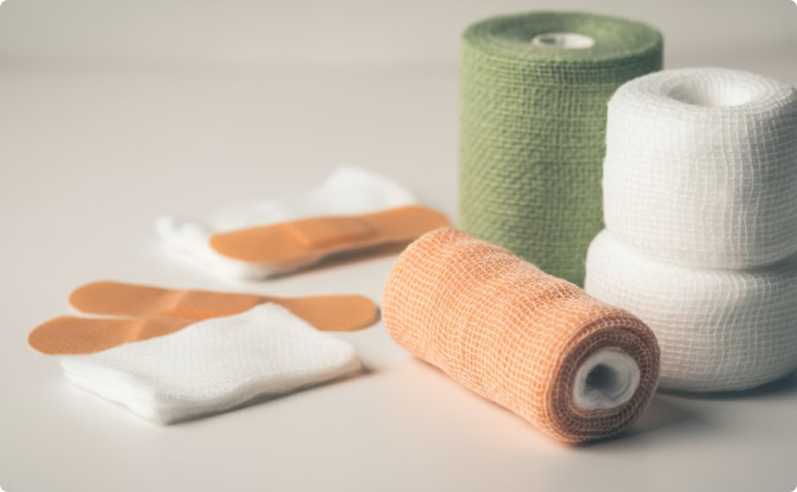
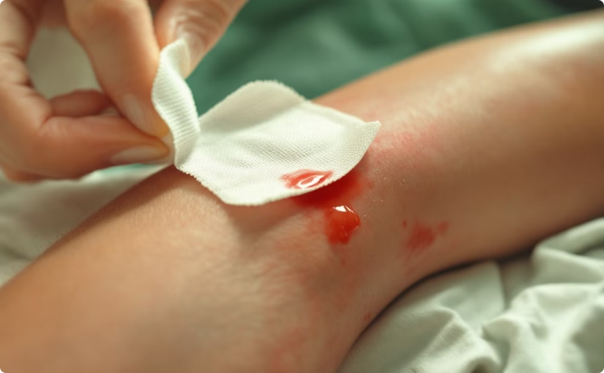
Traditional Wound Dressing Materials
Traditional wound dressing products include gauze, lint, plasters, bandages, and cotton wool. These materials are typically dry and used as primary or secondary dressings to protect wounds from contamination. Gauze dressings, made from woven and non-woven fibers of cotton, rayon, or polyesters, provide basic protection against bacterial infection. Sterile gauze pads are commonly used to absorb exudates and fluid from open wounds. While effective for basic wound protection, these traditional materials have limitations in managing complex or chronic wounds.
Traditional Dressings
Gauze Application
Gauze, cotton wool, and adhesive bandages represent common traditional wound dressing materials.
Sterile gauze pads are widely used for absorbing wound exudates and providing basic protection.

Slide 6
Components of Surgical Dressings
Surgical dressings encompass a wide range of materials used for covering, absorbing, protecting, and supporting injured or diseased tissues. The main components include surgical cotton, surgical gauze, bandages, and medicated tapes. Additionally, healthcare textiles like caps, masks, and doctor aprons are widely used in hospital settings. Selecting the appropriate type of surgical dressing is crucial for safeguarding patient welfare during surgery and wound treatment. These materials undergo strict testing to ensure they meet performance standards for physical, mechanical, and chemical properties.
Surgical Cotton
Surgical Gauze
Highly absorbent material for wound cleaning and protection
Versatile fabric for wound coverage and exudate absorption
Bandages
Medicated Tapes
Various types for wound wrapping and compression
Adhesive materials with added medicinal properties

Slide 7
Dressings vs. Bandages: Understanding the Difference
While the terms 'dressing' and 'bandage' are often used interchangeably, they serve distinct purposes in wound care. A dressing refers to the primary layer in direct contact with the wound. It is designed to protect the wound, absorb secretions, and prevent contamination. Bandages, on the other hand, are used to keep dressings in place, apply pressure to control bleeding, support medical devices like splints, or provide support to the body. Dressings should be sterile and large enough to cover the entire wound, while bandages can be used to secure dressings or provide additional support.
Dressings
Bandages
- Primary contact with wound - Sterile and absorbent - Protect and promote healing - Various types for different wounds
- Secure dressings in place - Apply pressure or support - Can be elastic or non-elastic - Used for various medical purposes

Slide 8
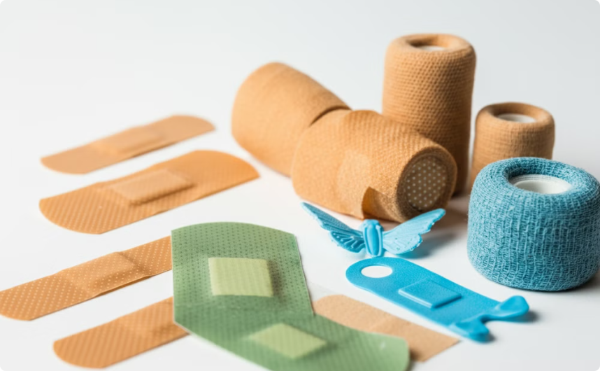
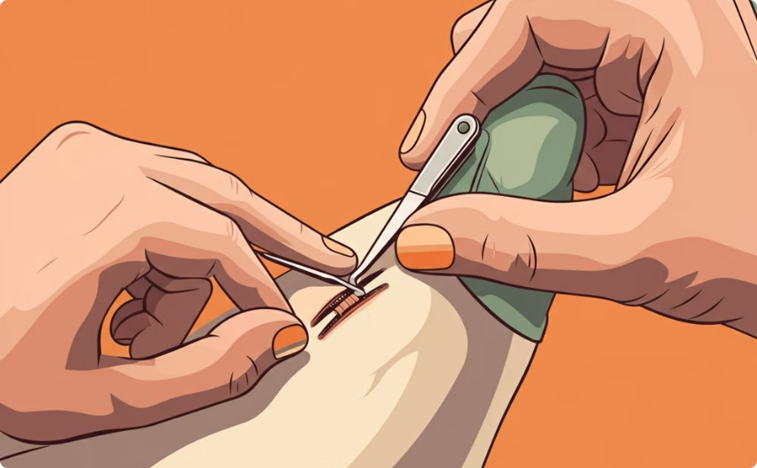
Types of Adhesive Bandages
Adhesive bandages, also known as sticking plasters or Band-Aids, are small medical dressings used for minor injuries. They come in various types, each designed for specific purposes. Blister plasters wick away moisture and provide cushioning. Blue plasters, often used in food service, are water-resistant and reinforced with metal bands. Stretch plasters are shaped to pull wound edges together, promoting faster healing. Butterfly closures, or butterfly stitches, are thin adhesive strips used to close small wounds without requiring medical professional application.
Adhesive Bandage Varieties
Butterfly Closure Application
Different types of adhesive bandages designed for specific wound care needs.
Butterfly closures in action, demonstrating their wound-closing capabilities.

Slide 9




Structure of Adhesive Bandages
Adhesive bandages consist of several key components. The backing and bag are typically made of coated paper or plastic. The adhesive sheet is usually a woven fabric, plastic (PVC, polyethylene, or polyurethane), or latex strip, which may be waterproof. The adhesive commonly used is an acrylate, including methacrylates and epoxy diacrylates. The absorbent pad is often made of cotton, sometimes with a thin, porous-polymer coating to prevent sticking to the wound. Some pads are medicated with antiseptic solutions, while others use water-absorbing hydrogels, particularly useful for blister treatment.
Backing
Adhesive Sheet
Absorbent Pad
Protective Cover
Coated paper or plastic outer layer
Fabric or plastic strip with adhesive
Cotton or hydrogel core for wound contact
Removable strip to keep adhesive clean

Slide 10
Cotton in Wound Care: Absorbent vs. Non-absorbent
Cotton used in wound care is classified into two main types: absorbent (purified) and non-absorbent. Absorbent cotton, also known as surgical cotton or cotton wool, is cleaned, de-oiled, and bleached cotton packed for medical use. It's highly absorbent and used in hospitals, nursing homes, and for first aid. Non-absorbent cotton, mechanically cleaned but not otherwise treated, has limited use for paddings and coverings of unbroken surfaces. It's also used as cotton plugs in bacteriological laboratories due to its non-absorbency. The choice between absorbent and non-absorbent cotton depends on the specific wound care needs.
Absorbent Cotton
Non-absorbent Cotton
- Cleaned and bleached - Highly absorbent - Used for wound dressings - Suitable for exudate management
- Mechanically cleaned only - Limited absorbency - Used for padding and lab work - Not suitable for wound exudates

Slide 11
Manufacturing Process of Surgical Cotton
The production of surgical cotton involves several key steps to ensure its purity and absorbency. The process begins with opening and cleaning raw cotton to remove dust and impurities. The cotton is then boiled with chemicals like caustic soda and detergents to remove natural waxes and oils. After washing, the cotton undergoes bleaching to improve its color and wetting properties. The bleached cotton is thoroughly washed again, treated with diluted sulphuric acid to neutralize excess alkali, and then dried. The dried cotton is processed through carding machines to form thin layers, which are then rolled, compressed, and cut to the required size. Finally, the cotton is packaged for medical use.
Opening and Cleaning
1
Raw cotton is loosened and cleaned of impurities
2
Boiling and Chemical Treatment
Cotton is boiled with chemicals to remove waxes and oils
Bleaching
3
Cotton is whitened and its absorbency improved
4
Washing and Neutralizing
Excess chemicals are removed and pH is balanced
Drying and Carding
5
Cotton is dried and formed into thin layers
6
Rolling and Packaging
Processed cotton is rolled, cut, and packaged for use

Slide 12
Quality Standards for Absorbent Cotton
Absorbent cotton used in medical applications must meet strict quality standards to ensure its effectiveness and safety. Key performance metrics include absorbency, sinking time, active fiber length, and the presence of neps or trash content. High-quality absorbent cotton should have an absorbency of at least 23 g/g, with premium products reaching 25-30 g/g. The sinking time should be less than 10 seconds, ideally under 5 seconds, to ensure rapid fluid uptake. The active fiber length should be no less than 10 mm to maintain strength and prevent shedding. Additionally, the cotton should have minimal neps (tangled fibers) and trash content to maintain a clean appearance and prevent skin irritation.
Parameter
Standard
Premium Quality
Absorbency
Min 23 g/g
25-30 g/g
Sinking Time
10 secs max
<5 secs
Active Fiber Length
Not less than 10 mm
>10 mm
pH Level
Neither strongly acidic or alkaline
Within neutral limits of pH 5-8

Slide 13
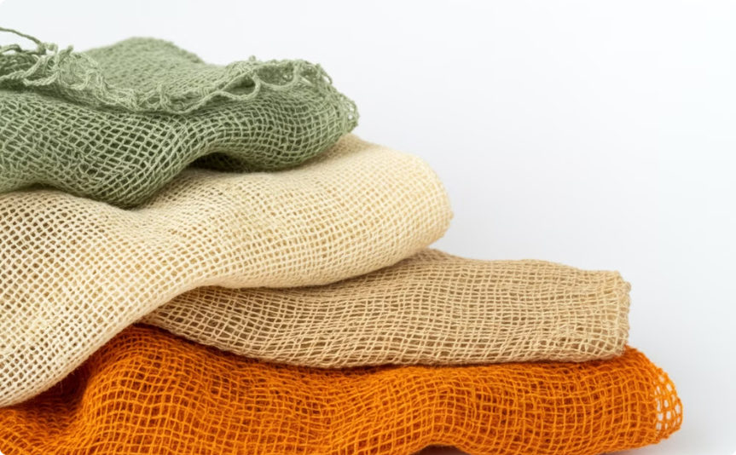
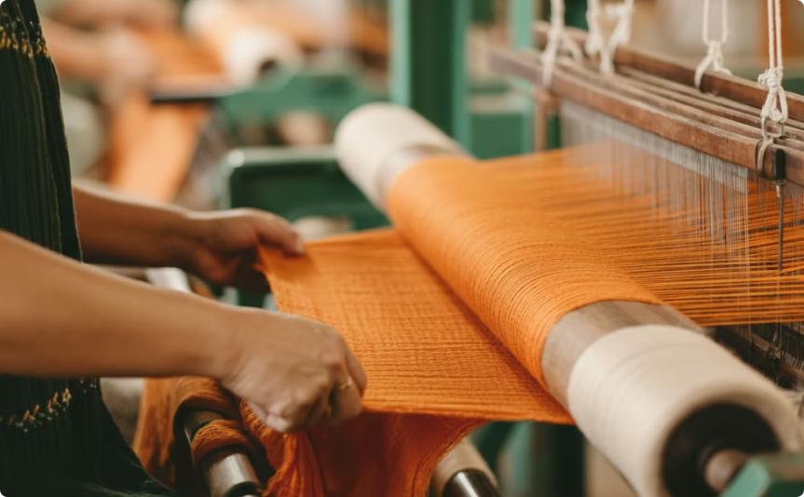
Gauze: A Versatile Wound Care Material
Gauze is a fundamental material in wound care, used for various purposes including primary wound dressings, absorbent secondary dressings, and larger dressings for purulent matter absorption. It is classified according to its mesh or number of threads per centimeter. The manufacturing process involves mechanically cleaning raw cotton fiber, spinning it into thread, and then weaving it into an open-mesh cloth. This gray, nonabsorbent cloth is then bleached white and rendered absorbent through processes similar to those used for surgical cotton. Gauze can be produced in different mesh densities to suit various wound care needs, from close-meshed for extra strength to more open structures for higher absorbency.
Gauze Mesh Varieties
Gauze Manufacturing
Different gauze mesh densities suited for various wound care applications.
The process of weaving cotton threads into gauze fabric.

Slide 14
Types of Gauze Dressings
Gauze is used to create various types of dressings, each serving specific purposes in wound care. Napkins and medical gauze cuts (pads) are designed for use as ready-made dressing tools or for manufacturing other dressings. Tampons, made from gauze strips, are used for stopping bleeding and draining purulent cavities. Gauze balls are used for wound drainage and skin treatment. Medical bandages, one of the most common gauze products, are used for fixation of surgical dressings and their manufacture. These products come in different sizes and can be sterile or non-sterile depending on their intended use.
Napkins and Pads
Tampons
Ready-made dressings for various wound sizes
For bleeding control and cavity drainage
Balls
Bandages
Used for wound drainage and skin cleaning
For dressing fixation and wound wrapping

Slide 15




Gauze Quality Standards and Specifications
Gauze used in medical applications must meet specific quality standards to ensure its effectiveness and safety. Standard specifications exist for both cotton gauze absorbent non-sterilized and cotton bandage cloth. The yarn used in manufacturing gauze should comply with European Medical Device Directive 93/42/EEC, class 1. The cloth must be woven in plain weave, bleached, and free from weaving defects. Proper packaging is crucial to protect the gauze's absorbency and allow for normal handling and transport without tearing. Each pack of gauze must be labeled with essential information including the material name, manufacturer details, CE mark, date of manufacture, dimensions, and sterilization status.
Compliance
Weave Quality
Packaging
Labeling
Meets European Medical Device Directive standards
Plain weave, bleached, and defect-free
Protects absorbency and integrity during transport
Includes all required product information

Slide 16
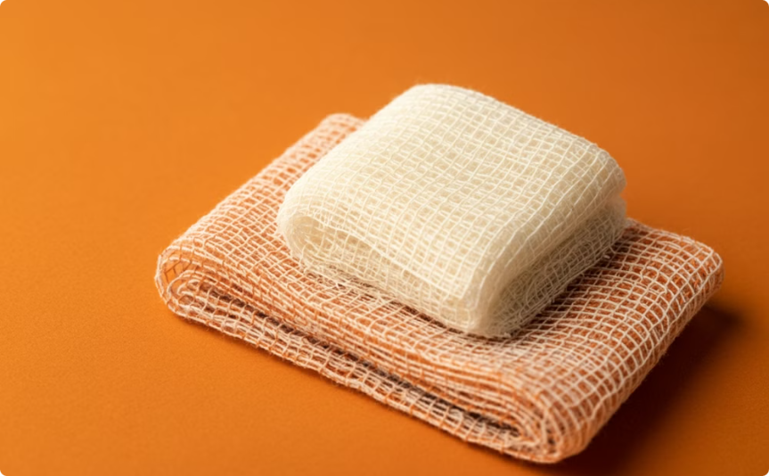
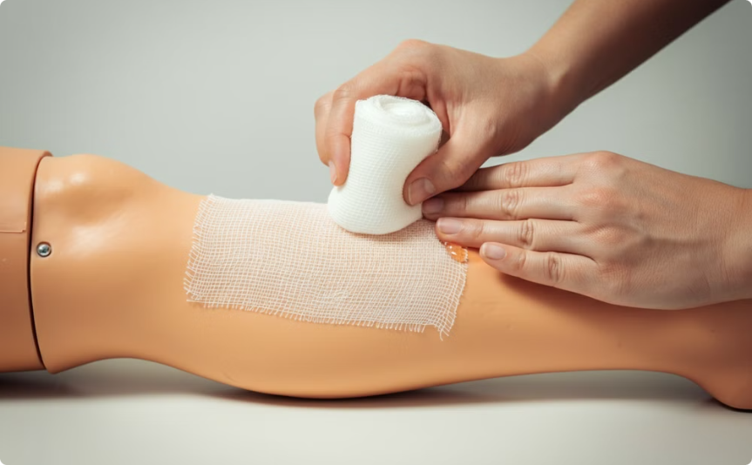
Hemostatic Gauze: Advanced Bleeding Control
Hemostatic gauze represents an advanced category of wound dressings designed to promote rapid blood coagulation in traumatic wounds involving arterial bleeding. These products have gained widespread use among EMS professionals and first responders, proving effective in saving lives on battlefields and in various accident scenarios. Hemostatic gauze products typically contain active ingredients that accelerate the clotting process. For example, Bioviva is a cellulose-based, bacteriostatic hemostatic gauze that transforms into a viscous gel upon contact with blood, sealing the wound site and activating the clotting system. These advanced dressings offer a significant improvement over traditional gauze in managing severe bleeding.
Hemostatic Gauze Structure
Hemostatic Action
Detailed view of hemostatic gauze showing its unique composition.
Visual representation of hemostatic gauze transforming and sealing a wound.

Slide 17
Types of Roller Bandages
Roller bandages are versatile wound care tools that come in two main types: elastic roller bandages and cotton or linen roller bandages. Elastic roller bandages are primarily used to apply support to strains or sprains. They are wrapped around joints or limbs multiple times, providing firm but not overly tight compression to avoid restricting circulation. Cotton or linen roller bandages, on the other hand, are used to cover gauze dressings. These come in various widths and are secured with tape, clips, or pins. They can also be used for wound compression when necessary and are typically sterile. The choice between elastic and non-elastic roller bandages depends on the specific wound care or support needs.
Elastic Roller Bandages
Cotton/Linen Roller Bandages
- Used for support and compression - Ideal for strains and sprains - Provides flexible, adjustable pressure - Allows some joint movement
- Used to cover wound dressings - Available in various widths - Can be used for wound compression - Typically sterile for medical use

Slide 18
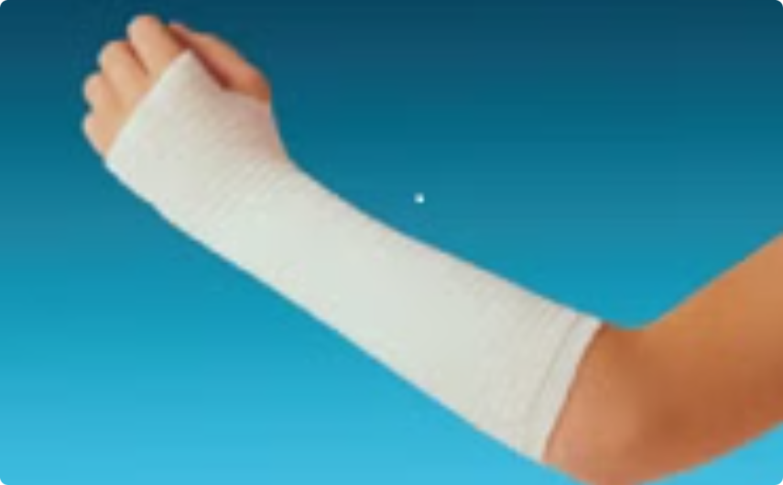
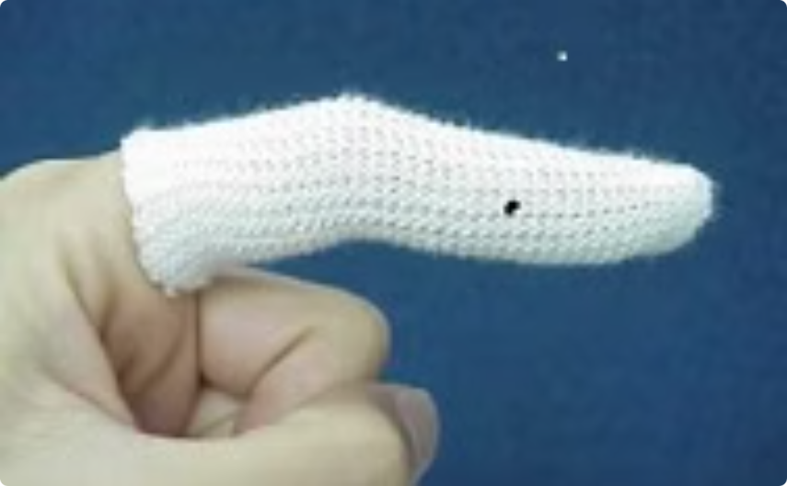
Tubular Bandages: Specialized Wound Coverage
Tubular bandages are designed to address the challenges of dressing wounds on fingers, toes, and areas with significant movement like elbows and knees. These bandages are particularly useful because they can be easily applied to difficult-to-bandage areas without the need for additional securing methods. The elastic nature of tubular bandages allows them to conform to the shape of the body part while providing consistent pressure and support. They are effective in keeping dressings in place on parts of the body that experience frequent movement, ensuring that the wound remains protected and the dressing stays secure throughout the healing process.
Tubular Bandage Types
Application Technique
Various sizes and types of tubular bandages for different body parts.
Demonstration of proper tubular bandage application on a finger.

Slide 19
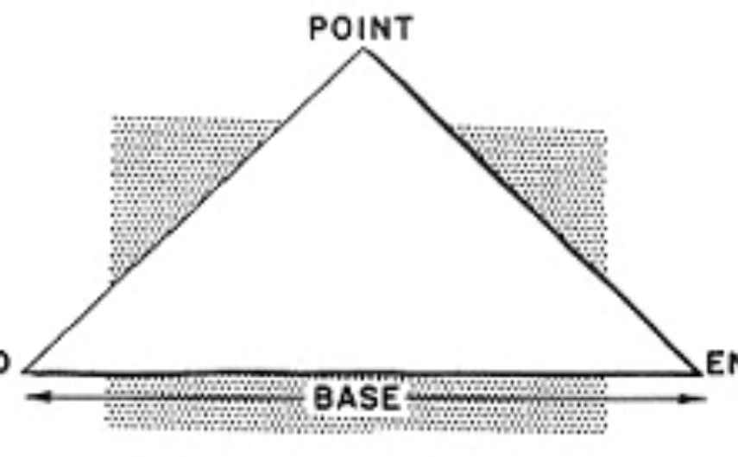
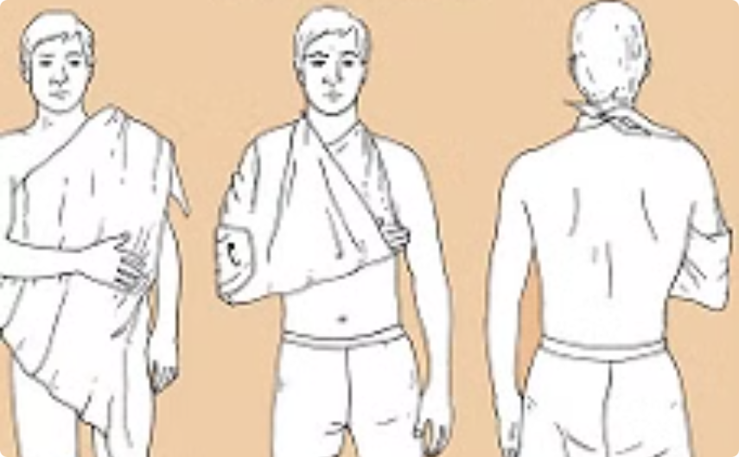
Triangular Bandages: Versatile First Aid Tool
Triangular bandages, made of cotton or disposable paper, are highly versatile tools in first aid and wound care. Their primary uses include creating slings to support, elevate, or immobilize upper limbs, which is particularly useful for broken bones, strains, or post-operative care. When folded narrowly, triangular bandages can serve as cold compresses to reduce swelling. They are also effective in applying pressure to wounds to control bleeding. The flexibility of triangular bandages makes them an essential component of first aid kits, allowing for quick and adaptable responses to various injury scenarios.
Triangular Bandage Structure
Arm Sling Application
The basic shape and form of a triangular bandage.
Demonstration of using a triangular bandage as an arm sling.

Slide 20
Gypsum Bandages: Immobilization for Fractures
Gypsum bandages, also known as plaster casts, are specialized dressings used in traumatology and orthopedics for immobilizing bone fractures and joints. Made from calcium sulfate hemihydrate and high-quality cotton, these bandages form a strong, rigid cast when moistened and applied to the affected area. Gypsum bandages have been widely used since the 1970s and are effective in supporting the healing process of broken bones by keeping the fractured parts immobile. They are typically worn for 6 to 8 weeks, though the duration may vary depending on the severity and location of the fracture. Gypsum bandages can be used to immobilize almost any part of the body, making them a versatile tool in orthopedic care.
1
Composition
2
Application
Made from calcium sulfate hemihydrate and high-quality cotton
Moistened and molded around the fractured limb or joint
3
Duration
4
Versatility
Typically worn for 6-8 weeks, depending on fracture severity
Can be used to immobilize various body parts

Slide 21
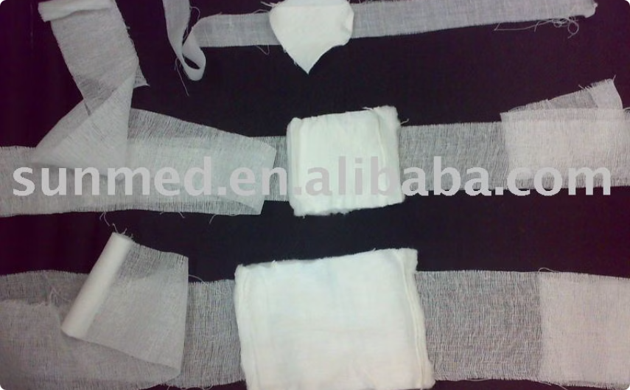
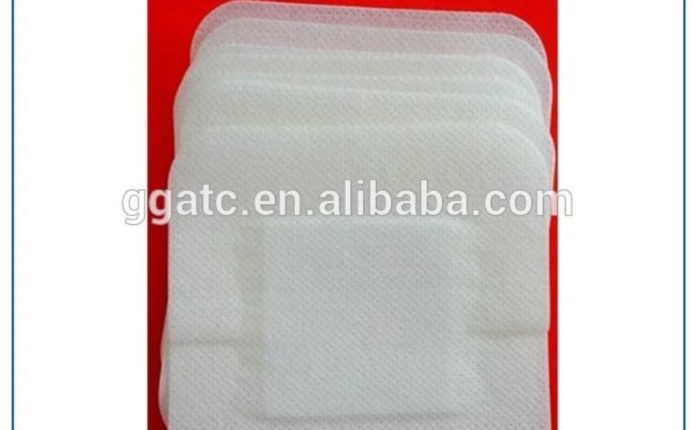
Absorbent Lint: Simple Yet Effective
Absorbent lint is a basic yet crucial component in wound care. It is a cotton cloth of plain weave that readily absorbs water, making it useful for various medical applications. However, its absorbency can be significantly reduced when medicated, with the final absorbency depending on the type of medicament incorporated. One of the key features of absorbent lint is its ability to be easily torn in both directions, allowing for customizable sizing and application. While simple in design, absorbent lint continues to play an important role in wound management, particularly in situations where basic absorption and protection are required.
Absorbent Lint Texture
Lint Application
Close-up view of absorbent lint showing its woven structure.
Demonstration of absorbent lint being used in wound care.

Slide 22




Characteristics of Ideal Wound Dressings
An ideal wound dressing should possess multiple characteristics to effectively promote healing and protect the wound. It should maintain a moist environment around the wound while being permeable to gases. The dressing should be capable of absorbing and retaining excess exudate without allowing it to leak from the outer surface. Easy and painless removal is crucial to avoid disturbing the healing process. Additionally, an ideal dressing should not cause allergies, should control pH and temperature, protect against microorganisms, minimize pain, and be economically viable. Modern wound dressings aim to incorporate these features to create an optimal healing environment and address various wound types and stages.
Moisture Control
Protection
Absorption
Comfort
Maintains optimal wound moisture
Guards against contaminants and bacteria
Manages wound exudate effectively
Ensures easy, painless application and removal

Slide 23
Evolution of Wound Dressing Technology
The field of wound dressing has seen significant advancements over the years. From 1980 to 2000, research focused on developing dressings that maintain wound moisture, addressing chronic wounds, deep wounds, and high exudation wounds. Post-2000, the introduction of Active or Bioactive Dressings marked a significant leap in wound care management. These dressings not only shorten healing time but also make wounds less prone to infections. They incorporate features like antibiotic properties and the ability to promote tissue growth and epithelial cell formation. This evolution has led to the development of third-generation materials like hydrogels and superabsorbent polymers (SAP), which have largely replaced traditional absorbent materials in advanced wound care.
Pre-1980
Post-2000
Traditional dry dressings
Introduction of bioactive dressings
1
2
3
4
1980-2000
Current Era
Focus on moist wound healing
Advanced materials like hydrogels and SAP

Slide 24
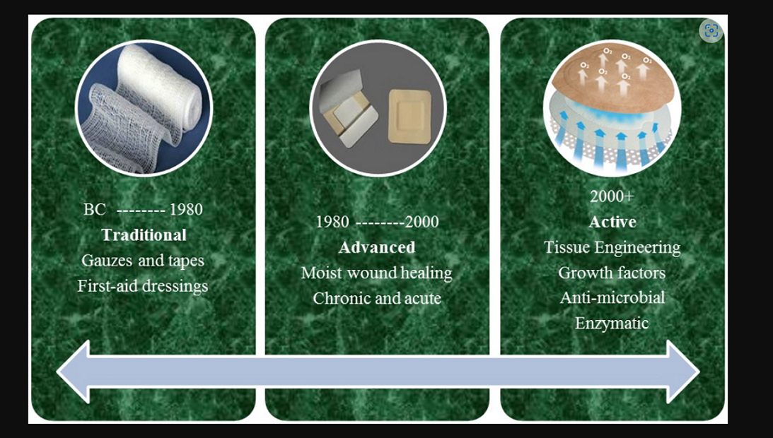

Slide 25
Several dressings have been developed. Classification of dressings was traditionally made on the nature of material rather than mode of action. These were then classified as conventional, biological and synthetic dressings. Each class were further classified as:
i) Primary dressings: The layer which was in direct contact with the wound was the primary dressings:
ii) Secondary dressings: The layer covering the primary dressings to further protect the wound was the secondary layer.
iii) Island dressings: It constituted of an absorbent core and a transparent layer with an adhesive on it.

