Slide 1

ODESSA NATIONAL MEDICAL UNIVERSITY
Faculty of pharmacy
Department of Organization and Economics of Pharmacy
with post-diploma specialization
Psychosocial hazards at work
The lecture was prepared by
senior teacher Oksana STEPANOVA

Slide 2
Agenda Style
01
Contents
Get a modern PowerPoint Presentation that is beautifully designed. I hope and I believe that this Template will your Time.
02
Contents
Get a modern PowerPoint Presentation that is beautifully designed. I hope and I believe that this Template will your Time.
03
Contents
Get a modern PowerPoint Presentation that is beautifully designed. I hope and I believe that this Template will your Time.
04
Contents
Get a modern PowerPoint Presentation that is beautifully designed. I hope and I believe that this Template will your Time.

Slide 3

Work-related psychosocial hazards are on the verge of surpassing many other occupational hazards in their contribution to ill-health, injury, disability, direct and indirect costs, and impact on business and national productivity. The risks associated with exposure to psychosocial hazards at work are compounded by the increasing background prevalence of mental health disorders in the working-age population.
Psychosocial hazards are fundamental to OHS because they are fundamental to human health. They can occur in any workplace, regardless of industry, size, equipment or tasks, simply because organizations are comprised of humans.
Accordingly, psychosocial hazards should be treated as a fundamental element of OHS, rather than an add-on element.
Notes:
This threat may affect many of the 169.6 million US workers by 2030 and result in adverse mental and physical health, leading to increased morbidity, mortality, and disability. In turn, these effects could have major impacts on national, business, and worker economic circumstances.

Slide 4

As well as physical and mental health outcomes, psychosocial hazards can have a negative impact on worker health behaviours (such as unhealthy eating, low physical activity, and drug and alcohol consumption), and on organizational outcomes (such as engagement, absenteeism, turnover and performance; It has also been recognised that psychosocial hazards can delay recovery from injury/illness and therefore can influence return-to-work outcomes

Slide 5

Psychosocial hazards
Psychosocial hazards are any hazards or risks in one’s environment and society that can cause harm. In a workplace setting, psychosocial hazards are things that can cause stress, which can then affect a person physically, psychologically, or both.

Slide 6
Difference Between Psychosocial and Psychological Hazards
In terms of workplace hazards, psychological safety and psychosocial safety are separate concerns.
Anything “psychosocial” refers to the relationships between humans with their thoughts, behaviors, and social environment. It is a term that refers to how mental health, or psychological factors, work with social factors and how they can affect a person.
The term “psychological” refers to things, feelings, and experiences that relate to the human mind and mental health. .
Notes:
Following this, it can be said then that psychological factors are an aspect of one’s psychosocial state, and managing it can be very beneficial.

Slide 7

Psychosocial hazards
Time pressure/role overload
Emotional demands associated with job
Low job control
Poorly defined roles
Low recognition and reward.
Poorly managed change
Interpersonal or team conflict (including bullying, violence, and aggression)
Organizational injustice
Low co-worker or supervisor support
Environmental
Notes:
Established psychosocial hazards include:

Slide 8

Psychosocial aspects of work and related hazards.
Psychosocial aspects of work | Associated psychosocial hazards
Job content | Lack of variety or short work cycles; fragmented or meaningless work; under-use of skills; high uncertainty; continuous exposure to difficult clients, patients, pupils, etc.
Workload and work pace | Work overload or too little work, machine pacing, high levels of time pressure, continually subject to tight deadlines
Work schedule | Shift work, night shifts, inflexible work schedules, unpredictable hours, long or unsociable hours
Control | Low participation in decision-making; lack of control over workload, pacing, shift working, etc.
Environment and equipment | Inadequate equipment availability, suitability, or maintenance; poor environmental conditions such as lack of space, poor lighting, excessive noise
Organizational culture and function | Poor communication; low levels of support for problem solving and personal development; poor managerial support; lack of definition of, or agreement on, organizational objectives

Slide 9

Psychosocial aspects of work and related hazards.
Psychosocial aspects of work | Associated psychosocial hazards
Interpersonal relationships at work | Social or physical isolation, poor relationships with superiors, interpersonal conflict, lack of social support, harassment, bullying, poor leadership style, third-party violence
Role in organization | Role ambiguity, role conflict, responsibility for people
Career development | Career stagnation and uncertainty, under-promotion or over-promotion, poor pay, job insecurity, low social value of work
Home-work interface | Conflicting demands of work and home, low support at home, problems relating to both partners being in the labor force (dual career)

Slide 10
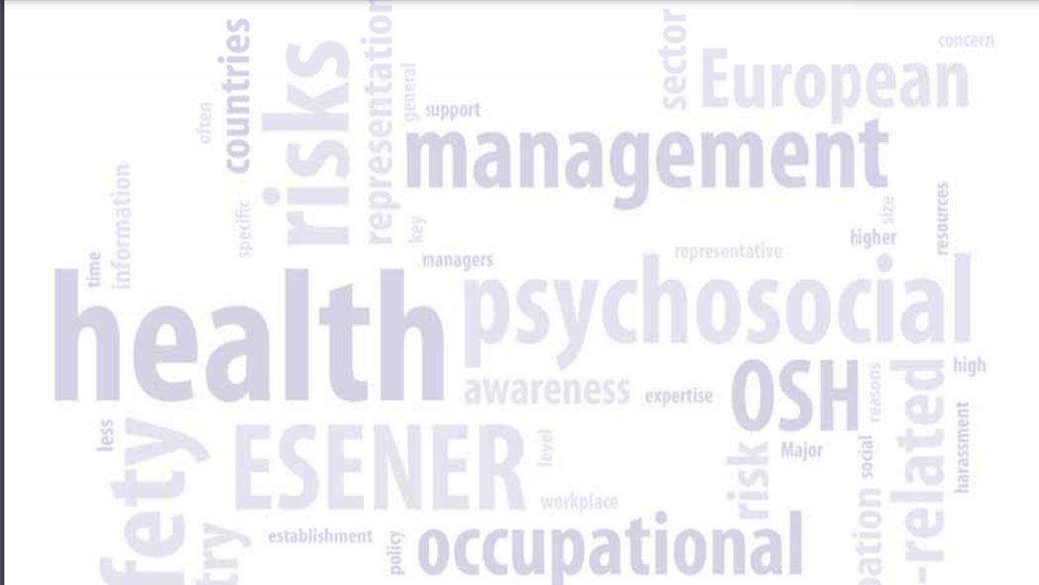
Occupational stress
Occupational stress - the physiological and psychological responses of workers who perceive that their work demands exceed their resources (e.g. skills, time, support) and/or abilities to cope with the work
The American Psychological Association’s Dictionary of Psychology defines Occupational Stress as “a physiological and psychological response to events or conditions in the workplace that is detrimental to health and well-being”.
Notes:
Having a clear understanding of the definition of occupational stress is important as the psychological and physiological stress response is the mechanism by which psychosocial hazards have an effect on people’s health and wellbeing. The definition of ‘stress’ has been the subject of much academic and public debate.

Slide 11
Occupational stress
The stress response is a multi-factorial (i.e. physiological, cognitive and emotional) response to a set of stimuli that can lead to ill health.
Stress is not a disease in its own right, but a pathway that can lead to ill-health, whether mental or physical health outcomes. The ill-health pathway occurs when there is significant ‘imbalance’ between the demands placed on a person, and the resources they have to cope with those demands.
The individual’s perception of their work characteristics (including their perceptions of their coping skills and how important it is to them that they cope) is an integral part of the stress equation.

Slide 12
Manifestation of Occupational stress
psychological strain
—affecting the rationale thinking abilities of an individual and can lead to loss in memory and concentration or depression and anxiety;
behavioral strain
—causing a change in the usual or normal habits of an individual, like, for example, binge eating or starving, excessive or loss of sleep, ignoring to perform regular tasks or duties and avoiding responsibilities and absenteeism.
physical strain
—affecting the various parts of the body and this is the most common way by which occupational stress manifests itself. It can range from having mild headaches or body pain to severe migraines;
Notes:
Occupational stress may manifest itself in one or more of the following three different ways:

Slide 13
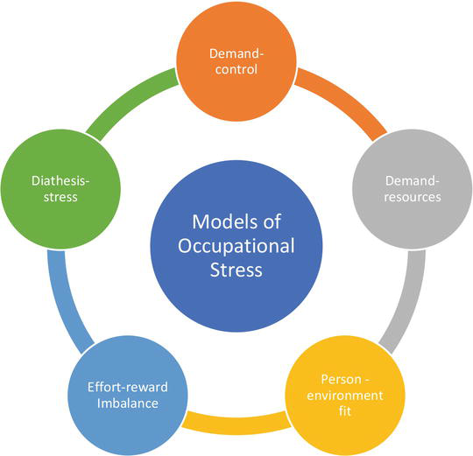
Models to explain the occurrence of occupational stress.
Notes:
There are a few theories in the field of psychology to explain the occurrence of occupational stress .The first and most accepted theory is the demand-control model wherein stress can happen when the workload is high; however, the decision-making authority is low.

Slide 14
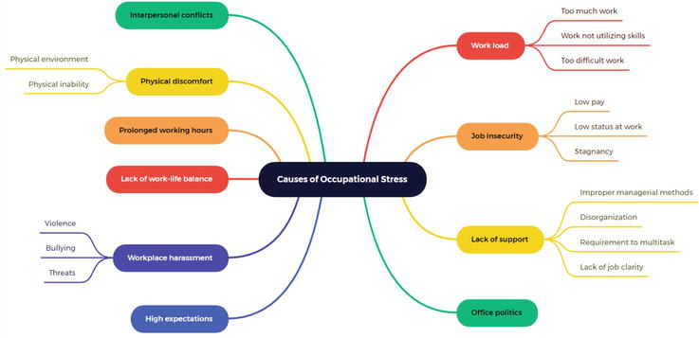
Cause of occupational stress

Slide 15
Coping strategies
NIOSH recommends the following strategies for organizations to help their employees cope with occupational stress:
Ø Managers should keep monitoring the workload of sub-ordinates and see to it that the workers are allocated work that is well within their skills set and capabilities and can also be reasonably completed within the time frame given;
Ø Each job must come with a clear description of its scope of work and roles and responsibilities;
Ø Sufficient resources should be available for the employees to complete the tasks;
Ø If new tasks are to be performed, especially with advancements in technology require employees to do tasks that may be beyond their current capabilities, then, suitable training should be given to them before they can undertake those specific tasks;
Ø Communication channels must be transparent, and all employees should be given an opportunity to voice out their opinions and decisions;
Ø Different leadership styles can be explored to figure out which style works well for the organization and its employees.
Notes:
In order to manage stress, it is essential to change ones’ own cognitive and behavioral efforts in dealing with the external or internal stimuli that is causing the stress and this is referred to as coping. Coping strategies can be worked out at both organizational level and also at personal levels. When it comes to organizational levels, it is first important for the management to understand the causative factors in the organization and come up with suitable measures. NIOSH recommends the following strategies for organizations to help their employees cope with occupational stress

Slide 16
Coping strategies
First among them is seeking social support—irrespective of what the social support can provide, be it in terms of advice or suitable contacts or material help or just a distraction, getting in touch with a human contact is valued when one is undergoing stress Seeking social support is also said to help an individual to overcome exhaustion and work–family conflicts
The next strategy is the “problem-solving” strategy, wherein the individual can put up a fight against the stressor, and this goes beyond just identifying the stressor. Studies have also shown that the problem-solving strategy helps an individual to gain more control over the job and thus overcome occupational stress.
The last strategy is the “avoidance” strategy which is equated to running away from the stressor and is a form of escapism. Even though studies have shown a positive correlation between avoidance and emotional exhaustion, certain longitudinal studies indicate that avoidance can potentially lead to depression 10 years down the road or more chronic and acute conditions 4 years later.
Notes:
Author Information
Show +
1. Introduction
The American Psychological Association’s Dictionary of Psychology defines Occupational Stress as “a physiological and psychological response to events or conditions in the workplace that is detrimental to health and well-being” [1]. Such responses do vary from individual to individual, and it depends on several factors such as the level of autonomy, responsibility and independence that the individual has in his or her workplace, the amount, pace and type of work that needs to be performed, the level of safety and security associated to the work and finally the relationships that the individual maintains with his or her colleagues and supervisors.
Occupational stress may manifest itself in one or more of the following three different ways: (i) physical strain—affecting the various parts of the body and this is the most common way by which occupational stress manifests itself. It can range from having mild headaches or body pain to severe migraines; (ii) psychological strain—affecting the rationale thinking abilities of an individual and can lead to loss in memory and concentration or depression and anxiety; (iii) behavioral strain—causing a change in the usual or normal habits of an individual, like, for example, binge eating or starving, excessive or loss of sleep, ignoring to perform regular tasks or duties and avoiding responsibilities and absenteeism.
The necessity to study occupational stress stems from the fact that it can have significant effects on both the physical and mental wellbeing of an individual and also an impact on the productivity of the workplace, which can have a negative impact on the global economy in turn. The Safety and Health at Work team of the International Labour Organization (ILO) found that the direct and indirect costs of occupational stress are in the range of billions of dollars annually all over the world [2].
The “State of the Global Workplace 2022 Report” by Gallup reports the results of the worldwide survey on the workplace wellbeing and shows that around 44% of the employees experience occupational stress around the world. Looking at some of the important factors that could have contributed to the occupational stress from the study, the United States and Canada have the highest regional percentage of engaged employees (33%), whereas Europe has the lowest regional percentage of the engaged employees (14%). Engaged employees refer to the employees who enthusiastically participate in all the activities of their work and are happy as their basic needs are met and are able to contribute positively to the organization. We could consider the second important factor as the percentage of employees living comfortably on their present household income which was found to be highest (55%) in Australia and New Zealand and lowest (10%) in Sub-Saharan Africa. The third factor is the social factor, which refers to the way by which employees were treated in their organizations—South Asia, which includes India, Sri Lanka, Bangladesh, Nepal, Pakistan and Afghanistan, had the highest regional percentage of respondents (19%) who felt that there were not treated with respect at their workplaces [3].
Advertisement
2. Theories for the occurrence of occupational stress
There are a few theories in the field of psychology to explain the occurrence of occupational stress (Figure 1). The first and most accepted theory is the demand-control model wherein stress can happen when the workload is high; however, the decision-making authority is low. Alternatively, when the workload is high and there is a significant lack of resources or support to perform that job, that can also lead to stress and in that case, the demand-resource model would be applicable. Stress can occur when the skills, abilities and attitude of the employee do not match the requirements of the job, and this is called the person–environment fit model. When the efforts put in for a particular job are not rewarded appropriately in the form of pay or fair treatment or even a mere appreciation, it can lead to stress, and in this case, it is referred to as the effort–reward imbalance model. Finally, as indicated at the start of this chapter, it is also important to understand that the ability to cope to various stressful conditions differs from individual to individual, and when the stressors go beyond an individual’s ability to cope with stress, then, it is referred to as the diathesis–stress model.
Figure 1.
Models to explain the occurrence of occupational stress.
Advertisement
3. Cause of occupational stress
One may argue that the causes of occupational stress may not be solely due to the workplace conditions and that there are possibilities of personal factors stemming from an individual’s family or social life that could have an impact on their physical and mental wellbeing. However, scientific evidences do show that several workplace conditions contribute to occupational stress in a significant manner. The various causes of occupational stress are depicted in Figure 2.
Figure 2.
Causes of occupational stress.
Advertisement
4. Coping strategies
In order to manage stress, it is essential to change ones’ own cognitive and behavioral efforts in dealing with the external or internal stimuli that is causing the stress and this is referred to as coping. Coping strategies can be worked out at both organizational level and also at personal levels. When it comes to organizational levels, it is first important for the management to understand the causative factors in the organization and come up with suitable measures. NIOSH recommends the following strategies for organizations to help their employees cope with occupational stress [4]:
Managers should keep monitoring the workload of sub-ordinates and see to it that the workers are allocated work that is well within their skills set and capabilities and can also be reasonably completed within the time frame given;
Each job must come with a clear description of its scope of work and roles and responsibilities;
Sufficient resources should be available for the employees to complete the tasks;
If new tasks are to be performed, especially with advancements in technology require employees to do tasks that may be beyond their current capabilities, then, suitable training should be given to them before they can undertake those specific tasks;
Communication channels must be transparent, and all employees should be given an opportunity to voice out their opinions and decisions;
Different leadership styles can be explored to figure out which style works well for the organization and its employees.
On personal front, there are a few coping strategies that an individual can explore to overcome occupational stress.

Slide 17
Thank you for your attention!

