Slide 1

ODESSA NATIONAL MEDICAL UNIVERSITY
Faculty of pharmacy
Department of Organization and Economics
of Pharmacy with post-diploma specialization
Occupational risks in the pharmaceutical industry
ОС
The lecture was prepared by
senior teacher Oksana STEPANOVA

Slide 2
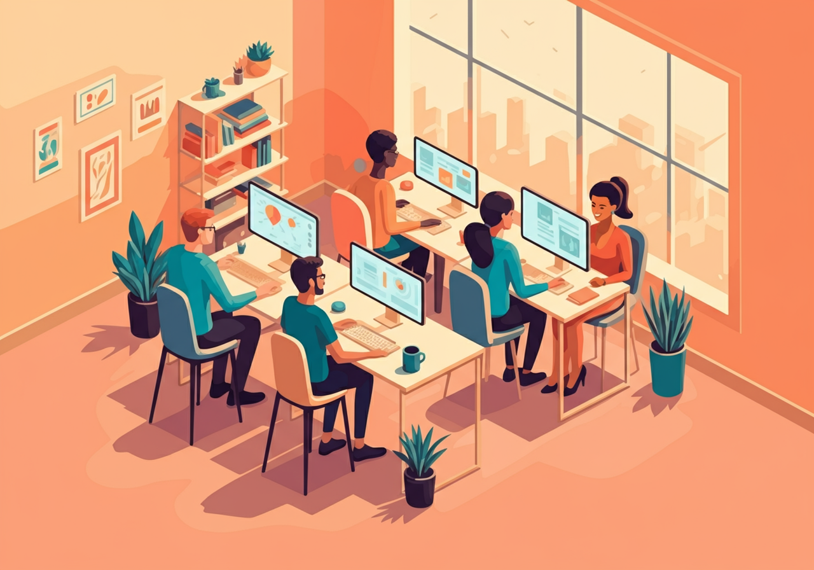
Ergonomics is a comprehensive science that studies the interaction of humans in the workplace to improve efficiency, safety, and comfort. It encompasses international standards for working conditions and aims to create optimal conditions for effective and comfortable work. In the pharmaceutical industry, ergonomics plays a key role in ensuring the health, safety, and productivity of employees, especially considering the specific nature of working with medications and prolonged periods spent in one position.
ОС

Slide 3
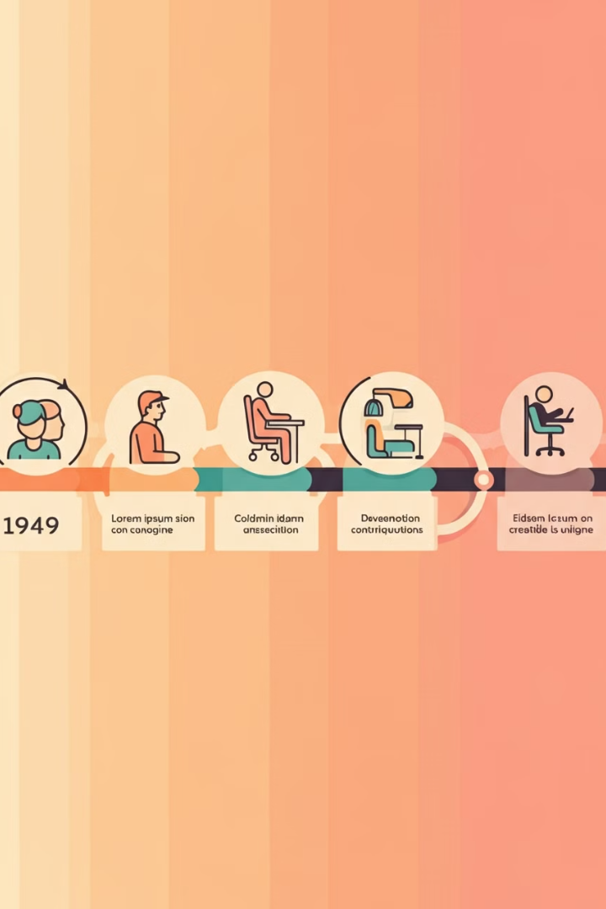
The History and Development of Ergonomics
1
1949
The term "Ergonomics" was established in England. A group of scientists founded an organisation that focused on ergonomic research in society.
2
USA
The academic discipline was known as "Human Factors (HF)".
3
Germany
Ergonomics was known as "Anthropotechnology".

Slide 4

Definition of Ergonomics
Etymology
Essence
In simple terms
Ergonomics consists of two words: "ergos" - work and "nomos" - law.
Comprehensive study of the functional capabilities of an individual in activities using technical means.
The relationship between humans and technology to create optimal working conditions.

Slide 5
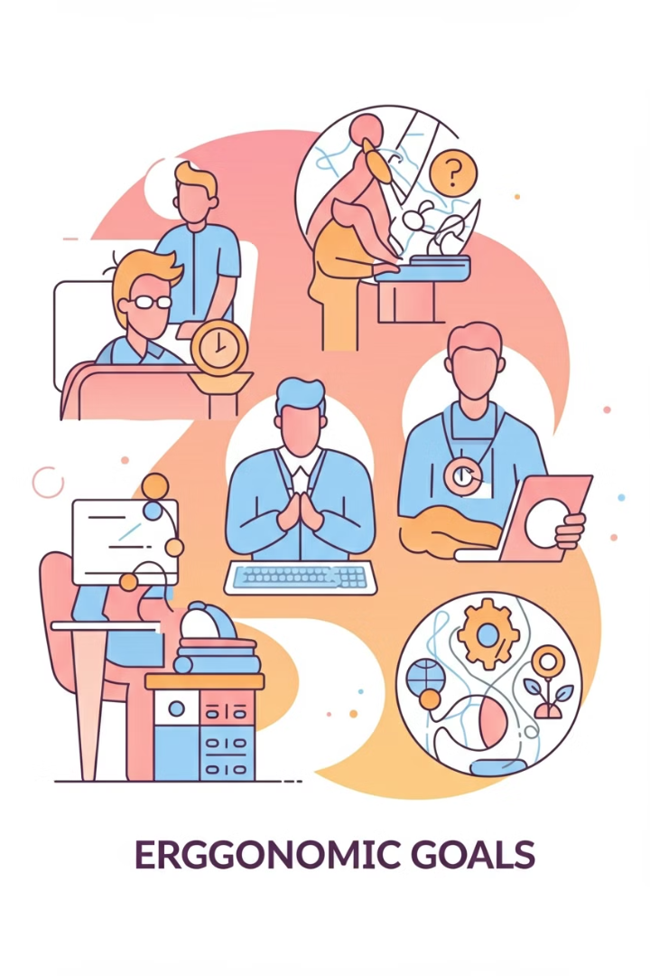
The Goals of Ergonomics
1
Optimal Conditions
Providing optimal working and rest conditions, taking into account the physiological and psychological needs of the individual.
2
Increased Efficiency
Optimising work processes and adapting objects and equipment to increase efficiency and productivity.
3
Preventing Illness
Preventing occupational diseases and injuries related to the improper use of the work environment.
4
Universality
Applying ergonomic principles in various areas of life to create more comfortable and safe conditions.

Slide 6
Spheres of Application of Ergonomics
Manufacturing and Offices
Healthcare
Design and Architecture
Optimisation of workplaces and processes to increase productivity and employee comfort.
Development of medical equipment and organisation of workplaces in healthcare facilities.
Creation of ergonomic interiors, objects and public spaces.

Slide 7
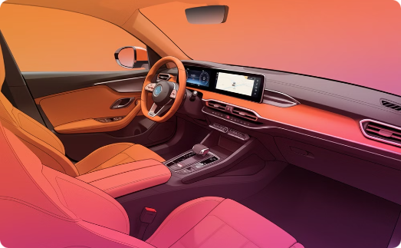

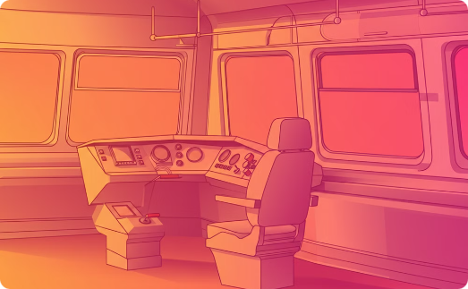
Ergonomics in Transport
Cars
Aeroplanes
Trains
Developing ergonomic seats and control panels for driver comfort and safety.
Optimising the pilot's cabin and passenger seating for comfortable and safe flights.
Ergonomic design of driver's cabs and passenger carriages for comfortable journeys.

Slide 8
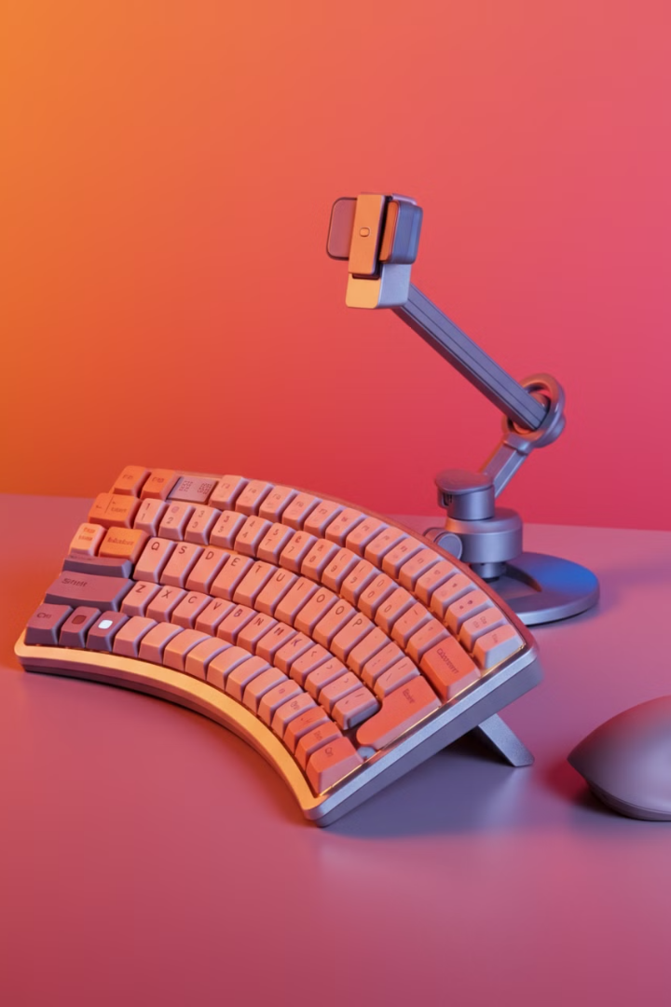



Ergonomics in Information Technology
Interfaces
Developing user-friendly and intuitive interfaces for software and websites.
User Experience
Optimising user interaction with digital products to enhance efficiency and satisfaction.
Hardware
Creating ergonomic computer peripherals to reduce user strain.

Slide 9
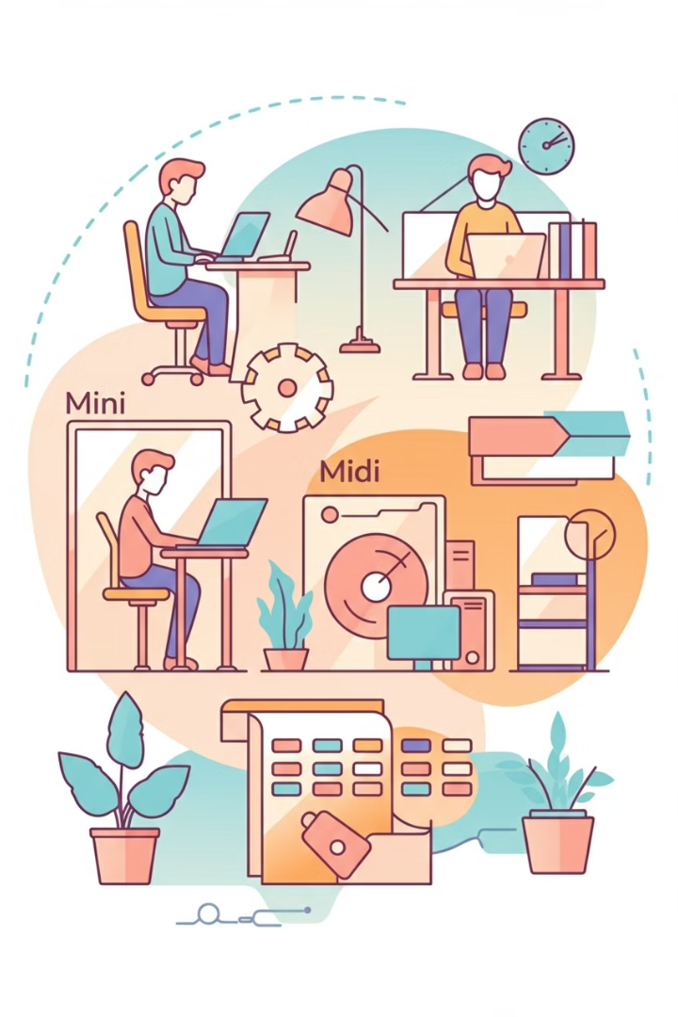
Directions of Ergonomics
Micro-ergonomics
Studying the interaction between the human and individual elements of the workplace
Meso-ergonomics
Investigating the interaction between the human and the work environment as a whole
Macro-ergonomics
Analysing the interaction between the human and global systems and organisations

Slide 10
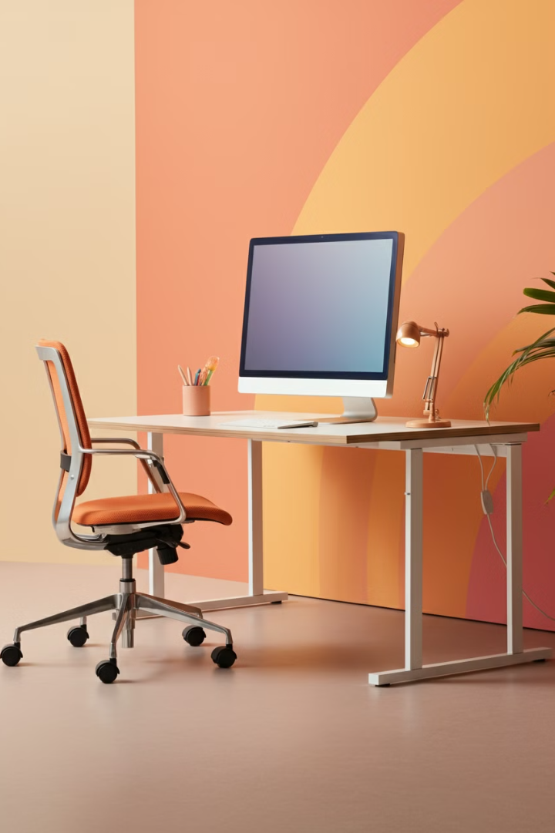
Physical Ergonomics
Workplace
Optimising the layout of the workplace for comfort and efficiency.
Working Posture
Ensuring the correct body position during work to reduce strain.
Musculoskeletal System
Considering the characteristics of the musculoskeletal system to prevent injuries and fatigue.
Equipment Adaptation
Adjusting furniture and tools to the parameters of the individual.

Slide 11

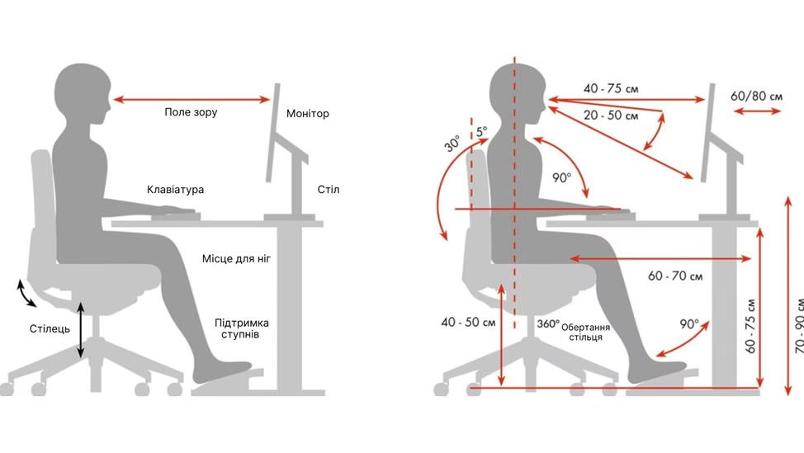
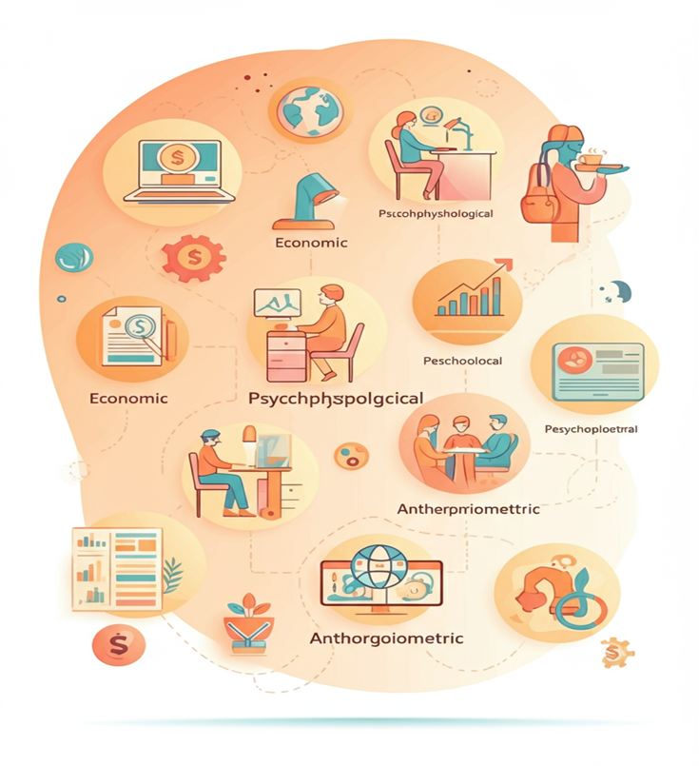
Optimising workspaces for comfort and efficiency.

Slide 12




Cognitive Ergonomics
Perception
Memory
Decision Making
Optimising the presentation of information for easy perception and processing.
Developing systems that facilitate the memorisation and recall of information.
Creating conditions for quick and effective decision-making in the work process.

Slide 13
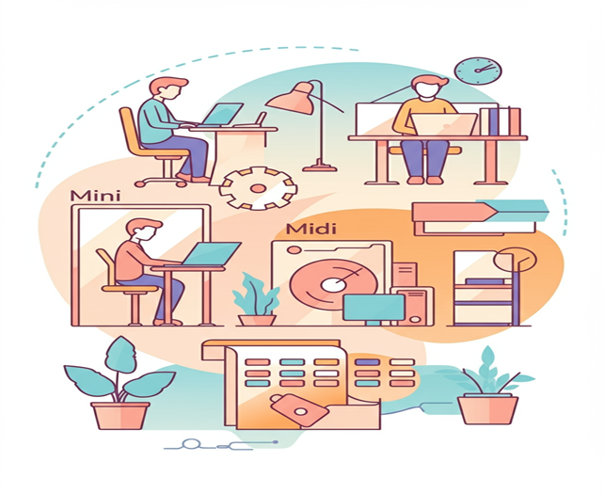
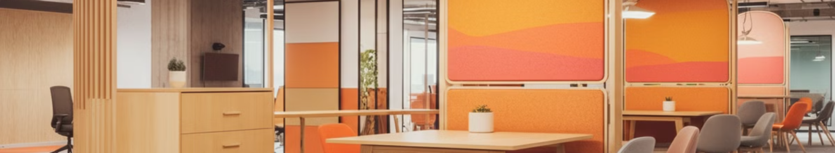
Organisational Ergonomics
Communication Systems
Employee Interaction
Resource Management
Optimising communication processes within the organisation to improve work efficiency.
Creating conditions for effective collaboration and information exchange between employees.
Developing ergonomic approaches to the allocation and utilisation of organisational resources.

Slide 14
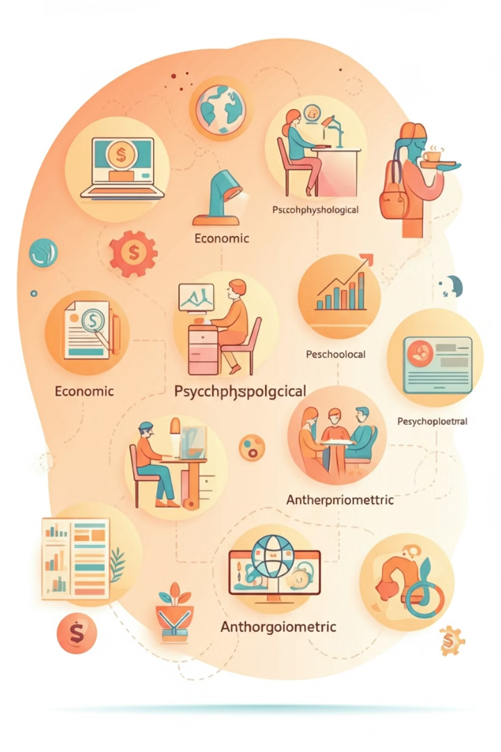
Ergonomic Requirements for the Organisation of Work Processes
1
Economic Requirements
Improving the technical equipment of work, selecting the optimal technology, and fully utilising equipment.
2
Psychophysiological Requirements
Correspondence between the physiological characteristics of the person and the elements of the technological process.
3
Psychological Requirements
Considering the capabilities of memory and thinking when organising the work process.
4
Anthropometric and Biomechanical Requirements
Correspondence between work tools and the physical parameters of the person.
https://www.youtube.com/watch?v=ZybOEkKI0CI

Slide 15

Hygiene requirements of ergonomics
Meteorological conditions
Air composition
Ensuring comfortable temperature, humidity and air movement in the workplace.
Control over the optimal physical and chemical composition of the air in the work premises.
Lighting
Noise and vibration
Providing adequate lighting levels for comfortable and safe work.
Minimising noise and vibration levels to preserve the health of employees.

Slide 16
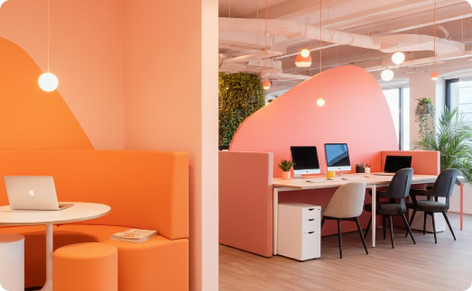
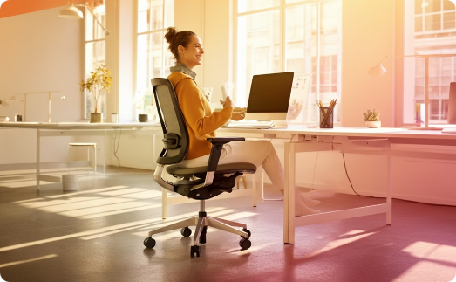

Aesthetic Requirements of Ergonomics
Workplace Design
Ergonomic Furniture
Accessories and Details
Creating a visually appealing and harmonious work space.
Developing functional and aesthetically pleasing furniture for the workplace.
Selecting harmonious colours and shapes for office supplies and accessories.

Slide 17
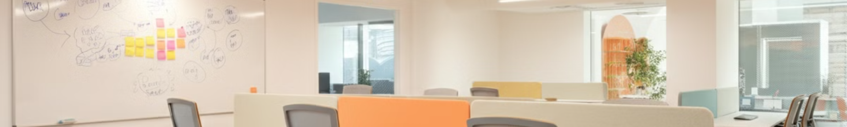



Social requirements of ergonomics
Increasing the content of work
Creating conditions for more meaningful and interesting work.
Creative activity
Stimulating a creative approach and initiative of employees.
Management efficiency
Optimisation of production and personnel management processes.

Slide 18
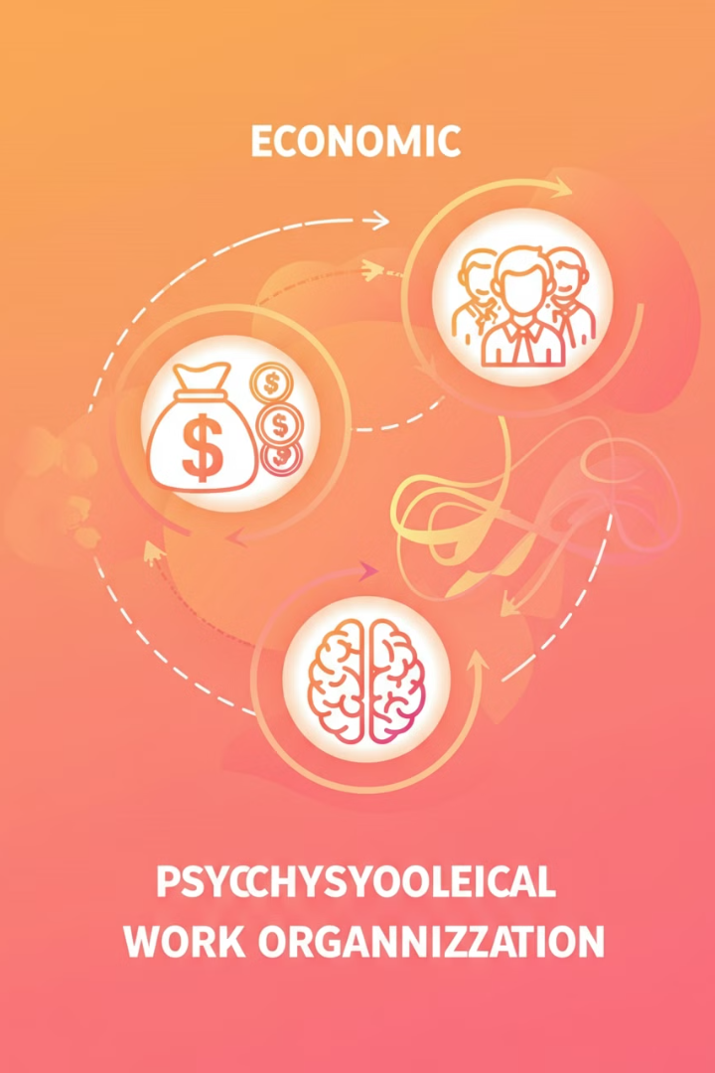



Main tasks of scientific work organisation
Economic task
Effective combination of technology and people in the production process.
Psychophysiological task
Creating favourable working conditions to preserve health.
Social task
Promoting the creative growth and self-improvement of employees.

Slide 19

Directions for the implementation of scientific work organisation
1
Rational forms of division of labour
Introduction of optimal forms of distribution and cooperation of labour.
2
Improvement of workplaces
Optimisation of planning and technological equipment of workplaces.
3
Introduction of advanced methods
Application of modern techniques and methods of work, especially when working with automated equipment.
4
Improving qualifications
Continuous training and development of professional skills of employees.

Slide 20

Improving Labour Standardisation
Reflecting Participation
Characterising Organisation
Optimising Processes
Standardisation as a way of reflecting the degree of each employee's participation in production.
Standardisation as an indicator of the achieved level of work organisation.
Using standardisation to improve work processes and increase efficiency.

Slide 21
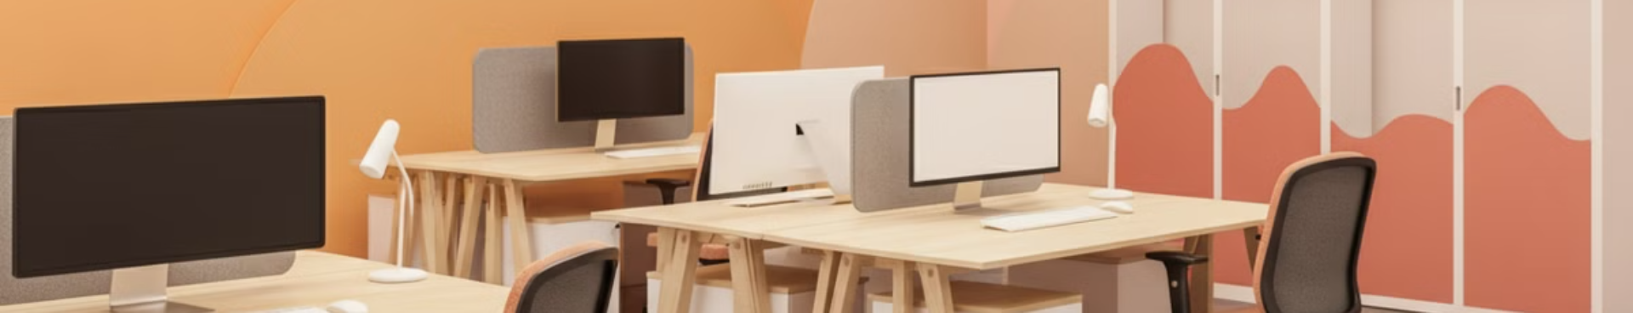
Improving Working Conditions
Computerisation
Climatic Conditions
Introduction of modern technologies to optimise the work process.
Ensuring optimal temperature, humidity and air movement.
Lighting
Elimination of Harmful Factors
Creating rational lighting of workplaces.
Minimising dust, gas, noise and vibration.

Slide 22




Employee Development
Discipline
Fostering a culture of compliance with government and labour discipline.
Responsibility
Developing a sense of responsibility for one's own and collective safety.
Professional Ethics
Cultivating professional values and ethical standards of behaviour.

Slide 23
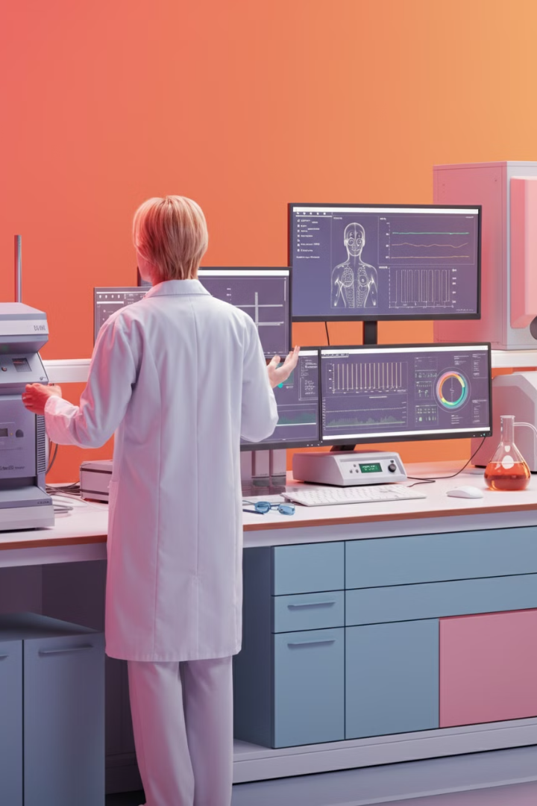
Physiology of Work
1
Definition
The science that studies changes in the functional state of the human body under the influence of work activity.
2
Aim
Substantiation of the physiological principles of the scientific organisation of the work process.
3
Objectives
Maintaining a high level of work capacity and preserving the health of employees.
4
Research Areas
Study of the functions of the nervous system, analysers, cardiovascular and other body systems during work.

Slide 24
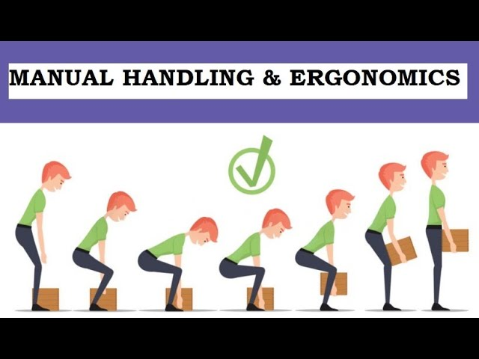
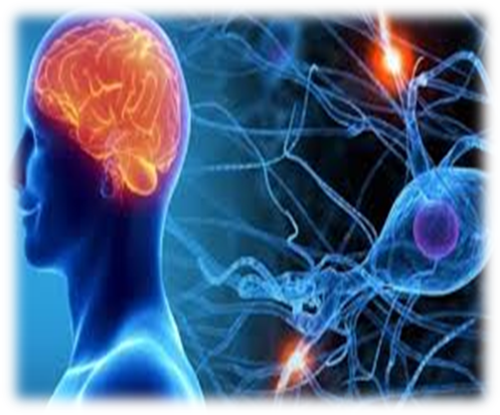
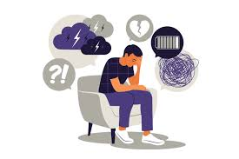
Types of Loads During Work
Muscle Loads
Nervous Loads
Emotional Loads
Caused by the working position of the body, the nature of the work movements and the tension of physiological functions.
Associated with the strain on attention, memory, sensory apparatus and the activation of thought processes.
Arise as a result of stressful situations and responsibility for completing tasks.

Slide 25

Classification of labour by workload
Physical labour
Predominance of muscle loads
Mental labour
Predominance of loads on the cerebral cortex
Mixed labour
Combination of physical and mental loads

Slide 26

Physiological Changes During Physical Labour
Energy Expenditure
Blood Circulation
Increased energy expenditure by the body.
Increased blood circulation to supply nutrients and oxygen.
Oxygen Consumption
Metabolism
Increased oxygen consumption by the body.
Changes in metabolism affecting the composition of the blood.

Slide 27




Features of Mental Work
Brain's Energy Needs
Increase in the brain's energy needs up to 15-20% of the total volume.
Oxygen Consumption
Increased oxygen consumption by the tissues of the cerebral cortex.
Nervous System
Intensive work of the central nervous system.

Slide 28
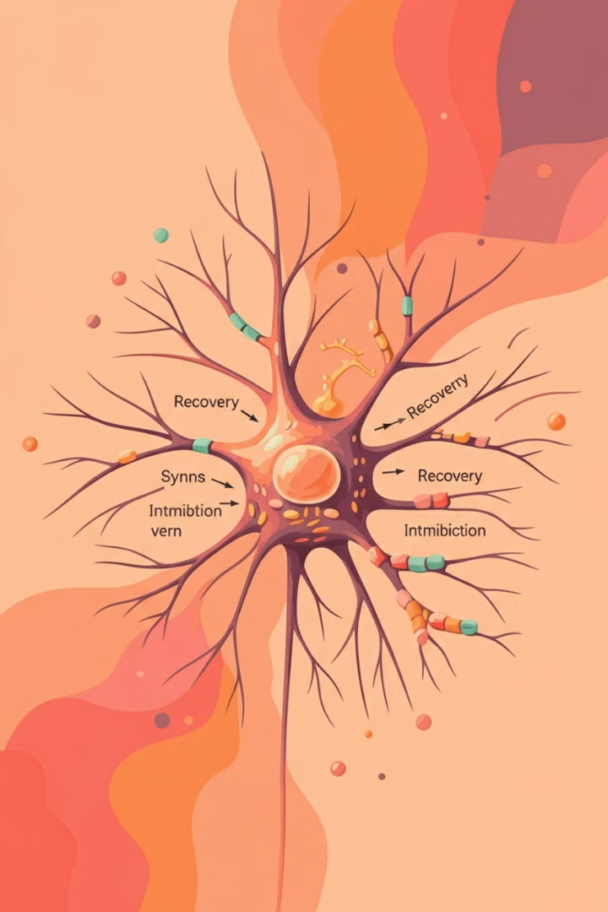
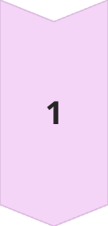


Processes in the nervous system during work
Excitation
This is an active process triggered by a stimulus and leads to a change in the state of a nerve cell. Excitation is transmitted along nerve fibres, causing a corresponding reaction in organs or tissues. For example, during physical work, the excitation of nerve cells corresponds to muscle contraction.
Inhibition
This is a passive process that suppresses or blocks excitation. Inhibition prevents excessive excitation of the nervous system and ensures its normal functioning. For example, during concentration on a task, inhibition may suppress extraneous stimuli, helping to focus attention.
Exhaustion and recovery
This is a cyclical process associated with the expenditure of energy by nerve cells during activity and subsequent recovery. Prolonged work requiring high concentration or physical exertion leads to exhaustion. After a period of rest, the nervous system replenishes its resources and is ready for new activity.

Slide 29
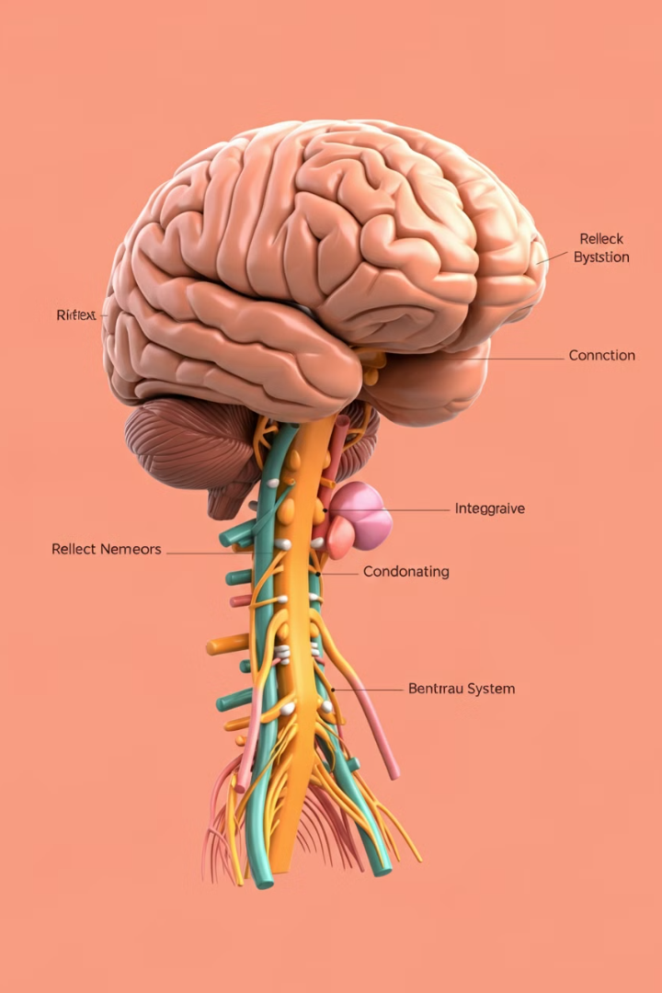
Functions of the Central Nervous System
1
Reflex
Providing unconditional and conditional reflexes for the adaptation of the organism.
2
Integrative
Ensuring the coordinated interaction of all organs and systems of the body.
3
Coordinating
Subordinating reflexes to the most important for the organism at the moment.

Slide 30

Fatigue and Exhaustion
Fatigue
Temporary changes in physiological and psychological state
Exhaustion
Accumulation of fatigue and chronic overload
Consequences of
Exhaustion
Reduced productivity, deterioration in work quality, increased risk of illness
https://www.youtube.com/watch?v=fpekfEJj334

Slide 31
Conditions for Improving Productivity and Preventing Fatigue
Gradual entry into the work process
Rhythmic performance of work tasks
Consistency of work activity
sequential and planned execution of all work tasks
synchronous increase in the intensity of the body's systems to adapt to the workload
determining the optimal pace of work for each employee
Optimal alternation of work and rest
Favourable social conditions
changing different forms of activity to restore strength
support of friendly relations in the team

Slide 32



Conclusion:
Health and Safety
Efficiency and Productivity
Motivation and Quality
Ergonomics is crucial for ensuring health, safety and efficiency in the workplace, especially in the pharmaceutical industry.
Proper design of workstations, tools and work processes in accordance with ergonomic principles helps reduce injury risks, decrease fatigue, increase productivity and improve overall employee well-being.
Considering ergonomic aspects allows for the creation of more comfortable working conditions, which positively impacts staff motivation and the quality of customer service. Therefore, implementing ergonomic approaches is an investment in long-term business efficiency and sustainability.

Slide 33

Thank you for your attention!

