Slide 1
ODESSA NATIONAL MEDICAL UNIVERSITY
Faculty of pharmacy
Department of Organization and Economics
of Pharmacy with post-diploma specialization
Occupational health and safety when working with hazardous medicines
The lecture was prepared by
senior teacher Oksana STEPANOVA
Notes:
Pharmacies store and use potent, poisonous and narcotic substances. To work with them, certain requirements are imposed that must be met by pharmacy employees in order to ensure healthy working conditions and prevent the harmful effects of these substances on the body. Therefore, the study of this topic by students is relevant for future professionals.

Slide 2
HIGHLY TOXIC SUBSTANCES
Highly toxic substances (HTS) are chemicals intended for use in the national economy and possessing toxicity capable of causing massive damage to humans, animals and plants. Among them, the most common are chlorine, ammonia, hydrogen sulphide, hydrocyanic acid, and sulphur dioxide, hydrogen bromide

Slide 3
HIGHLY TOXIC SUBSTANCES
Narcotic substances - substances of natural or synthetic origin, drugs, plants that pose a danger to public health in case of their abuse. .
Psychotropic substances - substances of natural or synthetic origin, drugs that can cause addiction and have a depressant or stimulating effect on the central nervous system or cause disturbances in perception, emotions, thinking, behaviour and pose a danger to public health in case of their abuse.
Potent medicines - medicinal products classified by the central executive body responsible for the formation and implementation of the state policy in the field of healthcare as potent medicinal products;
Poisonous medicinal products - medicinal products classified as poisonous by the central executive body responsible for the formation and implementation of the state policy in the field of healthcare;

Slide 4

Narcotic (psychotropic) combination medicinal products are narcotic (psychotropic) medicinal products containing small amounts of narcotic drugs or psychotropic substances and precursors included in the relevant tables of the List, and from which these drugs or substances cannot be extracted by easily accessible means and in quantities that make it possible to abuse them.

Slide 5
SYNDROMIC CLASSIFICATION OF HIGHLY POTENTIAL TOXIC SUBSTANCES(HPTS)
According to the degree of toxicity, the following are classified:
extremely toxic,
highly toxic,
highly toxic,
moderately toxic,
slightly toxic
practically non-toxic substances.
Notes:
Today, tens of thousands of different chemical compounds are used in Ukraine's economy, and every year this number increases by 200-1000 new substances. Chemicals can be divided into six groups according to the degree of toxicity through inhalation (via the respiratory system) and oral (via the gastrointestinal tract) routes of entry, and into four classes according to the degree of effect on the human body.

Slide 6
SYNDROMIC CLASSIFICATION OF (HPTS)
Substances with a predominantly asphyxiating effect (chlorine, phosphorus 3-chloride, phosphorus oxychloride, methyl isocyanate).
2. Substances with a predominantly generalised toxic effect (sulphur chloride, phosgene, chloropicrin).
3. Substances with suffocating and general toxic effects:
Ø a) with a pronounced cauterising effect (acrylonitrile, nitric acid);
Ø b) with a mild cauterising effect (sulphur dioxide, hydrogen sulphide, nitrogen oxides, hydrogen fluoride).
4. Substances that disrupt the generation, conduction and transmission of nerve impulses (carbon disulfide, organophosphorus compounds (OPC).
5. Substances with suffocating and neurotropic effects (ammonia).
6. Cytotoxic poisons (ethylene oxide, methyl bromide, dichloromethyl bromide, methyl chlorohydrin, ethane, dimethyl sulfate, dioxin, halogenated hydrocarbons).
Notes:
The group of HPTSs is heterogeneous in structure and physical and chemical properties. The biological effects of poisons are multifaceted. Thus, they can be classified on the basis of the primary syndrome that occurs during acute intoxication. Therefore, substances that can cause mass poisoning in the destruction of chemical facilities are divided (according to the syndromic classification) into the following groups:

Slide 7
Like most chemical compounds, when interacting with the body, HPTS cause local and resorptive effects. According to these manifestations, the HPTS can be divided into two groups:
Substances with a pronounced irritating and burning effect on the mucous membranes of the eyes, respiratory tract and skin (acrylonitrile, ammonia, hexamethyldiisocyanate, hydrazine, dimethyl sulfate, nitric acid, methyl bromide, methyl chloride, methyl vinyl ketone, methyl isocyanate, nitrogen oxides, phosphorus oxychloride).
Substances with a predominantly resorptive

Slide 8
Substances with a predominantly resorptive effect on organs.
Generally toxic - substances that mainly disrupt energy metabolism (compounds that disrupt oxygen transport in the blood: nitric acid, nitric acid, nitrogen oxides, carbon monoxide; inhibitors of the chain of respiratory enzymes and the tricarboxylic acid cycle)
2) neurotropic - substances that mainly disrupt the processes of generation, conduction and transmission of nerve impulses (organophosphate insecticides: dichlorvos, mercaptophos, thiophos;
3) cytotoxic - substances that mainly disrupt metabolic processes in cells (dimethyl sulphate, dioxin, methyl bromide, methyl chloride, ethylene oxide,

Slide 9
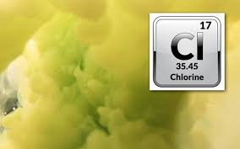
Substances with a predominantly asphyxiating effect.
Chlorine (Cl2) is a yellow-green gas with a pungent odour, 2.5 times heavier than air. It condenses into a liquid at a temperature of -34°C, its solidification point is -101.3°C. It is soluble in water and some organic solvents, and is well adsorbed by activated carbon.It is widely used due to its intense oxidising effect (bleach, disinfectant and disinfectant). It is transported in a liquid state.Accidents are most often associated with depressurisation of tanks or gas pipelines. May be freely released during the bleaching reaction. When it evaporates in the air, it creates a fog with water vapor, which consists of molecules of hydrochloric acid and chlorine. Chlorine interacts with oxygen, which can be accompanied by an explosion when heated and exposed to light; fires can occur, which will lead to the formation of phosgene.
Notes:
This group includes substances for which the main object of action in the body is the respiratory tract. Although poisoning can cause significant dysfunctions of other organs and systems, the death of victims is mainly associated with acute respiratory distress, and the pathogenesis is based on the development of acute toxic pulmonary edema and hypoxic hypoxia.

Slide 10
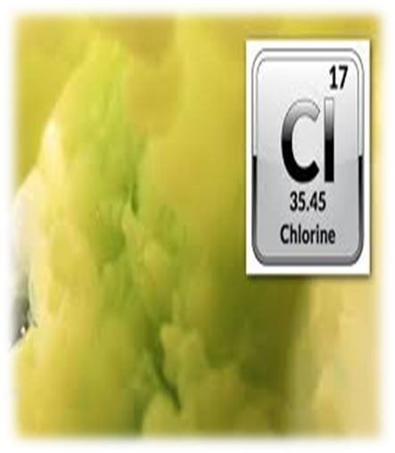
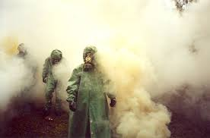
Chlorine enters the body through the respiratory organs and mucous membranes. It has a pronounced irritating and burning effect on the skin and eyes, as well as a resorptive effect. In the development of intoxication (especially in the initial stage), reflex effects due to irritation of the interoreceptors of the mucous membranes of the respiratory tract play an important role. An impressive toxodose of 0.6 mg min. /l, fatal tuxedoes 6.0 mg•min.

Slide 11
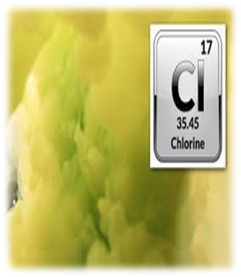
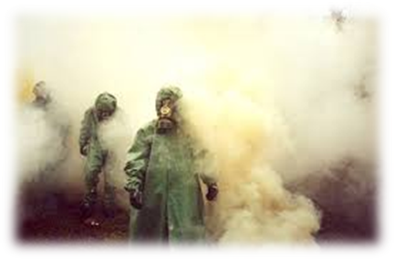
Chlorine is 2.5 times heavier than air, so the chlorine cloud will move downwind close to the ground. Chlorine irritates the respiratory tract and causes pulmonary edema. At high concentrations, death occurs after 1-2 sighs, at slightly lower concentrations, breathing stops after 5-25 minutes.
First aid: put a gas mask on the victim and take him out of the infected area. Complete rest, oxygen inhalation. In case of irritation of the respiratory tract - inhalation of ammonia, baking soda, washing the eyes, nose and mouth with a 2% soda solution; warm milk with soda, coffee.
Protection: industrial gas masks of the "B" and "M" brands, civilian gas masks 1P-5, children's gas masks and protective sets for children. At very high concentrations (8.6 mg/l) - insulating gas masks.

Slide 12
There are 5 periods in the development of intoxication with a predominantly suffocating effect: initial, latent, toxic pulmonary edema, regression, and long-term consequences .
The initial period is especially pronounced in case of poisoning with substances that have a caustic effect.
With the effect of poisons in small concentrations, symptoms of intoxication develop after a latent period , the duration of which depends on many factors and can range from 1 to 24, and sometimes up to 48 hours.
The main manifestations of the third period are the development of toxic rhinopharyngitis, laryngotracheitis, and conjunctivitis. The development of toxic bronchitis is observed in mild poisonings, toxic pneumonias in moderate poisonings, and toxic pulmonary edema in severe poisonings. In addition, in the clinical picture of intoxication, there are neurological disorders in the form of post-intoxication asthenic syndrome with vegetative-vascular dystonia, signs of meningitis, and myasthenic syndrome.

Slide 13
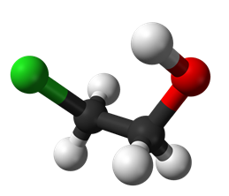
Substances with mostly general toxic action
Ethylene chlorohydrin ( Chlorethanol - CH 2 ОНCH 2 Cl ) is a colorless liquid with a weak odor. The boiling point is 29 o C, it dissolves well in water. Vapors are heavier than air.
A strong poison, acts by inhalation and when it enters the stomach. Lethal concentration of 1.2 g/m 3 when inhaled for 2 hours.
It is used in the production of dyes, wood impregnation agents , and in organic synthesis as a solvent. The slow-acting substance creates an unstable lesion.

Slide 14

The clinical picture of poisoning develops a few hours after the injury. At the moment of contact - slight irritation of the eyes, upper respiratory tract.
The first symptoms are weakness, strong thirst, heart pain. Tremor, ataxia, paralysis of the limbs, diarrhea, vomiting, breathing disorders, cyanosis develop. Death occurs from cessation of breathing. With a favorable course of poisoning, recovery occurs no earlier than a week later.
There are no specific means of therapy. Oxygen inhalation, administration of alkaline solutions, and symptomatic treatment are recommended.
Means of personal protection - a combined military filter gas mask with a 2.5-fold reduction in use time, insulating and filtering gas masks of the B, A, BFC brands, an RPG-67A respirator, and if they are not available, a cotton-gauze bandage moistened with a 2% solution of baking soda , protective suit, protective glasses, gloves.
Ethylene chlorohydrin

Slide 15
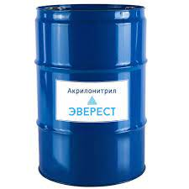
Substances characterized by suffocation and general toxic action
Acrylonitrile - easily ignites, forming explosive mixtures. Moderately soluble in water, hydrolyzes with the formation of low-toxic substances. The infected cloud spreads in the lower layers of the atmosphere. At a concentration of poison in the air of 0.035-0.22 g/m ³ within 20-45 minutes, symptoms of intoxication develop. At first there is a headache, weakness, nausea, vomiting, shortness of breath, sweating.
The clinic of the lesion develops when the substance enters through the gastrointestinal tract, intact skin and lungs. Treatment consists of three points: treatment of eye and skin lesions is carried out according to the general principles of treatment of chemical burns; prevention and therapy of toxic pulmonary edema; fight against manifestations of general toxic action.
Sodium thiosulfate is used as an antidote. Means of personal protection - insulating and filtering gas masks of type A, A8, protective suits, rubber boots, gloves. For degassing, a solution of caustic soda is used at the rate of 8 tons per 1 ton of SOD.

Slide 16

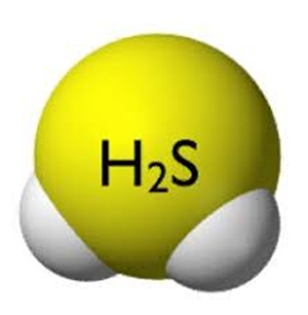
Hydrogen sulfide (H2S ) is a colorless gas that smells like rotten eggs. It is formed during the decay of products of plant and animal origin. Toxic concentrations can occur in coal mines, sulfur mines, etc. It can be an industrial by-product during the production of viscose, cellulose, during oil refining. Fast-acting poison, forms unstable lesions. It burns in air, and when mixed with it, it explodes with the formation of sulfur dioxide. It is especially dangerous in closed rooms. The main route of entry into the body is inhalation, but the route of intoxication through the skin is not excluded.
The poisoning clinic develops when inhaling hydrogen sulfide vapors at a concentration of 0.006 g/m3 for an hour. At the same time, there is a squint in the eyes, headache, lacrimation, photophobia, runny nose.

Slide 17
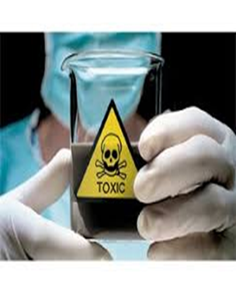
Substances that affect generation, conduction
and nerve impulse transmission
Carbon disulfide (СС ₂ ) is a colorless oily liquid with a pleasant fruity smell. The substance has a pronounced general resorptive effect. A narcotic effect is characteristic for significant concentrations, local manifestations are weak. The main route of entry into the body is inhalation, it is possible for the poison to penetrate through intact skin.
Clinical manifestations when inhaled for several hours at a concentration of 1.0-1.2 g/m ³ cause reddening of the face, euphoria, excitement, headache, then disturbances of sensitivity and balance, pain when swallowing, severe and long-lasting headache may appear , sometimes convulsions. At very high concentrations - loss of consciousness, death occurs from respiratory arrest. Treatment is symptomatic. There are no specific means of treatment. Personal protective equipment - insulating and filtering gas masks of brands A, M, BKF, protective suit, helmet, bib, rubber boots, gloves.
Notes:
Neurotropic poisons are substances that disrupt the mechanism of peripheral nervous regulation. The basis of the action is their ability to interfere with the processes of synthesis, storage, release and inactivation of mediators in the synapse, to disrupt the reactivity of postsynaptic receptors; change the permeability of ion channels.

Slide 18
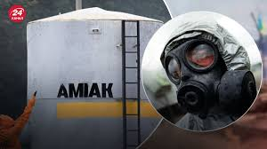
Substances that have a suffocating and neurotropic effect
Ammonia (NH 3 ) is a colorless gas with a sharp, suffocating smell. When cooled and under pressure, it liquefies into a transparent liquid that boils at -33 0 C. When it interacts with moist air, ammonia forms, and hydrocyanic acid with methane.
Ammonia is used for the production of nitric acid, ammonia fertilizer, as a refrigerant in refrigeration plants. Belongs to fast-acting poisons, forms unstable foci of damage in the area.
Manifestations of intoxication: ammonia has both a local and
general resorptive effect.
The local effect is due to the caustic effect of ammonia, which
is formed when ammonia interacts with moist skin and
mucous membranes. Chemical burns of the eyes and upper
respiratory tract are possible
Notes:
Substances of this group cause, in the case of inhalation damage, toxic edema of the lungs, against the background of which a severe damage to the nervous system is formed. The effect on the brain is based on a direct neurotoxic effect, which is enhanced by severe hypoxia caused by impaired external respiration.

Slide 19
Ammonia (NH 3 )
First aid:
fresh air, inhalation of warm water vapor 10% - menthol solution in chloroform, warm milk with mineral water or soda;
with suffocation - oxygen;
with a spasm of the glottis - heat on the neck, warm water inhalations;
in case of contact with the eyes - immediate washing with water or 0.5 - 1% - alum solution ;
in case of damage to the skin - washing with clean water, applying lotion with 5% acetic, citric or hydrochloric acid.

Slide 20
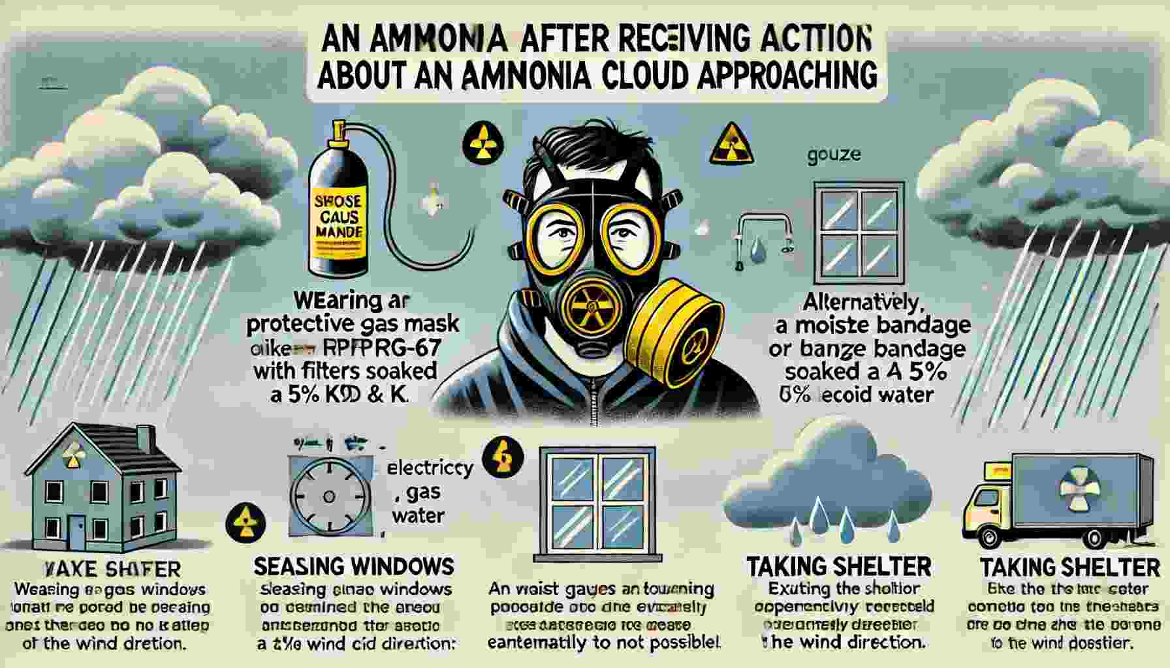

Slide 21

Occupational safety when working with narcotic, poisonous and potent substances.
According to the current legislation the following documents are attached to the license application:
1) a copy of a certificate (certificate, certificate of a specialist) confirming the professional suitability of the head of a legal entity or the head of a corresponding subdivision of a legal entity, an individual entrepreneur who has a license to conduct medical or veterinary practice, to engage in activities related to the circulation of narcotic drugs, psychotropic substances licensed substances and precursors;
2) a certificate from the relevant state or municipal health care institution stating that employees who have (or have) direct access to narcotic drugs, psychotropic substances and precursors in the course of their duties do not have mental disorders related to the abuse of alcoholic beverages , narcotic drugs or psychotropic substances, as well as the absence among the specified employees of persons recognized as unfit to perform certain types of activities (jobs, professions, services) related to the circulation of narcotic drugs, psychotropic substances and precursors (according to the form established by the Ministry of Health) ;

Slide 22

Occupational safety when working with narcotic, poisonous and potent substances.
3) a copy of the document confirming the right of ownership or the right to use, or shared use of the objects on which the economic activity of cultivating plants, included in list No. 3 of table I of the list, is carried out;
4) information about:
the state of the material and technical base of the economic entity and the availability of personnel with an indication of their qualification level;
the presence of a National Police permit for the use of facilities and premises intended for conducting economic activities related to the circulation of narcotic drugs, psychotropic substances and precursors;
the absence of employees who, in the course of their official duties, will have (or have) direct access to narcotic drugs, psychotropic substances and precursors, have not had a criminal record that has not been removed or not extinguished in accordance with the established procedure for committing minor, serious and especially serious crimes or criminal offenses, related to illegal trafficking of narcotic drugs, psychotropic substances and precursors, including those committed outside of Ukraine ( Appendix 3 ).

Slide 23
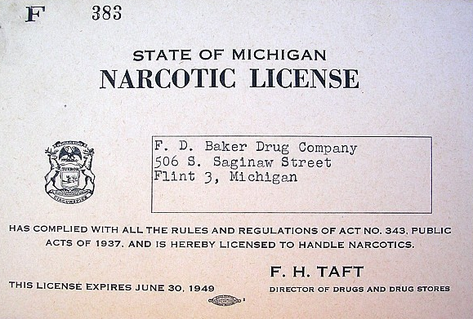
Occupational safety when working with narcotic, poisonous and potent substances.
5) a copy of the passport of the manager of the license applicant (or authorized person) with a note from the revenue and tax authority about the notification of refusal due to their religious beliefs to accept the registration number of the taxpayer's registration card (submitted only by natural persons - entrepreneurs who, because of their religious beliefs, refuse to accept registration number of the taxpayer's registration card and reported it to the relevant revenue and tax authority);
6) a description of the documents attached to the license application, in two copies.
During the term of the license, the licensee must ensure the storage of documents, copies of which were submitted to the licensing authority, and documents (copies) that confirm the authenticity of the data entered by the licensee in the documents submitted to the licensing authority.

Slide 24
For the issuance of a license, a one-time fee in the amount of one subsistence minimum, based on the amount of the subsistence minimum for able-bodied persons, valid on the day of the decision on the issuance of a license by the licensing authority, unless another fee is established by law. Renewing the license is free of charge
Persons of the management staff, who are entrusted with the responsibilities of monitoring the circulation of narcotic drugs, psychotropic substances and precursors, materially responsible persons and persons who will have access to the circulation of narcotic drugs, psychotropic substances and precursors based on their official duties, are determined by the order of the head of a legal entity (authorized person) or an individual entrepreneur who has a license to conduct medical or veterinary practice.
Access to the premises where narcotic drugs, psychotropic substances and precursors are stored is granted only to persons who are directly authorized to work related to the circulation of these drugs and substances.

Slide 25
1. Management of narcotic and controlled drugs 2923 04 30 !!!
https://www.youtube.com/watch?v=suAqfKRzSxM
2. Controlled Drug Administration
https://www.youtube.com/watch?v=6SNLMvLiXq8
3. IH Controlled Substances Policy (PHK0600)
https://www.youtube.com/watch?v=a6iyzDBJeho
4. Handling Narcotic Drugs (SQUH)
https://www.youtube.com/watch?app=desktop&v=uBC_ZZKEHFU
5. Automated Narcotics & Medication Dispensing Cabinets for Pharmacies https://www.youtube.com/watch?app=desktop&v=h-YSPmbHMjk
6. Safe Storage and Disposal of Opioid Medications
https://www.youtube.com/watch?v=va48Sov6AVE

Slide 26
Thank you

