Slide 1

MINISTRY OF HEALTH OF UKRAINE
ODESSA NATIONAL MEDICAL UNIVERSITY
Department of Pharmacy Organization and Economics
with post-diploma specialization
Safety and personal hygiene of personnel
when working in pharmacies
Prepared by senior teacher
Stepanova Oksana
ОС

Slide 2
Safety and Personal Hygiene in Pharmacies: Understanding PPE
Personal Protective Equipment (PPE) is crucial for ensuring safety and hygiene in pharmacy settings. This comprehensive guide explores the various types of PPE, their proper use, and importance in protecting both healthcare workers and patients from potential hazards. From gloves and gowns to respiratory protection, we'll examine the essential elements of PPE and best practices for implementation in pharmacies.
ОС
по Оксана Степанова

Slide 3
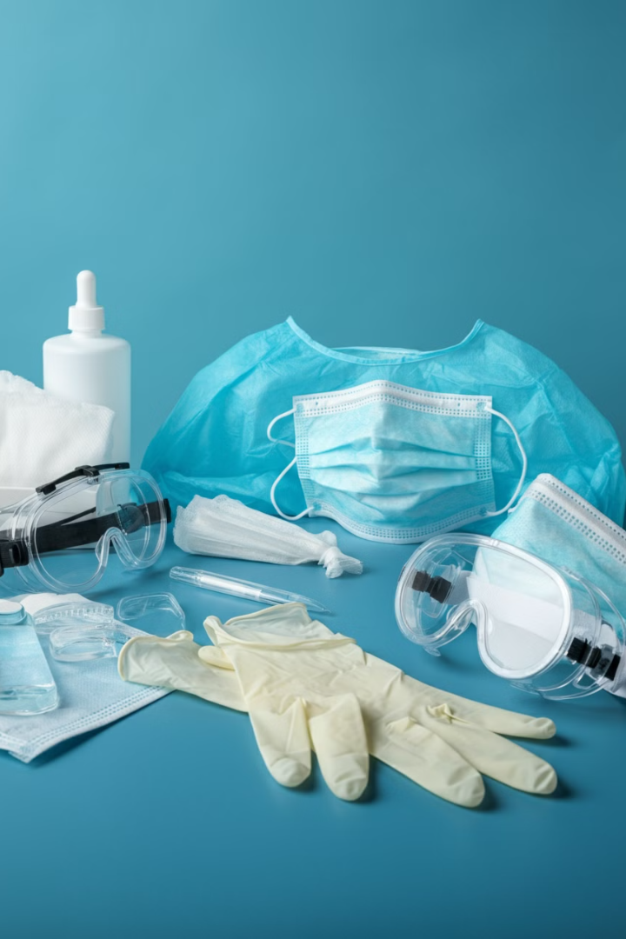
What is Personal Protective Equipment (PPE)?
1
Definition
PPE refers to protective clothing for eyes, head, ears, hands, respiratory system, body, and feet.
2
Purpose
Protects individuals from risks of injury and infection while minimizing exposure to chemical, biological, and physical hazards.
3
Last Line of Defense
Serves as the final barrier when engineering and administrative controls are insufficient in reducing or eliminating risks.

Slide 4
What is Personal Protective Equipment (PPE)?
1
Definition
PPE refers to protective clothing for eyes, head, ears, hands, respiratory system, body, and feet.
2
Purpose
Protects individuals from risks of injury and infection while minimizing exposure to chemical, biological, and physical hazards.
3
Last Line of Defense
Serves as the final barrier when engineering and administrative controls are insufficient in reducing or eliminating risks.

Slide 5

The Importance of PPE Safety
Ensure Safe Working Environment
1
PPE safety practices create a secure workplace for employees and visitors.
2
Compliance with Regulations
Helps businesses meet regulatory requirements, such as The Personal Protective Equipment at Work Regulations 1992.
Prevent Injuries and Illnesses
3
Protects against unnecessary workplace injuries and excessive chemical exposure.
4
Improve Productivity
Enhances employee productivity and efficiency by ensuring their safety.

Slide 6
PPE in Healthcare Settings
Common Use
Barrier Function
Patient Protection
PPE is widely used in healthcare settings such as hospitals, doctor's offices, and clinical labs.
Acts as a barrier between infectious materials and the wearer's skin, mouth, nose, or eyes.
Also protects high-risk patients from potential contaminants brought in by visitors and healthcare workers.

Slide 7

Effective Use of PPE
Proper Application
Correctly putting on and removing PPE is crucial for its effectiveness.
Infection Control
Used in conjunction with other practices like hand-washing and covering coughs.
Disposal
Proper removal and disposal of contaminated PPE prevents exposure to wearer and others.
Training
Regular training ensures staff understand the importance and correct use of PPE.

Slide 8
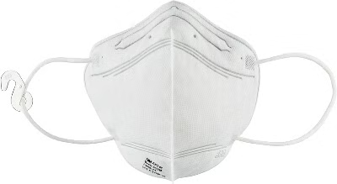





Hierarchy of Controls and PPE
Elimination
Physically remove the hazard
Substitution
Replace the hazard
Engineering Controls
Isolate people from the hazard
Administrative Controls
Change the way people work
PPE
Protect the worker with Personal Protective Equipment

Slide 9

PPE and the Healthcare Workforce
1
Main Hazards
2
Transmission Pathways
3
IPC Principles
PPE protects healthcare workers from radiation and biological agents.
Infection prevention and control measures include hand hygiene, PPE use, and waste management.
Mitigates person-to-person contact, droplet spread, airborne transmission, and contaminated objects.

Slide 10
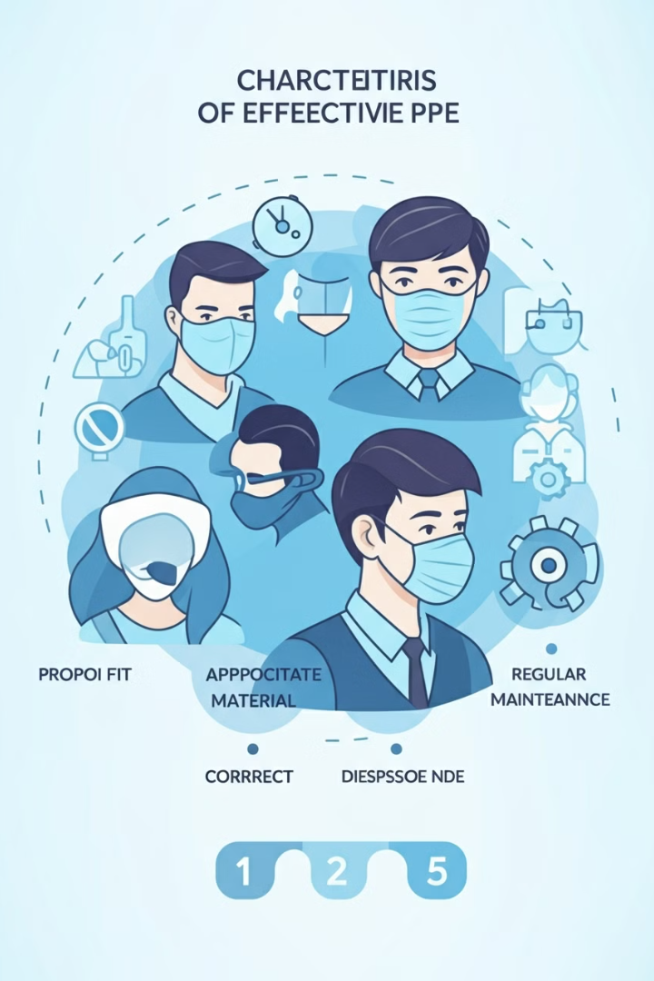
Characteristics of Effective PPE
Design Feature
Material Performance
Use Desirability
Protect mucous membranes
Withstand work duration
Standardized protocols
Minimize junctions
Withstand disinfection
Easy disposal
Unobstructed vision
Tropical climate resistant
Minimal steps
Enable communication
Human factors design

Slide 11

OSHA Standards for PPE
1
Hazardous Drugs
OSHA's document on Controlling Occupational Exposure to Hazardous Drugs outlines effective use of gloves and gowns.
2
PPE Standard
OSHA's Personal Protective Equipment standard requires employers to provide appropriate PPE for workers handling hazardous drugs.
3
Employer Responsibilities
Employers must ensure proper design, construction, maintenance, and use of PPE.

Slide 12





Types of Personal Protective Equipment
Gloves
Protect hands from direct contact with hazardous materials.
Safety Glasses
Shield eyes from splashes and airborne particles.
Respirators
Filter air to protect against harmful particles and gases.
Protective Suits
Full-body protection against hazardous substances.

Slide 13

Ensuring Proper Use of PPE
1
Assessment
Employers must assess the workplace to determine if hazards necessitate PPE use.
2
Selection
Choose appropriate PPE that protects against identified hazards and fits properly.
3
Communication
Inform employees about PPE selection decisions and requirements.
4
Certification
Verify and document the workplace hazard assessment.

Slide 14

Training Requirements for PPE Use
When PPE is Necessary
Employees must understand situations requiring PPE use.
Proper Use
Training on how to correctly don, doff, adjust, and wear PPE.
Limitations
Understanding the capabilities and constraints of PPE.
Care and Maintenance
Proper care, maintenance, useful life, and disposal of PPE.

Slide 15

Gloves: Essential PPE for Pharmacy Workers
1
Importance
Gloves are crucial for handling hazardous drugs and contaminated surfaces.
2
Selection
Choose gloves tested for permeation resistance to specific hazardous drugs.
3
Double Gloving
NIOSH recommends wearing two pairs of gloves when compounding, administering, and disposing of hazardous drugs.

Slide 16
Best Practices for Glove Use
Inspection
1
Check gloves for defects before use.
2
Regular Changes
Change gloves every 30-60 minutes or when damaged.
Powder-Free
3
Use powder-free gloves to avoid contamination.
4
Proper Removal
Remove gloves carefully, turning them inside-out.
Hand Hygiene
5
Wash hands thoroughly before and after glove use.

Slide 17

FDA Ban on Powdered Gloves
Ban Date
Reason
FDA published final rule banning powdered gloves on December 19, 2016.
Unreasonable and substantial risk of illness or injury to exposed individuals.
Risks
Affected Products
Severe airway inflammation, hypersensitivity reactions, granulomas, and adhesions.
Powdered surgeon's gloves, patient examination gloves, and absorbable powder for lubricating surgeon's gloves.

Slide 18
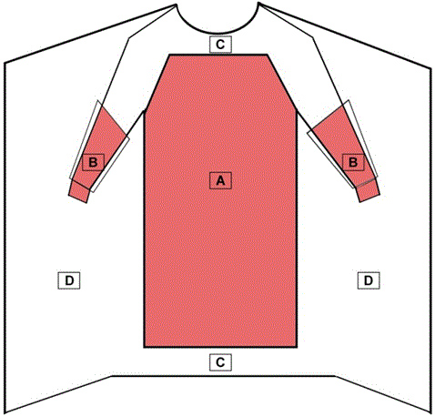
Medical Gowns: Types and Uses
Surgical Gowns
Isolation Gowns
Non-Surgical Gowns
Class II medical devices for surgical procedures, providing protection for both patient and healthcare personnel.
Used in medium to high-risk contamination situations, covering larger critical zones than surgical gowns.
Class I devices for low or minimal risk patient isolation situations, not for surgical or invasive procedures.

Slide 19





Levels of Protection in Medical Gowns
Level 1
Minimal risk, for basic care and standard isolation.
Level 2
Low risk, for blood draw, suturing, ICU, or pathology lab.
Level 3
Moderate risk, for arterial blood draw, IV insertion, ER, or trauma cases.
Level 4
High risk, for long, fluid-intense procedures, surgery, or when infectious diseases are suspected.

Slide 20
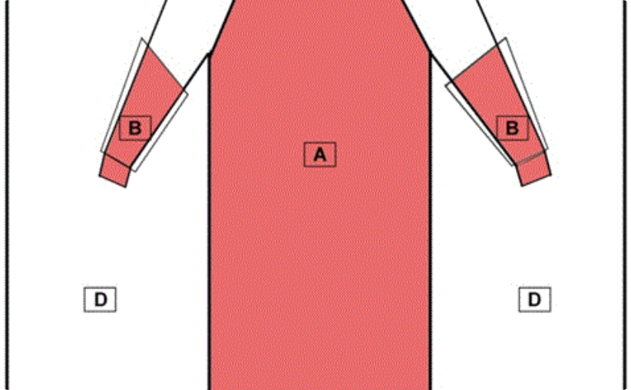
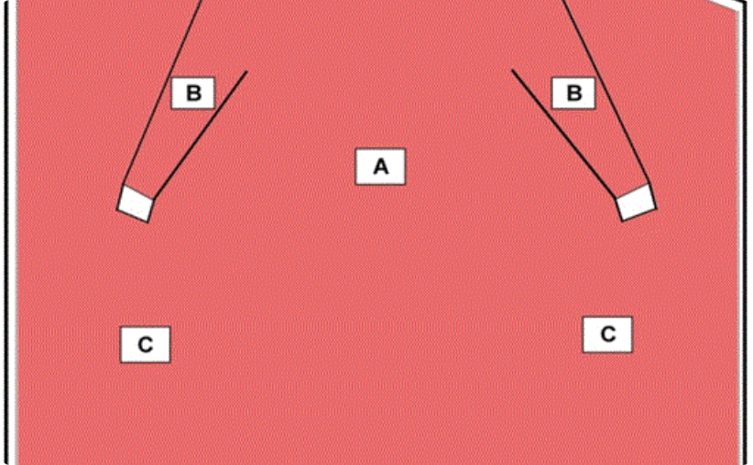
Critical Zones in Surgical Gowns
Front View
Critical Zone
The entire front of the gown (areas A, B, and C) requires at least level 1 barrier performance.
The critical zone comprises at least areas A and B, providing the highest level of protection.

Slide 21

Proper Gown Use in Pharmacy Settings
1
Single-Use
Dispose of gowns after each use to reduce exposure risk.
2
When to Wear
Use during compounding, administration, handling waste, and cleaning spills.
3
Changing Frequency
Change gowns every 2-3 hours or immediately after a spill or splash.
4
Proper Removal
Remove gowns carefully to avoid spreading contamination.

Slide 22
Respiratory Protection in Pharmacies
N95 Respirators
Surgical N95 Respirators
Chemical Cartridge Respirators
Provide efficient filtration of airborne particles, with a close facial fit.
Offer both respiratory protection and splash resistance, certified by FDA.
Used for protection against vapors or gases in large spill events.

Slide 23
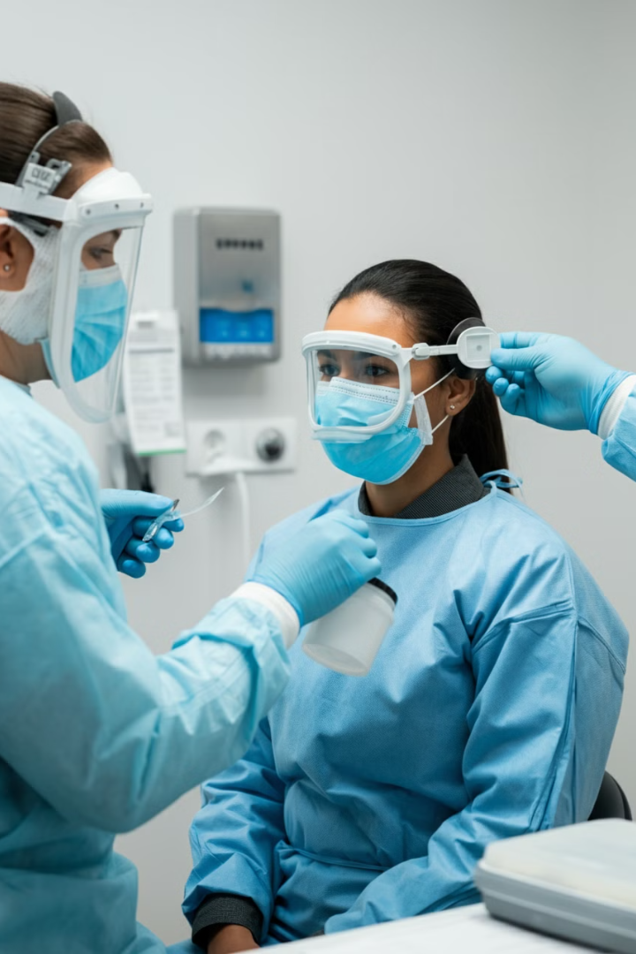
OSHA's Respiratory Protection Standard
Respirator Selection
Choose appropriate respirators based on workplace hazards.
Medical Evaluation
Ensure workers are physically able to use respirators.
Fit Testing
Conduct proper fit testing to ensure effective protection.
Training
Provide comprehensive training on respirator use and maintenance.

Slide 24

Face Masks vs. Respirators: Understanding the Differences
Feature
Face Masks
Respirators
Purpose
Source control
Personal protection
Fit
Loose-fitting
Tight-fitting
Filtration
Varies
High efficiency
Regulation
FDA
NIOSH
Reusability
Single-use
Some reusable

Slide 25

Barrier Face Coverings: ASTM F3502-21 Standard
1
Purpose
Provides minimum requirements for design, performance, testing, and labeling of barrier face coverings.
2
Coverage
Must cover at least the wearer's nose and mouth and fit snugly to prevent gapping.
3
Material
Non-irritating, non-toxic, and able to withstand ordinary handling and use.
4
Design
No vents or valves allowed, must be free of sharp edges or points.

Slide 26





Eye and Face Protection in Pharmacy Settings
Goggles
Protect eyes from splashes and airborne particles.
Face Shields
Provide full-face protection against splashes.
Full-Facepiece Respirators
Offer combined respiratory and eye/face protection.
Eyewash Stations
Essential for emergency eye rinsing.

Slide 27
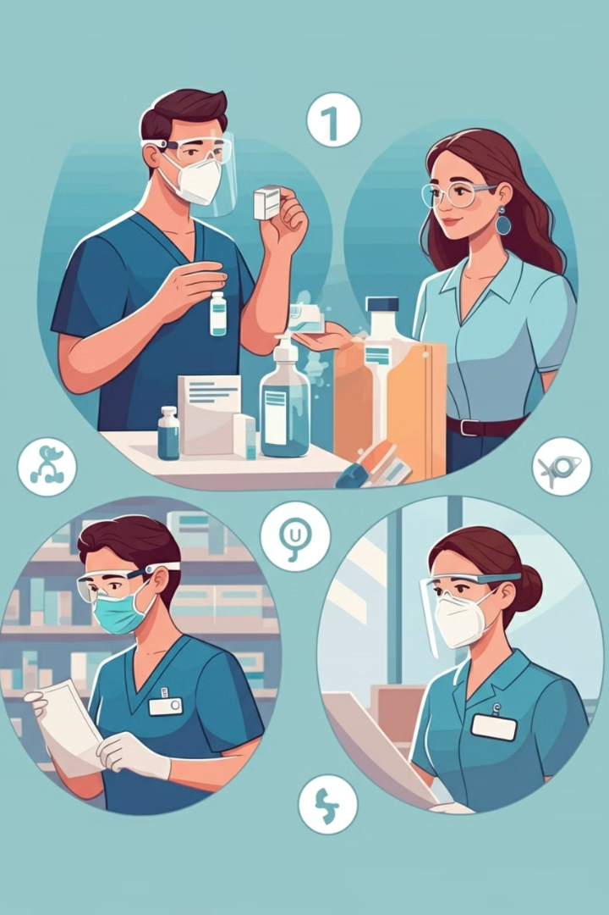
When to Use Eye and Face Protection
1
Compounding
When working with drugs outside a containment primary engineering control.
2
Above Eye Level
When working at or above eye level with hazardous materials.
3
Cleaning
When cleaning biosafety cabinets or compounding aseptic containment isolators.
4
Spill Management
When cleaning up spills of hazardous drugs.

Slide 28
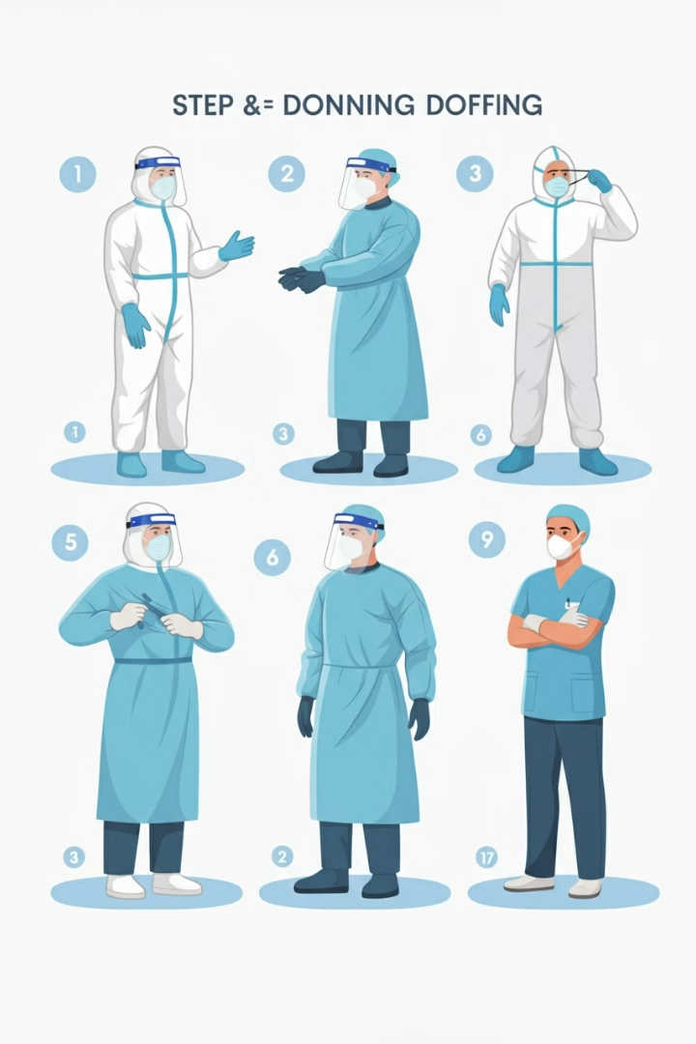




Proper Donning and Doffing of PPE
Donning Sequence
1. Gown, 2. Mask or respirator, 3. Goggles or face shield, 4. Gloves
Doffing Sequence
1. Gloves, 2. Goggles or face shield, 3. Gown, 4. Mask or respirator
Hand Hygiene
Perform hand hygiene between steps and after removing all PPE.
Disposal
Properly dispose of used PPE in designated containers.

Slide 29
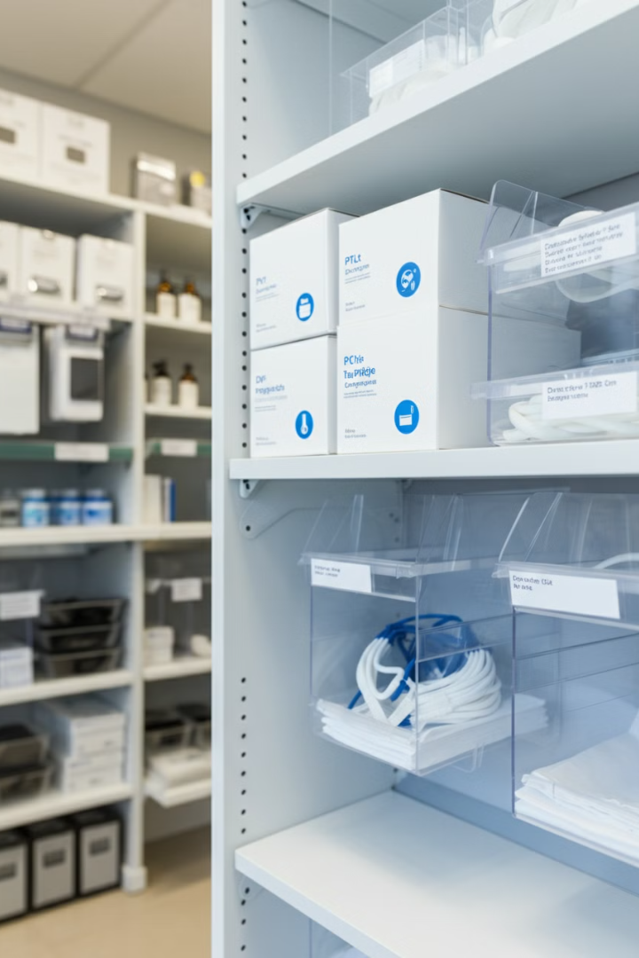
Maintaining and Storing PPE
Cleanliness
Keep PPE clean and sanitary at all times.
Inspection
Regularly inspect PPE for damage or wear.
Storage
Store PPE in a clean, dry area away from potential contaminants.
Replacement
Replace PPE according to manufacturer's recommendations or when damaged.

Slide 30

PPE Waste Management in Pharmacies
1
Segregation
Separate PPE waste from other types of waste.
2
Containment
Use appropriate containers for potentially contaminated PPE.
3
Labeling
Clearly label containers for PPE waste.
4
Disposal
Follow local regulations for proper disposal of PPE waste.

Slide 31
Training and Education on PPE Use
Initial Training
Refresher Courses
Documentation
Comprehensive training for all new employees on PPE use and safety protocols.
Regular updates and refresher training to maintain knowledge and skills.
Keep records of all training sessions and employee competency assessments.

Slide 32

Continuous Improvement in PPE Practices
1
Regular Audits
Conduct periodic audits of PPE use and compliance.
2
Feedback Mechanisms
Encourage employee feedback on PPE comfort and effectiveness.
3
Stay Updated
Keep abreast of new regulations and advancements in PPE technology.
4
Continuous Training
Provide ongoing education on the importance of proper PPE use.

