Slide 1
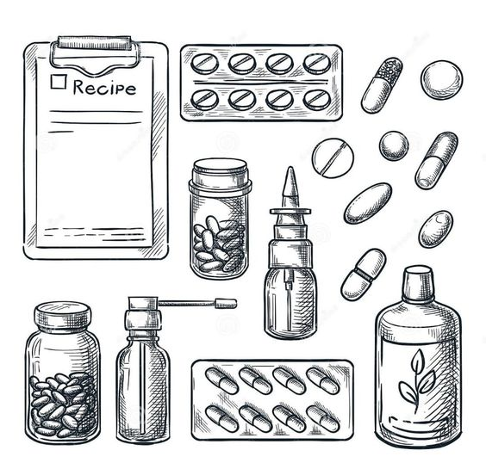
Ministry of Health of Ukraine
Odesa National Medical University
Faculty of Pharmacy
Department of Pharmaceutical Chemistry
and Drug Technology
Drug Technology
Lecture #6-7
Aqueous extracts from medicinal plant raw materials-infusion. Features of production. Mucus
Candidate of Chemical Sciences,
assistant Khrystyna HOLUBCHYK
Odesa-2025

Slide 2
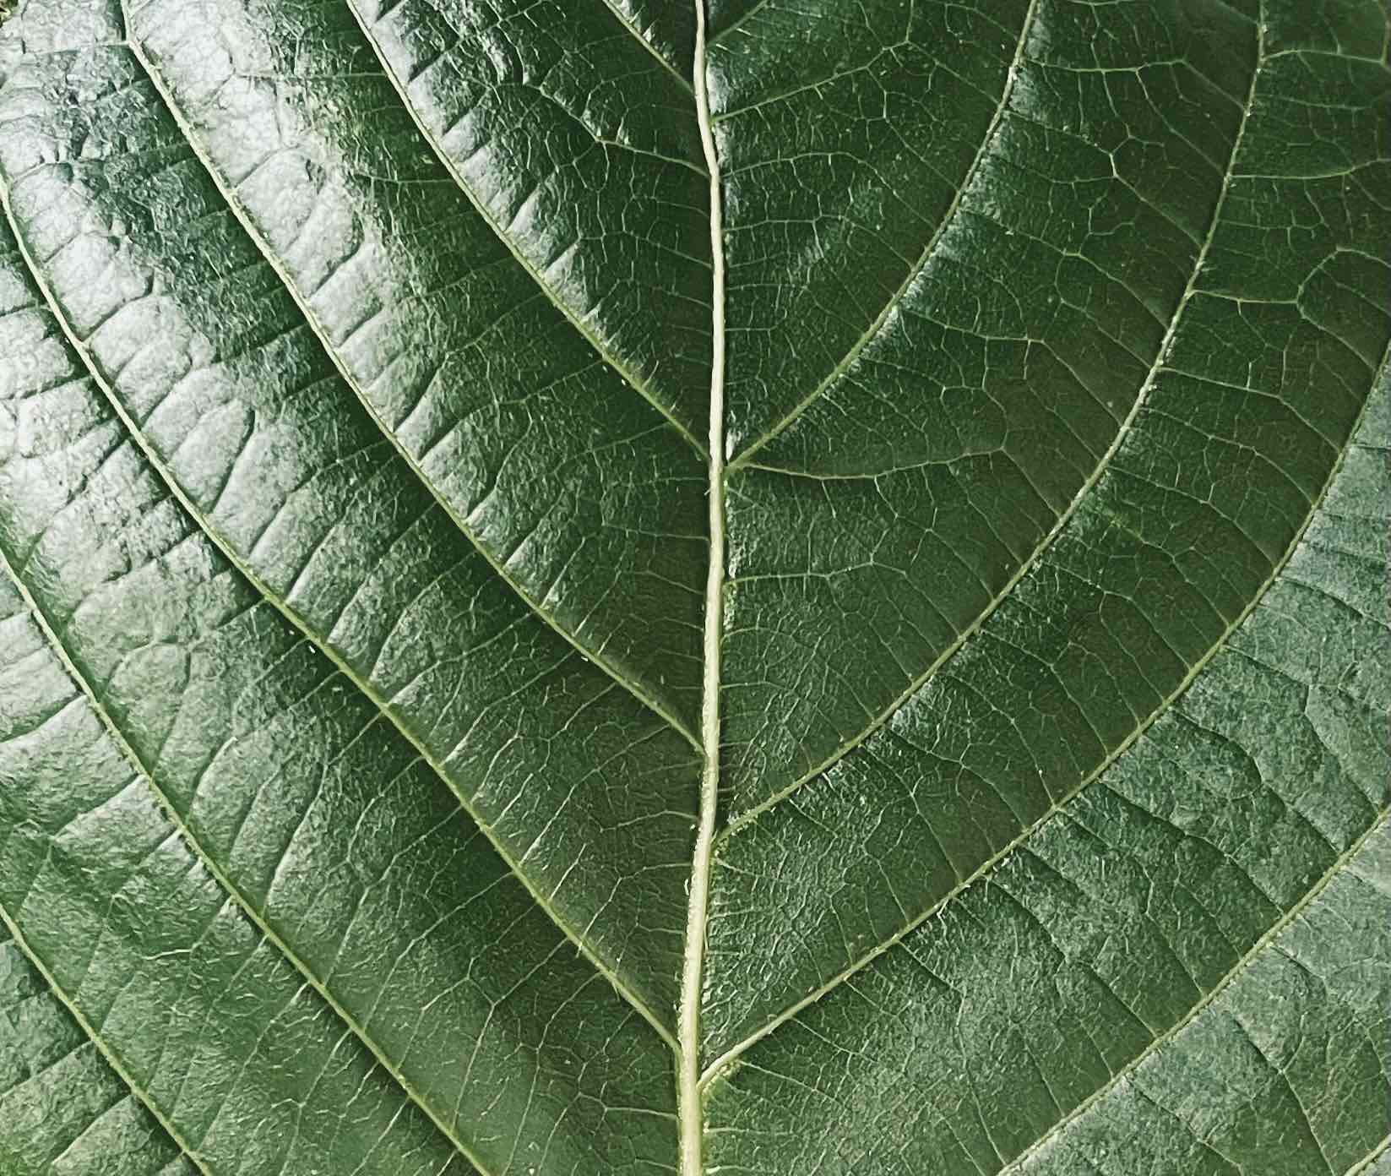
2
Infusions and decoctions are liquid dosage forms that are aqueous extracts of plant materials or aqueous solutions of extracts - concentrates that are specifically intended for treatment.

Slide 3
3
• Advantages of infusions and decoctions:
Availability of raw materials.
Ease of manufacture
Soft, complex, natural effect, which is especially valuable.
Metabolic processes are not disturbed, almost do not cause allergies.
Disadvantages of infusions and decoctions:
Bulky.
Long cooking time: 1.5-2 hours.
Excellent environment for microorganisms.
There are no accurate analysis methods

Slide 4
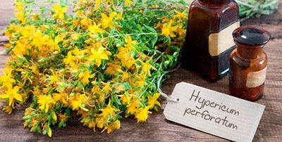
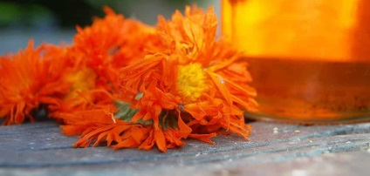
4
By their physicochemical nature, aqueous extracts are combined disperse systems:
true solutions or solutions of high-molecular + colloidal ones.
Depending on the method of production and composition, 3 groups of aqueous extracts are distinguished:
• infusions;
• decoctions;
• mucus.

Slide 5
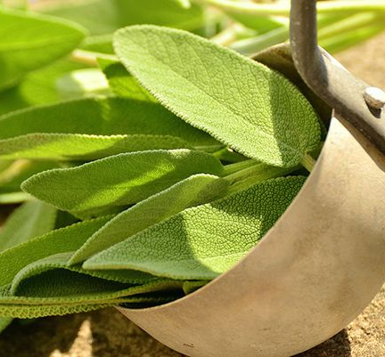
5
• Infusions are usually prepared from the soft parts of plants: leaves, flowers, stems, as well as from raw materials that contain volatile or unstable substances that easily evaporate or are destroyed by prolonged heating.
Salviaе officinalis folium

Slide 6
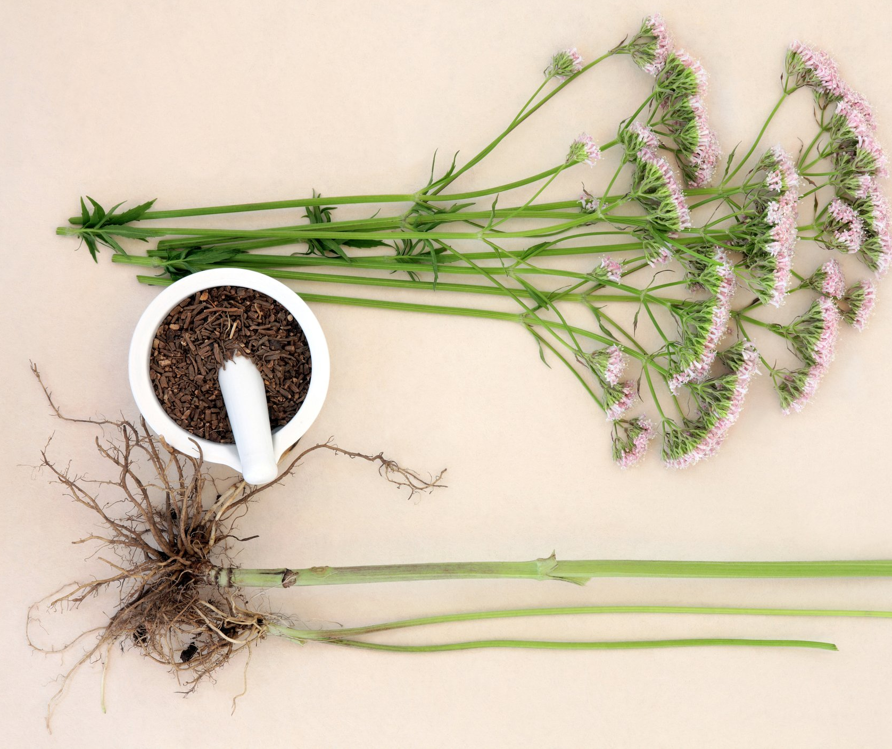
6
• Decoctions are most often prepared from the hard parts of plants – roots, rhizomes, tubers, etc. or from raw materials that contain hard-to-reach active ingredients.
Rhizomata cum radicibus Valerianae

Slide 7
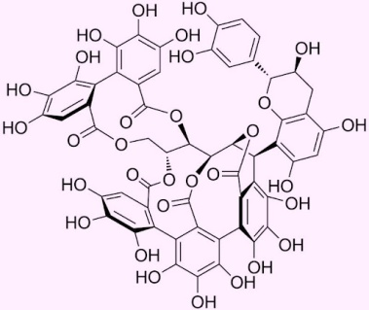
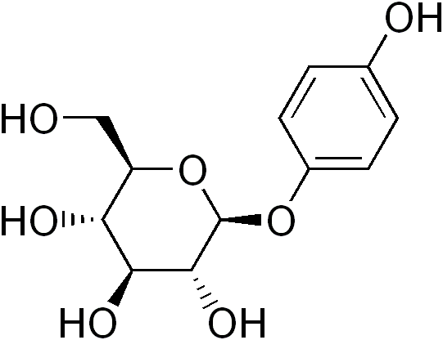
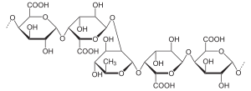
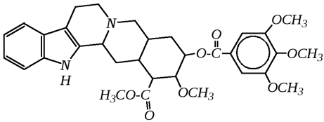
7
COMPOSITION OF WATER EXTRACTS
Pharmacologically active substances
- alkaloids,
– glycosides,
– essential oils,
– tannins, etc.
Associated (ballast) substances
– sugar,
– starch,
– pectins,
– pigments,
– resins, etc.

Slide 8
8
THEORETICAL BASIS OF THE EXTRACTION PROCESS
The process of extraction of active substances from the plant raw material consists of the following stages:
swelling
in the first moments of contact with the extractant, the cells of the dry raw material swell, during swelling, cells with air are filled with extractant
the primary sap formation inside cells
The extractant penetrates through the insoluble membranes into deeper cells and dissolves the substances contained in them, forming a concentrated solution - the primary juice.
mass exchange
as a result of the high concentration of primary sap inside the cells, significant pressure is created, which causes an exchange between the contents of the cells and the surrounding fluid

Slide 9
9
FACTORS AFFECTING THE EXTRACTION PROCESS
ratio between the amount of raw materials and the volume of the finished extract;
standardity of raw materials;
histological structure of raw materials;
degree of grinding of raw materials;
material of the equipment used;
temperature and time of infusion;
influence of enzymes and microflora;
chemical composition of active substances;
pH of the medium.

Slide 10
10
RATIO BETWEEN THE AMOUNT OF RAW MATERIALS AND THE VOLUME OF THE FINISHED EXTRACT
1:10 | 10.0 medicinal plant raw materials - 100ml of extract | The vast majority of medicinal plant raw materials do not contain potent substances
1:20 | 5.0 medicinal plant raw materials - 100ml of extract | Marshmallow root, rosehip fruits
1:30 | 3.3 medicinal plant raw materials - 100ml of extract | Valerian roots, adenium herb, ergot, istodu root, lily of the valley herb, sea onion tubers, soapwort rhizome with roots, senegal root, bluetongue rhizome with roots
1:400 | 0.25 medicinal plant raw materials - 100ml of extract | Potent plants (thermopsis herb, foxglove leaves, etc.)

Slide 11
11
Rp.: Infusi herbae Hyperici ex 10,0 – 200 ml
Da. Signa. For rinsing the oral cavity.
Rp.: Infusi hеrbае Lеоnuri 200 ml
Da. Signa. 1 tablespoon 3 times per day
the recipe specifies the amount of raw materials and the final volume of the aqueous extract
the recipe only specifies the volume of water extract

Slide 12
12
FACTORS AFFECTING THE EXTRACTION PROCESS
It should be taken into account that part of the water after extraction is always retained by plant materials, so the finished extract is obtained less than the water taken, and water loss is also due to evaporation and wetting of the walls of the infusion pot.
The amount of water absorbed depends on
the histological composition
the degree of grinding of the raw material.
Therefore, it is necessary to use individual coefficients of water absorption by the raw material in calculations.

Slide 13
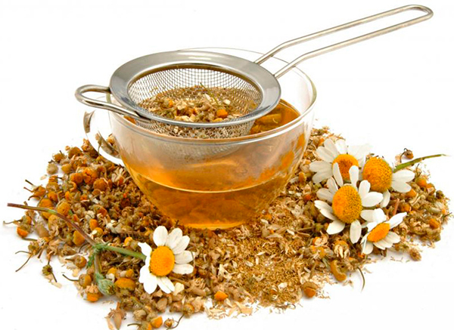
12
FACTORS AFFECTING THE EXTRACTION PROCESS
The water absorption coefficient - WAC (К_{W})- shows the amount of liquid held by 1.0 plant raw materials of a standard degree of grinding after squeezing in a perforated infuser cup.

Slide 14
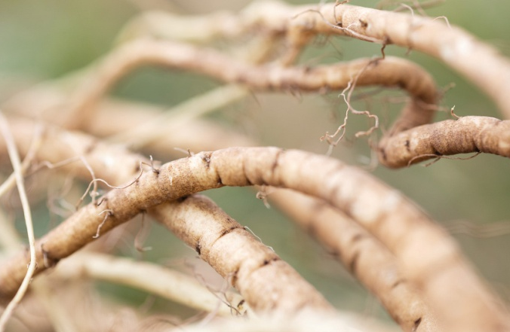
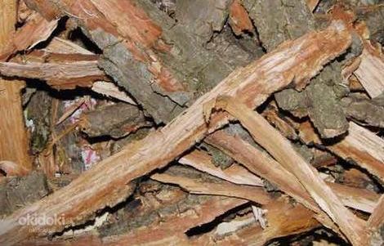
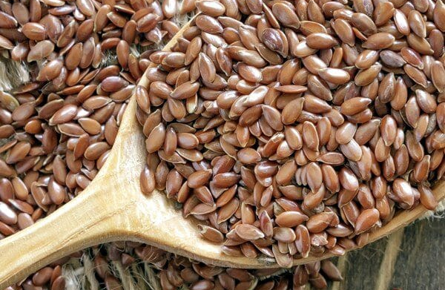
12
FACTORS AFFECTING THE EXTRACTION PROCESS
If the water absorption coefficient for the raw material is not available, it is recommended to use the following coefficients
for roots and rhizomes - 1.5 ml;
bark, grass, flowers - 2 ml;
seeds - 3 ml

Slide 15
12
FACTORS AFFECTING THE EXTRACTION PROCESS
The amount of water is determined by the sum of the volume of extract specified in the recipe and the amount of water, which is calculated by multiplying the mass of the raw material by the WAC.
For example, to obtain 200 ml of infusion from the herb of dog nettle water, you should take:
200 + (20.0 ∙ 2) = 240 ml.

Slide 16
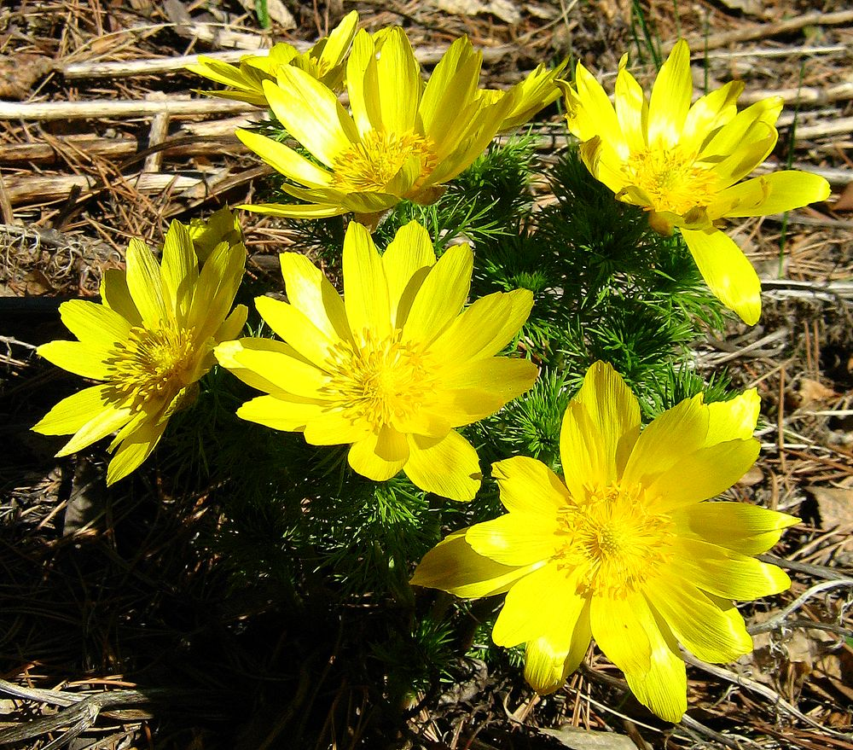
12
STANDARDITY OF RAW MATERIALS
Standard raw materials that meet the requirements of documents are called raw materials; they must be supplied to pharmacies with an indication on the label of the content of active substances in percent or its biological activity in units of action (UА). Raw materials must be standard or with a higher content of active substances and increased biological activity.
Adōnis vernālis

Slide 17
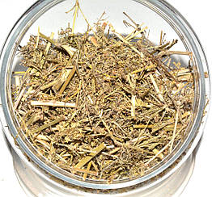
12
STANDARDITY OF RAW MATERIALS
In the case of non-standard raw materials, conversion to standard is carried out according to the formula:
Х = АхВ/С
X - the amount of raw materials with an increased content of active substances;
A - the prescribed amount of LRS in the recipe, g;
B - the standard content of active substances;
С - the actual amount of active substances (on the label).

Slide 18
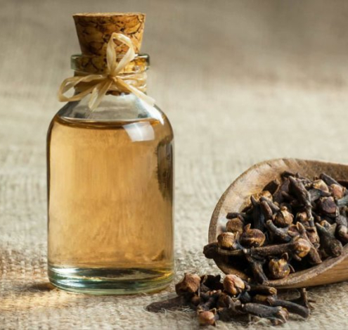
12
STANDARDITY OF RAW MATERIALS
The use of PRM with a lower content of active substances than according to regulatory and technical documentation is unacceptable - this leads to the production of extracts with an increased content of concomitant substances, which are cloudy, less stable

Slide 19
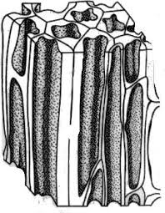
12
THE INFLUENCE OF THE HISTOLOGICAL STRUCTURE OF THE RAW MATERIAL
The extraction rate depends on the structure of the cell membranes. If the cell membrane is very dense, the cell tissue is not loose enough, and there are few intercellular passages and channels, then the extraction proceeds more slowly.
Infusions are prepared from loose tender raw materials (flowers, leaves, herbs).
Decoctions are prepared from dense raw materials (bark, roots, rhizomes).
Exceptions:
1) roots from rhizomes of valerian - infusion;
2) leaves of mountain ash, senna, lingonberries - decoction.

Slide 20
12
THE DEGREE OF GRINDING OF PLANT MATERIAL
For aqueous extracts of PRM, dried, crushed, sieved PRM is used.
With an increase in the degree of crushing of PRM, the surface of contact with the extractant increases - the extraction process is accelerated.
However, very fine grinding is impractical, - the powder clumps together - it facilitates the dissolution of pectin substances, starch, the process of washing out of the destroyed cells of these substances - the hoods are cloudy and deteriorate faster.

Slide 21
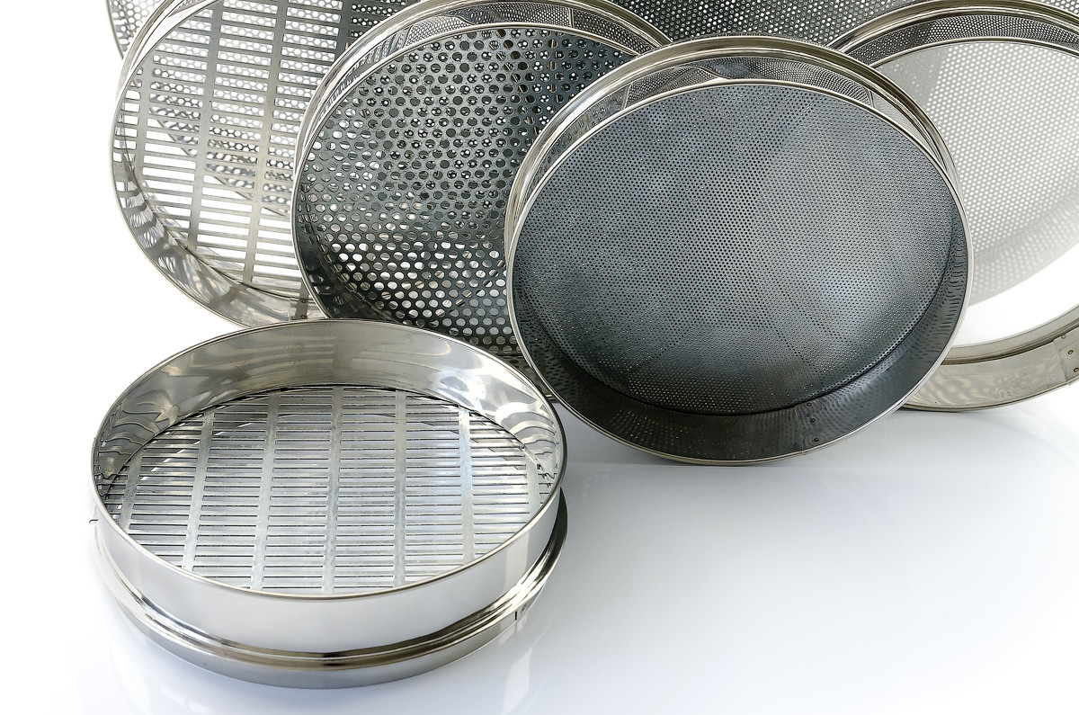
12
THE DEGREE OF GRINDING OF PLANT MATERIAL.
According to the regulatory and technical documentation
1) leaves, herbs, flowers are crushed and sieved through a sieve No. 50 with holes with a diameter of no more than 5mm;
leaves of bearberry, eucalyptus, lingonberry no more than 1mm (sieve No. 10).
2) bark, roots, stems no more than 3mm, sieve No. 30;
3) fruits and seeds - no more than 0.5mm, sieve No. 5.
The particle size of corn cobs should not be > 10mm.

Slide 22
12
TEMPERATURE AND DURATION OF THE EXTRACTION PROCESS
Infusions and decoctions are prepared by heating and differ from each other only in the duration of thermal exposure.
 | Volume = 1000 ml |  | Volume = 1000 -3000 ml
 | heat in a boiling water bath | Cool at room t°. | heat in a boiling water bath | Cool at room t°.
infusion | 15 min. | 45 min | 25 min. | 45 min
decoction | 30 min. | 10 min | 40 min | 10 min
NB! In the case of the indication "Cito!", the infusion is carried out for 25 minutes with subsequent artificial cooling.

Slide 23
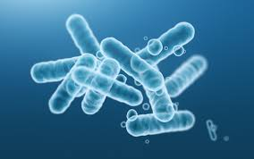
12
The influence of enzymes and microflora.
There are many enzymes in PRM. When a plant dies, a deep decomposition of active substances occurs in it due to the chaotic action of enzymes. The destructive action of enzymes stops when the plants are dried - therefore, drying should be as fast as possible after harvesting.
PRM is not free from microorganisms.
Microflora enters the extract from the air and during its preparation, causing various fermentation processes. The temperature of the boiling bath leads to the death of microorganisms.

Slide 24
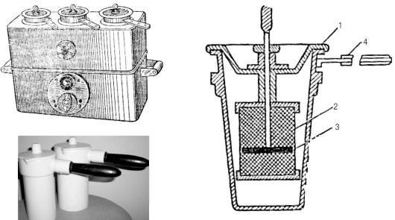
12
THE MATERIAL OF THE EQUIPMENT USED
In pharmacy practice, porcelain infusion cups are used (sometimes enameled and made of stainless steel).
They should not interact with plant material and active substances, have sufficient thermal conductivity and mechanical strength.
Infusion apparatus with electric heating AI-3 (left).
1-cover; 2-mesh basket; 3-press disk; 4-handle.

Slide 25
12
THE MATERIAL OF THE EQUIPMENT USED
Porcelain infusers do not heat up well, so it is necessary to preheat them for 15 minutes. The infuser should be at a height of 5-8 cm above the water surface, the temperature inside the infuser should be 97-98°С. It is not recommended to use infusers made of duralumin for preparing decoctions with tannins, alkaloids, organic acids (infusion of valerian roots and rhizomes).
Infusers are heated in special water (steam) baths — infusers designed for 2-3 infusers.

Slide 26
12
PH OF THE MEDIUM
This factor is especially important in the manufacture of infusions from raw materials containing alkaloids. Acidification of water contributes to the transition of poorly soluble alkaloid compounds - bases into easily soluble salts - alkaloids.
CHEMICAL COMPOSITION OF ACTIVE SUBSTANCES
Their stability, solubility in hot and cold water, compatibility and other properties significantly affect the extraction process.

Slide 27
12
SPECIAL CASES OF PREPARATION OF WATER EXTRACTS
Alcaloids | Cornua Secalіs cornutі Thermopsis herba; folia belladonna; Cinchona cortex | The raw material is extracted with water acidified with hydrochloric acid at a concentration of 0.83%. The amount of acid by mass is taken as much as the amount of alkaloids contained
Cardiac glycosides | Foxglove leaves, Adenium herb, Yellow dock herb, Sea onion tubers. | The pH of the medium should be neutral (in acidic and alkaline - cardiac glycosides are broken down); compliance with a certain degree of grinding; strict compliance with the temperature and time regimes of infusion in a boiling water bath (15 min.) and subsequent cooling (45 min). Failure to comply with the temperature regime can lead to the breakdown of glycosides to genins, which have less biological activity.

Slide 28
12
SPECIAL CASES OF PREPARATION OF WATER EXTRACTS
Еssential oils | Rhizome with valerian roots Mint, eucalyptus, sage leaves Thyme, oregano herb Chamomile, calendula flowers | always prepare an infusion; infusion is carried out in tightly closed infusion jars (essential oils are volatile); the contents of the infusion jar are not stirred during the infusion process; strain after the infusion has completely cooled.
anthraglycosides | Rhubarb roots Buckthorn bark Senna leaves Joshua berries | prepare decoctions; decoctions of rhubarb rhizomes and buckthorn bark are filtered immediately after removal from the water bath, since oxymethylanthraquinones are lost during cooling; decoction of senna leaves is filtered after complete cooling (3 - 4 hours) to avoid resinous substances that cause pain and colic in the intestine from entering the extract.

Slide 29
12
SPECIAL CASES OF PREPARATION OF WATER EXTRACTS
saponins | Chinese root, senegal, licorice Rhizome and blue root. | water extracts foam strongly when shaken; the most complete extraction takes place in a slightly alkaline environment, more often in the presence of sodium bicarbonate, which is added at the rate of 1.0 to 10.0 of the raw material, but only if it is prescribed in the recipe.
tannins | Oak bark Rhizome of snake gourd, Rhizome with roots of the rhizome Blueberry fruits Cowberry leaves Motherwort leaves | always prepare decoctions strain immediately after removing the infusion without cooling (since tannins are soluble in hot water, and when cooled, they precipitate as a flaky precipitate).

Slide 30
12
NOTA BENE
Multicomponent aqueous extracts from PRM containing the same group of biologically active substances, regardless of histological structure, are prepared simultaneously in one infusion container.
It is forbidden to replace PRM with tinctures, extracts, etc. galenic preparations, to prepare concentrated aqueous extracts, and to use concentrated solutions of medicinal products.

Slide 31
12
TECHNOLOGICAL STAGES OF PREPARATION OF WATER EXTRACTS
1. Grind the plant material.
2. Determine the quantitative ratio of the raw material and the extractant (purified water).
3. Extraction process:
a) preheat the porcelain infuser for 15 minutes in a boiling water bath (to t ° walls - up to 92 ° C);
b) place the plant material in a metal perforated cylinder, and in the infuser the calculated amount of purified water (room temperature);
c) heat in a boiling water bath with periodic stirring;
d) cool at room temperature.

Slide 32
12
TECHNOLOGICAL STAGES OF PREPARATION OF WATER EXTRACTS
4. Strain into a measuring cylinder (using a press strainer) through a double layer of gauze and a cotton swab in a funnel, squeeze out the rest of the plant material and add water (through the same plant material) to the prescribed volume of extract.
5. Add water-soluble salts to the filtered extract, dissolving the powdered medications. If necessary, dilute the solution with water to the required volume and filter into a bottle for dispensing.
6. Tinctures, liquid extracts, fruit and sugar syrups, novogalen preparations should be added to the (aqueous solution) of the finished infusion last in the dispensing glass.
7. Cork and arrange for dispensing.

Slide 33
12
Mucus
Mucus is a thick viscous solution of high molecular weight compounds, nitrogen-free substances, similar to polysaccharides.
For the manufacture of mucus, LRS is used, which contains mucous substances: marshmallow root, flax seeds, salep tubers, quince seeds, plantain.

Slide 34
12
Infusion or mucus of marshmallow root.
The marshmallow root contains: mucus 35%, starch 37%.
When making an infusion of marshmallow root, the following features are taken into account:
1. If the recipe does not specify the amount of raw materials, then the infusion is prepared at a 5% concentration (1:20), that is, from 5.0 marshmallow root, 100 ml of mucus must be obtained.
2. Marshmallow root absorbs a significant amount of water, which is retained by the swollen material. Therefore, when calculating the starting materials (water and raw materials), a consumption coefficient is used.

Slide 35
12
Infusion or mucus of marshmallow root.
The consumption coefficient shows how many times the amount of raw materials and water must be increased to obtain the required amount of extract.
CONSUMPTION COEFFICIENTS FOR ALTEA ROOT INFUSIONS
Ratio of raw material and water extract | consumption coefficient
1:100 | 1,05
2:100 | 1,1
3:100 | 1,15
4:100 | 1,2
5:100 | 1,3

Slide 36
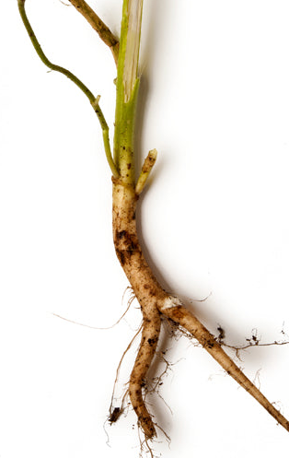
12
Infusion or mucus of marshmallow root.
The extract is prepared by cold infusion at room temperature for 30 minutes with periodic stirring (maceration method). Cold infusion is caused by the need to ensure the transition into the extract of only mucus - as an active substance and minimal extraction of associated substances - starch. When starch is extracted, the infusions become viscous, serve as a favorable environment for the reproduction of microflora.

Slide 37
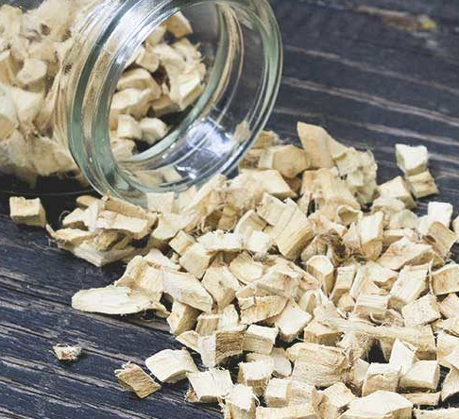
37
Infusion or mucus of marshmallow root.
After infusion, the extract is filtered without squeezing the raw material through a double layer of gauze into a measuring cylinder and brought to a given volume. When squeezing, swollen starch grains and fragments of tissue cells fall into the extract - the infusion turns cloudy and quickly spoils.

Slide 38
12
Examples

Slide 39
12
Rp: Infusi herbae Thermopsidis ex 0,5- 200 ml
Natrii benzoatis 4,0
Da. Signa: no. 1 tbsp 3 times a day.
Thermopsis herb 0.5
Standard raw material contains 1.5% alkaloids;
this means that 1.5 alkaloids are contained in 100.0 raw material:
1.5-100.0
x - 0.5
x = 0.0075 alkaloids
Solution of hydrochloric acid (1:10) 0.83%:
0.83 g of hydrogen chloride - in 100 ml of acid solution
0.0075 g - in x ml of acid solution
x = 0.9 ml = 18 drops (1 ml - 20 drops)

Slide 40
12
Date___________ to recipe No. _________
Rp: Herbae Thermopsidis 0.5
Solutionis Acidi hydrochlorici (1:10) gtts XVI11
Aquae purificatae 200 ml
Infusi herbae Thermopsidis ad 200 ml
Natrii benzoatis 4,0
V total = 200 ml
Prepared by:
Checked by:
Released by:

Slide 41
12
Manufacturing technology.
In a heated porcelain infusion pot, place 0.5 of crushed thermopsis herb, moisten with 18 drops of 0.83% hydrochloric acid solution and add 200 ml of water (WAC is not taken into account, since the number of PRM is less than 1.0).
Insist on a boiling water bath for 15 min., stirring occasionally.
Strain through a double layer of gauze into a measuring cylinder, insist at room temperature for 45 min. Squeeze. Make up to 200 ml with water purified through the raw material and transfer to a working beaker.
Dissolve 4.0 sodium benzoate.
Strain through a double layer of gauze and a cotton swab into a bottle for dispensing.
Stopper. Arrange for dispensing.

Slide 42
12
Rp: Infusi radicis Althaeae 100 ml
Natrii benzoatis 3.0
Natrii hydrocarbonatis 2.0
Liquoris Ammonii anisati 3 ml
Sirupi simplicis 10 ml
M.D.S: 1 tbsp 3 times a day.
This medicinal product is a mixture of raw materials containing mucus, with water-soluble substances, an odorous substance - ammonia-hanus drops, and a viscous liquid - sugar syrup.
The amount of raw materials is not specified - prepare the infusion in a ratio of 1:20 - 5.0 raw materials
The consumption coefficient -1 .3
m radicis Althaeae = 5.0 x 1.3 = 6.5
V Aquae purificatae = 100 * 1.3 = 130 ml

Slide 43
12
Date___________ to prescription no
Aquae purificatae 130 ml
Radicis Althaeae 6.5
Mucilaginis radicis Althaeae 100 ml
Natrii hydrocarbonatis 2.0
Sodium benzoate 3.0
Syrupi simplicis 10ml
Liauoris Ammonii anisati 3 ml
V total = 113 ml

Slide 44
12
Manufacturing technology.
Measure 130 ml of purified water into a working glass, weigh 6.5 marshmallow roots and insist for 30 minutes at room temperature, stirring with a glass rod.
Strain through a double layer of gauze into a measuring cylinder, bring to a volume of 100 ml.
Transfer to a working glass, where 2.0 sodium bicarbonate and 3.0 sodium benzoate are diluted, strain into a bottle for dispensing.
Measure 10 ml of sugar syrup and 3 ml of ammonia - anise drops into a working glass, mix with a glass rod and add to the finished infusion while shaking.
Cork. Arrange for dispensing.

Slide 45
12
USE OF EXTRACTS-CONCENTRATES IN AQUEOUS EXTRACTION TECHNOLOGY
Infusions and decoctions can be prepared not only from PRM, but also
by dissolving specially prepared corresponding extracts-concentrates.
Concentrated extracts are a special group of extracts, the main purpose of which is to serve as a starting material for the manufacture of pharmaceutical extracts (infusions and decoctions).
By consistency, concentrated extracts can be:
1) liquid (Extracta fluida),
2) dry (Extracta sicca).

Slide 46
12
Manufacturing technology.
I. Using dry salts and extract-concentrate:
Prepare by mass-volume method (Order of the Ministry of Health of Ukraine No. 197).
Take as much extract as prescribed in the recipe of plant raw materials (1: 1).
Calculate the amount of dry substances (up to 3%, 3% and more).
Measure purified water.
Dissolve salts.
Dissolve dry extract-concentrate.
Strain.
Add tinctures, syrups.
Cork, arrange for release.

Slide 47
12
Manufacturing technology.
II. Using concentrated salt solutions and dry extract-concentrate:
1. Determine the volume of the infusion.
2. Calculate the amount of concentrated solutions.
3. Determine the amount of purified water and measure it.
4. Dissolve the extract-concentrate.
5. Strain.
6. Measure the concentrated solutions.
7. Add tinctures, syrups.
8. Cork. Prepare for release.

Slide 48
12
Manufacturing technology.
II. Using concentrated salt solutions and dry extract-concentrate:
1. Determine the volume of the infusion.
2. Calculate the amount of concentrated solutions.
3. Determine the amount of purified water and measure it.
4. Dissolve the extract-concentrate.
5. Strain.
6. Measure the concentrated solutions.
7. Add tinctures, syrups.
8. Cork. Prepare for release.

Slide 49
12
I. Using dry salts and liquid extract-concentrate:
1) measure water;
2) dissolve salts;
3) strain;
4) measure liquid extract-concentrate;
5) cork, arrange for dispensing.

Slide 50
12
II. Using concentrated salt solutions and liquid extract-concentrate:
1) determine the volume of the dosage form;
2) calculate the amount of concentrated solutions and liquid extract-concentrate;
3) calculate the amount of purified water;
4) measure into a glass for dispensing:
- purified water
- concentrated solutions
- liquid extract-concentrate;
5) add tinctures, syrups;
6) cork, arrange for dispensing.

