Slide 1
NOISE. OCCUPATIONAL HEARING LOSS
Cochlear neuritis
Odessa National Medical University
Department of Occupational Pathology, Clinical Laboratory and Functional Diagnostics

Slide 2
The sensorial hearing loss is predominantly a chronic occupational affection of people engaged in “noise” occupations and production areas;
it develops gradually, depends on intensity and character of the occupational noise and is characterized by specific involvement of the acoustic analyzer and the development of complex of clinical non-specific symptoms and syndromes of most organs and systems.

Slide 3
Etiology
The causative factor of the NICL is occupational noise (ON).
Noise is a chaotic combination of sounds, which have formed due to mechanical oscillations of different intensity and frequency from 20 Hz to 16 KHz, which are perceived by a hearing analyser.

Slide 4
What is Noise Induced Hearing Loss?
  Noise induced hearing loss (NIHL) is a permanent impairment resulting from prolonged exposure to high levels of noise.
  NIHL can develop gradually from chronic or long term exposures to noise (there are engine testers, riveters, cutters, copper-smiths, weaver and spinners)
  NIHL can develop suddenly as a result of a sudden extreme noise (i.e.: gunfire, explosions)

Slide 5
Hearing : a Valuable Asset
The ability to hear affects quality of life
Low hearing levels can result in stressful and frustrating attempts at conversation
Spoken words can be misinterpreted
Driving, as well as equipment and machinery operation, will be affected
Once it’s gone – it’s gone!

Slide 6
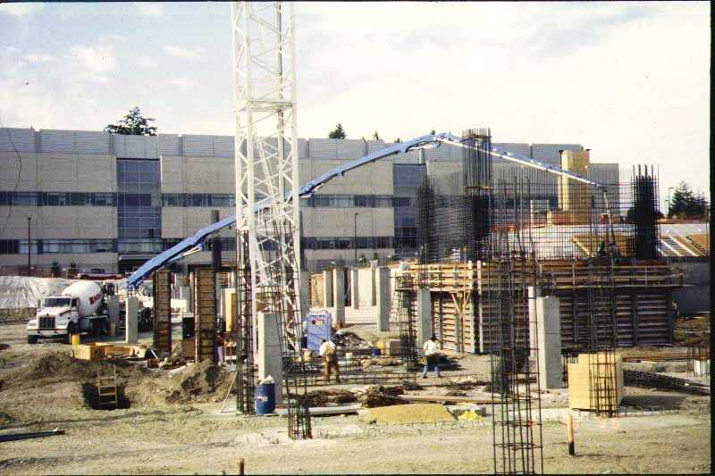
Construction noise:
many sources, hours, variable levels; dynamic
Neitzel

Slide 7
Intensity↔Pitch
Sound has two main characteristics:
Sound
Intensity
(Decibels)
Pitch
(Hertz)

Slide 8
Decibels
Decibel – the degree of loudness of a sound; an expression of the relative loudness of sound as perceived by the human ear [named after A.G. Bell]
dB or dBA – An A-weighted sound closely matches the perception of sound by the human ear
When screening children, guidelines recommend starting at 20 dB*
When screening adults, 25 dB is a standard starting level **
        Source – American Speech & Language Association
Notes:
Ambient noise may indicate beginning screening for children at 25 dB
** There is debate over using this 25 dB level for older adults – 65 and over

Slide 9
80dB
Maximum permissible level

Slide 10
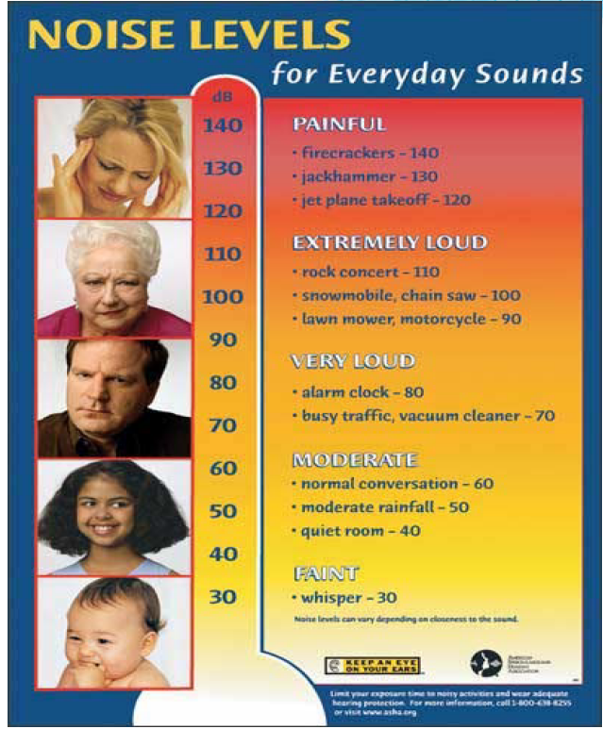

Slide 11

Noise Levels for
Common Tools
Mortising
Orb. Sand.
Table Saw
Planer
Belt Sander
Router
Metal Shear
Task/Tool
Hand Drill
Circular Saw
Tile Saw
Impact Wrench
Miter Saw
Chop Saw
Chain Saw
Hammer Drill
75
80
85
90
95
100
105
110
115

Slide 12
Hertz
Hertz (Hz) is the term used for the frequency of sound [named after a German physician]
Frequency is determined by the number of sound vibrations per second
The faster the cycles – the higher the frequency (the sound’s pitch)

Slide 13
20Hz
2000-4000Hz
20,000Hz
PITCH
The lowest limit of hearing range
NIHL
The upper limit of hearing range

Slide 14
Pathogenesis
The noise is proved a non-specific action on an organism, which manifested itself in the affection of the functional state onto organism, with disorders of the nervous and cardiovascular systems.

Slide 15
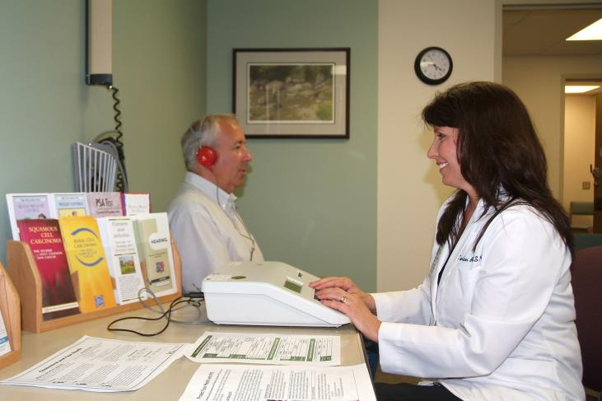
Hearing Test
Audiometry (from Latin: audīre, "to hear" and metria, “to measure") is a branch of audiology and the science of measuring hearing acuity for variations in sound intensity and pitch and for tonal purity, involving thresholds and differing frequencies

Slide 16

Frequency (Hz)
500
1000
2000
3000
4000
6000
0
10
20
30
Hearing Level (decibels)
40
50
60
70
80
90
Audiograms are set out with frequency in hertz (Hz) on the horizontal axis and a linear dB scale on the vertical axis.
For humans, normal hearing is between 10 dB and 15 dB
Notes:
http://www.cdc.gov/niosh/topics/noise/noisemeter_html/hp180.html
Hearing tests measure ability to hear various decibel levels at specific frequency (Hz) levels. Red line indicates the typical starting level of testing for adults
Source: Council for Accreditation in Occupational Hearing Conservation (CAOHC)

Slide 17
Assessment of the distance of perception of whispered and spoken speech is the determination of the distance from which the subject hears spoken and whispered speech
The study begins with determining the patient's ability to perceive whispering speech. The doctor, being at a distance of six meters from the patient, begins to whisper numbers or words. In this case, the patient stands facing the wall and with his back to the doctor, so that it is not possible to read the words on the lips.
What the patient has heard should be repeated loudly. If the whispered speech is not heard by the patient at a given distance, the ENT doctor comes closer and repeats the procedure again. This algorithm is repeated until the patient hears what the doctor is saying.

Slide 18
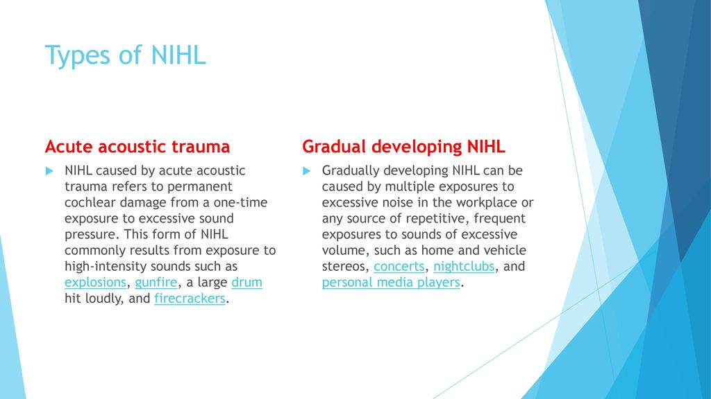

Slide 19
Long-term exposures to noise levels > 80 dBA can cause metabolic and destructive changes occur both in the hair cells of the cochlea, and in the spiral node and in the hairs of the cochlear nerves. This leads to their death and increased inability to perceive sound (for example, NIHL)
Extreme exposures can cause direct mechanical damage (acoustic trauma) to cochlear hair cells. Noise exposure is also associated with tinnitus (ringing in the ears) and hyperacusis. NIHL has traditionally been associated with occupational noise, but there is increasing evidence that music may play an important role as well
The possibility of a nonspecific effect of noise on the body was also proved, which was manifested in a violation of the functional state of the nervous and cardiovascular systems.

Slide 20
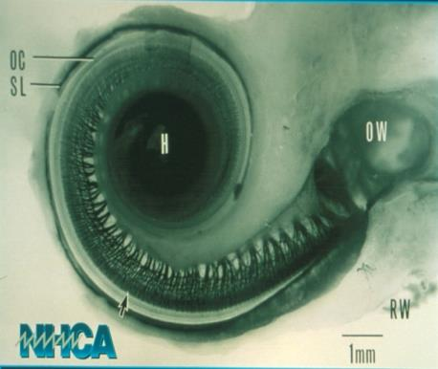
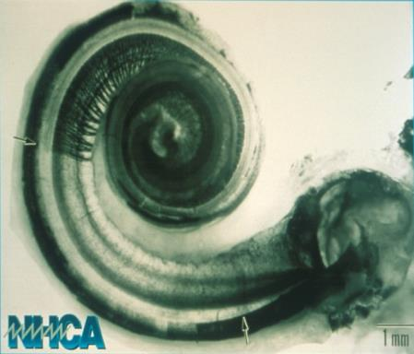
Cochlear Damage
Healthy Cochlea
Damaged Cochlea
Notes:
Source: http://www.hearingconservation.org/ National Hearing Conservation Association

Slide 21
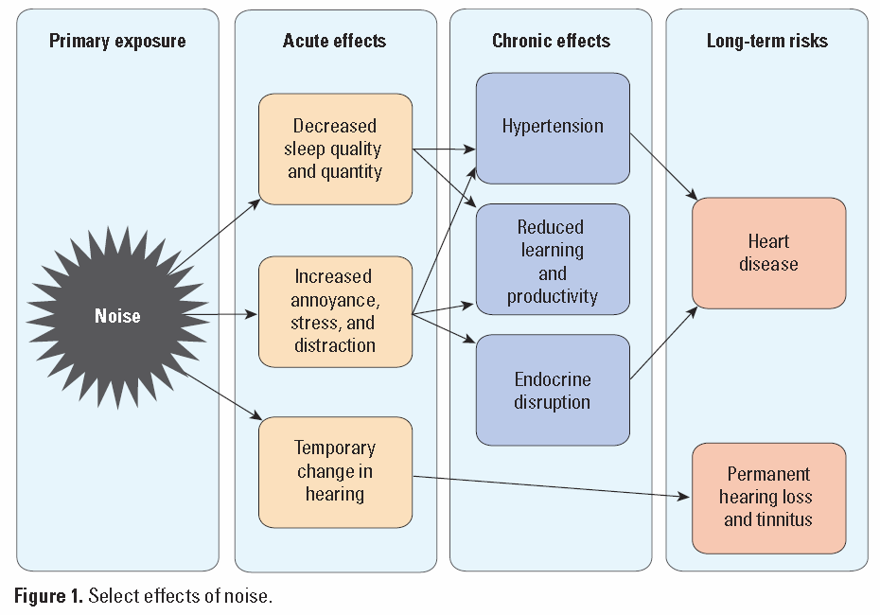
Effects of noise
http://ehp.niehs.nih.gov/1307272/

Slide 22
Clinics
The principal characteristics of occupational NIHL are as follows:
It is always sensorineural, primarily affecting the cochlear hair cells in the inner ear.
It is typically bilateral, since most noise exposures affect both ears symmetrically.
NIHL develops according to the type of cochlear neuritis and can be characterized by gradual progress.
At first, there is noise in ears, which becomes more intensive and
stable gradually.
Its first sign is a ‘‘notching’’ of the audiogram at the high frequencies of 3000, 4000, or 6000 Hz with recovery at 8000 Hz.
Hearing gradually worsens and the level of perception of whispering decreases.
There are four stages of hearing loss.

Slide 23
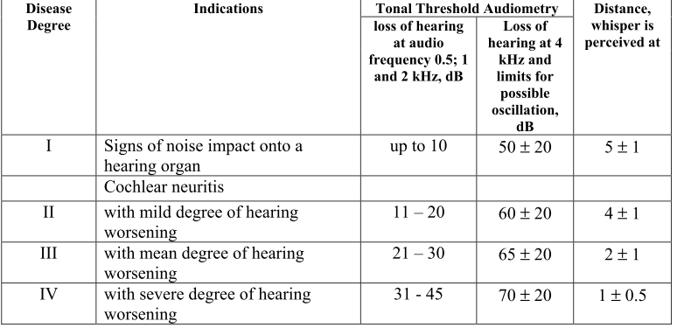
Criteria of Evaluation of Hearing Function for People, Who Work under Conditions of Impact of Noise and Vibration

Slide 24
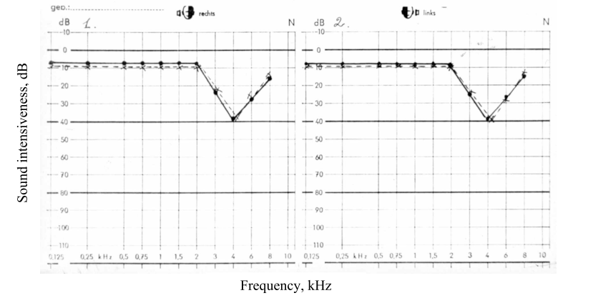
Audiogram at initial sings of the impact of noise onto hearing organs

Slide 25
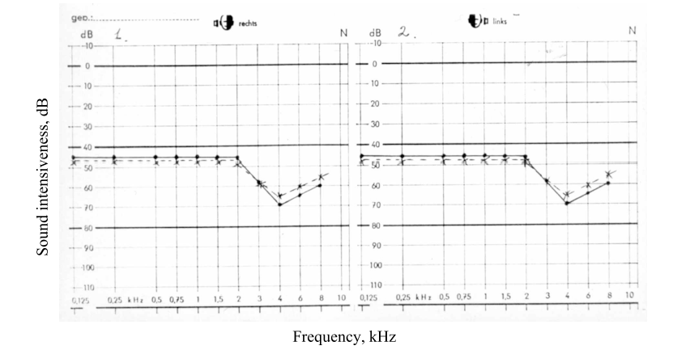
Audiogram at cochlear neuritis with a severe degree of hearing worsening

Slide 26
Other harmful effects of loud noise exposure
Aside from damaging your hearing, research shows that noise pollution and NIHL can lead to:
- Stress
- Anxiety
- Insomnia, even after the noise stops
- High blood pressure
- Increased heart rate
- Isolation due to hearing loss
- Depression due to hearing loss
Fortunately, research shows that hearing aids help with many of these health problems.

Slide 27
For occupational NIHL, it is characteristic to have the following:
gradual development of the process;
presence of correlation between disorders of the function of the central nervous system and a number of other organs and systems with changes of hearing sensitivity;
presence of similar cases of the disease among workers of the professional group;
absence of indications in the anamnesis as to the beginning of this disease during the period, which was prior the contact with occupational hazardous factors;
deafness is stable and permanent even when the source of noise is eliminated.

Slide 28
Diagnostics
The diagnose of cochlear neuritis is made based on:
occupational guidelines, sanitary and hygienic characteristics of labor;
anamnesis of the disease and life (known allergies, current or recent cold, sinus infections, medications (some can cause tinnitus/may be ototoxic), etc.
conditions, study of complaints of a patient;
instrumental examination of hearing and vestibular analyzers.

Slide 29
Treatment
Treatment is limited
Once your hearing is damaged it will never come back. There is no surgery, medication, implant, transplant or healing over time. Hearing aids magnify the volume of the sounds you do hear but they cannot bring back the sounds you are missing.
To increase the stability of the body and to reduce the effect of noise on the nervous and cardiovascular system, general strengthening therapy is recommended, the organization of regular nutrition, sleep regimen, mandatory stay in the fresh air for 1-2 hours daily. Drug treatment may include the use of sedatives, vitamin C and vitamin B complex. In the presence of angiodistonic syndrome, it is recommended to use spasmolitic means and ganglionic blockers, neurotropic drugs.

Slide 30
Verification of the ability to work
At the neuritis with mild decrease of hearing, the work ability of a patient is saved as a rule. It is necessary to conduct dynamic doctor observation, and conduct of outpatient treatment with utilization of sanatorium.
For cochlear neuritis with a moderate degree of hearing loss, skilled workers with long-term professional experience can also continue their work with the observance of preventive measures and outpatient treatment. Young people with a short period of work, as well as unqualified workers and people who are subject to impulse noise, especially in case of fast progressing of the process, it is necessary to recommend rational employment beyond noise.
At cochlear neuritis with a sever degree of hearing worsening, it is recommended to have rational employment, which is not connected with the impact of noise.
In all these cases, if rational employment is impossible without the demotion of qualification, patients are to be sent to the expert commission to determine a group of disability of an occupational character.

Slide 31
Protective measures
against noise exposure include engineering controls, work practices and personal protective equipment.
Every employer shall ensure that no worker is exposed to a sound level greater than an equivalent sound exposure level of 80 dBA

Slide 32
Best Management Practices
Engineering Controls
    Choose low noise tools and equipment when possible
    Place a barrier between machine and worker (i.e. tractor cab)
    Assess confined areas for noise levels and controls
    Maintain & lubricate equipment
    Dosimeters offer real time/TWA exposure data ( you don’t have to do all the math!)
Administrative Controls
    Limit amount of time employee spends at high noise source
    Provide quiet areas for relief from hazardous noise
      Alternate work duties
      Quiet or enclosed break area
Notes:
In open spaces – noise exposure is decreased by 6 dBA when distance between noise source and worker is doubled…

Slide 33
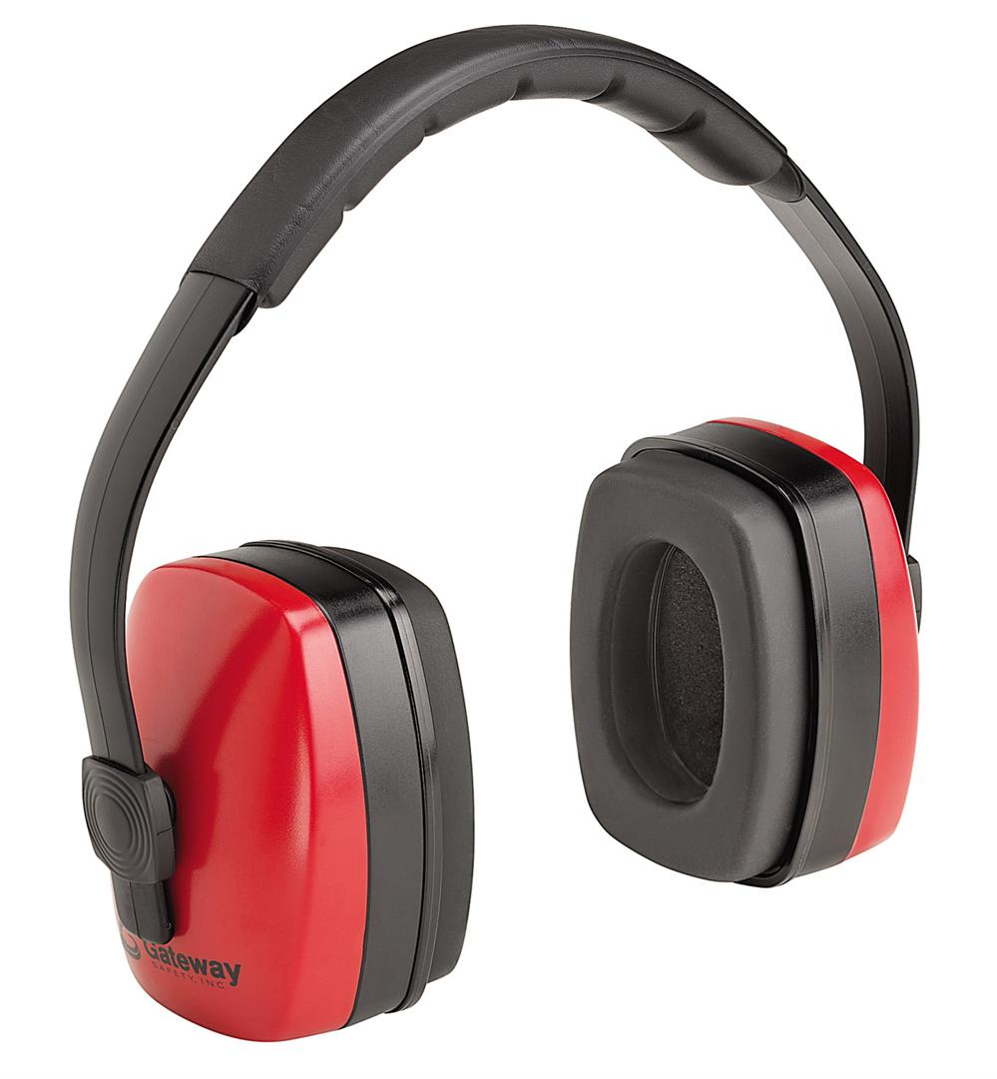
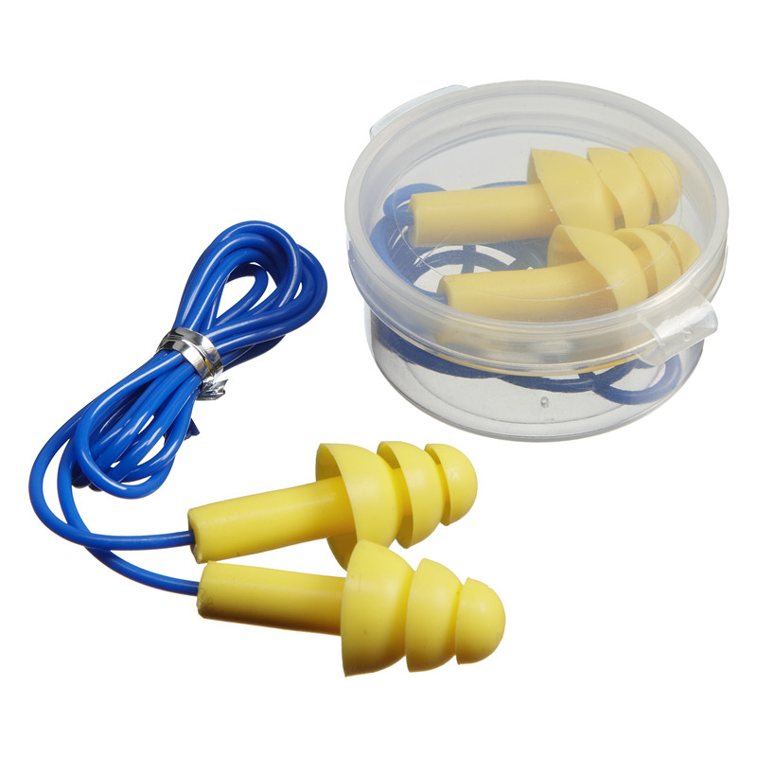
Means of Ear Protection
Earmuffs
Earplugs

Slide 34
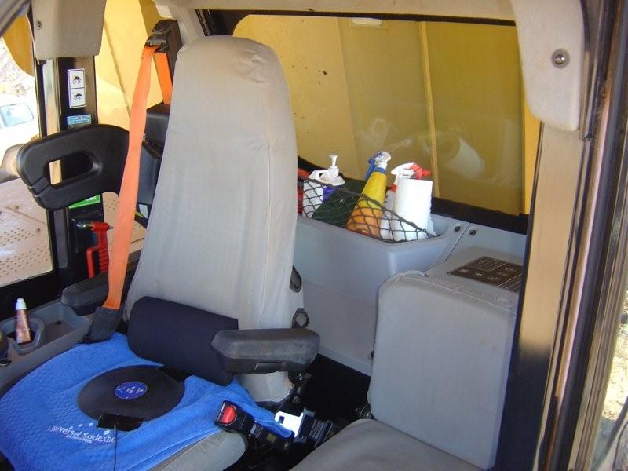
Truck Cabin
Noise through windows, noise through floor and sides, noise through connections, noise through door and window seals

Slide 35
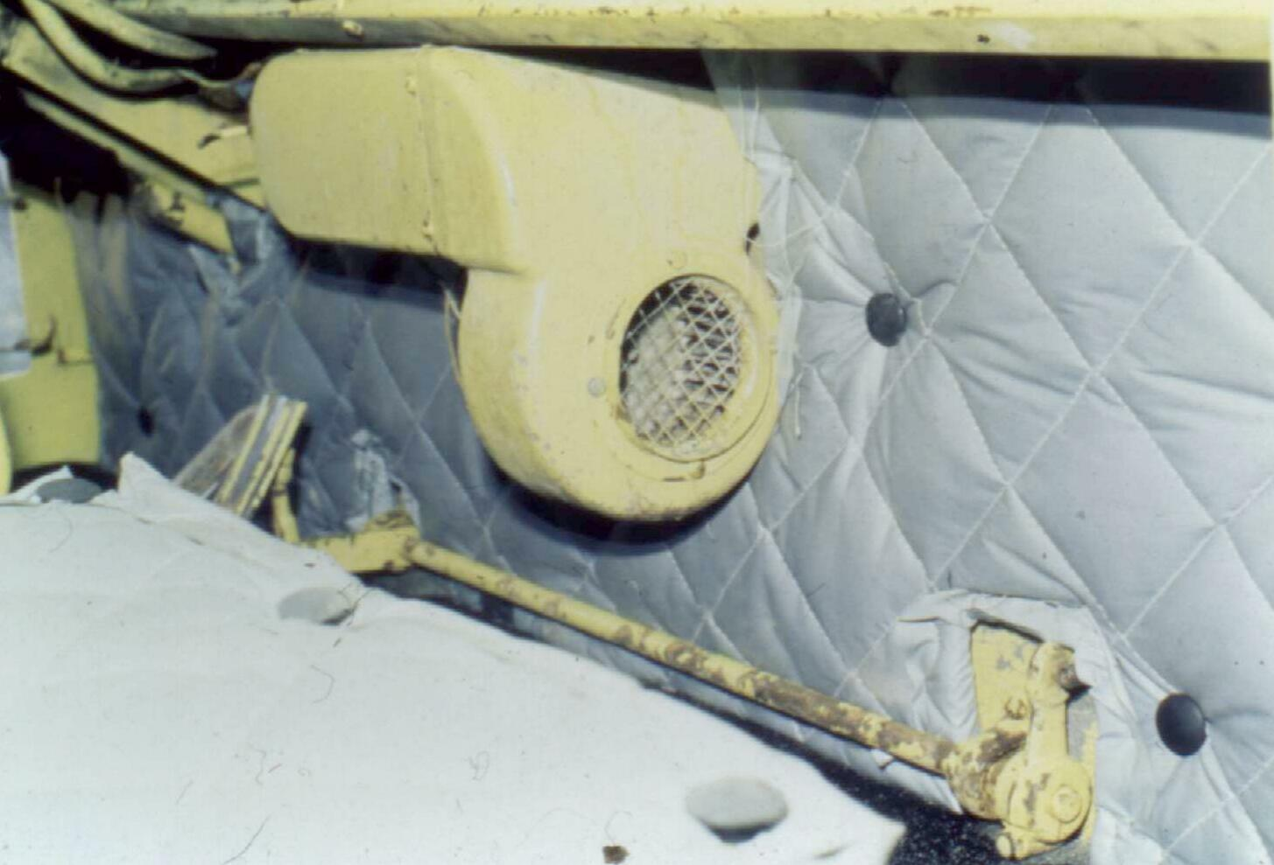
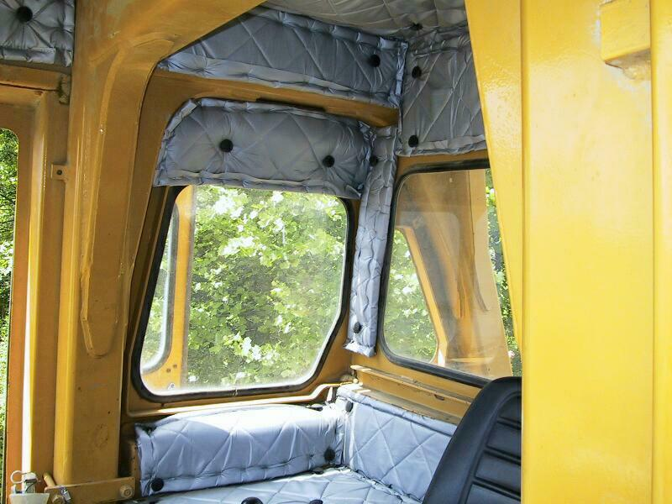
Absorption

Slide 36
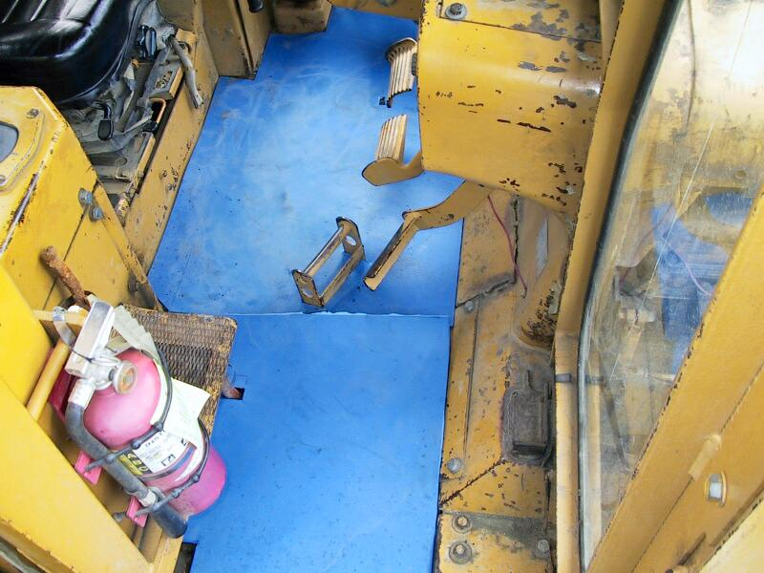
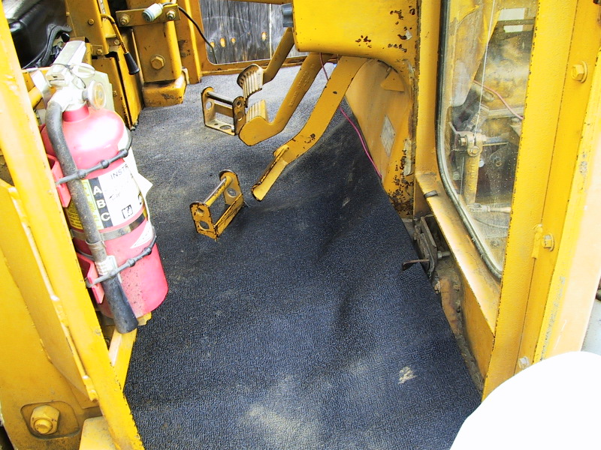
Damping material on floor covered with acoustical floor mat

Slide 37
Conclusion: We should remember
NIHL is entirely preventable but once acquired it is irreversible.
The haircells never grow back,
they are unrecoverable.
That is why we should take care today.

